Slide 1
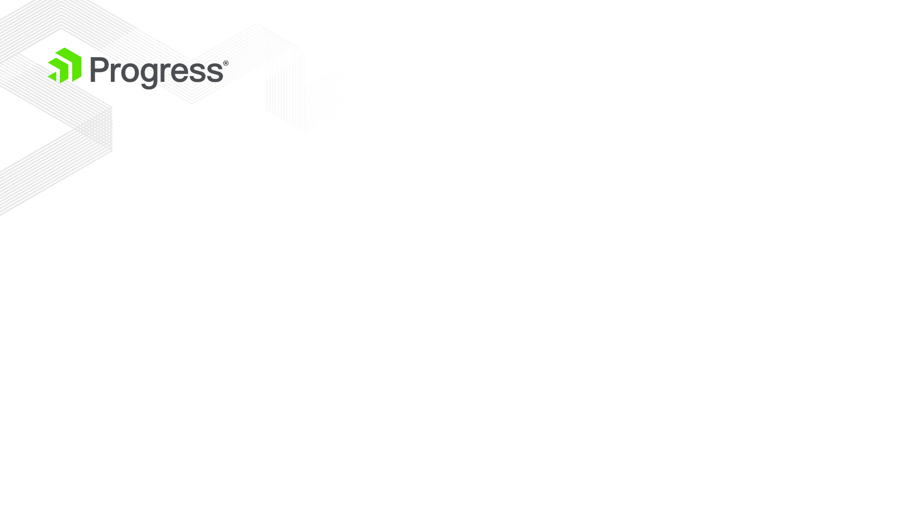
Single Page Application (SPA)
The application is contained within one single web page.
All necessary code is fully loaded.
Router
tracking the application state and navigating between the application states
View
handles the events of a certain screen from the application
the content can be HTML string or Kendo UI Template
Layout
Layout renders the Views

Slide 2
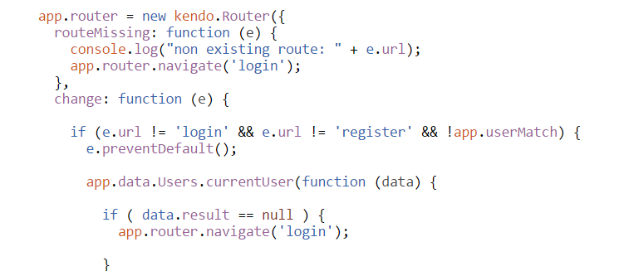
Router Class
Kendo UI Router
Methods;
start - Activates the router binding to the URL changes.
route – Registers new route.
navigate - Navigates to the given route.
Events;
routeMissing - Triggered when the URL does not match any of the provided routes..
change – Triggered when the fragment part of the URL changes.

Slide 3
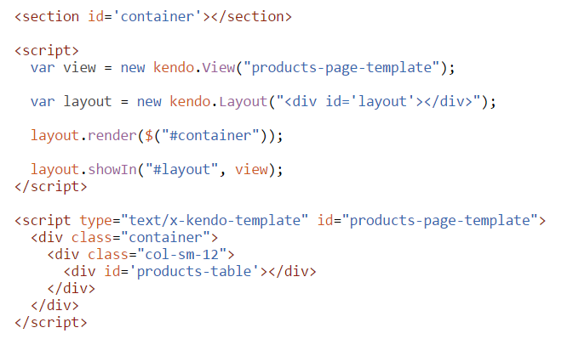
Layout Class
Kendo UI Layout
Methods;
showIn - Renders the View element in the element specified by the selector.

Slide 4
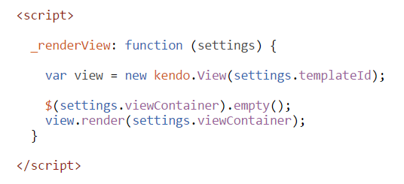
View Class
Kendo UI View
Properties;
model - The MVVM model to bind the element to.
evalElement - If set to true, the view template will be treated as kendo template and evaluated against the provided model instance.
Methods;
render – Renders / Retrieves the view contents.
Events;
init - Fires the first time the view renders.
show - Fires after the View is rendered.
hide - Fires when the View is replaced in a layout placeholder.

Slide 5
Q & A

