Slide 1

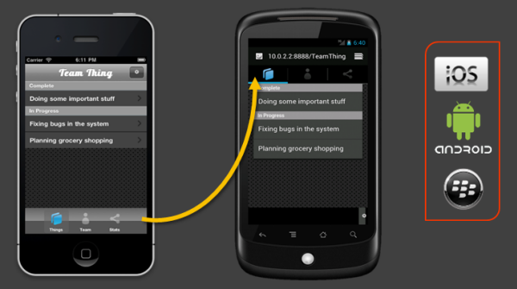
Kendo Hybrid UI Overview
build mobile app experiences through using HTML and JavaScript
automatically adapt to the native look and feel of different mobile platforms
focus on the content and functions of the apps
let the Kendo UI framework handle differences between platforms such as iOS and Android
Notes:
Where some mobile HTML frameworks focus on providing a one-size-fits-all experience, the Kendo UI hybrid framework focuses on delivering perfectly tailored experiences for different mobile platforms. Built and packaged correctly, the goal of such an application is to be virtually indistinguishable to end-users from a native SDK app.
The advantage of building apps with HTML, JavaScript, and Kendo UI is that you are able to maintain a single code base to target all major app platforms. Your team can focus on becoming masters of HTML, JavaScript, and CSS, rather than being average practitioners of Objective-C, Java, .NET, UIKit, and the myriad of other developer skills needed for cross-platform mobile app development.

Slide 2
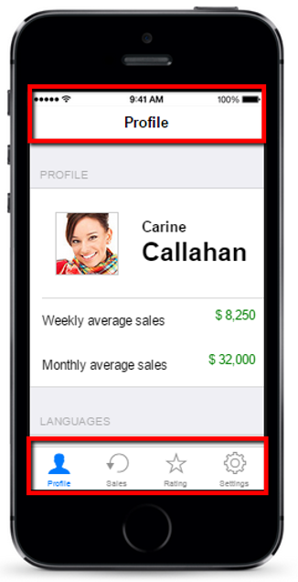
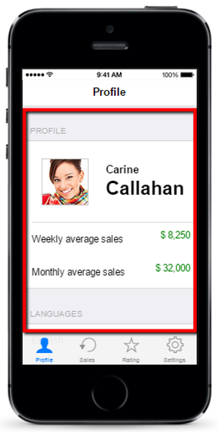
The Building blocks
Just like Single Page Applications the mobile apps are made of three components:
Application
Manages all navigation and application history
Loads views, renders mobile meta tags, etc.
Layout
Defines the reusable parts of the mobile app (navigation)
View
Individual pages of a mobile app. Views contains most of the app content

Slide 3
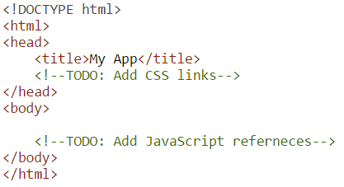
Create Sample Application
Create HTML Page
Kendo UI hybrid apps can be created by using simple HTML pages. First, create the index.html page

Slide 4
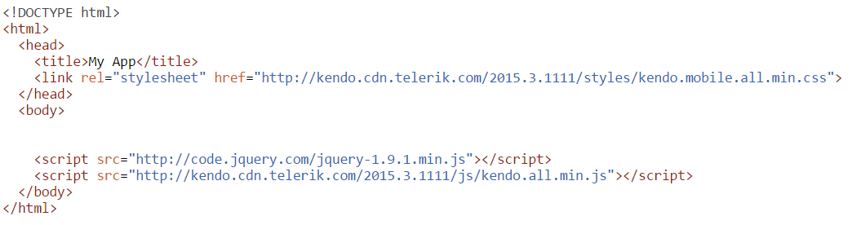
Add Reference to Kendo UI
Include the necessary Kendo UI styles and JavaScript files

Slide 5
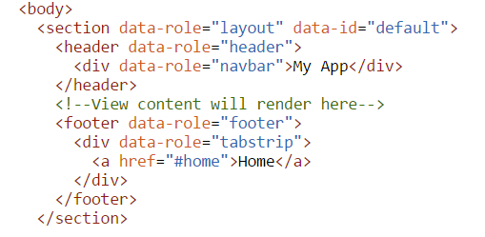
Define the Application Layout
The layout is the template of the application.
The content of the views will
be rendered inside the layout.
Multiple layouts are supported.
Usually the layout contains
Title bar
Navigation

Slide 6
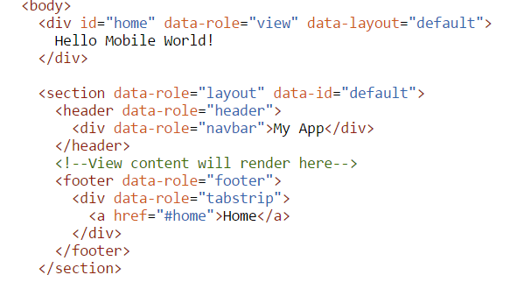
Create View
Every mobile application needs at least one view

Slide 7
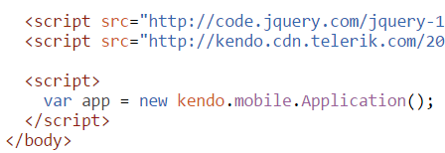
Initialize the Hybrid App
http://dojo.telerik.com/ETIxU

Slide 8

Add Views and Navigation
Add additional View
Multiple views can be defined in the same file or in separate HTML files.
For larger applications, maintaining views in separate files during development is preferred.

Slide 9
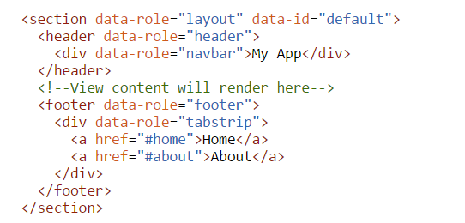
Handle Navigation
Enable the application to navigate to the new view by updating the TabStrip, including navigation link.

Slide 10
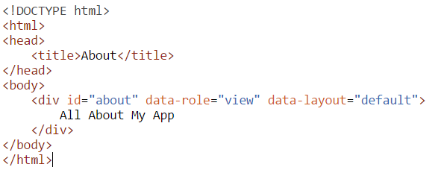
Adding view in separate file
To add view in separate file create file for that view about.html
Note that this page does not redefine references to the Kendo UI script or CSS resources.
This page requires minimal markup.
When the Kendo UI hybrid application loads a remote view—a view defined in separate file—it looks for the first data-role="view" in the body element and discards the rest of the page.

Slide 11
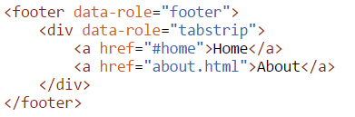
Add navigation for external view
When Kendo UI encounters a link to an external view, it automatically loads and caches the view with Ajax and provides a seamless navigation experience.
For external links add data-rel=“external” attribute

Slide 12
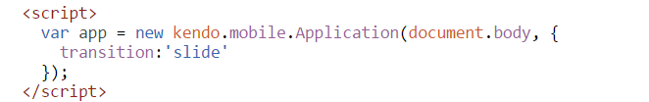
Add transition when switching between views
http://dojo.telerik.com/EFAni

Slide 13
Multiple Platforms Testing
The Kendo UI hybrid application renders with an iOS look and feel if it does not detect another mobile platform.
To test the look and feel of the application on other platforms, use any of the options below:
Force Platform Rendering
Use Browser Tools

Slide 14
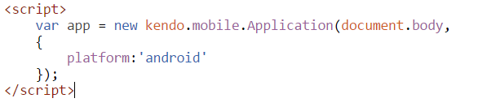
Force Platform Rendering
How to force platform rendering?
http://dojo.telerik.com/AqefA
This option will disable adaptive rendering. Switch it of before deploying if adaptive rendering is required.

Slide 15
Use Browser Tools
Kendo UI relies on the UserAgent string to trigger different platform renderings. If a browser reports that it is a specific mobile device, the mobile application responds and provides the correct, device-specific rendering.
Some desktop browsers, such as Google's Chrome, allow you to easily modify your user agent string, thereby allowing you to trick Kendo UI that your browser is a given mobile device. This helps you to quickly preview your application styling for different mobile platforms without changing any code.
Of course, nothing replaces actual testing on mobile devices. In many cases, the Kendo UI mobile styles look better on devices than in desktop browsers. Make sure you test on an iPhone, Android, BlackBerry, or whatever devices you intend to support before deploying your application or when previewing application styles.

Slide 16
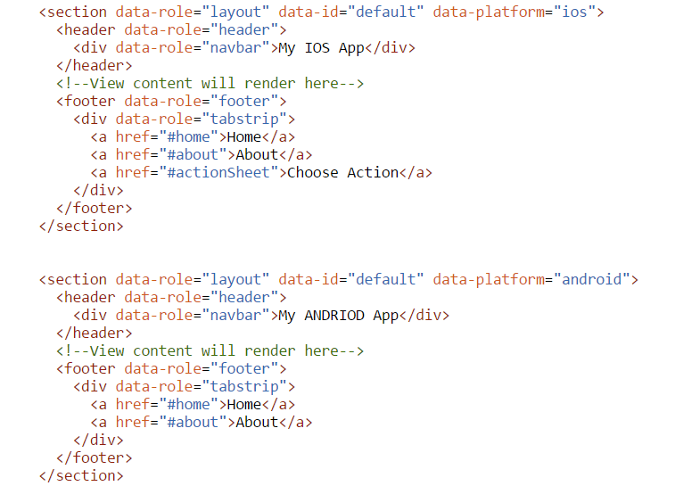
Layout options
Tweaking Apps for Specific Platforms
Kendo UI automatic platform adapting is a huge time-saver
However if you might want to customize the outlook of an application for specific platforms.
Use data-platform attribute.
http://dojo.telerik.com/ivEtU

Slide 17
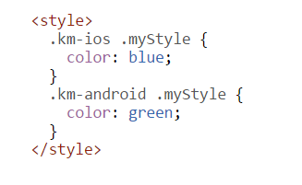
Use custom CSS for different platforms
When Kendo UI initializes an application, it adds a device-specific CSS class to the Application root element.
This allows you to create styles that specifically target different platforms.
km – kendo mobile

