Slide 1

Kendo Hybrid UI Application
The Kendo UI Application for mobile devices provides the necessary tools for building native-looking web based mobile applications.
Kendo UI Application for mobile initially takes care of adding a Viewport meta tag to your app to set the correct options it needs to function properly.
Additional Viewport meta tags, or at least the width and height options, are not supported and may result in unexpected behavior.
Notes:
Where some mobile HTML frameworks focus on providing a one-size-fits-all experience, the Kendo UI hybrid framework focuses on delivering perfectly tailored experiences for different mobile platforms. Built and packaged correctly, the goal of such an application is to be virtually indistinguishable to end-users from a native SDK app.
The advantage of building apps with HTML, JavaScript, and Kendo UI is that you are able to maintain a single code base to target all major app platforms. Your team can focus on becoming masters of HTML, JavaScript, and CSS, rather than being average practitioners of Objective-C, Java, .NET, UIKit, and the myriad of other developer skills needed for cross-platform mobile app development.

Slide 2
Getting started
Initialize the Mobile Application
The simplest Application for mobile consists of a single mobile View.
Initialize the Mobile View
When a mobile View is initialized, that is, the first time the user visits it, it initializes all Kendo UI web and hybrid mobile widgets, as well as the Kendo UI widgets for data visualization it contains.

Slide 3
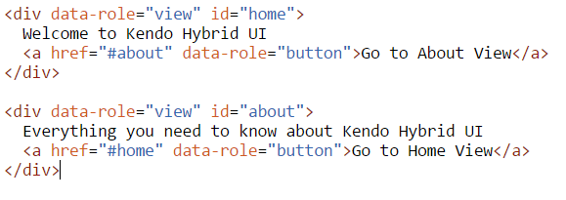
Navigation
When initialized, the mobile Application modifies the behavior of the Kendo UI hybrid widgets—ListView link items, buttons, tabs—so that they navigate between the mobile views when the user taps them. When targeting local views, the href attribute of the navigation widgets specifies the view id to navigate to, prefixed with #, like an anchor.

Slide 4
Link to External Pages
By default, all navigational widgets try to navigate to local views when tapped. This behavior can be overridden by setting the data-rel="external" attribute to the link element.

Slide 5
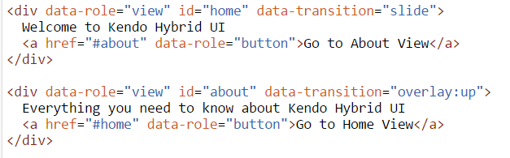
Transitions
To set transition on widget level use data-transition attribute
To set it on application level use transition parameter
If both are present, the one set locally will take precedence.

Slide 6
The transitions that are supported are:
slide
zoom
fade
overlay

Slide 7
The slide Transition
This is the default iOS View transition.
Old View content slides to the left and the new View content slides in its place.
Headers and footers (if present) use the fade transition.
The transition direction can be specified by using slide:(direction).
Supported directions are left and right. By default, the direction is left.

Slide 8
The fade Transition
The new View—along with its header and footer—content fades in on top of the previous View content.
http://dojo.telerik.com/ObicU

Slide 9
The zoom Transition
The new View—along with its header and footer content zooms from the center of the previous View.
The old View content fades out.
The zoom transition is suitable for displaying dialogs.
http://dojo.telerik.com/ObicU/2

Slide 10
The overlay Transition
The new View content slides on top of the previous View.
Unlike the slide transition, the previous View stays under the new one, and the headers and footers do not transition separately.
The transition direction can be specified by using the overlay:(direction) format.
Supported directions are down, left, up, and right. By default, the direction is left.
http://dojo.telerik.com/ObicU/3

Slide 11
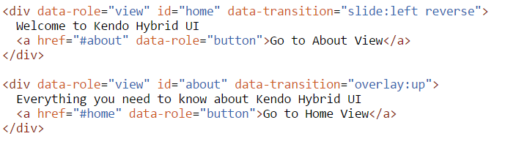
The reverse Transition
Each transition may be played in reverse.
To do so, add " reverse" after the transition definition.
For instance, to simulate returning to previous view using the slide transition, use "slide:left reverse".

Slide 12
When a View transitions to the View displayed before it
home > about > home —this is considered a back navigation.
In this case, the animation of the current View is applied in reverse.
For instance, navigating with the slide transition from home to about, then back to home, would cause the home View to slide from the right side of the screen.

