Slide 1

Kendo Hybrid UI View
Remote Views
The Kendo UI hybrid mobile Application can load Views remotely by using AJAX.
If the navigational widget href attribute value does not start with a hash (#), the application considers the View to be remote, and issues an AJAX request to the provided URL.
The View content—the first element with data-role="view"—is extracted from the AJAX response and appended to the Application DOM element.
If no element with data-role="view" is found, the body contents are wrapped in a <div data-role="view"> tag and used as a remote view.
If no element with data-role="view" is found and no body element is present, the entire response is wrapped in a <div data-role="view"> tag and used as a remote view.
Once the remote View is fetched, no additional round trips to the server occur when the View is displayed again.

Slide 2
The remote view request will also append—but not initialize—any additional views found in the AJAX response.
Inline style elements, inline script elements, and mobile layout definitions will also be evaluated and appended to the application.
The elements must be available in the root of the response, or nested inside the body element.
Scripts and styles from the head element (if present) will not be evaluated.

Slide 3
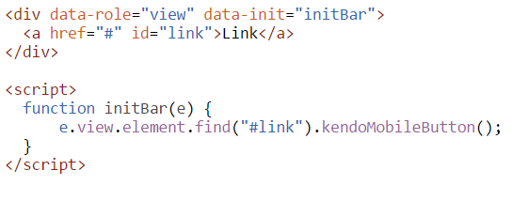
Remote Views with init Event Handler
If the remote view needs an additional scripting (widget-initialization or widget-binding) logic, it may be defined in the view init event handler, in the AJAX response.

Slide 4
View Event Lifecycle
Init - Fires after the mobile View and its child widgets are initialized.
beforeShow - Fires before the mobile View becomes visible. The event can be prevented by calling the preventDefault method of the event parameter, in case a redirection should happen.
Show - Fires when the mobile View becomes visible.
afterShow - Fires after the mobile View becomes visible. If the view is displayed with transition, the event is triggered after the transition is complete.
transitionStart - Fires when the mobile view transition starts.
http://dojo.telerik.com/ObicU/4

Slide 5
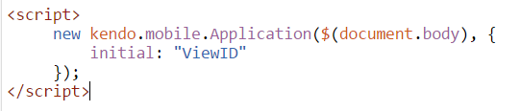
Initial Views
Show the Initial View
The Application component provides a way to specify the initial view to show. The initial view can be set by passing the view id in the options parameter of the Application constructor.
http://dojo.telerik.com/ObicU/5

