Slide 1

Kendo Hybrid UI Styling
The Kendo UI Hybrid framework is shipped with several separate CSS files:
kendo.mobile.all.min.css —This is the default one and includes all supported themes, common and icon CSS.
kendo.mobile.[platform/skin].min.css —The separate CSS files for every supported platform and skin, which are self-sufficient.
kendo.mobile.common.min.css —The common and icon CSS needed for the Kendo UI Mobile theme skeleton - use this one if you want to start a skin from scratch.
Hint
All themes and skins require the images sub-folder, which contains a mask for the iOS back button, icon fonts and the Windows Phone 8 PhoneGap icon workaround images.

Slide 2
Application styling scenarios
Every mobile application may be styled in several different ways.
Each approach requires two things:
Specific set of stylesheets
Set of application configuration options

Slide 3
Common Scenarios
Mobile Application Which Changes Its Theme Depending on the Device
For the platform-adaptive styling
Use kendo.mobile.all.min.css.
http://dojo.telerik.com/iFIGI

Slide 4
iOS Look
Mobile Application with iOS Look on All Devices
For targeting iOS devices only
iOS look is desired regardless of the device
Could be used
kendo.mobile.all.min.css
Or kendo.mobile.ios.min.css.
Both include the iOS6 (default) and iOS7+ looks.
Platform configuration majorVersion determines which one will be used.
http://dojo.telerik.com/uQEgO

Slide 5
Android Look
Mobile Application with Android Look on All Devices
Targeting Android devices only
Android look is desired regardless of the device
Could be used
kendo.mobile.all.min.css
Or kendo.mobile.android.dark.min.css (for dark, default mode)
Or kendo.mobile.android.light.min.css.
The platform configuration option should be set.
http://dojo.telerik.com/iSUtI (dark)
http://dojo.telerik.com/aZOdo (halo light)

Slide 6
Windows Look
Mobile Application with Windows Phone 8 Look on All Devices
Targeting Windows Phone devices only
Windows Phone look is desired regardless of the device
Could be used
kendo.mobile.all.min.css
Or kendo.mobile.wp8.min.css.
The platform configuration option should be set.
http://dojo.telerik.com/uMeVu

Slide 7
Platform Independent
Mobile Application with Platform Independent Skin
The Kendo UI Hybrid framework ships several device independent skins:
flat—kendo.mobile.flat.min.css
nova—kendo.mobile.nova.min.css
material—kendo.mobile.material.min.css
fiori—kendo.mobile.fiori.min.css
office365—kendo.mobile.office365.min.css
Hint
To activate the desired skin use:
kendo.mobile.${skin}.min.css
Set the necessary skin option.
http://dojo.telerik.com/amUhO (nova)

Slide 8
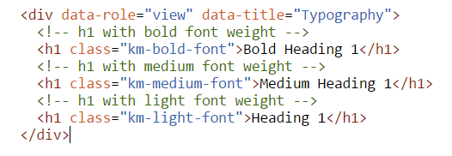
Nova Theme Features 1
Generic Content Styles
Provides predefined generic styles
h1 – h6
p elements.
Font Weights
The Kendo UI Nova theme provides
font weights
light, to activate use - km-light-font
medium, to activate use - km-medium-font
bold, to activate use - km-bold-font class
http://dojo.telerik.com/AvOlU

Slide 9
Nova Theme Features 2
Required Indicator
Use km-required class on the label. Will get (*) symbol after It.
http://dojo.telerik.com/IDUDE
Inline Fields
Use km-inline-field class set to the label.
http://dojo.telerik.com/EXUVU
Button as Legend
Use km-legend-button class. Will get button inside the legend.
http://dojo.telerik.com/uhAcI

Slide 10
Nova Theme Features 3
Fieldset and Legend
Legend can also be used as a first level Label.
http://dojo.telerik.com/AhuSU
Label Icons
Use km-icon-label and km- + data-icon classes on the label. Will get only Icons.
http://dojo.telerik.com/iziPi

Slide 11
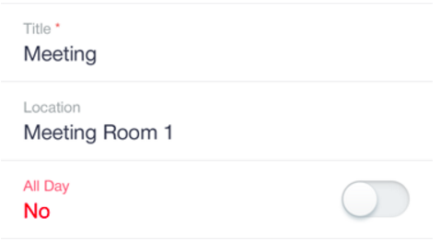
Nova Theme Features 4
Labels above fields
Use km-label-above class on the label.
http://dojo.telerik.com/oKana
Standalone Checkboxes and Radio Buttons
Use km-checkbox, km-checkbox-label (checkboxes)
Use km-radio, km-radio-label (radio buttons)
http://dojo.telerik.com/oKeMu

Slide 12
ThemeBuilder for Mobile
The Kendo UI themes for mobile
designed to be easily customizable
Using different colors and backgrounds.
Make it even easier using
Kendo UI ThemeBuilder for mobile.
Very simple to use
Drag and drop
colors,
gradients,
patterns
font styles
Provides import/export to get the needed CSS stylesheet.
http://demos.telerik.com/kendo-ui/mobilethemebuilder/

Slide 13
Forms
Automatic platform-dependent styling
Form elements when added to a mobile View.
Currently, the following form elements are styled:
Inputs of types
Text, Password, Search, url, Email, Number, Tel, file (not in iOS), Date, Time, Month, datetime
Single select elements
Kendo UI DropDownList replacements.
Hint
To have native-like forms layout
To properly align widgets with no additional styling,
Use Kendo UI ListView for mobile.

