Slide 1


Kendo Hybrid UI Components
Contains mobile-only widgets
Optimized for mobile devices
Look and feel natural
Handle touch gestures
They are not meant for web applications
Web widgets can be used in hybrid apps
Examples:
http://docs.telerik.com/kendo-ui/controls/hybrid/introduction

Slide 2
Using Hybrid Widgets
Use Kendo Hybrid ListView
Using Kendo UI DataSource object
http://dojo.telerik.com/ObicU/6

Slide 3
Using Kendo Web Widgets
Use Kendo Grid
http://dojo.telerik.com/ObicU/7

Slide 4
Include what you need
Add the necessary CSS files
http://dojo.telerik.com/ObicU/8

Slide 5
Use Kendo UI Chart
http://dojo.telerik.com/ObicU/9

Slide 6
Touch Events
The Kendo UI Touch component provides a cross-platform compatible API for handling user-initiated touch events, multi-touch gestures and event sequences such as drag, swipe, and others.
On pointer-enabled devices, i.e. desktops and laptops, mouse events are treated as touch events.

Slide 7
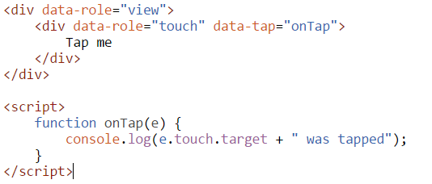
Getting Started
The Kendo UI Hybrid Application widget automatically initializes a Touch component for every element with a role data attribute set to touch present in the views/layouts markup.

Slide 8
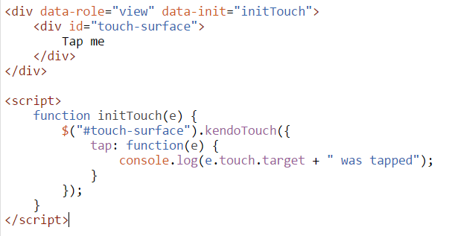
Alternatively, it can be initialized using jQuery plugin syntax in the containing mobile View init event handler.

Slide 9
Touch Event Info
Each touch event handler receives an event object as a parameter.
The touch event has a touch property, which contains information about the touch event like its current coordinates, initial position, the DOM element, etc.
The multi-touch gestures event object parameter has a touches property, which is an array of two touch objects.
In addition, a distance and center properties are exposed.

Slide 10
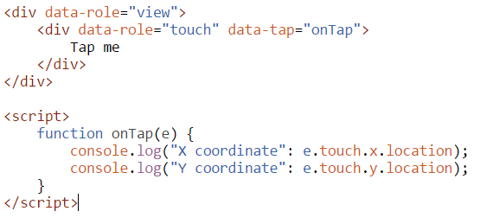
Access Touch Event Information

