Slide 1

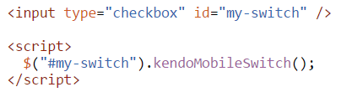
Integration with Kendo UI Web
Since Q1 2014 Kendo UI hybrid can be used with Kendo UI Web without active mobile application.
Getting Started
Use kendo.[skin].mobile.css or kendo.[skin].mobile.min.css
Instantiate Hybrid Mobile Widget

Slide 2
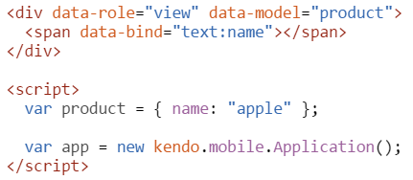
Using Kendo UI MVVM in mobile applicaiton
close integration
configuration options can be bound and managed through a view model.
Getting Started
The recommended way to use the Kendo UI MVVM with the Hybrid UI Application is through the model configuration option of the mobile view.
http://dojo.telerik.com/ILIxa

Slide 3
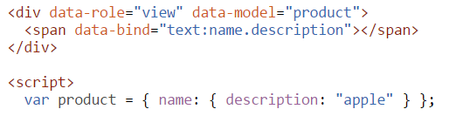
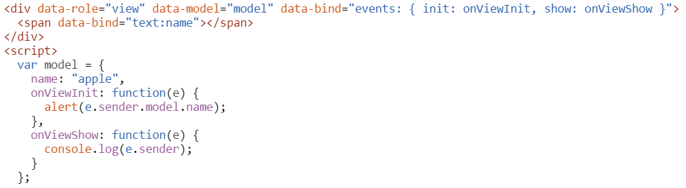
MVVM Complex model reference
http://dojo.telerik.com/IsOZI
MVVM Binding
When initialized, the mobile View calls kendo.bind on its child elements, using the provided model.
http://dojo.telerik.com/uwaHO

