Slide 1

Hybrid Mobile Application
What is Hybrid Mobile App
  Looks and feels like native app
  It’s built using HTML, JavaScript and CSS
  Hybrid apps use WebView, not Browser
Apache Cordova (PhoneGap) platform
  Set of JavaScript APIs to access device capabilities
    Accelerometer, GPS, Contacts, Camera, and more
  Access is through Plug-ins, built in native code
Mobile app vs Mobile website
  Mobile website is just a different look
  Mobile app is deployed on device

Slide 2
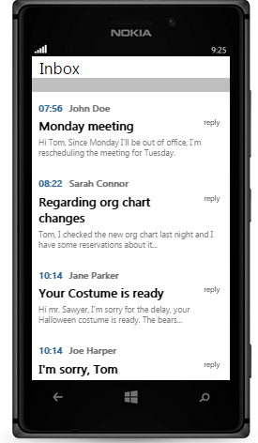
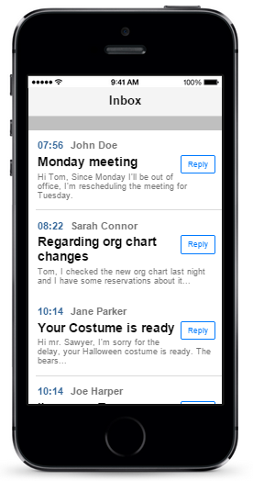
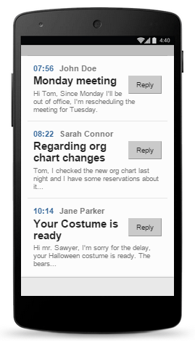
How hybrid apps are built
Telerik DevCloud
Your HTML5, Kendo Mobile Source Code
Apps
ready for deployment on iOS, Android, WP
Telerik AppBuilder

Slide 3
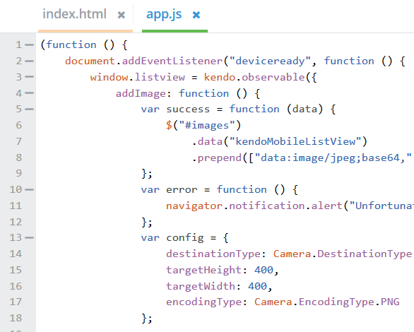

Telerik AppBuilder
Mobile development platform
  Desktop client
  In-browser client
  Extension to Visual Studio
  Command-line interface (CLI)
Integrated version control
  Private repository
  Supports third-party version control
LiveSync
  Test and Publish changes instantly

Slide 4
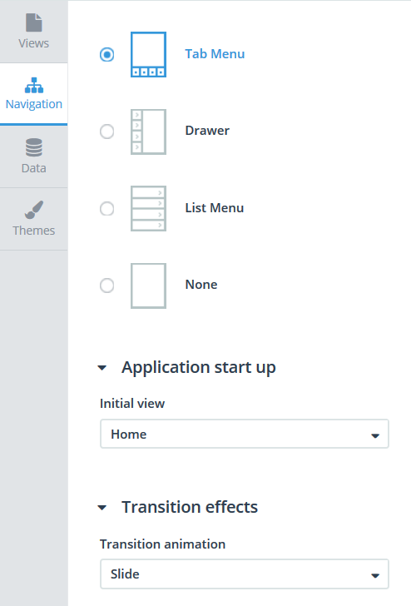
Telerik Screen Builder
Create or modify views
  Use built-in templates
  Select view title and icons
  Reorder views
Setup navigation
  Set navigation type
  Select transition effect
Data provider
  Data-bind views
Change app theme
  Native or flat

Slide 5
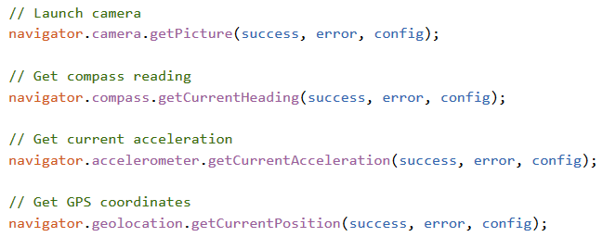
Using device sensors
To get reading from a sensor, callback functions for success and error must be passed as well as config object.

