Slide 1

Kendo UI Charts
Widget for rendering high-quality data visualizations.
Graphics are rendered on the client using SVG and Canvas
Most popular chart types are supported
Bar, Column, Line, Pie, Scatter, Bubble, etc.
Chart widget uses separate styles

Slide 2
Chart components
Series
Array of objects. Each object represents a series.
There are two types of series
Categorical
Scattered
Axes
Value axis (more than one value axis is supported)
Category axis

Slide 3
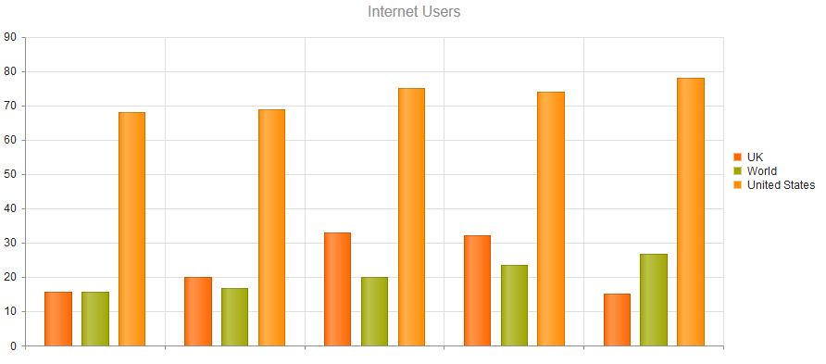

Categorical charts
Categorical charts use categorical series, made up of array of objects
Categorical series is used for ‘trend’ type of charting
Categorical series can share same axes
At least one axis must have data, the other is calculated
The axis orientation is inferred from the series type
Examples:
http://dojo.telerik.com/odelu
Notes:
http://dojo.telerik.com/ONaHo
Category axis, different series types
http://dojo.telerik.com/ItAhU

Slide 4
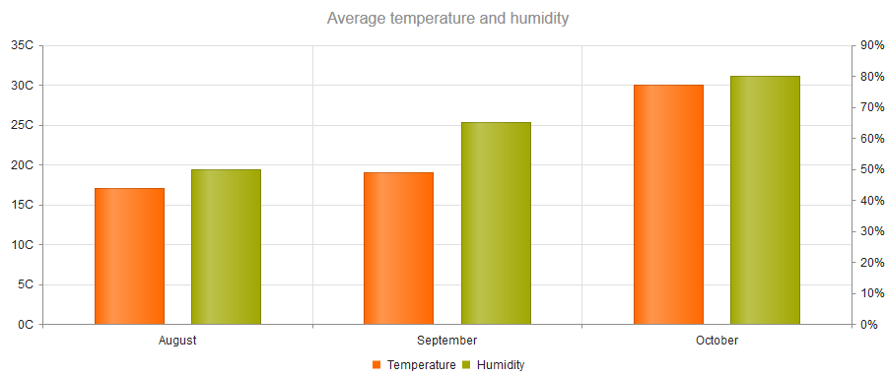
Binding categorical charts
Series and Axes can be bound to local or remote DataSource
The setting field indicates the field name in the data object that holds the value
Binding multi value axis
All additional value axes must have unique name setting
Examples:
http://dojo.telerik.com/OpAbO
Notes:
http://dojo.telerik.com/OXoBI
Data-bound multi-axis
Colored value-axis:
http://dojo.telerik.com/iFAqo

Slide 5
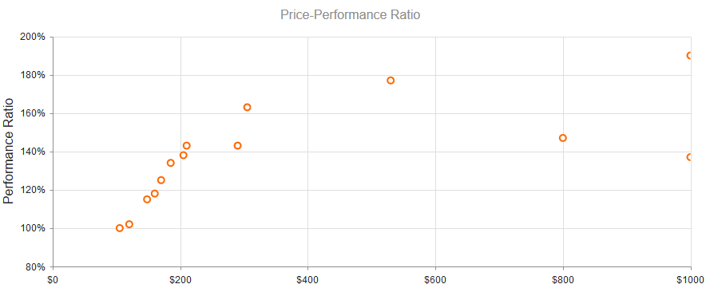
Scattered line (XY) charts
Scattered line charts use scattered series, made up of two-dimensional array of objects (matrix)
These series are used for “bubble” or “scattered” type of charting
Scattered and categorical series can not share same axes
The two axes must have data
Examples:
http://dojo.telerik.com/Egaci

Slide 6
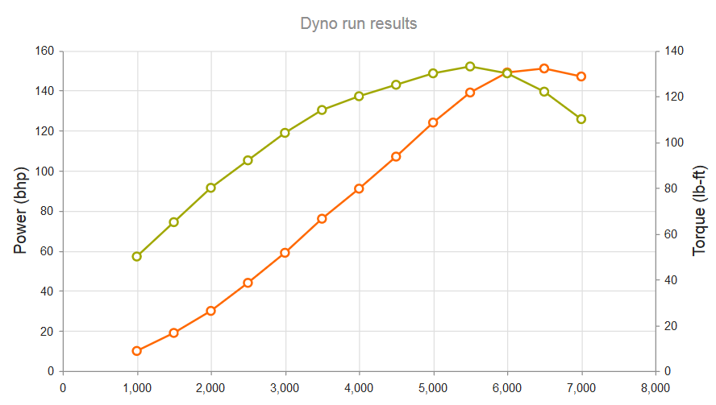
Binding scattered charts
Series and Axes can be bound to local or remote DataSource
The setting xField and yField indicate the field names in the data object that holds the value for each axis.
The X, Y axes are configured in xAxis and yAxis
Settings are similar to categoryAxis and valueAxis
Examples:
http://dojo.telerik.com/IhAnU

Slide 7

Charts responsiveness
Charts like Grids don’t resize automatically
To resize a chart you need resize its wrapper
by calling kendo.resize([widget].wrapper) or [widget].resize()
For auto-resize you need to handle resize event
Examples:
http://dojo.telerik.com/uViKe
Notes:
More about charts in kendo standard trainings

