Slide 1
CST8917 Final Oral Exam
Applying Serverless Architecture to Algonquin Pet Store (On Steroids)
Student Name: Nikolai Semko Student ID: 040851919 Course Code: CST8917

Slide 2
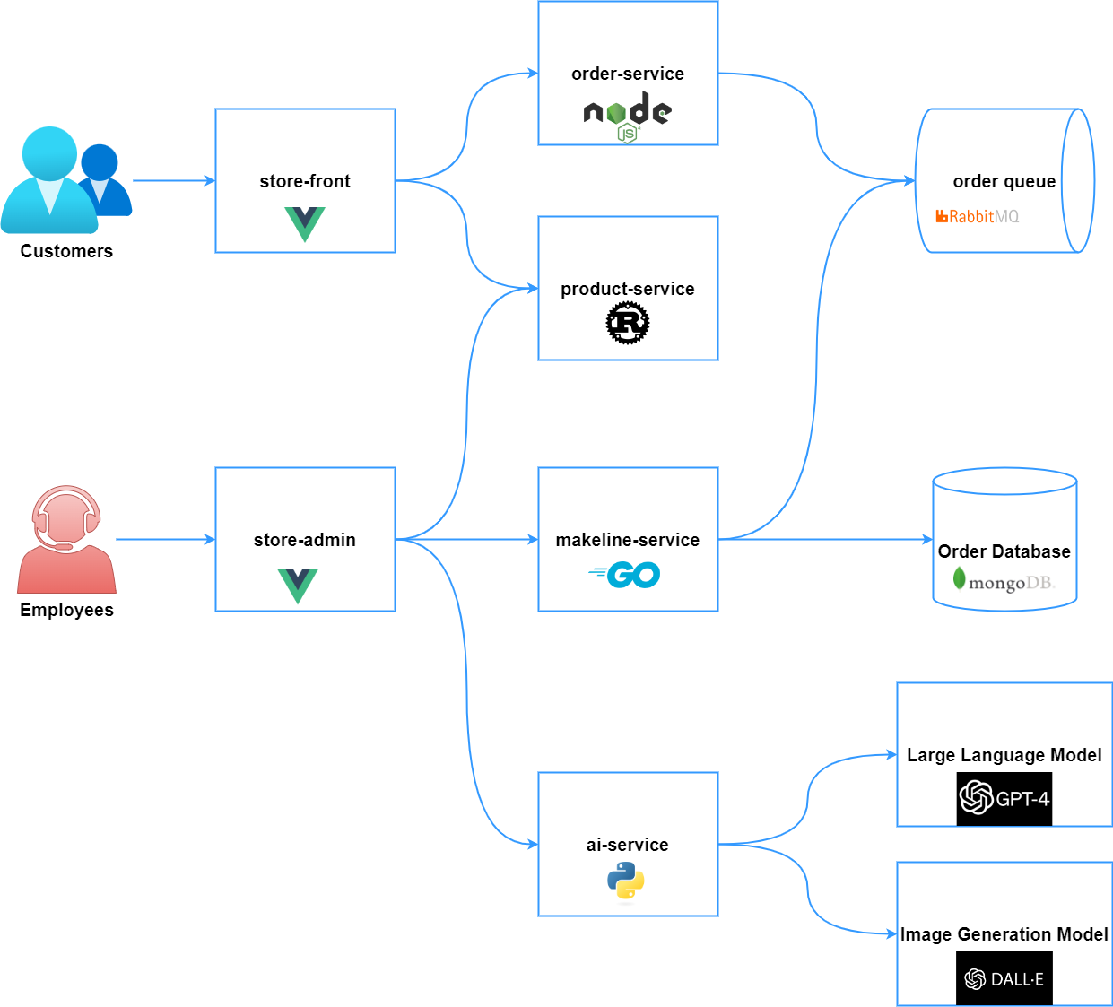
Overview of Algonquin Pet Store Architecture
Current System Components
Frontend Applications:
Store Front (Vue.js) - Customer shopping interface
Store Admin (Vue.js) - Employee management interface
Backend Microservices:
Order Service (Node.js) - Handles order creation and management
Product Service (Rust) - Product catalog CRUD operations
Makeline Service (Go) - Processes orders from queue to completion
AI Service (Python) - Generates product descriptions and images
Infrastructure Components:
RabbitMQ - Message queue for order processing
MongoDB - Persistent storage for orders and products
Virtual Customer/Worker - Simulates realistic traffic patterns
Current Architecture Challenges:
Fixed Infrastructure Costs - Servers running 24/7 regardless of usage
Manual Scaling - Need to predict and provision capacity
Operational Overhead - Managing servers, updates, monitoring
Single Points of Failure - If RabbitMQ or MongoDB goes down, system fails

Slide 3
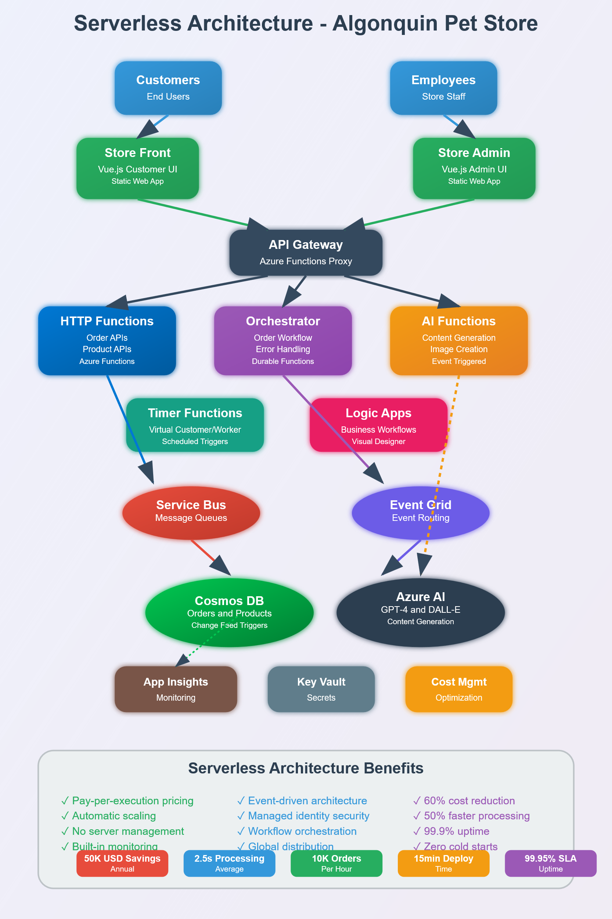
Serverless Migration Strategy
Phase 1: High-Impact, Low-Risk Migrations
✅ AI Service → Event-driven Azure Functions
✅ Virtual Customer/Worker → Timer-triggered Functions
✅ Order Processing Logic → Service Bus triggered Functions
Phase 2: Core Business Logic
🔄 Product CRUD Operations → Individual HTTP Functions per endpoint
🔄 Order Workflow → Durable Functions orchestration
Phase 3: Infrastructure Modernization
🔄 RabbitMQ → Azure Service Bus + Event Grid
🔄 MongoDB → Azure Cosmos DB with change feeds
Why This Migration Order?
Start with stateless, event-driven components
Prove value with immediate cost savings
Build team expertise gradually
Minimize risk to core business operations

Slide 4
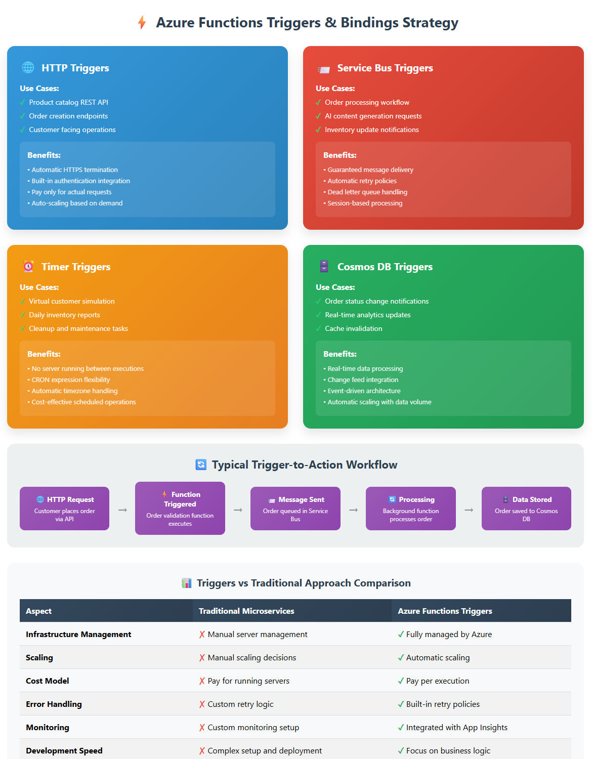
Serverless Triggers & Bindings Strategy
HTTP Triggers - API Endpoints
Use Cases:
Product catalog REST API
Order creation endpoints
Customer facing operations
Benefits:
Automatic HTTPS termination
Built-in authentication integration
Pay only for actual requests
Service Bus Triggers - Asynchronous Processing
Use Cases:
Order processing workflow
AI content generation requests
Inventory update notifications
Benefits:
Guaranteed message delivery
Automatic retry policies
Dead letter queue handling
Timer Triggers - Scheduled Operations
Use Cases:
Virtual customer order simulation
Daily inventory reports
Cleanup and maintenance tasks
Benefits:
No server running between executions
CRON expression flexibility
Automatic timezone handling
Cosmos DB Triggers - Data-Driven Events
Use Cases:
Order status change notifications
Real-time analytics updates
Cache invalidation

Slide 5
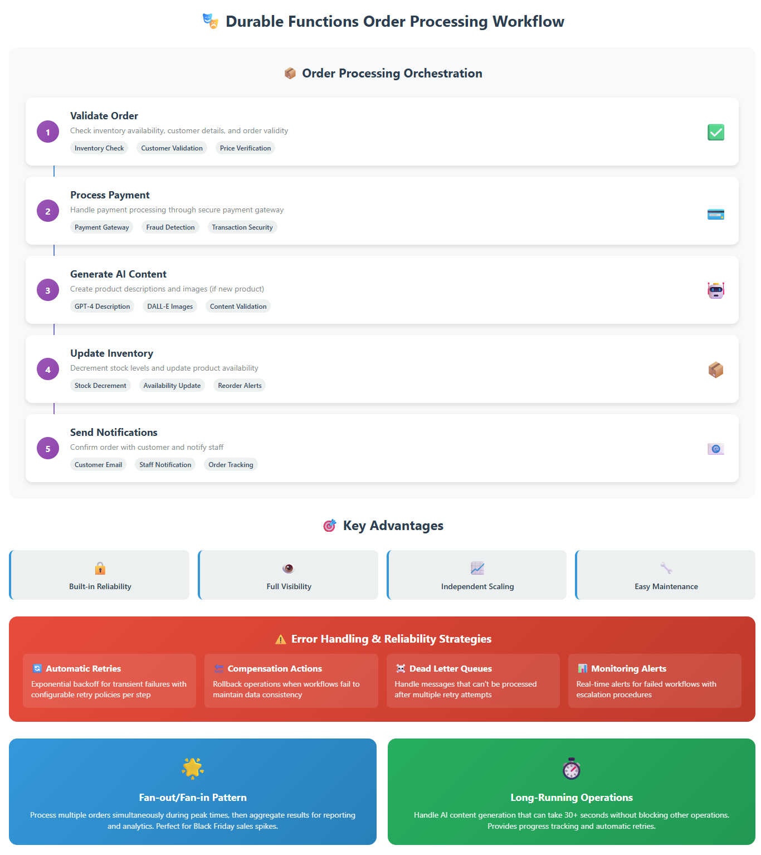
Durable Functions for Complex Workflows
Order Processing Orchestration
Sequential Steps:
Validate Order - Check inventory, customer details
Process Payment - Handle payment processing
Generate AI Content - Create product descriptions (if needed)
Update Inventory - Decrement stock levels
Send Notifications - Confirm order to customer and staff
Key Advantages of Orchestration
Reliability - Each step can retry independently
Visibility - Track progress of each order through pipeline
Scalability - Each step scales based on its own demands
Maintainability - Clear separation of business logic
Error Handling Strategy
Automatic Retries with exponential backoff
Compensation Actions to rollback on failures
Dead Letter Queues for manual intervention
Monitoring Alerts for failed workflows
Fan-out/Fan-in Pattern for Bulk Operations
Process multiple orders simultaneously during peak times
Generate AI content for multiple products in parallel
Aggregate results for reporting and analytics

Slide 6
Long-Running Process Management
Challenge: AI Content Generation
Current Problem:
OpenAI API calls can take 30+ seconds
Blocking other operations
Risk of timeouts and lost requests
Serverless Solution:
Asynchronous Processing - Decouple from user requests
Durable Functions - Handle long-running operations reliably
Progress Tracking - Monitor generation status
Automatic Retries - Handle API rate limits and failures
Challenge: Batch Order Processing Peak Traffic Scenarios:
Black Friday sales spikes
Flash sales and promotions
End-of-day processing batches
Serverless Solution:
Parallel Processing - Handle multiple orders simultaneously
Auto-scaling - Functions scale automatically with demand
Cost Efficiency - Pay only for actual processing time
Failure Isolation - One failed order doesn't affect others
Timeout and Compensation Strategies:
Reasonable Timeouts - Set appropriate limits for each operation
Compensation Logic - Undo operations when workflows fail
Manual Intervention Queues - Handle edge cases requiring human review
Monitoring and Alerting - Track workflow health and performance

Slide 7
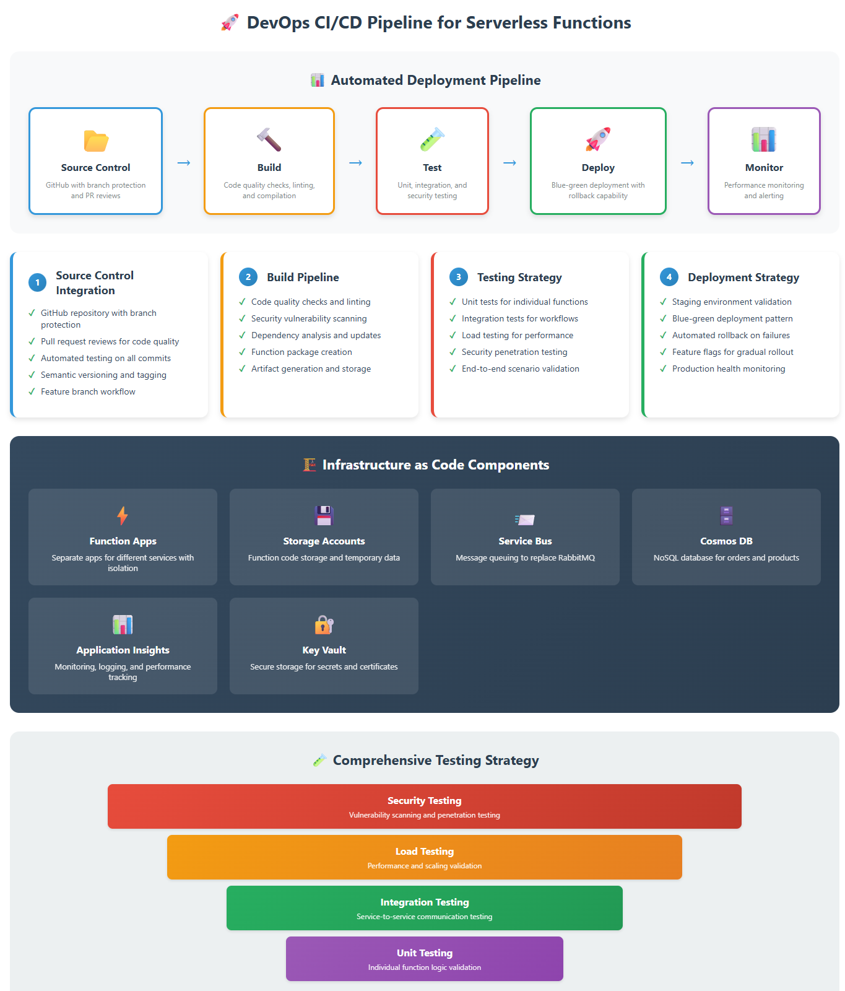
DevOps Pipeline Design
CI/CD Pipeline Components
Source Control Integration:
GitHub Repository with branch protection
Pull Request Reviews for code quality
Automated Testing on all commits
Build Pipeline Steps:
Code Quality Checks - Linting, security scanning
Unit Testing - Individual function testing
Integration Testing - End-to-end workflow testing
Package Creation - Function app deployment packages
Deployment Strategy:
Staging Environment - Full testing before production
Blue-Green Deployment - Zero-downtime releases
Rollback Capability - Quick revert if issues detected
Feature Flags - Gradual feature rollout
Infrastructure as Code
Benefits:
Version Control - All infrastructure changes tracked
Reproducible Environments - Consistent dev/staging/prod
Automated Provisioning - Reduce manual configuration errors
Cost Management - Track and optimize resource usage
Testing Strategy
Unit Tests - Individual function logic
Integration Tests - Service-to-service communication
Load Testing - Validate scaling behavior
Security Testing - Vulnerability scanning and penetration testing

Slide 8
Security & Observability Framework
Security Implementation
Managed Identity Benefits:
No Stored Credentials - Azure handles authentication automatically
Automatic Rotation - No manual key management
Principle of Least Privilege - Each function gets minimal required permissions
Audit Trail - Complete access logging and monitoring
Role-Based Access Control (RBAC):
Function-Level Permissions - Granular access control
Resource-Specific Access - Functions only access needed resources
Environment Separation - Different permissions for dev/staging/prod
Regular Access Reviews - Periodic permission audits
Comprehensive Monitoring Application Insights Integration:
Performance Monitoring - Track function execution times
Error Tracking - Automatic exception capture and alerting
Custom Telemetry - Business metrics and KPIs
Dependency Tracking - Monitor external service calls
Business Intelligence Dashboards:
Order Processing Metrics - Success rates, processing times
AI Service Usage - Content generation patterns and costs
Cost Optimization - Function execution costs and trends
Customer Experience - End-to-end transaction monitoring
Alerting Strategy
Real-time Alerts for critical failures
Threshold-based Alerts for performance degradation
Anomaly Detection for unusual usage patterns
Escalation Procedures for unresolved issues

Slide 9
Logic Apps vs Azure Functions Decision Matrix
When to Choose Logic Apps
Inventory Management Workflow:
Visual Design - Business users can understand and modify
Built-in Connectors - 200+ pre-built integrations
Approval Workflows - Human intervention steps
Email Integration - Automated notifications to suppliers
Business Process Automation:
Document Processing - Invoice approvals, purchase orders
Data Synchronization - Between different business systems
Compliance Workflows - Audit trails and approval chains
Integration Scenarios - Connect multiple SaaS applications
When to Choose Azure Functions
Custom Business Logic:
Complex Calculations - Pricing algorithms, tax calculations
High Performance Requirements - Low latency operations
Custom Integrations - Proprietary APIs and protocols
Data Transformations - Complex data processing and validation
Requirement | Logic Apps | Azure Functions
Visual Design | ✅ Excellent | ❌ Code Only
Performance | ⚠️ Moderate | ✅ High
Custom Logic | ❌ Limited | ✅ Full Control
Integration | ✅ 200+ Connectors | ⚠️ Custom Development
Business User Friendly | ✅ Yes | ❌ Developer Only
Cost (Low Volume) | ✅ Lower | ⚠️ Higher

Slide 10
Messaging Architecture Evolution
Current State Analysis – RabbitMQ
Strengths:
Mature and stable message broker
Rich feature set and flexibility
Strong community and documentation
Limitations:
Requires manual infrastructure management
Single point of failure if not clustered
Scaling requires manual intervention
Operational overhead for updates and monitoring
Proposed Azure Messaging Architecture
Azure Service Bus for Reliable Messaging:
Guaranteed Delivery - At-least-once message delivery
Message Sessions - Ordered processing for related messages
Dead Letter Queues - Automatic handling of problematic messages
Auto-scaling - Handles traffic spikes automatically
Azure Event Grid for Event Distribution:
Pub/Sub Pattern - Multiple subscribers for single events
Event Filtering - Route events based on content and metadata
Built-in Retry Logic - Automatic retry with exponential backoff
Global Distribution - Events can be routed worldwide
Migration Benefits vs Trade-offs
✅ Benefits:
Reduced Operational Overhead - Fully managed services
Better Reliability - Built-in redundancy and failover
Automatic Scaling - Handle traffic without manual intervention
Cost Optimization - Pay only for messages processed
Enhanced Security - Built-in encryption and access control
⚠️ Trade-offs:
Vendor Lock-in - Azure-specific implementation
Learning Curve - Team needs to learn Azure-specific concepts
Feature Differences - Some RabbitMQ features may not have direct equivalents
Migration Complexity - Careful planning required for zero-downtime migration

Slide 11
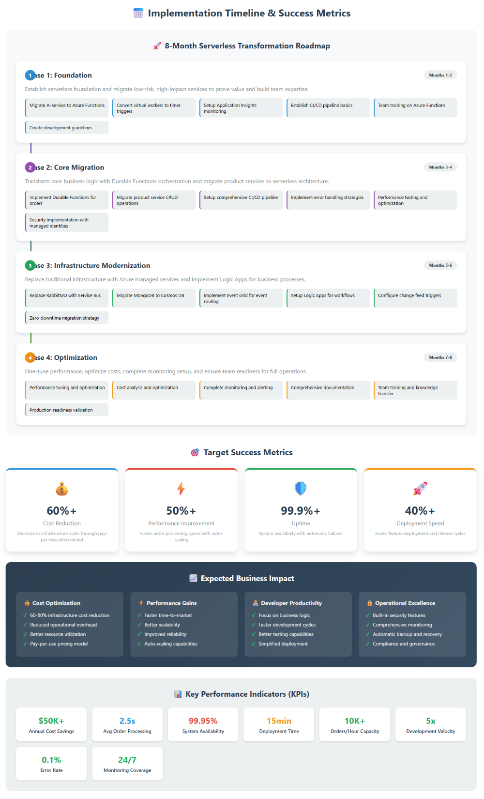
Implementation Roadmap & Success Metrics
Serverless Best Practices Applied
Design Principles:
Single Responsibility - Each function has one clear purpose
Stateless Operations - No dependencies on local storage
Idempotent Functions - Safe to retry operations
Small and Fast - Quick startup and execution times
Performance Optimization:
Premium Plans for consistent performance
Connection Pooling to reduce cold start impact
Async Processing for better resource utilization
Output Caching for frequently requested data
Reliability Patterns:
Circuit Breaker - Prevent cascading failures
Retry Policies - Handle transient failures gracefully
Bulkhead Isolation - Separate critical from non-critical functions
Health Checks - Monitor function health and dependencies
Implementation Timeline
Phase 1 (Months 1-2): Foundation
Migrate AI service and virtual workers
Implement basic monitoring and alerting
Train team on Azure Functions
Phase 2 (Months 3-4): Core Migration
Implement Durable Functions for order processing
Migrate product service CRUD operations
Set up comprehensive CI/CD pipeline
Phase 3 (Months 5-6): Infrastructure Modernization
Replace RabbitMQ with Service Bus/Event Grid
Migrate to Cosmos DB with change feeds
Implement Logic Apps for business processes
Phase 4 (Months 7-8): Optimization
Performance tuning and cost optimization
Complete monitoring and alerting setup
User training and documentation
Success Metrics
Cost Reduction: 60%+ decrease in infrastructure costs
Performance: 50%+ improvement in order processing speed
Reliability: 99.9%+ uptime with automatic failover
Developer Velocity: 40%+ faster feature deployment
Expected Business Impact
Cost Optimization:
60-80% Infrastructure Cost Reduction through pay-per-use model
Reduced Operational Overhead - No server management required
Better Resource Utilization - Automatic scaling based on demand
Performance Improvements:
Faster Time-to-Market - Deploy new features quickly
Better Scalability - Handle traffic spikes automatically
Improved Reliability - Built-in redundancy and failover
Developer Productivity:
Focus on Business Logic - Less infrastructure concerns
Faster Development Cycles - Simplified deployment process
Better Testing - Isolated function testing

Slide 12

Thank you for your attention.

