Slide 1
CST8917 Final Oral Exam
Applying Serverless Architecture to Algonquin Pet Store (On Steroids)
Student Name: Nikolai Semko Student ID: 040851919 Course Code: CST8917

Slide 2
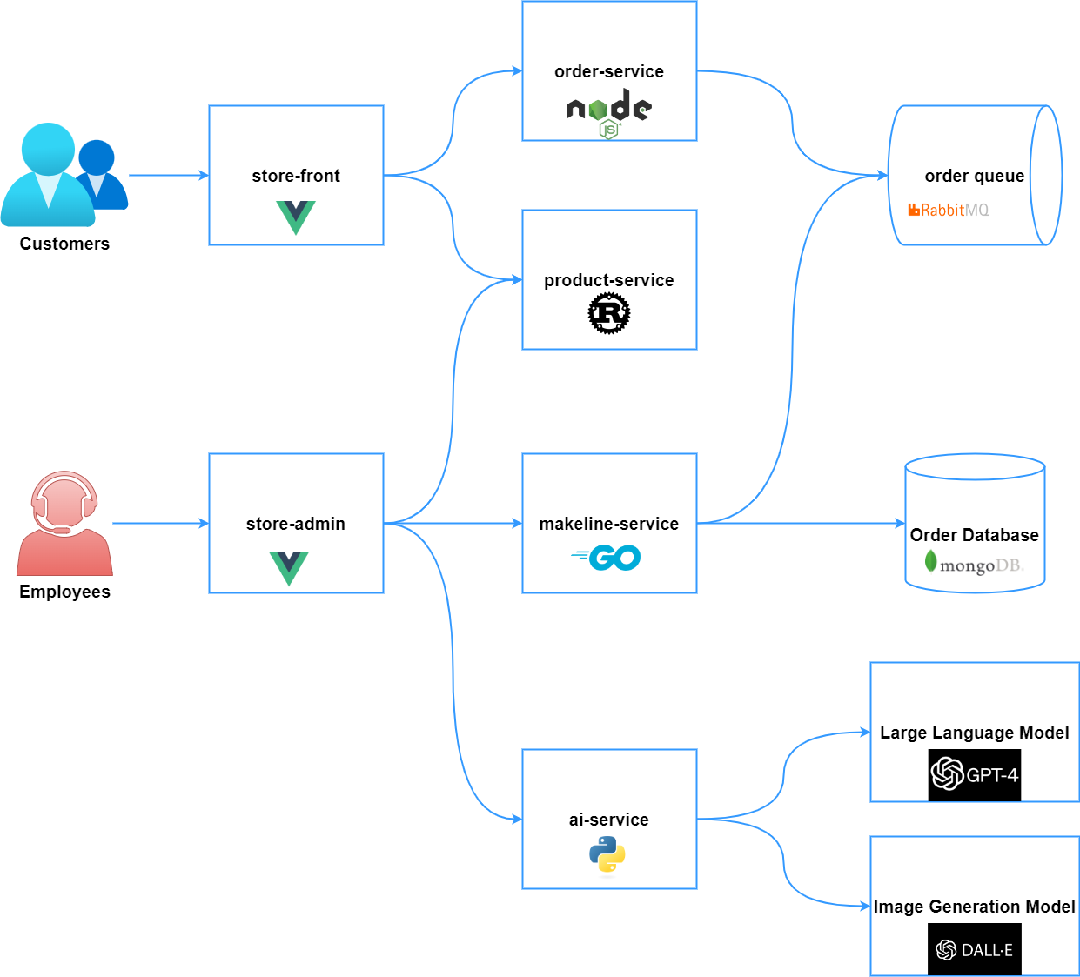
Overview of Algonquin Pet Store Architecture
Current System Components
Frontend Applications:
Store Front (Vue.js) - Customer shopping interface
Store Admin (Vue.js) - Employee management interface
Backend Microservices:
Order Service (Node.js) - Handles order creation and management
Product Service (Rust) - Product catalog CRUD operations
Makeline Service (Go) - Processes orders from queue to completion
AI Service (Python) - Generates product descriptions and images
Infrastructure Components:
RabbitMQ - Message queue for order processing
MongoDB - Persistent storage for orders and products
Virtual Customer/Worker - Simulates realistic traffic patterns
Current Architecture Challenges:
Fixed Infrastructure Costs - Servers running 24/7 regardless of usage
Manual Scaling - Need to predict and provision capacity
Operational Overhead - Managing servers, updates, monitoring
Single Points of Failure - If RabbitMQ or MongoDB goes down, system fails

Slide 3
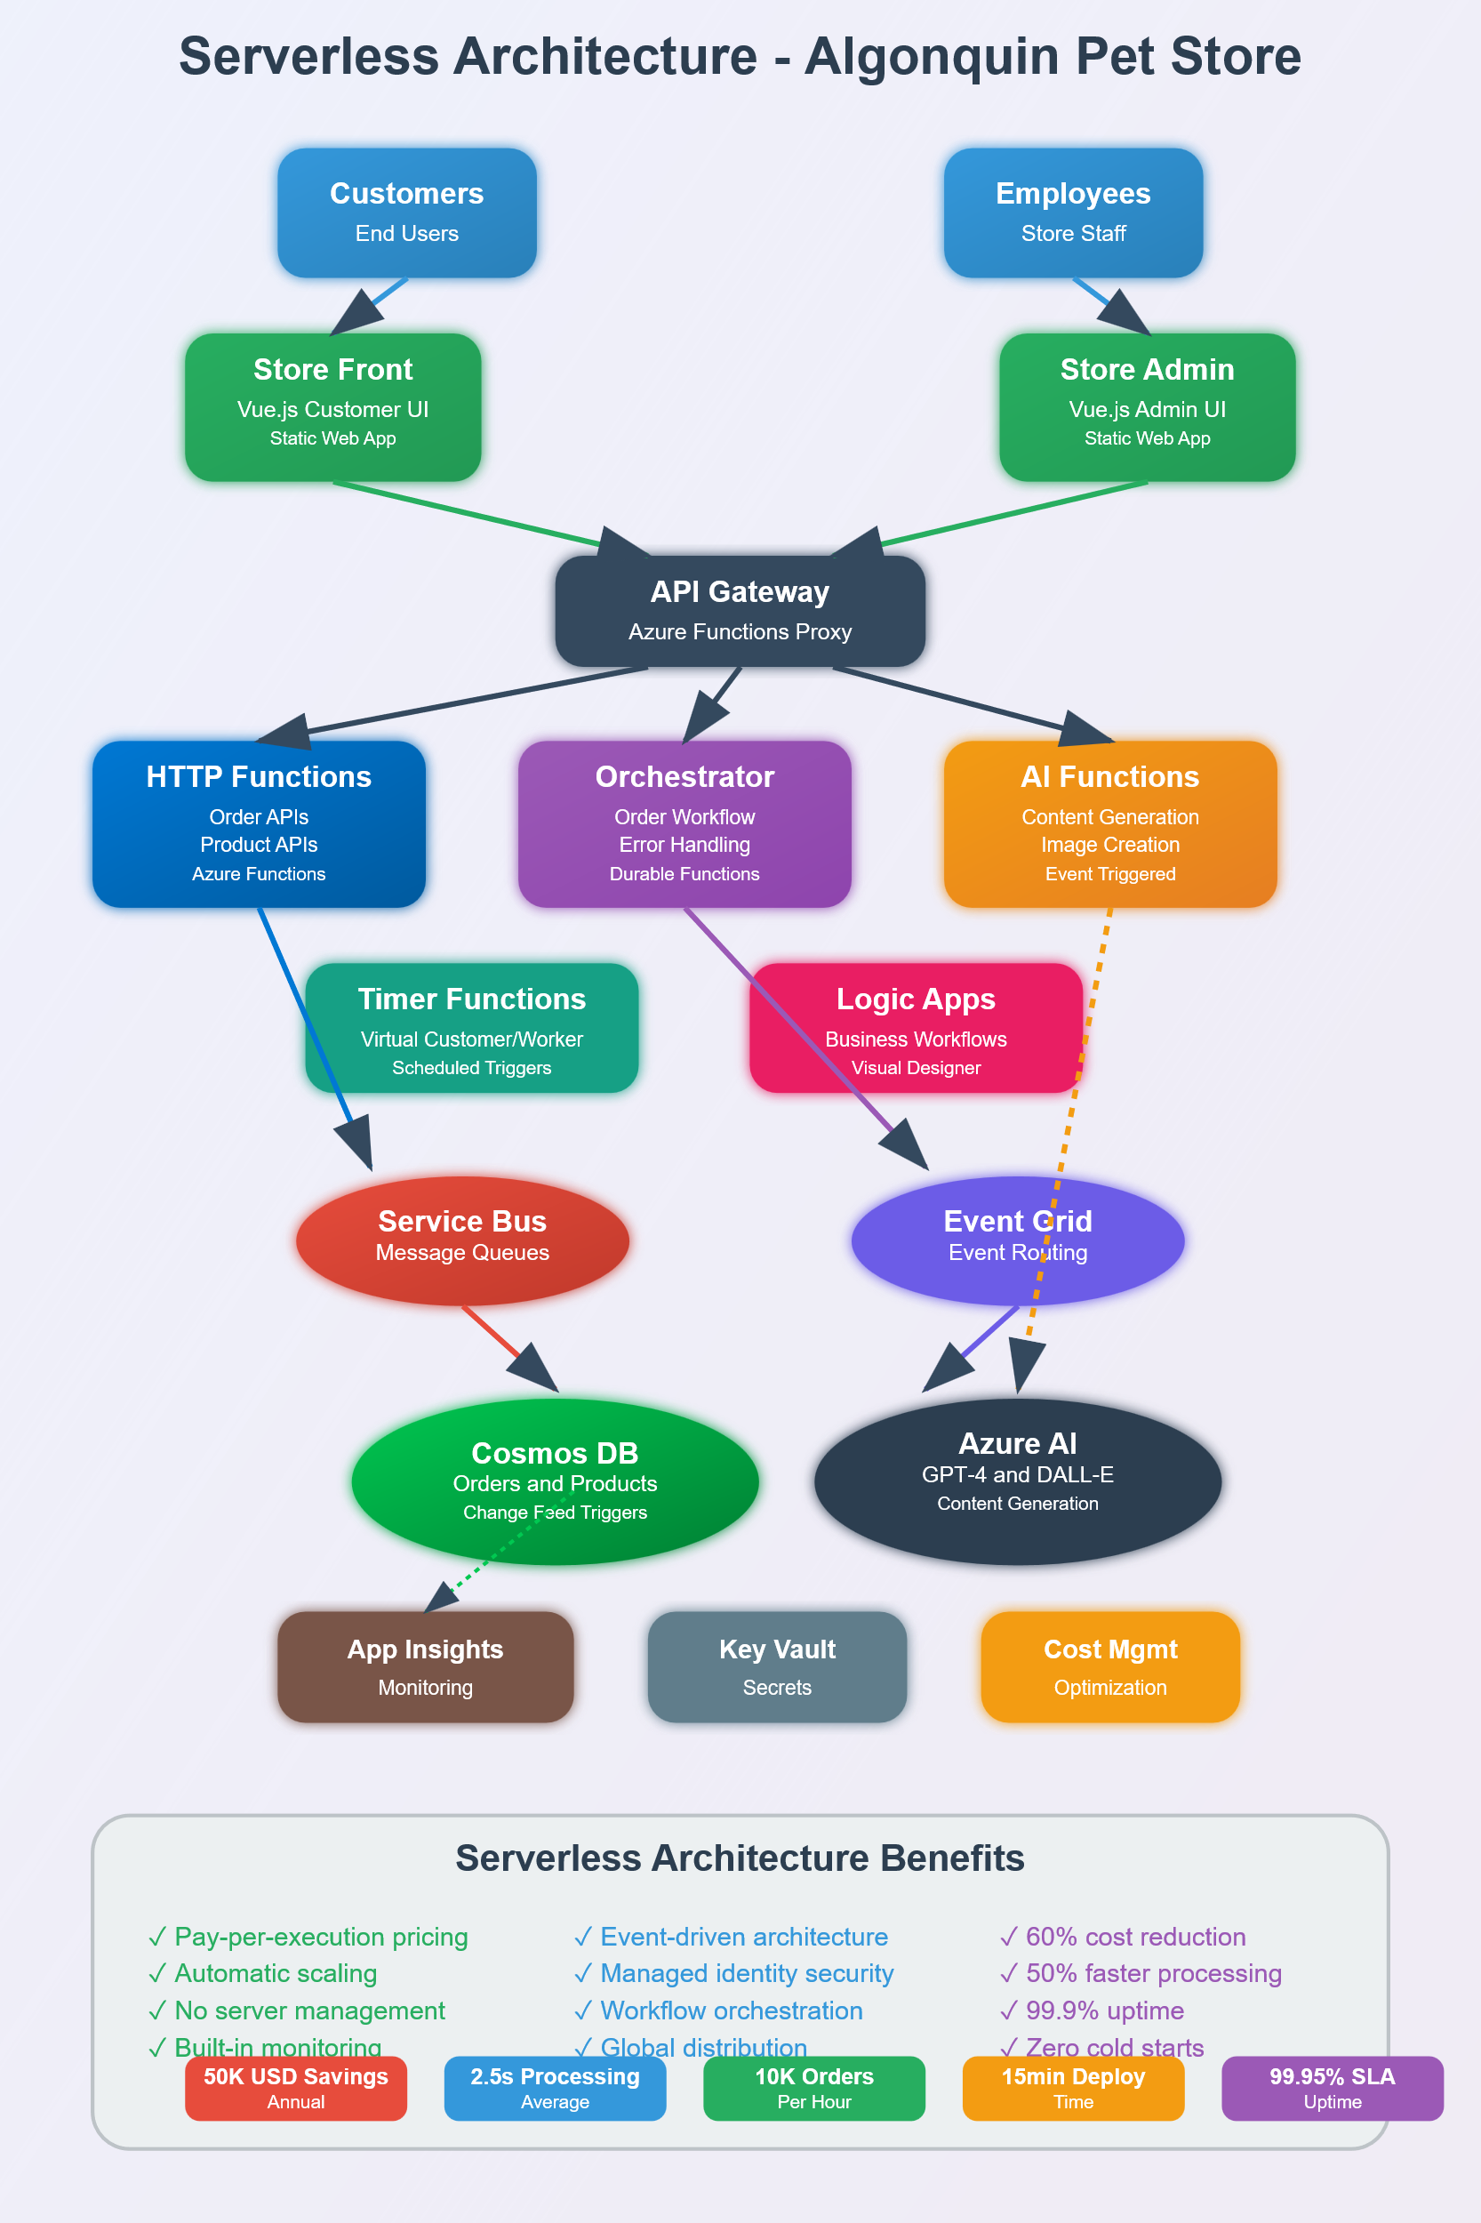
Serverless Migration Strategy
Phase 1: High-Impact, Low-Risk Migrations
✅ AI Service → Event-driven Azure Functions
✅ Virtual Customer/Worker → Timer-triggered Functions
✅ Order Processing Logic → Service Bus triggered Functions
Phase 2: Core Business Logic
🔄 Product CRUD Operations → Individual HTTP Functions per endpoint
🔄 Order Workflow → Durable Functions orchestration
Phase 3: Infrastructure Modernization
🔄 RabbitMQ → Azure Service Bus + Event Grid
🔄 MongoDB → Azure Cosmos DB with change feeds
Why This Migration Order?
Start with stateless, event-driven components
Prove value with immediate cost savings
Build team expertise gradually
Minimize risk to core business operations

Slide 4
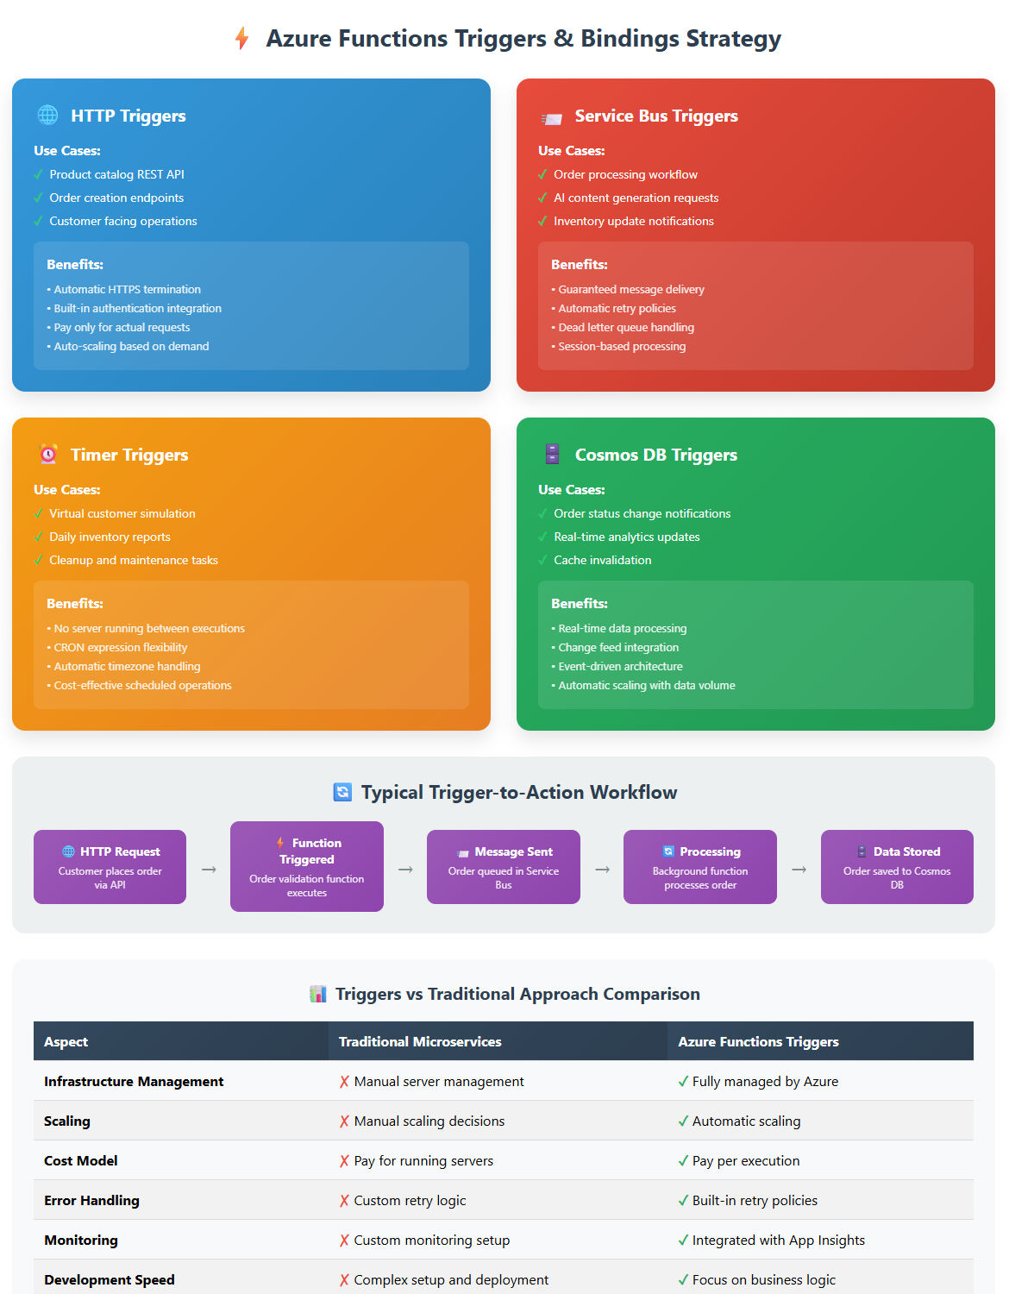
Serverless Triggers & Bindings Strategy
HTTP Triggers - API Endpoints
Use Cases:
Product catalog REST API
Order creation endpoints
Customer facing operations
Benefits:
Automatic HTTPS termination
Built-in authentication integration
Pay only for actual requests
Service Bus Triggers - Asynchronous Processing
Use Cases:
Order processing workflow
AI content generation requests
Inventory update notifications
Benefits:
Guaranteed message delivery
Automatic retry policies
Dead letter queue handling
Timer Triggers - Scheduled Operations
Use Cases:
Virtual customer order simulation
Daily inventory reports
Cleanup and maintenance tasks
Benefits:
No server running between executions
CRON expression flexibility
Automatic timezone handling
Cosmos DB Triggers - Data-Driven Events
Use Cases:
Order status change notifications
Real-time analytics updates
Cache invalidation

Slide 5
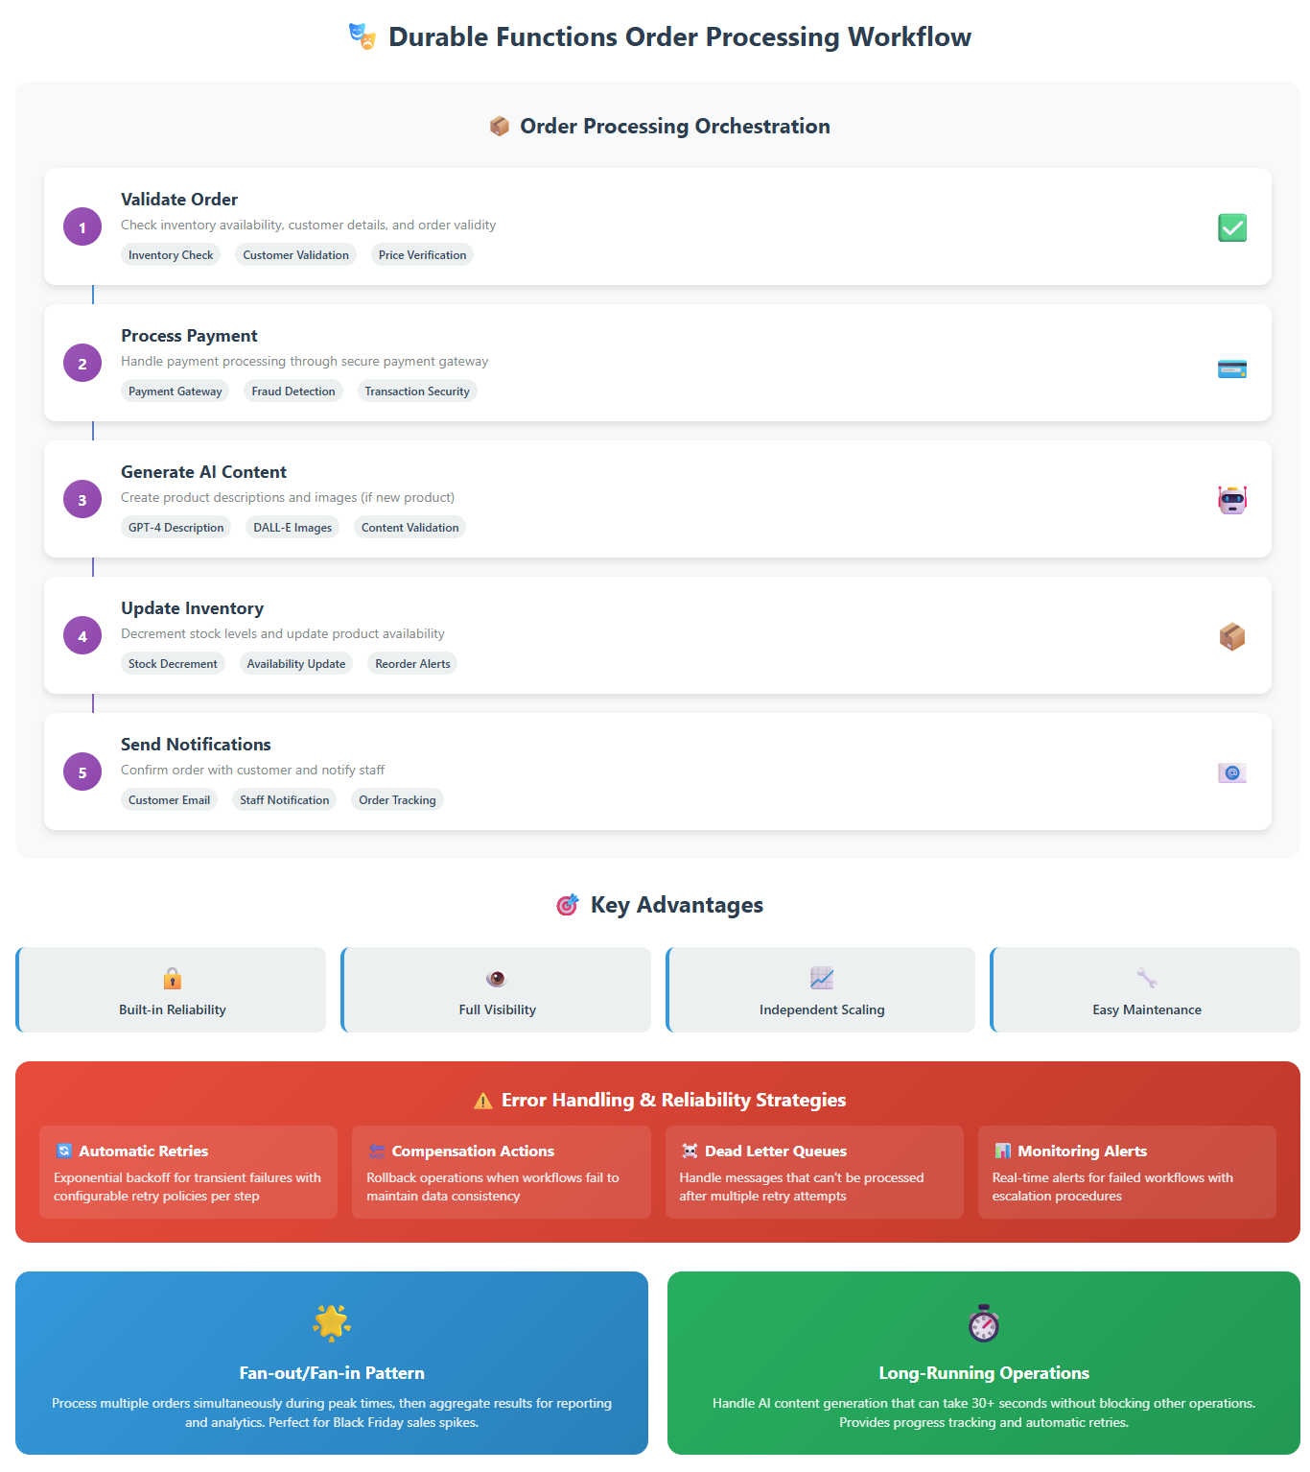
Durable Functions for Complex Workflows
Order Processing Orchestration
Sequential Steps:
Validate Order - Check inventory, customer details
Process Payment - Handle payment processing
Generate AI Content - Create product descriptions (if needed)
Update Inventory - Decrement stock levels
Send Notifications - Confirm order to customer and staff
Key Advantages of Orchestration
Reliability - Each step can retry independently
Visibility - Track progress of each order through pipeline
Scalability - Each step scales based on its own demands
Maintainability - Clear separation of business logic
Error Handling Strategy
Automatic Retries with exponential backoff
Compensation Actions to rollback on failures
Dead Letter Queues for manual intervention
Monitoring Alerts for failed workflows
Fan-out/Fan-in Pattern for Bulk Operations
Process multiple orders simultaneously during peak times
Generate AI content for multiple products in parallel
Aggregate results for reporting and analytics

Slide 6
Long-Running Process Management
Challenge: AI Content Generation
Current Problem:
OpenAI API calls can take 30+ seconds
Blocking other operations
Risk of timeouts and lost requests
Serverless Solution:
Asynchronous Processing - Decouple from user requests
Durable Functions - Handle long-running operations reliably
Progress Tracking - Monitor generation status
Automatic Retries - Handle API rate limits and failures
Challenge: Batch Order Processing Peak Traffic Scenarios:
Black Friday sales spikes
Flash sales and promotions
End-of-day processing batches
Serverless Solution:
Parallel Processing - Handle multiple orders simultaneously
Auto-scaling - Functions scale automatically with demand
Cost Efficiency - Pay only for actual processing time
Failure Isolation - One failed order doesn't affect others
Timeout and Compensation Strategies:
Reasonable Timeouts - Set appropriate limits for each operation
Compensation Logic - Undo operations when workflows fail
Manual Intervention Queues - Handle edge cases requiring human review
Monitoring and Alerting - Track workflow health and performance

Slide 7
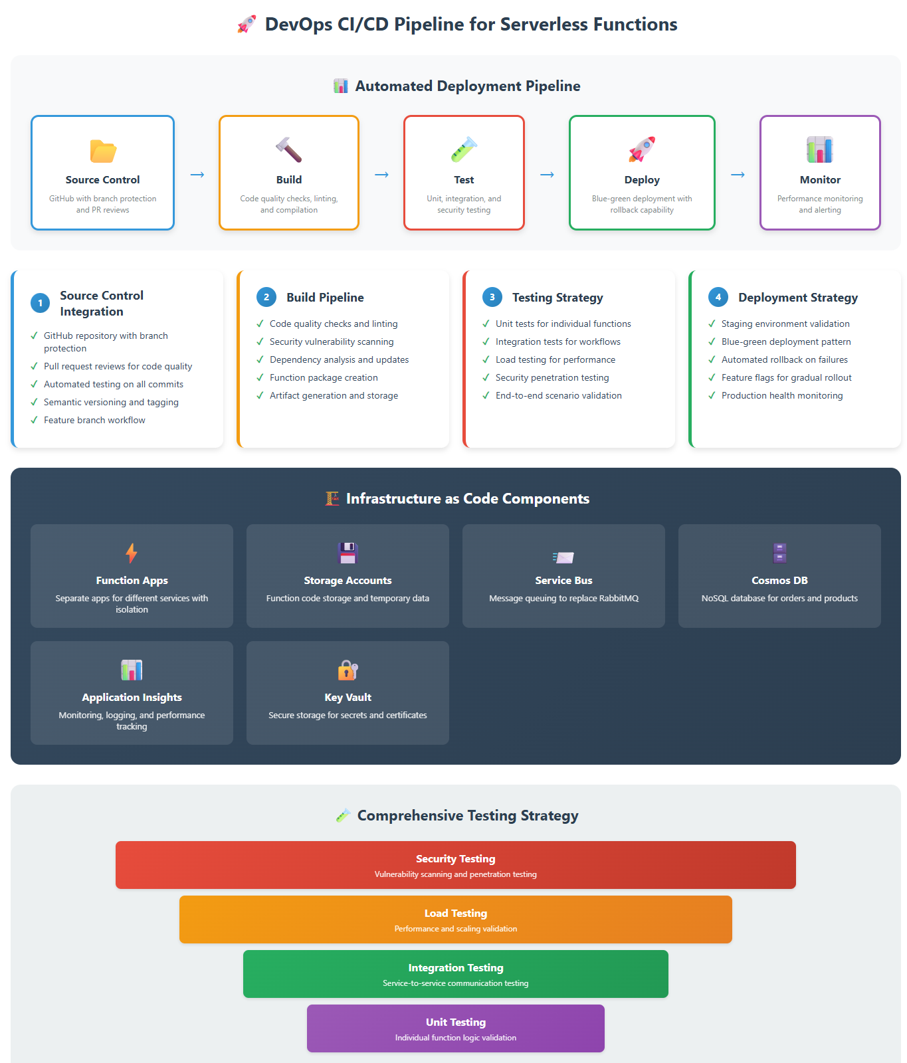
Durable Functions for Complex Workflows
Order Processing Orchestration
Sequential Steps:
Validate Order - Check inventory, customer details
Process Payment - Handle payment processing
Generate AI Content - Create product descriptions (if needed)
Update Inventory - Decrement stock levels
Send Notifications - Confirm order to customer and staff
Key Advantages of Orchestration
Reliability - Each step can retry independently
Visibility - Track progress of each order through pipeline
Scalability - Each step scales based on its own demands
Maintainability - Clear separation of business logic
Error Handling Strategy
Automatic Retries with exponential backoff
Compensation Actions to rollback on failures
Dead Letter Queues for manual intervention
Monitoring Alerts for failed workflows
Fan-out/Fan-in Pattern for Bulk Operations
Process multiple orders simultaneously during peak times
Generate AI content for multiple products in parallel
Aggregate results for reporting and analytics

Slide 8
Durable Functions for Complex Workflows
Order Processing Orchestration
Sequential Steps:
Validate Order - Check inventory, customer details
Process Payment - Handle payment processing
Generate AI Content - Create product descriptions (if needed)
Update Inventory - Decrement stock levels
Send Notifications - Confirm order to customer and staff
Key Advantages of Orchestration
Reliability - Each step can retry independently
Visibility - Track progress of each order through pipeline
Scalability - Each step scales based on its own demands
Maintainability - Clear separation of business logic
Error Handling Strategy
Automatic Retries with exponential backoff
Compensation Actions to rollback on failures
Dead Letter Queues for manual intervention
Monitoring Alerts for failed workflows
Fan-out/Fan-in Pattern for Bulk Operations
Process multiple orders simultaneously during peak times
Generate AI content for multiple products in parallel
Aggregate results for reporting and analytics

Slide 9
Durable Functions for Complex Workflows
Order Processing Orchestration
Sequential Steps:
Validate Order - Check inventory, customer details
Process Payment - Handle payment processing
Generate AI Content - Create product descriptions (if needed)
Update Inventory - Decrement stock levels
Send Notifications - Confirm order to customer and staff
Key Advantages of Orchestration
Reliability - Each step can retry independently
Visibility - Track progress of each order through pipeline
Scalability - Each step scales based on its own demands
Maintainability - Clear separation of business logic
Error Handling Strategy
Automatic Retries with exponential backoff
Compensation Actions to rollback on failures
Dead Letter Queues for manual intervention
Monitoring Alerts for failed workflows
Fan-out/Fan-in Pattern for Bulk Operations
Process multiple orders simultaneously during peak times
Generate AI content for multiple products in parallel
Aggregate results for reporting and analytics

Slide 10
Durable Functions for Complex Workflows
Order Processing Orchestration
Sequential Steps:
Validate Order - Check inventory, customer details
Process Payment - Handle payment processing
Generate AI Content - Create product descriptions (if needed)
Update Inventory - Decrement stock levels
Send Notifications - Confirm order to customer and staff
Key Advantages of Orchestration
Reliability - Each step can retry independently
Visibility - Track progress of each order through pipeline
Scalability - Each step scales based on its own demands
Maintainability - Clear separation of business logic
Error Handling Strategy
Automatic Retries with exponential backoff
Compensation Actions to rollback on failures
Dead Letter Queues for manual intervention
Monitoring Alerts for failed workflows
Fan-out/Fan-in Pattern for Bulk Operations
Process multiple orders simultaneously during peak times
Generate AI content for multiple products in parallel
Aggregate results for reporting and analytics

Slide 11
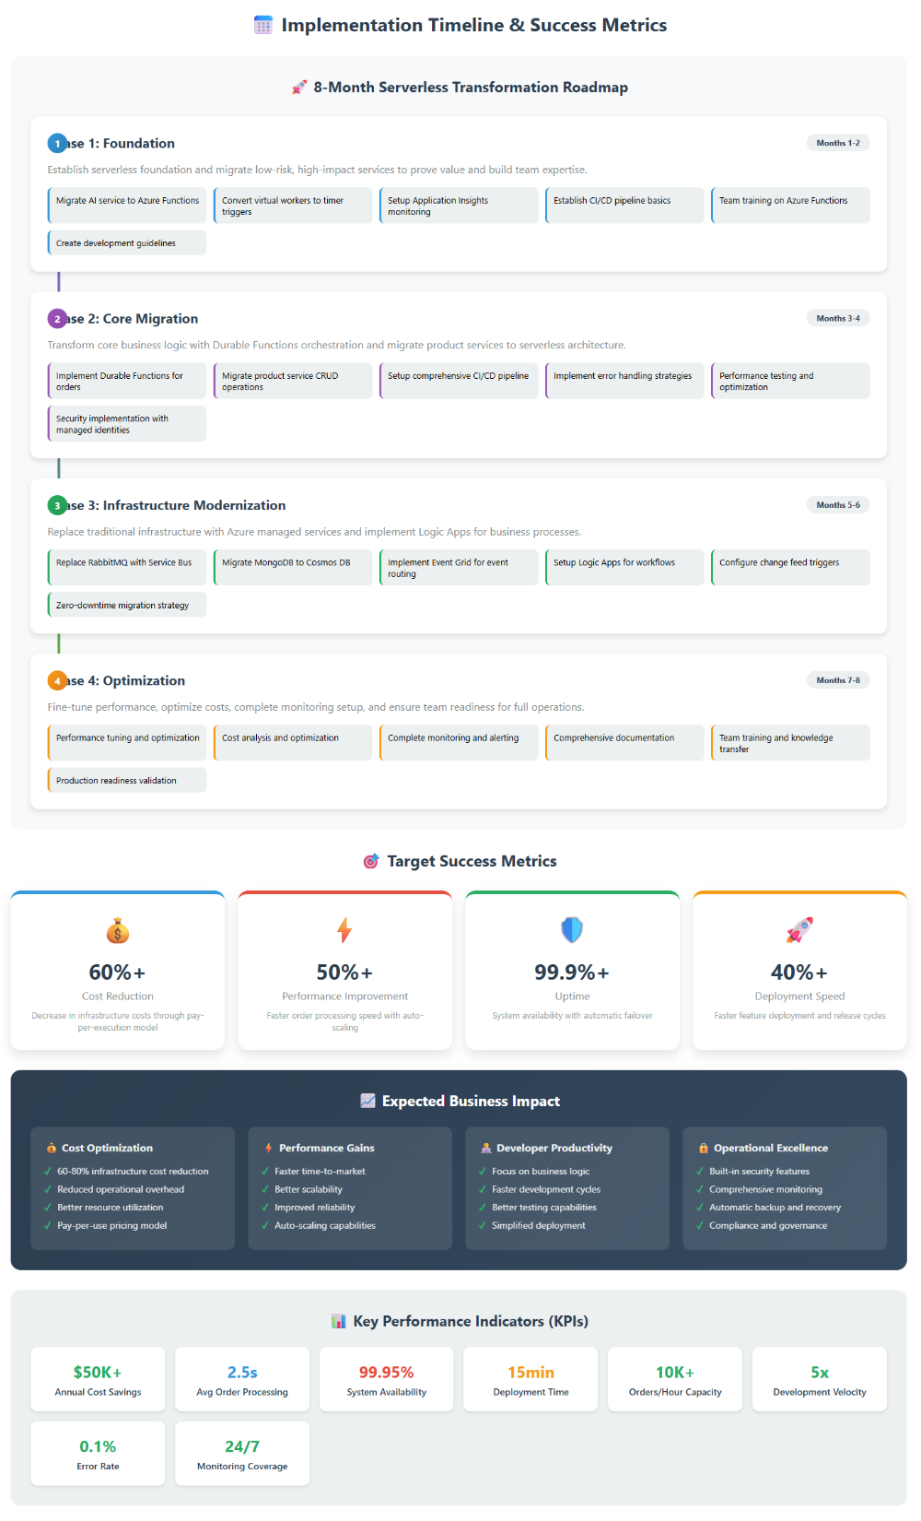
Durable Functions for Complex Workflows
Order Processing Orchestration
Sequential Steps:
Validate Order - Check inventory, customer details
Process Payment - Handle payment processing
Generate AI Content - Create product descriptions (if needed)
Update Inventory - Decrement stock levels
Send Notifications - Confirm order to customer and staff
Key Advantages of Orchestration
Reliability - Each step can retry independently
Visibility - Track progress of each order through pipeline
Scalability - Each step scales based on its own demands
Maintainability - Clear separation of business logic
Error Handling Strategy
Automatic Retries with exponential backoff
Compensation Actions to rollback on failures
Dead Letter Queues for manual intervention
Monitoring Alerts for failed workflows
Fan-out/Fan-in Pattern for Bulk Operations
Process multiple orders simultaneously during peak times
Generate AI content for multiple products in parallel
Aggregate results for reporting and analytics

