Slide 1
CST8919 DevOps - Security and Compliance
Final Oral Exam
Securing Algonquin Pet Store (On Steroids)
Student: Nikolai Semko Student ID: 040851919 Course Code: CST8919 Date: 07/08/2025

Slide 2
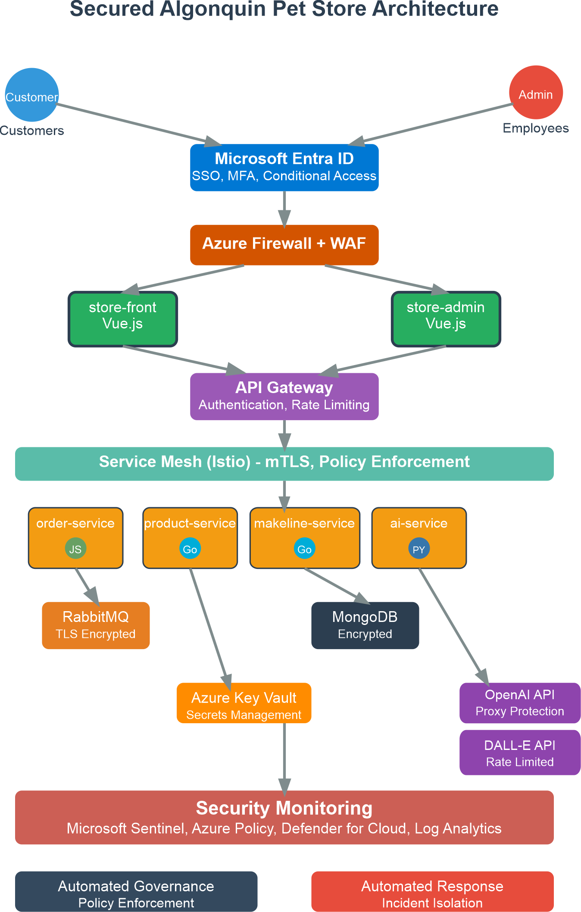
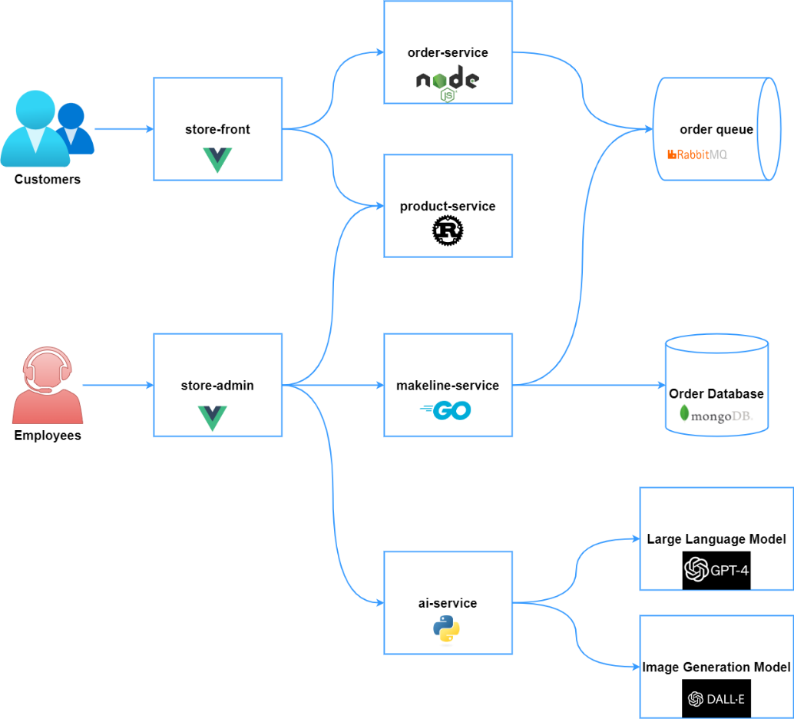
ARCHITECTURE OVERVIEW
Target Security Architecture:
Microsoft Entra ID for federated identity management
API Gateway with comprehensive security controls
Service mesh for encrypted inter-service communication
Comprehensive monitoring with Microsoft Sentinel
Automated policy enforcement via Azure Policy
Current Architecture Components:
No authentication/authorization layer
Unencrypted inter-service communication
Direct external API access without protection
Limited audit logging capabilities
No network segmentation or policy enforcement

Slide 3
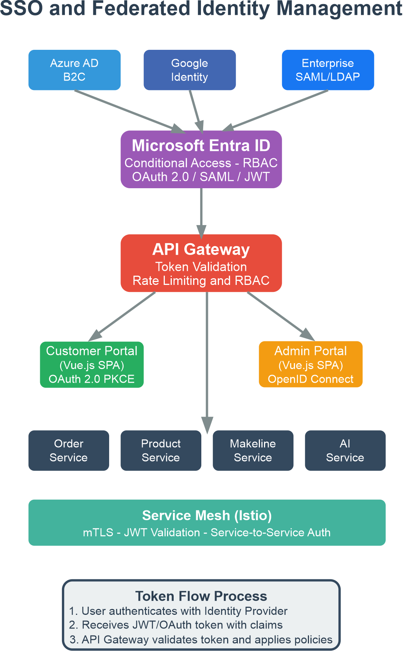
SSO & Federated Identity Management
Implementation Strategy:
Customer Authentication: Microsoft Entra ID B2C with social logins
Employee Authentication: Enterprise SAML/LDAP federation
Protocol Stack: OAuth 2.0 with PKCE for SPAs, OpenID Connect for admin access
Token Management: JWT with short expiration and refresh token rotation
Services Requiring SSO:
Store-front (customer portal) - OAuth 2.0 PKCE flow
Store-admin (employee portal) - OpenID Connect with MFA
All backend microservices via API Gateway token validation

Slide 4
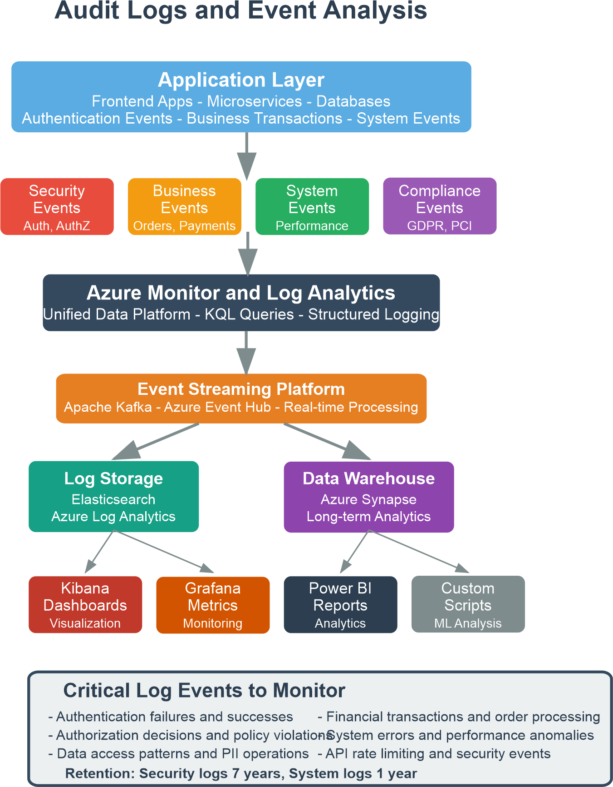
AUDIT LOGS & EVENT ANALYSIS
Comprehensive Logging Strategy:
Security Events: Authentication, authorization, privilege escalation attempts
Business Events: Order processing, payment transactions, inventory changes
System Events: Performance metrics, error rates, resource utilization
Compliance Events: GDPR consent management, PCI DSS access logs
Azure Analytics Stack:
Azure Monitor: Unified telemetry collection platform
Log Analytics Workspace: Centralized log storage with KQL querying
Structured Logging: JSON format for automated processing
Retention Policies: 7 years for security logs, 1 year for system logs

Slide 5
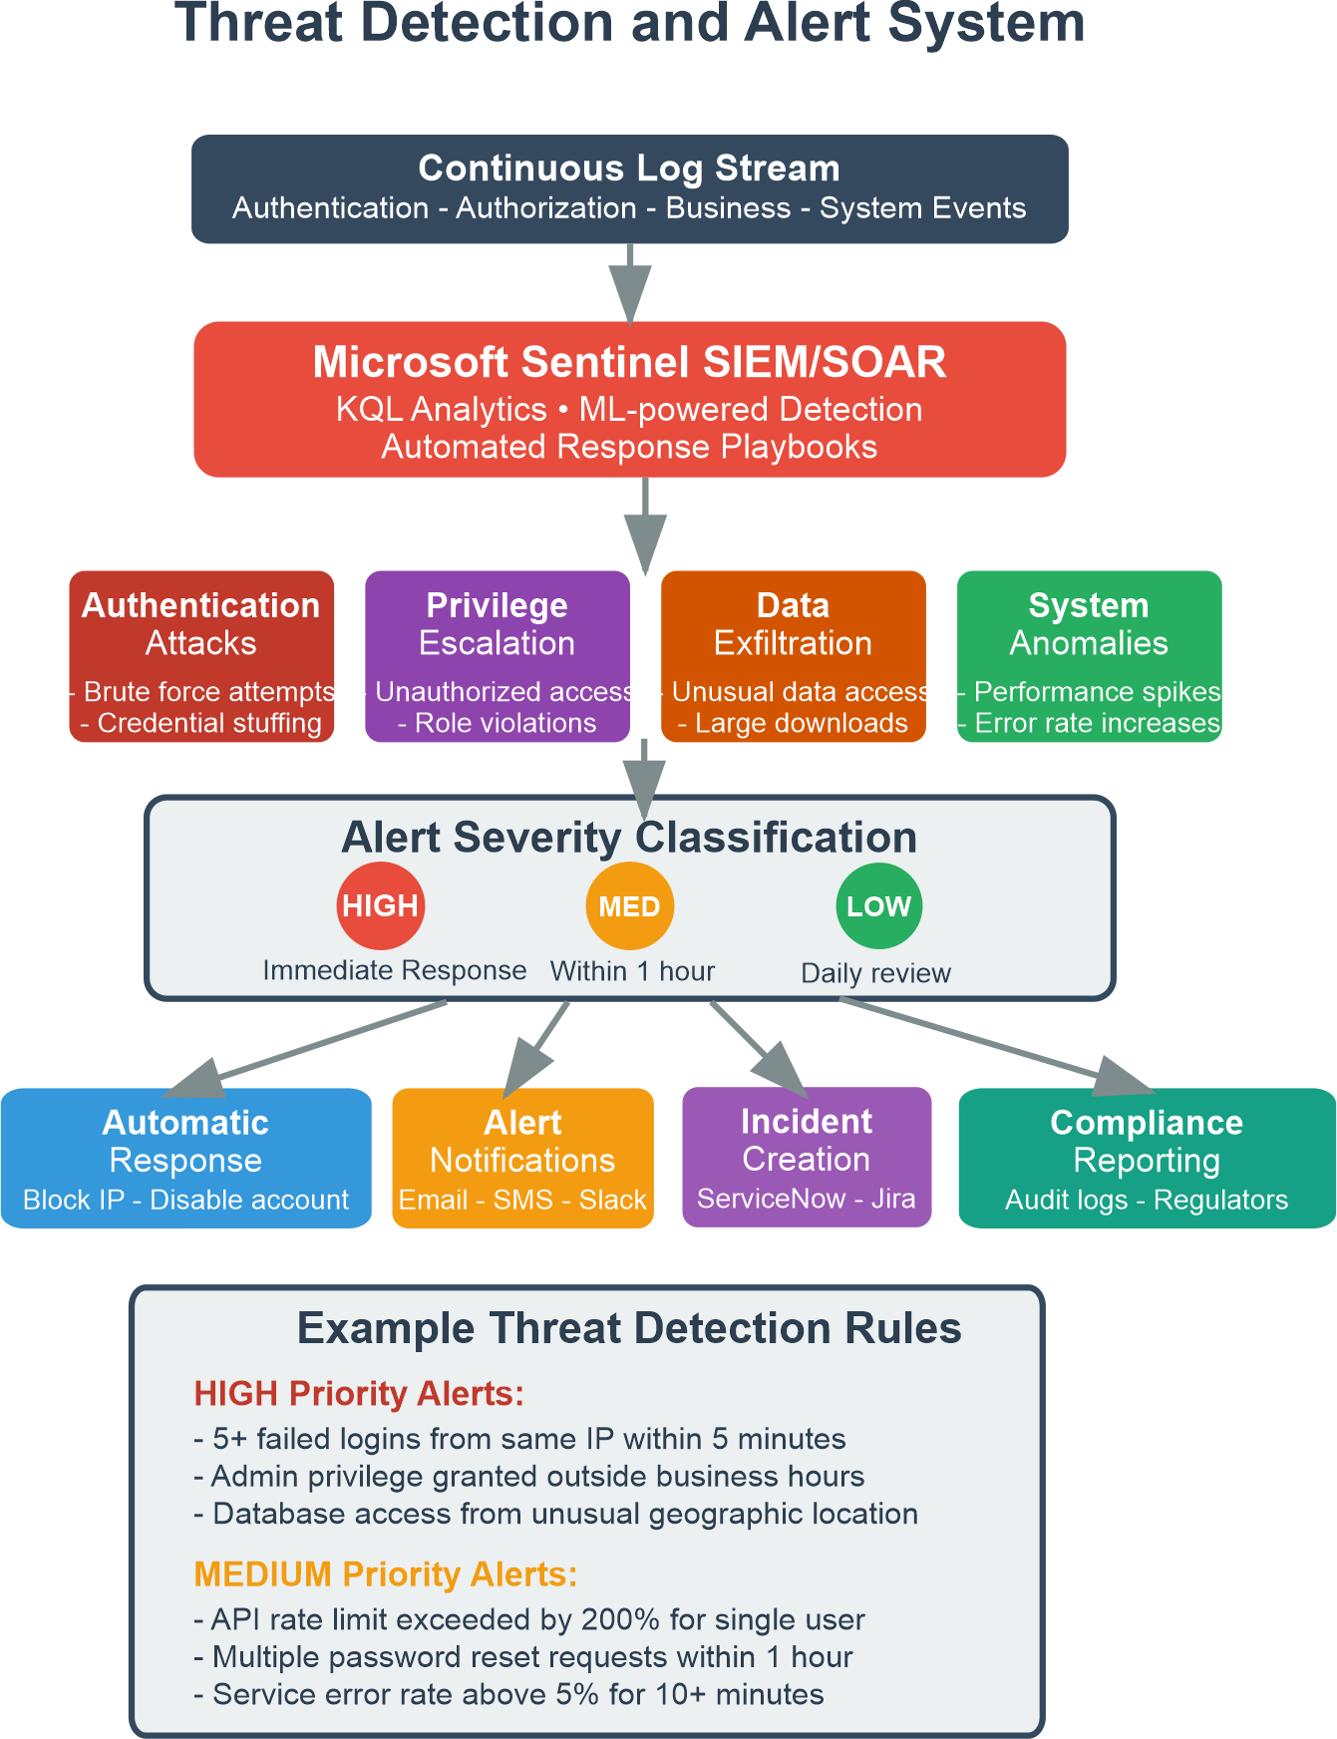
THREAT DETECTION IN AUDIT LOGS
Microsoft Sentinel SIEM/SOAR Integration:
ML-Powered Detection: Behavioral analytics and anomaly detection
KQL Analytics: Custom queries for threat hunting and investigation
Automated Playbooks: Immediate response to confirmed threats
Alert Classification & Response:
HIGH Priority: Immediate automated response (IP blocking, account suspension)
MEDIUM Priority: Security team notification within 1 hour
LOW Priority: Daily review and trend analysis
Example Detection Rules:
5+ failed authentication attempts from single IP within 5 minutes
Administrative privilege elevation outside business hours
Data access patterns indicating potential exfiltration
Geographic anomalies in user authentication patterns

Slide 6
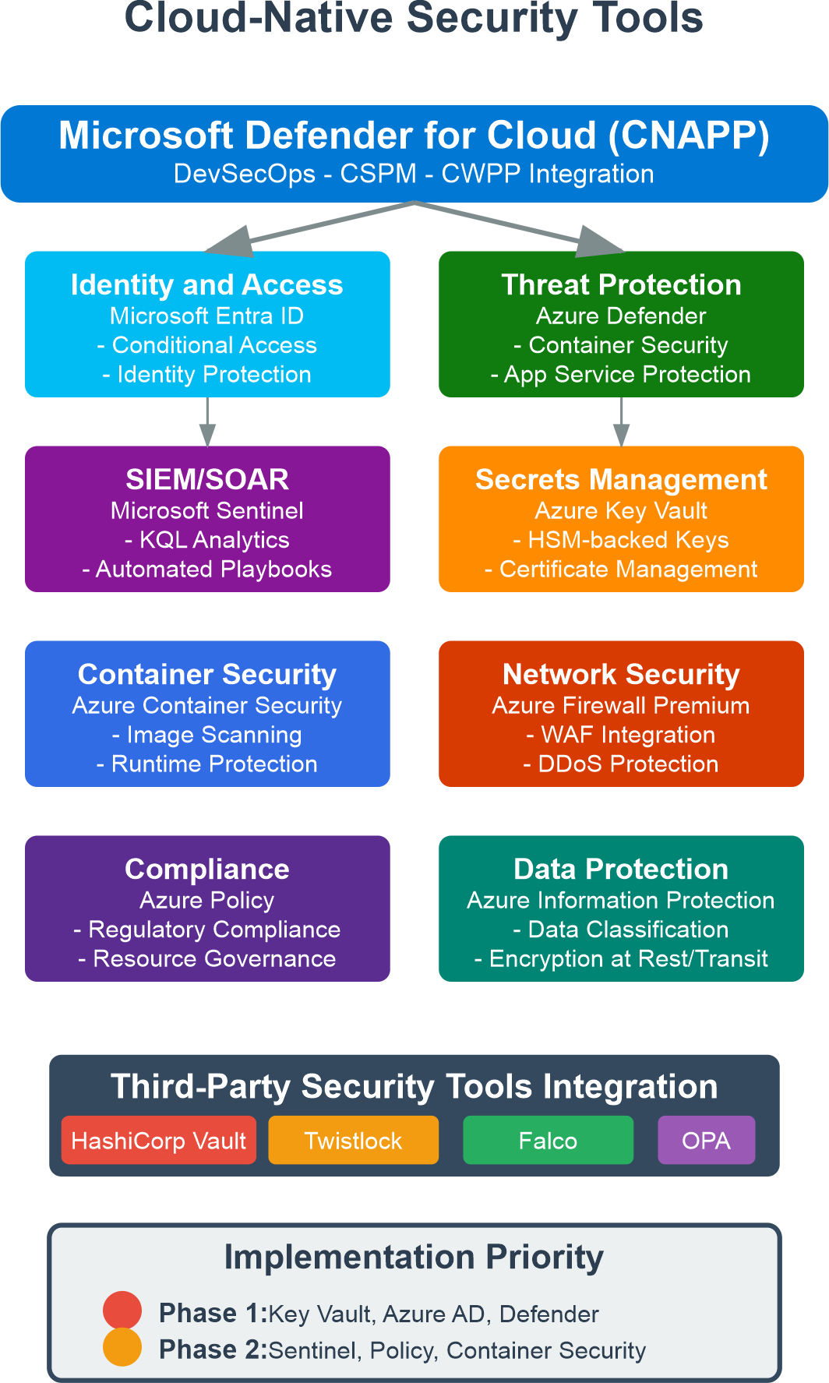
CLOUD-NATIVE SECURITY TOOLS
Microsoft Defender for Cloud (CNAPP Platform):
DevSecOps: Container image scanning and Infrastructure as Code security
CSPM: Cloud Security Posture Management for continuous compliance
CWPP: Cloud Workload Protection Platform for runtime security
Implementation Phases:
Phase 1: Microsoft Entra ID, Azure Key Vault, Defender for Cloud
Phase 2: Microsoft Sentinel, Azure Policy, container security scanning
Phase 3: Advanced threat protection and automated response optimization
Integration Points:
Identity Protection: Conditional access with risk-based authentication
Secrets Management: Azure Key Vault with HSM-backed key storage
Network Security: Azure Firewall Premium with integrated WAF capabilities

Slide 7
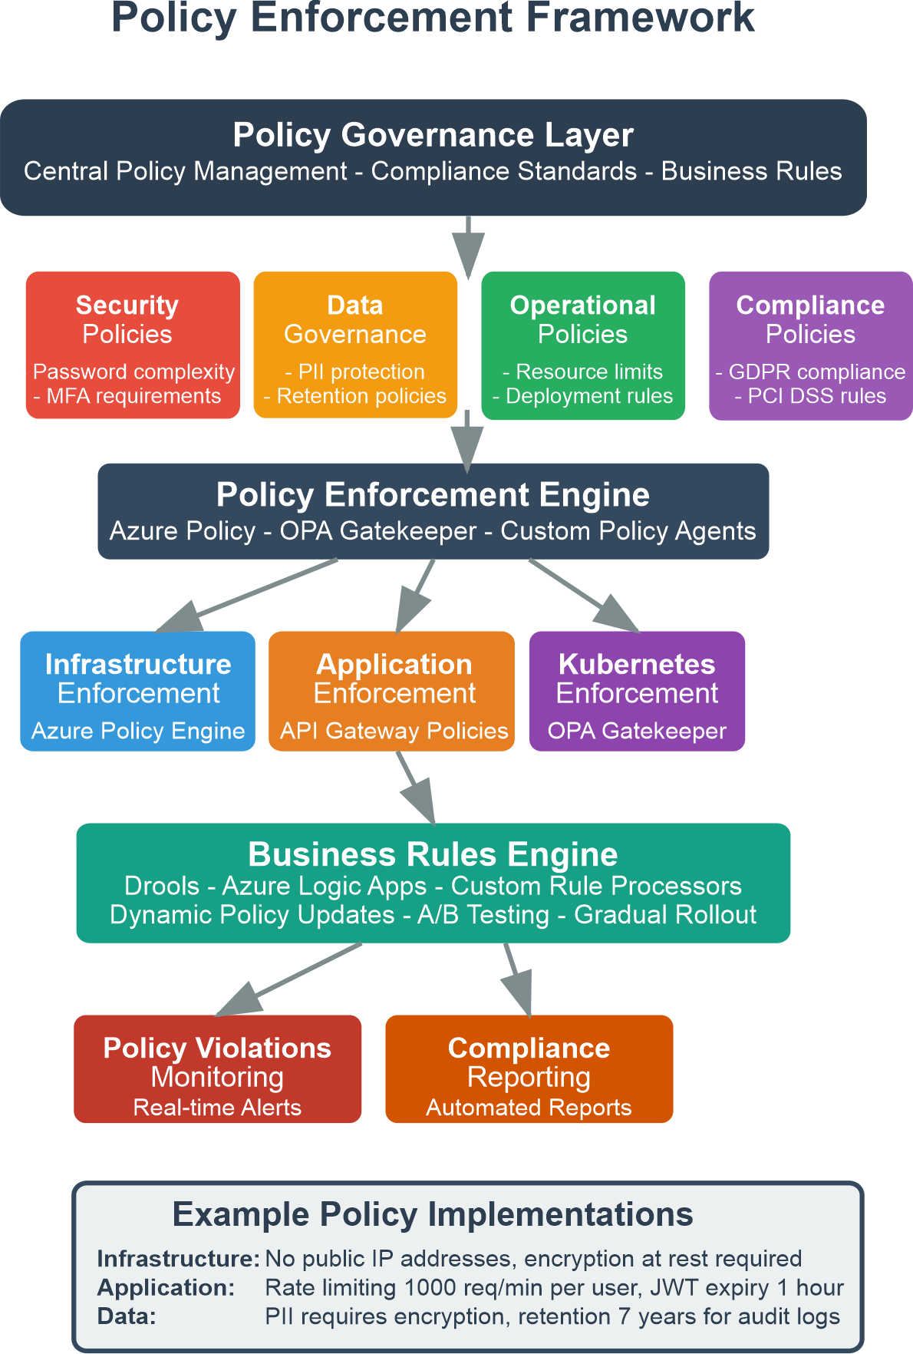
ORGANIZATIONAL POLICY ENFORCEMENT
Multi-Layer Policy Framework:
Infrastructure Level: Azure Policy for resource governance and compliance
Application Level: API Gateway policies for rate limiting and access control
Kubernetes Level: Open Policy Agent Gatekeeper for workload security
Data Level: Information protection policies for PII and sensitive data
Automated Enforcement Examples:
Security Policies: Mandatory encryption at rest, no public IP addresses
Compliance Policies: GDPR data residency, PCI DSS access controls
Operational Policies: Resource tagging requirements, cost management
Business Rules Engine:
Azure Logic Apps for complex workflow automation
Dynamic policy updates with gradual rollout capabilities
A/B testing for policy impact assessment

Slide 8
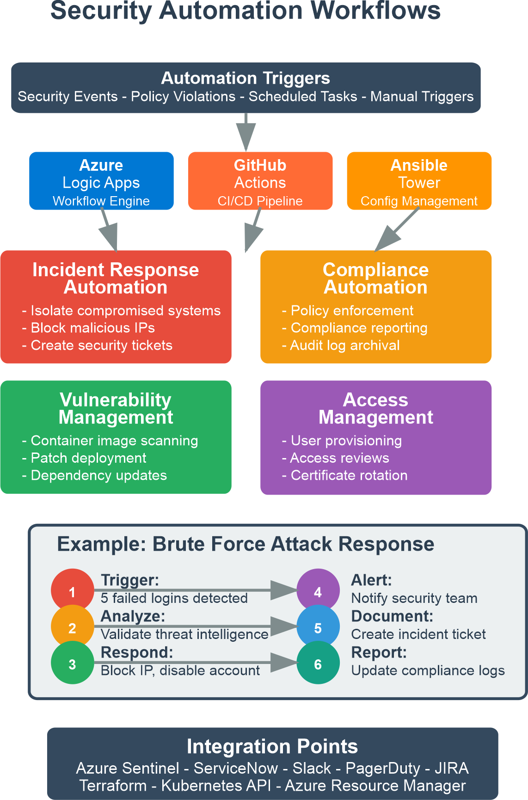
SECURITY AUTOMATION
Automated Security Workflows:
Incident Response: Automatic threat containment and escalation
Compliance Management: Scheduled policy scans and remediation
Vulnerability Management: Container scanning and patch deployment
Access Management: User lifecycle automation and certificate rotation
Automation Platforms:
Azure Logic Apps: Primary workflow orchestration engine
GitHub Actions: CI/CD security automation and scanning
Microsoft Sentinel: SOAR capabilities for threat response
Example Workflow - Brute Force Attack Response:
Detection: 5+ failed logins trigger Sentinel alert
Analysis: Threat intelligence validation and risk scoring
Response: Automatic IP blocking and account suspension
Notification: Security team alert via Teams/email
Documentation: Incident creation in ServiceNow
Reporting: Compliance log updates

Slide 9
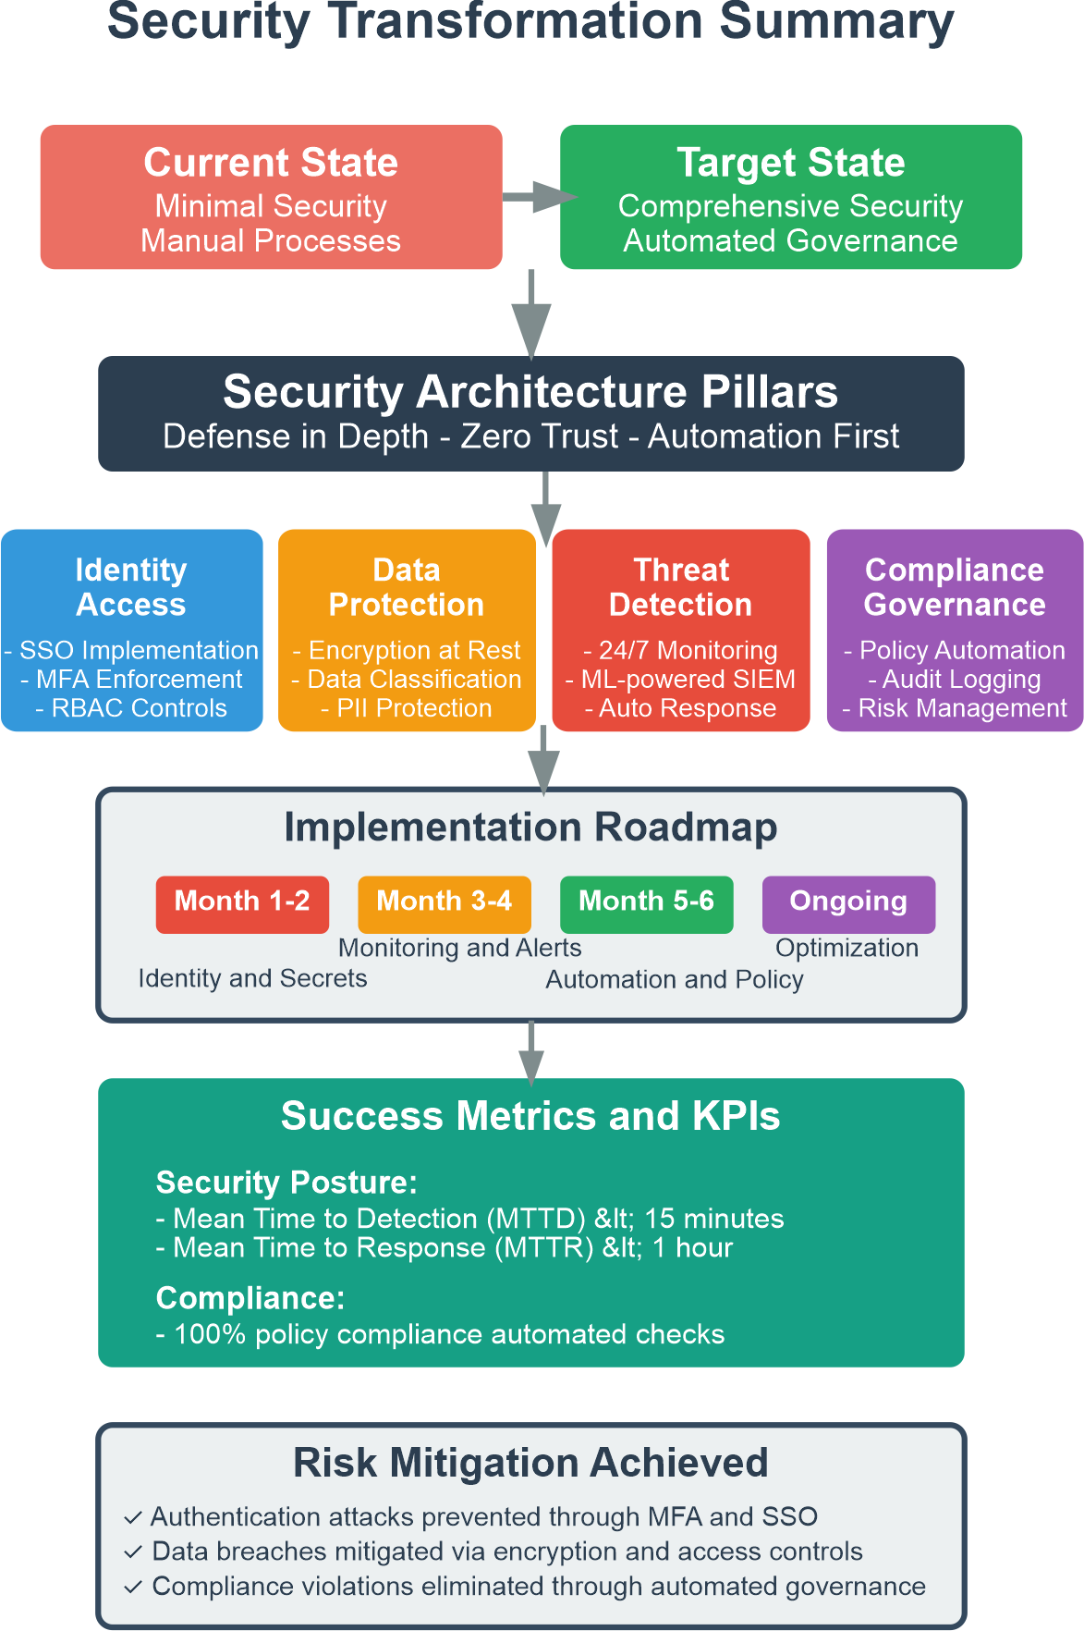
BEST PRACTICES & SUMMARY
Security Transformation Achieved:
Identity & Access: Microsoft Entra ID with SSO, MFA, and conditional access
Data Protection: Encryption at rest/transit, classification, PII protection
Threat Detection: 24/7 monitoring with ML-powered analytics
Compliance & Governance: Automated policy enforcement and audit logging
Implementation Roadmap:
Month 1-2: Identity infrastructure and secrets management
Month 3-4: Monitoring, alerting, and threat detection
Month 5-6: Automation workflows and policy enforcement
Ongoing: Optimization and continuous improvement
Success Metrics:
Mean Time to Detection (MTTD) < 15 minutes
Mean Time to Response (MTTR) < 1 hour
100% automated policy compliance checks
Zero security misconfigurations through CSPM
Risk Mitigation Achieved: ✓ Authentication attacks prevented through SSO and conditional access ✓ Data breaches mitigated via encryption and access controls ✓ Compliance violations eliminated through automated governance

Slide 10
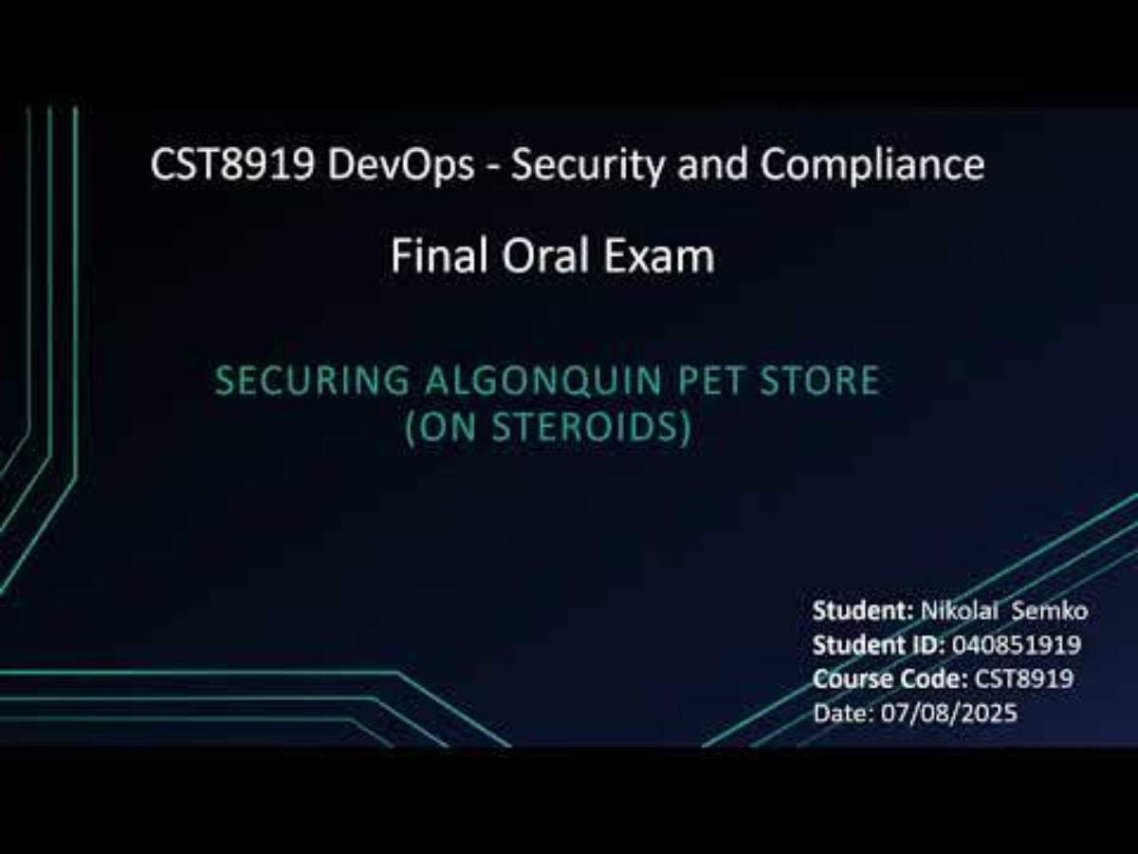
Thank you for your attention.

