Slide 1
The interesting traditions of China
Made by Nicolai Gershtein

Slide 2
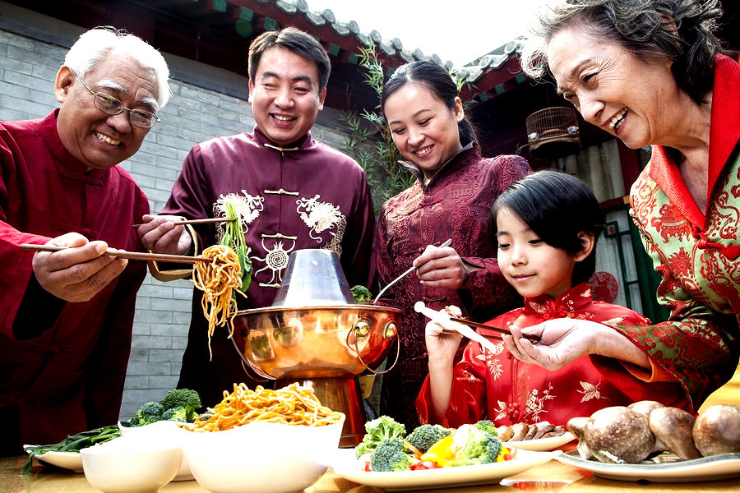
The basis of Chinese customs
Respect for elders
Punctuality
Knowledge and love of the
national history and literature

Slide 3
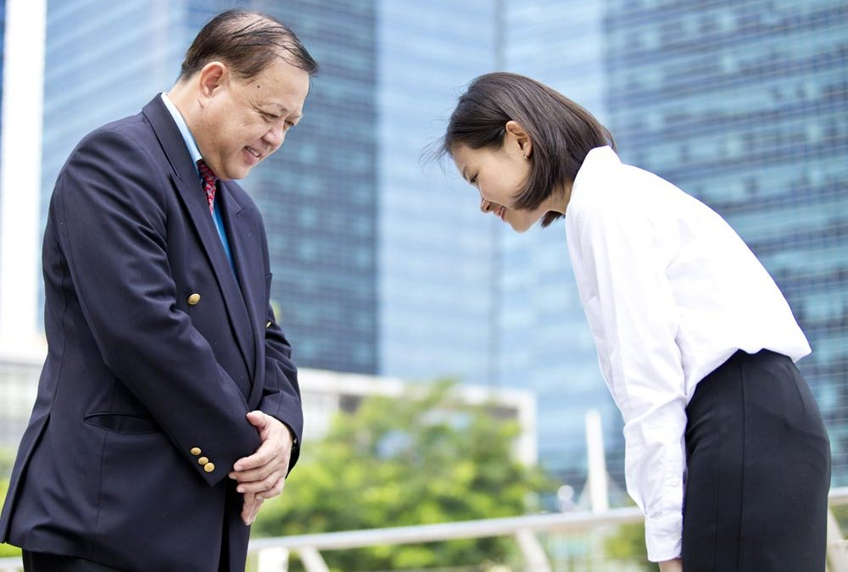
Chinese greeting
Today the modern Chinese just nod their heads, but if they want to show respect, they may bow.

Slide 4
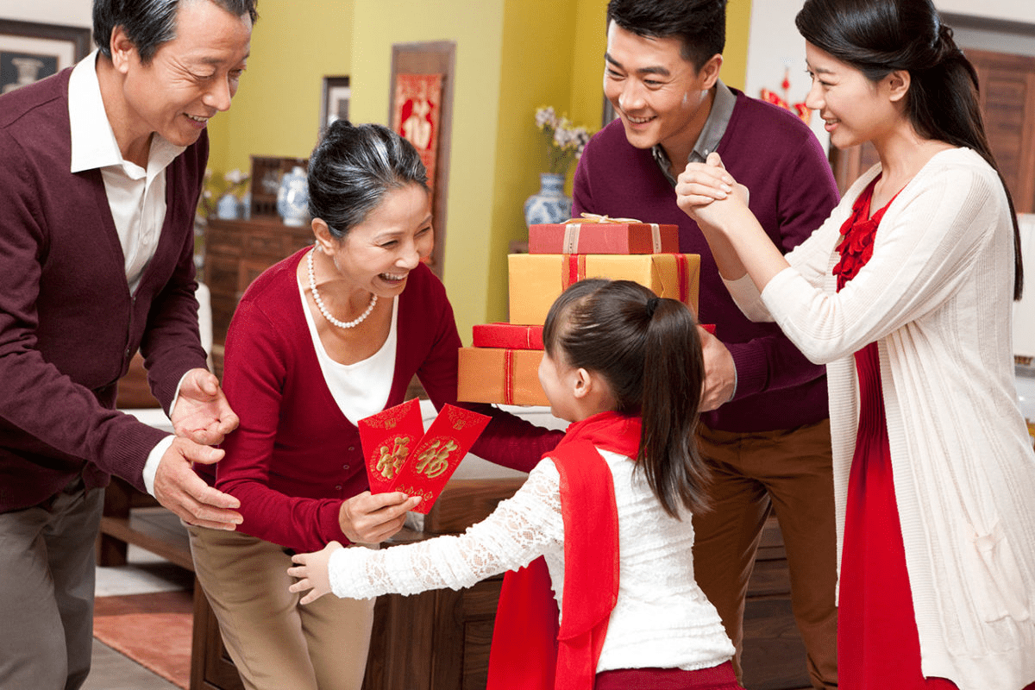
Giving of presents
If you happen to visit a Chinese you should bear in mind not to give an odd number of presents as odd numbers are considered unlucky in China.

Slide 5
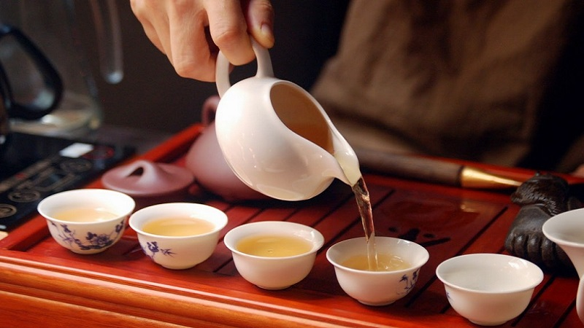
Tea ceremony
Drinking tea is a way to achieve inner harmony and bliss. Depending on the time of year, the Chinese drink different varieties of tea.

Slide 6
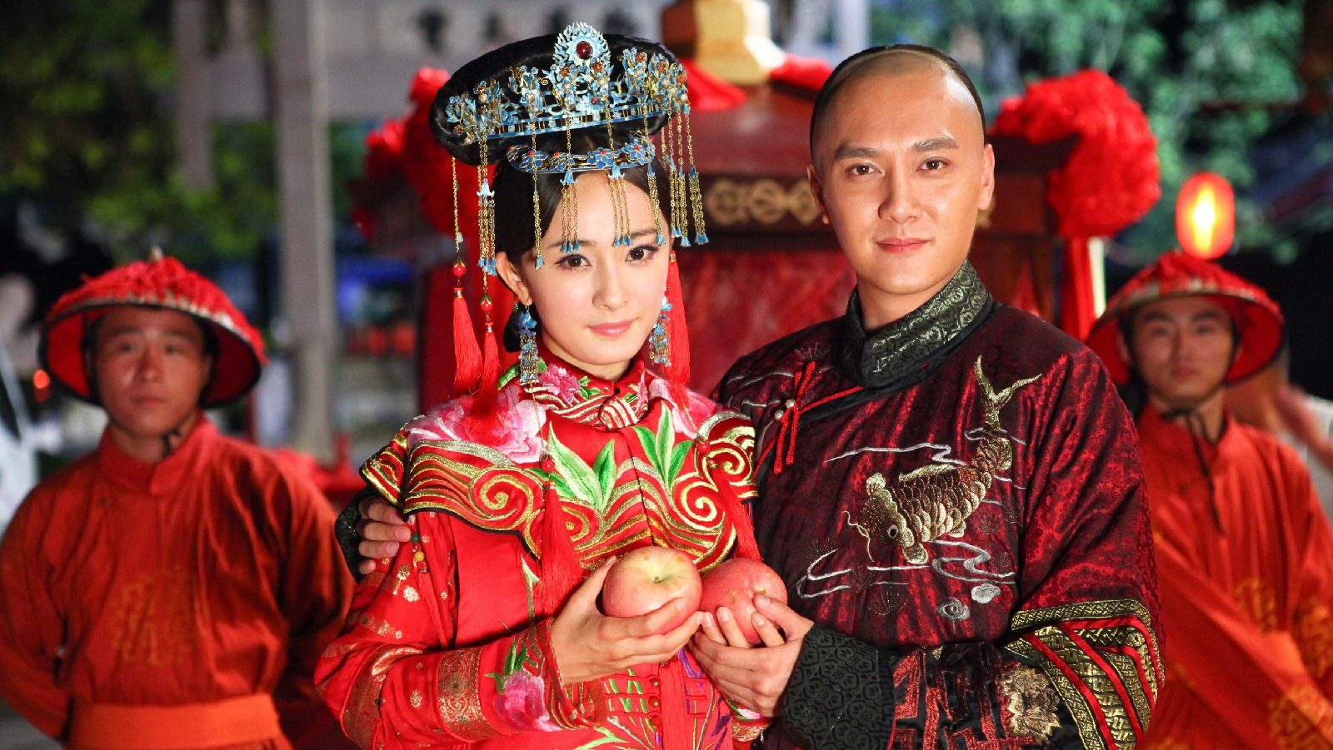
The Chinese are very superstitious people
Despite the technological progress, a large part of the population observes
traditions and customs, which extend back over three thousand years.

Slide 7
Thanks for your attention!

