Slide 1
Modular Primal-Dual Fixpoint Logic Solving for Temporal Verification
Hiroshi Unno University of Tsukuba
Tachio Terauchi Waseda University
Yu Gu University of Tsukuba
Eric Koskinen Stevens Institute of Technology
Appeared in POPL’23

Slide 2



Background: Constraint-based Verification with Constrained Horn Clauses (CHCs)
Target Program $𝓟$ & Specification $ψ$
RustHorn [Matsushita+’20,…]
JayHorn [Kahsai+’16,…]
SeaHorn [Gurfinkel+’15,…]
RCaml for OCaml [U.+‘09,…]
Verification intermediary independent of particular target and method ☺
Constraint Generation
CHCs Constraints $𝓒$ on Predicate Variables
But limited to safety verification ☹
Constraint Solving
SPACER [Komuravelli+ ’14,…]
Hoice [Champion+ ’18,…]
Eldarica [Hojjat+ ’18,…] PCSat [U.+’20,…]
$𝓒$ is Sat ($𝓟$ satisfies $ψ$),
$𝓒$ is Unsat ($𝓟$ violates $ψ$), or Unknown/Timeout

Slide 3



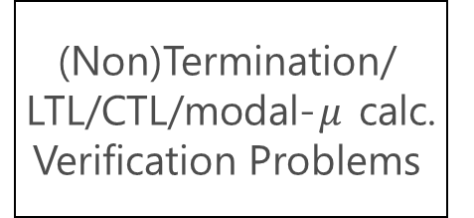
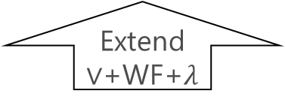

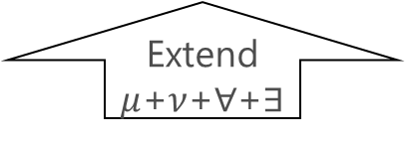

Extensions of CHCs for Non-Safety Verification
This Work
[U.+ AAAI’20, CAV’21]
(Non)Termination/ LTL/CTL/modal-$μ$ calc. Verification Problems
$Δ_{2}^{1}$-complete
$Σ_{2}^{1}$-complete
$μ$CLP
pfwCSP
Modularly Encode
Reduce
Extend $μ$+$ν$+$∀$+$∃$
Extend $∨$+WF+$λ$
$Π_{1}^{0}$-complete
$Π_{1}^{0}$-complete
Safety Verification Problems
Constraint Logic Program (CLP)
Constrained Horn Clauses (CHCs)
Encode
Reduce
[U.+ CAV’17]
Theorem Proving
Constraint Satisfaction

Slide 4

Extensions of CHCs for Non-Safety Verification
This Work
[U.+ AAAI’20, CAV’21]
(Non)Termination/ LTL/CTL/modal-$μ$ calc. Verification Problems
$μ$CLP
pfwCSP
Modularly Encode
Reduce
Extend $μ$+$ν$+$∀$+$∃$
Extend $∨$+WF+$λ$
Safety Verification Problems
Constraint Logic Program (CLP)
Constrained Horn Clauses (CHCs)
Encode
Reduce
[U.+ CAV’17]
Theorem Proving
Constraint Satisfaction

Slide 5


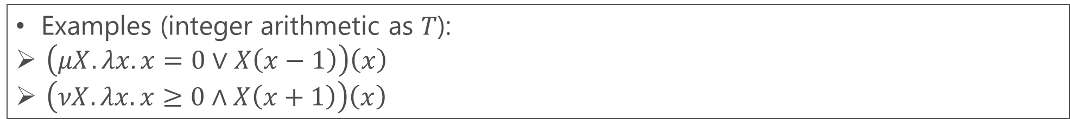
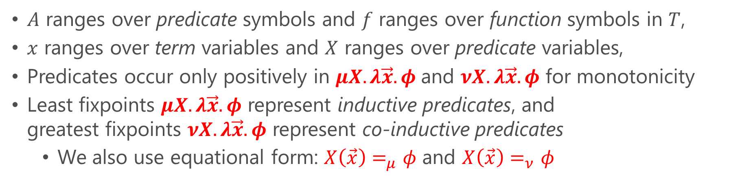

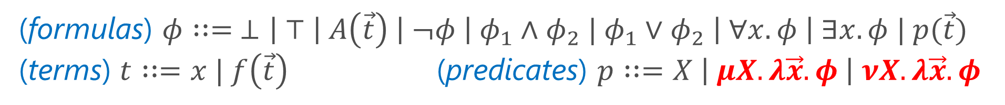


$μ$CLP: An Extension of CLP with Quantifiers and Arbitrarily-Nested (Co-)Inductive Predicates
Can be seen as a first-order fixpoint logic modulo background theories $T$
(formulas) $φ∷= ⊥\left| ⊤ \right| A\left(\vec{t}\right) \left| ¬φ \right| φ_{1}∧φ_{2} | φ_{1}∨φ_{2} \left| ∀x. φ \right| ∃x. φ | p(\vec{t})$
(terms) $t∷=x | f\left(\vec{t}\right)$(predicates) $p∷=X \left| μX.λ\vec{x}. φ \right| νX.λ\vec{x}. φ$
$A$ ranges over predicate symbols and $f$ ranges over function symbols in $T$,
$x$ ranges over term variables and $X$ ranges over predicate variables,
Predicates occur only positively in $μX.λ\vec{x}. φ$and $νX.λ\vec{x}. φ$ for monotonicity
Least fixpoints $μX.λ\vec{x}. φ$ represent inductive predicates, and greatest fixpoints $νX.λ\vec{x}. φ$ represent co-inductive predicates
We also use equational form: $X\left(\vec{x}\right)=_{μ}φ$ and $X\left(\vec{x}\right)=_{ν}φ$
Examples (integer arithmetic as 𝑇):
$\left(μX.λx.x=0∨X\left(x−1\right)\right)\left(x\right)$
$\left(νX.λx.x≥0∧X\left(x+1\right)\right)\left(x\right)$
$$⇔x=0∨x=1∨x=2∨…$$
$$⇔∃z≥0.x=z$$
$$⇔x≥0∧x+1≥0∧x+2≥0∧…$$
$$⇔∀z≥0. x+z≥0$$

Slide 6
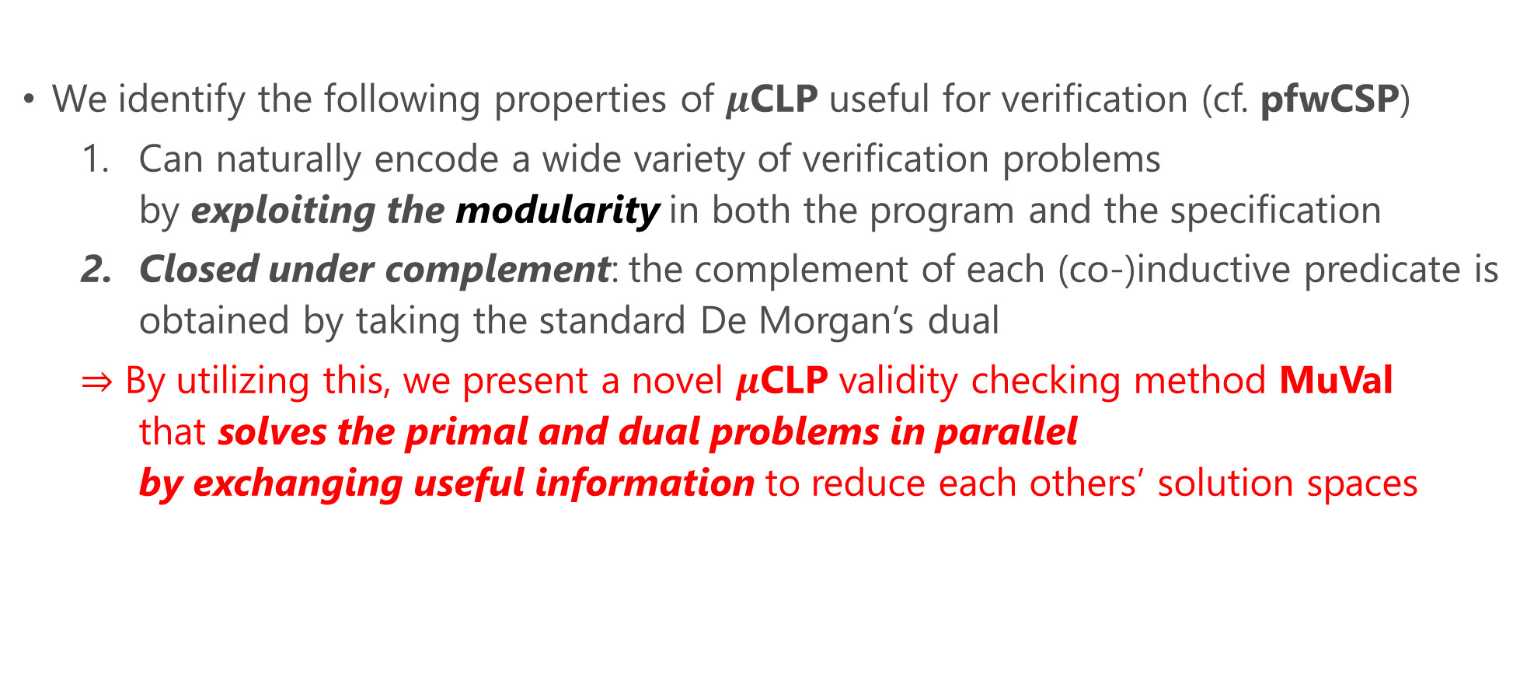
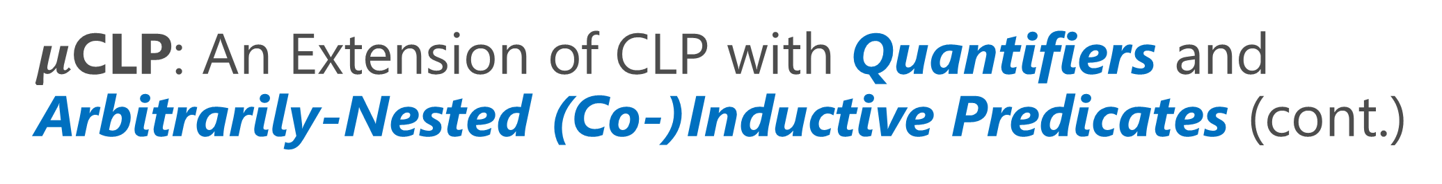
$μ$CLP: An Extension of CLP with Quantifiers and Arbitrarily-Nested (Co-)Inductive Predicates (cont.)
We identify the following properties of $μ$CLP useful for verification (cf. pfwCSP)
Can naturally encode a wide variety of verification problems by exploiting the modularity in both the program and the specification
Closed under complement: the complement of each (co-)inductive predicate is obtained by taking the standard De Morgan’s dual
$⇒$ By utilizing this, we present a novel $μ$CLP validity checking method MuVal that solves the primal and dual problems in parallel by exchanging useful information to reduce each others’ solution spaces

Slide 7
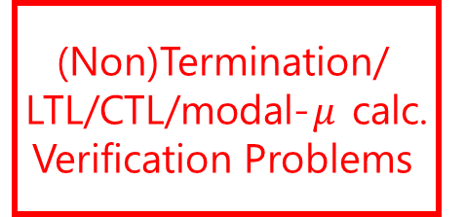
Extensions of CHCs for Non-Safety Verification
This Work
[U.+ AAAI’20, CAV’21]
(Non)Termination/ LTL/CTL/modal-$μ$ calc. Verification Problems
$μ$CLP
pfwCSP
Modularly Encode
Reduce
Extend $μ$+$ν$+$∀$+$∃$
Extend $∨$+WF+$λ$
Safety Verification Problems
Constraint Logic Program (CLP)
Constrained Horn Clauses (CHCs)
Encode
Reduce
[U.+ CAV’17]
Theorem Proving
Constraint Satisfaction

Slide 8
$μ$CLP Encoding of Various Verification Problems
Can exploit the modularity in both the program and the specification by expressing each loops and (recursive) functions in the program and sub-formulas of the property as individual (possibly nested) (co-)inductive predicates
Modular (non-)termination verification of imperative programs (Section 3.2)
Omega-regular model checking of labeled transition systems (Section 3.3)
Modal 𝜇-calculus model checking of labeled transition systems [Kobayashi+’19]
Omega-regular model checking of first-order recursive programs [Kobayashi+’19]
Modular and value-dependent temporal verification of higher-order effectful programs [Nanjo+’18] and further extensions to delimited continuations [Sekiyama&U.’23] and algebraic effects [Kawamata+’24]

Slide 9
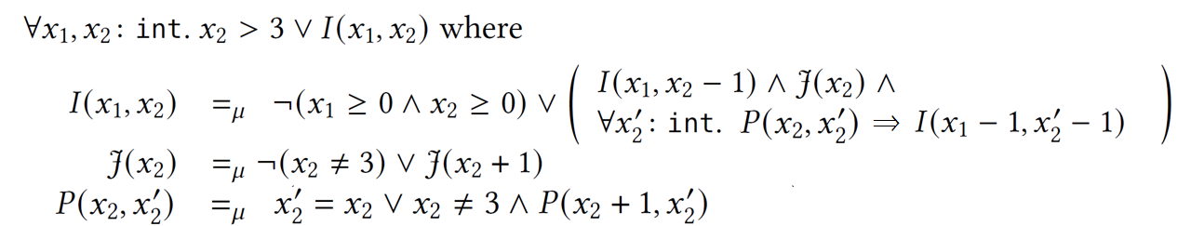
Running Example (from [Urban+’13,’14]):
assume (x2 <= 3); while (x1 >= 0 && x2 >= 0) { if (nondet()) { while (x2 != 3 && nondet()) { x2 = x2 + 1; } x1 = x1 - 1; } x2 = x2 - 1; }
See the paper for a formal definition of this sound and complete modular encoding for termination
Modular Encoding for Termination
The weakest precondition for the termination of the outer loop
The weakest precondition for the termination of the inner loop
The strongest postcondition of the inner loop

Slide 10
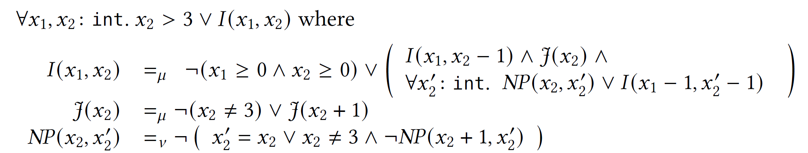
Running Example (from [Urban+’13,’14]):
assume (x2 <= 3); while (x1 >= 0 && x2 >= 0) { if (nondet()) { while (x2 != 3 && nondet()) { x2 = x2 + 1; } x1 = x1 - 1; } x2 = x2 - 1; }
See the paper for a formal definition of this sound and complete modular encoding for termination
Modular Encoding for Termination
The weakest precondition for the termination of the outer loop
The weakest precondition for the termination of the inner loop
The complement of the strongest postcondition of the inner loop

Slide 11
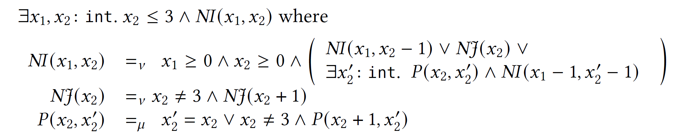
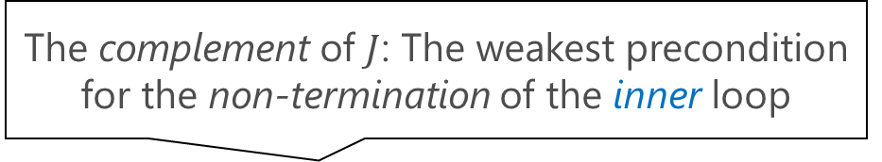
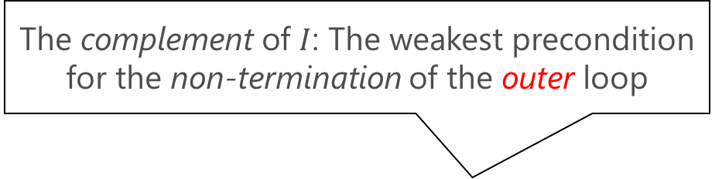
$μ$CLP encoding the termination verification problem
The complement of $I$: The weakest precondition for the non-termination of the outer loop
De Morgan’s Dual
$μ$CLP encoding the non-termination verification problem
The complement of $J$: The weakest precondition for the non-termination of the inner loop
The strongest postcondition of the inner loop

Slide 12

Extensions of CHCs for Non-Safety Verification
This Work
[U.+ AAAI’20, CAV’21]
(Non)Termination/ LTL/CTL/modal-$μ$ calc. Verification Problems
$μ$CLP
pfwCSP
Modularly Encode
Reduce
Extend $μ$+$ν$+$∀$+$∃$
Extend $∨$+WF+$λ$
Safety Verification Problems
Constraint Logic Program (CLP)
Constrained Horn Clauses (CHCs)
Encode
Reduce
[U.+ CAV’17]
Theorem Proving
Constraint Satisfaction

Slide 13
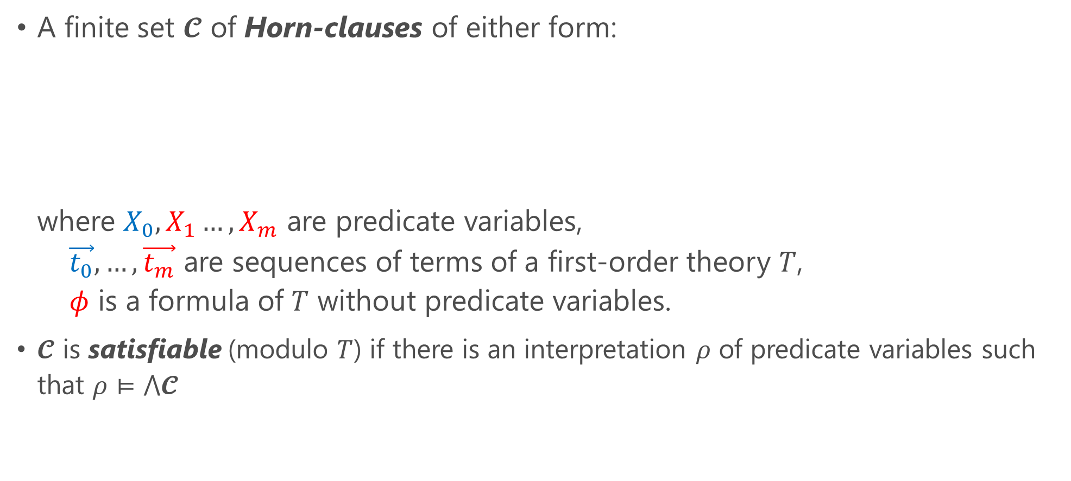

CHCs: Constrained Horn Clauses (see e.g., [Bjørner+ ’15] )
A finite set $𝓒$ of Horn-clauses of either form: where $X_{0},X_{1}…,X_{m}$ are predicate variables, $\vec{t_{0}},…,\vec{t_{m}}$ are sequences of terms of a first-order theory $T$, $φ$ is a formula of $T$ without predicate variables.
$𝓒$ is satisfiable (modulo $T$) if there is an interpretation $ρ$ of predicate variables such that $ρ⊨⋀𝓒$
$$X_{0}\left(\vec{t_{0}}\right)⟸\left(X_{1}\left(\vec{t_{1}}\right)∧…∧X_{m}\left(\vec{t_{m}}\right)∧φ\right)$$
or
$$⊥ ⟸\left(X_{1}\left(\vec{t_{1}}\right)∧…∧X_{m}\left(\vec{t_{m}}\right)∧φ\right)$$

Slide 14
Extensions of CHCs for Non-Safety Verification
This Work
[U.+ AAAI’20, CAV’21]
(Non)Termination/ LTL/CTL/modal-$μ$ calc. Verification Problems
$μ$CLP
pfwCSP
Modularly Encode
Reduce
Extend $μ$+$ν$+$∀$+$∃$
Extend $∨$+WF+$λ$
Safety Verification Problems
Constraint Logic Program (CLP)
Constrained Horn Clauses (CHCs)
Encode
Reduce
[U.+ CAV’17]
Theorem Proving
Constraint Satisfaction

Slide 15
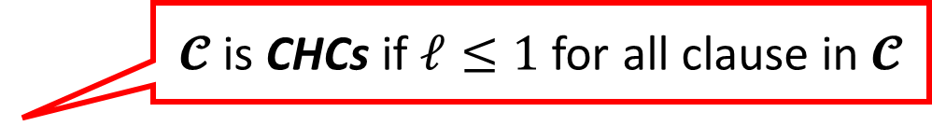
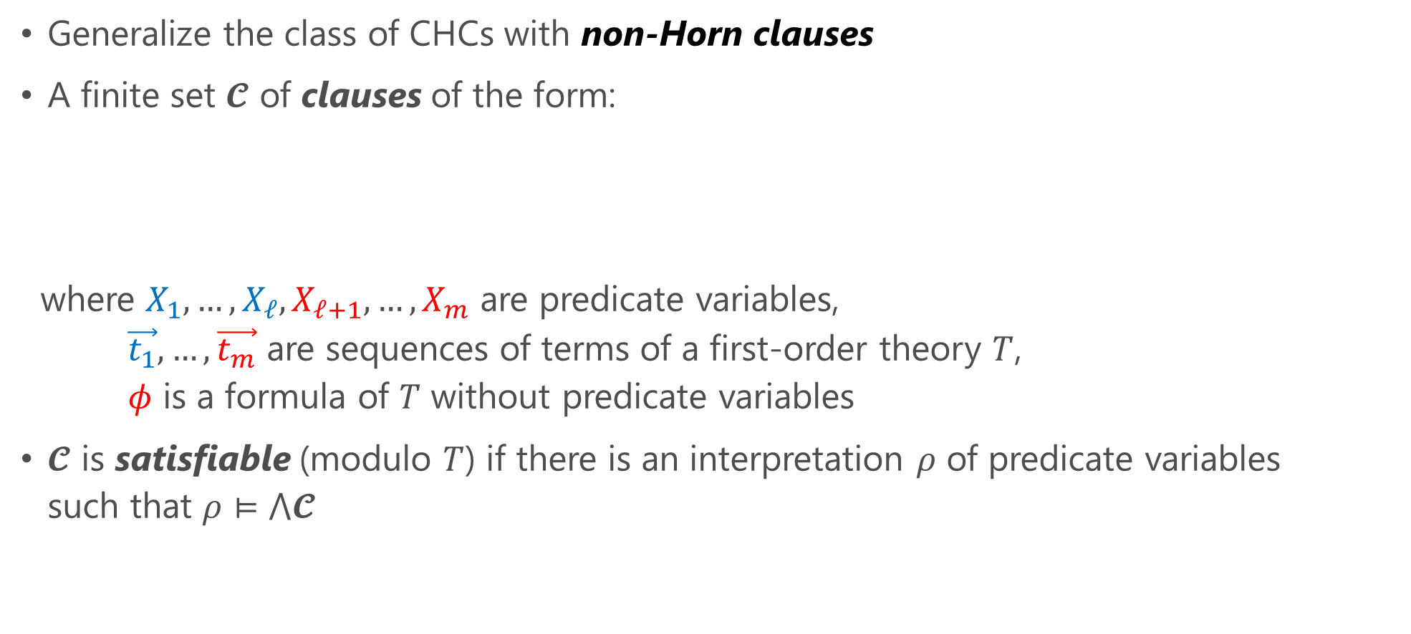
pCSP: Predicate Constraint Satisfaction Problem [U.+’20]
Generalize the class of CHCs with non-Horn clauses
A finite set $𝓒$ of clauses of the form:
where $X_{1},…,X_{ℓ},X_{ℓ+1},…,X_{m}$ are predicate variables, $\vec{t_{1}},…,\vec{t_{m}}$ are sequences of terms of a first-order theory $T$, $φ$ is a formula of $T$ without predicate variables
$𝓒$ is satisfiable (modulo $T$) if there is an interpretation $ρ$ of predicate variables such that $ρ⊨⋀𝓒$
$𝓒$ is CHCs if $ℓ≤1$ for all clause in $𝓒$
$$\left(X_{1}\left(\vec{t_{1}}\right)∨…∨X_{ℓ}\left(\vec{t_{ℓ}}\right)\right)⟸\left(X_{ℓ+1}\left(\vec{t_{ℓ+1}}\right)∧…∧X_{m}\left(\vec{t_{m}}\right)∧φ\right)$$

Slide 16

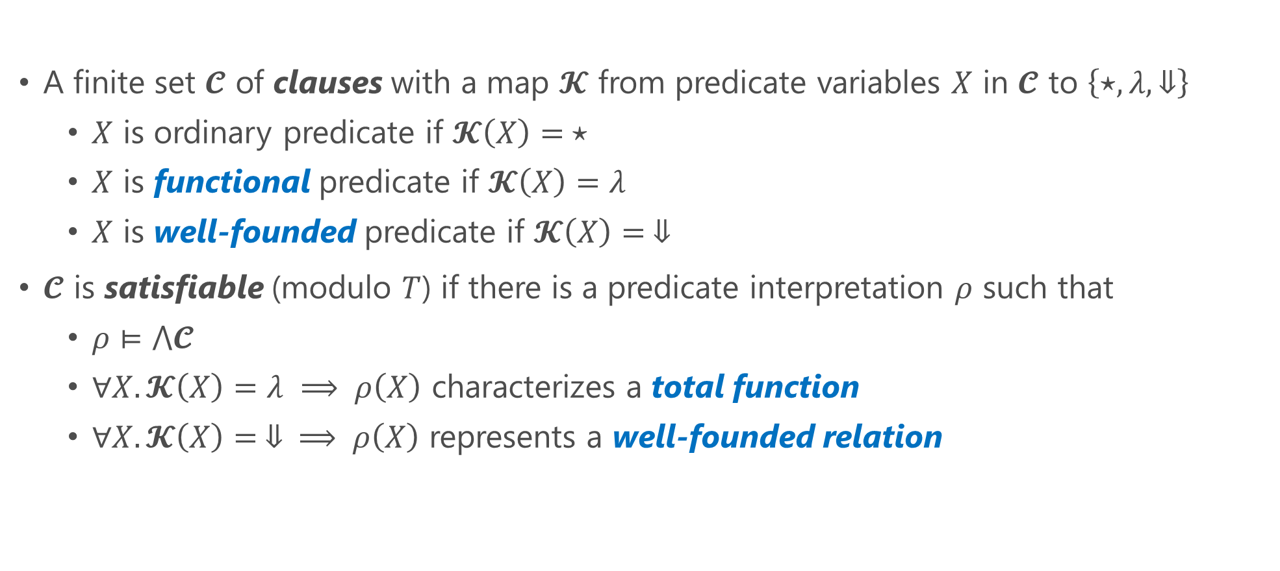
pfwCSP: pCSP with Functional and Well-founded Predicates [U.+’21] (cf. $∀∃$CHCs with dwf [Beyene+’13])
A finite set $𝓒$ of clauses with a map $𝓚$ from predicate variables $X$ in $𝓒$ to $\left\{⋆,λ,⇓\right\}$
$X$ is ordinary predicate if $𝓚\left(X\right)= ⋆$
$X$ is functional predicate if $𝓚\left(X\right)=λ$
$X$ is well-founded predicate if $𝓚\left(X\right)= ⇓$
$𝓒$ is satisfiable (modulo $T$) if there is a predicate interpretation $ρ$ such that
$ρ⊨⋀𝓒$
$∀X.𝓚\left(X\right)=λ ⟹ ρ\left(X\right)$ characterizes a total function
$∀X.𝓚\left(X\right)= ⇓ ⟹ ρ\left(X\right)$ represents a well-founded relation

Slide 17
Extensions of CHCs for Non-Safety Verification
This Work
[U.+ AAAI’20, CAV’21]
(Non)Termination/ LTL/CTL/modal-$μ$ calc. Verification Problems
$μ$CLP
pfwCSP
Modularly Encode
Reduce
Extend $μ$+$ν$+$∀$+$∃$
Extend $∨$+WF+$λ$
Safety Verification Problems
Constraint Logic Program (CLP)
Constrained Horn Clauses (CHCs)
Encode
Reduce
[U.+ CAV’17]
Theorem Proving
Constraint Satisfaction

Slide 18

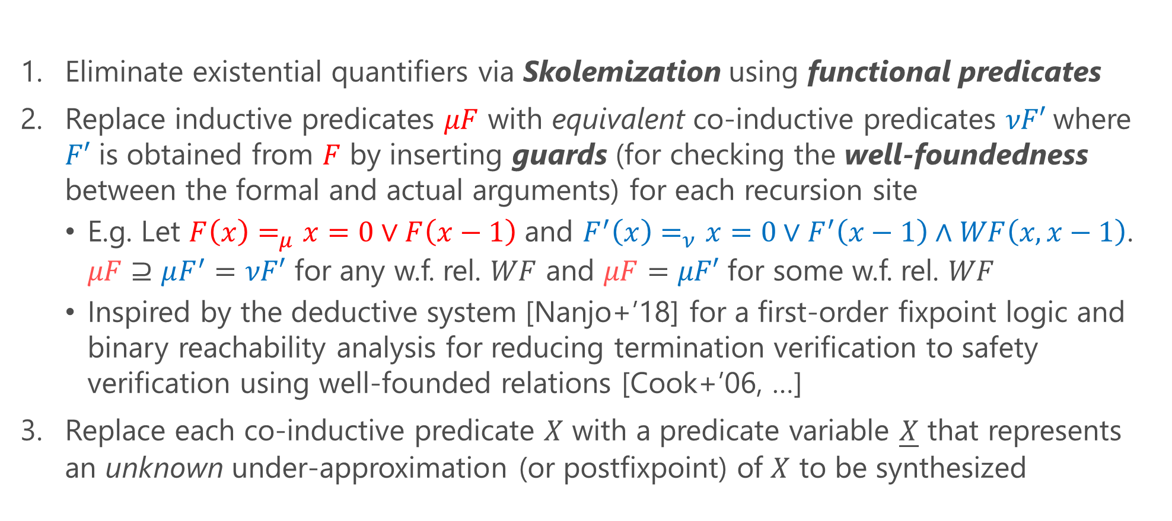
Sound and Complete Reduction of $μ$CLP Validity to pfwCSP Satisfiability
Eliminate existential quantifiers via Skolemization using functional predicates
Replace inductive predicates $μF$ with equivalent co-inductive predicates $νF′$where $F′$ is obtained from $F$ by inserting guards (for checking the well-foundedness between the formal and actual arguments) for each recursion site
E.g. Let $F\left(x\right)=_{μ}x=0∨F\left(x−1\right)$ and $F^{′}\left(x\right)=_{ν}x=0∨F^{′}\left(x−1\right)∧WF\left(x,x−1\right)$. $μF⊇μF^{′}=νF′$ for any w.f. rel. $WF$ and $μF=μF′$ for some w.f. rel. $WF$
Inspired by the deductive system [Nanjo+’18] for a first-order fixpoint logic and binary reachability analysis for reducing termination verification to safety verification using well-founded relations [Cook+’06, …]
Replace each co-inductive predicate $X$ with a predicate variable $\underline{X}$ that represents an unknown under-approximation (or postfixpoint) of $X$ to be synthesized

Slide 19
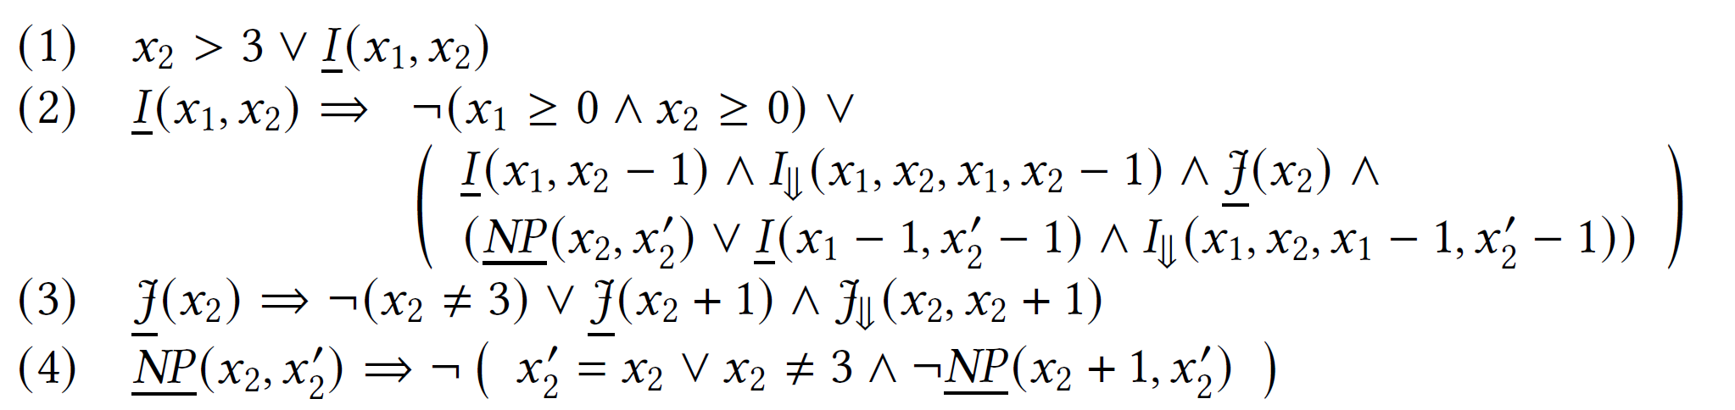
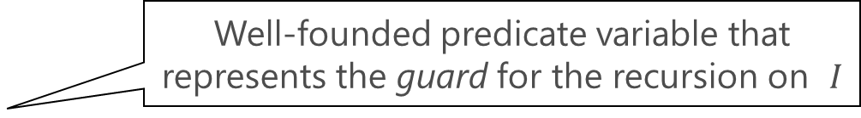
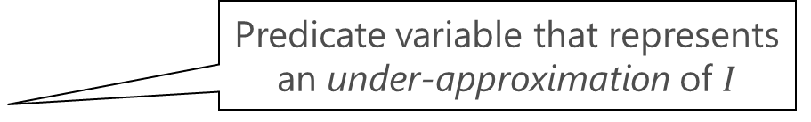
$μ$CLP encoding the termination verification problem
Reduce
Predicate variable that represents an under-approximation of $I$
The corresponding pfwCSP
Well-founded predicate variable that represents the guard for the recursion on $I$

Slide 20
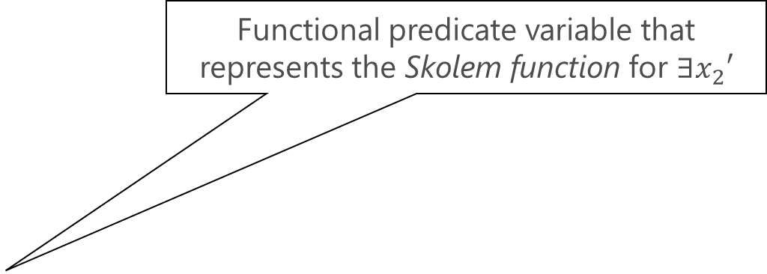
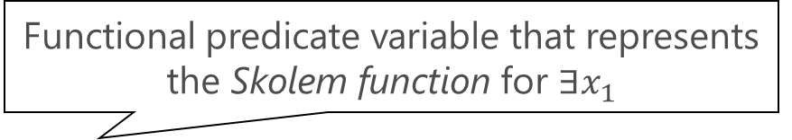
$μ$CLP encoding the non-termination verification problem
Functional predicate variable that represents the Skolem function for $∃x_{1}$
Reduce
The corresponding pfwCSP
Functional predicate variable that represents the Skolem function for $∃x_{2}′$

Slide 21
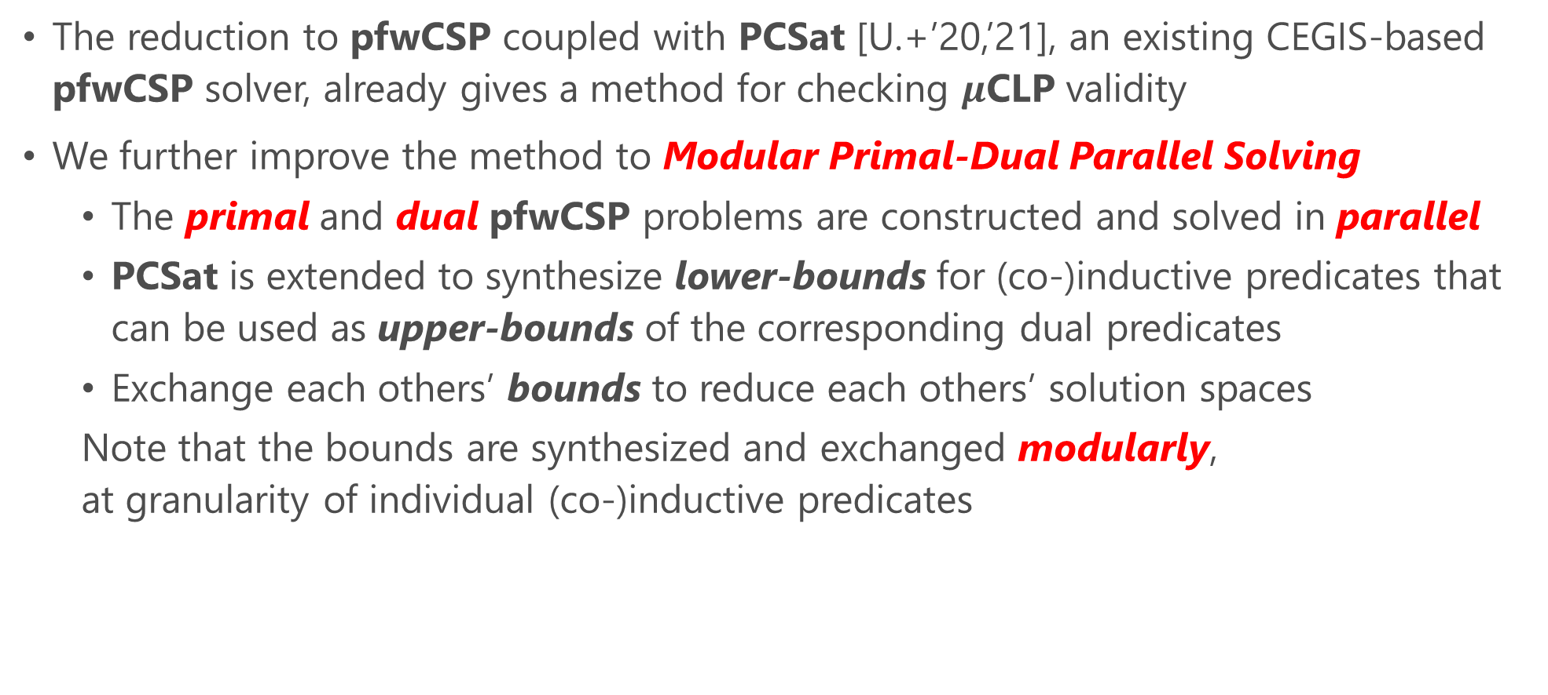
MuVal: A $μ$CLP Validity Checking Method
The reduction to pfwCSP coupled with PCSat [U.+’20,’21], an existing CEGIS-based pfwCSP solver, already gives a method for checking $μ$CLP validity
We further improve the method to Modular Primal-Dual Parallel Solving
The primal and dual pfwCSP problems are constructed and solved in parallel
PCSat is extended to synthesize lower-bounds for (co-)inductive predicates that can be used as upper-bounds of the corresponding dual predicates
Exchange each others’ bounds to reduce each others’ solution spaces
Note that the bounds are synthesized and exchanged modularly, at granularity of individual (co-)inductive predicates

Slide 22

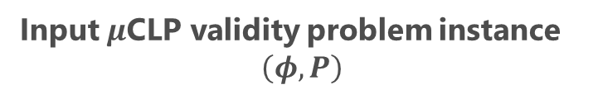


Overall Flow
Input $μ$CLP validity problem instance
$$\left(φ, P\right)$$
$$¬\left(φ, P\right)$$
Dualize
ToPfwCSP
ToPfwCSP
Primal Solver
$$\left(C_{p}, k_{p}\right)$$
Dual Solver
$$\left(C_{d}, k_{d}\right)$$
SAT
UNSAT
SAT
UNSAT
PCSAT [U.+ ‘20,’21]
PCSAT [U.+ ‘20,’21]
Cand. Sol.
Cand. Sol.
UB
UB
LOWERBOUNDSCHECK
LOWERBOUNDSCHECK
Valid
Invalid

Slide 23





Intuition behind Exchanging Upper Bounds
$$νNP=¬ μP$$ $\underline{P},\underline{NP}$ represent lower bounds synthesized by PCSat: $\underline{P}⊆μP$ and $\underline{NP}⊆νNP$
Therefore,
$$μP⊆¬ \underline{NP}$$ and $$νNP⊆¬ \underline{P}$$
$$μP$$
$$νNP$$
$$\underline{NP}$$
$$\underline{P}$$

Slide 24
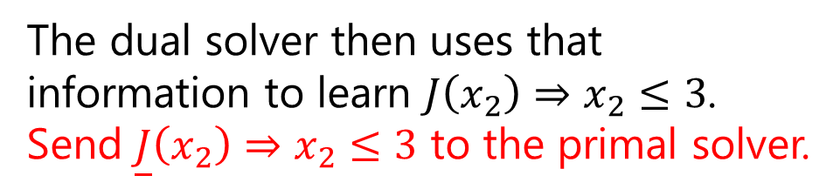
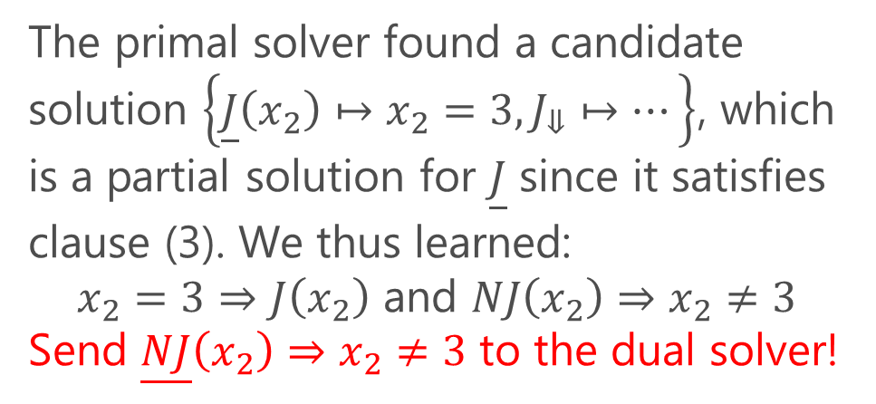
The primal pfwCSP
The primal solver found a candidate solution $\left\{\underline{J}\left(x_{2}\right)↦x_{2}=3,J_{⇓}↦…\right\}$, which is a partial solution for $\underline{J}$ since it satisfies clause (3). We thus learned:
$x_{2}=3⇒J\left(x_{2}\right)$ and $NJ\left(x_{2}\right)⇒x_{2}≠3$
Send $\underline{NJ}\left(x_{2}\right)⇒x_{2}≠3$ to the dual solver!
The dual solver then uses that information to learn $J\left(x_{2}\right)⇒x_{2}≤3$. Send $\underline{J}\left(x_{2}\right)⇒x_{2}≤3$ to the primal solver.
The primal solver then uses it to obtain an actual solution, thus proving termination:

Slide 25
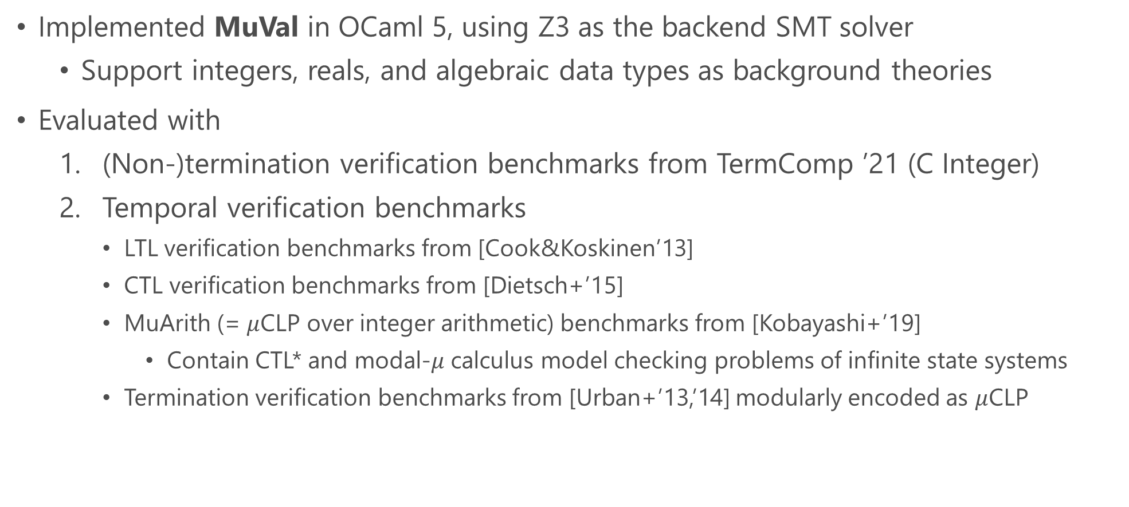
Implementation and Evaluation
Implemented MuVal in OCaml 5, using Z3 as the backend SMT solver
Support integers, reals, and algebraic data types as background theories
Evaluated with
(Non-)termination verification benchmarks from TermComp ’21 (C Integer)
Temporal verification benchmarks
LTL verification benchmarks from [Cook&Koskinen’13]
CTL verification benchmarks from [Dietsch+’15]
MuArith (= $μ$CLP over integer arithmetic) benchmarks from [Kobayashi+’19]
Contain CTL* and modal-$μ$ calculus model checking problems of infinite state systems
Termination verification benchmarks from [Urban+’13,’14] modularly encoded as $μ$CLP

Slide 26
Evaluation with TermComp Benchmarks
MuVal-parallel: MuVal with primal-dual parallel solving (but without exchange of learned upper-bounds)
AProVE: The winner of the C Integer track in 2018, 2020, and 2021
iRankFinder [Ben-Amram&Genaim’14]
UltimateAutomizer [Heizmann+’14]

Slide 27
Evaluation with TermComp Benchmarks
Mu2CHC: A MuArith validity checker based on a reduction to CHCs [Kobayashi+’19]
MuVal-parallel-exc: MuVal-parallel + exchange of learned upper-bounds

Slide 28
Evaluation with Temporal Verification Benchmarks
The paper also presents a comparison with UltimateLTLAutomizer
[Dietsch+‘15]

Slide 29
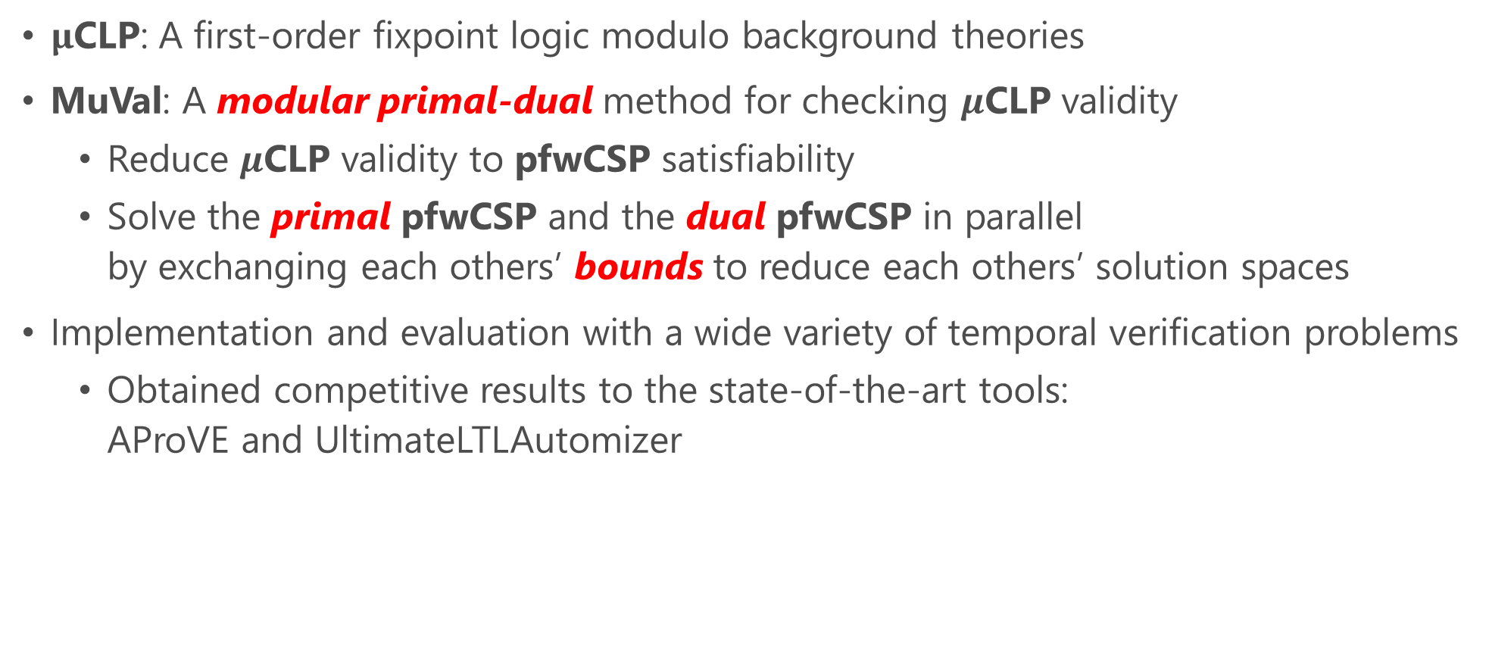
Summary
$μ$CLP: A first-order fixpoint logic modulo background theories
MuVal: A modular primal-dual method for checking $μ$CLP validity
Reduce $μ$CLP validity to pfwCSP satisfiability
Solve the primal pfwCSP and the dual pfwCSP in parallel by exchanging each others’ bounds to reduce each others’ solution spaces
Implementation and evaluation with a wide variety of temporal verification problems
Obtained competitive results to the state-of-the-art tools: AProVE and UltimateLTLAutomizer

Slide 30
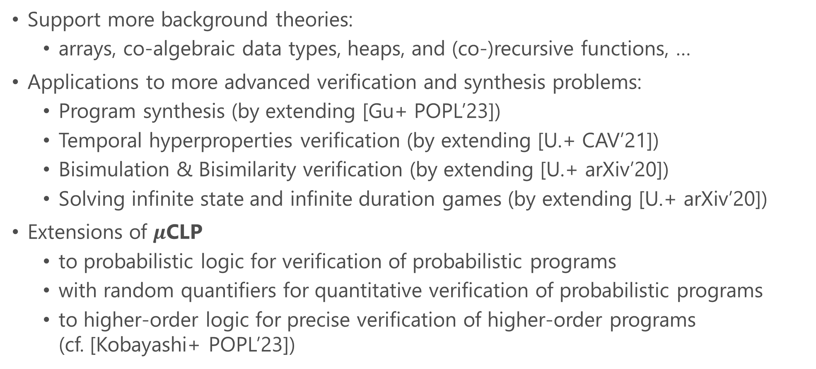
Future and Ongoing Work
Support more background theories:
arrays, co-algebraic data types, heaps, and (co-)recursive functions, …
Applications to more advanced verification and synthesis problems:
Program synthesis (by extending [Gu+ POPL’23])
Temporal hyperproperties verification (by extending [U.+ CAV’21])
Bisimulation & Bisimilarity verification (by extending [U.+ arXiv’20])
Solving infinite state and infinite duration games (by extending [U.+ arXiv’20])
Extensions of $μ$CLP
to probabilistic logic for verification of probabilistic programs
with random quantifiers for quantitative verification of probabilistic programs
to higher-order logic for precise verification of higher-order programs (cf. [Kobayashi+ POPL’23])

