Slide 1

Z3: An Efficient SMT Solver
Powerful
Leonardo de Moura and Nikolaj Bjørner
Microsoft Research

Slide 2
Overview
Z3 is a Satisfiability Modulo Theories (SMT) solver.
Z3 integrates several decision procedures.
Z3 is used in several program analysis, verification, test-case generation projects at Microsoft.
Z3 1.2 is freely available for academic research:
http://research.microsoft.com/projects/z3

Slide 3
Satisfiability Modulo Theories (SMT)
Uninterpreted Functions
Array Theory
Arithmetic

Slide 4
Main features
Linear real and integer arithmetic.
Fixed-size bit-vectors
Uninterpreted functions
Extensional arrays
Quantifiers
Model generation
Several input formats (Simplify, SMT-LIB, Z3, Dimacs)
Extensive API (C/C++, .Net, OCaml)

Slide 5
Z3: Core System Components
Text
C
.NET
OCaml
Theories
Bit-Vectors
Rewriting Simplification
Arithmetic
Arrays
E-matching
Core Theory
Partial orders
Tuples
SAT solver

Slide 6











Clients: Program Verification
Hyper-V
VCC
Boogie
Win. Modules
HAVOC
Verification
condition
Bug path
Rustan Leino, Mike Barnet, Michal Mosƙal, Shaz Qadeer, Shuvendu Lahiri, Herman Venter, Peter Muller,
Wolfram Schulte, Ernie Cohen

Slide 7
Z3 & Program Verification
Quantifiers, quantifiers, quantifiers, …
Modeling the runtime
Frame axioms (“what didn’t change”)
Users provided assertions (e.g., the array is sorted)
Prototyping decision procedures (e.g., reachability, heaps, …)
Solver must be fast in satisfiable instances.
Trade-off between precision and performance.
Candidate (Potential) Models

Slide 8


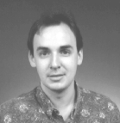



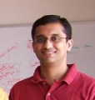


Clients: Test case generation
Run Test and Monitor
Execution Path
Path Condition
seed
Test Inputs
Known Paths
New input
Constraint System
Solve
Unexplored path
Vigilante
Nikolai Tillmann, Peli de Halleux, Patrice Godefroid
Aditya Nori, Jean Philippe Martin, Miguel Castro,
Manuel Costa, Lintao Zhang

Slide 9
Z3 & Test case generation
Formulas may be a big conjunction
Pre-processing step
Eliminate variables and simplify input format
Incremental: solve several similar formulas
New constraints are asserted.
push and pop: (user) backtracking
Lemma reuse
“Small Models”
Given a formula F, find a model M, that minimizes the value of the variables x₀ … x_{n}

Slide 10
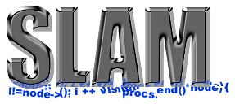





Client: Static Driver Verifier
Z3 is part of SDV 2.0 (Windows 7)
It is used for:
Predicate abstraction (c2bp)
Counterexample refinement (newton)
Ella Bounimova, Vlad Levin, Jakob Lichtenberg,
Tom Ball, Sriram Rajamani, Byron Cook

Slide 11
Z3 & Static Driver Verifier
All-SAT
Fast Predicate Abstraction
Unsatisfiable cores
Why the abstract path is not feasible?

Slide 12


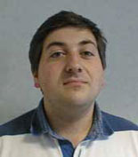

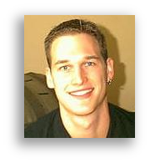

More Microsoft clients
Bounded model-checking of model programs
Termination
Security protocols
Business application modeling
Cryptography
Model Based Testing (SQL-Server)
Your killer-application here

Slide 13
Some Technical goodies
Model-based Theory Combination
How to efficiently combine theory solvers?
Use models to control Theory Combination.
E-matching abstract machine
Term indexing data-structures for incremental matching modulo equalities.
Relevancy propagation
Use Tableau advantages with DPLL engine

Slide 14
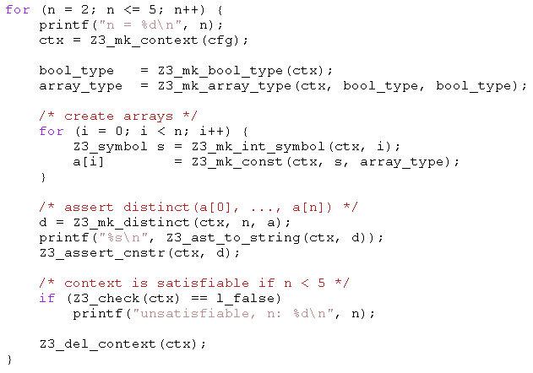
Example: C API
Given arrays:
bool a1[bool];
bool a2[bool];
bool a3[bool];
bool a4[bool];
All can be distinct.
Add:
bool a5[bool];
Two of a1,..,a5 must be equal.

Slide 15
Future/Current Work
Coming soon (Z3 2.0):
Proofs & Unsat cores
Superposition Calculus
Decidable Fragments
Machine Learning
Non linear arithmetic (Gröbner Bases)
Inductive Datatypes
Improved Array & Bit-vector theories
Several performance improvements
More “customers” & Applications

Slide 16
Conclusions
Z3 is a new SMT solver from Microsoft Research.
Z3 is used in several projects.
Z3 is freely available for academic research:
http://research.microsoft.com/projects/z3

