Slide 1
Decision Engines for Software Analysis using SMT Solvers PLDI 2010 - Toronto
Leonardo de Moura and Nikolaj Bjørner
Microsoft Research

Slide 2
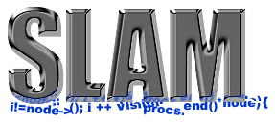




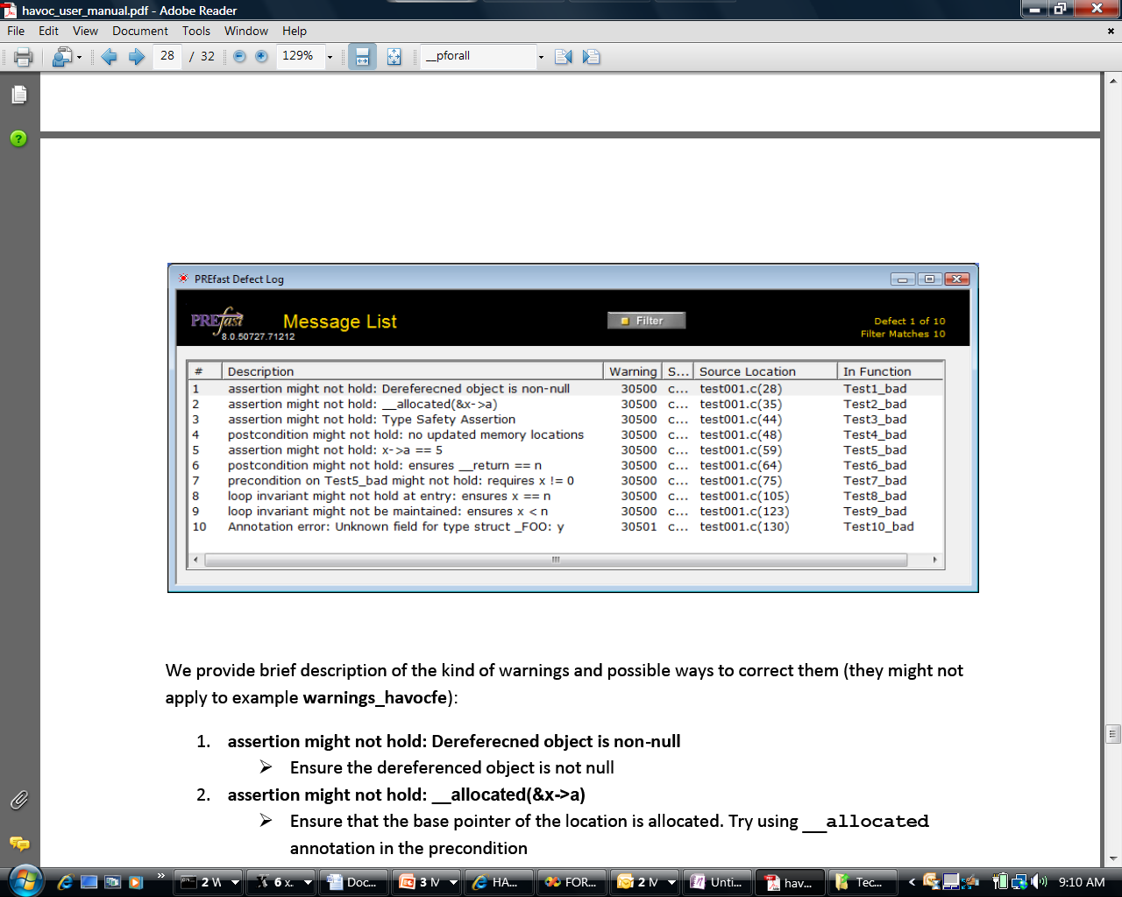

A Decision Engine for Software
Some Microsoft engines:
SDV: The Static Driver Verifier
PREfix: The Static Analysis Engine for C/C++.
Pex: Program EXploration for .NET.
SAGE: Scalable Automated Guided Execution
Spec#: C# + contracts
VCC: Verifying C Compiler for the Viridian Hyper-Visor
HAVOC: Heap-Aware Verification of C-code.
SpecExplorer: Model-based testing of protocol specs.
Yogi: Dynamic symbolic execution + abstraction.
FORMULA: Model-based Design
F7: Refinement types for security protocols
M3: Model Program Modeling
VS3: Abstract interpretation and Synthesis
They all use the SMT solver Z3.
Hyper-V

Slide 3
Applications
Test case generation
Verifying Compilers
Predicate Abstraction
Invariant Generation
Type Checking
Model Based Testing

Slide 4
Theorem Provers/Satisfiability Checkers
A formula F is valid
Iff
¬F is unsatisfiable
Theorem Prover/
Satisfiability Checker
Satisfiable
Model
F
Unsatisfiable
Proof

Slide 5
Theorem Provers/Satisfiability Checkers
A formula F is valid
Iff
¬F is unsatisfiable
Theorem Prover/
Satisfiability Checker
Satisfiable
Model
F
Unsatisfiable
Proof
Timeout
Memout

Slide 6



Verification/Analysis Tool: “Template”
Problem
Verification/Analysis
Tool
Logical Formula
Theorem Prover/
Satisfiability Checker
Satisfiable
(Counter-example)
Unsatisfiable

Slide 7

SMT@Microsoft: Solver
Z3 is a new solver developed at Microsoft Research.
Development/Research driven by internal customers.
Free for academic research.
Interfaces:
http://research.microsoft.com/projects/z3
Z3
Text
C/C++
.NET
OCaml

Slide 8
Test case generation

Slide 9
Test case generation
Test (correctness + usability) is 95% of the deal:
Dev/Test is 1-1 in products.
Developers are responsible for unit tests.
Tools:
Annotations and static analysis (SAL + ESP)
File Fuzzing
Unit test case generation

Slide 10
Security is critical
Security bugs can be very expensive:
Cost of each MS Security Bulletin: $600k to $Millions.
Cost due to worms: $Billions.
The real victim is the customer.
Most security exploits are initiated via files or packets.
Ex: Internet Explorer parses dozens of file formats.
Security testing: hunting for million dollar bugs
Write A/V
Read A/V
Null pointer dereference
Division by zero

Slide 11

Hunting for Security Bugs.
Two main techniques used by “black hats”:
Code inspection (of binaries).
Black box fuzz testing.
Black box fuzz testing:
A form of black box random testing.
Randomly fuzz (=modify) a well formed input.
Grammar-based fuzzing: rules to encode how to fuzz.
Heavily used in security testing
At MS: several internal tools.
Conceptually simple yet effective in practice

Slide 12

Directed Automated Random Testing ( DART)
Run Test and Monitor
Execution Path
Path Condition
seed
Test Inputs
Known Paths
New input
Constraint System
Solve

Slide 13
DARTish projects at Microsoft
PEX
Implements DART for .NET.
YOGI
Implements DART to check the feasibility of program paths generated statically.
Vigilante
Partially implements DART to dynamically generate worm filters.
Implements DART for x86 binaries.
SAGE

Slide 14
What is Pex?
Test input generator
Pex starts from parameterized unit tests
Generated tests are emitted as traditional unit tests

Slide 15
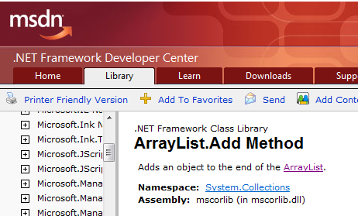
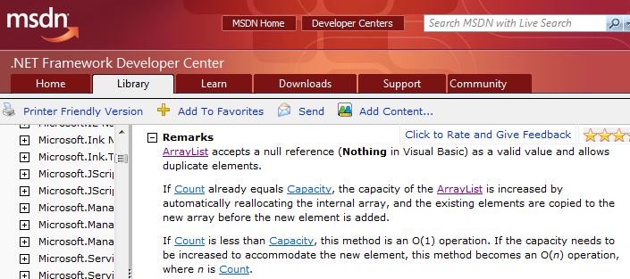
ArrayList: The Spec

Slide 16
ArrayList: AddItem Test
class ArrayListTest { [PexMethod] void AddItem(int c, object item) { var list = new ArrayList(c); list.Add(item);
Assert(list[0] == item); }
}
class ArrayList {
object[] items; int count;
ArrayList(int capacity) {
if (capacity < 0) throw ...;
items = new object[capacity]; }
void Add(object item) {
if (count == items.Length) ResizeArray();
items[this.count++] = item; } ...

Slide 17
ArrayList: Starting Pex…
class ArrayListTest { [PexMethod] void AddItem(int c, object item) { var list = new ArrayList(c); list.Add(item);
Assert(list[0] == item); }
}
 | Inputs
class ArrayList {
object[] items; int count;
ArrayList(int capacity) {
if (capacity < 0) throw ...;
items = new object[capacity]; }
void Add(object item) {
if (count == items.Length) ResizeArray();
items[this.count++] = item; } ...

Slide 18
ArrayList: Run 1, (0,null)
class ArrayListTest { [PexMethod] void AddItem(int c, object item) { var list = new ArrayList(c); list.Add(item);
Assert(list[0] == item); }
}
 | Inputs
 | (0,null)
class ArrayList {
object[] items; int count;
ArrayList(int capacity) {
if (capacity < 0) throw ...;
items = new object[capacity]; }
void Add(object item) {
if (count == items.Length) ResizeArray();
items[this.count++] = item; } ...

Slide 19
ArrayList: Run 1, (0,null)
class ArrayListTest { [PexMethod] void AddItem(int c, object item) { var list = new ArrayList(c); list.Add(item);
Assert(list[0] == item); }
}
 | Inputs | Observed Constraints
 | (0,null) | !(c<0)
class ArrayList {
object[] items; int count;
ArrayList(int capacity) {
if (capacity < 0) throw ...;
items = new object[capacity]; }
void Add(object item) {
if (count == items.Length) ResizeArray();
items[this.count++] = item; } ...
c < 0 → false

Slide 20
ArrayList: Run 1, (0,null)
class ArrayListTest { [PexMethod] void AddItem(int c, object item) { var list = new ArrayList(c); list.Add(item);
Assert(list[0] == item); }
}
 | Inputs | Observed Constraints
 | (0,null) | !(c<0) && 0==c
class ArrayList {
object[] items; int count;
ArrayList(int capacity) {
if (capacity < 0) throw ...;
items = new object[capacity]; }
void Add(object item) {
if (count == items.Length) ResizeArray();
items[this.count++] = item; } ...
0 == c → true

Slide 21
ArrayList: Run 1, (0,null)
class ArrayListTest { [PexMethod] void AddItem(int c, object item) { var list = new ArrayList(c); list.Add(item);
Assert(list[0] == item); }
}
 | Inputs | Observed Constraints
 | (0,null) | !(c<0) && 0==c
item == item → true
class ArrayList {
object[] items; int count;
ArrayList(int capacity) {
if (capacity < 0) throw ...;
items = new object[capacity]; }
void Add(object item) {
if (count == items.Length) ResizeArray();
items[this.count++] = item; } ...
This is a tautology,
i.e. a constraint that is always true,
regardless of the chosen values.
We can ignore such constraints.

Slide 22
ArrayList: Picking the next branch to cover
class ArrayListTest { [PexMethod] void AddItem(int c, object item) { var list = new ArrayList(c); list.Add(item);
Assert(list[0] == item); }
}
Constraints to solve | Inputs | Observed Constraints
 | (0,null) | !(c<0) && 0==c
!(c<0) && 0!=c
class ArrayList {
object[] items; int count;
ArrayList(int capacity) {
if (capacity < 0) throw ...;
items = new object[capacity]; }
void Add(object item) {
if (count == items.Length) ResizeArray();
items[this.count++] = item; } ...

Slide 23
ArrayList: Solve constraints using SMT solver
class ArrayListTest { [PexMethod] void AddItem(int c, object item) { var list = new ArrayList(c); list.Add(item);
Assert(list[0] == item); }
}
Constraints to solve | Inputs | Observed Constraints
 | (0,null) | !(c<0) && 0==c
!(c<0) && 0!=c | (1,null)
class ArrayList {
object[] items; int count;
ArrayList(int capacity) {
if (capacity < 0) throw ...;
items = new object[capacity]; }
void Add(object item) {
if (count == items.Length) ResizeArray();
items[this.count++] = item; } ...

Slide 24
ArrayList: Run 2, (1, null)
class ArrayListTest { [PexMethod] void AddItem(int c, object item) { var list = new ArrayList(c); list.Add(item);
Assert(list[0] == item); }
}
Constraints to solve | Inputs | Observed Constraints
 | (0,null) | !(c<0) && 0==c
!(c<0) && 0!=c | (1,null) | !(c<0) && 0!=c
class ArrayList {
object[] items; int count;
ArrayList(int capacity) {
if (capacity < 0) throw ...;
items = new object[capacity]; }
void Add(object item) {
if (count == items.Length) ResizeArray();
items[this.count++] = item; } ...
0 == c → false

Slide 25
ArrayList: Pick new branch
class ArrayListTest { [PexMethod] void AddItem(int c, object item) { var list = new ArrayList(c); list.Add(item);
Assert(list[0] == item); }
}
Constraints to solve | Inputs | Observed Constraints
 | (0,null) | !(c<0) && 0==c
!(c<0) && 0!=c | (1,null) | !(c<0) && 0!=c
c<0
class ArrayList {
object[] items; int count;
ArrayList(int capacity) {
if (capacity < 0) throw ...;
items = new object[capacity]; }
void Add(object item) {
if (count == items.Length) ResizeArray();
items[this.count++] = item; } ...

Slide 26
ArrayList: Run 3, (-1, null)
class ArrayListTest { [PexMethod] void AddItem(int c, object item) { var list = new ArrayList(c); list.Add(item);
Assert(list[0] == item); }
}
Constraints to solve | Inputs | Observed Constraints
 | (0,null) | !(c<0) && 0==c
!(c<0) && 0!=c | (1,null) | !(c<0) && 0!=c
c<0 | (-1,null)
class ArrayList {
object[] items; int count;
ArrayList(int capacity) {
if (capacity < 0) throw ...;
items = new object[capacity]; }
void Add(object item) {
if (count == items.Length) ResizeArray();
items[this.count++] = item; } ...

Slide 27
ArrayList: Run 3, (-1, null)
class ArrayListTest { [PexMethod] void AddItem(int c, object item) { var list = new ArrayList(c); list.Add(item);
Assert(list[0] == item); }
}
Constraints to solve | Inputs | Observed Constraints
 | (0,null) | !(c<0) && 0==c
!(c<0) && 0!=c | (1,null) | !(c<0) && 0!=c
c<0 | (-1,null) | c<0
class ArrayList {
object[] items; int count;
ArrayList(int capacity) {
if (capacity < 0) throw ...;
items = new object[capacity]; }
void Add(object item) {
if (count == items.Length) ResizeArray();
items[this.count++] = item; } ...
c < 0 → true

Slide 28
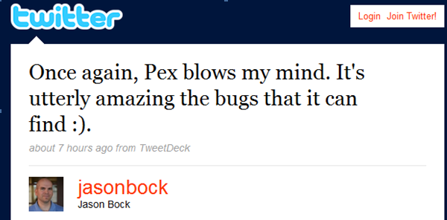
ArrayList: Run 3, (-1, null)
class ArrayListTest { [PexMethod] void AddItem(int c, object item) { var list = new ArrayList(c); list.Add(item);
Assert(list[0] == item); }
}
Constraints to solve | Inputs | Observed Constraints
 | (0,null) | !(c<0) && 0==c
!(c<0) && 0!=c | (1,null) | !(c<0) && 0!=c
c<0 | (-1,null) | c<0
class ArrayList {
object[] items; int count;
ArrayList(int capacity) {
if (capacity < 0) throw ...;
items = new object[capacity]; }
void Add(object item) {
if (count == items.Length) ResizeArray();
items[this.count++] = item; } ...

Slide 29
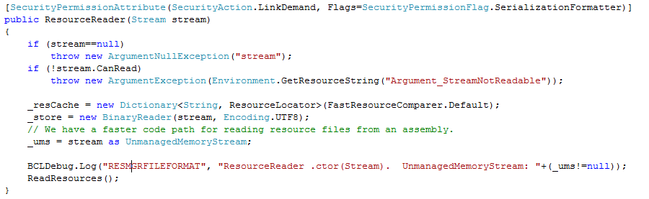
White box testing in practice
How to test this code?
(Real code from .NET base class libraries.)

Slide 30
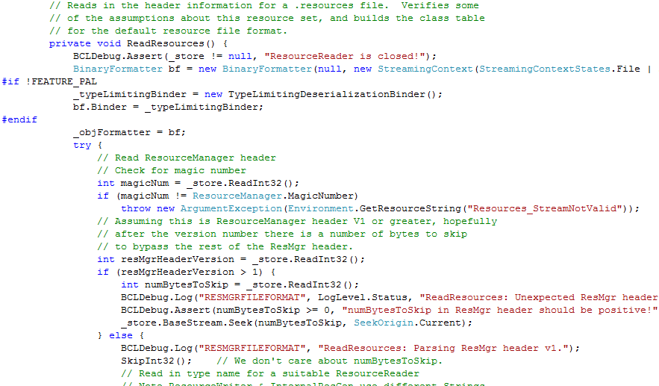
White box testing in practice

Slide 31
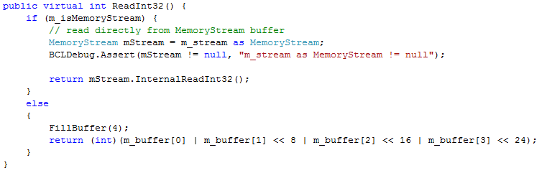
White box testing in practice

Slide 32
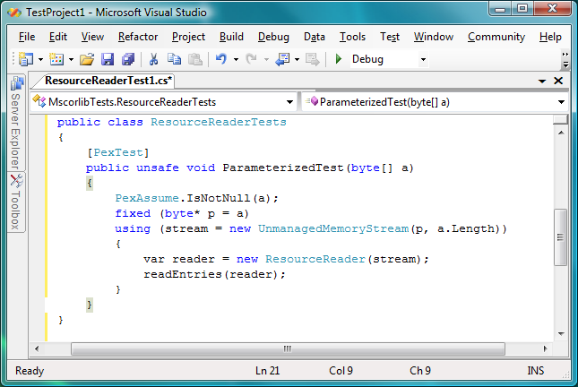
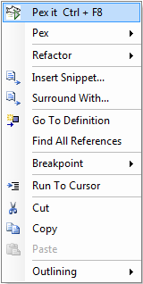
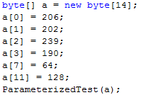
Pex – Test Input Generation
Test input, generated by Pex

Slide 33
Test Input Generation by Dynamic Symbolic Execution
Initially, choose Arbitrary
Run Test and Monitor
Solve
Test Inputs
Constraint System
Execution Path
Known Paths
Choose an
Uncovered Path
Record
Path Condition
Result: small test suite,
high code coverage
Finds only real bugs
No false warnings

Slide 34
PEX ↔ Z3
Rich Combination
Linear arithmetic
Bitvector
Arrays
Models
∀-Quantifier
API
Huge number of small problems. Textual interface is too inefficient.
Used to model custom theories (e.g., .NET type system)
Model used as test inputs
Free
Functions

Slide 35
PEX ↔ Z3
Rich Combination
Linear arithmetic
Bitvector
Arrays
Free
Functions
∀-Quantifier
Used to model custom theories (e.g., .NET type system)
Undecidable (in general)

Slide 36
PEX ↔ Z3
Rich Combination
Linear arithmetic
Bitvector
Arrays
Free
Functions
∀-Quantifier
Used to model custom theories (e.g., .NET type system)
Undecidable (in general)
Solution:
Return “Candidate” Model
Check if trace is valid by executing it

Slide 37
PEX ↔ Z3
Rich Combination
Linear arithmetic
Bitvector
Arrays
Free
Functions
∀-Quantifier
Used to model custom theories (e.g., .NET type system)
Undecidable (in general)
Refined solution:
Support for decidable fragments.

Slide 38
SAGE
Apply DART to large applications (not units).
Start with well-formed input (not random).
Combine with generational search (not DFS).
Negate 1-by-1 each constraint in a path constraint.
Generate many children for each parent run.
parent

Slide 39
SAGE
Apply DART to large applications (not units).
Start with well-formed input (not random).
Combine with generational search (not DFS).
Negate 1-by-1 each constraint in a path constraint.
Generate many children for each parent run.
generation 1
parent

Slide 40
Zero to Crash in 10 Generations
Starting with 100 zero bytes …
SAGE generates a crashing test for Media1 parser
00000000h: 00 00 00 00 00 00 00 00 00 00 00 00 00 00 00 00 ; ................
00000010h: 00 00 00 00 00 00 00 00 00 00 00 00 00 00 00 00 ; ................
00000020h: 00 00 00 00 00 00 00 00 00 00 00 00 00 00 00 00 ; ................
00000030h: 00 00 00 00 00 00 00 00 00 00 00 00 00 00 00 00 ; ................
00000040h: 00 00 00 00 00 00 00 00 00 00 00 00 00 00 00 00 ; ................
00000050h: 00 00 00 00 00 00 00 00 00 00 00 00 00 00 00 00 ; ................
00000060h: 00 00 00 00 ; ....
Generation 0 – seed file

Slide 41
Zero to Crash in 10 Generations
Starting with 100 zero bytes …
SAGE generates a crashing test for Media1 parser
00000000h: 52 49 46 46 3D 00 00 00 ** ** ** 20 00 00 00 00 ; RIFF=...*** ....
00000010h: 00 00 00 00 00 00 00 00 00 00 00 00 00 00 00 00 ; ................
00000020h: 00 00 00 00 00 00 00 00 00 00 00 00 00 00 00 00 ; ................
00000030h: 00 00 00 00 73 74 72 68 00 00 00 00 76 69 64 73 ; ....strh....vids
00000040h: 00 00 00 00 73 74 72 66 B2 75 76 3A 28 00 00 00 ; ....strf²uv:(...
00000050h: 00 00 00 00 00 00 00 00 00 00 00 00 01 00 00 00 ; ................
00000060h: 00 00 00 00 ; ....
Generation 10 – CRASH

Slide 42
SAGE (cont.)
SAGE is very effective at finding bugs.
Works on large applications.
Fully automated
Easy to deploy (x86 analysis – any language)
Used in various groups inside Microsoft
Powered by Z3.

Slide 43
SAGE↔ Z3
Formulas are usually big conjunctions.
SAGE uses only the bitvector and array theories.
Pre-processing step has a huge performance impact.
Eliminate variables.
Simplify formulas.
Early unsat detection.

Slide 44
Static Driver Verifier

Slide 45

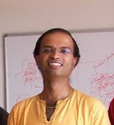
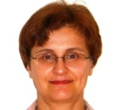

Static Driver Verifier
Z3 is part of SDV 2.0 (Windows 7)
It is used for:
Predicate abstraction (c2bp)
Counter-example refinement (newton)
Ella Bounimova, Vlad Levin, Jakob Lichtenberg,
Tom Ball, Sriram Rajamani, Byron Cook

Slide 46
Overview
http://research.microsoft.com/slam/
SLAM/SDV is a software model checker.
Application domain: device drivers.
Architecture:
c2bp C program → boolean program (predicate abstraction).
bebop Model checker for boolean programs.
newton Model refinement (check for path feasibility)
SMT solvers are used to perform predicate abstraction and to check path feasibility.
c2bp makes several calls to the SMT solver. The formulas are relatively small.

Slide 47
Example
Do this code obey the looking rule?
do {
KeAcquireSpinLock();
nPacketsOld = nPackets;
if(request){
request = request->Next;
KeReleaseSpinLock();
nPackets++;
}
} while (nPackets != nPacketsOld);
KeReleaseSpinLock();

Slide 48
Example
Model checking Boolean program
U
do {
KeAcquireSpinLock();
if(*){
KeReleaseSpinLock();
}
} while (*);
KeReleaseSpinLock();
L
L
L
U
L
U
L
U
U
E

Slide 49
Example
Is error path feasible?
U
do {
KeAcquireSpinLock();
nPacketsOld = nPackets;
if(request){
request = request->Next;
KeReleaseSpinLock();
nPackets++;
}
} while (nPackets != nPacketsOld);
KeReleaseSpinLock();
L
L
L
U
L
U
L
U
U
E

Slide 50
Example
Add new predicate to
Boolean program
b: (nPacketsOld == nPackets)
U
do {
KeAcquireSpinLock();
nPacketsOld = nPackets;
if(request){
request = request->Next;
KeReleaseSpinLock();
nPackets++;
}
} while (nPackets != nPacketsOld);
KeReleaseSpinLock();
L
b = true;
L
L
U
b = b ? false : *;
L
U
!b
L
U
U
E

Slide 51
Example
Model Checking
Refined Program
b: (nPacketsOld == nPackets)
U
do {
KeAcquireSpinLock();
b = true;
if(*){
KeReleaseSpinLock();
b = b ? false : *;
}
} while (!b);
KeReleaseSpinLock();
L
b
L
L
b
U
b
b
L
U
!b
b
L
U
b
U
E

Slide 52
Example
Model Checking
Refined Program
b: (nPacketsOld == nPackets)
U
do {
KeAcquireSpinLock();
b = true;
if(*){
KeReleaseSpinLock();
b = b ? false : *;
}
} while (!b);
KeReleaseSpinLock();
L
b
L
L
b
U
b
b
L
U
!b
b
L
b
U

Slide 53
Example
Model Checking
Refined Program
b: (nPacketsOld == nPackets)
U
do {
KeAcquireSpinLock();
b = true;
if(*){
KeReleaseSpinLock();
b = b ? false : *;
}
} while (!b);
KeReleaseSpinLock();
L
b
L
L
b
U
b
b
L
U
!b
b
L
b
U

Slide 54
Observations about SLAM
Automatic discovery of invariants
driven by property and a finite set of (false) execution paths
predicates are not invariants, but observations
abstraction + model checking computes inductive invariants (Boolean combinations of observations)
A hybrid dynamic/static analysis
newton executes path through C code symbolically
c2bp+bebop explore all paths through abstraction
A new form of program slicing
program code and data not relevant to property are dropped
non-determinism allows slices to have more behaviors

Slide 55
Predicate Abstraction: c2bp
Given a C program P and F = {p₁, … , p_{n}}.
Produce a Boolean program B(P, F)
Same control flow structure as P.
Boolean variables {b₁, … , b_{n}} to match {p₁, … , p_{n}}.
Properties true in B(P, F) are true in P.
Each p_{i} is a pure Boolean expression.
Each p_{i} represents set of states for which p_{i} is true.
Performs modular abstraction.

Slide 56
Abstracting Expressions via F
Implies_{F} (e)
Best Boolean function over F that implies e.
ImpliedBy_{F} (e)
Best Boolean function over F that is implied by e.
ImpliedBy_{F} (e) = not Implies_{F} (not e)

Slide 57
Implies_{F}(e) and ImpliedBy_{F}(e)
e
ImpliedBy_{F}(e)
Implies_{F}(e)

Slide 58
Computing Implies_{F}(e)
minterm m = l₁ and ... and l_{n}, where l_{i} = p_{i}, or l_{i} = not p_{i}.
Implies_{F}(e): disjunction of all minterms that imply e.
Naive approach
Generate all 2^{n} possible minterms.
For each minterm m, use SMT solver to check validity of m implies e.
Many possible optimizations

Slide 59
Computing Implies_{F}(e)
F = { x < y, x = 2}
e : y > 1
Minterms over F
!x<y, !x=2 implies y>1
x<y, !x=2 implies y>1
!x<y, x=2 implies y>1
x<y, x=2 implies y>1

Slide 60
Computing Implies_{F}(e)
F = { x < y, x = 2}
e : y > 1
Minterms over F
!x<y, !x=2 implies y>1
x<y, !x=2 implies y>1
!x<y, x=2 implies y>1
x<y, x=2 implies y>1

Slide 61
Computing Implies_{F}(e)
F = { x < y, x = 2}
e : y > 1
Minterms over F
!x<y, !x=2 implies y>1
x<y, !x=2 implies y>1
!x<y, x=2 implies y>1
x<y, x=2 implies y>1
Implies_{F}(y>1) = x<y ∧ x=2

Slide 62
Computing Implies_{F}(e)
F = { x < y, x = 2}
e : y > 1
Minterms over F
!x<y, !x=2 implies y>1
x<y, !x=2 implies y>1
!x<y, x=2 implies y>1
x<y, x=2 implies y>1
Implies_{F}(y>1) = b₁ ∧ b₂

Slide 63
Newton
Given an error path p in the Boolean program B.
Is p a feasible path of the corresponding C program?
Yes: found a bug.
No: find predicates that explain the infeasibility.
Execute path symbolically.
Check conditions for inconsistency using SMT solver.

Slide 64
Z3 & Static Driver Verifier
All-SAT
Better (more precise) Predicate Abstraction
Unsatisfiable cores
Why the abstract path is not feasible?
Fast Predicate Abstraction

Slide 65
Bit-precise Scalable Static Analysis
PREfix [Moy, Bjorner, Sielaff 2009]

Slide 66
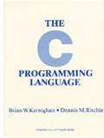
What is wrong here?
int binary_search(int[] arr, int low, int high, int key)
while (low <= high)
{
// Find middle value
int mid = (low + high) / 2;
int val = arr[mid]; if (val == key) return mid; if (val < key) low = mid+1; else high = mid-1; } return -1;
}
void itoa(int n, char* s) {
if (n < 0) {
*s++ = ‘-’;
n = -n;
}
// Add digits to s
….
Package: java.util.Arrays
Function: binary_search
Book: Kernighan and Ritchie
Function: itoa (integer to ascii)

Slide 67
What is wrong here?
3(INT_MAX+1)/4 + (INT_MAX+1)/4
= INT_MIN
int binary_search(int[] arr, int low, int high, int key)
while (low <= high)
{
// Find middle value
int mid = (low + high) / 2;
int val = arr[mid]; if (val == key) return mid; if (val < key) low = mid+1; else high = mid-1; } return -1;
}
void itoa(int n, char* s) {
if (n < 0) {
*s++ = ‘-’;
n = -n;
}
// Add digits to s
….
Package: java.util.Arrays
Function: binary_search
Book: Kernighan and Ritchie
Function: itoa (integer to ascii)

Slide 68
What is wrong here?
-INT_MIN= INT_MIN
3(INT_MAX+1)/4 + (INT_MAX+1)/4
= INT_MIN
int binary_search(int[] arr, int low, int high, int key)
while (low <= high)
{
// Find middle value
int mid = (low + high) / 2;
int val = arr[mid]; if (val == key) return mid; if (val < key) low = mid+1; else high = mid-1; } return -1;
}
void itoa(int n, char* s) {
if (n < 0) {
*s++ = ‘-’;
n = -n;
}
// Add digits to s
….
Package: java.util.Arrays
Function: binary_search
Book: Kernighan and Ritchie
Function: itoa (integer to ascii)

Slide 69
The PREfix Static Analysis Engine
int init_name(char **outname, uint n)
{
if (n == 0) return 0;
else if (n > UINT16_MAX) exit(1);
else if ((*outname = malloc(n)) == NULL) {
return 0xC0000095; // NT_STATUS_NO_MEM;
}
return 0;
}
int get_name(char* dst, uint size)
{
char* name;
int status = 0;
status = init_name(&name, size);
if (status != 0) {
goto error;
}
strcpy(dst, name);
error:
return status;
}
C/C++ functions

Slide 70
The PREfix Static Analysis Engine
int init_name(char **outname, uint n)
{
if (n == 0) return 0;
else if (n > UINT16_MAX) exit(1);
else if ((*outname = malloc(n)) == NULL) {
return 0xC0000095; // NT_STATUS_NO_MEM;
}
return 0;
}
int get_name(char* dst, uint size)
{
char* name;
int status = 0;
status = init_name(&name, size);
if (status != 0) {
goto error;
}
strcpy(dst, name);
error:
return status;
}
model for function init_name
outcome init_name_0:
guards: n == 0
results: result == 0
outcome init_name_1:
guards: n > 0; n <= 65535
results: result == 0xC0000095
outcome init_name_2:
guards: n > 0|; n <= 65535
constraints: valid(outname)
results: result == 0; init(*outname)
models
C/C++ functions

Slide 71
The PREfix Static Analysis Engine
int init_name(char **outname, uint n)
{
if (n == 0) return 0;
else if (n > UINT16_MAX) exit(1);
else if ((*outname = malloc(n)) == NULL) {
return 0xC0000095; // NT_STATUS_NO_MEM;
}
return 0;
}
int get_name(char* dst, uint size)
{
char* name;
int status = 0;
status = init_name(&name, size);
if (status != 0) {
goto error;
}
strcpy(dst, name);
error:
return status;
}
model for function init_name
outcome init_name_0:
guards: n == 0
results: result == 0
outcome init_name_1:
guards: n > 0; n <= 65535
results: result == 0xC0000095
outcome init_name_2:
guards: n > 0|; n <= 65535
constraints: valid(outname)
results: result == 0; init(*outname)
models
path for function get_name
guards: size == 0
constraints:
facts: init(dst); init(size); status == 0
paths
pre-condition for function strcpy
init(dst) and valid(name)
C/C++ functions
warnings

Slide 72
Overflow on unsigned addition
m_nSize == m_nMaxSize == UINT_MAX
iElement = m_nSize;
if( iElement >= m_nMaxSize )
{
bool bSuccess = GrowBuffer( iElement+1 );
…
}
::new( m_pData+iElement ) E( element );
m_nSize++;
iElement + 1 == 0
Code was written for address space < 4GB
Write in unallocated memory

Slide 73
Using an overflown value as allocation size
Overflow check
ULONG AllocationSize;
while (CurrentBuffer != NULL) {
if (NumberOfBuffers > MAX_ULONG / sizeof(MYBUFFER)) {
return NULL; } NumberOfBuffers++; CurrentBuffer = CurrentBuffer->NextBuffer;
}
AllocationSize = sizeof(MYBUFFER)*NumberOfBuffers;
UserBuffersHead = malloc(AllocationSize);
Increment and exit from loop
Possible overflow

Slide 74
Model-based Design - FORMULA

Slide 75
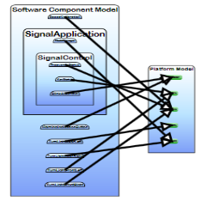
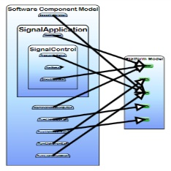
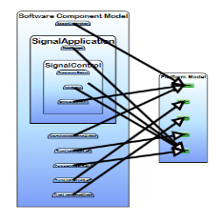
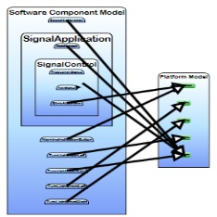
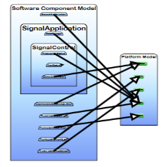
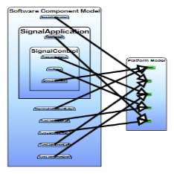
FORMULA: Design Space Exploration
Use Design Space Exploration to identify valid candidate architectures

Slide 76
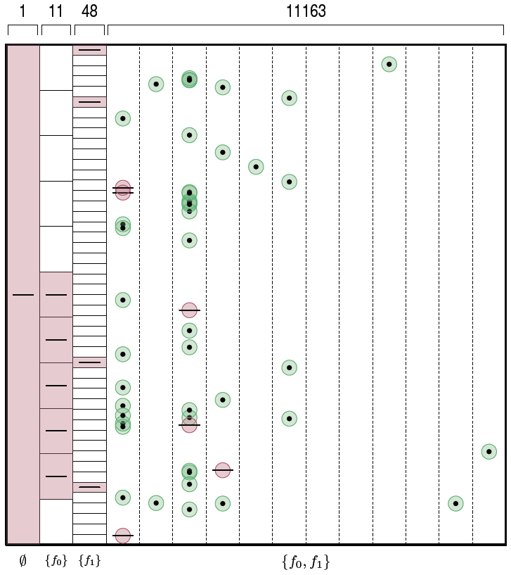
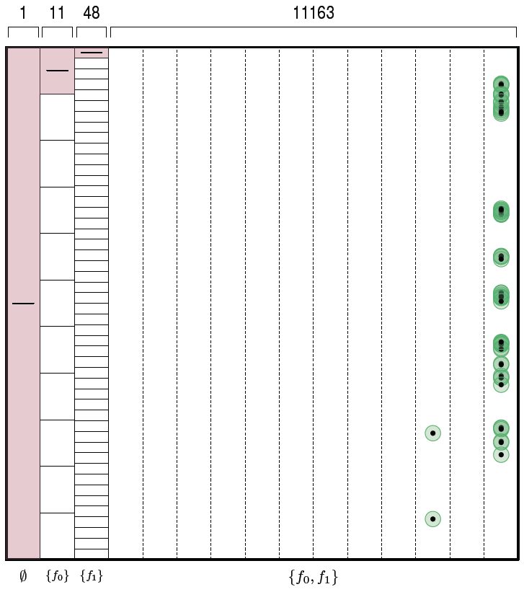
FORMULA: Diversified Search
SMT Formula
Subtract all
isomorphic
solutions
SMT Formula
Z3 Solver
Subtract all
isomorphic
solutions
Diversify and
Constrain
Search Space
Remember this model

Slide 77
Verifying Compilers
Annotated Program
Verification Condition F
pre/post conditions
invariants
and other annotations

Slide 78
Annotations: Example
class C {
private int a, z;
invariant z > 0
public void M()
requires a != 0
{
z = 100/a;
}
}

Slide 79
Spec# Approach for a Verifying Compiler
Source Language
C# + goodies = Spec#
Specifications
method contracts,
invariants,
field and type annotations.
Program Logic:
Dijkstra’s weakest preconditions.
Automatic Verification
type checking,
verification condition generation (VCG),
SMT
Spec# (annotated C#)
Spec# Compiler
Boogie PL
VC Generator
Formulas
SMT Solver

Slide 80
Command language
assert P
assume P
S T
x := E
x := x + 1
x := 10
havoc x
S ; T

Slide 81
Reasoning about execution traces
Hoare triple { P } S { Q } says that
every terminating execution trace of S that starts in a state satisfying P
does not go wrong, and
terminates in a state satisfying Q

Slide 82
Reasoning about execution traces
Hoare triple { P } S { Q } says that
every terminating execution trace of S that starts in a state satisfying P
does not go wrong, and
terminates in a state satisfying Q
Given S and Q, what is the weakest P’ satisfying {P’} S {Q} ?
P' is called the weakest precondition of S with respect to Q, written wp(S, Q)
to check {P} S {Q}, check P ⇒ P’

Slide 83
Weakest preconditions
Q[ E / x ]
(∀x • Q )
P ∧ Q
P ⇒ Q
wp( S, wp( T, Q ))
wp( S, Q ) ∧ wp( T, Q )
wp( x := E, Q ) =
wp( havoc x, Q ) =
wp( assert P, Q ) =
wp( assume P, Q ) =
wp( S ; T, Q ) =
wp( S T, Q ) =

Slide 84
Structured if statement
if E then S else T end =
assume E; S
assume ¬E; T

Slide 85
While loop with loop invariant
while E invariant J do S end
= assert J; havoc x; assume J; ( assume E; S; assert J; assume false assume ¬E )
where x denotes the assignment targets of S
check that the loop invariant holds initially
“fast forward” to an arbitrary iteration of the loop
check that the loop invariant is maintained by the loop body

Slide 86
Spec# Chunker.NextChunk translation
procedure Chunker.NextChunk(this: ref where $IsNotNull(this, Chunker)) returns ($result: ref where $IsNotNull($result, System.String));
// in-parameter: target object
free requires $Heap[this, $allocated];
requires ($Heap[this, $ownerFrame] == $PeerGroupPlaceholder || !($Heap[$Heap[this, $ownerRef], $inv] <: $Heap[this, $ownerFrame]) || $Heap[$Heap[this, $ownerRef], $localinv] == $BaseClass($Heap[this, $ownerFrame])) && (forall $pc: ref :: $pc != null && $Heap[$pc, $allocated] && $Heap[$pc, $ownerRef] == $Heap[this, $ownerRef] && $Heap[$pc, $ownerFrame] == $Heap[this, $ownerFrame] ==> $Heap[$pc, $inv] == $typeof($pc) && $Heap[$pc, $localinv] == $typeof($pc));
// out-parameter: return value
free ensures $Heap[$result, $allocated];
ensures ($Heap[$result, $ownerFrame] == $PeerGroupPlaceholder || !($Heap[$Heap[$result, $ownerRef], $inv] <: $Heap[$result, $ownerFrame]) || $Heap[$Heap[$result, $ownerRef], $localinv] == $BaseClass($Heap[$result, $ownerFrame])) && (forall $pc: ref :: $pc != null && $Heap[$pc, $allocated] && $Heap[$pc, $ownerRef] == $Heap[$result, $ownerRef] && $Heap[$pc, $ownerFrame] == $Heap[$result, $ownerFrame] ==> $Heap[$pc, $inv] == $typeof($pc) && $Heap[$pc, $localinv] == $typeof($pc));
// user-declared postconditions
ensures $StringLength($result) <= $Heap[this, Chunker.ChunkSize];
// frame condition
modifies $Heap;
free ensures (forall $o: ref, $f: name :: { $Heap[$o, $f] } $f != $inv && $f != $localinv && $f != $FirstConsistentOwner && (!IsStaticField($f) || !IsDirectlyModifiableField($f)) && $o != null && old($Heap)[$o, $allocated] && (old($Heap)[$o, $ownerFrame] == $PeerGroupPlaceholder || !(old($Heap)[old($Heap)[$o, $ownerRef], $inv] <: old($Heap)[$o, $ownerFrame]) || old($Heap)[old($Heap)[$o, $ownerRef], $localinv] == $BaseClass(old($Heap)[$o, $ownerFrame])) && old($o != this || !(Chunker <: DeclType($f)) || !$IncludedInModifiesStar($f)) && old($o != this || $f != $exposeVersion) ==> old($Heap)[$o, $f] == $Heap[$o, $f]);
// boilerplate
free requires $BeingConstructed == null;
free ensures (forall $o: ref :: { $Heap[$o, $localinv] } { $Heap[$o, $inv] } $o != null && !old($Heap)[$o, $allocated] && $Heap[$o, $allocated] ==> $Heap[$o, $inv] == $typeof($o) && $Heap[$o, $localinv] == $typeof($o));
free ensures (forall $o: ref :: { $Heap[$o, $FirstConsistentOwner] } old($Heap)[old($Heap)[$o, $FirstConsistentOwner], $exposeVersion] == $Heap[old($Heap)[$o, $FirstConsistentOwner], $exposeVersion] ==> old($Heap)[$o, $FirstConsistentOwner] == $Heap[$o, $FirstConsistentOwner]);
free ensures (forall $o: ref :: { $Heap[$o, $localinv] } { $Heap[$o, $inv] } old($Heap)[$o, $allocated] ==> old($Heap)[$o, $inv] == $Heap[$o, $inv] && old($Heap)[$o, $localinv] == $Heap[$o, $localinv]);
free ensures (forall $o: ref :: { $Heap[$o, $allocated] } old($Heap)[$o, $allocated] ==> $Heap[$o, $allocated]) && (forall $ot: ref :: { $Heap[$ot, $ownerFrame] } { $Heap[$ot, $ownerRef] } old($Heap)[$ot, $allocated] && old($Heap)[$ot, $ownerFrame] != $PeerGroupPlaceholder ==> old($Heap)[$ot, $ownerRef] == $Heap[$ot, $ownerRef] && old($Heap)[$ot, $ownerFrame] == $Heap[$ot, $ownerFrame]) && old($Heap)[$BeingConstructed, $NonNullFieldsAreInitialized] == $Heap[$BeingConstructed, $NonNullFieldsAreInitialized];

Slide 87
Verification conditions: Structure
BIG
and-or tree
(ground)
∀ Axioms
(non-ground)
Control & Data Flow

Slide 88



Hypervisor: A Manhattan Project
Meta OS: small layer of software between hardware and OS
Mini: 100K lines of non-trivial concurrent systems C code
Critical: must provide functional resource abstraction
Trusted: a verification grand challenge
Hypervisor
Hardware

Slide 89
HV Correctness: Simulation
A partition cannot distinguish (with some exceptions)
whether a machine instruction is executed
a) through the HV OR b) directly on a processor
Partition
Operating System
App
App
App
App
App
App
≈
machine instruction
mov EAX, 23
machine instruction
mov EAX, 23
Hypervisor
Disk
NIC
CPU
RAM
Disk
NIC
CPU
RAM
Notes:
One of the lemmas required for this is, of course, memory safety of the hypervisor kernel, which in turn relies on the correctness of the underlying data structures and the absence of race conditions.

Slide 90
Hypervisor Implementation
real code, as shipped with Windows Server 2008
ca. 100 000 lines of C, 5 000 lines of x64 assembly
concurrency
spin locks, r/w locks, rundowns, turnstiles
lock-free accesses to volatile data and hardware covered by implicit protocols
scheduler, memory allocator, etc.
access to hardware registers (memory management, virtualization support)

Slide 91

Hypervisor Verification (2007 – 2010)
Partners:
European Microsoft Innovation Center
Microsoft Research
Microsoft’s Windows Div.
Universität des Saarlandes
co-funded by the German Ministry of Education and Research
http://www.verisoftxt.de

Slide 92
Challenges for Verification of Concurrent C
Memory model that is adequate and efficient to reason about
Modular reasoning about concurrent code
Invariants for (large and complex) C data structures
Huge verification conditions to be proven automatically
“Live” specifications that evolve with the code

Slide 93

The Microsoft Verifying C Compiler (VCC)
Source Language
ANSI C +
Design-by-Contract Annotations +
Ghost state +
Theories +
Metadata Annotations
Program Logic
Dijkstra’s weakest preconditions
Automatic Verification
verification condition generation (VCG)
automatic theorem proving (SMT)

Slide 94
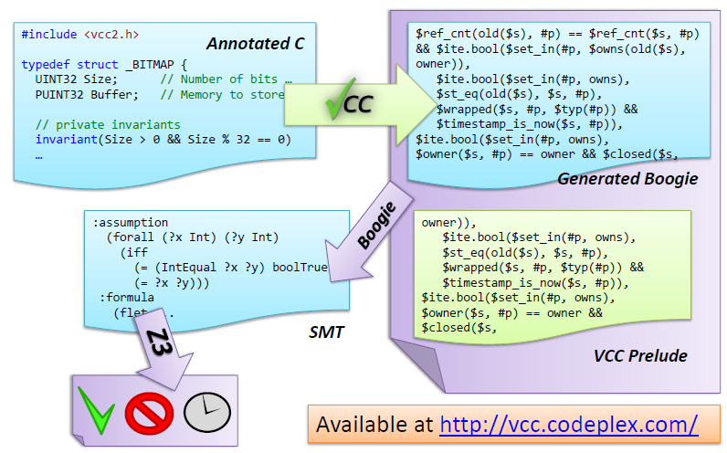
VCC Architecture

Slide 95
Contracts / Modular Verification
int foo(int x)
requires(x > 5) // precond
ensures(result > x) // postcond
{
…
}
void bar(int y; int ∗z)
writes(z) // framing
requires(y > 7)
maintains(∗z > 7) // invariant
{
∗z = foo(y);
assert(∗z > 7);
}
function contracts: pre-/postconditions, framing
modularity: bar only knows contract (but not code) of foo
advantages:
modular verification: one function at a time
no unfolding of code: scales to large applications

Slide 96
Hypervisor: Some Statistics
VCs have several MB
Thousands of non ground clauses
Users are willing to wait at most 5 min per VC

Slide 97
Hypervisor: Some Statistics
VCs have several Mb
Thousands of non ground clauses
Developers are willing to wait at most 5 min per VC
Are you willing to wait more than 5 min for your compiler?

Slide 98
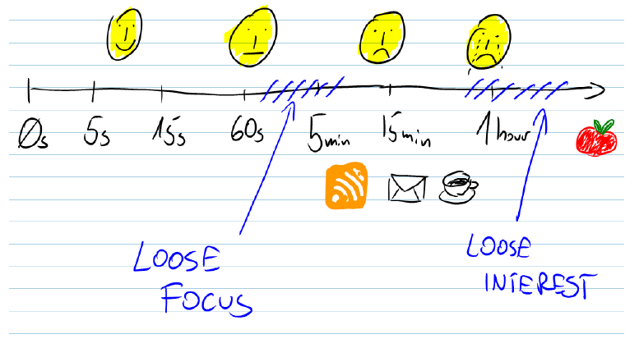
Verification Attempt Time vs. Satisfaction and Productivity
By Michal Moskal (VCC Designer and Software Verification Expert)

Slide 99
Why did my proof attempt fail?
1. My annotations are not strong enough!
weak loop invariants and/or contracts
2. My theorem prover is not strong (or fast) enough.
Send “angry” email to Nikolaj and Leo.

Slide 100
VCC Performance Trends Nov 08 – Mar 09
Modification in invariant checking
Switch to Z3 v2
Z3 v2 update
Attempt to improve Boogie/Z3 interaction
Switch to Boogie2

Slide 101

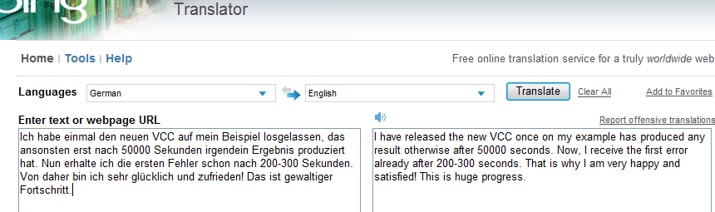
The Importance of Speed

Slide 102
Challenge
Quantifiers, quantifiers, quantifiers, …
Modeling the runtime
∀ h,o,f: IsHeap(h) ∧ o ≠ null ∧ read(h, o, alloc) = t ⇒ read(h,o, f) = null ∨ read(h, read(h,o,f),alloc) = t

Slide 103
Challenge
Quantifiers, quantifiers, quantifiers, …
Modeling the runtime
Frame axioms
∀ o, f: o ≠ null ∧ read(h₀, o, alloc) = t ⇒ read(h₁,o,f) = read(h₀,o,f) ∨ (o,f) ∈ M

Slide 104
Challenge
Quantifiers, quantifiers, quantifiers, …
Modeling the runtime
Frame axioms
User provided assertions
∀ i,j: i ≤ j ⇒ read(a,i) ≤ read(b,j)

Slide 105
Challenge
Quantifiers, quantifiers, quantifiers, …
Modeling the runtime
Frame axioms
User provided assertions
Theories
x: p(x,x)
x,y,z: p(x,y), p(y,z) ⇒ p(x,z)
x,y: p(x,y), p(y,x) ⇒ x = y

Slide 106
Challenge
Quantifiers, quantifiers, quantifiers, …
Modeling the runtime
Frame axioms
User provided assertions
Theories
Solver must be fast in satisfiable instances.
We want to find bugs!

Slide 107
Bad news
There is no sound and refutationally complete
procedure for
linear integer arithmetic + free function symbols

Slide 108
Many Approaches
Heuristic quantifier instantiation
Combining SMT with Saturation provers
Complete quantifier instantiation
Decidable fragments
Model based quantifier instantiation

Slide 109
Challenge: Modeling Runtime
Is the axiomatization of the runtime consistent?
False implies everything
Partial solution: SMT + Saturation Provers
Found many bugs using this approach

Slide 110
Challenge: Robustness
Standard complain
“I made a small modification in my Spec, and Z3 is timingout”
This also happens with SAT solvers (NP-complete)
In our case, the problems are undecidable
Partial solution: parallelization

Slide 111
Parallel Z3
Joint work with Y. Hamadi (MSRC) and C. Wintersteiger
Multi-core & Multi-node (HPC)
Different strategies in parallel
Collaborate exchanging lemmas
Strategy 1
Strategy 2
Strategy 3
Strategy 4
Strategy 5

Slide 112
Hey, I don’t trust these proofs
Z3 may be buggy.
Solution: proof/certificate generation.
Engineering problem: these certificates are too big.

Slide 113
Hey, I don’t trust these proofs
Z3 may be buggy.
Solution: proof/certificate generation.
Engineering problem: these certificates are too big.
The Axiomatization of the runtime may be buggy or inconsistent.
Yes, this is true. We are working on new techniques for proving satisfiability (building a model for these axioms)

Slide 114
Hey, I don’t trust these proofs
Z3 may be buggy.
Solution: proof/certificate generation.
Engineering problem: these certificates are too big.
The Axiomatization of the runtime may be buggy or inconsistent.
Yes, this is true. We are working on new techniques for proving satisfiability (building a model for these axioms)
The VCG generator is buggy (i.e., it makes the wrong assumptions)
Do you trust your compiler?

Slide 115
Engineer Perspective
These are bug-finding tools!
When they return “Proved”, it just means they cannot find more bugs.
I add Loop invariants to speedup the process.
I don’t want to waste time analyzing paths with 1,2,…,k,… iterations.
They are successful if they expose bugs not exposed by regular testing.

Slide 116
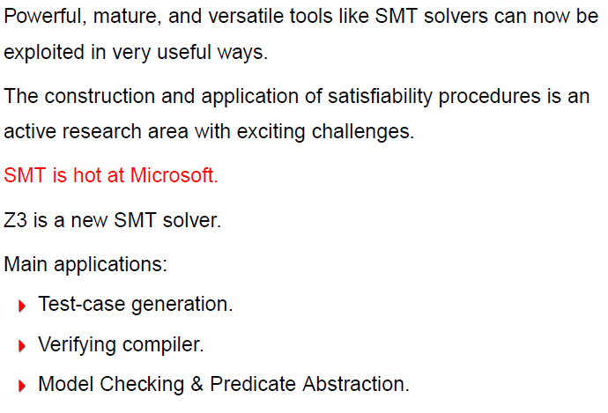
Conclusion

