Slide 1
Decision Engines for Software Analysis using SMT Solvers PLDI 2010 - Toronto
Leonardo de Moura and Nikolaj Bjørner
Microsoft Research

Slide 2
Symbolic Reasoning
Verification/Analysis tools need some form of Symbolic Reasoning

Slide 3
Symbolic Reasoning
Logic is “The Calculus of Computer Science” (Z. Manna).
High computational complexity
Undecidable
(FOL + LA)
Semi-decidable
(First-order logic)
NEXPTime-complete
(EPR)
PSpace-complete
(QBF)
NP-complete
(Propositional logic)
P-time
(Equality)

Slide 4
Applications
Test case generation
Verifying Compilers
Predicate Abstraction
Invariant Generation
Type Checking
Model Based Testing

Slide 5






Some Applications @ Microsoft
HAVOC
Hyper-V
Terminator T-2
VCC
NModel
Vigilante
SpecExplorer
F7
SAGE

Slide 6
Test case generation
unsigned GCD(x, y) {
requires(y > 0);
while (true) {
unsigned m = x % y;
if (m == 0) return y;
x = y;
y = m;
}
}
(y₀ > 0) and
(m₀ = x₀ % y₀) and
not (m₀ = 0) and
(x₁ = y₀) and
(y₁ = m₀) and
(m₁ = x₁ % y₁) and
(m₁ = 0)
x₀ = 2
y₀ = 4
m₀ = 2
x₁ = 4
y₁ = 2
m₁ = 0
SSA
Solver
We want a trace where the loop is executed twice.

Slide 7
Type checking
Signature:
div : int, { x : int | x ≠ 0 } → int
Subtype
Call site:
if a ≤ 1 and a ≤ b then
return div(a, b)
Verification condition
a ≤ 1 and a ≤ b implies b ≠ 0

Slide 8
What is logic?
Logic is the art and science of effective reasoning.
How can we draw general and reliable conclusions from a collection of facts?
Formal logic: Precise, syntactic characterizations of well-formed expressions and valid deductions.
Formal logic makes it possible to calculate consequences at the symbolic level.
Computers can be used to automate such symbolic calculations.

Slide 9
What is logic?
Logic studies the relationship between language, meaning, and (proof) method.
A logic consists of a language in which (well-formed) sentences are expressed.
A semantic that distinguishes the valid sentences from the refutable ones.
A proof system for constructing arguments justifying valid sentences.
Examples of logics include propositional logic, equational logic, first-order logic, higher-order logic, and modal logics.

Slide 10
What is logical language?
A language consists of logical symbols whose interpretations are fixed, and non-logical ones whose interpretations vary.
These symbols are combined together to form well-formed formulas.
In propositional logic PL, the connectives ∧, ∨, and ¬ have a fixed interpretation, whereas the constants p, q, r may be interpreted at will.

Slide 11
Propositional Logic
Formulas: ϕ := p | ϕ₁ ∨ϕ₂ | ϕ₁ ∧ϕ₂ | ¬ϕ₁ | ϕ₁ ⇒ ϕ₂
Examples:
p ∨ q ⇒ q ∨ p
p ∧ ¬q ∧ (¬p ∨ q)
We say p and q are propositional variables.

Slide 12
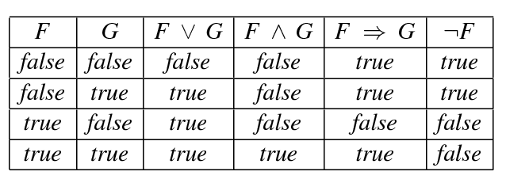
Interpretation
An interpretation M assigns values {true, false} to propositional variables.
Let F and G range over PL formulas.

Slide 13
Satisfiability & Validity
A formula is satisfiable if it has an interpretation that makes it logically true.
In this case, we say the interpretation is a model.
A formula is unsatisfiable if it does not have any model.
A formula is valid if it is logically true in any interpretation.
A propositional formula is valid if and only if its negation is unsatisfiable.

Slide 14
Satisfiability & Validity: examples
p ∨ q ⇒ q ∨ p
p ∨ q ⇒ q
p ∧ ¬q ∧ (¬p ∨ q)

Slide 15
Satisfiability & Validity: examples
p ∨ q ⇒ q ∨ p VALID
p ∨ q ⇒ q SATISFIABLE
p ∧ ¬q ∧ (¬p ∨ q) UNSATISFIABLE

Slide 16
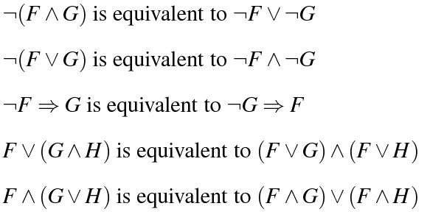
Equivalence
We say two formulas F and G are equivalent if and only if they evaluate to the same value (true or false) in every interpretation

Slide 17
Equisatisfiable
We say formulas A and B are equisatisfiable if and only if A is satisfiable if and only if B is.
During this tutorial, we will describe transformations that preserve equivalence and equisatisfiability.

Slide 18
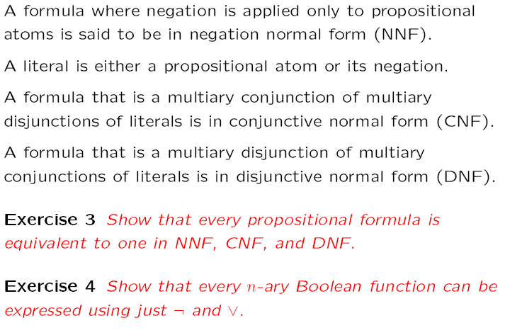
Normal Forms

Slide 19
Normal Forms
NNF?
(p ∨ ¬q) ∧ (q ∨ ¬(r ∧ ¬p))

Slide 20
Normal Forms
NNF? NO
(p ∨ ¬q) ∧ (q ∨ ¬(r ∧ ¬p))

Slide 21
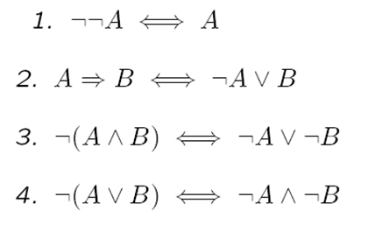
Normal Forms
NNF? NO
(p ∨ ¬q) ∧ (q ∨ ¬(r ∧ ¬p))

Slide 22
Normal Forms
NNF? NO
(p ∨ ¬q) ∧ (q ∨ ¬(r ∧ ¬p))
⇔
(p ∨ ¬q) ∧ (q ∨ (¬r ∨ ¬¬p))

Slide 23
Normal Forms
NNF? NO
(p ∨ ¬q) ∧ (q ∨ ¬(r ∧ ¬p))
⇔
(p ∨ ¬q) ∧ (q ∨ (¬r ∨ ¬¬p))
⇔
(p ∨ ¬q) ∧ (q ∨ (¬r ∨ p))

Slide 24
Normal Forms
CNF?
((p ∧ s) ∨ (¬q ∧ r)) ∧ (q ∨ ¬p ∨ s) ∧ (¬r ∨ s)

Slide 25
Normal Forms
CNF? NO
((p ∧ s) ∨ (¬q ∧ r)) ∧ (q ∨ ¬p ∨ s) ∧ (¬r ∨ s)

Slide 26
Normal Forms
CNF? NO
((p ∧ s) ∨ (¬q ∧ r)) ∧ (q ∨ ¬p ∨ s) ∧ (¬r ∨ s)
Distributivity
1. A∨(B∧C) ⇔ (A∨B)∧(A∨C)
2. A∧(B∨C) ⇔ (A∧B)∨(A∧C)

Slide 27
Normal Forms
CNF? NO
((p ∧ s) ∨ (¬q ∧ r)) ∧ (q ∨ ¬p ∨ s) ∧ (¬r ∨ s)
⇔
((p ∧ s) ∨ ¬q)) ∧ ((p ∧ s) ∨ r)) ∧ (q ∨ ¬p ∨ s) ∧ (¬r ∨ s)
Distributivity
1. A∨(B∧C) ⇔ (A∨B)∧(A∨C)
2. A∧(B∨C) ⇔ (A∧B)∨(A∧C)

Slide 28
Normal Forms
CNF? NO
((p ∧ s) ∨ (¬q ∧ r)) ∧ (q ∨ ¬p ∨ s) ∧ (¬r ∨ s)
⇔
((p ∧ s) ∨ ¬q)) ∧ ((p ∧ s) ∨ r)) ∧ (q ∨ ¬p ∨ s) ∧ (¬r ∨ s)
⇔
(p ∨ ¬q) ∧ (s ∨ ¬q) ∧ ((p ∧ s) ∨ r)) ∧ (q ∨ ¬p ∨ s) ∧ (¬r ∨ s)
Distributivity
1. A∨(B∧C) ⇔ (A∨B)∧(A∨C)
2. A∧(B∨C) ⇔ (A∧B)∨(A∧C)

Slide 29
Normal Forms
CNF? NO
((p ∧ s) ∨ (¬q ∧ r)) ∧ (q ∨ ¬p ∨ s) ∧ (¬r ∨ s)
⇔
((p ∧ s) ∨ ¬q)) ∧ ((p ∧ s) ∨ r)) ∧ (q ∨ ¬p ∨ s) ∧ (¬r ∨ s)
⇔
(p ∨ ¬q) ∧ (s ∨ ¬q) ∧ ((p ∧ s) ∨ r)) ∧ (q ∨ ¬p ∨ s) ∧ (¬r ∨ s)
⇔
(p ∨ ¬q) ∧ (s ∨ ¬q) ∧ (p ∨ r) ∧ (s ∨ r) ∧ (q ∨ ¬p ∨ s) ∧ (¬r ∨ s)

Slide 30
Normal Forms
DNF?
p ∧ (¬p ∨ q) ∧ (¬q ∨ r)

Slide 31
Normal Forms
DNF? NO, actually this formula is in CNF
p ∧ (¬p ∨ q) ∧ (¬q ∨ r)

Slide 32
Normal Forms
DNF? NO, actually this formula is in CNF
p ∧ (¬p ∨ q) ∧ (¬q ∨ r)
Distributivity
1. A∨(B∧C) ⇔ (A∨B)∧(A∨C)
2. A∧(B∨C) ⇔ (A∧B)∨(A∧C)

Slide 33
Normal Forms
DNF? NO, actually this formula is in CNF
p ∧ (¬p ∨ q) ∧ (¬q ∨ r)
⇔
((p ∧ ¬p) ∨ (p ∨ q)) ∧ (¬q ∨ r)
Distributivity
1. A∨(B∧C) ⇔ (A∨B)∧(A∨C)
2. A∧(B∨C) ⇔ (A∧B)∨(A∧C)

Slide 34
Normal Forms
DNF? NO, actually this formula is in CNF
p ∧ (¬p ∨ q) ∧ (¬q ∨ r)
⇔
((p ∧ ¬p) ∨ (p ∨ q)) ∧ (¬q ∨ r)
⇔
(p ∨ q) ∧ (¬q ∨ r)
Distributivity
1. A∨(B∧C) ⇔ (A∨B)∧(A∨C)
2. A∧(B∨C) ⇔ (A∧B)∨(A∧C)
Other Rules
A∧¬A ⇔ ⊥
A∨⊥ ⇔ A

Slide 35
Normal Forms
DNF? NO, actually this formula is in CNF
p ∧ (¬p ∨ q) ∧ (¬q ∨ r)
⇔
((p ∧ ¬p) ∨ (p ∨ q)) ∧ (¬q ∨ r)
⇔
(p ∨ q) ∧ (¬q ∨ r)
⇔
((p ∨ q) ∧ ¬q) ∨ ((p ∨ q) ∧ r)
Distributivity
1. A∨(B∧C) ⇔ (A∨B)∧(A∨C)
2. A∧(B∨C) ⇔ (A∧B)∨(A∧C)
Other Rules
A∧¬A ⇔ ⊥
A∨⊥ ⇔ A

Slide 36
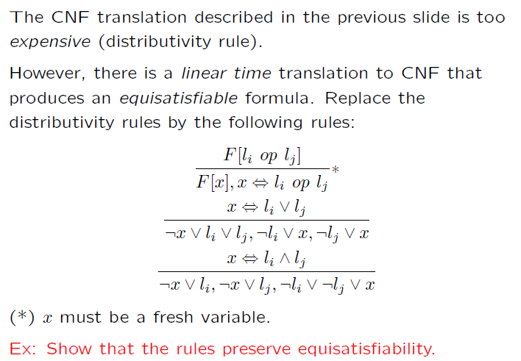
Efficient CNF Translation

Slide 37
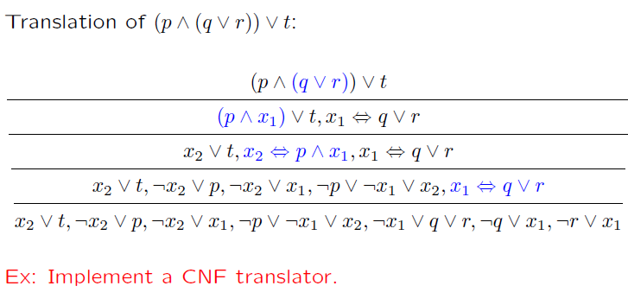
CNF translation (example)

Slide 38
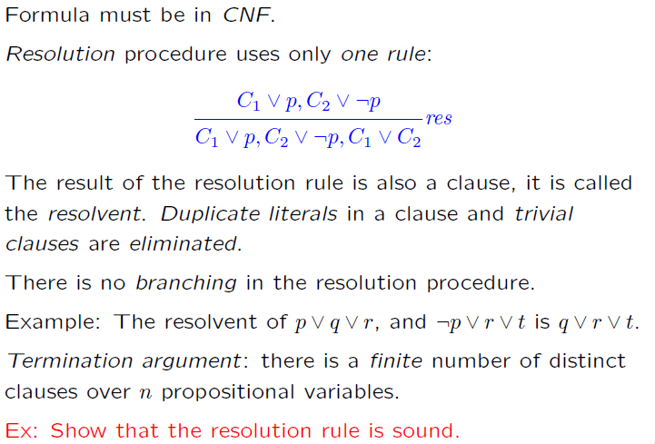
Resolution

Slide 39
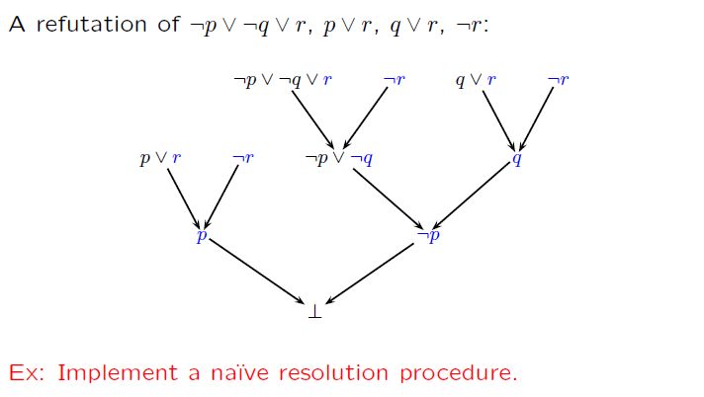
Resolution (example)

Slide 40
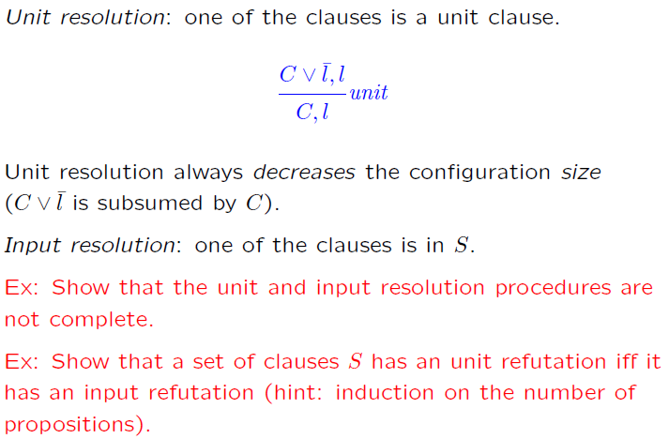
Unit & Input Resolution

Slide 41
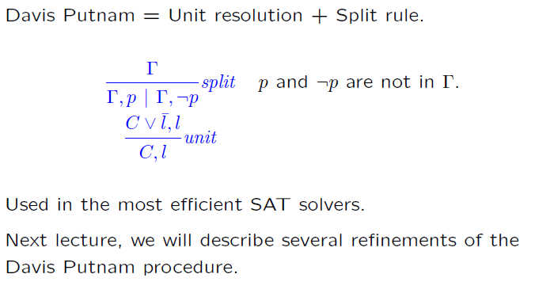
DPLL
DPLL

Slide 42
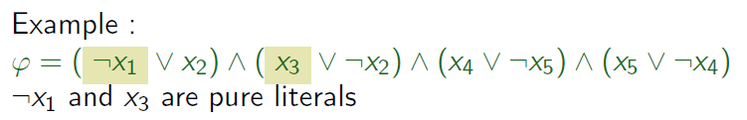
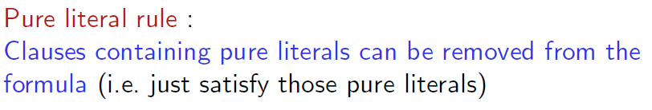

Pure Literals
A literal is pure if only occurs positively or negatively.

Slide 43
Pure Literals
A literal is pure if only occurs positively or negatively.

Slide 44
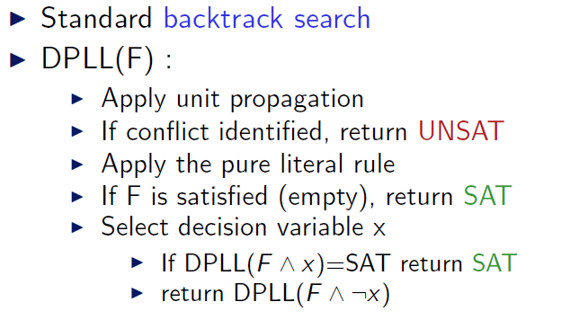
DPLL (as a procedure)

Slide 45
Satisfiability Modulo Theories (SMT)
Is formula F satisfiable modulo theory T ?
SMT solvers have specialized algorithms for T

Slide 46
Satisfiability Modulo Theories (SMT)
b + 2 = c and f(read(write(a,b,3), c-2) ≠ f(c-b+1)

Slide 47
Satisfiability Modulo Theories (SMT)
b + 2 = c and f(read(write(a,b,3), c-2) ≠ f(c-b+1)
Arithmetic

Slide 48
Satisfiability Modulo Theories (SMT)
b + 2 = c and f(read(write(a,b,3), c-2) ≠ f(c-b+1)
Array Theory
Arithmetic

Slide 49
Satisfiability Modulo Theories (SMT)
b + 2 = c and f(read(write(a,b,3), c-2) ≠ f(c-b+1)
Uninterpreted Functions
Array Theory
Arithmetic

Slide 50
Satisfiability Modulo Theories (SMT)
b + 2 = c and f(read(write(a,b,3), c-2)) ≠ f(c-b+1)
Substituting c by b+2

Slide 51
Satisfiability Modulo Theories (SMT)
b + 2 = c and f(read(write(a,b,3), b+2-2)) ≠ f(b+2-b+1)
Simplifying

Slide 52
Satisfiability Modulo Theories (SMT)
b + 2 = c and f(read(write(a,b,3), b)) ≠ f(3)

Slide 53
Satisfiability Modulo Theories (SMT)
b + 2 = c and f(read(write(a,b,3), b)) ≠ f(3)
Applying array theory axiom
forall a,i,v: read(write(a,i,v), i) = v

Slide 54
Satisfiability Modulo Theories (SMT)
b + 2 = c and f(3) ≠ f(3)
Inconsistent/Unsatisfiable

Slide 55
Ground formulas
For most SMT solvers: F is a set of ground formulas
Many Applications
Bounded Model Checking
Test-Case Generation

Slide 56
Little Engines of Proof
An SMT Solver is a collection of
Little Engines of Proof

Slide 57
Little Engines of Proof
An SMT Solver is a collection of
Little Engines of Proof
Examples:
SAT Solver
Equality solver

Slide 58

SMT@Microsoft: Solver
Z3 is a new solver developed at Microsoft Research.
Development/Research driven by internal customers.
Free for academic research.
Interfaces:
http://research.microsoft.com/projects/z3
Z3
Text
C/C++
.NET
OCaml

Slide 59
Deciding Equality
a = b, b = c, d = e, b = s, d = t, a≠ e, a≠ s
a
b
c
d
e
s
t

Slide 60
Deciding Equality
a = b, b = c, d = e, b = s, d = t, a≠ e, a≠ s
a
b
c
d
e
s
t

Slide 61
Deciding Equality
a = b, b = c, d = e, b = s, d = t, a≠ e, a≠ s
a,b
c
d
e
s
t

Slide 62
Deciding Equality
a = b, b = c, d = e, b = s, d = t, a≠ e, a≠ s
a,b
c
d
e
s
t

Slide 63
Deciding Equality
a = b, b = c, d = e, b = s, d = t, a≠ e, a≠ s
a,b,c
d
e
s
t

Slide 64
Deciding Equality
a = b, b = c, d = e, b = s, d = t, a≠ e, a≠ s
a,b,c
d
e
s
t

Slide 65
Deciding Equality
a = b, b = c, d = e, b = s, d = t, a≠ e, a≠ s
a,b,c
d,e
s
t

Slide 66
Deciding Equality
a = b, b = c, d = e, b = s, d = t, a≠ e, a≠ s
a,b,c
d,e
s
t

Slide 67
Deciding Equality
a = b, b = c, d = e, b = s, d = t, a≠ e, a≠ s
a,b,c,s
d,e
t

Slide 68
Deciding Equality
a = b, b = c, d = e, b = s, d = t, a≠ e, a≠ s
a,b,c,s
d,e
t

Slide 69
Deciding Equality
a = b, b = c, d = e, b = s, d = t, a≠ e, a≠ s
a,b,c,s
d,e,t

Slide 70
Deciding Equality
a = b, b = c, d = e, b = s, d = t, a≠ e, a≠ s
a,b,c,s
d,e,t

Slide 71
Deciding Equality
a = b, b = c, d = e, b = s, d = t, a≠ e, a≠ s
a,b,c,s
d,e,t
Unsatisfiable

Slide 72
Deciding Equality
a = b, b = c, d = e, b = s, d = t, a≠ e
a,b,c,s
d,e,t
Model construction

Slide 73
Deciding Equality
a = b, b = c, d = e, b = s, d = t, a≠ e
a,b,c,s
♦₁
♦₂
d,e,t
Model construction
|M| = {♦₁ ,♦₂} (universe, aka domain)

Slide 74
Deciding Equality
a = b, b = c, d = e, b = s, d = t, a≠ e
a,b,c,s
♦₁
♦₂
d,e,t
Model construction
|M| = {♦₁ ,♦₂} (universe, aka domain)
M(a) = ♦₁ (assignment)

Slide 75
Deciding Equality
a = b, b = c, d = e, b = s, d = t, a≠ e
a,b,c,s
♦₁
♦₂
d,e,t
Alternative notation:
a^{M} = ♦₁
Model construction
|M| = {♦₁ ,♦₂} (universe, aka domain)
M(a) = ♦₁ (assignment)

Slide 76
Deciding Equality
a = b, b = c, d = e, b = s, d = t, a≠ e
a,b,c,s
♦₁
♦₂
d,e,t
Model construction
|M| = {♦₁ ,♦₂} (universe, aka domain)
M(a) = M(b) = M(c) = M(s) = ♦₁
M(d) = M(e) = M(t) = ♦₂

Slide 77
Deciding Equality: Termination, Soundness, Completeness
Termination: easy
Soundness
Invariant: all constants in a “ball” are known to be equal.
The “ball” merge operation is justified by:
Transitivity and Symmetry rules.
Completeness
We can build a model if an inconsistency was not detected.
Proof template (by contradiction):
Build a candidate model.
Assume a literal was not satisfied.
Find contradiction.

Slide 78
Deciding Equality: Termination, Soundness, Completeness
Completeness
We can build a model if an inconsistency was not detected.
Instantiating the template for our procedure:
Assume some literal c = d is not satisfied by our model.
That is, M(c) ≠ M(d).
This is impossible, c and d must be in the same “ball”.
c,d,…
♦_{i}
M(c) = M(d) = ♦_{i}

Slide 79
Deciding Equality: Termination, Soundness, Completeness
Completeness
We can build a model if an inconsistency was not detected.
Instantiating the template for our procedure:
Assume some literal c ≠ d is not satisfied by our model.
That is, M(c) = M(d).
Key property: we only check the disequalities after we processed all equalities.
This is impossible, c and d must be in the different “balls”
c,…
d,…
♦_{i}
♦_{j}
M(c) = ♦_{i}
M(d) = ♦_{j}

Slide 80
Deciding Equality + (uninterpreted) Functions
a = b, b = c, d = e, b = s, d = t, f(a, g(d)) ≠ f(b, g(e))
Congruence Rule:
x₁ = y₁, …, x_{n} = y_{n} implies f(x₁, …, x_{n}) = f(y₁, …, y_{n})

Slide 81
Deciding Equality + (uninterpreted) Functions
a = b, b = c, d = e, b = s, d = t, f(a, g(d)) ≠ f(b, g(e))
First Step: “Naming” subterms
Congruence Rule:
x₁ = y₁, …, x_{n} = y_{n} implies f(x₁, …, x_{n}) = f(y₁, …, y_{n})

Slide 82
Deciding Equality + (uninterpreted) Functions
a = b, b = c, d = e, b = s, d = t, f(a, v₁) ≠ f(b, g(e))
v₁ ≡ g(d)
First Step: “Naming” subterms
Congruence Rule:
x₁ = y₁, …, x_{n} = y_{n} implies f(x₁, …, x_{n}) = f(y₁, …, y_{n})

Slide 83
Deciding Equality + (uninterpreted) Functions
a = b, b = c, d = e, b = s, d = t, f(a, v₁) ≠ f(b, g(e))
v₁ ≡ g(d)
First Step: “Naming” subterms
Congruence Rule:
x₁ = y₁, …, x_{n} = y_{n} implies f(x₁, …, x_{n}) = f(y₁, …, y_{n})

Slide 84
Deciding Equality + (uninterpreted) Functions
a = b, b = c, d = e, b = s, d = t, f(a, v₁) ≠ f(b, v₂)
v₁ ≡ g(d), v₂ ≡ g(e)
First Step: “Naming” subterms
Congruence Rule:
x₁ = y₁, …, x_{n} = y_{n} implies f(x₁, …, x_{n}) = f(y₁, …, y_{n})

Slide 85
Deciding Equality + (uninterpreted) Functions
a = b, b = c, d = e, b = s, d = t, f(a, v₁) ≠ f(b, v₂)
v₁ ≡ g(d), v₂ ≡ g(e)
First Step: “Naming” subterms
Congruence Rule:
x₁ = y₁, …, x_{n} = y_{n} implies f(x₁, …, x_{n}) = f(y₁, …, y_{n})

Slide 86
Deciding Equality + (uninterpreted) Functions
a = b, b = c, d = e, b = s, d = t, v₃ ≠ f(b, v₂)
v₁ ≡ g(d), v₂ ≡ g(e), v₃ ≡ f(a, v₁)
First Step: “Naming” subterms
Congruence Rule:
x₁ = y₁, …, x_{n} = y_{n} implies f(x₁, …, x_{n}) = f(y₁, …, y_{n})

Slide 87
Deciding Equality + (uninterpreted) Functions
a = b, b = c, d = e, b = s, d = t, v₃ ≠ f(b, v₂)
v₁ ≡ g(d), v₂ ≡ g(e), v₃ ≡ f(a, v₁)
First Step: “Naming” subterms
Congruence Rule:
x₁ = y₁, …, x_{n} = y_{n} implies f(x₁, …, x_{n}) = f(y₁, …, y_{n})

Slide 88
Deciding Equality + (uninterpreted) Functions
a = b, b = c, d = e, b = s, d = t, v₃ ≠ v₄
v₁ ≡ g(d), v₂ ≡ g(e), v₃ ≡ f(a, v₁) , v₄ ≡ f(b, v₂)
First Step: “Naming” subterms
Congruence Rule:
x₁ = y₁, …, x_{n} = y_{n} implies f(x₁, …, x_{n}) = f(y₁, …, y_{n})

Slide 89
Deciding Equality + (uninterpreted) Functions
a = b, b = c, d = e, b = s, d = t, v₃ ≠ v₄
v₁ ≡ g(d), v₂ ≡ g(e), v₃ ≡ f(a, v₁) , v₄ ≡ f(b, v₂)
a,b,c,s
d,e,t
v₁
v₂
v₃
v₄
Congruence Rule:
x₁ = y₁, …, x_{n} = y_{n} implies f(x₁, …, x_{n}) = f(y₁, …, y_{n})

Slide 90
Deciding Equality + (uninterpreted) Functions
a = b, b = c, d = e, b = s, d = t, v₃ ≠ v₄
v₁ ≡ g(d), v₂ ≡ g(e), v₃ ≡ f(a, v₁) , v₄ ≡ f(b, v₂)
a,b,c,s
d,e,t
v₁
v₂
v₃
v₄
Congruence Rule:
x₁ = y₁, …, x_{n} = y_{n} implies f(x₁, …, x_{n}) = f(y₁, …, y_{n})
d = e implies g(d) = g(e)

Slide 91
Deciding Equality + (uninterpreted) Functions
a = b, b = c, d = e, b = s, d = t, v₃ ≠ v₄
v₁ ≡ g(d), v₂ ≡ g(e), v₃ ≡ f(a, v₁) , v₄ ≡ f(b, v₂)
a,b,c,s
d,e,t
v₁
v₂
v₃
v₄
Congruence Rule:
x₁ = y₁, …, x_{n} = y_{n} implies f(x₁, …, x_{n}) = f(y₁, …, y_{n})
d = e implies v₁ = v₂

Slide 92
Deciding Equality + (uninterpreted) Functions
We say:
v₁ and v₂ are congruent.
a = b, b = c, d = e, b = s, d = t, v₃ ≠ v₄
v₁ ≡ g(d), v₂ ≡ g(e), v₃ ≡ f(a, v₁) , v₄ ≡ f(b, v₂)
a,b,c,s
v₁,v₂
d,e,t
v₃
v₄
Congruence Rule:
x₁ = y₁, …, x_{n} = y_{n} implies f(x₁, …, x_{n}) = f(y₁, …, y_{n})
d = e implies v₁ = v₂

Slide 93
Deciding Equality + (uninterpreted) Functions
a = b, b = c, d = e, b = s, d = t, v₃ ≠ v₄
v₁ ≡ g(d), v₂ ≡ g(e), v₃ ≡ f(a, v₁) , v₄ ≡ f(b, v₂)
a,b,c,s
v₁,v₂
d,e,t
v₃
v₄
Congruence Rule:
x₁ = y₁, …, x_{n} = y_{n} implies f(x₁, …, x_{n}) = f(y₁, …, y_{n})
a = b, v₁ = v₂ implies f(a, v₁) = f(b, v₂)

Slide 94
Deciding Equality + (uninterpreted) Functions
a = b, b = c, d = e, b = s, d = t, v₃ ≠ v₄
v₁ ≡ g(d), v₂ ≡ g(e), v₃ ≡ f(a, v₁) , v₄ ≡ f(b, v₂)
a,b,c,s
v₁,v₂
d,e,t
v₃
v₄
Congruence Rule:
x₁ = y₁, …, x_{n} = y_{n} implies f(x₁, …, x_{n}) = f(y₁, …, y_{n})
a = b, v₁ = v₂ implies v₃ = v₄

Slide 95
Deciding Equality + (uninterpreted) Functions
a = b, b = c, d = e, b = s, d = t, v₃ ≠ v₄
v₁ ≡ g(d), v₂ ≡ g(e), v₃ ≡ f(a, v₁) , v₄ ≡ f(b, v₂)
a,b,c,s
v₁,v₂
d,e,t
v_{3,}v₄
Congruence Rule:
x₁ = y₁, …, x_{n} = y_{n} implies f(x₁, …, x_{n}) = f(y₁, …, y_{n})
a = b, v₁ = v₂ implies v₃ = v₄

Slide 96
Deciding Equality + (uninterpreted) Functions
a = b, b = c, d = e, b = s, d = t, v₃ ≠ v₄
v₁ ≡ g(d), v₂ ≡ g(e), v₃ ≡ f(a, v₁) , v₄ ≡ f(b, v₂)
a,b,c,s
v₁,v₂
d,e,t
v_{3,}v₄
Unsatisfiable
Congruence Rule:
x₁ = y₁, …, x_{n} = y_{n} implies f(x₁, …, x_{n}) = f(y₁, …, y_{n})

Slide 97
Deciding Equality + (uninterpreted) Functions
a = b, b = c, d = e, b = s, d = t, a ≠ v₄, v₂ ≠ v₃
v₁ ≡ g(d), v₂ ≡ g(e), v₃ ≡ f(a, v₁) , v₄ ≡ f(b, v₂)
Changing the problem
a,b,c,s
v₁,v₂
d,e,t
v_{3,}v₄
Congruence Rule:
x₁ = y₁, …, x_{n} = y_{n} implies f(x₁, …, x_{n}) = f(y₁, …, y_{n})

Slide 98
Deciding Equality + (uninterpreted) Functions
a = b, b = c, d = e, b = s, d = t, a ≠ v₄, v₂ ≠ v₃
v₁ ≡ g(d), v₂ ≡ g(e), v₃ ≡ f(a, v₁) , v₄ ≡ f(b, v₂)
a,b,c,s
v₁,v₂
d,e,t
v_{3,}v₄
Congruence Rule:
x₁ = y₁, …, x_{n} = y_{n} implies f(x₁, …, x_{n}) = f(y₁, …, y_{n})

Slide 99
Deciding Equality + (uninterpreted) Functions
a = b, b = c, d = e, b = s, d = t, a ≠ v₄, v₂ ≠ v₃
v₁ ≡ g(d), v₂ ≡ g(e), v₃ ≡ f(a, v₁) , v₄ ≡ f(b, v₂)
a,b,c,s
v₁,v₂
d,e,t
v_{3,}v₄
Congruence Rule:
x₁ = y₁, …, x_{n} = y_{n} implies f(x₁, …, x_{n}) = f(y₁, …, y_{n})

Slide 100
Deciding Equality + (uninterpreted) Functions
a = b, b = c, d = e, b = s, d = t, a ≠ v₄, v₂ ≠ v₃
v₁ ≡ g(d), v₂ ≡ g(e), v₃ ≡ f(a, v₁) , v₄ ≡ f(b, v₂)
a,b,c,s
v₁,v₂
♦₁
♦₂
♦₃
♦₄
d,e,t
v_{3,}v₄
Model construction:
|M| = {♦₁ ,♦₂ ,♦₃ ,♦₄}
M(a) = M(b) = M(c) = M(s) = ♦₁
M(d) = M(e) = M(t) = ♦₂
M(v₁) = M(v₂) = ♦₃
M(v₃) = M(v₄) = ♦₄

Slide 101
Deciding Equality + (uninterpreted) Functions
a = b, b = c, d = e, b = s, d = t, a ≠ v₄, v₂ ≠ v₃
v₁ ≡ g(d), v₂ ≡ g(e), v₃ ≡ f(a, v₁) , v₄ ≡ f(b, v₂)
a,b,c,s
v₁,v₂
♦₁
♦₂
♦₃
♦₄
d,e,t
v_{3,}v₄
Model construction:
|M| = {♦₁ ,♦₂ ,♦₃ ,♦₄}
M(a) = M(b) = M(c) = M(s) = ♦₁
M(d) = M(e) = M(t) = ♦₂
M(v₁) = M(v₂) = ♦₃
M(v₃) = M(v₄) = ♦₄
Missing:
Interpretation for f and g.

Slide 102
Deciding Equality + (uninterpreted) Functions
Building the interpretation for function symbols
M(g) is a mapping from |M| to |M|
Defined as:
M(g)(♦_{i}) = ♦_{j} if there is v ≡ g(a) s.t.
M(a) = ♦_{i}
M(v) = ♦_{j}
= ♦_{k}, otherwise (♦_{k} is an arbitrary element)
Is M(g) well-defined?

Slide 103
Deciding Equality + (uninterpreted) Functions
Building the interpretation for function symbols
M(g) is a mapping from |M| to |M|
Defined as:
M(g)(♦_{i}) = ♦_{j} if there is v ≡ g(a) s.t.
M(a) = ♦_{i}
M(v) = ♦_{j}
= ♦_{k}, otherwise (♦_{k} is an arbitrary element)
Is M(g) well-defined?
Problem: we may have
v ≡ g(a) and w ≡ g(b) s.t.
M(a) = M(b) = ♦₁ and M(v) = ♦₂ ≠ ♦₃ = M(w)
So, is M(g)(♦₁) = ♦₂ or M(g)(♦₁) = ♦₃?

Slide 104
Deciding Equality + (uninterpreted) Functions
Building the interpretation for function symbols
M(g) is a mapping from |M| to |M|
Defined as:
M(g)(♦_{i}) = ♦_{j} if there is v ≡ g(a) s.t.
M(a) = ♦_{i}
M(v) = ♦_{j}
= ♦_{k}, otherwise (♦_{k} is an arbitrary element)
Is M(g) well-defined?
Problem: we may have
v ≡ g(a) and w ≡ g(b) s.t.
M(a) = M(b) = ♦₁ and M(v) = ♦₂ ≠ ♦₃ = M(w)
So, is M(g)(♦₁) = ♦₂ or M(g)(♦₁) = ♦₃?
This is impossible because of the congruence rule!
a and b are in the same “ball”, then so are v and w

Slide 105
Deciding Equality + (uninterpreted) Functions
a = b, b = c, d = e, b = s, d = t, a ≠ v₄, v₂ ≠ v₃
v₁ ≡ g(d), v₂ ≡ g(e), v₃ ≡ f(a, v₁) , v₄ ≡ f(b, v₂)
a,b,c,s
v₁,v₂
♦₁
♦₂
♦₃
♦₄
d,e,t
v_{3,}v₄
Model construction:
|M| = {♦₁ ,♦₂ ,♦₃ ,♦₄}
M(a) = M(b) = M(c) = M(s) = ♦₁
M(d) = M(e) = M(t) = ♦₂
M(v₁) = M(v₂) = ♦₃
M(v₃) = M(v₄) = ♦₄

Slide 106
Deciding Equality + (uninterpreted) Functions
a = b, b = c, d = e, b = s, d = t, a ≠ v₄, v₂ ≠ v₃
v₁ ≡ g(d), v₂ ≡ g(e), v₃ ≡ f(a, v₁) , v₄ ≡ f(b, v₂)
Model construction:
|M| = {♦₁ ,♦₂ ,♦₃ ,♦₄}
M(a) = M(b) = M(c) = M(s) = ♦₁
M(d) = M(e) = M(t) = ♦₂
M(v₁) = M(v₂) = ♦₃
M(v₃) = M(v₄) = ♦₄
M(g)(♦_{i}) = ♦_{j} if there is v ≡ g(a) s.t.
M(a) = ♦_{i}
M(v) = ♦_{j}
= ♦_{k}, otherwise

Slide 107
Deciding Equality + (uninterpreted) Functions
a = b, b = c, d = e, b = s, d = t, a ≠ v₄, v₂ ≠ v₃
v₁ ≡ g(d), v₂ ≡ g(e), v₃ ≡ f(a, v₁) , v₄ ≡ f(b, v₂)
Model construction:
|M| = {♦₁ ,♦₂ ,♦₃ ,♦₄}
M(a) = M(b) = M(c) = M(s) = ♦₁
M(d) = M(e) = M(t) = ♦₂
M(v₁) = M(v₂) = ♦₃
M(v₃) = M(v₄) = ♦₄
M(g) = {♦₂ →♦₃}
M(g)(♦_{i}) = ♦_{j} if there is v ≡ g(a) s.t.
M(a) = ♦_{i}
M(v) = ♦_{j}
= ♦_{k}, otherwise

Slide 108
Deciding Equality + (uninterpreted) Functions
a = b, b = c, d = e, b = s, d = t, a ≠ v₄, v₂ ≠ v₃
v₁ ≡ g(d), v₂ ≡ g(e), v₃ ≡ f(a, v₁) , v₄ ≡ f(b, v₂)
Model construction:
|M| = {♦₁ ,♦₂ ,♦₃ ,♦₄}
M(a) = M(b) = M(c) = M(s) = ♦₁
M(d) = M(e) = M(t) = ♦₂
M(v₁) = M(v₂) = ♦₃
M(v₃) = M(v₄) = ♦₄
M(g) = {♦₂ →♦₃}
M(g)(♦_{i}) = ♦_{j} if there is v ≡ g(a) s.t.
M(a) = ♦_{i}
M(v) = ♦_{j}
= ♦_{k}, otherwise

Slide 109
Deciding Equality + (uninterpreted) Functions
a = b, b = c, d = e, b = s, d = t, a ≠ v₄, v₂ ≠ v₃
v₁ ≡ g(d), v₂ ≡ g(e), v₃ ≡ f(a, v₁) , v₄ ≡ f(b, v₂)
Model construction:
|M| = {♦₁ ,♦₂ ,♦₃ ,♦₄}
M(a) = M(b) = M(c) = M(s) = ♦₁
M(d) = M(e) = M(t) = ♦₂
M(v₁) = M(v₂) = ♦₃
M(v₃) = M(v₄) = ♦₄
M(g) = {♦₂ →♦₃, else →♦₁}
M(g)(♦_{i}) = ♦_{j} if there is v ≡ g(a) s.t.
M(a) = ♦_{i}
M(v) = ♦_{j}
= ♦_{k}, otherwise

Slide 110
Deciding Equality + (uninterpreted) Functions
a = b, b = c, d = e, b = s, d = t, a ≠ v₄, v₂ ≠ v₃
v₁ ≡ g(d), v₂ ≡ g(e), v₃ ≡ f(a, v₁) , v₄ ≡ f(b, v₂)
Model construction:
|M| = {♦₁ ,♦₂ ,♦₃ ,♦₄}
M(a) = M(b) = M(c) = M(s) = ♦₁
M(d) = M(e) = M(t) = ♦₂
M(v₁) = M(v₂) = ♦₃
M(v₃) = M(v₄) = ♦₄
M(g) = {♦₂ →♦₃, else →♦₁}
M(f) = { (♦₁ ,♦₃) →♦₄, else →♦₁}
M(g)(♦_{i}) = ♦_{j} if there is v ≡ g(a) s.t.
M(a) = ♦_{i}
M(v) = ♦_{j}
= ♦_{k}, otherwise

Slide 111
Deciding Equality + (uninterpreted) Functions
What about predicates?
p(a, b), ¬p(c, b)

Slide 112
Deciding Equality + (uninterpreted) Functions
What about predicates?
p(a, b), ¬p(c, b)
f_{p}(a, b) = T, f_{p} (c, b) ≠ T

Slide 113
Deciding Equality + (uninterpreted) Functions
It is possible to implement our procedure in
O(n log n)

Slide 114
Case Analysis
Many verification/analysis problems require: case-analysis
x ≥ 0, y = x + 1, (y > 2 ∨ y < 1)

Slide 115
Case Analysis
Many verification/analysis problems require: case-analysis
x ≥ 0, y = x + 1, (y > 2 ∨ y < 1)
Naïve Solution: Convert to DNF
(x ≥ 0, y = x + 1, y > 2) ∨ (x ≥ 0, y = x + 1, y < 1)

Slide 116
Case Analysis
Many verification/analysis problems require: case-analysis
x ≥ 0, y = x + 1, (y > 2 ∨ y < 1)
Naïve Solution: Convert to DNF
(x ≥ 0, y = x + 1, y > 2) ∨ (x ≥ 0, y = x + 1, y < 1)
Too Inefficient!
(exponential blowup)

Slide 117
SMT : Basic Architecture
SAT
Theory
Solvers
SMT
Equality + UF
Arithmetic
Bit-vectors
…
Case Analysis

Slide 118
DPLL
M | F
Partial model
Set of clauses

Slide 119
DPLL
Guessing
p | p ∨ q, ¬q ∨ r
p, ¬q | p ∨ q, ¬q ∨ r

Slide 120
DPLL
Deducing
p | p ∨ q, ¬p ∨ s
p, s| p ∨ q, ¬p ∨ s

Slide 121
DPLL
Backtracking
p, ¬s, q | p ∨ q, s ∨ q, ¬p∨ ¬q
p, s| p ∨ q, s ∨ q, ¬p∨ ¬q

Slide 122
Modern DPLL
Efficient indexing (two-watch literal)
Non-chronological backtracking (backjumping)
Lemma learning

Slide 123
SAT + Theory solvers
Basic Idea
x ≥ 0, y = x + 1, (y > 2 ∨ y < 1)
Abstract (aka “naming” atoms)
p₁, p₂, (p₃ ∨ p₄)
p₁ ≡ (x ≥ 0), p₂ ≡ (y = x + 1),
p₃ ≡ (y > 2), p₄ ≡ (y < 1)

Slide 124
SAT + Theory solvers
Basic Idea
x ≥ 0, y = x + 1, (y > 2 ∨ y < 1)
Abstract (aka “naming” atoms)
p₁, p₂, (p₃ ∨ p₄)
p₁ ≡ (x ≥ 0), p₂ ≡ (y = x + 1),
p₃ ≡ (y > 2), p₄ ≡ (y < 1)
SAT
Solver

Slide 125
SAT + Theory solvers
Basic Idea
x ≥ 0, y = x + 1, (y > 2 ∨ y < 1)
Abstract (aka “naming” atoms)
p₁, p₂, (p₃ ∨ p₄)
p₁ ≡ (x ≥ 0), p₂ ≡ (y = x + 1),
p₃ ≡ (y > 2), p₄ ≡ (y < 1)
SAT
Solver
Assignment
p₁, p₂, ¬p₃, p₄

Slide 126
SAT + Theory solvers
Basic Idea
x ≥ 0, y = x + 1, (y > 2 ∨ y < 1)
Abstract (aka “naming” atoms)
p₁, p₂, (p₃ ∨ p₄)
p₁ ≡ (x ≥ 0), p₂ ≡ (y = x + 1),
p₃ ≡ (y > 2), p₄ ≡ (y < 1)
SAT
Solver
Assignment
p₁, p₂, ¬p₃, p₄
x ≥ 0, y = x + 1,
¬(y > 2), y < 1

Slide 127
SAT + Theory solvers
Basic Idea
x ≥ 0, y = x + 1, (y > 2 ∨ y < 1)
Abstract (aka “naming” atoms)
p₁, p₂, (p₃ ∨ p₄)
p₁ ≡ (x ≥ 0), p₂ ≡ (y = x + 1),
p₃ ≡ (y > 2), p₄ ≡ (y < 1)
SAT
Solver
Assignment
p₁, p₂, ¬p₃, p₄
x ≥ 0, y = x + 1,
¬(y > 2), y < 1
Unsatisfiable
x ≥ 0, y = x + 1, y < 1
Theory
Solver

Slide 128
SAT + Theory solvers
Basic Idea
x ≥ 0, y = x + 1, (y > 2 ∨ y < 1)
Abstract (aka “naming” atoms)
p₁, p₂, (p₃ ∨ p₄)
p₁ ≡ (x ≥ 0), p₂ ≡ (y = x + 1),
p₃ ≡ (y > 2), p₄ ≡ (y < 1)
SAT
Solver
Assignment
p₁, p₂, ¬p₃, p₄
x ≥ 0, y = x + 1,
¬(y > 2), y < 1
New Lemma
¬p₁∨¬p₂∨¬p₄
Unsatisfiable
x ≥ 0, y = x + 1, y < 1
Theory
Solver

Slide 129
SAT + Theory solvers
New Lemma
¬p₁∨¬p₂∨¬p₄
Unsatisfiable
x ≥ 0, y = x + 1, y < 1
Theory
Solver
AKA
Theory conflict

Slide 130
SAT + Theory solvers: Main loop
procedure SmtSolver(F)
(F_{p}, M) := Abstract(F)
loop
(R, A) := SAT_solver(F_{p})
if R = UNSAT then return UNSAT
S := Concretize(A, M)
(R, S’) := Theory_solver(S)
if R = SAT then return SAT
L := New_Lemma(S’, M)
Add L to F_{p}

Slide 131
SAT + Theory solvers
Basic Idea
F: x ≥ 0, y = x + 1, (y > 2 ∨ y < 1)
Abstract (aka “naming” atoms)
F_{p} : p₁, p₂, (p₃ ∨ p₄)
M: p₁ ≡ (x ≥ 0), p₂ ≡ (y = x + 1),
p₃ ≡ (y > 2), p₄ ≡ (y < 1)
SAT
Solver
A: Assignment
p₁, p₂, ¬p₃, p₄
S: x ≥ 0, y = x + 1,
¬(y > 2), y < 1
L: New Lemma
¬p₁∨¬p₂∨¬p₄
S’: Unsatisfiable
x ≥ 0, y = x + 1, y < 1
Theory
Solver

Slide 132
SAT + Theory solvers
F: x ≥ 0, y = x + 1, (y > 2 ∨ y < 1)
Abstract (aka “naming” atoms)
F_{p} : p₁, p₂, (p₃ ∨ p₄)
M: p₁ ≡ (x ≥ 0), p₂ ≡ (y = x + 1),
p₃ ≡ (y > 2), p₄ ≡ (y < 1)
SAT
Solver
A: Assignment
p₁, p₂, ¬p₃, p₄
S: x ≥ 0, y = x + 1,
¬(y > 2), y < 1
L: New Lemma
¬p₁∨¬p₂∨¬p₄
S’: Unsatisfiable
x ≥ 0, y = x + 1, y < 1
Theory
Solver
procedure SMT_Solver(F)
(F_{p}, M) := Abstract(F)
loop
(R, A) := SAT_solver(F_{p})
if R = UNSAT then return UNSAT
S = Concretize(A, M)
(R, S’) := Theory_solver(S)
if R = SAT then return SAT
L := New_Lemma(S, M)
Add L to F_{p}
“Lazy translation” to
DNF

Slide 133
SAT + Theory solvers
State-of-the-art SMT solvers implement
many improvements.

Slide 134
SAT + Theory solvers
Incrementality
Send the literals to the Theory solver as they are assigned by the SAT solver
p₁ ≡ (x ≥ 0), p₂ ≡ (y = x + 1),
p₃ ≡ (y > 2), p₄ ≡ (y < 1), p₅ ≡ (x < 2),
p₁, p₂, p₄ | p₁, p₂, (p₃ ∨ p₄), (p₅ ∨ ¬p₄)
Partial assignment is already
Theory inconsistent.

Slide 135
SAT + Theory solvers
Efficient Backtracking
We don’t want to restart from scratch after each backtracking operation.

Slide 136
SAT + Theory solvers
Efficient Lemma Generation (computing a small S’)
Avoid lemmas containing redundant literals.
p₁ ≡ (x ≥ 0), p₂ ≡ (y = x + 1),
p₃ ≡ (y > 2), p₄ ≡ (y < 1), p₅ ≡ (x < 2),
p₁, p₂, p₃, p₄ | p₁, p₂, (p₃ ∨ p₄), (p₅ ∨ ¬p₄)
¬p₁∨¬p₂ ∨¬p₃ ∨¬p₄
Imprecise Lemma

Slide 137
SAT + Theory solvers
Theory Propagation
It is the SMT equivalent of unit propagation.
p₁ ≡ (x ≥ 0), p₂ ≡ (y = x + 1),
p₃ ≡ (y > 2), p₄ ≡ (y < 1), p₅ ≡ (x < 2),
p₁, p₂ | p₁, p₂, (p₃ ∨ p₄), (p₅ ∨ ¬p₄)
p₁, p₂ imply ¬p₄ by theory propagation
p₁, p₂ , ¬p₄ | p₁, p₂, (p₃ ∨ p₄), (p₅ ∨ ¬p₄)

Slide 138
SAT + Theory solvers
Theory Propagation
It is the SMT equivalent of unit propagation.
p₁ ≡ (x ≥ 0), p₂ ≡ (y = x + 1),
p₃ ≡ (y > 2), p₄ ≡ (y < 1), p₅ ≡ (x < 2),
p₁, p₂ | p₁, p₂, (p₃ ∨ p₄), (p₅ ∨ ¬p₄)
p₁, p₂ imply ¬p₄ by theory propagation
p₁, p₂ , ¬p₄ | p₁, p₂, (p₃ ∨ p₄), (p₅ ∨ ¬p₄)
Tradeoff between precision × performance.

Slide 139
An Architecture: the core
Core
Arithmetic
Bit-Vectors
Scalar Values
Equality
Uninterpreted Functions
SAT Solver

Slide 140
An Architecture: the core
Core
Arithmetic
Bit-Vectors
Scalar Values
Equality
Uninterpreted Functions
Case Analysis
SAT Solver

Slide 141
An Architecture: the core
Core
Arithmetic
Bit-Vectors
Scalar Values
Equality
Uninterpreted Functions
Blackboard:
equalities, disequalities,
predicates
SAT Solver

Slide 142
Linear Arithmetic
Many approaches
Graph-based for difference logic: a – b ≤ 3
Fourier-Motzkin elimination:
Standard Simplex
General Form Simplex

Slide 143
Difference Logic: a – b ≤ 5
Very useful in practice!
Most arithmetical constraints in software verification/analysis are in this fragment.
x := x + 1
x₁ = x₀ + 1
x₁ - x₀ ≤ 1, x₀ - x₁ ≤ -1

Slide 144
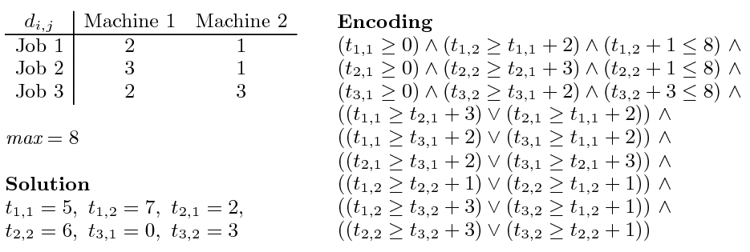
Job shop scheduling

Slide 145
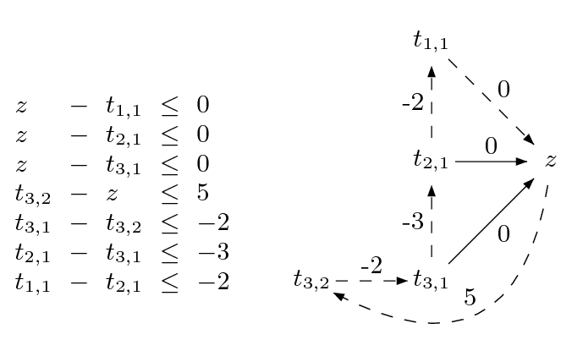
Difference Logic
Chasing negative cycles!
Algorithms based on Bellman-Ford (O(mn)).

Slide 146
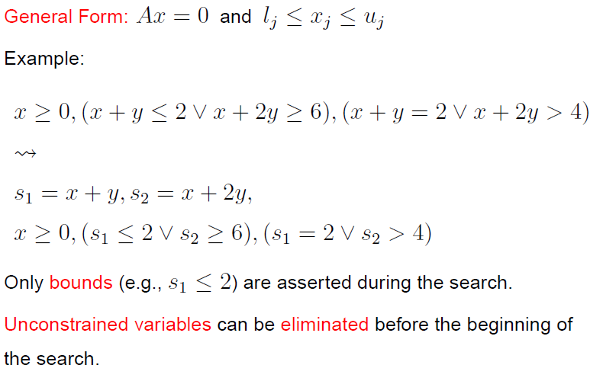
General Form

Slide 147
From Definitions to a Tableau
s₁ ≡ x + y, s₂ ≡ x + 2y

Slide 148
From Definitions to a Tableau
s₁ ≡ x + y, s₂ ≡ x + 2y
s₁ = x + y,
s₂ = x + 2y

Slide 149
From Definitions to a Tableau
s₁ ≡ x + y, s₂ ≡ x + 2y
s₁ = x + y,
s₂ = x + 2y
s₁ - x - y = 0
s₂ - x - 2y = 0

Slide 150
From Definitions to a Tableau
s₁ ≡ x + y, s₂ ≡ x + 2y
s₁ = x + y,
s₂ = x + 2y
s₁ - x - y = 0
s₂ - x - 2y = 0
s₁, s₂ are basic (dependent)
x,y are non-basic

Slide 151
Pivoting
A way to swap a basic with a non-basic variable!
It is just equational reasoning.
Key invariant: a basic variable occurs in only one equation.
Example: swap s₁ and y
s₁ - x - y = 0
s₂ - x - 2y = 0

Slide 152
Pivoting
A way to swap a basic with a non-basic variable!
It is just equational reasoning.
Key invariant: a basic variable occurs in only one equation.
Example: swap s₁ and y
s₁ - x - y = 0
s₂ - x - 2y = 0
-s₁ + x + y = 0
s₂ - x - 2y = 0

Slide 153
Pivoting
A way to swap a basic with a non-basic variable!
It is just equational reasoning.
Key invariant: a basic variable occurs in only one equation.
Example: swap s₁ and y
s₁ - x - y = 0
s₂ - x - 2y = 0
-s₁ + x + y = 0
s₂ - x - 2y = 0
-s₁ + x + y = 0
s₂ - 2s₁ + x = 0

Slide 154
Pivoting
A way to swap a basic with a non-basic variable!
It is just equational reasoning.
Key invariant: a basic variable occurs in only one equation.
Example: swap s₁ and y
It is just substituting equals by equals.
s₁ - x - y = 0
s₂ - x - 2y = 0
-s₁ + x + y = 0
s₂ - x - 2y = 0
-s₁ + x + y = 0
s₂ - 2s₁ + x = 0

Slide 155
Pivoting
Definition:
An assignment (model) is a mapping from variables to values
A way to swap a basic with a non-basic variable!
It is just equational reasoning.
Key invariant: a basic variable occurs in only one equation.
Example: swap s₁ and y
It is just substituting equals by equals.
s₁ - x - y = 0
s₂ - x - 2y = 0
-s₁ + x + y = 0
s₂ - x - 2y = 0
Key Property:
If an assignment satisfies the equations before a pivoting step, then it will also satisfy them after!
-s₁ + x + y = 0
s₂ - 2s₁ + x = 0

Slide 156
Pivoting
Definition:
An assignment (model) is a mapping from variables to values
A way to swap a basic with a non-basic variable!
It is just equational reasoning.
Key invariant: a basic variable occurs in only one equation.
Example: swap s₂ and y
It is just substituting equals by equals.
s₁ - x - y = 0
s₂ - x - 2y = 0
Example:
M(x) = 1
M(y) = 1
M(s₁) = 2
M(s₂) = 3
-s₁ + x + y = 0
s₂ - x - 2y = 0
Key Property:
If an assignment satisfies the equations before a pivoting step, then it will also satisfy them after!
-s₁ + x + y = 0
s₂ - 2s₁ + x = 0

Slide 157
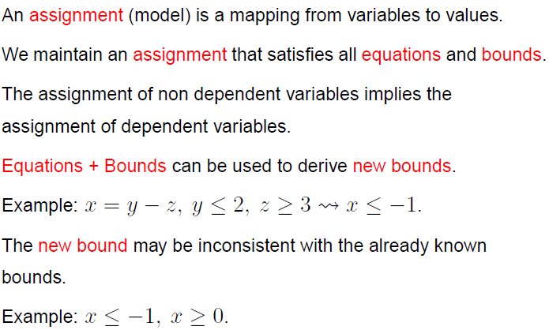
Equations + Bounds + Assignment

Slide 158
“Repairing Models”
If the assignment of a non-basic variable does not satisfy a bound, then fix it and propagate the change to all dependent variables.
a = c – d
b = c + d
M(a) = 0
M(b) = 0
M(c) = 0
M(d) = 0
1 ≤ c
a = c – d
b = c + d
M(a) = 1
M(b) = 1
M(c) = 1
M(d) = 0
1 ≤ c

Slide 159
“Repairing Models”
If the assignment of a non-basic variable does not satisfy a bound, then fix it and propagate the change to all dependent variables. Of course, we may introduce new “problems”.
a = c – d
b = c + d
M(a) = 0
M(b) = 0
M(c) = 0
M(d) = 0
1 ≤ c
a ≤ 0
a = c – d
b = c + d
M(a) = 1
M(b) = 1
M(c) = 1
M(d) = 0
1 ≤ c
a ≤ 0

Slide 160
“Repairing Models”
If the assignment of a basic variable does not satisfy a bound, then pivot it, fix it, and propagate the change to its new dependent variables.
a = c – d
b = c + d
M(a) = 0
M(b) = 0
M(c) = 0
M(d) = 0
1 ≤ a
c = a + d
b = a + 2d
M(a) = 0
M(b) = 0
M(c) = 0
M(d) = 0
1 ≤ a
c = a + d
b = a + 2d
M(a) = 1
M(b) = 1
M(c) = 1
M(d) = 0
1 ≤ a

Slide 161
“Repairing Models”
Sometimes, a model cannot be repaired. It is pointless to pivot.
a = b – c
a ≤ 0, 1 ≤ b, c ≤ 0
M(a) = 1
M(b) = 1
M(c) = 0
The value of M(a) is too big. We can reduce it by:
reducing M(b)
not possible b is at lower bound
increasing M(c)
not possible c is at upper bound

Slide 162
“Repairing Models”
Extracting proof from failed repair attempts is easy.
s₁ ≡ a + d, s₂ ≡ c + d
a = s₁ – s₂ + c
a ≤ 0, 1 ≤ s₁, s₂ ≤ 0, 0 ≤ c
M(a) = 1
M(s₁) = 1
M(s₂) = 0
M(c) = 0

Slide 163
“Repairing Models”
Extracting proof from failed repair attempts is easy.
s₁ ≡ a + d, s₂ ≡ c + d
a = s₁ – s₂ + c
a ≤ 0, 1 ≤ s₁, s₂ ≤ 0, 0 ≤ c
M(a) = 1
M(s₁) = 1
M(s₂) = 0
M(c) = 0
{ a ≤ 0, 1 ≤ s₁, s₂ ≤ 0, 0 ≤ c } is inconsistent

Slide 164
“Repairing Models”
Extracting proof from failed repair attempts is easy.
s₁ ≡ a + d, s₂ ≡ c + d
a = s₁ – s₂ + c
a ≤ 0, 1 ≤ s₁, s₂ ≤ 0, 0 ≤ c
M(a) = 1
M(s₁) = 1
M(s₂) = 0
M(c) = 0
{ a ≤ 0, 1 ≤ s₁, s₂ ≤ 0, 0 ≤ c } is inconsistent
{ a ≤ 0, 1 ≤ a + d, c + d ≤ 0, 0 ≤ c } is inconsistent

Slide 165
Combining Theories
In practice, we need a combination of theories.
b + 2 = c and f(read(write(a,b,3), c-2)) ≠ f(c-b+1)
A theory is a set (potentially infinite) of first-order sentences.
Main questions:
Is the union of two theories T1 ∪ T2 consistent?
Given a solvers for T1 and T2, how can we build a solver for
T1 ∪ T2?

Slide 166
Disjoint Theories
Two theories are disjoint if they do not share function/constant and predicate symbols.
= is the only exception.
Example:
The theories of arithmetic and arrays are disjoint.
Arithmetic symbols: {0, -1, 1, -2, 2, …, +, -, *, >, <, ≥, ≤}
Array symbols: { read, write }

Slide 167
Purification
It is a different name for our “naming” subterms procedure.
b + 2 = c, f(read(write(a,b,3), c-2)) ≠ f(c-b+1)
b + 2 = c, v₆ ≠ v₇
v₁ ≡ 3, v₂ ≡ write(a, b, v₁), v₃ ≡ c-2, v₄ ≡ read(v₂, v₃),
v₅ ≡ c-b+1, v₆ ≡ f(v₄), v₇ ≡ f(v₅)

Slide 168
Purification
It is a different name for our “naming” subterms procedure.
b + 2 = c, f(read(write(a,b,3), c-2)) ≠ f(c-b+1)
b + 2 = c, v₆ ≠ v₇
v₁ ≡ 3, v₂ ≡ write(a, b, v₁), v₃ ≡ c-2, v₄ ≡ read(v₂, v₃),
v₅ ≡ c-b+1, v₆ ≡ f(v₄), v₇ ≡ f(v₅)
b + 2 = c, v₁ ≡ 3, v₃ ≡ c-2, v₅ ≡ c-b+1,
v₂ ≡ write(a, b, v₁), v₄ ≡ read(v₂, v₃),
v₆ ≡ f(v₄), v₇ ≡ f(v₅), v₆ ≠ v₇

Slide 169
Stably Infinite Theories
A theory is stably infinite if every satisfiable QFF is satisfiable in an infinite model.
EUF and arithmetic are stably infinite.
Bit-vectors are not.

Slide 170
Important Result
The union of two consistent, disjoint, stably infinite theories is consistent.

Slide 171
Convexity
A theory T is convex iff
for all finite sets S of literals and
for all a₁ = b₁∨ … ∨ a_{n} = b_{n}
S implies a₁ = b₁∨ … ∨ a_{n} = b_{n}
iff
S implies a_{i} = b_{i} for some 1 ≤ i ≤ n

Slide 172
Convexity: Results
Every convex theory with non trivial models is stably infinite.
All Horn equational theories are convex.
formulas of the form s₁ ≠ r₁∨ … ∨ s_{n} ≠ r_{n} ∨ t = t’
Linear rational arithmetic is convex.

Slide 173
Convexity: Negative Results
Linear integer arithmetic is not convex
1 ≤ a ≤ 2, b = 1, c = 2 implies a = b ∨ a = c
Nonlinear arithmetic
a² = 1, b = 1, c = -1 implies a = b ∨ a = c
Theory of bit-vectors
Theory of arrays
c₁ = read(write(a, i, c₂), j), c₃ = read(a, j)
implies c₁ = c₂ ∨ c₁ = c₃

Slide 174
Combination of non-convex theories
EUF is convex (O(n log n))
IDL is non-convex (O(nm))
EUF ∪ IDL is NP-Complete
Reduce 3CNF to EUF ∪ IDL
For each boolean variable p_{i} add 0 ≤ a_{i} ≤ 1
For each clause p₁ ∨ ¬p₂ ∨ p₃ add
f(a₁, a₂, a₃) ≠ f(0, 1, 0)

Slide 175
Combination of non-convex theories
EUF is convex (O(n log n))
IDL is non-convex (O(nm))
EUF ∪ IDL is NP-Complete
Reduce 3CNF to EUF ∪ IDL
For each boolean variable p_{i} add 0 ≤ a_{i} ≤ 1
For each clause p₁ ∨ ¬p₂ ∨ p₃ add
f(a₁, a₂, a₃) ≠ f(0, 1, 0)
implies
a₁ ≠ 0 ∨ a₂ ≠ 1 ∨ a₃ ≠ 0

Slide 176
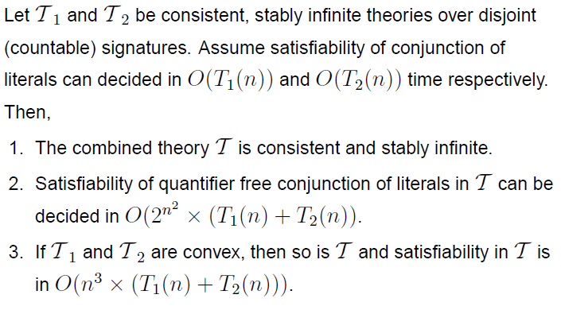
Nelson-Oppen Combination

Slide 177
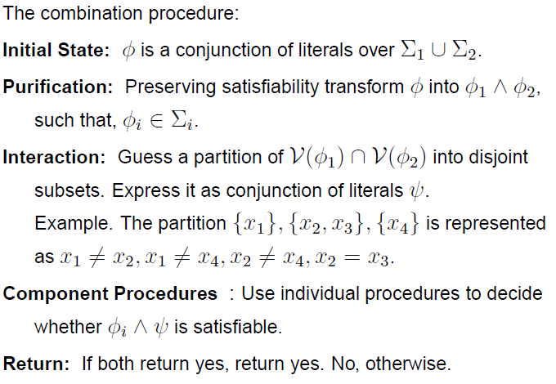
Nelson-Oppen Combination

Slide 178
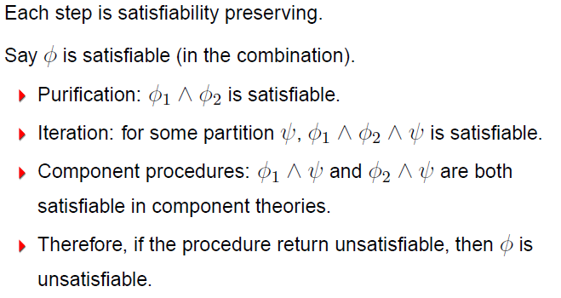
Soundness

Slide 179
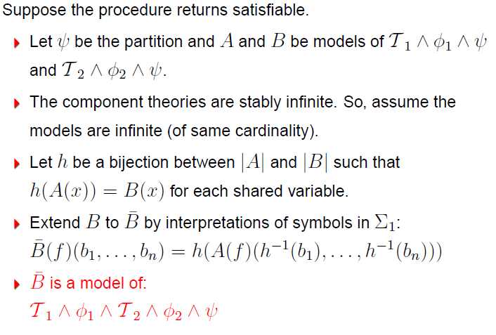
Completeness

Slide 180
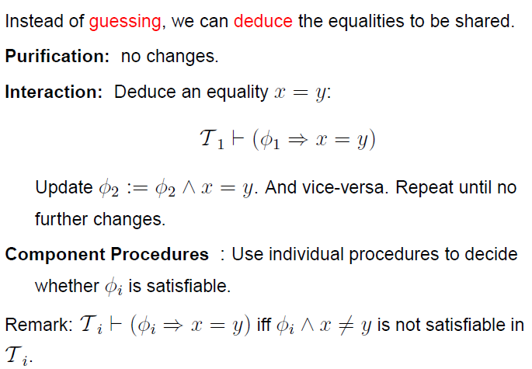
NO deterministic procedure (for convex theories)

Slide 181
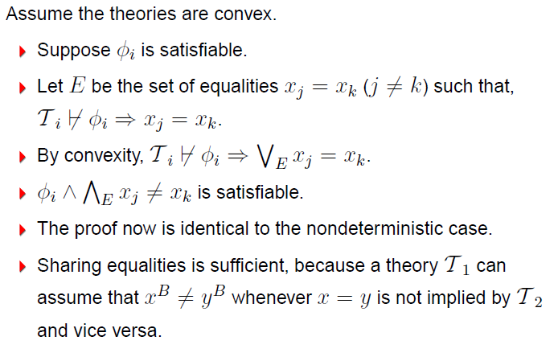
NO deterministic procedure Completeness

Slide 182
NO procedure: Example
b + 2 = c, f(read(write(a,b,3), c-2)) ≠ f(c-b+1)
Arithmetic
b + 2 = c,
v₁ ≡ 3,
v₃ ≡ c-2,
v₅ ≡ c-b+1
Arrays
v₂ ≡ write(a, b, v₁), v₄ ≡ read(v₂, v₃)
EUF
v₆ ≡ f(v₄),
v₇ ≡ f(v₅),
v₆ ≠ v₇

Slide 183
NO procedure: Example
b + 2 = c, f(read(write(a,b,3), c-2)) ≠ f(c-b+1)
Arithmetic
b + 2 = c,
v₁ ≡ 3,
v₃ ≡ c-2,
v₅ ≡ c-b+1
Arrays
v₂ ≡ write(a, b, v₁), v₄ ≡ read(v₂, v₃)
EUF
v₆ ≡ f(v₄),
v₇ ≡ f(v₅),
v₆ ≠ v₇
Substituting c

Slide 184
NO procedure: Example
b + 2 = c, f(read(write(a,b,3), c-2)) ≠ f(c-b+1)
Arithmetic
b + 2 = c,
v₁ ≡ 3,
v₃ ≡ b,
v₅ ≡ 3
Arrays
v₂ ≡ write(a, b, v₁), v₄ ≡ read(v₂, v₃),
EUF
v₆ ≡ f(v₄),
v₇ ≡ f(v₅),
v₆ ≠ v₇
Propagating v₃ = b

Slide 185
NO procedure: Example
b + 2 = c, f(read(write(a,b,3), c-2)) ≠ f(c-b+1)
Arithmetic
b + 2 = c,
v₁ ≡ 3,
v₃ ≡ b,
v₅ ≡ 3
Arrays
v₂ ≡ write(a, b, v₁), v₄ ≡ read(v₂, v₃),
v₃ = b
EUF
v₆ ≡ f(v₄),
v₇ ≡ f(v₅),
v₆ ≠ v₇,
v₃ = b
Deducing v₄ = v₁

Slide 186
NO procedure: Example
b + 2 = c, f(read(write(a,b,3), c-2)) ≠ f(c-b+1)
Arithmetic
b + 2 = c,
v₁ ≡ 3,
v₃ ≡ b,
v₅ ≡ 3
Arrays
v₂ ≡ write(a, b, v₁), v₄ ≡ read(v₂, v₃),
v₃ = b,
v₄ = v₁
EUF
v₆ ≡ f(v₄),
v₇ ≡ f(v₅),
v₆ ≠ v₇,
v₃ = b
Propagating v₄ = v₁

Slide 187
NO procedure: Example
b + 2 = c, f(read(write(a,b,3), c-2)) ≠ f(c-b+1)
Arithmetic
b + 2 = c,
v₁ ≡ 3,
v₃ ≡ b,
v₅ ≡ 3,
v₄ = v₁
Arrays
v₂ ≡ write(a, b, v₁), v₄ ≡ read(v₂, v₃),
v₃ = b,
v₄ = v₁
EUF
v₆ ≡ f(v₄),
v₇ ≡ f(v₅),
v₆ ≠ v₇,
v₃ = b,
v₄ = v₁
Propagating v₅ = v₁

Slide 188
NO procedure: Example
b + 2 = c, f(read(write(a,b,3), c-2)) ≠ f(c-b+1)
Arithmetic
b + 2 = c,
v₁ ≡ 3,
v₃ ≡ b,
v₅ ≡ 3,
v₄ = v₁
Arrays
v₂ ≡ write(a, b, v₁), v₄ ≡ read(v₂, v₃),
v₃ = b,
v₄ = v₁
EUF
v₆ ≡ f(v₄),
v₇ ≡ f(v₅),
v₆ ≠ v₇,
v₃ = b,
v₄ = v₁,
v₅ = v₁
Congruence: v₆ = v₇

Slide 189
NO procedure: Example
b + 2 = c, f(read(write(a,b,3), c-2)) ≠ f(c-b+1)
Arithmetic
b + 2 = c,
v₁ ≡ 3,
v₃ ≡ b,
v₅ ≡ 3,
v₄ = v₁
Arrays
v₂ ≡ write(a, b, v₁), v₄ ≡ read(v₂, v₃),
v₃ = b,
v₄ = v₁
EUF
v₆ ≡ f(v₄),
v₇ ≡ f(v₅),
v₆ ≠ v₇,
v₃ = b,
v₄ = v₁,
v₅ = v₁ ,
v₆ = v₇
Unsatisfiable

Slide 190
NO deterministic procedure
Deterministic procedure may fail for non-convex theories.
0 ≤ a ≤ 1, 0 ≤ b ≤ 1, 0 ≤ c ≤ 1,
f(a) ≠ f(b),
f(a) ≠ f(c),
f(b) ≠ f(c)

Slide 191
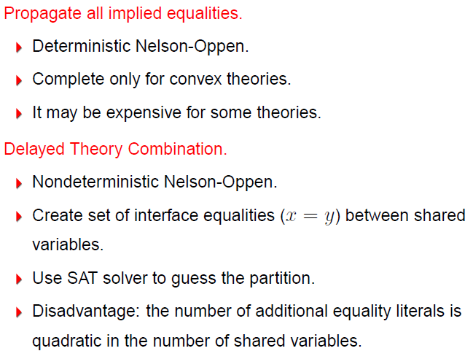
Combining Procedures in Practice

Slide 192
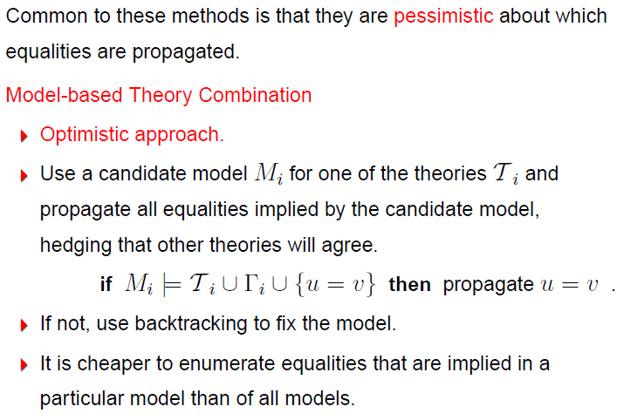
Combining Procedures in Practice

Slide 193

Example

Slide 194

Example

Slide 195
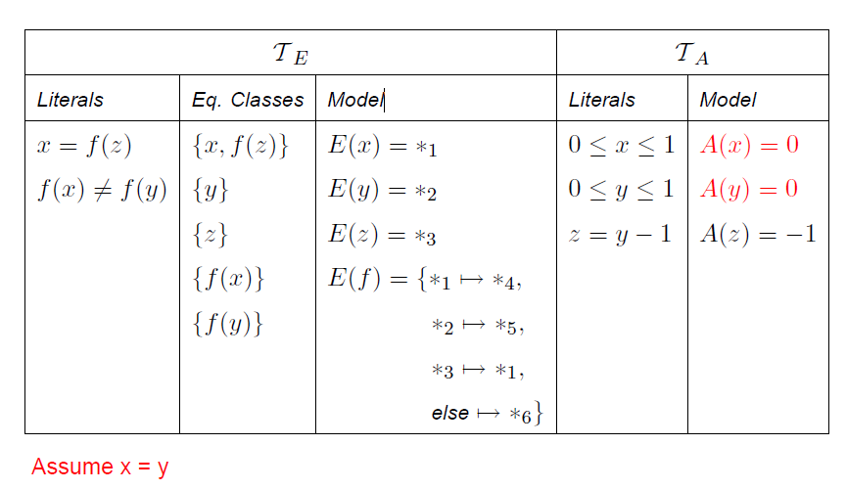
Example

Slide 196
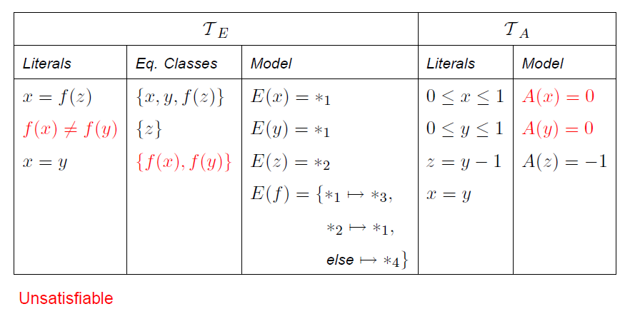
Example

Slide 197
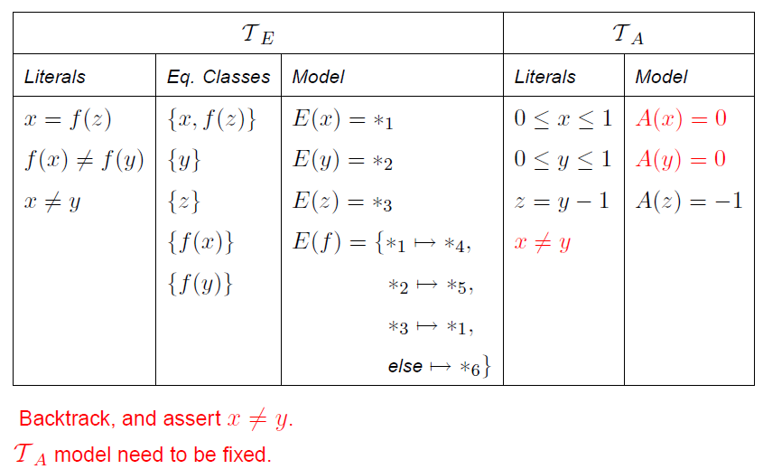
Example

Slide 198
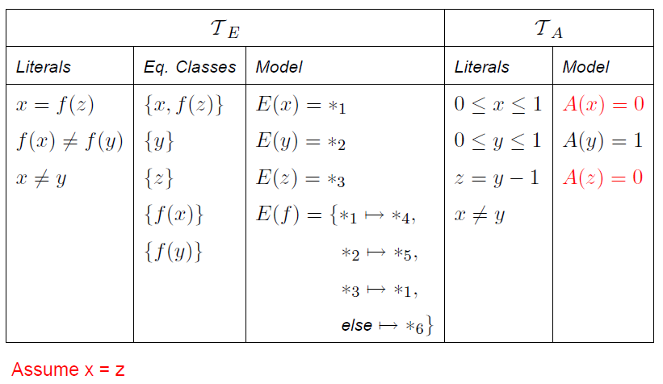
Example

Slide 199
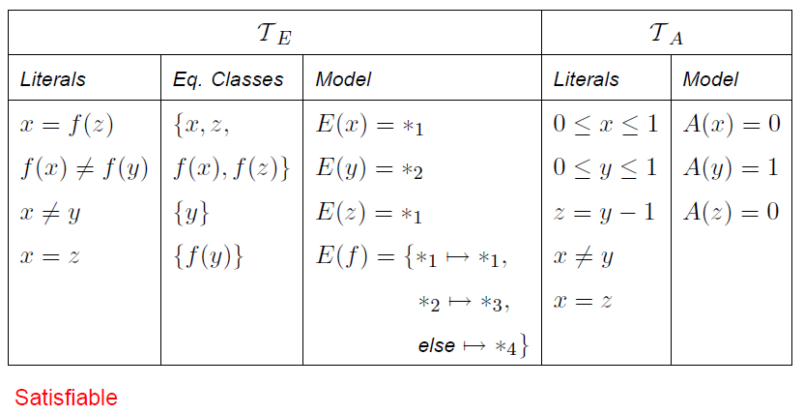
Example

Slide 200
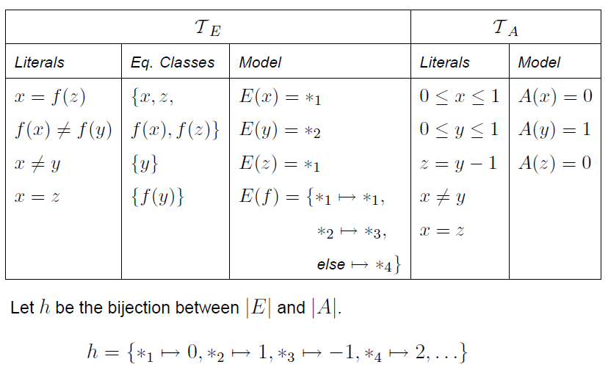
Example

Slide 201
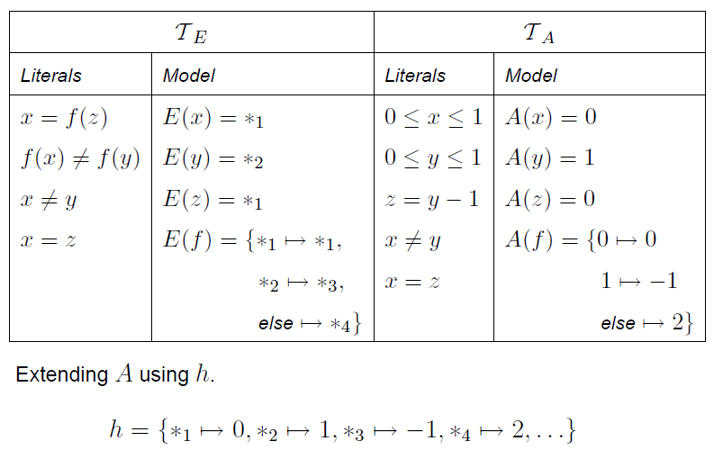
Example

Slide 202
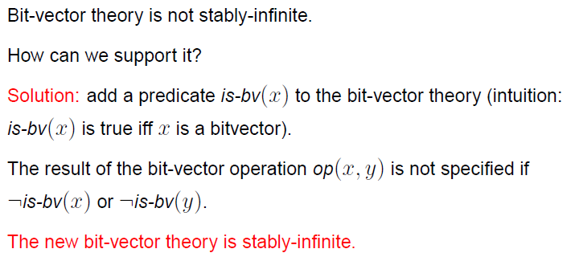
Non-stably infinite theories in practice

