Slide 1


Pex
Program Exploration with Pex
Nikolai Tillmann, Peli de Halleux
http://research.microsoft.com/Pex

Slide 2
What is Pex
Test input generator
Pex starts from parameterized unit tests
Generated tests are emitted as traditional unit tests
Dynamic symbolic execution framework
Analysis of .NET instructions (bytecode)
Instrumentation happens automatically at JIT time
Using SMT-solver Z3 to check satisfiability and generate models = test inputs

Slide 3
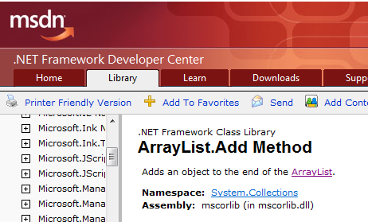
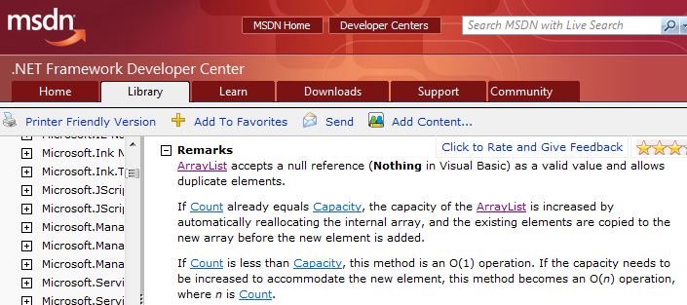
ArrayList: The Spec

Slide 4
ArrayList: AddItem Test
class ArrayListTest { [PexMethod] void AddItem(int c, object item) { var list = new ArrayList(c); list.Add(item);
Assert(list[0] == item); }
}
class ArrayList {
object[] items; int count;
ArrayList(int capacity) {
if (capacity < 0) throw ...;
items = new object[capacity]; }
void Add(object item) {
if (count == items.Length) ResizeArray();
items[this.count++] = item; } ...

Slide 5
ArrayList: Starting Pex…
class ArrayListTest { [PexMethod] void AddItem(int c, object item) { var list = new ArrayList(c); list.Add(item);
Assert(list[0] == item); }
}
 | Inputs
class ArrayList {
object[] items; int count;
ArrayList(int capacity) {
if (capacity < 0) throw ...;
items = new object[capacity]; }
void Add(object item) {
if (count == items.Length) ResizeArray();
items[this.count++] = item; } ...

Slide 6
ArrayList: Run 1, (0,null)
class ArrayListTest { [PexMethod] void AddItem(int c, object item) { var list = new ArrayList(c); list.Add(item);
Assert(list[0] == item); }
}
 | Inputs
 | (0,null)
class ArrayList {
object[] items; int count;
ArrayList(int capacity) {
if (capacity < 0) throw ...;
items = new object[capacity]; }
void Add(object item) {
if (count == items.Length) ResizeArray();
items[this.count++] = item; } ...

Slide 7
ArrayList: Run 1, (0,null)
class ArrayListTest { [PexMethod] void AddItem(int c, object item) { var list = new ArrayList(c); list.Add(item);
Assert(list[0] == item); }
}
 | Inputs | Observed Constraints
 | (0,null) | !(c<0)
class ArrayList {
object[] items; int count;
ArrayList(int capacity) {
if (capacity < 0) throw ...;
items = new object[capacity]; }
void Add(object item) {
if (count == items.Length) ResizeArray();
items[this.count++] = item; } ...
c < 0 → false

Slide 8
ArrayList: Run 1, (0,null)
class ArrayListTest { [PexMethod] void AddItem(int c, object item) { var list = new ArrayList(c); list.Add(item);
Assert(list[0] == item); }
}
 | Inputs | Observed Constraints
 | (0,null) | !(c<0) && 0==c
class ArrayList {
object[] items; int count;
ArrayList(int capacity) {
if (capacity < 0) throw ...;
items = new object[capacity]; }
void Add(object item) {
if (count == items.Length) ResizeArray();
items[this.count++] = item; } ...
0 == c → true

Slide 9
ArrayList: Run 1, (0,null)
class ArrayListTest { [PexMethod] void AddItem(int c, object item) { var list = new ArrayList(c); list.Add(item);
Assert(list[0] == item); }
}
 | Inputs | Observed Constraints
 | (0,null) | !(c<0) && 0==c
item == item → true
class ArrayList {
object[] items; int count;
ArrayList(int capacity) {
if (capacity < 0) throw ...;
items = new object[capacity]; }
void Add(object item) {
if (count == items.Length) ResizeArray();
items[this.count++] = item; } ...
This is a tautology,
i.e. a constraint that is always true,
regardless of the chosen values.
We can ignore such constraints.

Slide 10
ArrayList: Picking the next branch to cover
class ArrayListTest { [PexMethod] void AddItem(int c, object item) { var list = new ArrayList(c); list.Add(item);
Assert(list[0] == item); }
}
Constraints to solve | Inputs | Observed Constraints
 | (0,null) | !(c<0) && 0==c
!(c<0) && 0!=c
class ArrayList {
object[] items; int count;
ArrayList(int capacity) {
if (capacity < 0) throw ...;
items = new object[capacity]; }
void Add(object item) {
if (count == items.Length) ResizeArray();
items[this.count++] = item; } ...

Slide 11
ArrayList: Solve constraints using SMT solver
class ArrayListTest { [PexMethod] void AddItem(int c, object item) { var list = new ArrayList(c); list.Add(item);
Assert(list[0] == item); }
}
Constraints to solve | Inputs | Observed Constraints
 | (0,null) | !(c<0) && 0==c
!(c<0) && 0!=c | (1,null)
class ArrayList {
object[] items; int count;
ArrayList(int capacity) {
if (capacity < 0) throw ...;
items = new object[capacity]; }
void Add(object item) {
if (count == items.Length) ResizeArray();
items[this.count++] = item; } ...
Z3
Constraint solver
Z3 has decision procedures for
Arrays
Linear integer arithmetic
Bitvector arithmetic
…
(Everything but floating-point numbers)

Slide 12
ArrayList: Run 2, (1, null)
class ArrayListTest { [PexMethod] void AddItem(int c, object item) { var list = new ArrayList(c); list.Add(item);
Assert(list[0] == item); }
}
Constraints to solve | Inputs | Observed Constraints
 | (0,null) | !(c<0) && 0==c
!(c<0) && 0!=c | (1,null) | !(c<0) && 0!=c
class ArrayList {
object[] items; int count;
ArrayList(int capacity) {
if (capacity < 0) throw ...;
items = new object[capacity]; }
void Add(object item) {
if (count == items.Length) ResizeArray();
items[this.count++] = item; } ...
0 == c → false

Slide 13
ArrayList: Pick new branch
class ArrayListTest { [PexMethod] void AddItem(int c, object item) { var list = new ArrayList(c); list.Add(item);
Assert(list[0] == item); }
}
Constraints to solve | Inputs | Observed Constraints
 | (0,null) | !(c<0) && 0==c
!(c<0) && 0!=c | (1,null) | !(c<0) && 0!=c
c<0
class ArrayList {
object[] items; int count;
ArrayList(int capacity) {
if (capacity < 0) throw ...;
items = new object[capacity]; }
void Add(object item) {
if (count == items.Length) ResizeArray();
items[this.count++] = item; } ...

Slide 14
ArrayList: Run 3, (-1, null)
class ArrayListTest { [PexMethod] void AddItem(int c, object item) { var list = new ArrayList(c); list.Add(item);
Assert(list[0] == item); }
}
Constraints to solve | Inputs | Observed Constraints
 | (0,null) | !(c<0) && 0==c
!(c<0) && 0!=c | (1,null) | !(c<0) && 0!=c
c<0 | (-1,null)
class ArrayList {
object[] items; int count;
ArrayList(int capacity) {
if (capacity < 0) throw ...;
items = new object[capacity]; }
void Add(object item) {
if (count == items.Length) ResizeArray();
items[this.count++] = item; } ...

Slide 15
ArrayList: Run 3, (-1, null)
class ArrayListTest { [PexMethod] void AddItem(int c, object item) { var list = new ArrayList(c); list.Add(item);
Assert(list[0] == item); }
}
Constraints to solve | Inputs | Observed Constraints
 | (0,null) | !(c<0) && 0==c
!(c<0) && 0!=c | (1,null) | !(c<0) && 0!=c
c<0 | (-1,null) | c<0
class ArrayList {
object[] items; int count;
ArrayList(int capacity) {
if (capacity < 0) throw ...;
items = new object[capacity]; }
void Add(object item) {
if (count == items.Length) ResizeArray();
items[this.count++] = item; } ...
c < 0 → true

Slide 16
ArrayList: Run 3, (-1, null)
class ArrayListTest { [PexMethod] void AddItem(int c, object item) { var list = new ArrayList(c); list.Add(item);
Assert(list[0] == item); }
}
Constraints to solve | Inputs | Observed Constraints
 | (0,null) | !(c<0) && 0==c
!(c<0) && 0!=c | (1,null) | !(c<0) && 0!=c
c<0 | (-1,null) | c<0
class ArrayList {
object[] items; int count;
ArrayList(int capacity) {
if (capacity < 0) throw ...;
items = new object[capacity]; }
void Add(object item) {
if (count == items.Length) ResizeArray();
items[this.count++] = item; } ...

Slide 17
Pex – Test more with less effort
Reduce testing costs
Automated analysis, reproducible results
Produce more secure software
White-box code analysis
Produce more reliable software
Analysis based on contracts written as code

Slide 18
Z3 & Test case generation
Formulas may be a big conjunction
Pre-processing step
Eliminate variables and simplify input format
Incremental: solve several similar formulas
New constraints are asserted.
push and pop: (user) backtracking
Lemma reuse
“Small Models”
Given a formula F, find a model M, that minimizes the value of the variables x₀ … x_{n}

Slide 19
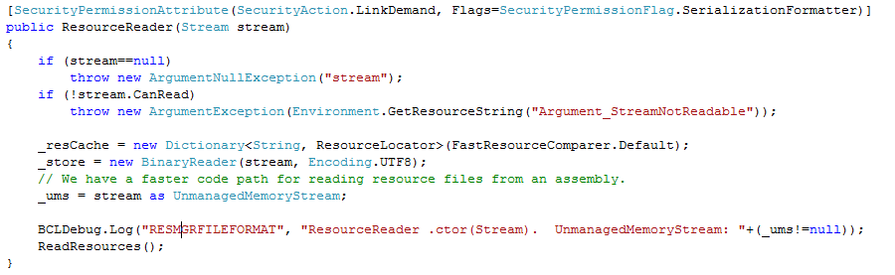
White box testing in practice
How to test this code?
(Real code from .NET base class libraries.)

Slide 20
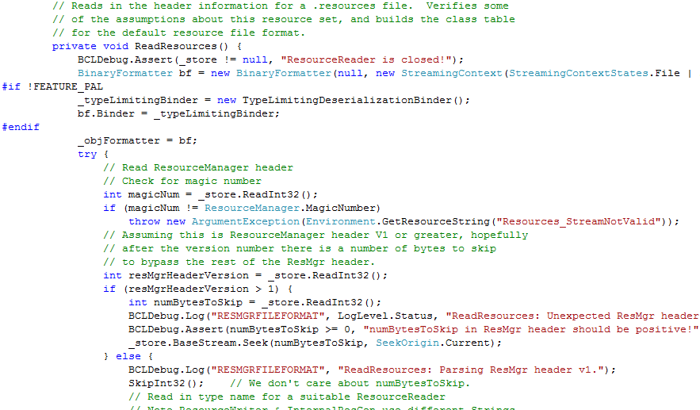
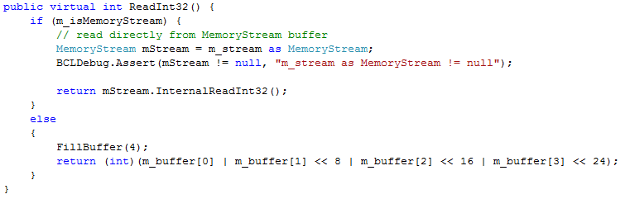
White box testing in practice

Slide 21
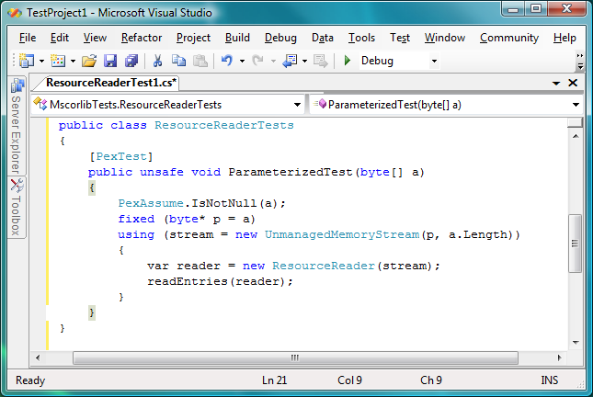
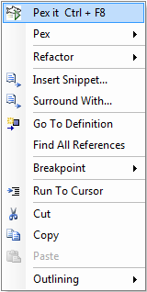
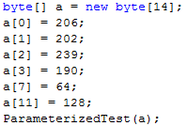
Pex – Test Input Generation tomorrow
Test input, generated by Pex
21

Slide 22
Test Input Generation by Dynamic Symbolic Execution
Initially, choose Arbitrary
Run Test and Monitor
Solve
Test Inputs
Constraint System
Execution Path
Known Paths
Choose an
Uncovered Path
Record
Path Condition
Result: small test suite, high code coverage
Finds only real bugs
No false warnings

Slide 23
Test Input Generation by Dynamic Symbolic Execution
a[0] = 0;
a[1] = 0;
a[2] = 0;
a[3] = 0;
…
Initially, choose Arbitrary
Run Test and Monitor
Solve
Test Inputs
Constraint System
Execution Path
Known Paths
Choose an
Uncovered Path
Record
Path Condition
Result: small test suite, high code coverage
Finds only real bugs
No false warnings

Slide 24

Test Input Generation by Dynamic Symbolic Execution
Initially, choose Arbitrary
Path Condition:
… ⋀ magicNum != 0x95673948
Run Test and Monitor
Solve
Test Inputs
Constraint System
Execution Path
Known Paths
Choose an
Uncovered Path
Record
Path Condition
Result: small test suite, high code coverage
Finds only real bugs
No false warnings

Slide 25
Test Input Generation by Dynamic Symbolic Execution
Initially, choose Arbitrary
Run Test and Monitor
… ⋀ magicNum != 0x95673948
… ⋀ magicNum == 0x95673948
Solve
Test Inputs
Constraint System
Execution Path
Known Paths
Choose an
Uncovered Path
Record
Path Condition
Result: small test suite, high code coverage
Finds only real bugs
No false warnings

Slide 26
Test Input Generation by Dynamic Symbolic Execution
a[0] = 206;
a[1] = 202;
a[2] = 239;
a[3] = 190;
Initially, choose Arbitrary
Run Test and Monitor
Solve
Test Inputs
Constraint System
Execution Path
Known Paths
Choose an
Uncovered Path
Record
Path Condition
Result: small test suite, high code coverage
Finds only real bugs
No false warnings

Slide 27
Test Input Generation by Dynamic Symbolic Execution
Initially, choose Arbitrary
Run Test and Monitor
Solve
Test Inputs
Constraint System
Execution Path
Known Paths
Choose an
Uncovered Path
Record
Path Condition
Result: small test suite, high code coverage
Finds only real bugs
No false warnings

Slide 28
Automatic Test Input Generation:
Whole-program, white box code analysis
Initially, choose Arbitrary
Run Test and Monitor
Solve
Test Inputs
Constraint System
Execution Path
Known Paths
Choose an
Uncovered Path
Record
Path Condition
Result: small test suite, high code coverage
Finds only real bugs
No false warnings

Slide 29
Constraint Solving: Preprocessing
Independent constraint optimization + Constraint caching (similar to EXE)
Idea: Related execution paths give rise to "similar" constraint systems
Example: Consider x>y ⋀ z>0 vs. x>y ⋀ z<=0
If we already have a cached solution for a "similar" constraint system, we can reuse it
x=1, y=0, z=1 is solution for x>y ⋀ z>0
we can obtain a solution for x>y ⋀ z<=0 by
reusing old solution of x>y: x=1, y=0
combining with solution of z<=0: z=0

Slide 30
Constraint Solving: Z3
Decision procedures for uninterpreted functions with equalities, linear integer arithmetic, bitvector arithmetic, arrays, tuples
Support for universal quantifiers
Used to model custom theories, e.g. .NET type system
Model generation
Models used as test inputs
Incremental solving
Push / Pop of contexts for model minimization
Programmatic API
For small constraint systems, text through pipes would add huge overhead

Slide 31
Monitoring by Code Instrumentation
ldtoken Point::X
call __Monitor::LDFLD_REFERENCE
ldfld Point::X
call __Monitor::AtDereferenceFallthrough
br L2
L1:
call __Monitor::AtBranchTarget
call __Monitor::LDC_I4_M1
ldc.i4.m1
L2:
call __Monitor::RET
stloc.0
leave L4
} catch NullReferenceException {
‘ call __Monitor::AtNullReferenceException
rethrow
}
L4: leave L5
} finally {
call __Monitor::LeaveMethod
endfinally
}
L5: ldloc.0
ret
class Point { int x; int y;
public static int GetX(Point p) {
if (p != null) return p.X;
else return -1; } }
ldtoken Point::GetX
call __Monitor::EnterMethod
brfalse L0
ldarg.0
call __Monitor::NextArgument<Point>
L0: .try {
.try {
call __Monitor::LDARG_0
ldarg.0
call __Monitor::LDNULL
ldnull
call __Monitor::CEQ
ceq
call __Monitor::BRTRUE
brtrue L1
call __Monitor::BranchFallthrough
call __Monitor::LDARG_0
ldarg.0
…
Prologue
Record concrete values to have all information when this method is called with no proper context
(The real C# compiler output is actually more complicated.)
Calls to build path condition
Calls will perform symbolic computation
Epilogue
Calls to build path condition

