Slide 1
SMT @ Microsoft
Nikolaj Bjørner and Leonardo de Moura
Microsoft Research
Microsoft Corporation
McMaster University, November 28, 2007

Slide 2
Outline
Verificationeering @ Microsoft
Introducing Z3, a Satisfiability Modulo Theory Solver.
Selected projects
Test generation:
Pex, SAGE, Vigilante
Program verification:
Spec#, Boogie, VCC
The Viridian Hypervisor
Program analysis and model checking:
SLAM/SDV, Yogi, Terminator

Slide 3



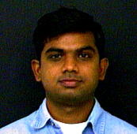

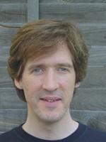






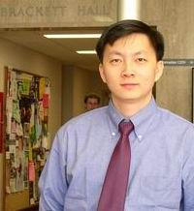

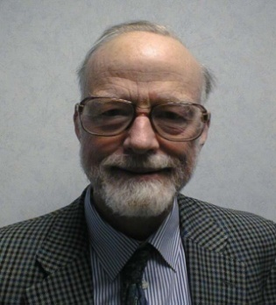
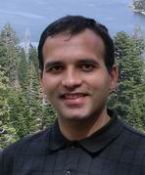
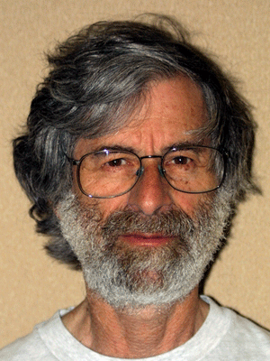



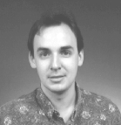
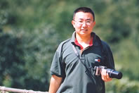


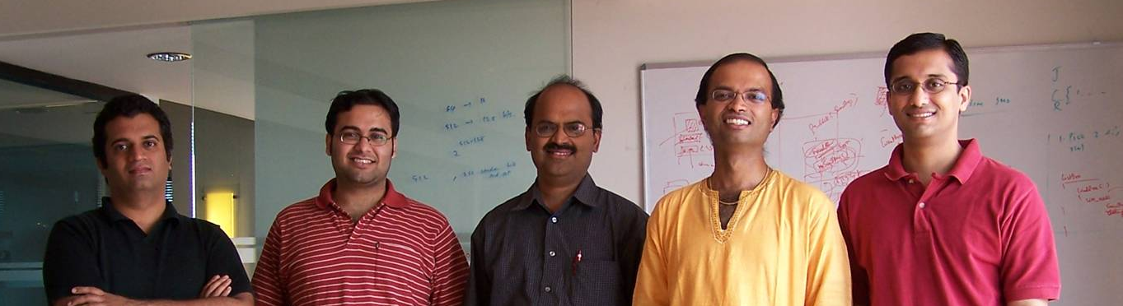



Verificationeering researchers

Slide 4
Verificationeering projects
Static Driver Verifier (Ball, Rajamani …)
Symbolic model checking for Windows drivers.
Well established. Shipped with the Windows driver verification tools.
Test Generation (Godefroid, Halleux, Lahiri, Levin, Tillmann, Zhang ...)
Use decision procedures to generate test inputs.
Program Verification (Barnett, Cohen, Leino, Schulte, ...)
Spec#/Boogie: programming with contracts.
The Viridian Hypervisor: Comprehensive functional correctness.
Software Model-checking (Muthuvathi, Nori, Qadeer, …)
Yogi: concrete execution + symbolic partition refinement.
Chess: multi-threaded programs
Termination, Separation, Heaps (Berdine, Cook, Lahiri, Qadeer, ...)
Model Based Testing (Grieskamp, Veanes, ...)
SpecExplorer, MUnit: Use models to extract test cases.
Proofs and protocols (Benton, Gonthier, Fournet, Lamport, …)

Slide 5
Z3 plumbing: A Satisfiability Modulo Theories solver
x86
.NET CLR
VCC
Spec#
Windows Drivers
SAGE, Pex,
Yogi, Vigilante
Boogie
SLAM
Static Driver Verifier
Path constraints
Path to bug position
Models
Verification conditions
True/False
Transition abstraction
Backend:
SMT solver: Z3

Slide 6
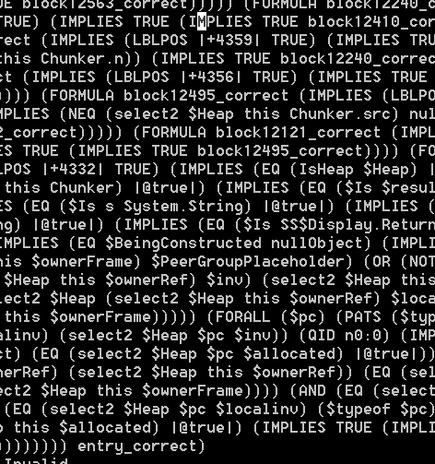
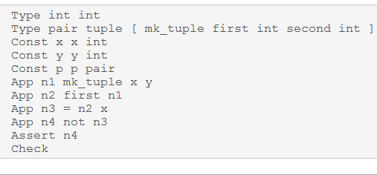
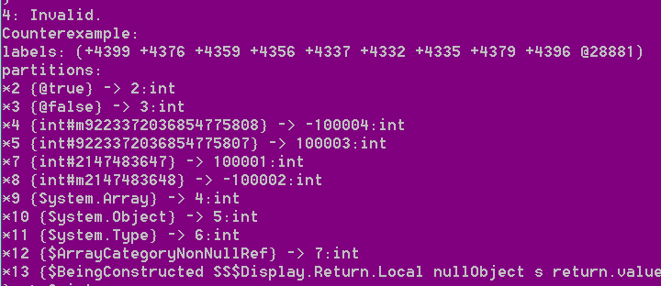
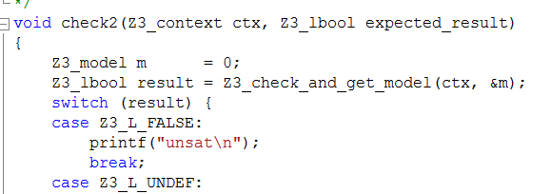
Interfacing with Z3
Text formats:
Simplify
SMT-LIB
Native Z3
Binary.
From C, .NET, OCaml.
Output: (Un)SAT, model:

Slide 7
Unit Tests
Verificationeering @ Microsoft
Selected projects
Test generation:
Pex, SAGE, Vigilante
Program verification:
Spec#, Boogie, VCC
The Viridian Hypervisor
Program analysis and model checking:
SLAM/SDV, Yogi, Terminator

Slide 8
Automatic Generation of Unit Tests
Test (correctness + usability) is 95% of the deal:
Dev/Test is 1-1 in products.
Developers are responsible for unit tests.
Tools:
Annotations and static analysis (SAL, ESP)
File Fuzzing
Unit test case generation.
Use program analysis tools, automated theorem proving

Slide 9
Security is Critical
Security bugs can be very expensive:
Cost of each MS Security Bulletin: $600K to $Millions [MS Treasury Group]
Cost due to worms (Slammer, CodeRed, Blaster, etc.): $Billions
The real victim is the customer.
Most security exploits are initiated via files or packets
Ex: Internet Explorer parses dozens of file formats
Security testing: hunting for million-dollar bugs
Write A/V (always exploitable), Read A/V (sometimes exploitable), NULL-pointer dereference, division-by-zero (harder to exploit but still DOS attacks), etc.
Notes:
Every month, MS publishes a list of critical security updates and each item on that list has a price tag typically in the order of millions of dollars…
Security means much more than just finding security bugs, but finding those bugs is an important part of it.
IE parses dozens of file formats…

Slide 10

Hunting for Security Bugs
Two main techniques used by “black hats”:
Code inspection (of binaries) and Blackbox fuzz testing
Blackbox fuzz testing:
A form of blackbox random testing
Randomly fuzz (=modify) a well-formed input
Grammar-based fuzzing: rules that encode how to fuzz
Heavily used in security testing
At MS: various internal tools
Conceptually simple yet effective in practice…
Has been instrumental in weeding out 1000’s of bugs during development and test

Slide 11
Challenge: Automatic Code-Driven Test Generation
Given program with a set of input parameters,
Generate inputs that maximize code coverage
x = 1, y = 2
x = -2, y = -3
Input x, y
z := x + y
z > x-y
Return z
error();
Solve: z = x + y ∧ z > x - y
Solve: z = x + y ∧ z ≤ x - y

Slide 12
Method: Dynamic Test Generation
Run program with random inputs.
Gather constraints on inputs.
Use constraint solver to
generate new inputs.
Combination with randomization: DART Godefroid-Klarlund-Sen-05,…
Input x, y
Z := x + y
z == hash(x)
Return z
error();
Can’t statically generate value for x that satisfy “z==hash(x)”
But we can solve for y in: x + y = hash(x)

Slide 13
Test generation life cycle
Initially, choose Arbitrary
Solve
Run Test
and Monitor
Test Inputs
Constraint System
Execution Path
Known Paths
Represent a path not seen before
Path Condition

Slide 14
DARTish projects at Microsoft
SAGE (CSE) implements DART for x86 binaries and merges it with “fuzz” testing for finding security bugs
PEX (MSR-Redmond FSE group) implements DART for .NET binaries in conjunction with “parameterized-unit tests” for unit testing of .NET programs
YOGI (MSR India) implements DART to check the feasibility of program paths generated statically using a SLAM-like tool
Vigilante (MSR Cambridge) partially implements DART to dynamically generate worm filters
Notes:
[Vigilante: given an execution trace where an attack is observed, Vigilante attempts to generate alternative executions traces witnessing the same attack; and then blocks all these inputs.]

Slide 15
Initial Experiences with SAGE
25+ security bugs and counting…
(most missed by blackbox fuzzers)
OS component X
4 new bugs: “This was an area that we heavily fuzz tested in Vista”
OS component Y
Arithmetic/stack overflow in y.dll
Media format A
Arithmetic overflow; DOS crash in previously patched component
Media format B & C
Hard-to-reproduce uninitialized-variable bug
Notes:
SAGE was released internally to a few groups about 2 months ago.
The initial feedback is very positive. SAGE has already been able to find more than 25 security bugs
In various apps (most missed by blackbox fuzzers).

Slide 16

Pex
Pex monitors the execution of .NET application using the CLR profiling API.
Pex dynamically checks for violations of programming rules, e.g. resource leaks.
Pex suggests code snippets to the user, which will prevent the same failure from happening again.
Very instrumental in exposing bugs in .NET libraries.

Slide 17
Pex unit-test case generation
Demo
… from a credit card number verifier to valid credit card numbers.

Slide 18
Test-case generation & SMT
Formulas are usually a big conjunction.
Incrementality: solve several similar formulas.
“Small models”.
True Arithmetic × Machine Arithmetic.

Slide 19
Test-case generation & SMT
Formulas are usually a big conjunction.
Pre-processing step.
Eliminate variables and simplify input formula.
Significant performance impact.
Incrementality: solve several similar formulas.
“Small models”
True Arithmetic × Machine Arithmetic.

Slide 20
Test-case generation & SMT
Formulas are usually a big conjunction.
Incrementality: solve several similar formulas.
Z3 is incremental: new constraints can be asserted.
push and pop: (user) backtracking.
Reuse (some) lemmas.
“Small models”
True Arithmetic × Machine Arithmetic.

Slide 21
Test-case generation & SMT
Formulas are usually a big conjunction.
Incrementality: solve several similar formulas.
“Small models”.
Given a set of constraints C, find a model M that minimizes the value of the variables x₀, . . . , x_{n}.
Eager (cheap) Solution:
Assert C.
While satisfiable
Peek x_{i} such that M[x_{i}] is big
Assert x_{i} < c, where c is a small constant
Return last found model
True Arithmetic × Machine Arithmetic

Slide 22
Test-case generation & SMT
Formulas are usually a big conjunction.
Incrementality: solve several similar formulas.
“Small models”.
Given a set of constraints C, find a model M that minimizes the value of the variables x₀, . . . , x_{n}.
Refinement (convex):
Eager solution stops as soon as the context becomes unsatisfiable.
A “bad” choice (peek x_{i}) may prevent us from finding a good solution.
Use push and pop to retract “bad” choices.
True Arithmetic × Machine Arithmetic
Precision vs. Performance.

Slide 23
A Verifying Compiler
Verificationeering @ Microsoft
Selected projects
Test generation:
Pex, SAGE, Vigilante
Program verification:
Spec#, Boogie, VCC
The Viridian Hypervisor
Program analysis/model checking
A verifying compiler uses automated .. reasoning to check the correctness of the program that it compiles. Correctness is specified by types, assertions, .. and other redundant annotations that accompany the program.” [Hoare, 2004]

Slide 24
Spec# Approach for a Verifying Compiler
Source language:
C# + goodies = Spec#
Specifications:
method contracts,
invariants,
field and type annotations
Program logic:
Dijkstra’s weakest preconditions
Automatic verification:
type checking,
verification condition generation (VCG),
automatic theorem proving (ATP)
Spec# (annotated C#)
Spec# Compiler
Boogie PL
VC Generator
Formulas
Automatic Theorem Prover

Slide 25
Spec# Approach for a Verifying Compiler
Source language:
C# + goodies = Spec#
Specifications:
method contracts,
invariants,
field and type annotations
Program logic:
Dijkstra’s weakest preconditions
Automatic verification:
type checking,
verification condition generation (VCG),
automatic theorem proving (ATP)
class C{
private int a, z;
invariant a!=0;
public void M()
requires a!=0;
{z = 100/a;}
wp(S; T, Q) = wp(S, wp(T, Q))
wp(assert x>1, Q) = x>1 ∧ Q

Slide 26
Interacting with Spec#
Demo
… and Z3 underneath.

Slide 27



The Microsoft Hypervisor
Meta OS: small layer of software between hardware and OS
Mini: 60K lines of non-trivial concurrent systems C code
Critical: must provide functional resource abstraction
Trusted: a grand verification challenge
Hypervisor
Hardware

Slide 28
Hypervisor Architecture
is well layered!

Slide 29
What is to be verified?
Source code
C + x64 assembly
Sample verifiable slices:
Safety: Basic memory safety
Functionality: Hypervisor simulates a number of virtual x64 machines.
Utility: Hypervisor services guest OS with available resources.

Slide 30
Tool: A Verifying C Compiler
annotated C program
VCC
BoogiePL program
Boogie
verification condition
Z3
Isabelle
Simplify
program spec?

Slide 31
Methodologies
A C-ish memory model
Abstract heaps
Bit-level precision
Embedded specs in C
Pure functions
Framing
Reads/writes
Better together: Framing + Pure functions
pointer = block-ID x offset
power2(x): 0 == ((x – 1) & x)
pure bool positive(int* x) {
return valid(x, sizeof(*x)) && 0<*x; }
pure int value(int* x)
requires(positive(x))
reads(x,sizeof(*x))
{ return *x; }

Slide 32
Outlook
The verification project has very recently started
It is a multi- man multi-year effort with MSR Aachen, and MPI Saarbrüecken.
Wish us good luck ☺.

Slide 33
Tool: HAVOC
A tool for specifying and checking properties of systems software
written in C.
It also translates annotated C into Boogie PL.
It allows the expression of richer properties about the program
heap and data structures such as linked lists and arrays.
HAVOC is being used to specify and check:
Complex locking protocols over heap-allocated data structures in Windows.
Properties of collections such as IRP queues in device drivers.
Correctness properties of custom storage allocators.

Slide 34
Verifying Compilers & SMT
Quantifiers, Quantifiers, . . .
Modeling the runtime.
Frame axioms (“what didn’t change”).
User provided assertions and invariants (e.g., the array is sorted).
Prototyping decision procedures (e.g., reachability, partial orders, . . . ).
Z3: pragmatic approach
Heuristic Quantifier Instantiation.
E-matching (i.e., matching modulo equalities).

Slide 35
Program analysis and model checking
Verificationeering @ Microsoft
Selected projects
Test generation:
Pex, SAGE, Vigilante
Program verification:
Spec#, Boogie, VCC
The Viridian Hypervisor
Program analysis and model checking:
SLAM/SDV, Yogi, Terminator

Slide 36
SLAM: device driver verification
http://research.microsoft.com/slam/
SLAM/SDV is a software model checker.
Application domain: device drivers.
Architecture
c2bp C program to boolean program (predicate abstraction).
bebop Model checker for boolean programs.
Newton Model refinement (check for path feasibility)
SMT solvers are used to perform predicate abstraction and to check path feasibility.
c2bp makes several calls to the SMT solver.
The formulas are relatively small.

Slide 37
Yogi and Terminator
Yogi (Aditya, Rajamani, …) combines DARTish techniques with partition refinement.
Terminator (Cook, …)
termination checker
F#+Z3 blog:
http://www.foment.net/byron/fsharp.shtml
Both are good candidate additions to SDV.

Slide 38
Conclusions
Formal verification is hot at Microsoft.
Main applications:
Test-case generation.
Verifying compiler.
Model Checking & Predicate Abstraction.
Z3 is a new SMT solver.
http://research.microsoft.com/projects/z3
The Art, Craft, Science and Internals of Z3 in the talk by Leonardo de Moura

Slide 39

Your SMT problem. Our joy.
© 2007 Microsoft Corporation. All rights reserved. Microsoft, Windows, Windows Vista and other product names are or may be registered trademarks and/or trademarks in the U.S. and/or other countries.
The information herein is for informational purposes only and represents the current view of Microsoft Corporation as of the date of this presentation. Because Microsoft must respond to changing market conditions, it should not be interpreted to be a commitment on the part of Microsoft, and Microsoft cannot guarantee the accuracy of any information provided after the date of this presentation. MICROSOFT MAKES NO WARRANTIES, EXPRESS, IMPLIED OR STATUTORY, AS TO THE INFORMATION IN THIS PRESENTATION.

