Slide 1
Z3 -An Efficient
SMT Solver

Slide 2
Main features
Linear real and integer arithmetic.
Fixed-size bit-vectors
Uninterpreted functions
Extensional arrays
Quantifiers
Model generation
Several input formats (Simplify, SMT-LIB, Z3, Dimacs)
Extensive API (C/C++, .Net, OCaml)

Slide 3
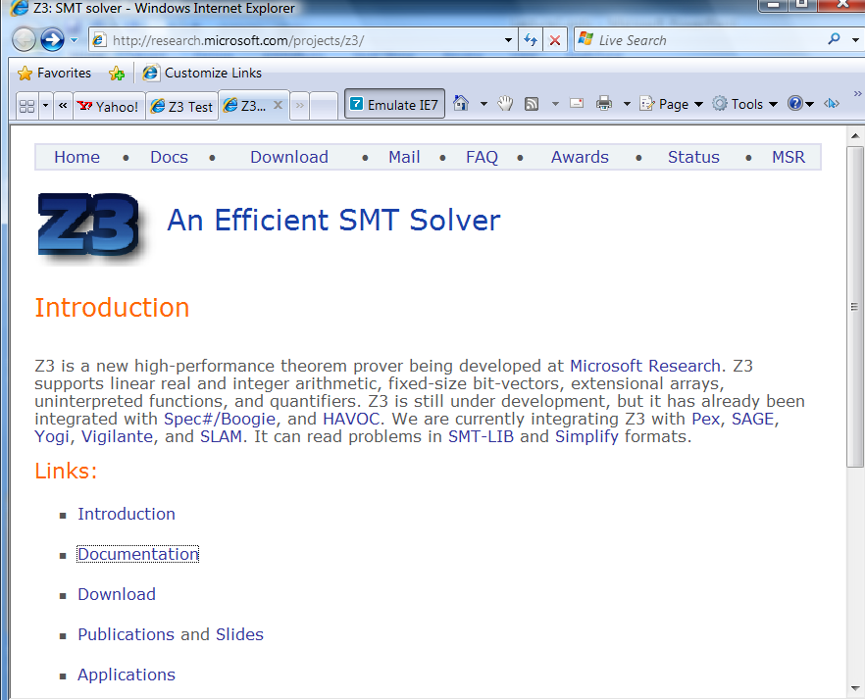
Web

Slide 4
Supporting material
http://research.microsoft.com/projects/z3/documentation.html

Slide 5
Z3: Core System Components
Text
C
.NET
OCaml
Theories
Bit-Vectors
Rewriting Simplification
Arithmetic
Arrays
E-matching
Core Theory
Partial orders
Tuples
SAT solver

Slide 6
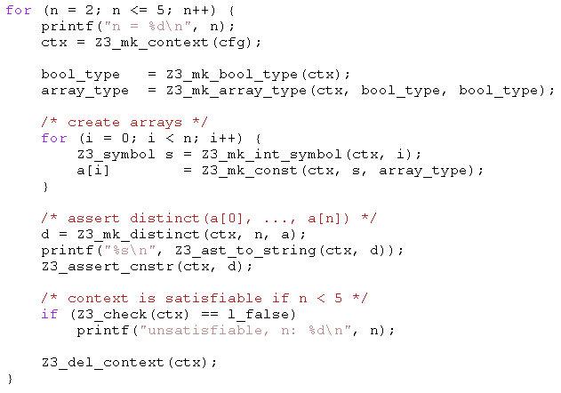
Example: C API
Given arrays:
bool a1[bool];
bool a2[bool];
bool a3[bool];
bool a4[bool];
All can be distinct.
Add:
bool a5[bool];
Two of a1,..,a5 must be equal.

Slide 7
Example: SMT-LIB
(benchmark integer-linear-arithmetic
:status sat
:logic QF_LIA
:extrafuns ((x1 Int) (x2 Int) (x3 Int) (x4 Int) (x5 Int))
:formula (and (>= (- x1 x2) 1)
(<= (- x1 x2) 3)
(= x1 (+ (* 2 x3) x5))
(= x3 x5)
(= x2 (* 6 x4)))
)
(benchmark array
:logic QF_AUFLIA
:status unsat
:extrafuns ((a Array) (b Array) (c Array))
:extrafuns ((i Int) (j Int))
:formula (and
(= (store a i v) b)
(= (store a j w) c)
(= (select b j) w)
(= (select c i) v)
(not (= b c))
)

Slide 8
SMT-LIB syntax – basics
benchmark ::= (benchmark name [:status (sat | unsat | unknown)] :logic logic-name declaration*)
declaration ::= :extrafuns (func-decl*) | :extrapreds (pred-decl*) | :extrasorts (sort-decl*) | :assumption fmla | :formula fmla
sort-decl ::= id - identifier
func-decl ::= id sort-decl* sort-decl - name of function, domain, range
pred-decl ::= id sort-decl* - name of predicate, domain
fmla ::= (and fmla*) | (or fmla*) | (not fmla) | (if_then_else fmla fmla fmla) | (= term term) | (implies fmla fmla) (iff fmla fmla) | (predicate term*)
Term ::= (ite fmla term term) | (id term*) - function application | id - constant

Slide 9
SMT-LIB syntax - basics
Logics:
QF_UF – Un-interpreted functions. Built-in sort U
QF_AUFLIA – Arrays and Integer linear arithmetic.
Built-in Sorts:
Int, Array (of Int to Int)
Built-in Predicates:
<=, >=, <, >,
Built-in Functions:
+, *, -, select, store.
Constants: 0, 1, 2, …

Slide 10
SMT-LIB – encodings
Q: There is no built-in function for max or min. How do I encode it?
(max x y) is the same as (ite (> x y) x y)
Also: replace (max x y) by fresh constant max_x_y add assumptions: :assumption (implies (> x y) (= max_x_y x)) :assumption (implies (<= x y) (= max_x_y y))
Q: Encode the predicate (even n), that is true when n is even.

Slide 11
Quantifiers
Quantified formulas in SMT-LIB:
fmla ::= … | (forall bound* fmla) | (exists bound* fmla)
Bound ::= ( id sort-id )
Q: I want f to be an injective function. Write an axiom that forces f to be injective.
Patterns: guiding the instantiation of quantifiers (Lecture 5)
fmla ::= … | (forall (?x A) (?y B) fmla :pat { term }) | (exists (?x A) (?y B) fmla :pat { term })
Q: what are the patterns for the injectivity axiom?

Slide 12
Using the Z3 (managed) API
open Microsoft.Z3
open System.Collections.Generic
open System
let par = new Config()
do par.SetParamValue("MODEL", "true")
let z3 = new TypeSafeContext(par)
Create a context z3:
let check (fmla) =
z3.Push();
z3.AssertCnstr(fmla);
(match z3.Check() with
| LBool.False -> Printf.printf "unsat\n"
| LBool.True -> Printf.printf "sat\n"
| LBool.Undef -> Printf.printf "unknown\n"
| _ -> assert false); z3.Pop(1ul)
Check a formula
Push
AssertCnstr
Check
Pop

Slide 13
Using the Z3 (managed) API
let (===) x y = z3.MkEq(x,y)
let (==>) x y = z3.MkImplies(x,y)
let (&&) x y = z3.MkAnd(x,y)
let neg x = z3.MkNot(x)
let a = z3.MkType(“a”)
let f_decl = z3.MkFuncDecl("f",a,a)
let x = z3.MkConst(“x”,a)
let f x = z3.MkApp(f_decl,x)
Declaring z3 shortcuts, constants and functions
Proving a theorem
let fmla1 = ((x === f(f(f(f(f(f x))))) && (x === f(f(f x)))) ==> (x === (f x))
do check (neg fmla1)
(benchmark euf :logic QF_UF :extrafuns ((f U U) (x U)) :formula (not (implies (and (= x (f(f(f(f(f x)))))) (= x (f(f(f x))))) (= x (f x))))
compared to

Slide 14
Enumerating models
We want to find models for
But we only care about different

Slide 15
Enumerating models
Representing the problem
void Test() {
Config par = new Config();
par.SetParamValue("MODEL", "true");
z3 = new TypeSafeContext(par);
intT = z3.MkIntType();
i1 = z3.MkConst("i1", intT); i2 = z3.MkConst("i2", intT);
i3 = z3.MkConst("i3", intT);
z3.AssertCnstr(Num(2) < i1 & i1 <= Num(5));
z3.AssertCnstr(Num(1) < i2 & i2 <= Num(7));
z3.AssertCnstr(Num(-1) < i3 & i3 <= Num(17));
z3.AssertCnstr(Num(0) <= i1 + i2 + i3 & Eq(i2 + i3, i1));
Enumerate();
par.Dispose();
z3.Dispose();
}

Slide 16
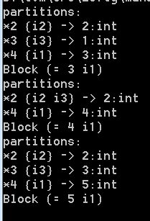
Enumerating models
Enumeration:
void Enumerate() {
TypeSafeModel model = null;
while (LBool.True == z3.CheckAndGetModel(ref model)) {
model.Display(Console.Out);
int v1 = model.GetNumeralValueInt(model.Eval(i1));
TermAst block = Eq(Num(v1),i1);
Console.WriteLine("Block {0}", block);
z3.AssertCnstr(!block);
model.Dispose();
}
}
TermAst Eq(TermAst t1, TermAst t2) { return z3.MkEq(t1,t2); }
TermAst Num(int i) { return z3.MkNumeral(i, intT); }

Slide 17
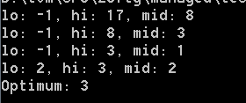
Push, Pop
int Maximize(TermAst a, int lo, int hi) {
while (lo < hi) {
int mid = (lo+hi)/2;
Console.WriteLine("lo: {0}, hi: {1}, mid: {2}",lo,hi,mid);
z3.Push();
z3.AssertCnstr(Num(mid+1) <= a & a <= Num(hi));
TypeSafeModel model = null;
if (LBool.True == z3.CheckAndGetModel(ref model)) {
lo = model.GetNumeralValueInt(model.Eval(a));
model.Dispose();
}
else hi = mid;
z3.Pop();
}
return hi;
}
Maximize(i3,-1,17):

Slide 18
Push, Pop – but reuse search
int Maximize(TermAst a, int lo, int hi) {
while (lo < hi) {
int mid = (lo+hi)/2;
Console.WriteLine("lo: {0}, hi: {1}, mid: {2}",lo,hi,mid);
z3.Push();
z3.AssertCnstr(Num(mid+1) <= a & a <= Num(hi));
TypeSafeModel model = null;
if (LBool.True == z3.CheckAndGetModel(ref model)) {
lo = model.GetNumeralValueInt(model.Eval(a));
model.Dispose();
lo = Maximize(a, lo, hi);
}
else hi = mid;
z3.Pop();
}
return hi;
}

