Slide 1
OKLO project
Kallieros Nikolaos
Github: https://github.com/NikolaosKallieros/oklo_project
9/20/2023

Slide 2
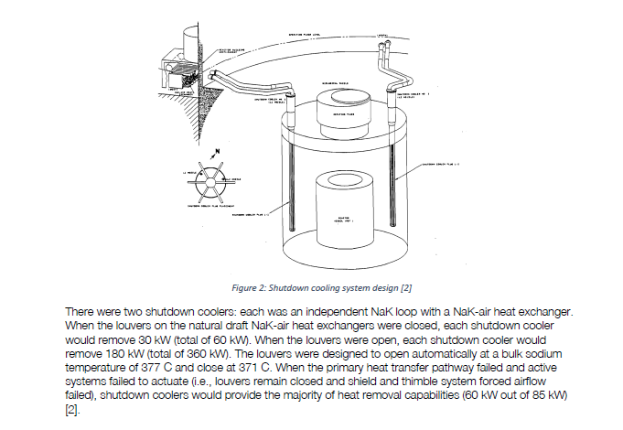
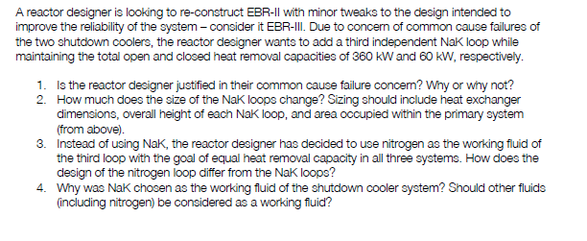
DRACS calculation:

Slide 3
Common cause failure:
To defend a system against common cause failure:
Reduce your coupling factors
Reduce the probability of causes
Coupling factors:
Same design
Same hardware
Same function
Same installation, maintenance, or operations staff
Same procedures
Same system/component interface
Same location
Same environment
Probability of causes
assume they depend on:
Max circuit temperature
Max circuit flow
Maximum circuit temperature and flow will change, so there is a merit from the designer
Do not change!

Slide 4
NaK DRACS simulation:
Multiple approaches could be used
Using heat exchanger theory (LMTD)
RELAP/ lumped parameter modeling system
CFD
complexity
Decided to use lumped parameter modeling offered by MATLAB: like MODELICA, TRACE.

Slide 5
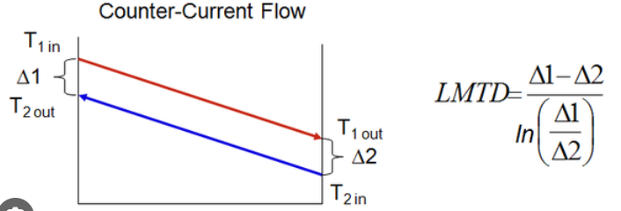
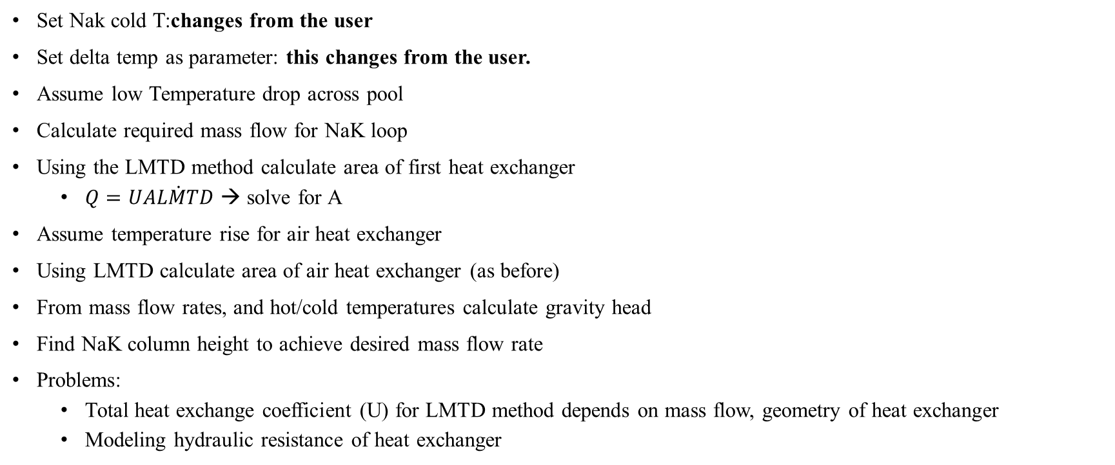
Approach using LMTD theory:
Set Nak cold T:changes from the user
Set delta temp as parameter: this changes from the user.
Assume low Temperature drop across pool
Calculate required mass flow for NaK loop
Using the LMTD method calculate area of first heat exchanger
$Q=U\dot{ALMTD}$ → solve for A
Assume temperature rise for air heat exchanger
Using LMTD calculate area of air heat exchanger (as before)
From mass flow rates, and hot/cold temperatures calculate gravity head
Find NaK column height to achieve desired mass flow rate
Problems:
Total heat exchange coefficient (U) for LMTD method depends on mass flow, geometry of heat exchanger
Modeling hydraulic resistance of heat exchanger

Slide 6
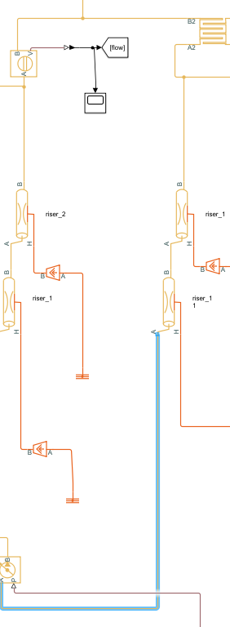
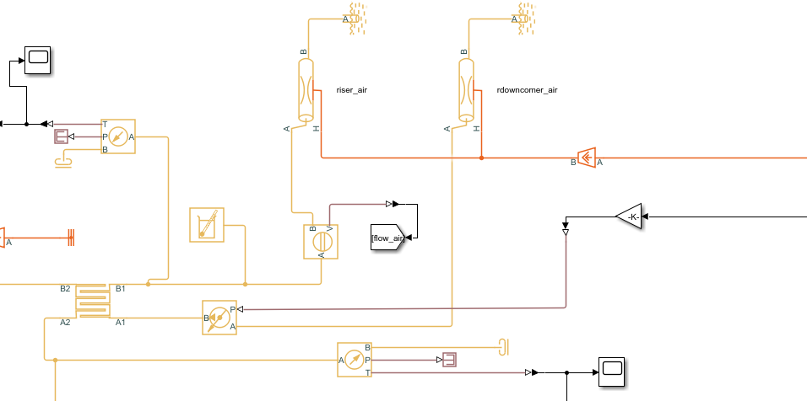
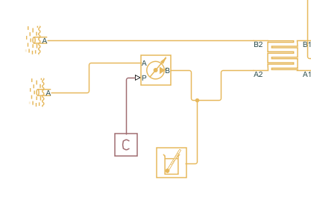
Lumped model approach:
Air heat exchanger
NaK riser
NaK downcomer
pool heat exchanger
Pool: constant 377 degC T
Na properties for fluid

Slide 7
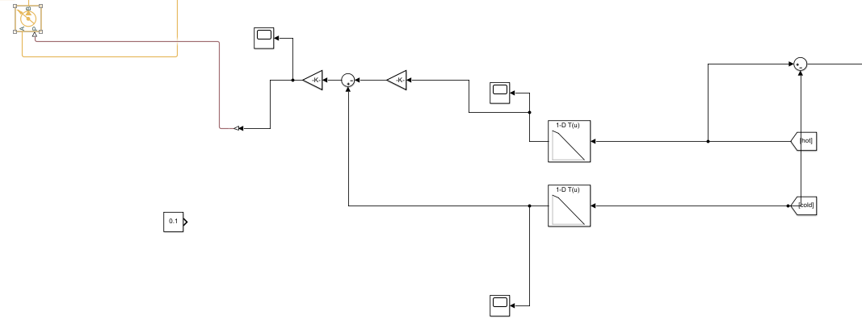
Simulate natural circulation flow:
SIMCAPE does not have modeled the gravity term in its pipe model, so the gravity effect was modeled using a pump block
For ease of modeling and due to limited time, we do not integrate the density over the loop to get the pressure differential, but assume that vertical pipes will have either the hot or the cold temperature.
Hot liquid T
Assign pressure to loop
Multiply by gravity + height
Cold liquid T
Look up tables to get density

Slide 8
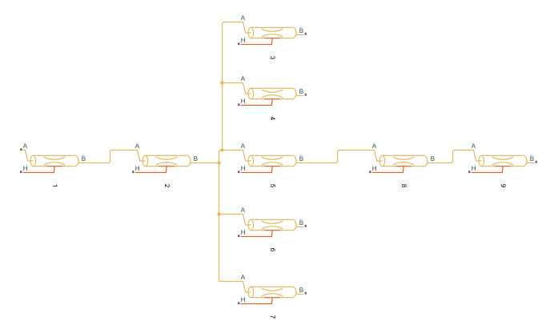
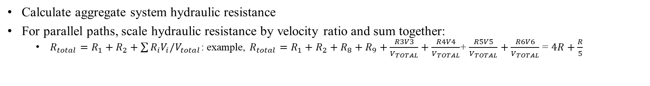
Hydraulic resistance calc:
Calculate aggregate system hydraulic resistance
For parallel paths, scale hydraulic resistance by velocity ratio and sum together:
$R_{total}=R_{1}+R_{2}+\sum{R_{i}V_{i}/V_{total}}$: example, $R_{total}=R_{1}+R_{2}+R_{8}+R_{9}+\frac{R3V3}{V_{TOTAL}}+\frac{R4V4}{V_{TOTAL}}$+ $\frac{R5V5}{V_{TOTAL}}+\frac{R6V6}{V_{TOTAL}}$ = $4R+\frac{R}{5}$

Slide 9

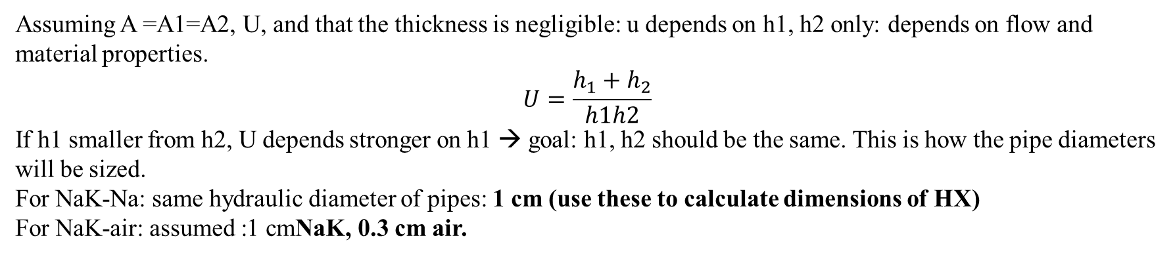
Heat exchanger structure:
Assuming A =A1=A2, U, and that the thickness is negligible: u depends on h1, h2 only: depends on flow and material properties.
$$U=\frac{h_{1}+h_{2}}{h1h2}$$
If h1 smaller from h2, U depends stronger on h1 → goal: h1, h2 should be the same. This is how the pipe diameters will be sized.
For NaK-Na: same hydraulic diameter of pipes: 1 cm (use these to calculate dimensions of HX)
For NaK-air: assumed :1 cmNaK, 0.3 cm air.

Slide 10
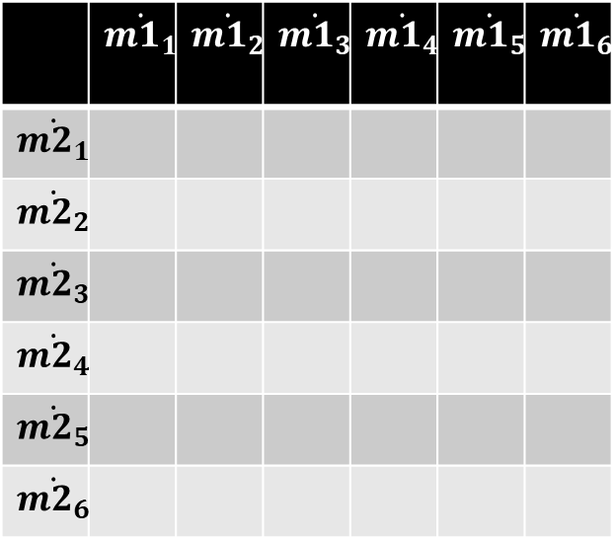
Model improvements:
Hydraulic resistances are not calculated properly → but they affect the system response greatly
Use CFD data to calculate heat exchange pressure drop, equivalent heat exchange rates as a function of mass flow rates of 2 liquids
Create transfer function with inputs the heat exchanger flow rates and output the heat transfer through the exchanger
Not enough time!!!
 | $$\dot{m1_{1}}$$ | $$\dot{m1_{2}}$$ | $$\dot{m1_{3}}$$ | $$\dot{m1_{4}}$$ | $$\dot{m1_{5}}$$ | $$\dot{m1_{6}}$$
$$\dot{m2_{1}}$$
$$\dot{m2_{2}}$$
$$\dot{m2_{3}}$$
$$\dot{m2_{4}}$$
$$\dot{m2_{5}}$$
$$\dot{m2_{6}}$$
Heat transfer rates

Slide 11
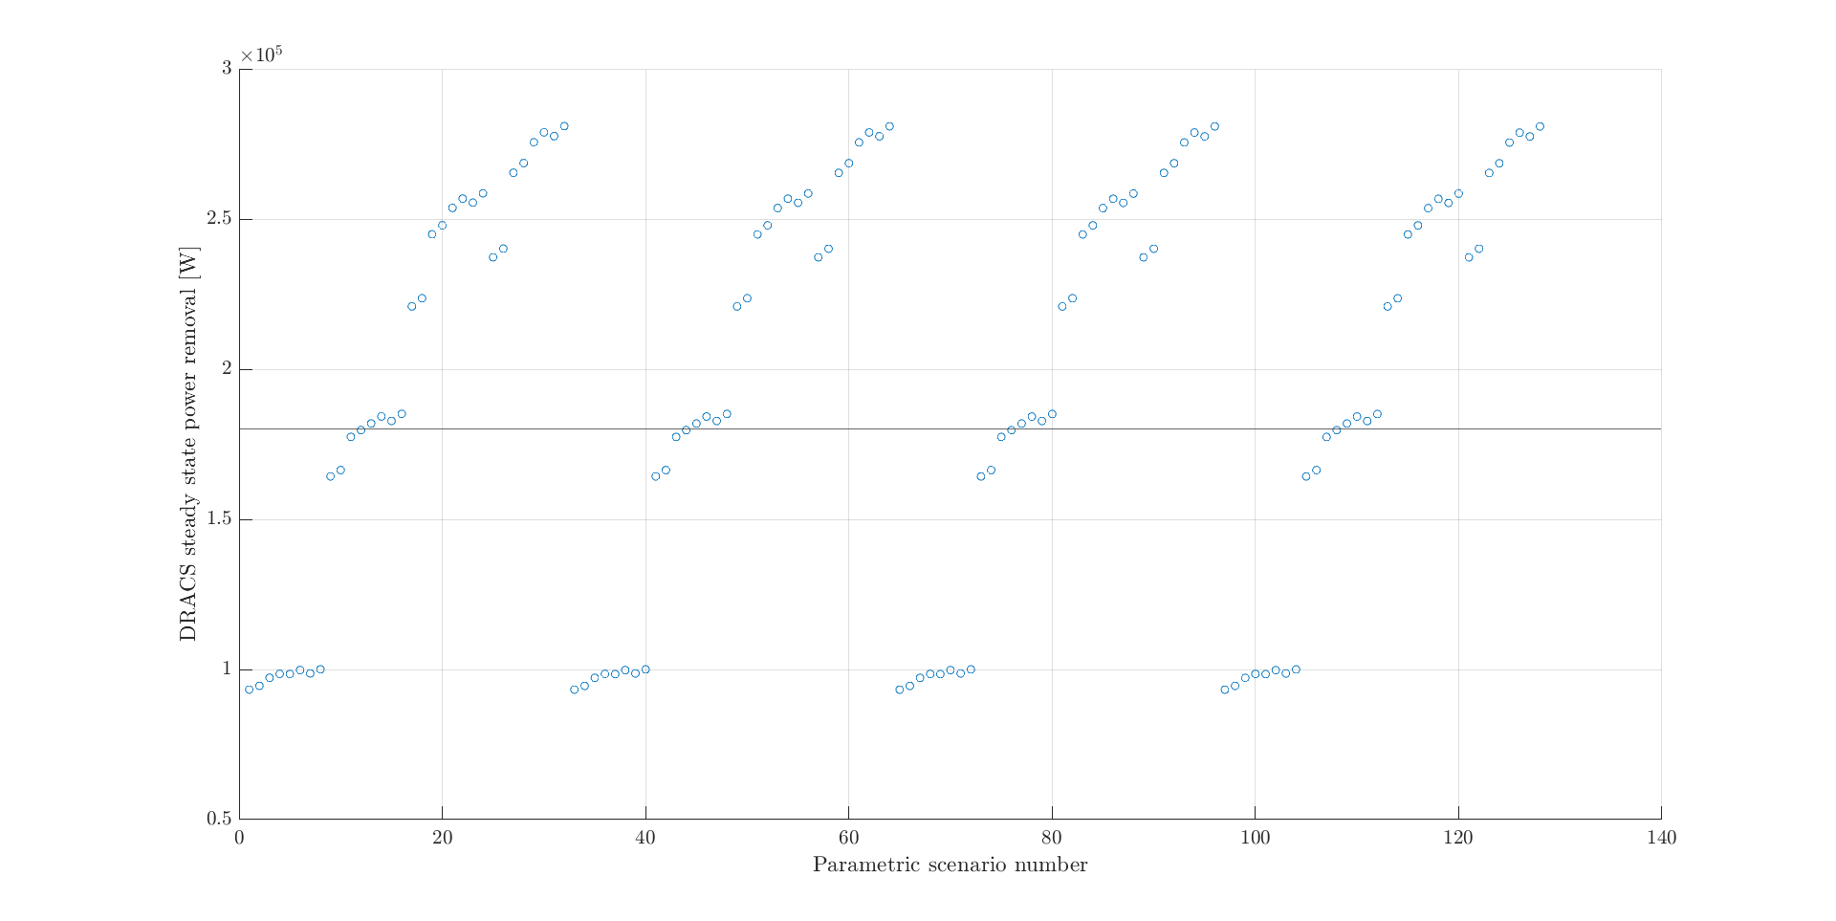
Parametric NaK results:
Run model parametrically as a function of:
NaK heat exchanger area
Air heat exchanger area
NaK loop height
Air chimney height

Slide 12
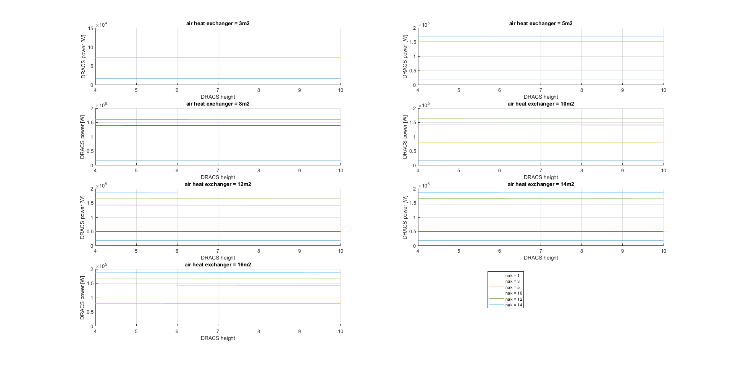
120kW removal → height: 4+4 m
Nak area: 8m2
Air area 14 m2
256*18/12 pipes of 1 m height @ 1 cm radius
180kW removal → height: 4+4m
Nak area: 12m2
Air area 14 m2
HX dim: 256 pipes of 1 m height @ 1 cm radius

Slide 13
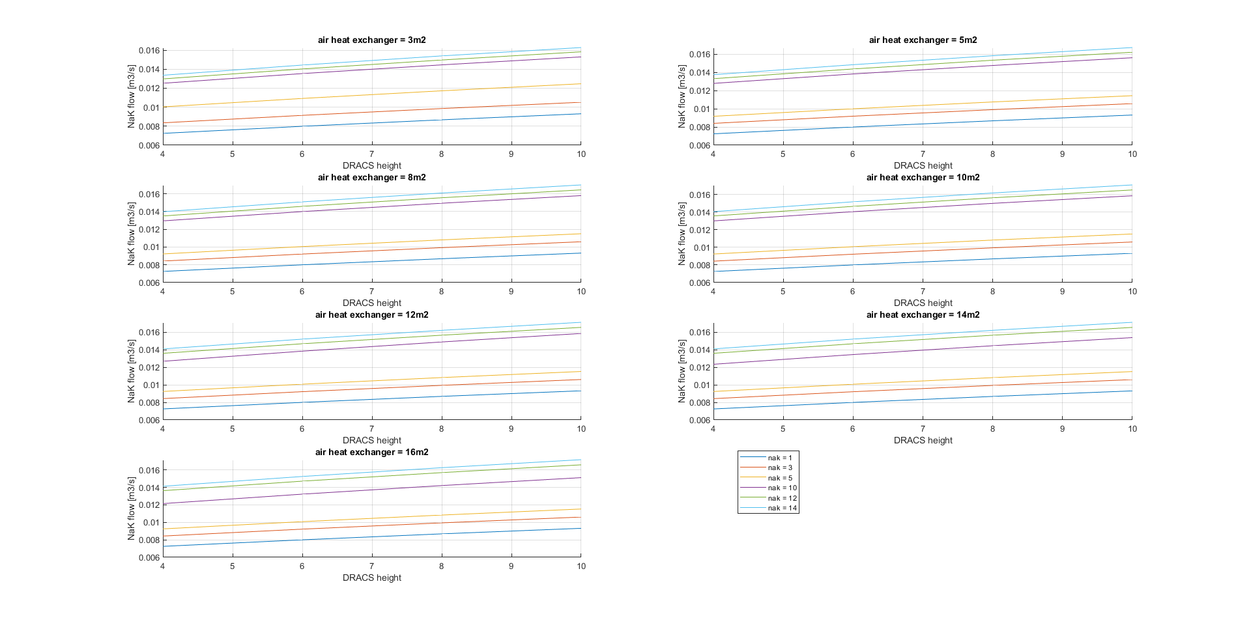
NaK flow increases with height of NaK column.
Total heat removal remains the same.
Since flow increases
Time inside heat exchanger decreases
Time for heat transfer decreases
Temperature difference at heat exchanger inlet/outlet decreases.

Slide 14
Heat exchanger scaling fluids for NaK loop:
Simulations with air as working fluid did not work as expected:
Use LMTD theory of heat exchangers to approximate heat exchanger area
Assume: same temperatures for the working fluid (same LMTD)
Heat transfer coefficient for Na-N2: 10 times less than that of Na-NaK
Area of primary heat exchanger: 10 times more
Equivalently: for air-air heat exchanger: 5 times more.
Same mass flow →1000 velocity
Height of loop: hydraulic resistance for air: 20 times less
Height of loop should be much higher!
Alternatively, the heat exchange areas can be higher and the loop height smaller.
50x pressure difference

Slide 15
Working fluid selection:
The following should be considered for the fluid selection:
Normal operation:
Thermal properties
Conductivity
Specific heat
Because of superior thermal properties: smaller safety systems for NaK.
Fluid properties:
Viscosity → hydraulic resistance
Density with temperature
Accident operation:
What if there is a leak from DRACS to the sodium pool: Na, fluid interaction
Size of Heat Exchangers
Good fluids: Na, NaK, other with high thermal conductivity, high $cp∗rho$

Slide 16
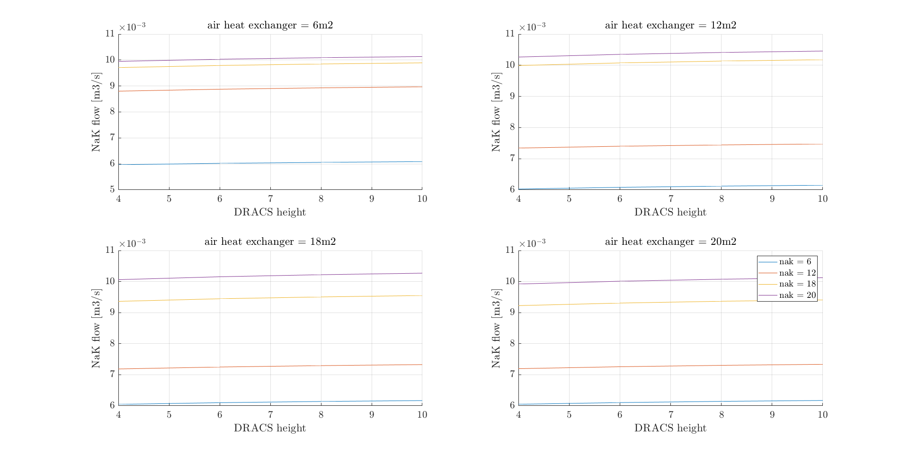
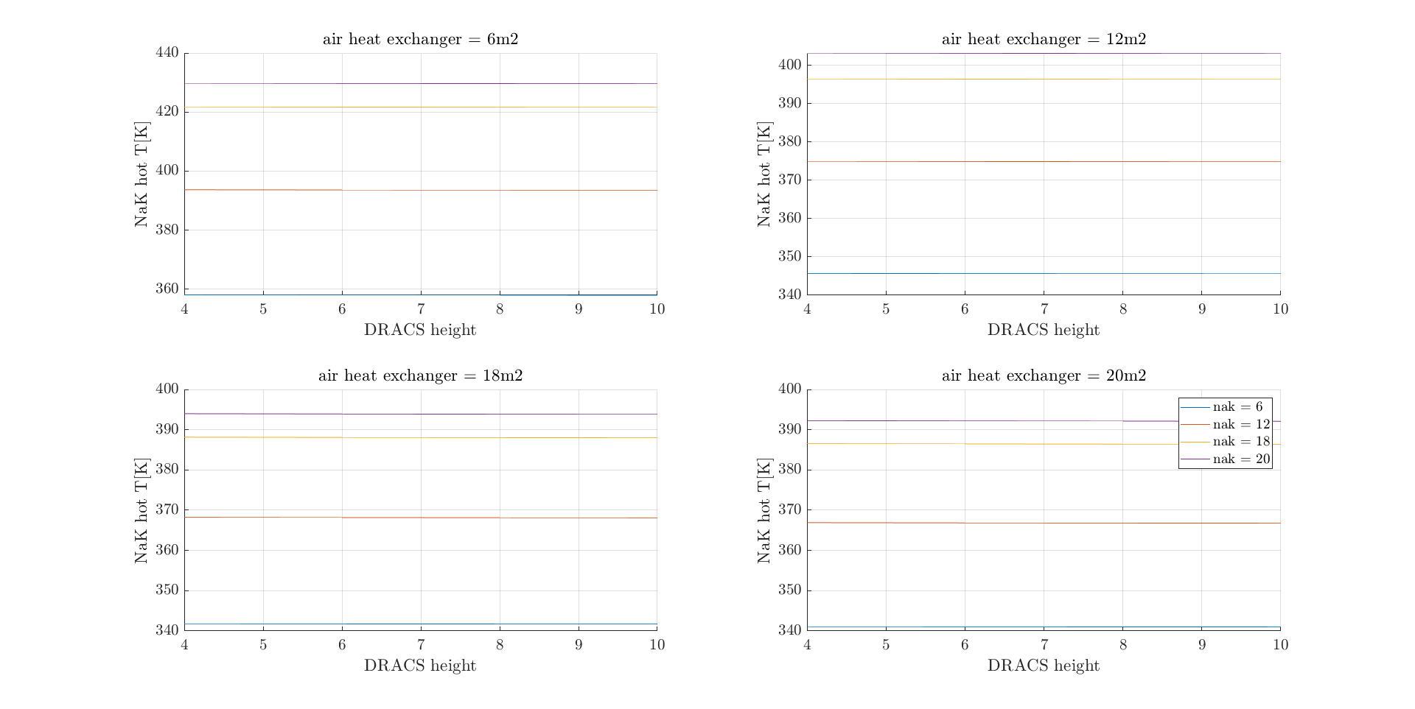
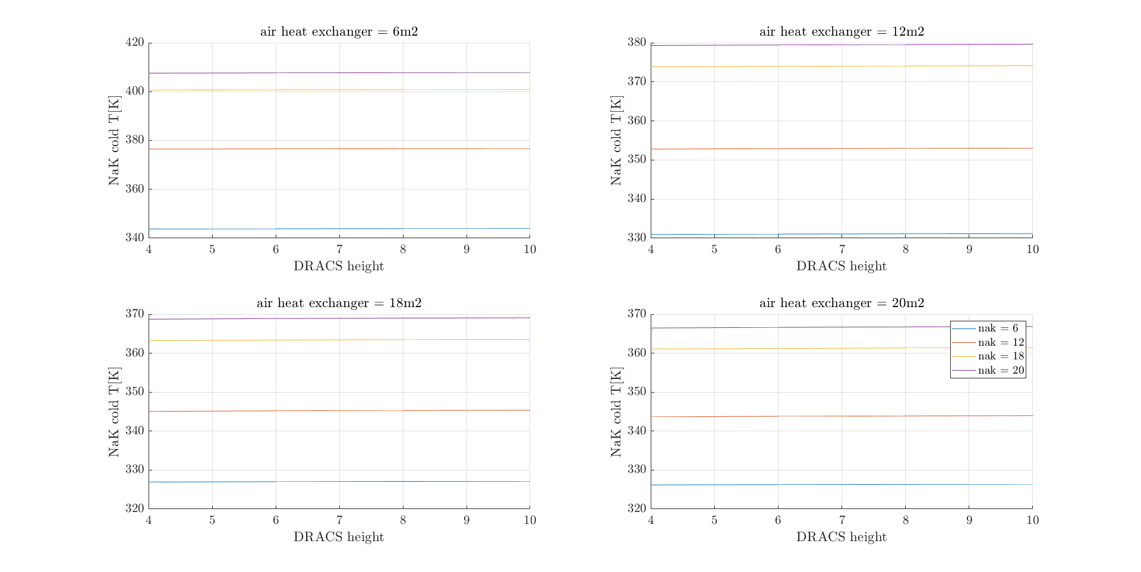
Appendix: NaK

Slide 17
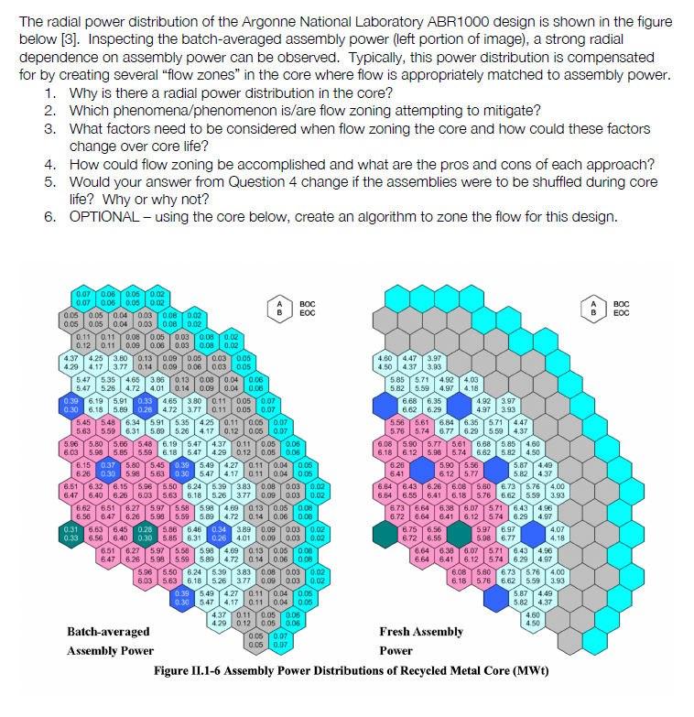
Flow zoning

Slide 18
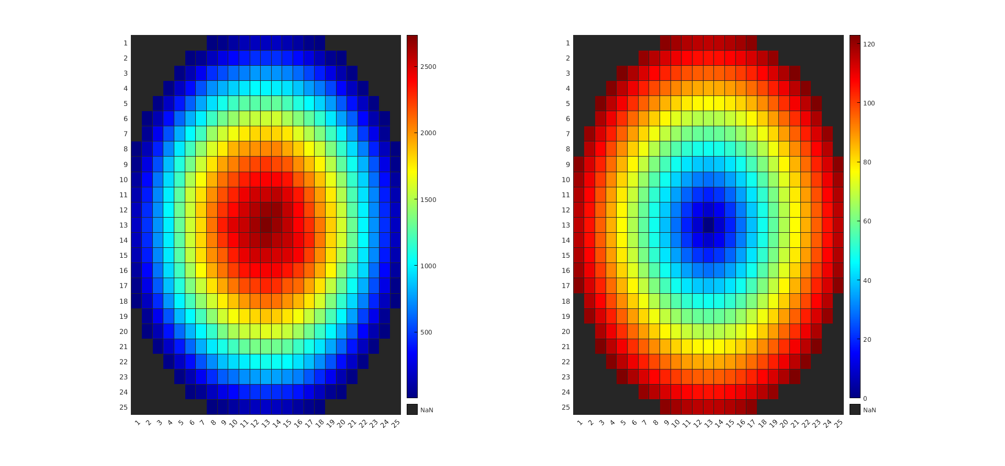
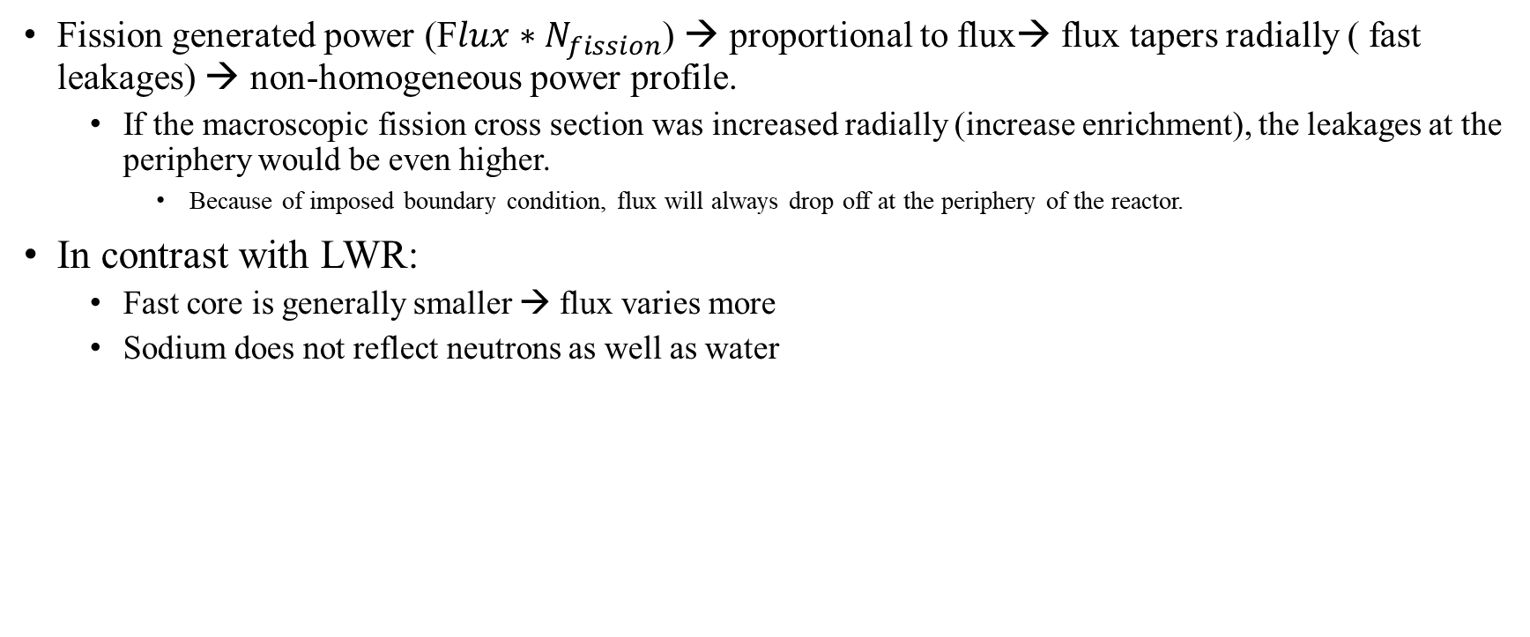
Why radial power distribution:
Fission generated power (F$lux∗N_{fission}$) → proportional to flux→ flux tapers radially ( fast leakages) → non-homogeneous power profile.
If the macroscopic fission cross section was increased radially (increase enrichment), the leakages at the periphery would be even higher.
Because of imposed boundary condition, flux will always drop off at the periphery of the reactor.
In contrast with LWR:
Fast core is generally smaller → flux varies more
Sodium does not reflect neutrons as well as water
From my thesis for sodium cooled microreactor

Slide 19
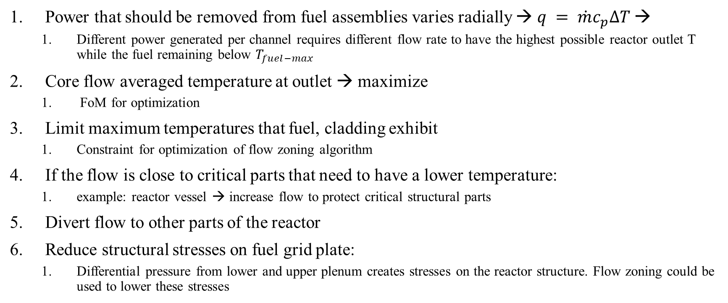
Which phenomena is flow-zoning mitigating:
Power that should be removed from fuel assemblies varies radially → $q = \dot{m}c_{p}∆T$→
Different power generated per channel requires different flow rate to have the highest possible reactor outlet T while the fuel remaining below $T_{fuel−max}$
Core flow averaged temperature at outlet → maximize
FoM for optimization
Limit maximum temperatures that fuel, cladding exhibit
Constraint for optimization of flow zoning algorithm
If the flow is close to critical parts that need to have a lower temperature:
example: reactor vessel → increase flow to protect critical structural parts
Divert flow to other parts of the reactor
Reduce structural stresses on fuel grid plate:
Differential pressure from lower and upper plenum creates stresses on the reactor structure. Flow zoning could be used to lower these stresses

Slide 20
What factors should be considered:
Power generation per channel
How power generation changes with BU/ time
What if power distribution remains the same but total power reduces? With the installed orifices would the flow distribution also remain the same without changing the orifices?
It depends!
If the power generation changes above the flow-zone “power levels” → variable orifice should be installed
What is flow velocity at orifices → cavitation? Thermal striping?
Pressure drop at channels might not be the same (different channel hydraulic diameter)
Flow regime:
If laminar hydraulic resistance does not depend on flow velocity
If turbulent however resistance does depend on flow velocity → tend to spread evenly the flow, compensate with higher orrifie resistance.
Ease of installation of orifices, cost
Orifice design should be modular: should be able to be stacked on top of each other to create the desired pressure drop
How the flow enters the lower plenum:
Downcomer?
Mixing plate?

Slide 21
How is flow zoning done:
Goal: vary outlet T radially
To do so: vary flow → vary pressure drop per flow zone
Only solution is to add extra hydraulic resistance to the zones that should have a smaller flow
Another impractical solution would be to have individual feeding systems (pumps) for each flow zone.
This resistance can either be constant throughout the lifetime of the reactor, or change as a function of BU.
What if core is shuffled:
If core is shuffled → radial power distribution changes
Either implement flow zoning algorithm described below to optimize for outlet T for core’s lifetime, with constant orifice resistance
Or use variable orifices

Slide 22
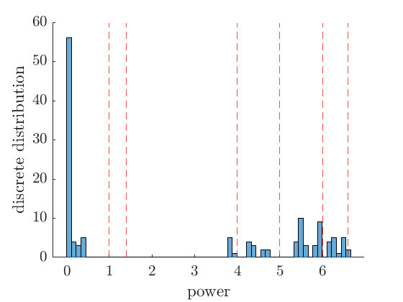
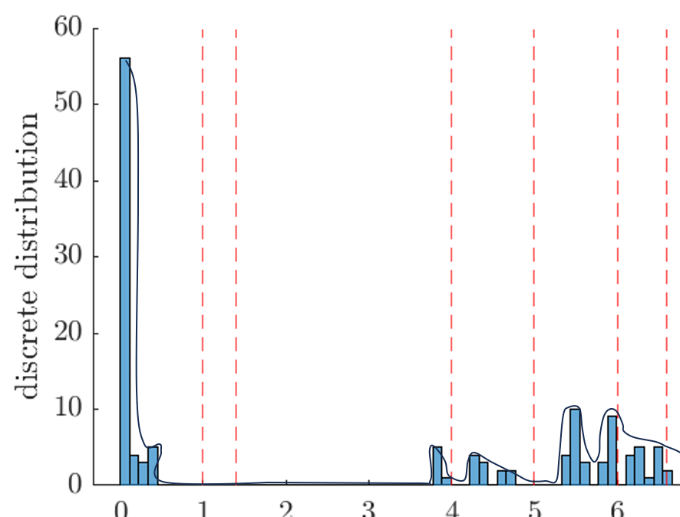
Flow zoning algorithm to maximize outlet temp:
Problem statement: position of cuts is what? So that core averaged outlet T is maximized while fuel T below limits
Optimization parameters
FoM
constraints
Discrete optimization problem → harder to solve. It could be approximated by using the equivalent “Continuous problem”
Take power values and create histogram:
From discrete distribution function, can analytically approximate its shape:
Now we have an analytical description of the distribution function of the radial power density.

Slide 23
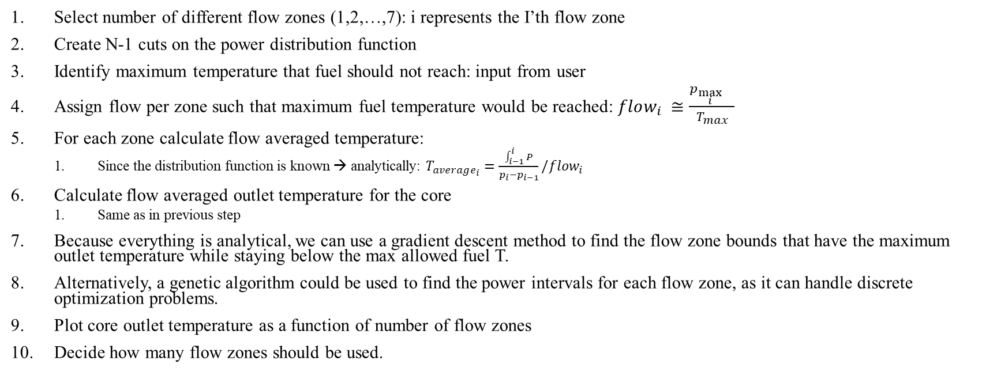
Algorithm continued:
Select number of different flow zones (1,2,…,7): i represents the I’th flow zone
Create N-1 cuts on the power distribution function
Identify maximum temperature that fuel should not reach: input from user
Assign flow per zone such that maximum fuel temperature would be reached: $flow_{i} ≅\frac{p_{\max_{i}{}}}{T_{max}}$
For each zone calculate flow averaged temperature:
Since the distribution function is known → analytically: $T_{average_{i}}=\frac{\int_{i−1}^{i}{P}}{p_{i}−p_{i−1}}/flow_{i}$
Calculate flow averaged outlet temperature for the core
Same as in previous step
Because everything is analytical, we can use a gradient descent method to find the flow zone bounds that have the maximum outlet temperature while staying below the max allowed fuel T.
Alternatively, a genetic algorithm could be used to find the power intervals for each flow zone, as it can handle discrete optimization problems.
Plot core outlet temperature as a function of number of flow zones
Decide how many flow zones should be used.

Slide 24
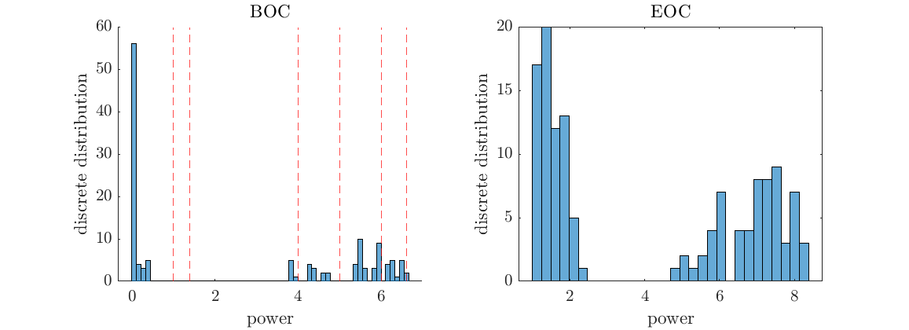
If we have multiple power distribution functions (BOC, EOC, etc.) :
Distribution function for each snap-shot (previous algorithm)
Conduct same analysis as before, but with common bounds for multiple snap-shots
FoM: Average outlet temperature from all snap-shots

