Slide 1
„Wo ist die Hefe?“
Team Awesome - IT Schwarz

Slide 2


Lidl Plus²
2

Slide 3
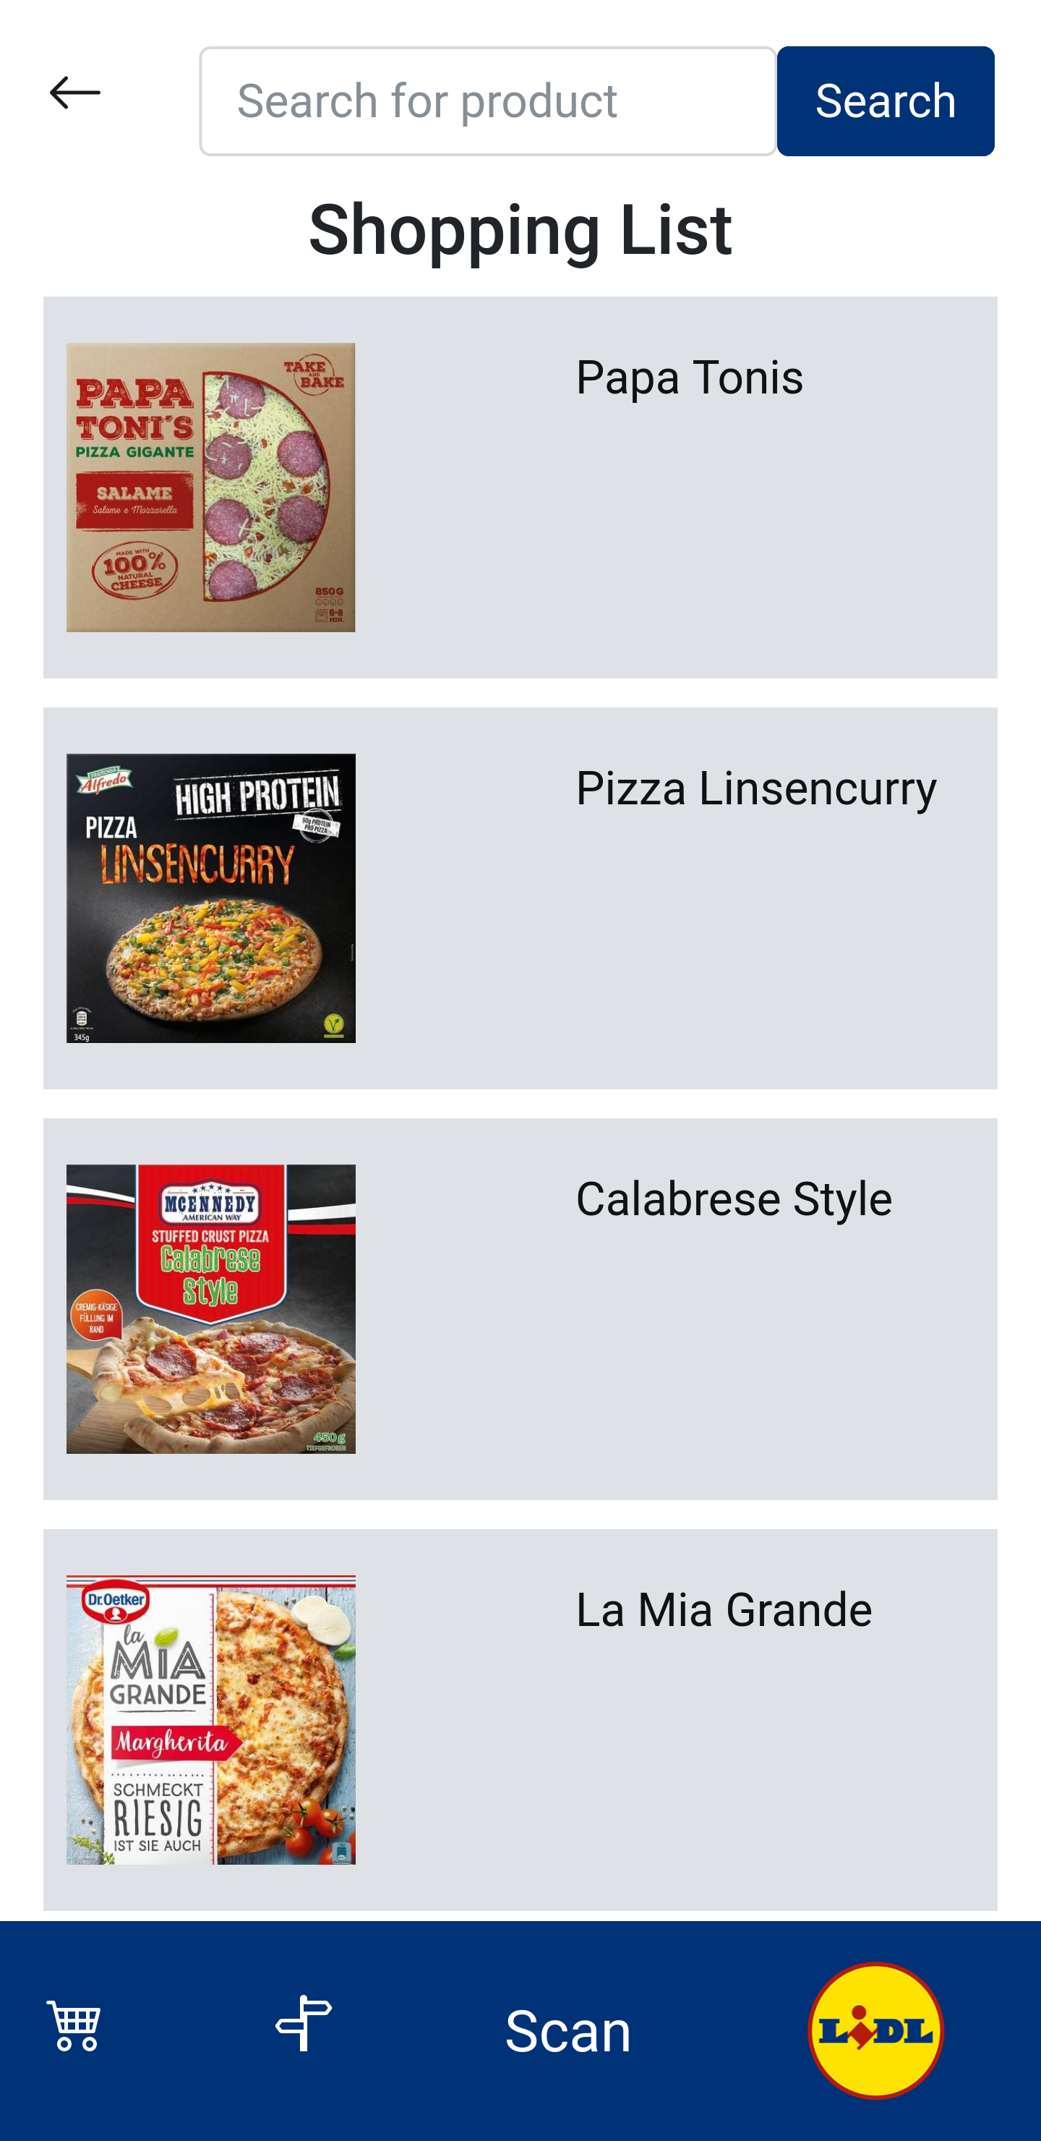
Lidl Plus² - shopping list
recommends products
from previous shopping trips,
fitting products
learns buy-rhythm for future recommendations
filters out known allergies and incompatibilities
adds products that you scan with your phone
2

Slide 4
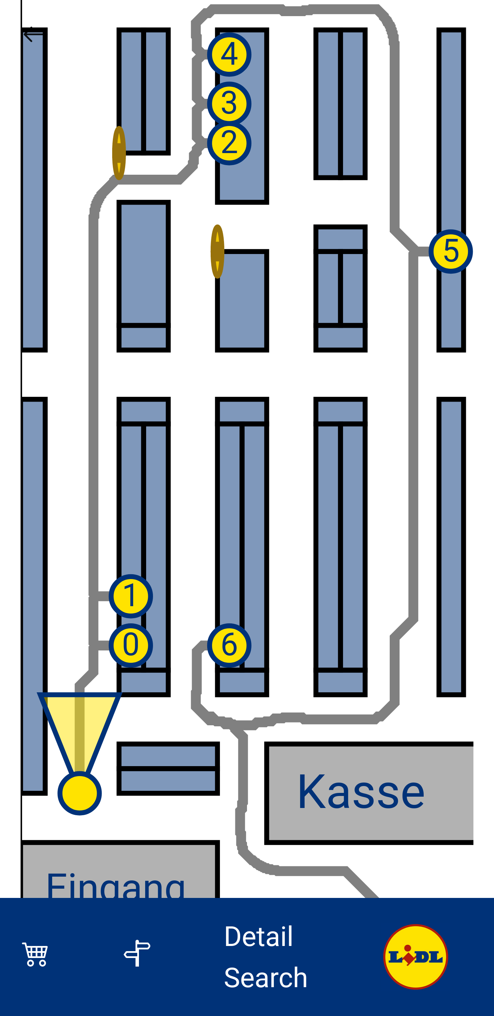
Lidl Plus² - navigator
calculates shortest route to collect all products (travelling sales man - optimization)
localization:
gyro detects steps to measure distance
compass detects direction of view / movement
references itself when items are scanned
shows special offers along the route
includes „hidden“ specials (shopping experience gamification)

Slide 5
Lidl Plus² - scan to find
scan shelf to find product
OCR scans codes of price tags to reference position in market
indicates user where searched device is

Slide 6
Lidl Plus² - scan to buy
scan device to pay on the spot
reduces shopping time
reduces cashiers at checkout
stores all invoices in the app

