Slide 1
Overview
N-gram graphs overview
Serial Update Operation
GPU overview
Parallel Update Operation
Results

Slide 2
N-gram graphs
General concept applicable in various fields
An ’entity’ is broken into ‘pieces’ (called n-grams)
n-grams are connected with edges (based on some logic)
Capable of text representation
Useful in many applications (e.g. topic extraction

Slide 3
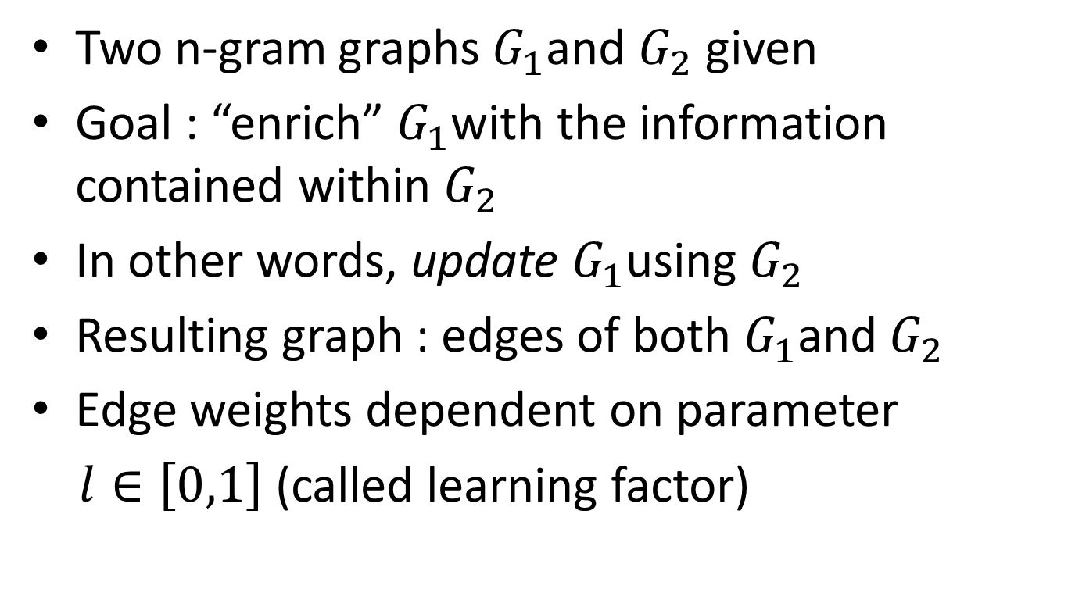
Serial Update Operation
Two n-gram graphs $G_{1}$and $G_{2}$ given
Goal : “enrich” $G_{1}$with the information contained within $G_{2}$
In other words, update $G_{1}$using $G_{2}$
Resulting graph : edges of both $G_{1}$and $G_{2}$
Edge weights dependent on parameter
$l∈\left[0,1\right]$ (called learning factor)

Slide 4
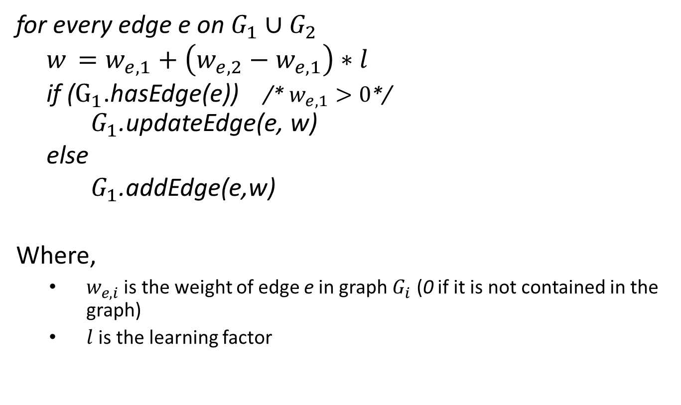
Serial Update Operation - Algorithm
for every edge e on $G_{1}∪G_{2}$
$w_{ }=w_{e,1}+\left(w_{e,2}−w_{e,1}\right)∗l$
if ($G_{1}$.hasEdge(e)) /* $w_{e,1}>0$*/
$G_{1}$.updateEdge(e, w)
else
$G_{1}$.addEdge(e,w)
Where,
$w_{e,i}$ is the weight of edge e in graph $G_{i}$ (0 if it is not contained in the graph)
$l$ is the learning factor

Slide 5

Update Operation – Execution time
$G_{1}$updated also with other graphs $G_{i}$, i=3,4,…
$G_{1}$can then represent a whole class of documents
Big number of consecutive update operations $→$ time consuming
#updates | 100 | 200 | 300 | 400 | 500 | 600 | 700 | 800 | 900 | 1000
time(sec) | 57.16 | 187.37 | 344.02 | 544.38 | 775.26 | 1050.9 | 1287.8 | 1591.3 | 1874.1 | 2182.9

Slide 6
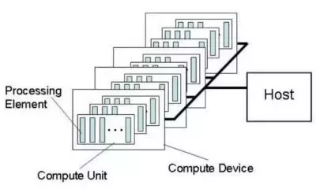
GPU Overview
A GPU consists of a number of Compute Units (CUs)
Each CU consists of a number of Processing Elements (cores)
The exact number of CUs and cores per CU is vendor-dependent
Typical values are 8 CUs and 32 cores/CU for a total of 256 cores

Slide 7
Programming model
Each core executes the same function called kernel
Each instance of the kernel operates on different data
Great for data-parallel applications (for example matrix multiplication)

Slide 8
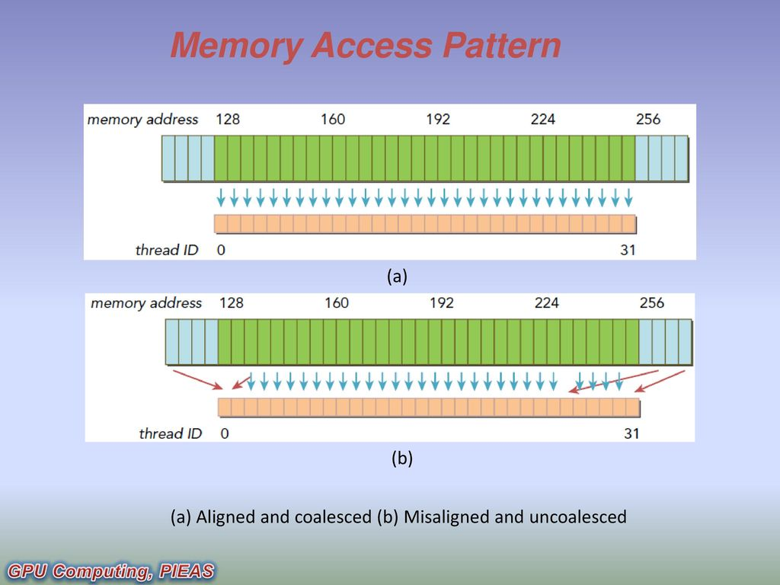
Memory access coalescing

Slide 9
Parallel Update Operation (1/4)
Update operation parallelizable
Edge weight update : independent computation
Individual computations assigned to threads
Threads mapped to GPU cores

Slide 10
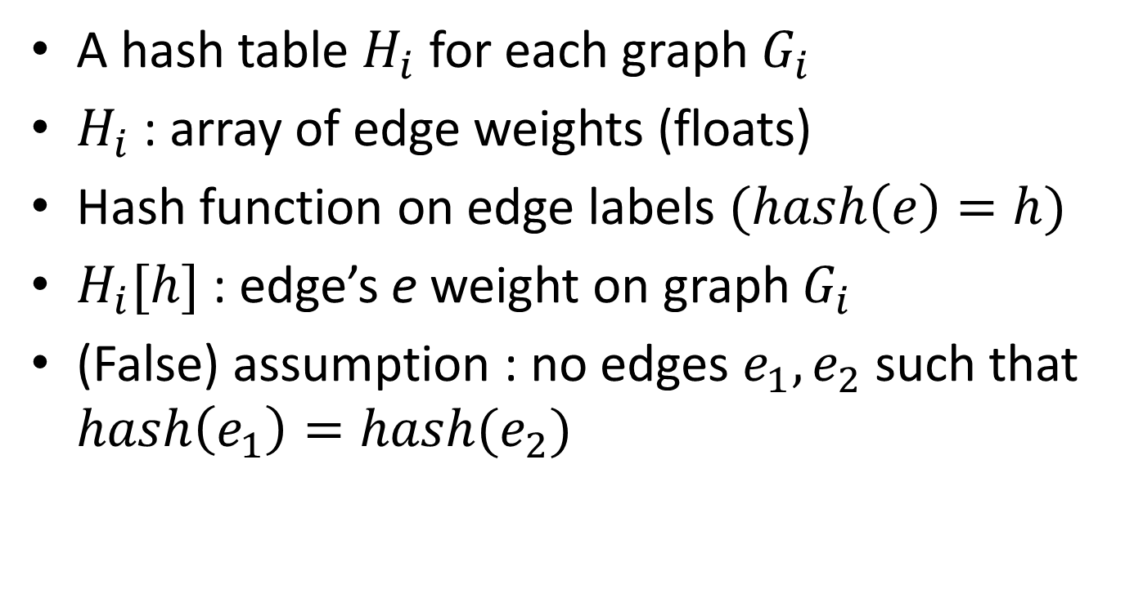
Parallel Update Operation (2/4)
A hash table $H_{i}$ for each graph $G_{i}$
$H_{i}$ : array of edge weights (floats)
Hash function on edge labels $(hash\left(e\right)=h)$
$H_{i}[h]$ : edge’s e weight on graph $G_{i}$
(False) assumption : no edges $e_{1},e_{2}$ such that $hash\left(e_{1}\right)=hash(e_{2})$

Slide 11
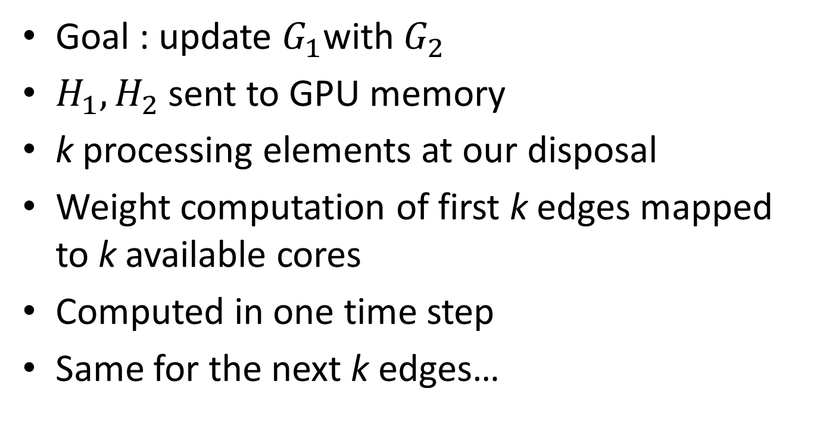
Parallel Update Operation (3/4)
Goal : update $G_{1}$with $G_{2}$
$H_{1},H_{2}$ sent to GPU memory
k processing elements at our disposal
Weight computation of first k edges mapped to k available cores
Computed in one time step
Same for the next k edges…

Slide 12





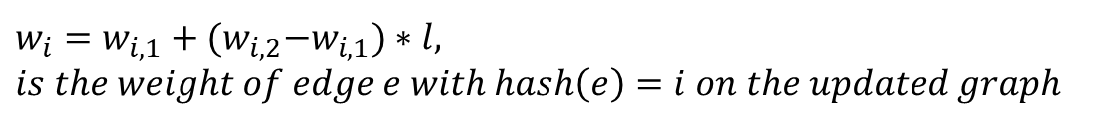

Parallel Update Operation (4/4)
$$w_{0}$$ | $$w_{1}$$ | …….. | $$w_{k−1}$$ | $$w_{k}$$
………..
$$H_{1}$$
$$w_{0,1}$$ | $$w_{1,1}$$ | …….. | $$w_{k−1,1}$$ | $$w_{k,1}$$
$$thread_{0}$$
$$thread_{1}$$
$$thread_{k−1}$$
$$thread_{0}$$
………..
$$H_{2}$$
$$w_{0,2}$$ | $$w_{1,2}$$ | …….. | $$w_{k−1,2}$$ | $$w_{k,2}$$
one time step
$$w_{i,j} is the weight of edge e with hash\left(e\right)=i on graph G_{j}$$
$$w_{i}=w_{i,1}+{(w}_{i,2}−w_{i,1})∗l,$$
$$is the weight of edge e with hash\left(e\right)=i on the updated graph$$

Slide 13
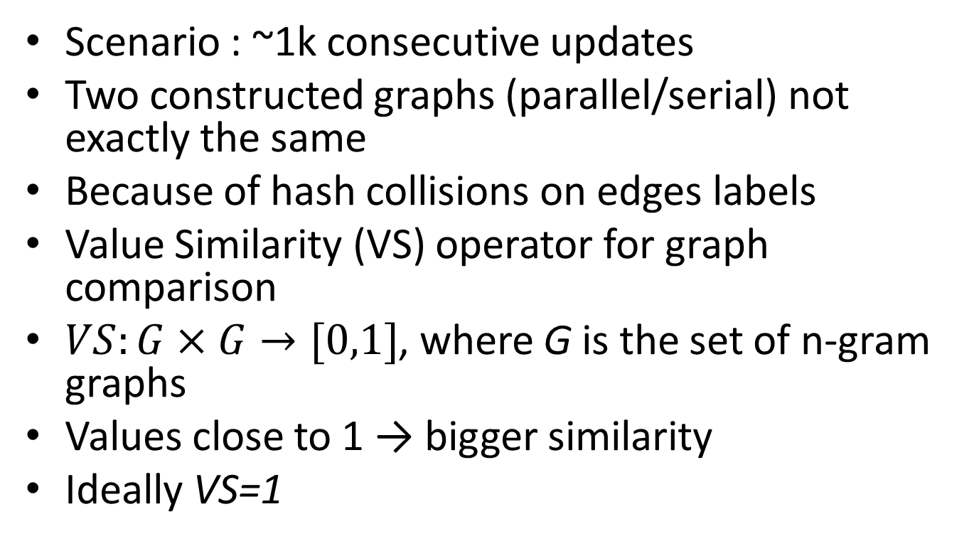
Parallel vs Serial – Similarity
Scenario : ~1k consecutive updates
Two constructed graphs (parallel/serial) not exactly the same
Because of hash collisions on edges labels
Value Similarity (VS) operator for graph comparison
$VS:G×G→[0,1]$, where G is the set of n-gram graphs
Values close to 1 → bigger similarity
Ideally VS=1

Slide 14
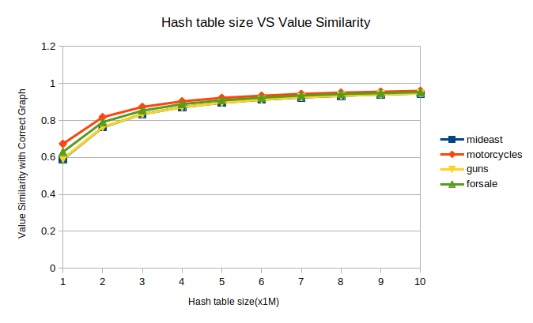

Results (1/2)
(hash table size $↑$) (hash collisions $↓$) (VS$→$1)

Slide 15
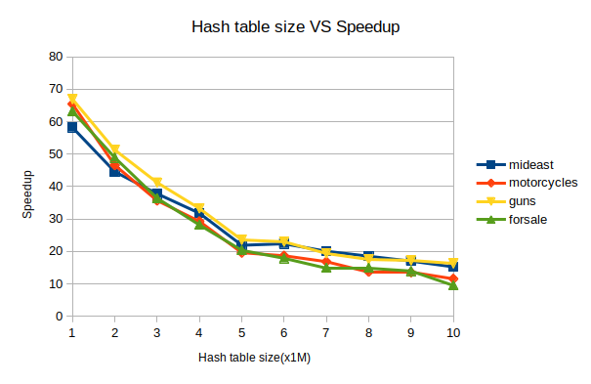

Results (2/2)
$speedup=\frac{serial time}{parallel time}$
(hash table size $↑$) (parallel time $↑$) (speedup $↓$)

Slide 16
Conclusions – Future work
Update operation indeed parallelizable
Non-negligible speedup
Speedup – VS tradeoff
VS threshold should be examined
Collision resolution for GPU program
Similar n-gram graph operations parallelizable

