Slide 1
A SEIR Model of U.S. Influenza Spread Incorporating Interstate Travel Data
Brian Klahn, Xiangwen Wang

Slide 2

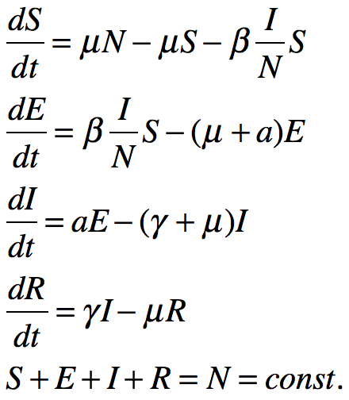
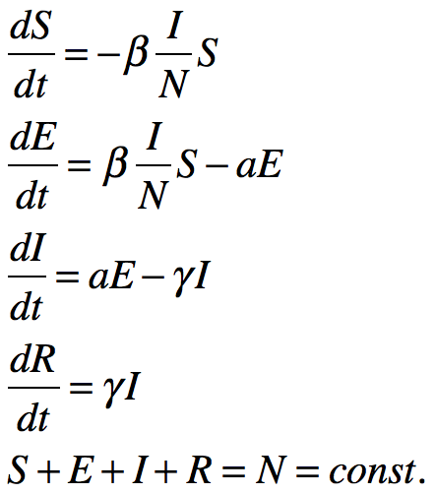
SEIR Model
Proposed by Aron and Schwartz in 1984
One additional compartment is included in the model: Exposed (E) -- individuals that are infected but not infectious
born rate = death rate
Simp. : acute outbreak
J. Aron and I. Schwartz, J. Theor. Biol. 110:665-679 (1984)
H. Hethcote and S. Levin, Applied Mathematical Ecology, 193-211 (1989)

Slide 3
Multi-Group SEIR Models
Proposed to describe the transmission dynamics of infectious diseases in heterogeneous (age, gender, space, etc.) host populations
Population is divided into groups
Homogenous within a group
Age-based multi-group modeling
Two-Group Age Model for Nosocomial Infection
Gender-based multi-group modeling
Spread of Zika with influence of sexual transmission
Treatment-based multi-group modeling
Heroin addiction
P. Magal, et al. SIAM JAM (2013)
P. Padmanabhan, et al. Letters in Biomathematics (2017)
X, Liu, et al. JNSA, (2016)

Slide 4
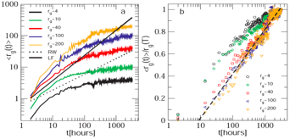
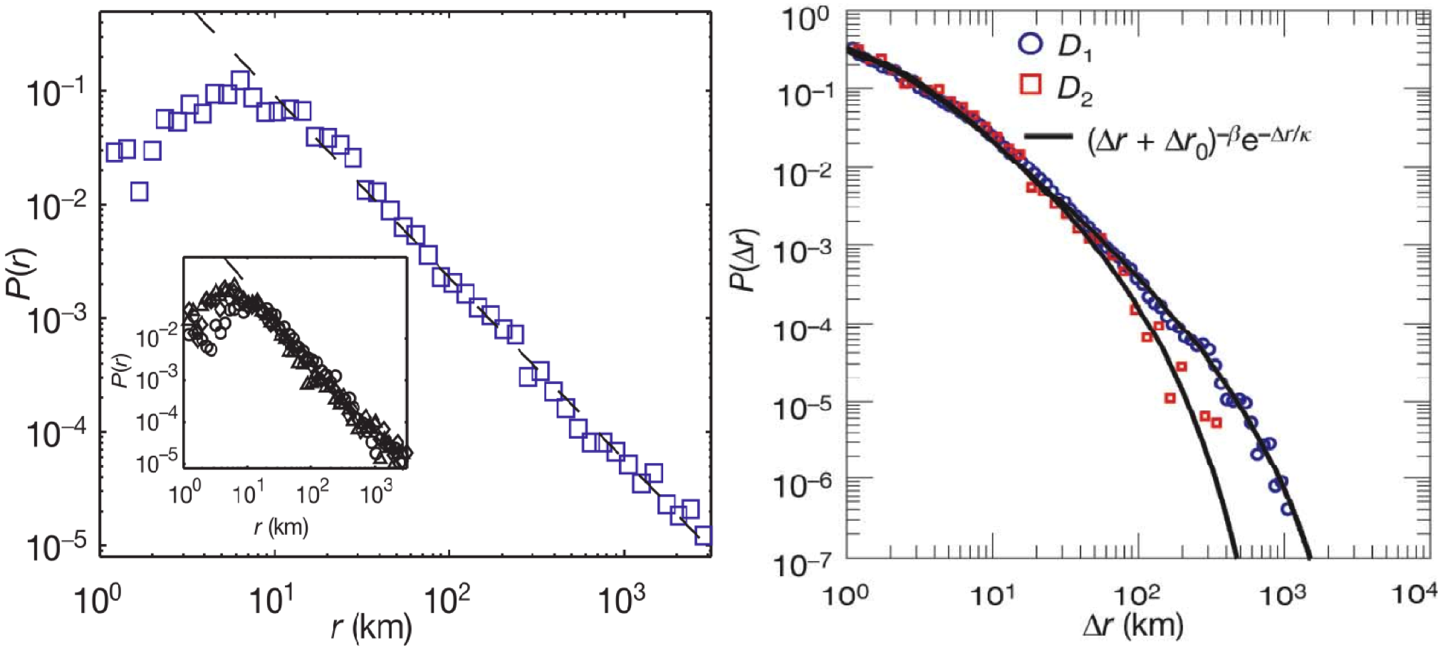
Human Mobility Pattern
Characteristics in human mobility
Localization
Frequent short-range movements
Occasionally long-range relocations
Inter-city / inter-state / inter-country movements
How these movements affect epidemic spreading?
C. Song, et al. Science 327, 1018–1021 (2010)
D. Brockmann, et al. Nature 439, 462-465 (2006)
M. González, et al. Nature 453, 779-782 (2008)

Slide 5
Agent Based Models
Can be used to add/include discrete behaviors
Don’t require/assume uniform/identical behavior for all members of a kind/class
“Using data-driven agent-based models for forecasting emerging infectious diseases”
Better suited to domains where the natural unit of decomposition is the individual
Can be validated at the individual level
Etc.

Slide 6
Equation-Based Models
Work well for changing physical quantities
Can give exact results
Well-known analysis methods (for ODE-based, etc.)
E.g. “Modeling the initial transmission dynamics of influenza A H1N1 in Guangdong Province, China.”
Can be easily scaled up with affordable computational costs
Interpretability of the model and parameters

Slide 7
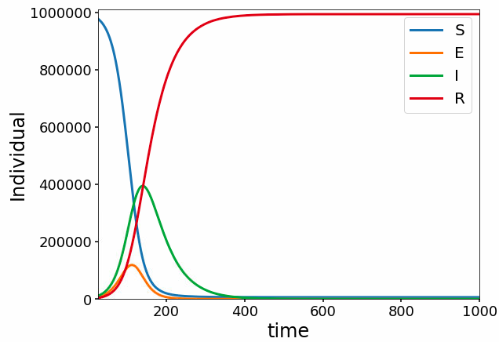

Feasibility Analysis with Agent-Based Modeling
10 cities, each consists of 100,000 individuals
Cities are fully connected
At each time step, a small proportion of the individuals will migrate among cities
Initially, only one city has infectious individuals (I, 5%)
All the other individuals are initially susceptible (S)
Other parameters:
Vary the migration rate, and check its impact on the spreading of epidemics

Slide 8
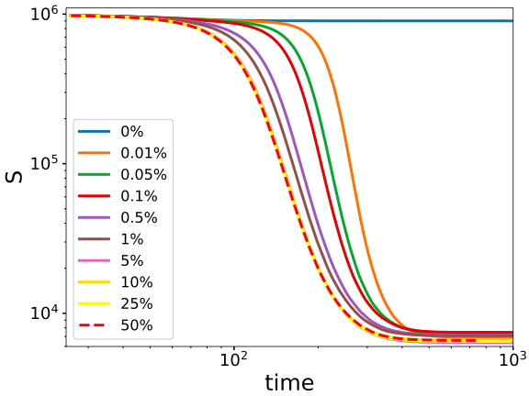
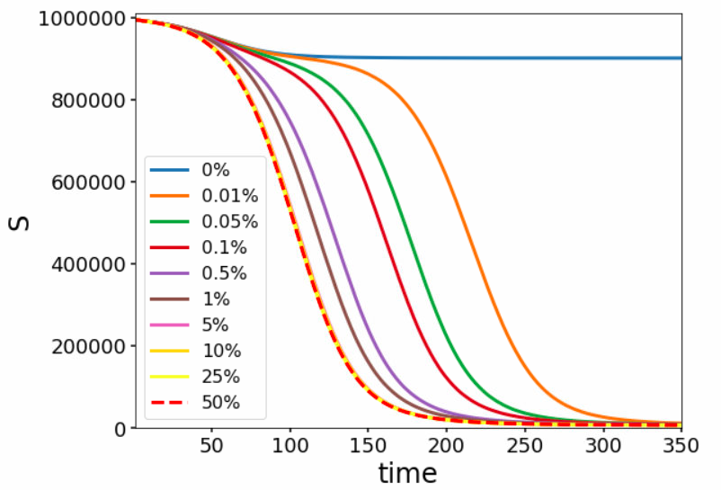
Migration Rate
Effectiveness
Accelerating the spreading
Saturation
Increasing the infecticious

Slide 9
The Model-Building Framework
Plug in a single-compartment disease model, and automatically generate an inter-territory disease-spread model.
The system automatically ingests/integrates
inter-territorial commuter flows
land areas
state populations
The modeler could switch out the disease model and/or adjust the global parameters affecting all the reactions, as well as setting initial values for any states.
Scenario: start only with a certain number Infected people in one state, and see how fast it might reach the other states.

Slide 10
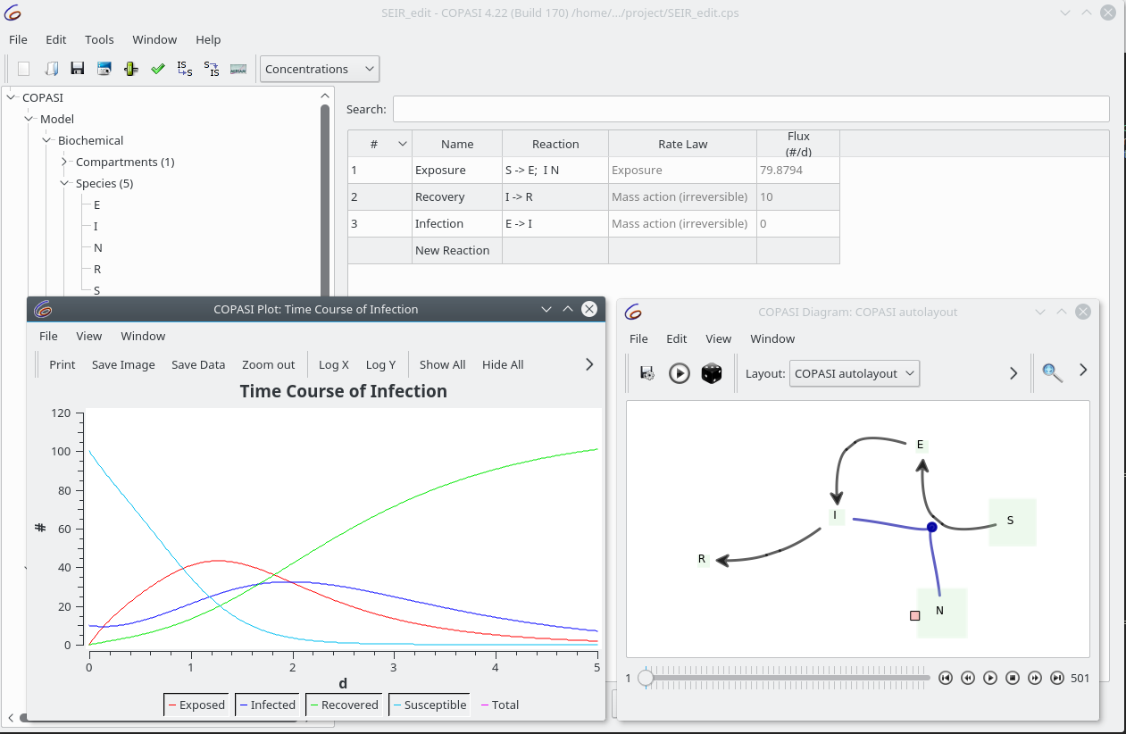
Single Compartment SEIR Model in COPASI

Slide 11
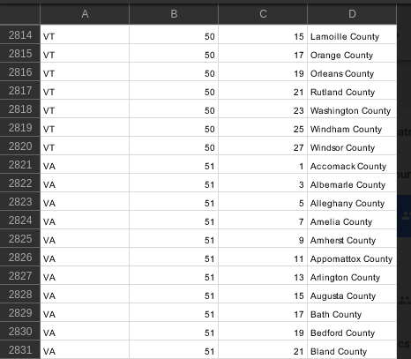
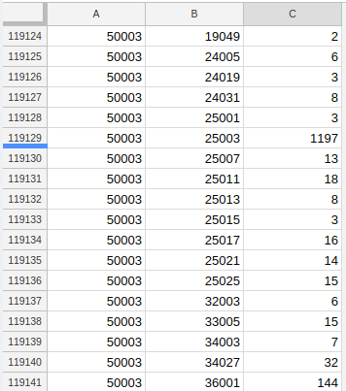
Example Travel Data
U.S. state and county coded commute flows (including long-distance)

Slide 12
Equations for Moving People
A = land area in square miles (analogous to volume, in concentration rate laws)
F = flow number of people in per day, from each state
O = total flow out to any states
N = total state population (calculated by assignment of sum of S, E, I, and R)
[I_{VA}] = (I_{VA} + F_{WV}I_{WV}/N_{WV} + . . . - O_{VA}I_{VA}/N_{VA})/A_{VA}
[S_{VA}]= . . .
[E_{VA}]= . . .

Slide 13
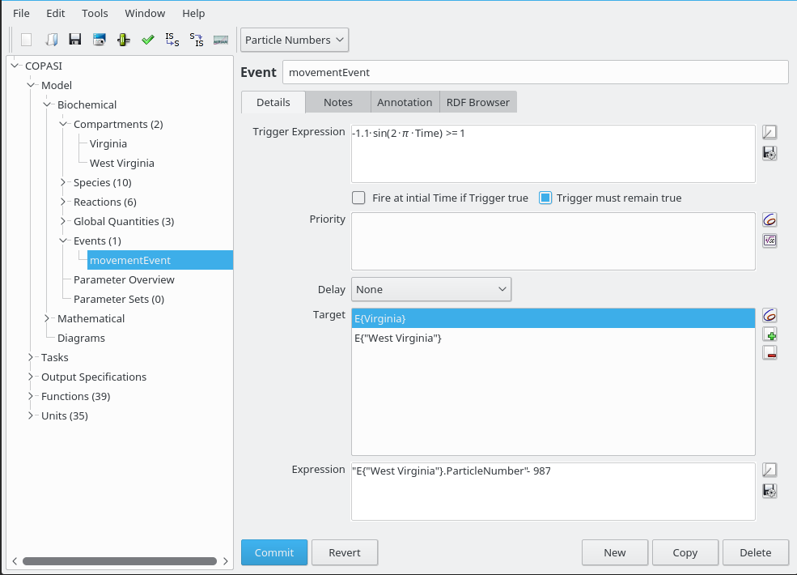
Implementing People Movement
Daily event “trigger” expression
Multiple “target” - “expression” pairs programmatically generated
Each expression dynamically weights the flows in and out by the numbers in given health condition/total

Slide 14
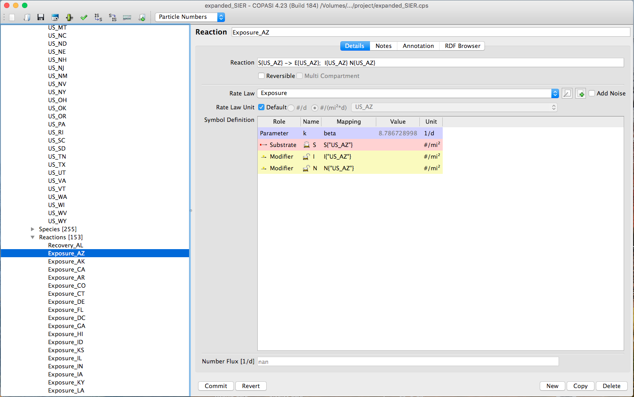
Expanded Model
Separate reactions
Separate species (“conditions”)
Rate constants are global variables
Rates calculated from one built-in and one user-defined function.

Slide 15
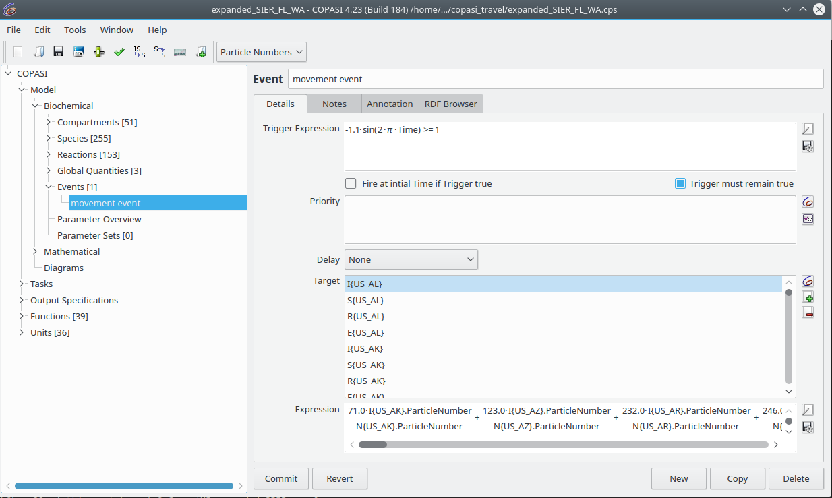
Travel Expressions in COPASI

Slide 16
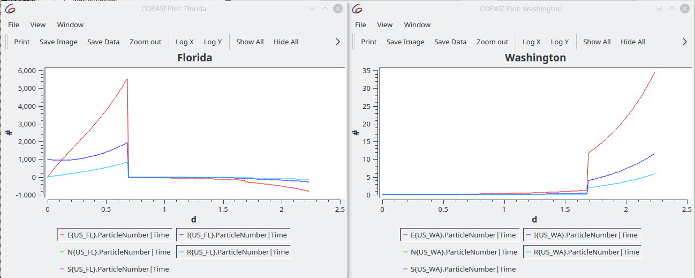
First Step Results (before LSODAR exeception)
1000 Infected seeded in Florida (population is about 21,000,000), results in 5 to 12 Infected and Exposed in Washington, the next day.

Slide 17
After fixing integrator error . . .
Lower seeding number
Raise time course duration to months. The previous result showed just did one travel event. We want many, to show any fluctuations, etc.
Tweek global parameters
Show plots for more/all states (maybe automate COPASI plot creation in builder)

Slide 18
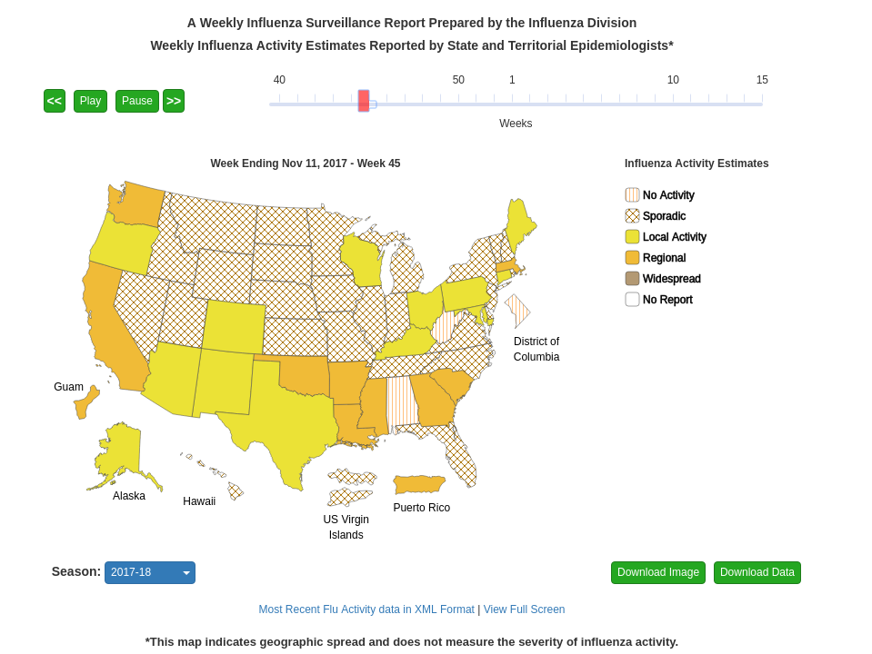
Validation
COPASI’s time course plot might show a pattern where Infections peak at later times, for less “directly connected” states, similar to these flu season graphics.
https://www.cdc.gov/flu/weekly/usmap.htm

Slide 19
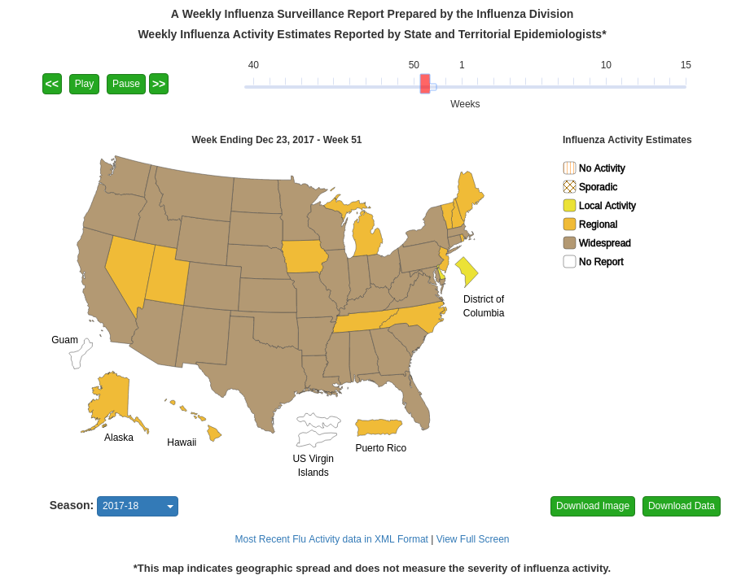
Validation
There might be a wave-like pattern, seen in similar graphics.
https://www.cdc.gov/flu/weekly/usmap.htm

Slide 20
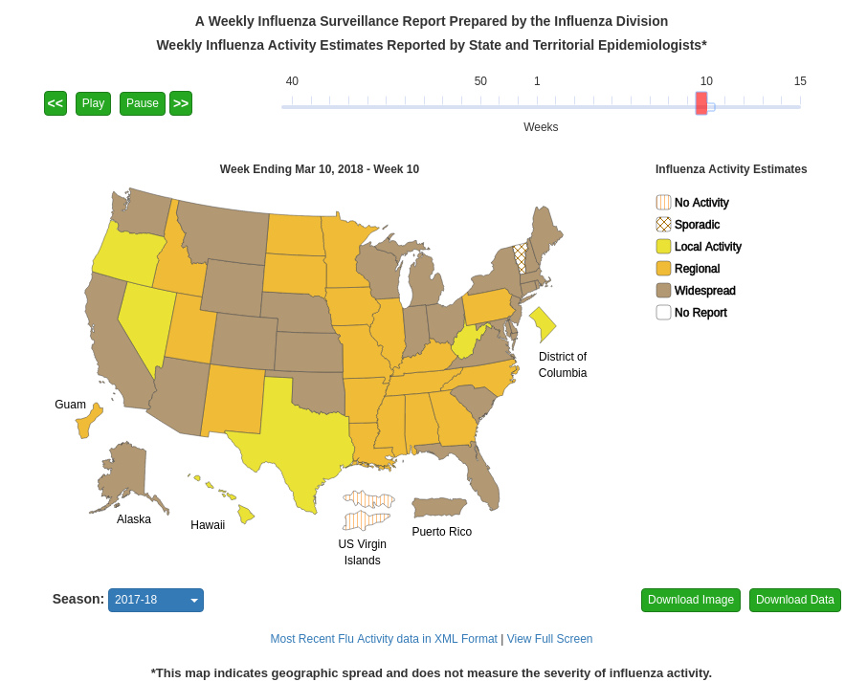
Validation
COPASI time course plot data could be used to set similar graphics. More importantly, it could give clues about interventions which might limit or make the spread less volatile, making for less stress on locally limited resources.
https://www.cdc.gov/flu/weekly/usmap.htm

Slide 21
Interventions
What do we do with this?
Influenza: 12,000 - 56,000 deaths/year; 140,000 - 710,000 hospitalizations/year
“$10.4 billion annually for medical expenses like hospitalizations in addition to $7 billion a year in sick days and lost productivity”
Put vaccine stockpiles in key locations (travel routes or densely populated areas)
Forecast a warning about a potential flu wave moving to your area
Inform policy about isolation education and travel habits
https://www.cdc.gov/flu/about/disease/burden.htm
https://www.marketwatch.com/story/this-is-how-much-this-years-flu-season-could-cost-you-2018-01-09

Slide 22
Potential Extensions or Variations
Add event to simulate closer quarters during winter months, by making all land areas smaller by a given factor (stored in a global value)
Maybe add in a function for hospitalization rate
Use COPASI’s parameter estimation “Task” to optimize fit for experimental data.
Use COPASI’s sensitivities “Task” to try and see which things make the biggest difference in, say, spread of infections.
More formally encapsulate COPASI-containing agents, with their own single-compartment SEIR models (representing states, etc.), to allow further perturbations, and/or processing in a compute cluster.
Trigger alerts when Infection levels/proportions reach a threashold

Slide 23
Thanks to . . .
Stefan Hoops
Bryan Lewis
Anil Vullikanti

Slide 24
Questions?

Slide 25
Review
SIER model
Susceptible
Infected
Exposed
Recovered
Some assumptions
“Well-mixed”, homogeneous population in defined area
No births or deaths

