Slide 1
A SEIR Model of U.S. Influenza Spread Incorporating Interstate Travel Data

Slide 2
Review
SIER model
Susceptible
Infected
Exposed
Recovered
Some assumptions
“Well-mixed”, homogeneous population in defined area
No births or deaths

Slide 3

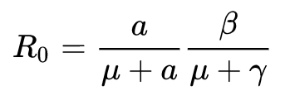
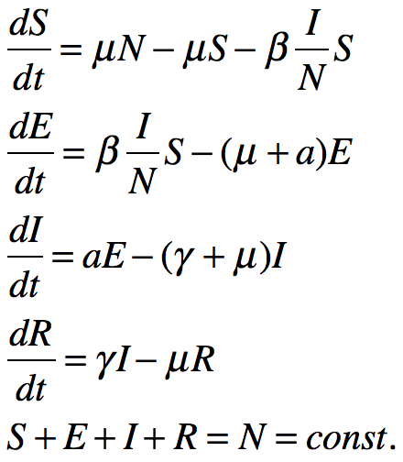
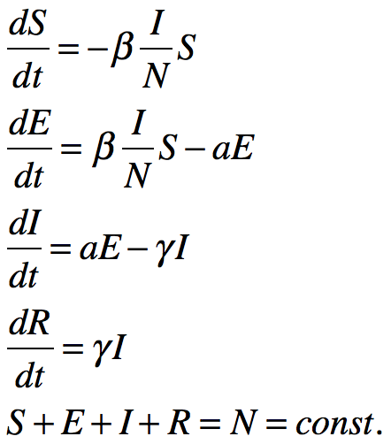
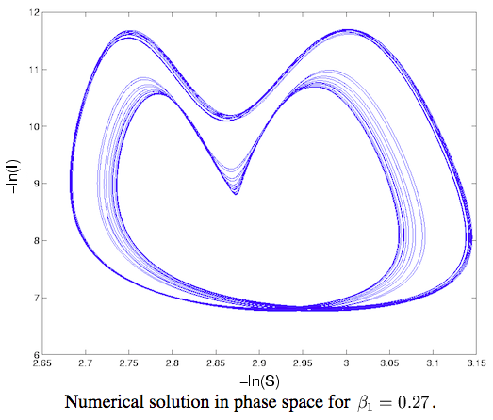
SEIR Model
Proposed by Aron and Schwartz in 1984
One additional compartment is included in the model: Exposed (E) -- individuals that are infected but not infectious, e.g. ...
Simp. : born rate = death rate
Simp. : acute outbreak
It successfully reproduces the periodic behavior for epidemic models
J. Aron and I. Schwartz, J. Theor. Biol. 110:665-679 (1984)
H. Hethcote and S. Levin, Applied Mathematical Ecology, 193-211 (1989)

Slide 4
SEIR Models for Epidemic Prediction
Tracking epidemics with Google Trends data
State-space SEIR model
Parameter adjustment is based on a sequential surveillance model
Rely on the Google flu Trends data
Modeling the parameters in H1N1 outbreak
Modified SEIR model, infectious includes symptomatic and asymptomatic individuals
Observed epidemic data were used to estimate initial parameters
To predict H1N1 outbreak in Guangdong, China
Ebola outbreak forecast
Agent-based spatial SEIR model
Synthetic population and social contact network were generated
Simulation optimization / Bayesian calibration were used for adjusting parameter configuration
V. Dukic, H. Lopes, N. Polson, JASA, 107:500, 1410-1426 (2012)
X. Tan, L.Yuan, et al. International Journal of Infectious Diseases, 17, e479-e484 (2013)
S. Venkatramanan, et al. Epidemics, in Press (2017)

Slide 5
Equation-Based Models (EBM)
Work well for changing physical quantities
Can give exact results
Well-known analysis methods (for ODE-based, etc.)
E.g. “Modeling the initial transmission dynamics of influenza A H1N1 in Guangdong Province, China.”
Can be easily scaled up with affordable computational costs
Interpretability of the model and parameters

Slide 6
Agent Based Models
Can be used to add/include discrete behaviors
Don’t require/assume uniform/identical behavior for all members of a kind/class
“Using data-driven agent-based models for forecasting emerging infectious diseases”
Better suited to domains where the natural unit of decomposition is the individual
Can be validated at the individual level
Etc.

Slide 7
The Idea
Combine some features of both forms of modeling.
Make a system to create a simple model, for quick, in-field, assessment.
The construct:
48 compartment COPASI model, representing 48 contiguous U.S. states
SEIR model “running” in each state
Regularly update individuals (“particles”), based on commuter travel data, using COPASI “events”
Commuter data is a first step of incorporating agent-like human behavior
In COPASI, the ODE SEIR model can be converted to a stochastic model, also.
Goal application: a quickly created and deployable modeling system an assessment agency might run in the field.

Slide 8
The Plan
A quick, one-compartment model was prototyped in COPASI, based on the following SEIR web application. http://www.public.asu.edu/~hnesse/classes/seir.html
Create 48 compartments containing the SEIR reactions
Use Python-COPASI language bindings to create script to generate model with compartments, “species”, events, etc.
COPASI events will be periodically triggered to move people between pairs of states
The numbers transferred between pairs of states will be determined by U.S. Census Bureau, American Community Survey (ACS) data, normalized by state population.
Start with tractable model, then add complexity as needed.

Slide 9
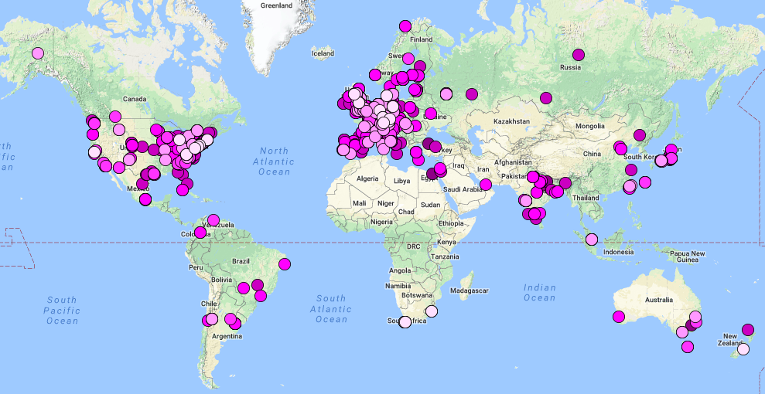
Introduction to COPASI
COmplex PAthway SImulator
copasi.org
Both ODE and stochastic simulation
Hybrid methods with automatic switching
Will have ODEs with stochastic “noise” terms
Many analysis “tasks” available
Steady state determination
Parameter scanning
Parameter estimation (optimized to fit experimental results)
Sensitivity analysis
Bifurcation analysis (using “cross section” task)
Support for model-checking and quick identification of modeling errors/warnings

Slide 10
Introduction to COPASI
Cross-platform GUI and command-line
Open source, available on GitHub
Well supports SBML standard
Active development and maintenance
9 core software team members
Many core developers/testers regularly use COPASI in research
Many users, and mature, knowledgeable user community (online user forum)
Soon coming features
Delayed differential equations
Higher level API, for more programmatic model creation/editing, etc.
Model versioning and provenance
more

Slide 11
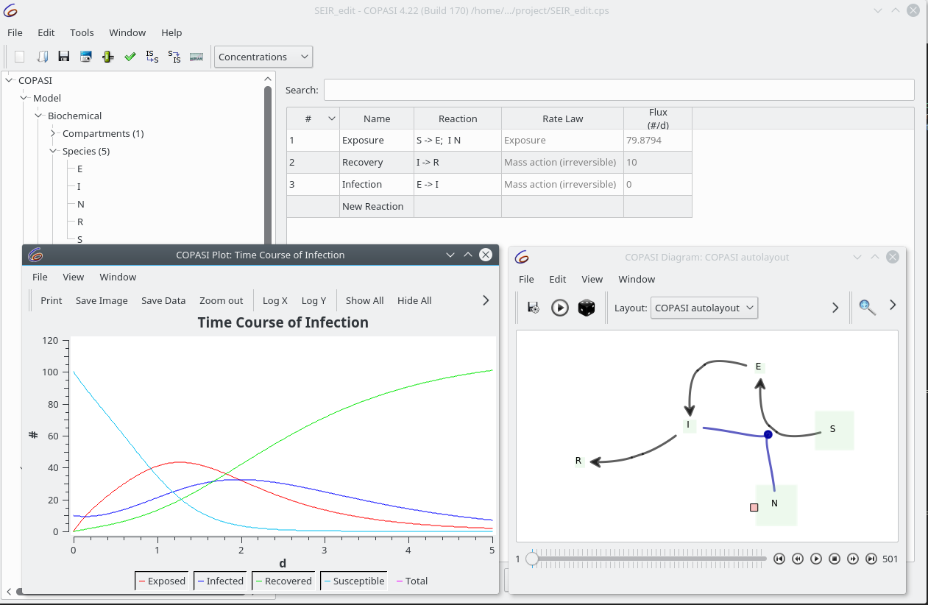
Single Compartment SEIR Model in COPASI

Slide 12
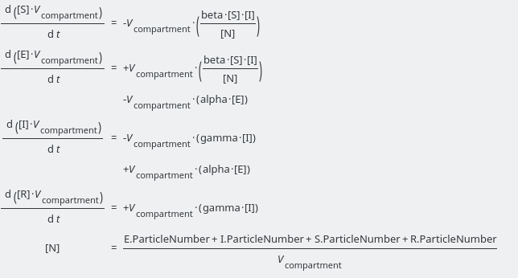
ODEs Generated from Reaction Specifications

Slide 13
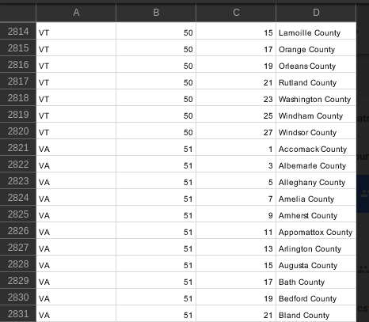
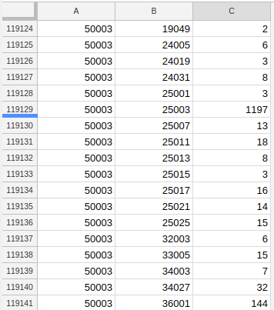
The Travel Data
U.S. state and county coded commute flows

Slide 14
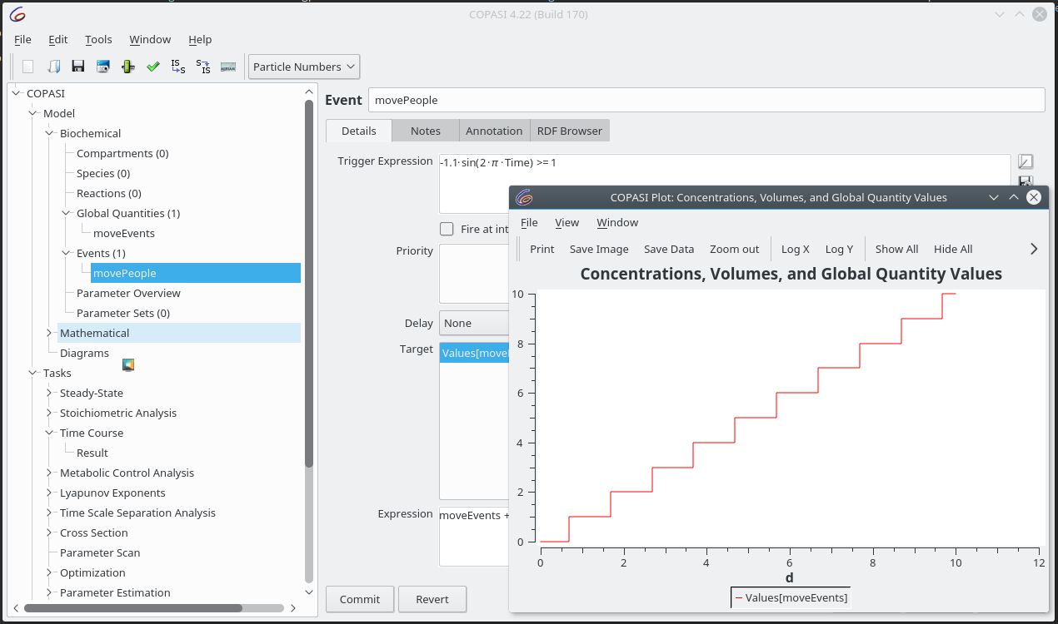
Implementing People Movement
Could model as intercompartmental transport reaction with representative rates, but data granularity doesn’t require/support this.
So use COPASI “events” functionality to move individuals, triggered by periodic (e.g. sine) function.

Slide 15
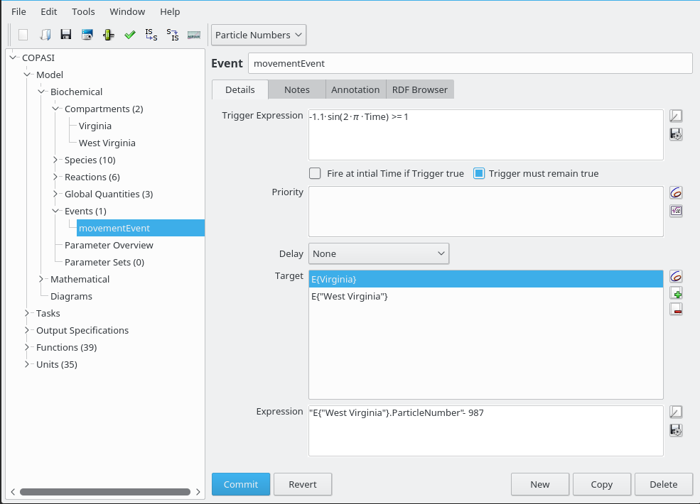
Implementing People Movement
Multiple targets and expressions for the daily trigger.
Targets can be compartment-specific
Underlying model (with multiple compartments, targets, and expressions) create with Python bindings and/or xml library manipulation of cps file

Slide 16
Data Decisions and Processing
Probably only look at contiguous U.S. states, for now (maybe better validation results).
Aggregate totals for all counties, in one state.
Maybe load into RDMS and use SQL to help with summing/aggregating counts, and joining on common U.S. state keys
Or just join with some Python code
Maybe use fractional movement to set proportions of susceptible and exposed people moved.
Perhaps systematically modify proportion of infected travelers to be lower than those who might feel well enough to not stay home.

Slide 17
Potential Extensions or Variations
Maybe add in a function for hospitalization rate
Once the compartments and travel pattern data events are set up, plug in other disease models.
Use COPASI’s parameter estimation “Task” to optimize fit for experimental data.
Use COPASI’s sensitivities “Task” to try and see which things make the biggest difference in, say, spread of infections.
More formally encapsulate COPASI-containing agents, with their own single-compartment SEIR models (representing states, etc.), to allow further perturbations, and/or processing in a compute cluster.

Slide 18
Thanks to . . .
Stefan Hoops
Bryan Lewis
Anil Vullikanti

Slide 19
Questions?

