Slide 1

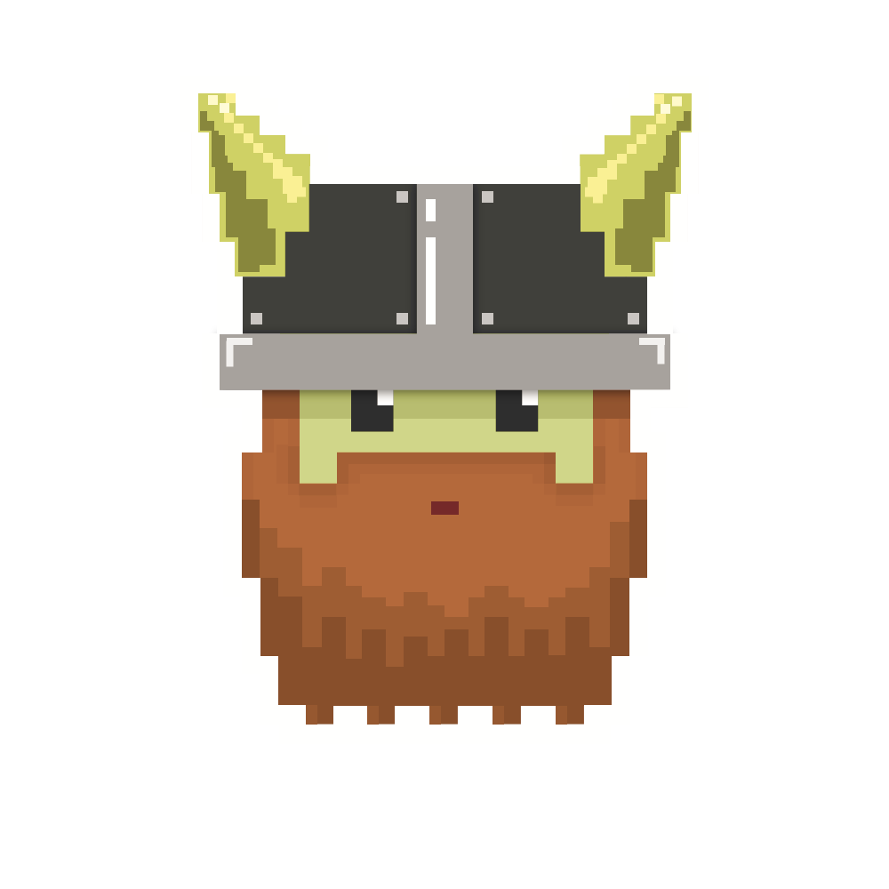
dvcoders
Week 2: Basic Movement
Phaser.io Video Game Project
Sep 27

Slide 2
Review
2D shooter game with JavaScript with Phaser.io
Preload: load image (Before starts)
Create: create objects (Once on start)
Update execute game (Repeat until end)
How to load image file and create “sprites”

Slide 3
Debug Tips
Console/Error message
Right click on page->inspect
Black Screen:
“You have error!”
Green box with diagonal image:
“I don’t have that image!”

Slide 4
Coordinates system
Origin at Top Left side
Down Right is positive side of axis

Slide 5
Anchor
Big object,
Where is the center of object?
Setting Anchor will center your object

Slide 6
Anchor
sprite.anchor.set(xRatio, yRatio);
*Ratio based on width and height

Slide 7
Physics Engine
Arcade
: Easy and quick
Ninja
: More advanced collision
P2/Particle storm
:????????

Slide 8
Physics Engine
//physics engine
game.physics.startSystem(Phaser.Physics.ARCADE);
//apply physics to player sprite
game.physics.enable(player, Phaser.Physics.ARCADE);

Slide 9
Objects/Class
Radio class -> Radio object
Car class -> Car object and Radio object
contains Radio
Access radio object in car object
carObject.radio

Slide 10
Accessing x and y of Sprite
sprite.body.x
sprite.body.y

Slide 11
Input
game.input.keyboard.isDown(Phaser.Keyboard.KEY)
*KEY:
LEFT RIGHT
UP DOWN
SPACEBAR
Check others on API or Phaser homepage

Slide 12
Expectation
Create 3 more platforms
Basic Movement

Slide 13
Challenge
sprite.body.velocity.x
sprite.body.acceleration.x
(Yes, there is y for these also)

Slide 14
Next
Physics and Collision
Gravity
Collsions
Jump

Slide 15
dvcoders
Week 2: Basic Movement
Phaser.io Video Game Project
Sep 27

