Slide 1

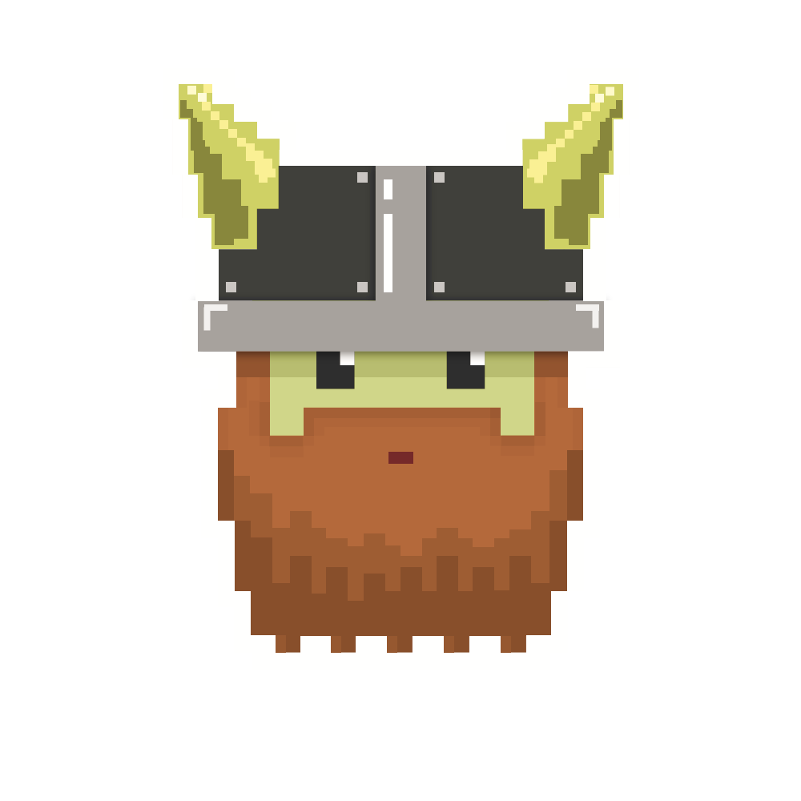
dvcoders
Week 3: Physics
Phaser.io Video Game Project
Oct 4

Slide 2
Review
Coordinate system with origin at top left
Using sprite.body.x (or y) to manipulate position
Use anchor to center the object

Slide 3
Gravity
Some objects (most of them) have gravity
Technically, constant acceleration downward
You can, but don’t need to create by your own

Slide 4
Gravity
sprite.body.allowGravity = true;
sprite.body.gravity.y = PLAYER_GRAVITY;
PLAYER_GRAVITY is constant value

Slide 5
Gravity
sprite.body.acceleration.y = PLAYER_GRAVITY;
More intuitive method (I guess…)

Slide 6
Fixed sprites
game.physics.enable(floor, Phaser.Physics.ARCADE);
floor.body.immovable = true;
Floor is now fixed, not moving at all

Slide 7
Collision
Collision physics is hard
That’s why we use phaser.io
(Duh)

Slide 8
Physics Engine
game.physics.arcade.collide(sprite1, sprite2);

Slide 9
dvcoders
Week 3: Physics
Phaser.io Video Game Project
Oct 4

