Slide 1

Wattcast - Electricity load forecasting from county to household level
Nikolaus Houben, han li, Tianzhen hong
NikolausHouben/WattCast

Slide 2
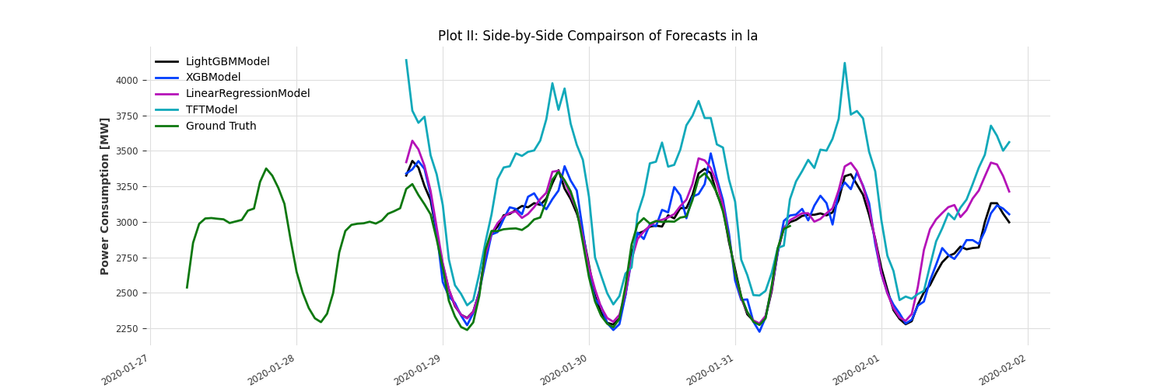
County level Data – Los Angeles

Slide 3
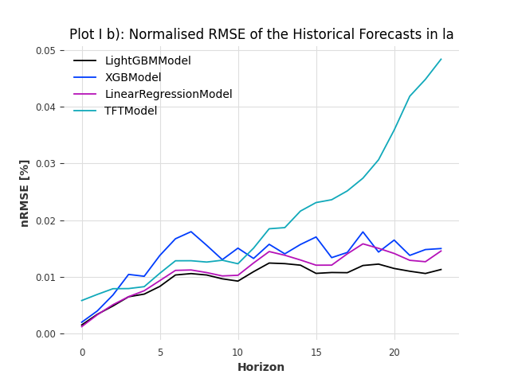
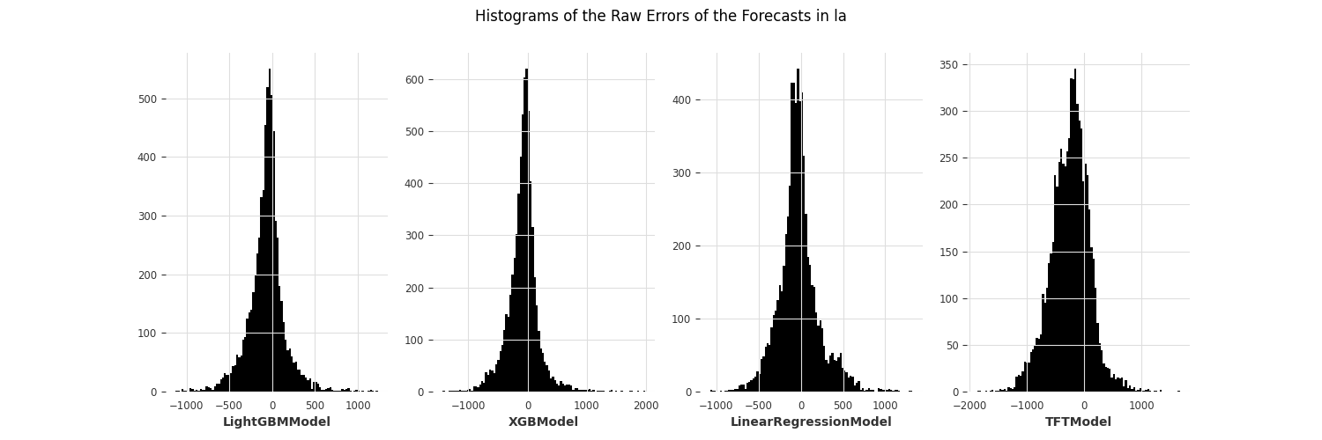
County level Data – Los Angeles

Slide 4
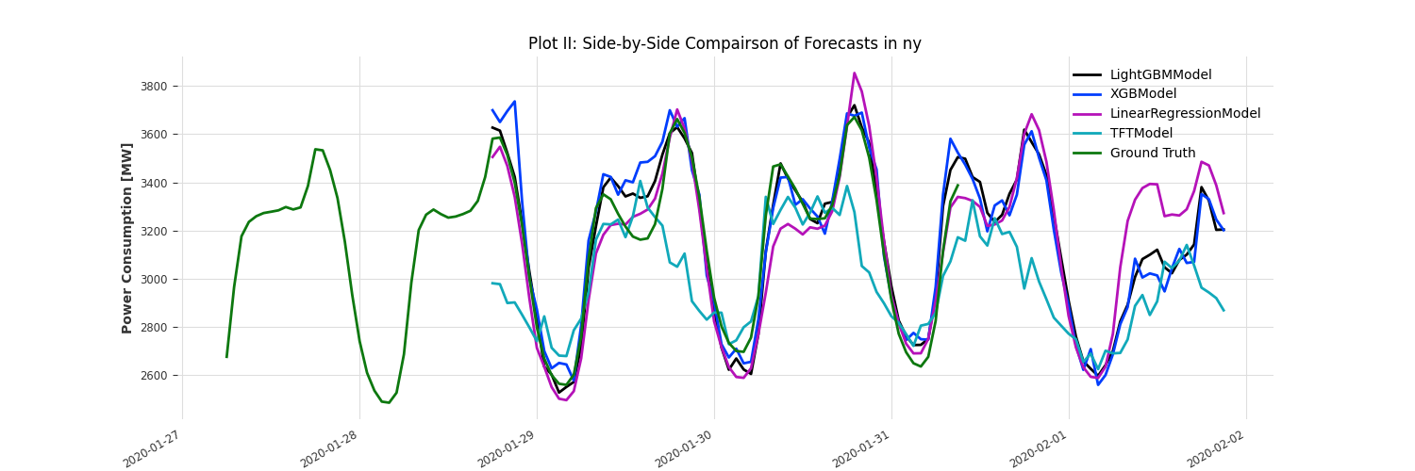
County level Data – New York

Slide 5
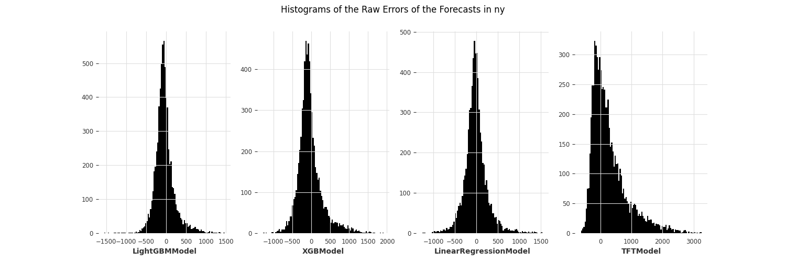
County level Data – New york

