Slide 1
Research

Slide 2

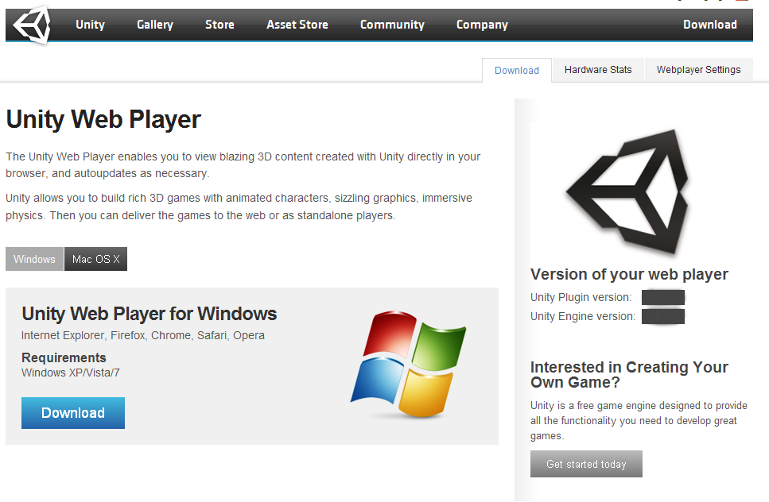
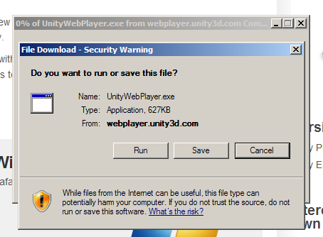
Unity webplayer install

Slide 3
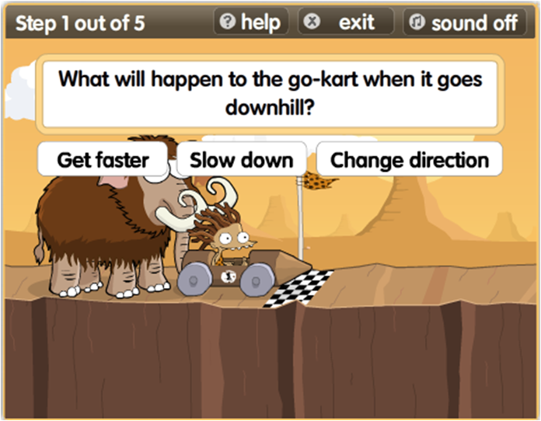
Learning process...asking questions in the game

Slide 4
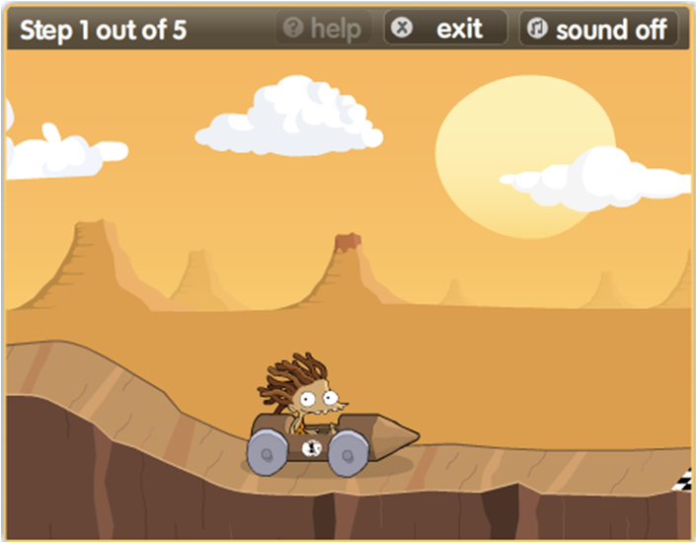
and see what is going to happen...

Slide 5
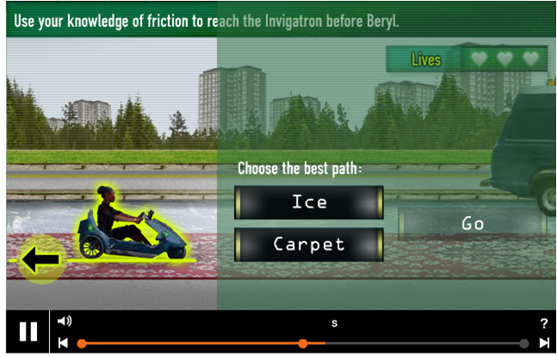
ICE CARPET WATER SAND ETC...
WHAT ELSE CAN WE USE? I was thinking we just keep it to 3, Stone, Sand (or Grass?) and Ice.-Will

Slide 6
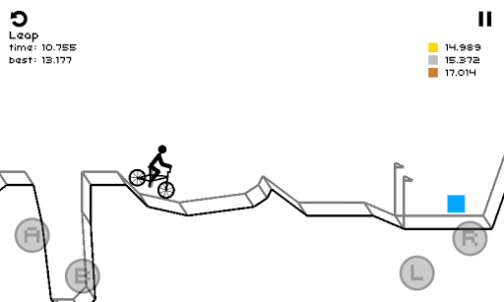
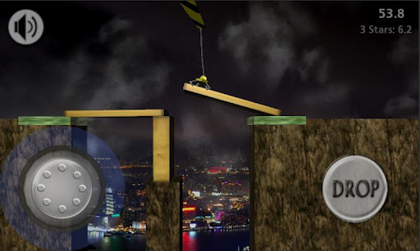
those are just ideas...it is not the final concept for the game
Build your own level...with different materials

Slide 7
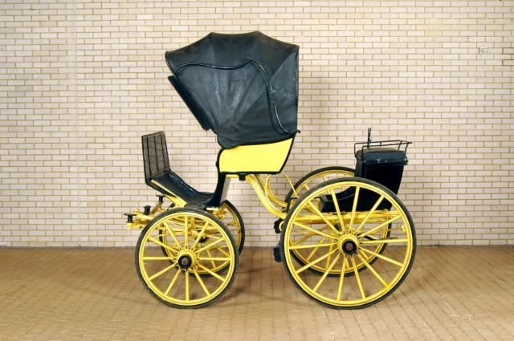
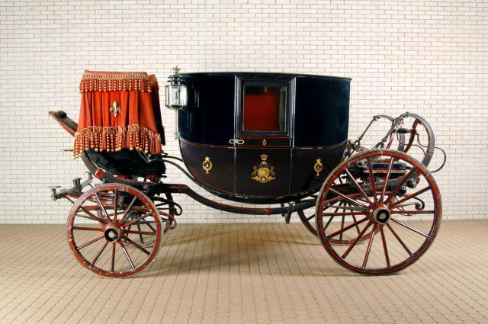
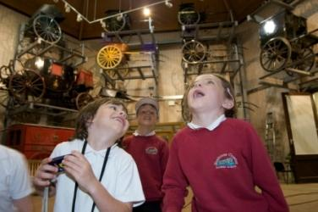
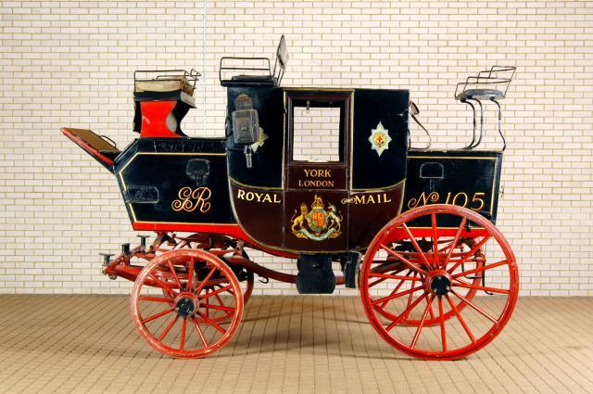
Carts and carriages at the museum
These are some of the carts at the museum of which we're going to base some of the general art around. -This all good?

Slide 8
Puzzles
The level editor would be in the 'Free Play mode' The other would be the puzzle mode in which the children would have to make their own cart to get to X.
This is where the materials/physics would come into play in a very simple form.

