Slide 1


JavaScript Part 2: Course Introduction
JS Course Program, Evaluation, Exams, Resources
Doncho Minkov
Technical Trainer
http://minkov.it
Telerik Software Academy
academy.telerik.com

Slide 2

Table of Contents
JavaScript Part 2
The JavaScript Course Program
Exams and Evaluation
Standard Criteria
Bonuses
Resources for the Course

Slide 3

JavaScript Part 2
One more step in becoming a Ninja

Slide 4

What's Coming Next?
JavaScript - Part 2
The next course from JavaScript development
Advanced JavaScript
Pretty much the same
Lectures once a week
Practical exam after a month
The course exam?
3-4 problems for 4-5 hours

Slide 5

JavaScript Part 2 – Program
What Will We Cover in the JavaScript Course?

Slide 6


JavaScript Part 2 - Course Program
JavaScript Part 2 Course Intro
Course Program, Exams, Evaluation
DOM and DOM Manipulation
Document Object Model
Selecting, editing and removing HTML elements

Slide 7


JavaScript Part 2 - Course Program (2)
Events
JavaScript Event Model
Attaching and detaching events
JavaScript APIs
Canvas, SVG, WebStorages, geolocation, web workers, drag and drop

Slide 8
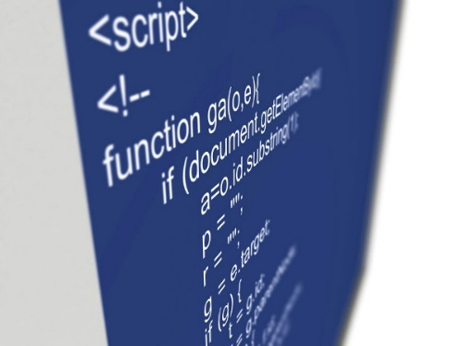
JavaScript Part 2 - Course Program (3)
Advanced functions
Function object, recursion, function scope, nested functions, closures
JavaScript OOP
JSON objects and function constructors
Inheritance and polymorphism
Private and public members
Exceptions
Try-catch block, throwing exceptions
Built-in and custom exceptions

Slide 9


JavaScript Part 2 - Course Program (4)
JS Performance
jsperf.com
Object creation
Function constructors or JSON
DOM manipulation
Caching selected elements
Appending elements
Associative arrays
For, for-in or foreach

Slide 10
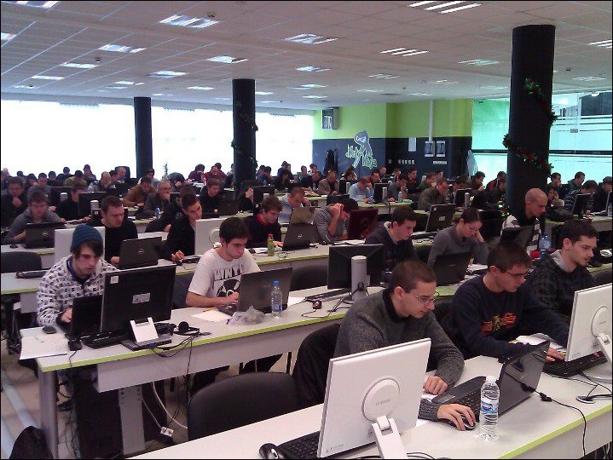

JavaScript Part 2 - Course Program (5)
Exam preparation
Solving problems with JavaScript
Practical Exam

Slide 11





Evaluation
Thank God There Are Bonuses!

Slide 12

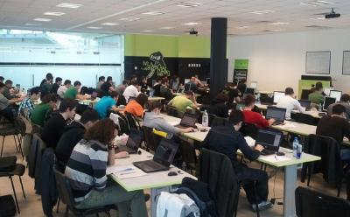
JavaScript Part 1 – Evaluation
Evaluation components
Practical exam – 60%
Homework – 15%
Homework evaluation – 15%
3 peer reviews per homework
Attendance in class – 10%
Bonuses
Forums activity – bonus up to 15%
Helping the other students – bonus up to 15%
PC Magazine contest – bonus up to 20%

Slide 13








Resources
What We Need in Addition to this Course Content?

Slide 14
Telerik Academy Resources
JavaScript Part 1
Introduction to JavaScript
Data types, operators, functions, loops, arrays
Web Design with HTML5, CSS3 and JavaScript
All Software Academy courses in one place
HTML, CSS, JavaScript and JS Libraries
http://academy.telerik.com/student-courses/ web-design-and-ui/javascript-part-1/
http://academy.telerik.com/student-courses/ archive/web-design-html-5-css-3-javascript

Slide 15
Online JavaScript Resources
Mozilla Development Network (MDN)
https://developer.mozilla.org
Mostly used for the presentations
Web Platform
http://www.webplatform.org
The place where all masters contribute
Adobe, Apple, Facebook, Google, HP, Intel, Microsoft, Mozilla, Nokia, Opera, W3C

Slide 16
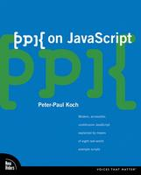


Recommended Books
“PPK on JavaScript”, Peter Paul-Koch, New Riders Press, 2006, ISBN 9780321423306
Eloquent JavaScript Marijn Haverbeke Free Book
JavaScript: The Good Parts, O’Reilly Media/Yahoo Press, 2008, ISBN: 9780596517748

Slide 17
Course Web Site & Forums
Register for the "Telerik Academy Forums":
Discuss the course exercises with your colleagues
Find solutions for the exercises
Share source code / discuss ideas
The JavaScript part 2 official web site:
forums.academy.telerik.com/web-design-with-html5-css-and-javascript
http://academy.telerik.com/student-courses/web-design-and-ui/javascript-part-2/

Slide 18
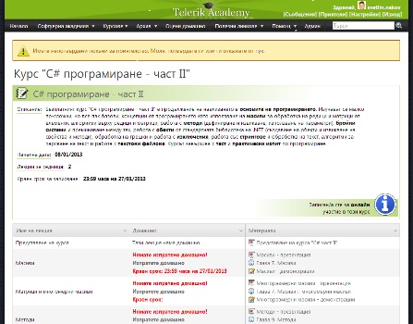
Telerik Integrated Learning System (TILS)
The Telerik Integrated Learning System (TILS)
www.telerikacademy.com
Important resource for all students
Homework submissions
Homework peer reviews
Presence cards with barcode
Reports about your results
telerikacademy.com/Courses/Courses/Details/64

Slide 19



Required Software
Software needed for this course:
Microsoft Visual Studio 2012 or Visual Studio Express 2012 (free version of VS 2012)
Sublime Text
Komodo IDE
Notepad ++

Slide 20



JavaScript Part 2 Introduction
http://academy.telerik.com

Slide 21



Free Trainings @ Telerik Academy
Web Design and UI Technologies @ Telerik Academy
html5course.telerik.com
Telerik Software Academy
academy.telerik.com
Telerik Academy @ Facebook
facebook.com/TelerikAcademy
Telerik Software Academy Forums
forums.academy.telerik.com

