Slide 1




PHP Fog
Rock-solid Cloud Platform for PHP
Nikolay Kostov
Technical Trainer
Telerik Corp.
http://Nikolay.IT

Slide 2

Table of Contents
What is PHP Fog?
Installing Ready-to-Use Applications and Frameworks
PHP Fog Platform Overview
Working with Git and SSH Keys
Creating and Deploying Custom PHP Applications
PHP Fog Add-Ons

Slide 3


What is PHP Fog?
http://phpfog.com/

Slide 4

PHP Fog
Cloud-based PHP hosting service
Founded in August 2010 by Lucas Carlson
Rock-solid cloud platform for PHP
Fast, reliable, easy and scalable hosting for PHP
Reliable by design (Runs on Amazon EC2)
Fast performance
Very easy deployment
Jumpstart applications
Custom applications (deploying using Git)

Slide 5




PHP Fog Pricing
PHP Fog offers free and paid PHP cloud hosting
 | Shared Cloud | Silver Cloud | Gold Cloud | Platinum Cloud
Applications | 3 | 10 | 30 | 125
RAM | Shared | 613 MB | 1.7 GB | 7.5 GB
CPU | Shared | 2 Burst ECUs | 1 Compute Unit | 4 Compute Units
Storage | 100 MB | 10GB | 50GB | 100GB
Custom Domains | $5 / month | Free | Free | Free
Scalable MySQL | Yes | Yes | Yes | Yes
Price | Forever free | $29 / month $2.90 / app | $79 / month $2.62 / app | $249 / month $1.99 / app

Slide 6
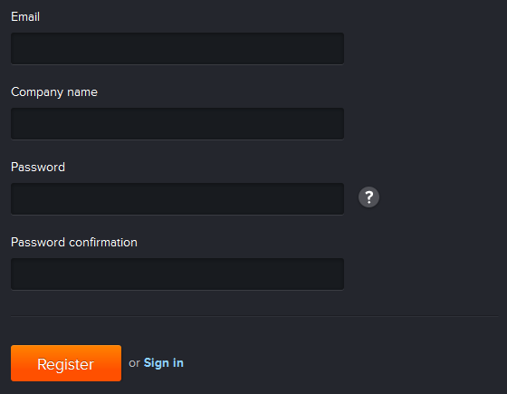
Registration Demo
Creating free PHP cloud in PHP Fog
https://phpfog.com/register

Slide 7
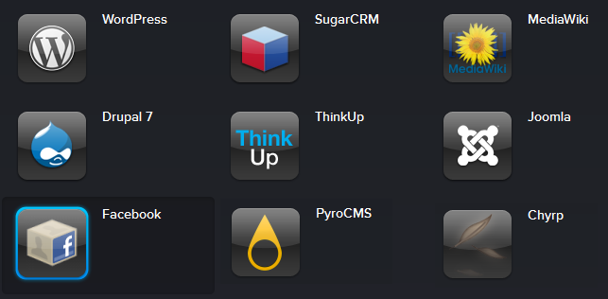
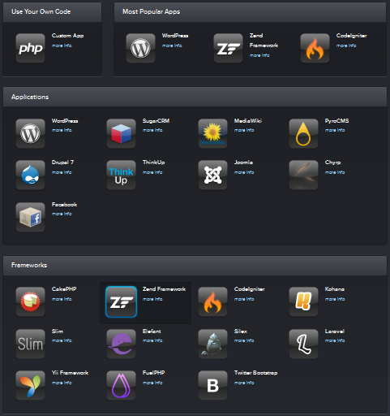
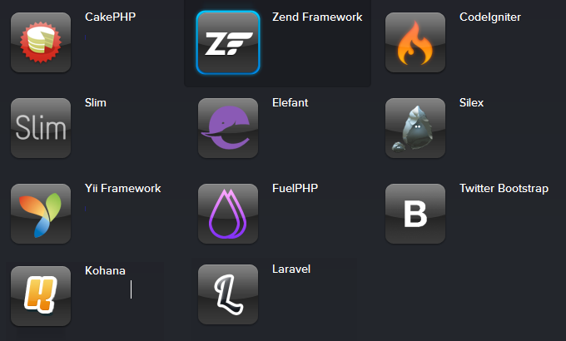
Installing Ready-to-Use Applications and Frameworks

Slide 8
PHP Fog Jumpstarts
Ready to use PHP applications and PHP Frameworks with just few clicks
Few seconds and you have fully functional application in the cloud
Full access to the application administration
Full access to the database and the files
9 Ready-to-use PHP applications
11 Pre-installed PHP frameworks

Slide 9
Ready-to-use Applications
Large variety of ready-to-use applications:
CMS, Blogs, Wikis, CRM, Facebook apps, etc.

Slide 10

Pre-Installed PHP Frameworks
A lot of pre-installed PHP frameworks
Including Zend, CakePHP, Yii, CodeIngniter, etc.

Slide 11

Creating Wordpress Blog with PHP Fog Demo
Installing and configuring Wordpress application with PHP Fog

Slide 12

Moving Wordpress.com Blog to the Cloud
Moving Wordpress.com Blog to the Cloud with PHP Fog

Slide 13

PHP Fog Platform Overview
Request Cache Load Balancer App Servers Database

Slide 14

PHP Fog – Cache
The Cache layer (Vanish) intercepts the request and can deliver lightning-fast responses
50-80% of responses can be served from the cache, ensuring responsiveness and diminishing server load to an absolute minimum
Varnish is a state-of-the-industry caching solution for web applications
Varnish ensures that your PHP applications serve cached responses intelligently

Slide 15

PHP Fog – Load Balancer
PHP Fog load balancing uses Nginx (free, open-source, high-performance web server)
Directs requests to the application server best able to handle the requests
If a server is unavailable, it is routed to a new server thus improves the reliability of your app
When you add more servers they are automatically made available and the load balancer is automatically updated

Slide 16

PHP Fog – App Servers
Each and every app server is a dedicated Linux server running an Apache instance
Apache serving 59% of web content online
mod_php provides robust PHP-scripting language support for the Apache web host
APC is an accelerator & optimizer so your PHP code gets compiled and runs fast every time
The locked-down environment ensures your application is secure by default

Slide 17
PHP Fog – Database
All applications get a primary and passive MySQL database
The primary database server is synchronized to a passive database slave which provides an up-to-the-minute snapshot of your MySQL databases
The database slave is used for application fail-over in case the primary server isn’t behaving properly
The database is easily scalable

Slide 18
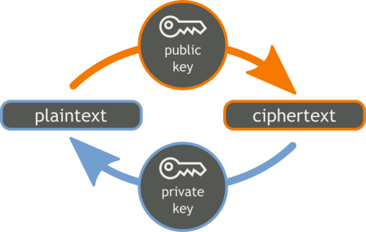

Working with Git and SSH RSA Keys

Slide 19

What is Git?
Git
Source-control system (Like SVN, TFS, etc.)
Can work with local and remote repositories
Git Bash – command line interface for Git
Free (open source)
Has Windows versions (msysgit , TortoiseGIT)

Slide 20
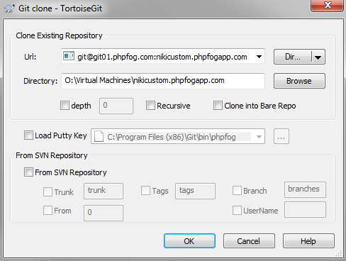

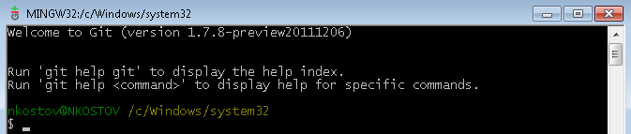
Using Git with Windows
TortoiseGit
http://code.google.com/p/tortoisegit/
Git Bash – msysgit
http://code.google.com/p/msysgit/

Slide 21
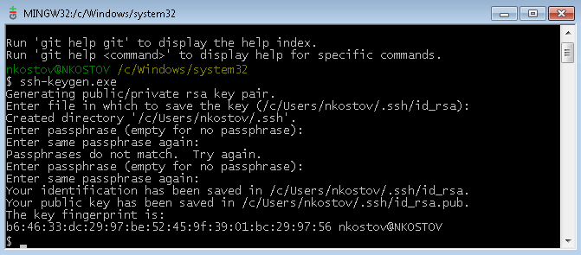
Generate SSH Keys
Using Git Bash and ssh-keygen.exe you can generate RSA keys for PHP Fog authentication
RSA is an algorithm for public-key cryptography
dev.appfog.com/features/article/generating_a_ssh_key

Slide 22
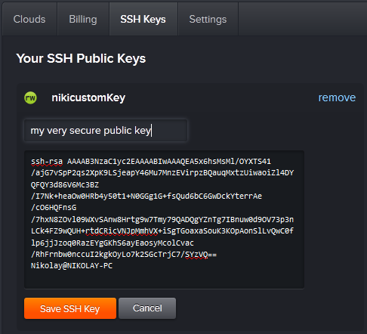
Use Git in PHP Fog
In order to access the source code for your application with PHP Fog, you'll need to use the generated SSH key with your Git client and your PHP Fog account from the following link:
phpfog.com/user_session/new#/ssh_keys

Slide 23

Creating and Uploading SSH keys in PHP Fog Demo

Slide 24

Creating and Deploying Custom PHP Applications

Slide 25

PHP Fog Custom Applications
Write your own PHP application in the cloud
You need Git and SSH key created and saved in your local machine and in the PHP Fog
You have access to MySQL database
You have full source code access
You can use add-ons, custom environment variables, domains, permissions, etc.

Slide 26
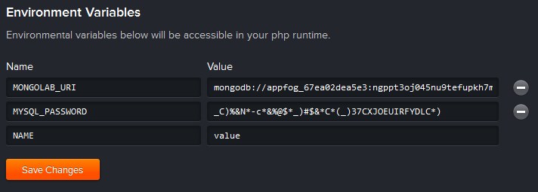
Environment Variables
Environment variables let you specify data that you do not want in your source code repository (like passwords)
You can access these variables in PHP through the getenv() function

Slide 27


MySQL Databases in PHP Fog
All custom applications in PHP Fog have their own easy-to-use MySQL database
All connection details can be found in the "Database" tab of your application in PHP Fog
You can administrate your database using phpMyAdmin (web-based mysql admin tool)
http://myadmin.phpfogapp.com/

Slide 28

Creating and Deploying Custom PHP Application Demo

Slide 29
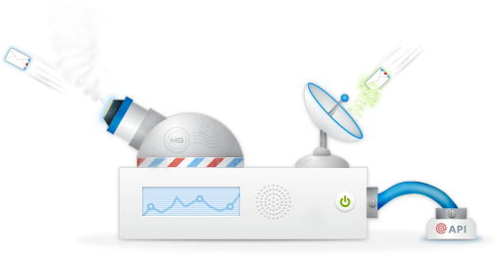

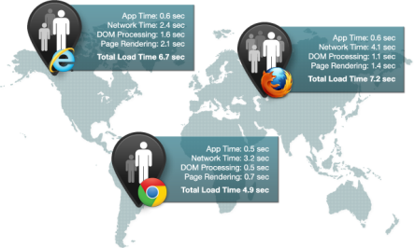

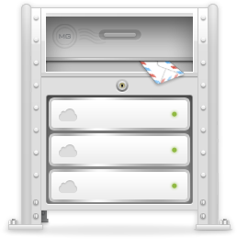
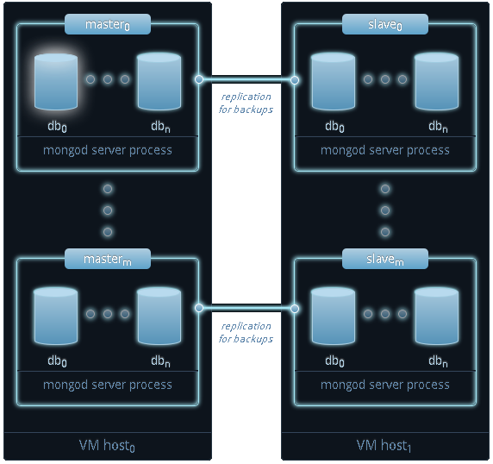
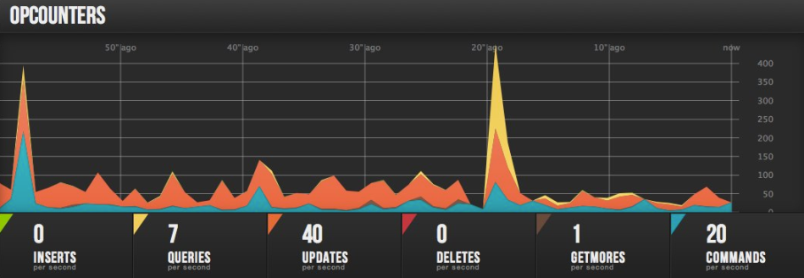


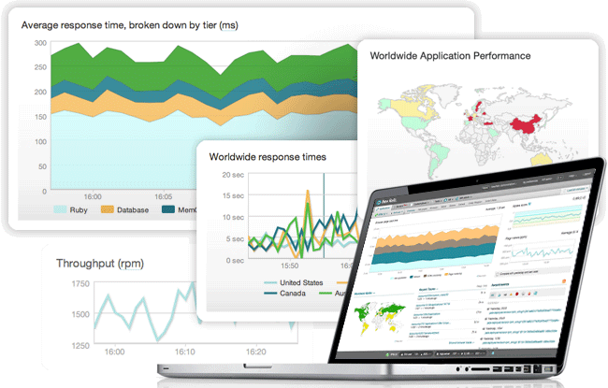
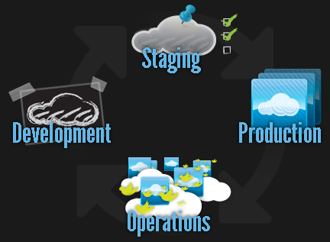
PHP Fog Add-Ons

Slide 30

PHP Fog Add-Ons – MongoLab
MongoLab
Cloud-based database provider that hosts MongoDB databases on various cloud providers such as EC2 and Rackspace
Replication, backups, monitoring and uptime
Easy-to-use web administration tools and developer APIs
Homepage: mongolab.com
PHP Fog Docs

Slide 31


PHP Fog Add-Ons – MongoHQ
MongoHQ
Hosted database solution for getting applications up and running on MongoDB, fast.
Homepage: https://mongohq.com
PHP Fog Docs

Slide 32

PHP Fog Add-Ons – ClearDB
ClearDB
Reliable, fault tolerant database-as-a-service for your MySQL powered applications
It's designed around the premise of failure to ensure that your database is available and secure, no matter what
Homepage: http://cleardb.com
PHP Fog Docs

Slide 33

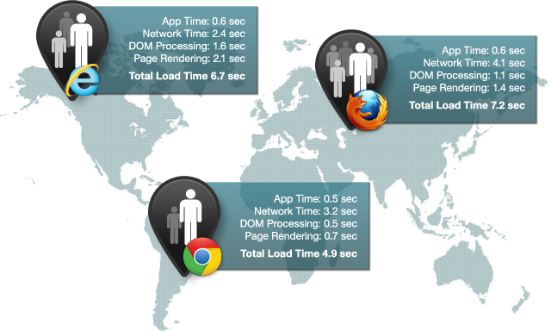
PHP Fog Add-Ons – NewRelic
NewRelic
Offers application performance monitoring and alerting for applications application servers
Homepage: http://newrelic.com/
PHP Fog Docs

Slide 34

PHP Fog Add-Ons – Blitz
Blitz
Self-service cloud based performance testing
Built for API, cloud, web and mobile developers
Helps you ensure:
Performance
Scalability
Security
Homepage: http://blitz.io/
PHP Fog Docs

Slide 35

PHP Fog Add-Ons – Mailgun
Mailgun
Programmable email platform
Send and receive messages
Create mailboxes
Create email campaigns
Homepage: http://mailgun.net
PHP Fog Docs

Slide 36


PHP Fog Add-Ons – CloudMailin
CloudMailin
You are given an email address that will forward any incoming message to your app
You can also seamlessly check the delivery status of each of your incoming emails via the dashboard, bounce emails that you do not wish to receive and use your own domain name.
Homepage: http://cloudmailin.com/
PHP Fog Docs

Slide 37


PHP Fog Add-Ons – IronWorker
IronWorker
Easy-to-use and massively scalable task queue
Gives cloud developers a simple way to offload front-end tasks and manage their scheduled jobs and background processing
Homepage: http://iron.io/products/worker
PHP Fog Docs

Slide 38


PHP Fog Add-Ons – IronMQ
IronMQ
Flexible, scalable, durable messaging system
Lets different parts of a cloud app connect with and scale independently from other internal and external processes
Homepage: http://iron.io/products/mq
PHP Fog Docs

Slide 39
PHP Fog Useful Links
More info: https://phpfog.com/about
Pricing: https://phpfog.com/pricing
Blog: http://blog.phpfog.com/
FAQ: http://dev.appfog.com/features/article/faq
Documentation: http://dev.appfog.com/
Forums: http://community.phpfog.com/
Register: https://phpfog.com/signup
Platform: https://phpfog.com/platform
Add-Ons: https://phpfog.com/addons

Slide 40
PHP Fog
http://clouddevcourse.telerik.com

Slide 41
Homework
Create your own PHP Fog account
Install two ready-to-use applications (e.g. Wordpress, Joomla, MediaWiki, etc.)
Configure the applications as you wish and change their default theme to one that you prefer the most
Write and deploy simple PHP application that uses at least one MySQL table
As a result of your homework submit the sources and the links of your PHP Fog apps

