Slide 1
OOP + SOLID
Object Orientated Programming
SOLID Principles
Nikolay Tkachenko

Slide 2
What is OOP?
OOP (object-oriented programming) is programming paradigm based on the concept of objects. The objects can contain data and code. The data is fields or attributes or properties of object. The code is methods or procedures.
Abstraction is a mechanism to identify the main, most common characteristics of objects.
Encapsulation is a mechanism to restrict the ability to read and change data.
Inheritance is a mechanism that lets you describe a new class based on an existing (parent) class.
Polymorphism is a mechanism to work with several types as if they were the same type. The change object’s behavior will be different depending on their type.
Abstraction, encapsulation, inheritance and polymorphism are the four main theoretical principles of object-oriented programming. But Java also works with three OOP concepts: association, aggregation and composition.

Slide 3
OOP Principles and design principles
Abstraction
Encapsulation
Inheritance
Polymorphism
+ Association, aggregation, composition
+ SOLID (SRP, OCP, LSP, ISP, DIP)
+ DRY (Don’t repeat yourself)

Slide 4
DRY (Don’t repeat yourself)
Don't repeat yourself (DRY) could be the motto for the inheritance concept.
Inheritance lets you create a child class that inherits the fields and methods of the parent class without redefining them.
With such a common code, we take it to the base class from which other classes that use the common code and new their implementation are inherited

Slide 5
What are class and object?
A class is an abstract blueprint used to create more specific, concrete objects. Classes often represent broad categories, like Robots or Machines that share attributes. These classes define what attributes an instance of this type will have, like mass or power, but not the value of those attributes for a specific object.
Classes can also contain functions, called methods available only to objects of that type. These functions are defined within the class and perform some action helpful to that specific type of object.

Slide 6
Inheritance
Inheritance is a mechanism that lets you describe a new class based on an existing (parent) class. Using Inheritance, in derived classes we can reuse the code of existing super classes.
What does it mean – inheritance makes it possible to create a child class that inherits the fields and methods of the parent class. The child class can override the values and methods of the parent class, but it’s not necessary. It can also add new data and functionality to its parent.
Parent classes are also called superclasses or base classes, while child classes are known as subclasses or derived classes as well. Java uses the extends keyword to implement the principle of inheritance in code.
Inheritance in Java:
A class (child class) can extend another (parent class) by inheriting its features
Implements the DRY (Don’t repeat yourself) programming principle
Improves code reusability
Multi-level inheritance is allowed in Java (a child class can have its own child class as well)
Multiple inheritances are not allowed in Java (a class can’t extend more than one class)

Slide 7
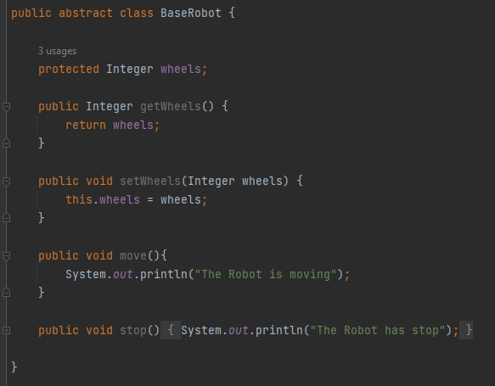
Inheritance
The Base class

Slide 8
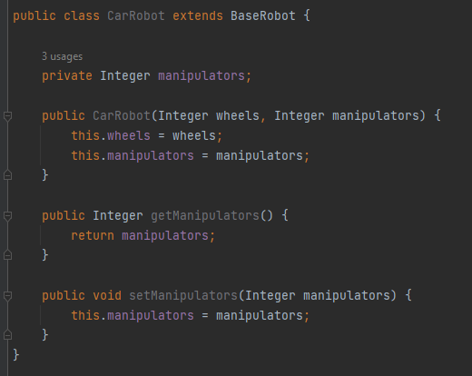
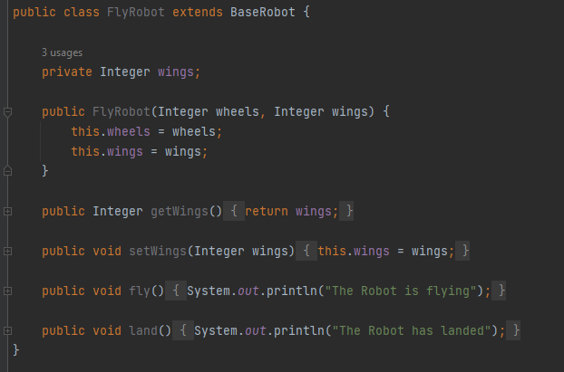
Inheritance
Child classes

Slide 9
Abstraction
Abstraction means a concept or an Idea which is not associated with any particular instance. Using abstract class/Interface we express the intent of the class rather than the actual implementation. In a way, one class should not know the inner details of another in order to use it, just knowing the interfaces should be good enough.
What does it mean – abstraction aims to hide complexity from users and show them only relevant information. For example, if you’re manage a robot, you don’t need to know about its internal workings.
You can hide internal implementation details using abstract classes or interfaces. On the abstract level, you only need to define the method signature (name and parameter list) and let each class implement them in their own way.
Abstraction in Java:
Hides the underlying complexity of data
Helps avoid repetitive code
Presents only the signature of internal functionality
Gives flexibility to programmers to change the implementation of abstract behavior
Partial abstraction can be achieved with abstract classes
Total abstraction can be achieved with interfaces

Slide 10
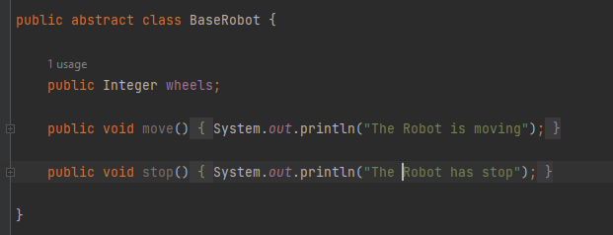
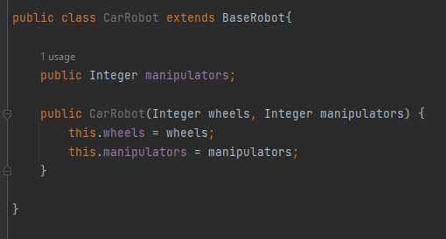
Abstraction

Slide 11
Encapsulation
Encapsulation is private instance variable and public accessor methods.
What does it mean – encapsulation helps with data security, allowing you to protect the data stored in a class from system-wide access. As the name suggest, it safeguards the internal contents of a class like a capsule.
You can implement encapsulation in java by making the fields (class variables) private and accessing them via their public getter and setter methods.
Encapsulation in Java:
Restrict direct access to data members (fields) of a class
Fields are set to private
Each field has a getter and setter method

Slide 12
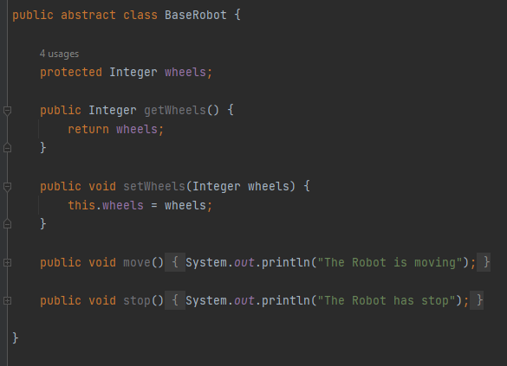
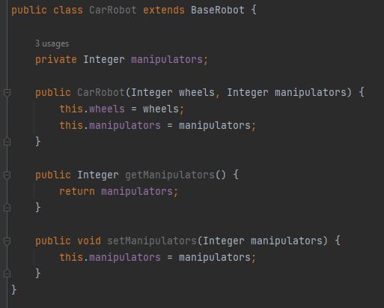
Encapsulation

Slide 13
Polymorphism
Polymorphism means one name many forms. It is further of two types — static and dynamic.
Static polymorphism is achieved using method overloading and dynamic polymorphism using method overriding. It is closely related to inheritance. We can write a code that works on the superclass, and it will work with any subclass type as well.
What does it mean – polymorphism refers to the ability to perform a certain action in different ways. In Java, polymorphism can take two forms: method overloading and method overriding
Polymorphism in Java:
The same method name is used several times
Different methods of the same name can be called from an object
All Java object can be considered polymorphic (at the minimum, they are of their own type and instance of the Object class)
Static polymorphism in Java is implemented by method overloading
Dynamic polymorphism in Java is implemented by method overriding

Slide 14
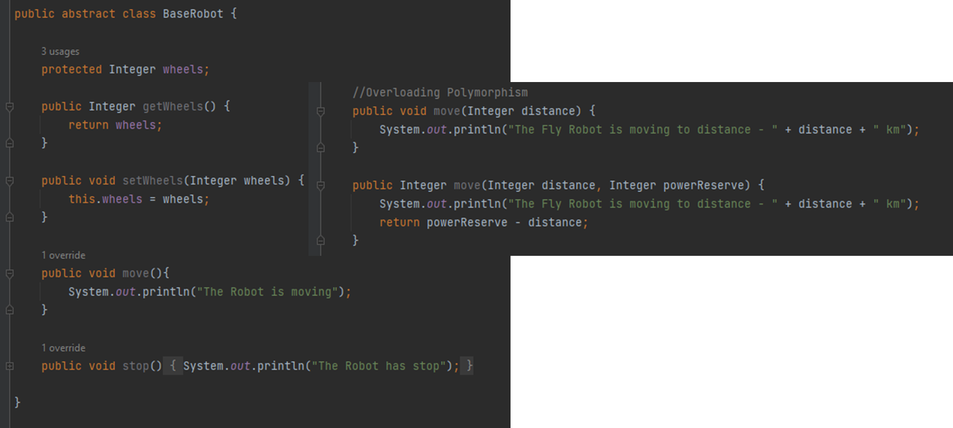
Polymorphism
Method overloading example.

Slide 15
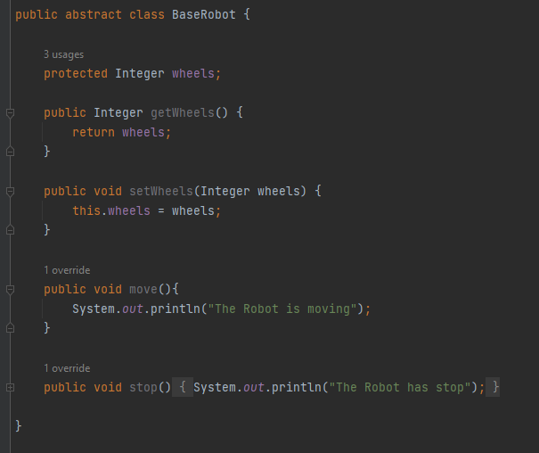

Polymorphism
Method overriding example

Slide 16
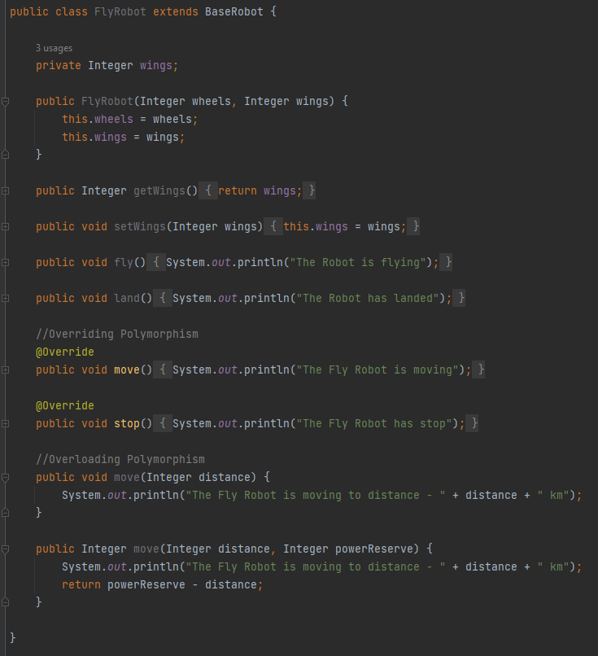
Polymorphism

Slide 17
Association
Association is a weak relationship between objects otherwise unrelated objects. An association is a «using» relationship between two or more objects in which the objects have their own lifetime and there is no owner.
What does it mean – Association means act of establishing a relationship between two unrelated classes. For example, when you declare two fields of different types (Service Robot and Military Robots) within the same class and make them interact with each other, you have created an association. Another example, imagine the relationship between a Service Robot and a Factory. A Factory can be associated with multiple Service Robots. At the same time, one Service Robot can work multiple Factories.
Association in Java:
Two separate classes are associated through their objects
The two classes are unrelated, each can exist without the other one
Can be a one-to-one, one-to-many, manty-to-one, many-to-many relationship

Slide 18
Aggregation
Aggregation is defined as a relation that exists between two or more two objects which individually have their own individual life cycle along with the ownership.
What does it mean – Aggregation is a narrower kind of association. It occurs when there’s a one-way (HAS-A) relationship between the two classes we associate through their objects.
For example, every Weapon has a robot, but the Robot doesn’t necessarily have a Weapon. When you declare the Weapon class, you can create a field of the Robot type that shows which Robot the Weapon belongs to. Then, when you instantiate a new Weapon object, you can access the data stored in the related Robot as well.
Aggregation in Java:
One-directional association
Represents a HAS-A relationship between two classes/objects
Only one class/object is dependent on the other

Slide 19
Composition
Composition is a form of association that occurs when an object's life is tightly bound to another object's life.
What does it mean – Composition is a stricter form of aggregation. It Occurs when the two classes you associate are mutually dependent and can’t exist without each other.
For example, take a Robot and a Reactor class. A Robot cannot run without a Reactor, while the Reactor also can’t function without being built into the Robot. This kind of relationship between objects is also called a PART-OF relationship.
Composition in Java:
A restricted form of aggregation
Represents a PART-OF relationship between two classes/objects
Both classes/objects are dependent on each other
If one class/object ceases to exist, the other can’t survive alone

Slide 20
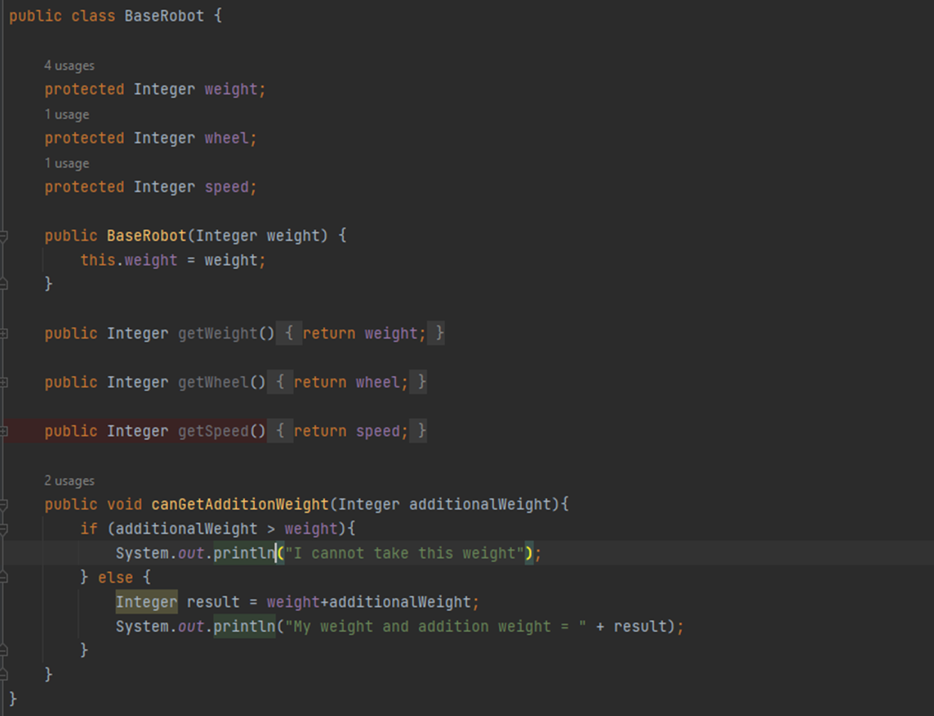
DRY (Base class)

Slide 21
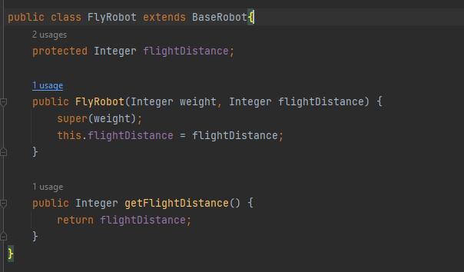
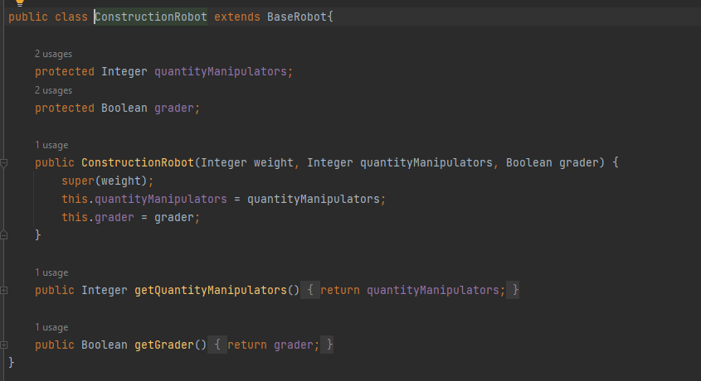
DRY (Child classes)

Slide 22
SOLID
SOLID is a mnemonic acronym for five design principles intended to make object-oriented designs more understandable, flexible, and maintainable.
S – SRP (Single Responsibility Principle)
O – OCP (Open-Closed Principle)
L – LSP (Liskov Substitution Principle)
I – ISP (Interface Segregation Principle)
D – DIP (Dependency Inversion Principle)

Slide 23
S – SRP (Single Responsibility Principle)
This principle states that a class should only have one responsibility. Furthermore, it should only have one reason to change.
What does it mean – every class in Java should have a single job do.
Below you can see an example of a Java class that does not follow the single responsibility principle.
Here you can see an example of Java class that does follow the single responsibility principle. You can see that instead method class contains others classes with this methods.

Slide 24
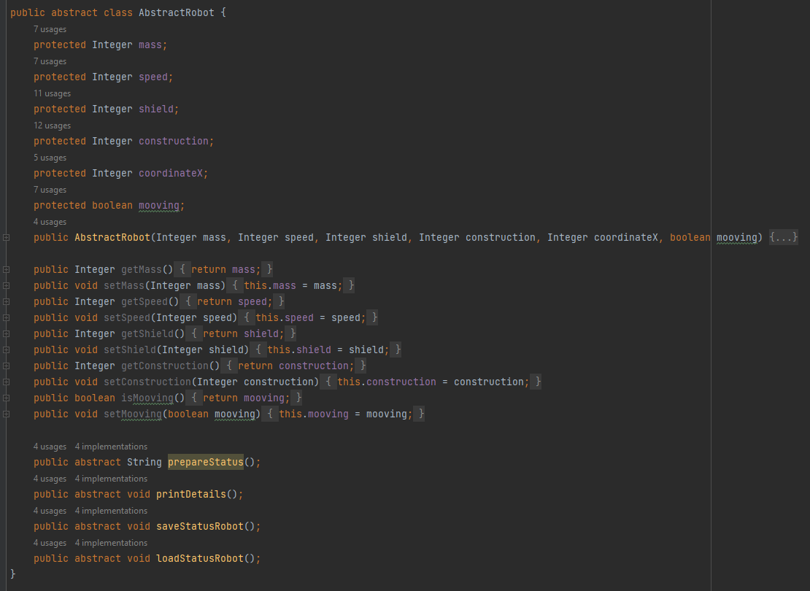
S – SRP (Single Responsibility Principle)
Base class

Slide 25
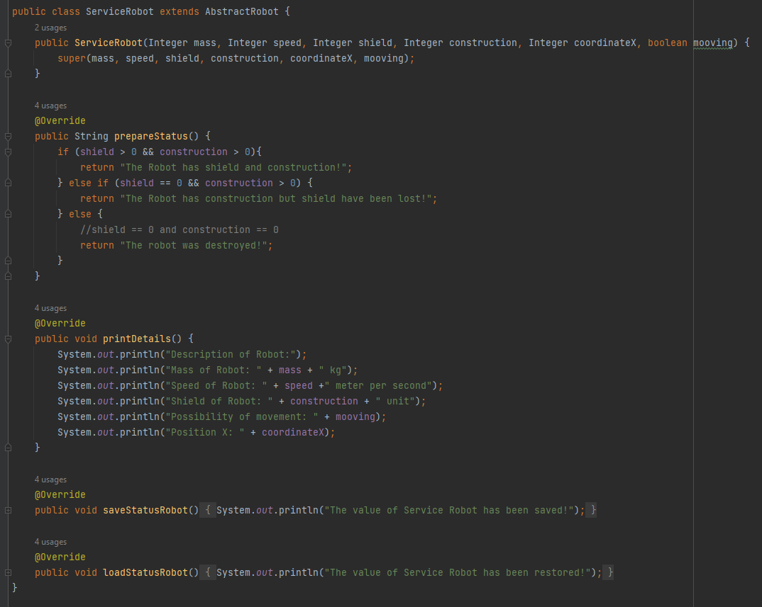
S – SRP (Single Responsibility Principle)
Code without SRP

Slide 26
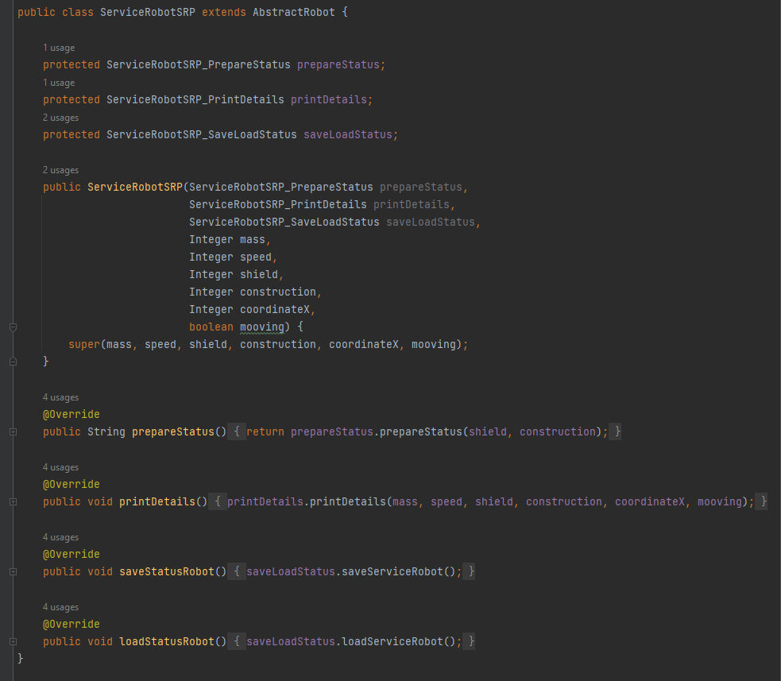
S – SRP (Single Responsibility Principle)
Code with SRP. Part 01

Slide 27
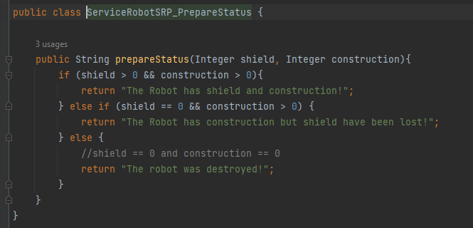
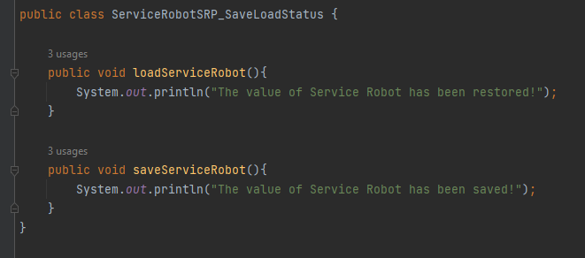
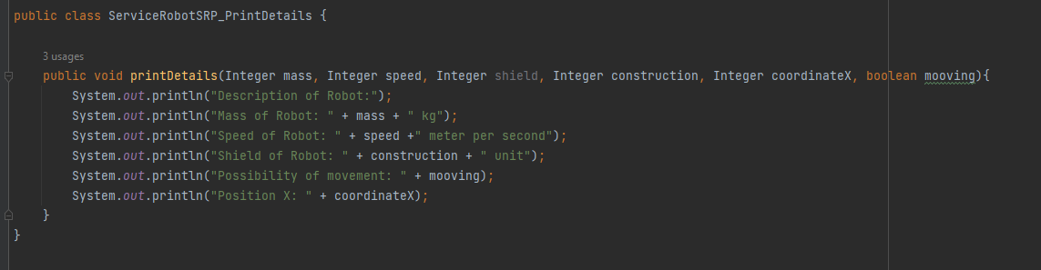
S – SRP (Single Responsibility Principle)
Code with SRP. Part 02

Slide 28
O – OCP (Open-Closed Principle)
Classes should be open for extension but closed for modification. In doing so, we stop ourselves from modifying existing code and causing potential new bugs in an otherwise working application.
What does it mean – you need to design your code in such a way that everyone can reuse your feature by just extending it and if they need any customization they can extend it and add their feature on top of it like a abstraction.

Slide 29
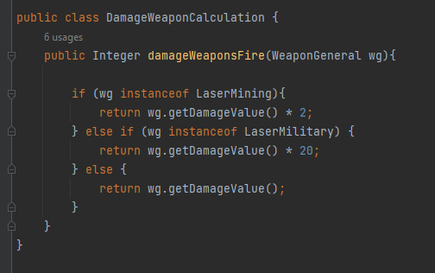
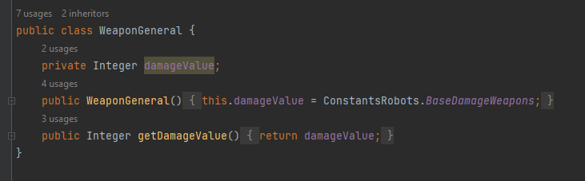

O – OCP (Open-Closed Principle)
Code without OCP

Slide 30
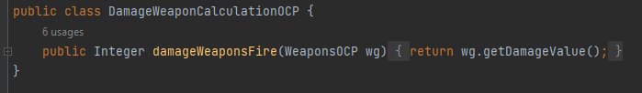
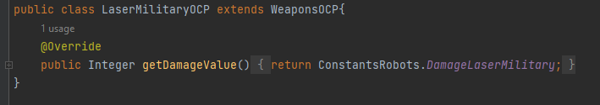
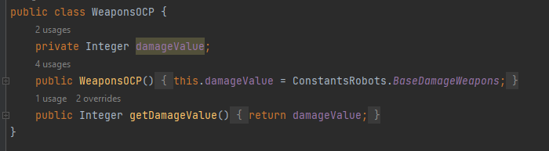
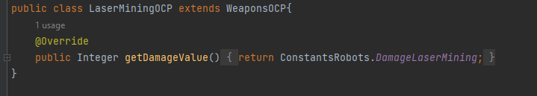
O – OCP (Open-Closed Principle)
Code with OCP

Slide 31
L – LSP (Liskov Substitution Principle)
If class A is a subtype of class B, we should be able to replace B with A without disrupting the behavior of our program.
What does it mean - The child class must retain the logic defined in the parent class.

Slide 32
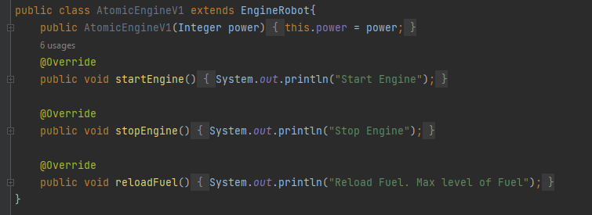
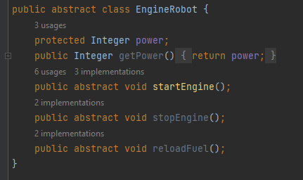
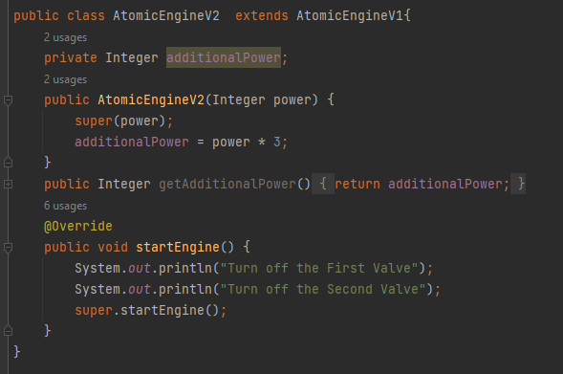
L – LSP (Liskov Substitution Principle)
Code without LSP

Slide 33
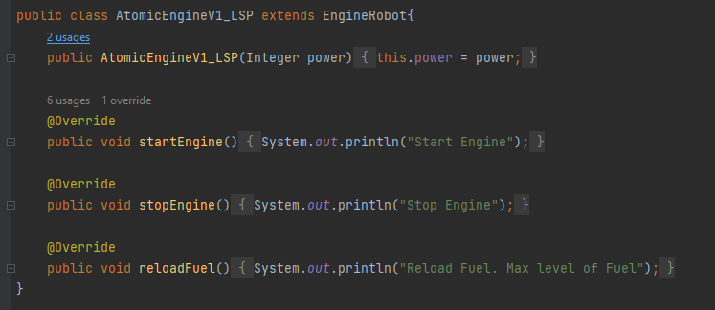
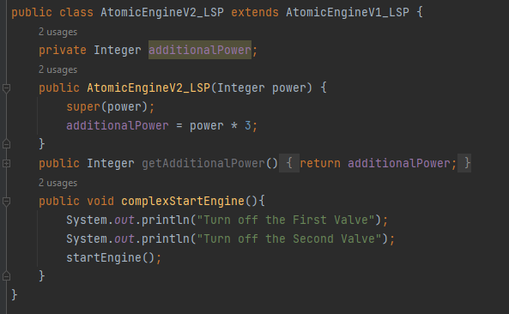
L – LSP (Liskov Substitution Principle)
Code with LSP

Slide 34
I – ISP (Interface Segregation Principle)
Larger interfaces should be split into smaller ones. By doing so, we can ensure that implementing classes only need to be concerned about the methods that are of interest to them.
What does it mean – we need segregate interface based on client need. Because in another case our class will be contain many useless methods.

Slide 35
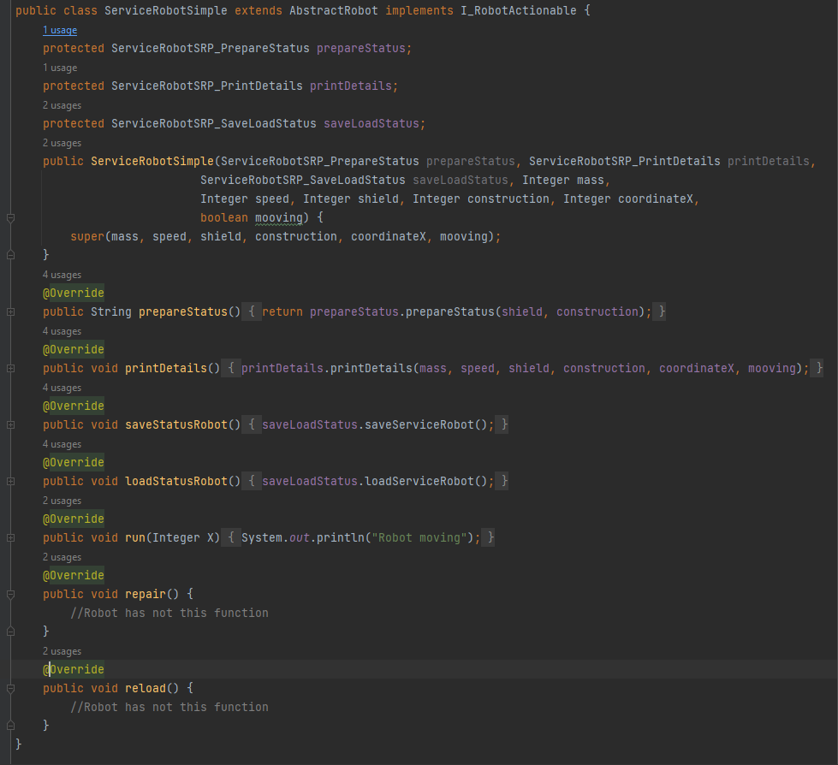
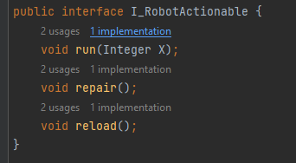
I – ISP (Interface Segregation Principle)
Code without ISP

Slide 36
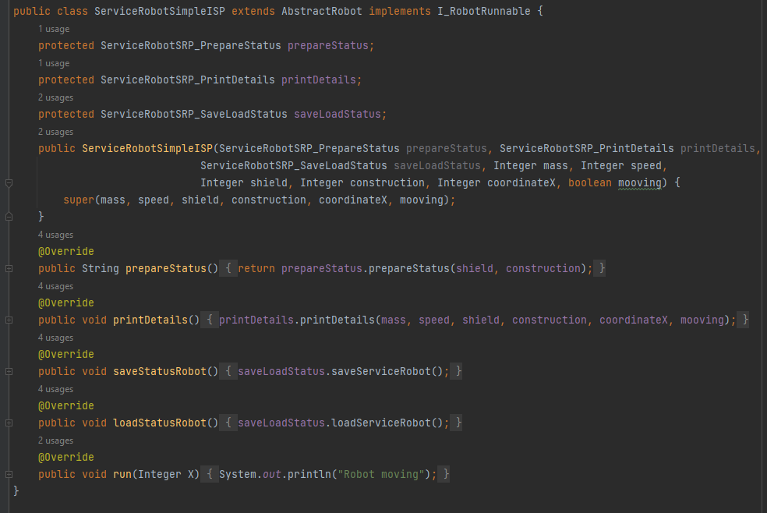


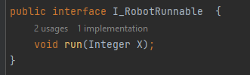
I – ISP (Interface Segregation Principle)
Code with ISP

Slide 37
D – DIP (Dependency Inversion Principle)
The principle of dependency inversion refers to the decoupling of software modules. This way, instead of high-level modules depending on low-level modules, both will depend on abstractions.
What does it mean – The principle states that we must use abstractions instead of concrete implementation. High-level modules should not depend on low-level module but both should depend on the abstraction.
Let’s consider an use case
I will create robots and get to robot weapons. In the First case the robot was got weapons from classes. But the Second case the robot was got weapons from abstraction.

Slide 38
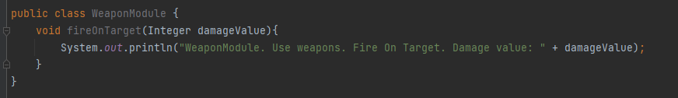
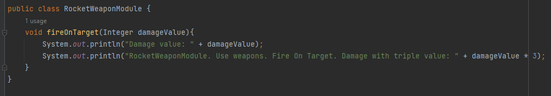
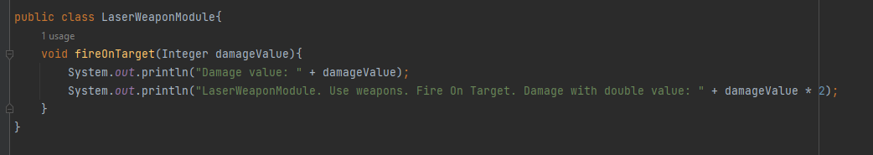
D – DIP (Dependency Inversion Principle)
I create laser and rocket weapons from different classes.

Slide 39
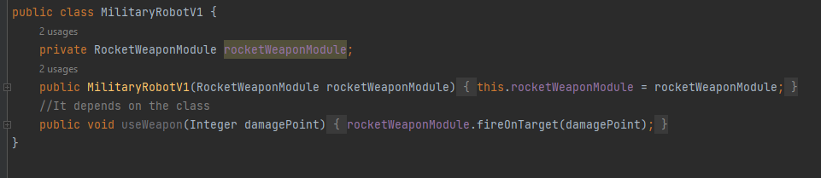
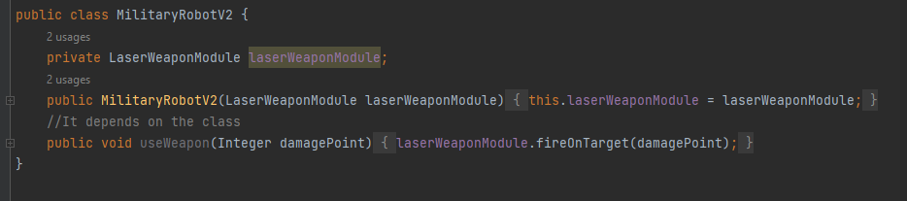
D – DIP (Dependency Inversion Principle)
I have created two classes for robot. Once of them uses rocket weapons, another uses laser weapons.
This code violates the principle of DIP (Dependency Inversion Principle).

Slide 40
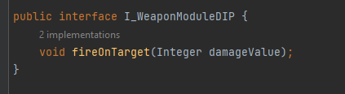
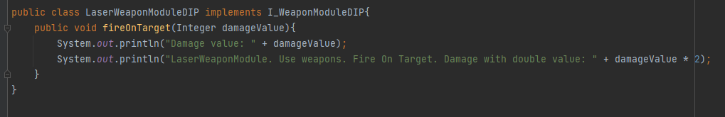
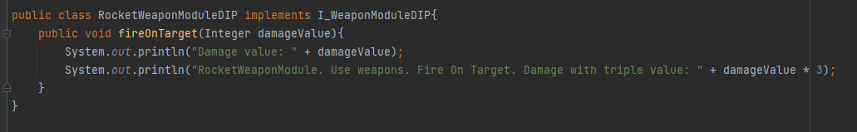
D – DIP (Dependency Inversion Principle)
Below You can see right code. This code follows the principle of DIP.
All classes of weapons implementation one interface with general method. I do not specify a specific weapon class in the construct in the robot class.
I only specify the interface. Thus, the robot class does not depend on the specific class, but depends on the abstraction. I can create any robot with any weapon.

Slide 41
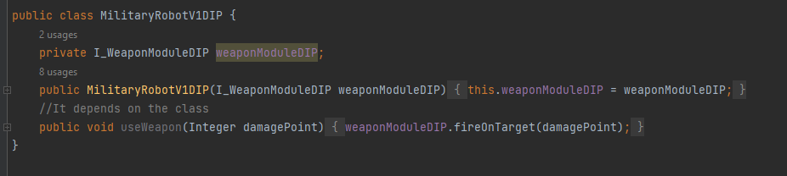
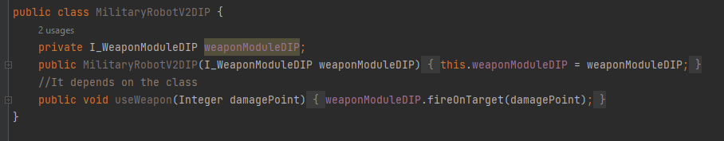
D – DIP (Dependency Inversion Principle)
Classes with DIP principles

Slide 42
Useful Links:
https://raygun.com/blog/oop-concepts-java/
https://www.infoworld.com/article/3029325/exploring-association-aggregation-and-composition-in-oop.html
https://en.wikipedia.org/wiki/Association_(object-oriented_programming)
https://algodaily.com/lessons/association-aggregation-composition-casting
https://www.digitalocean.com/community/conceptual_articles/s-o-l-i-d-the-first-five-principles-of-object-oriented-design
Github: https://github.com/NikolayIvTkachenko/oop_solid_course

