Slide 1

Introduction to React.js
What is React, JSX, Overview and Syntax
SoftUni Team
Technical Trainers
Software University
https://softuni.bg

Slide 2

Table of Contents
React Overview
Installation
JSX Syntax
Composition

Slide 3
Have a Question?
sli.do #reactjs

Slide 4

React Overview
History and Philosophy

Slide 5
What is React.js?
React is a JavaScript library for building user interfaces (UI)
Focused on creating reusable components
Developed by Facebook
const HelloMessage = (props) => (
<div>Hello {props.name}</div>
);
ReactDOM.render(
<HelloMessage name="Maria" />,
document.getElementById('root')
);

Slide 6
Features
Open-source
Declarative
Design simple views for each state in your app
Easier to debug
Component-Based
Encapsulated components that manage their own state
Keep state out of the DOM

Slide 7

Features
Isomorphic
JavaScript that runs on both client & server
Better user experience
Native support
Compose rich mobile UI in Android, iOS

Slide 8

Advantages
Easy to learn
Fast performance
Use all ES6 features
Promises, Classes and Modules
Compatible with other libraries
Great error reporting

Slide 9

React Installation
Packages, Setup, Structure

Slide 10
Create React App
Less to learn - instant reloads help you focus on development
Only one dependency - no complicated version mismatches
No Lock-In - under the hood Webpack, Babel, ESLint
Install the React app creator (one-time global install)

Slide 11
Install and Run the React App Creator
Run the React app creator
Starts your React app from the command line
Browse your app from http://localhost:3000
npx create-react-app my-app
cd my-app
npm start

Slide 12
Finding Information
Visit the official website
Documentation
Online sandbox
https://reactjs.org/
https://reactjs.org/docs/installation.html
https://codesandbox.io/

Slide 13
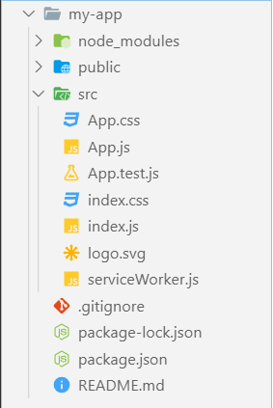
React App Structure
package.json - project configuration
Module name, dependencies, build actions
index.html
App main HTML file
index.js
App main JS file (startup script)
App.js, App.css, App.test.js
React component "App"

Slide 14

Live Demo

Slide 15

JSX Syntax
JSX
Overview, Syntax, Advantages

Slide 16
JSX Overview
JSX is React's JavaScript superset language
Has all of JavaScript's features and more
Unique approach to mixing HTML and JS
Compiles to plain JavaScript
<div className="red">Children Text</div>
React.createElement("div",
{ className: "red" },
"Children Text"
);

Slide 17
JSX Syntax
<div className="red">Children Text</div>
<MyCounter count={3 + 5} />
Expression
let gameScores = {
player1: 2,
player2: 5
};
<DashboardUnit index="2" onClick={() => {}>
<h1>Scores</h1>
<Scoreboard className="results" scores={gameScores} />
</DashboardUnit>
Custom component
Pass variable as prop

Slide 18
JSX Rules and Principles
Standard elements use lowercase names
div, span, form, input, …
Custom components always use Pascal case
MyCustomComponent, Greeting, ScoreBoard, …
Component name cannot be an expression
Use a variable instead
There must be a root element
More info at: https://reactjs.org/docs/jsx-in-depth.html

Slide 19
Compilation
JSX compiles to function calls
<div className="red">Children Text</div>
Element type (HTML tag name)
Properties object
React.createElement("div",
{ className: "red" },
"Children Text" [, …]);
List of children

Slide 20
Live Demo

Slide 21

Composition
Definition and Advantages

Slide 22
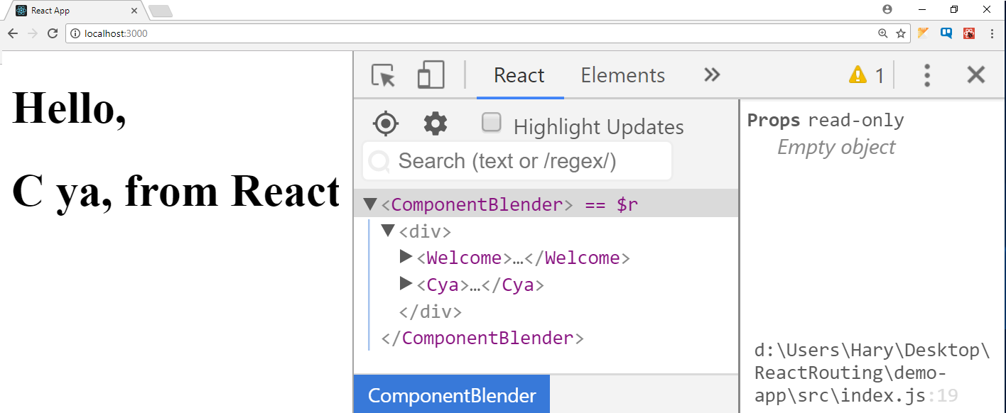
Composition
React components can be nested, like DOM elements
function Welcome() {
return <h1>Hello, from React</h1>;
}
function Cya() {
return <h1>C ya, from React</h1>;
}
function ComponentBlender() {
return (
<div>
<Welcome />
<Cya />
</div>
);
}
ReactDOM.render(<ComponentBlender />,
document.getElementById('root'));

Slide 23
Component Syntax
Names always start with uppercase
Tags must be closed
If there are no children - use self-closing tags
Information is passed via props
<Dropdown> A dropdown list <UserHead name='homeHeader' />
<Menu>
<MenuItem>Do Something</MenuItem>
<MenuItem>Do Something Fun!</MenuItem>
<MenuItem>Do Something Else</MenuItem>
</Menu>
</Dropdown>

Slide 24
Advantages
Encapsulate logic
Separate your code
Easier to maintain and debug
Allows reusability
Components are neat

Slide 25

Components Overview
Syntax, Functional and Class Components

Slide 26
Components Overview
Components let you
Split the UI into independent and reusable pieces
Think about isolation
React let you define components as
Functions
Classes
26

Slide 27
Functional Component
Functional component is a JS function which
Accepts single argument called props (object with data)
Returns a React Element
function Person(props){
return <div>My name is {props.name}</div>
}

Slide 28
Class Component
To define a React component class, you need to extend React.Component
The only method you must define is called render()
class Person extends React.Component {
render() {
return <h1>My name is {this.props.name}</h1>
}
}

Slide 29
Component Syntax
Names always start with UpperCase
Tags always must be closed
Information is passed via props
<Dropdown> A dropdown list
<UserHead name="homeHeader" />
<Menu>
<MenuItem>Do Something</MenuItem>
<MenuItem>Do Something Fun!</MenuItem>
</Menu>
</Dropdown>

Slide 30

Component Props and State
Overview

Slide 31
Props and State Overview
In React props and state represent the rendered values
Both are plain JavaScript objects
Both hold information that influences the output of render
31

Slide 32
Props and State Overview
They are different in one important way
Props get passed to the component (like function params)
State is managed within the component (like local variables)
32

Slide 33

Component Props
Passing Data, Access and Usage

Slide 34
Component Props
Props is short for properties
Are received from above (parent)
Immutable as far as the component receiving them is concerned
A component cannot change its own props, but it is responsible for putting together the props of its child components

Slide 35
Passing Props to Nested Components
We use props to pass data from parent to child
const BookList = () => {
return (
<ul>
<Book
title="IT"
author="Stephen King"
price="20"
/>
<Book
title="The Hunger Games"
author="Suzanne Collins"
price="10"
/>
</ul>
);};
Use className to set css classes
const Book = (props) => {
return (
<li className="book">
<div>{props.title}</div>
<div>{props.author}</div>
<div>{props.price}</div>
</li>
);
};
Prop name should start with lowercase letter

Slide 36
Children Property
Use children property to access information between opening and closing tags
const BookList = () => {
return (
<ul>
<Book
title="IT"
author="Stephen King"
price="20">
<span>
Some value here
</span>
</Book>
</ul>
);};
const Book = (props) => {
return (
<li className="book">
…
<div>{props.children}</div>
</li>
);
};
Could be plain text or nested HTML

Slide 37

Props Demo

Slide 38

Storing and Modifying Data
Component State

Slide 39
Component State Overview
The heart of every React component is its "state"
It determines how the component renders and behaves
State allows you to create components that are dynamic and interactive
39

Slide 40
State
State starts with default value when a component mounts
After mounts, suffers from mutations in time
Its serializable
Component manages its own state internally
40

Slide 41
Component State Example
State holds information that can change over time
Usually as a result of user input or system events
function Timer(props) {
const [time, setTime] = React.useState(0);
setTimeout(() => {
setTime(time + 1);
}, 1000);
return <h1>{time} sec.</h1>;
}

Slide 42

State Hook

Slide 43
State Hook
Hook is a special function that lets you "hook into" React features
useState is a Hook that lets you add React state to function components
You don't have to convert functional component into class to use state
43

Slide 44
State Hook
Calling useState inside functional component to add some local state to it
React will preserve this state between re-renders
useState returns a pair
Current state value
Function that lets you update it
import React, { useState } from 'react';
const [count, setCount] = useState(0);

Slide 45
State Hook
import React, { useState } from 'react';
const counter = () {
const [count, setCount] = useState(0);
return (
<div>
<p>Counter: {count}</p>
<button onClick={() => setCount(count + 1)}>
Click me
</button>
</div>
);
}

Slide 46
State Hook
You can call the update function from anywhere
It's similar to this.setState in class, except it doesn't merge the old and new state together
The only argument to useState hooks is the initial state
Unlike this.state, here doesn't have to be an object
Although it can be if you want

Slide 47
State Hook
You can use the State Hook more than once in a single component
The initial state argument is only used during the first render
const registerComponent = () {
const [email, setEmail] = useState("");
const [age, setAge] = useState("0");
const [password, setPassword] = useState("");
// ...
}

Slide 48
State Demo

Slide 49

Handling Events

Slide 50
Handling Events
Handling events with React elements is very similar to handling event on DOM elements
The syntactic differences are:
React events are named using camelCase
With JSX you pass a function as the event handler
50

Slide 51
Handling Events
When using React you should generally
Not need to call addEventListener to add listeners to a DOM element after it is created
Just provide a listener when the element is initially rendered
<button onClick={this.clickHandler}
Click me! I'm a counter
</button>

Slide 52
Handling Events
<button onClick={(e) => this.deleteRow(id, e)}>Delete Row</button>
There are two ways to passing arguments to event handlers
Using arrow functions
Using bind
<button onClick={(e) => this.deleteRow(id, e)}>
Delete Row
</button>
<button onClick={this.deleteRow.bind(this, id)}>
Delete Row
</button>

Slide 53
Handling Events
const [clicks, setClicks] = useState(0);
clickHandler = () => {
setClicks(c => c + 1)
}
<Button clickHandler={clickHandler} clicks={clicks} />
<button className="counter"
onClick={props.clickHandler}>
Click me! I'm a counter [{props.clicks}]
</button>

Slide 54
SyntheticEvent
Event handlers will be passed instances of SyntheticEvent
It has the same interface as the browser's native event
Including stopPropagation() and preventeDefault()
Except the events work identically across all browsers
function onClick(event) {
console.log(event);
console.log(event.type);
const eventType = event.type;
}

Slide 55
Handling Events Demo

Slide 56

Conditional Rendering

Slide 57
Conditional Rendering
Conditional rendering in React works the same way conditions work in JavaScript using:
Operators like if
Conditional (ternary) operators
57

Slide 58
Conditional Rendering
Using if operator
function UserGreeting(props) {
return <h1>Welcome back!</h1>;
}
function GuestGreeting(props) {
return <h1>Please sign up.</h1>;
}
function Greeting(props) {
const isLoggedIn = props.isLoggedIn;
if (isLoggedIn) {
return <UserGreeting />;
}
return <GuestGreeting />
}

Slide 59
Conditional Rendering
Using ternary operator
function UserGreeting(props) {
return <h1>Welcome back!</h1>;
}
function GuestGreeting(props) {
return <h1>Please sign up.</h1>;
}
function Greeting(props) { return (
<div>
{ props.isLoggedIn ? < UserGreeting /> : <GuestGreeting /> }
</div>
)}

Slide 60




Lists and Keys
Identify Items, Reconciliation

Slide 61
Lists and Keys
Using map() we can build collections of elements and include them in JSX using {}
Keys should be given to the elements inside the array to give the elements a stable identity
Keys help React identify which items have changed, are added, or are removed
61

Slide 62

Lists and Keys
Using map() to take an array of numbers and double their values
Rendering Multiple Components
const numbers = [1, 2, 3, 4, 5];
const doubled = numbers.map((number) => number * 2);
console.log(doubled); // [2, 4, 6, 8, 10]
const numbers = [1, 2, 3, 4, 5];
const listItems = numbers.map((number) =>
<li>{number}</li>
);

Slide 63
Basic List Component
Basic List Component looks like
function NumberList(props) {
const numbers = props.numbers;
const listItems = numbers.map((number) =>
<li>{number}</li>
);
return (
<ul>{listItems}</ul>
);
}

Slide 64
Lists and Keys
You can build collections of elements and include them in JSX using {}
Usually lists are rendered inside a component
function NumberList(props) {
const numbers = props.numbers;
const listItems = numbers.map((number) =>
<li>{number}</li>
);
return <ul>{listItems}</ul>;
}

Slide 65

Lists and Keys
When you render an array of elements, React needs a key prop to identify elements for optimization purposes
If they don't have it, you will get
It won't stop your work

Slide 66
Picking a Key
The best way to pick a key is to use a string that uniquely identifies a list item among its siblings
Most often you would use ID's from your data as keys
const todoItems = todos.map((todo) =>
<li key={todo.id}>
{todo.text}
</li>
);

Slide 67
Extracting Components with Keys
Keys only make sense in the context of the surrounding array
function NumberList(props) {
const numbers = props.numbers;
const listItems = numbers.map((number) =>
<ListItem key={number.toString()} value={number} />
);
return (
<ul>
{listItems}
</ul>
);
}
Keep the key on the list item
function ListItem(props) {
return <li>{props.value}</li>;
}

Slide 68
List and Keys
Don't use indexes for keys if the order may change
Keys serve as a hint to React, but they don't get passed to your component
If you need the same value, pass it explicitly as prop with a different name
const content = posts.map((post) =>
<Post
key={post.id} id={post.id} title={post.title}
/>
);

Slide 69
Lists and Keys
Keys don't need to be globally unique (only among their siblings)
const sidebar = (
<ul>
{props.posts.map((post) =>
<li key={post.id}>
{post.title}
</li>
)}
</ul>
);
const posts = [
{id: 1, title: '...', content: '...'},
{id: 2, title: '...', content: '...'}];
const content = props.posts.map((post) =>
<div key={post.id}>
<h3>{post.title}</h3>
<p>{post.content}</p>
</div>);

Slide 70

Component Lifecycle

Slide 71
Component Lifecycle
A component has "lifecycle methods" that can be overridden to run code at times in the process
A component has 3 lifecycle phases
Mounting
Updating
Unmounting
71

Slide 72
Lifecycle Methods
Mounting - where the component and all its children are mounted (created and inserted to the DOM)
Updating - component is re-rendered because changes are made to its props or state
Unmounting - occurs when a component instance is unmounted (removed from the DOM)

Slide 73

Effect Hook

Slide 74
Effect Hook
You most likely perform: data fetching, subscriptions or manually changing the DOM
Operations like these are called side effects
They can affect other components and can't be done during the rendering
useEffect hook adds the ability to perform side effects from a function component
74

Slide 75
Effect Hook
useEffect hook serves the same purpose as
componentDidMount
componentDidUpdate
componentWillUnmount
But they are bundled into a single API
Import { useEffect } from 'react';

Slide 76
Effect Hook
useEffect hook accepts a function that contains imperative, possibly effectful code
That function will run after the render is committed to the screen
By default effects run after every completed render
But you can choose to fire them only when certain value have changed

Slide 77
Effect Hook
import React, { useState, useEffect } from 'react';
const counter = () {
const [count, setCount] = useState(0);
// Similar to componentDidMount and componentDidUpdate
useEffect(() => {
document.title = `The counter reached: ${count} times`;
});
// ...
}

Slide 78
Effect Hook
When you call useEffect you're telling React to run your "effect" function after flushing changes to the DOM
Effects are declared inside the component so they have access to its props and state
Effects may also optionally specify how to "clean up" after them by returning a function

Slide 79
Effect Hook
Often, effects create resources that need to be cleaned up before the component leaves the screen
To do this, the function passed to useEffect may return a clean-up function
useEffect(() => {
const subscription = props.source.subscribe();
return () => {
// Clean up the subscription
subscription.unsubscribe();
};
});

Slide 80

Effect Hook Demo

Slide 81

CSS Modules

Slide 82
CSS Modules
CSS files in which all class names and animation names are scoped locally by default
All URLs and imports are relative
Importing CSS Module from a JS Module
Exports an object with all mapping from local names to global names
82

Slide 83
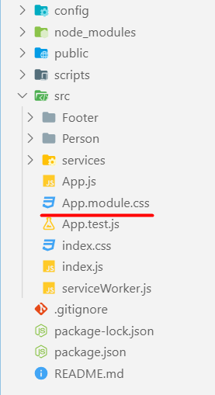
CSS Modules
React supports CSS Modules alongside regular stylesheet using the [name].module.css file naming convention
.App {
text-align: center;
}
.btn {
background-color: green;
color: white;
border-radius: 15px;
margin: 2%;
padding: 0.5%;
font-size: 24px;
cursor: pointer;
}

Slide 84
CSS Modules
CSS Modules let you use the same CSS class name in different file without worrying about naming clashes
.error {
background-color: white;
color: red;
}
CSS File called Button.module.css
import React, { Component } from 'react';
import styles from './Button.module.css';
class Button extends Component {
render() {
return <button className={styles.error}>Error Button</button>;
}
}
Importing all styles
Using error class from the css file

Slide 85

Using Fetch API
Fetching Remote Data

Slide 86
Fetch API
The Fetch API provides an interface for accessing and manipulating requests and responses
fetch() function which provides easy way to fetch resources asynchronously
Functionality like this was previously achieved using XMLHttpRequest
86

Slide 87
Fetch API
fetch() takes one mandatory argument (the path to the resource you want to fetch)
Second argument is optionally (init options - object)
returns a promise
Once response is retrieved, there are several methods that defines what and how should be handled

Slide 88
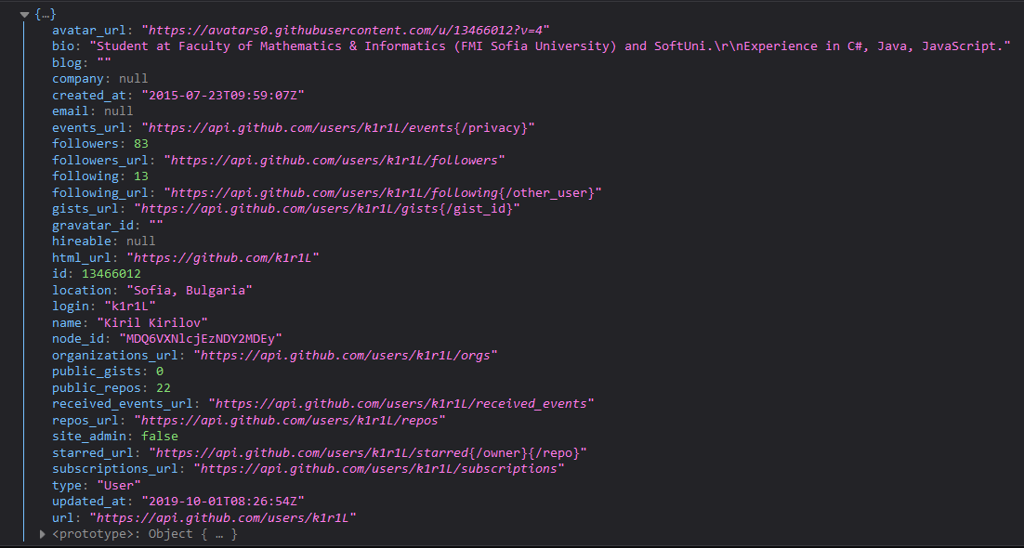
Fetch API
Fetch API with then/catch example
fetch('https://api.github.com/users/k1r1L')
.then((response) => response.json())
.then((myJson) => console.log(myJson))
.catch((myErr) => console.error(myErr));

Slide 89
Fetch API
Fetch API with async/await example
(async () => {
try {
const response = await fetch('https://api.github.com/users/k1r1L');
const myJson = await response.json();
console.log(myJson);
} catch (myErr) {
console.error(myErr);
}
})();

Slide 90
Fetch Services
The basic idea is to isolate the concern of fetching data inside components
Fetching data logic should separated as service
const apiUrl = '...';
export const getData = () => {
return fetch(apiUrl)
.then(res => res.json())
.then(data => data.results)
.catch(error => console.error(error))
};

Slide 91
Fetch Service
Import the useState and useEffect hooks
import { useState, useEffect } from 'react';
import { getData } from './services/fetching-data-service';
function App() {
const [state, setState] = useState({ data: [], isLoading: false });
useEffect(() => {
setState((state) => ({ ...state, isLoading: true }));
getData().then((data) => {
setState((state) => ({ ...state, data, isLoading: false }));
});
}, []);
Import the service
Using the useState hook
Using the useEffect hook
Using the service

Slide 92
Fetch Service
return (
<div className='container'>
{state.data.map((x) => (<p key={x.id}> {x.text}</p>))}
</div>
);
}
export default App;
Return the HTML structure

Slide 93
Virtual DOM
The virtual DOM (VDOM)
Virtual representation of a UI is kept in the memory
Synced the real DOM by a library such as ReactDOM
The term Virtual DOM is usually associated with React elements
They are the objects representing the UI
93

Slide 94
Virtual DOM
React keeps track of all elements in a virtual DOM
On change, a diffing algorithm is applied
Only the needed parts are updated in the browser
React syntax is declarative
You only describe the desired result
ReactDOM takes care of the order of operations

Slide 95

Routing Overview
Navigation for Single Page Apps

Slide 96
What is Client-side Routing?
Client-side routing is internal handling of a route
It's a pivotal element of writing SPA's
Allows navigation, without a full reloading of the page
Loading only the initial HTML, CSS and JS
Gives better UX

Slide 97
Single Page Applications
A Router loads the correct content when the location changes
Change in content is reflected in the address bar
Benefits
Load all scripts only once
Maintain state across multiple pages
Browser history can be used
Build User Interfaces that react quickly

Slide 98

React-Router
Routing Library Tailored for React

Slide 99
React Router
React Router is an API for React applications
Uses component structure
const App =(
<Routes>
<Route path="/catalog" element={<Catalog />} />
<Route path="/about" element={<About />} />
</Routes>);
ReactDOM.render((
<BrowserRouter>
<App />
</BrowserRouter>
), document.getElementById('root'))

Slide 100
Installation and Setup
Install using npm from the terminal
Route, Link, BrowserRouter, Routes components helps to implement the routing
npm install react-router-dom --save
import {
BrowserRouter as Router,
Routes,
Route,
Link,
} from 'react-router-dom';

Slide 101
Adding More Scenes
React components can be wrapped in a Route and bound to a specific path
<BrowserRouter>
<Routes>
<Route path="/" element={<App />} />
<Route path="/catalog" element={<Catalog />} />
<Route path="/about" element={<About />} />
</Routes>
</BrowserRouter>

Slide 102
Route Matching
Route path is exact by default
Use * as a wildcard
<Routes>
<Route path="/" element={<Home />} />
<Route path="/about" element={<About />} />
<Route path="/user/:id" element={<User />} />
<Route path="*" element={<NotFound />} />
</Routes >
Default route

Slide 103
Navigating with Link
Link replaces <a> and automatically prevents page reload
class App extends Component {
render() {
return (
<div>
<h1>React Router Tutorial</h1>
<Link to="/catalog">Catalog</Link>
<Link to="/about">About</Link>
</div>
);
}
}

Slide 104
useParams
Parameters are dynamic parts of the URL
Configure the Route to work with params
Access from the component
/catalog/elecronics/XYZ5538
<Route path="/catalog/:category/:userId" component={Catalog}/>
const {category, userId} = useParams();

Slide 105
useLocation
The location object represents
Where the app is now
Where you want it to go
Where it was
A location object is never mutated

Slide 106
Redirects
You can redirect the user by rendering a Navigate component
you can replace route state instead of push with replace attribute
You can redirect with useNavigate hook
...
if (condition) { return <Navigate to="/home" />
}
Determine the component to render at run-time

Slide 107
Active Links
NavLink knows when it's currently active
We can style them with style, className or children
<NavLink to="/catalog"
style={({isActive}) =>
isActive ? { color: 'red’ } : {}}>
Catalog
</NavLink >
<NavLink to="/catalog"
className={({isActive}) =>
isActive ? activeStyle : undefined}>
Catalog
</NavLink >

Slide 108
Nested Routes
You can dynamically nest routes
const About = () => (
<div>
<h1>About Page</h1>
<Route
path="contact"
element={<Contact />}
/>
</div>
)

Slide 109

Lazy Loading
Code-Splitting, Bundling, React.lazy

Slide 110
Code-Splitting – Bundling
Most React apps will have their files "bundled" using tools like Webpack or Browserify
Bundling is the process of
Following imported files
Merging them into a single file (bundle)
110

Slide 111
Code-Splitting Bundling
The bundle can be included on a webpage to load an entire app at once
export function add(a, b) {
return a + b;
}
import { add } from './math.js';
console.log(add(16, 26));
function add(a, b) {
return a + b;
}
console.log(add(16, 26));
111

Slide 112
Dynamic Import
The best way to introduce code-splitting into your app is through the dynamic import() syntax
import { add } from './math';
console.log(add(16, 26));
import("./math").then(math => {
console.log(math.add(16, 26));
});

Slide 113
Using React.lazy
The React.lazy function lets you render a dynamic import as a regular component
const OtherComponent = React.lazy(() => import('./OtherComponent'));
function MyComponent() {
return (
<div>
<OtherComponent />
</div>
);
}

Slide 114
Suspense – Showing Indicators
The Suspense component shows fallback content while we're waiting for another component to load
function MyComponent() {
return (
<div>
<Suspense fallback={<div>Loading...</div>}>
<OtherComponent />
</Suspense>
</div>
);
}
Accepts any React element

Slide 115
Route-based Code Splitting
An example of how to setup route-based code splitting
const Home = lazy(() => import('./routes/Home'));
const About = lazy(() => import('./routes/About’));
const App = () => (
<Router>
<Suspense fallback={<div>Loading...</div>}>
<Routes>
<Route path="/" component={<Home />} />
<Route path="/about" component={<About />} />
</Routes>
</Suspense>
</Router>
);

Slide 116

Forms
Controlled and Uncontrolled Forms

Slide 117
Forms
Form elements work a little bit differently in React
They naturally keep some initial state
React provides 2 standard ways to handle forms
Controlled components
Uncontrolled components
117

Slide 118
Uncontrolled Components Demo

Slide 119

Controlled Components

Slide 120
Controlled Components
Most recommending technique to implement forms
In a controlled component, form data is handled by a React
Input element's value is kept in the state
Custom handlers for change or submit events
Piping all the input state through a React Component

Slide 121
Controlled Forms
Inputs are explicitly managed
The value is stored inside the component state
Input is recorded with event handlers
setState
Name:
Component
Pesho
value:
changeHandler
change event

Slide 122
Form Component Declaration
const Register = () => {
const [email, setEmail] = useState('');
const emailChangeHandler = (e) => { setEmail(e.target.value); }
submitHandler(event) {
event.preventDefault();
// Doing some AJAX with the data...
}
// Continues ...
}

Slide 123
Form Component Rendering
...
return (
<form onSubmit={submitHandler}>
<div>
<label htmlFor='email'>Email:</label>
<input type="email"
value={email}
onChange={emailChangeHandler} />
</div>
// And so on for other input elements...
<button type="submit">Register</button>
</>
);
};

Slide 124
Unified Input Approach
React handles all form input elements the same
textarea uses a value prop
select uses a value prop on the root element
Pass an array to select multiple values
<form onSubmit={this.handleSubmit}>
<textarea value={this.state.value} onChange={this.handleChange} />
<input type="submit" value="Submit" />
</form>
<select multiple={ true } value={ ['A', 'B', 'C'] }>

Slide 125
Use cases
Sometimes can be tedious to use controlled components
Writing every handler for every way your data
Pipe all the input state
Reuse changeHandler and state
Uncontrolled components is an alternative technique for implementing input forms

Slide 126

useRef

Slide 127
Uncontrolled Components
To write an Uncontrolled Component you can create a reference to specific DOM element
Refs are created using React.createRef()
Attached to React elements via the ref attribute
const MyComponent = () => {
myRef = React.createRef();
return <div ref={this.myRef} />;
}

Slide 128
Using Refs Example
const Register = () => {
inputRef = React.createRef();
handleSubmit(event) {
event.preventDefault();
alert('A name was submitted: ' + inputRef.current.value);
}
// Continues ...
}

Slide 129
Using Refs Example
render() {
return (
<form onSubmit={handleSubmit}>
<label>
Name:
<input type="text" ref={inputRef} />
</label>
<input type="submit" value="Submit" />
</form>
);
}

Slide 130
When to Use Refs ?
There are a few good use cases for refs
Managing focus, text selection, or media playback
Triggering imperative animations
Integrating with third-party DOM libraries
Avoid using refs for anything that can be done declaratively
Don't overuse refs

Slide 131
Introduction
React Hooks
JS functions which can be only used inside Functional Component or other Hooks
New feature in React 16.8
Let you use state and other React features without writing a class
131

Slide 132
Introduction
React Hooks have specified naming
Starting with lowercase: "use "
Followed by function name like: "State"
useState, useEffect, useContext…
The basic idea is to expose stateful functionalities to functional component
managing state
adding lifecycle methods

Slide 133
Introduction
You can make everything work that you could make working class based components
The are highly re-usable and independent for each component
Using hooks to share functionality, NOT data between components
React hooks have nothing to do with Lifecycle Methods
Can't replace lifecycle methods with React hooks

Slide 134
State Hook

Slide 135
State Hook
Hook is a special function that lets you "hook into" React features
useState is a Hook that lets you add React state to function components
You don't have to convert functional component into class to use state
135

Slide 136
State Hook
Calling useState hook inside functional component to add some local state to it
React will preserve this state between re-renders
useState returns a pair
Current state value
Function that lets you update it
import { useState } from 'react';
const [count, setCount] = useState(0);

Slide 137
State Hook
import { useState } from 'react';
const counter = () {
const [count, setCount] = useState(0);
return (
<div>
<p>Counter: {count}</p>
<button onClick={() => setCount(count + 1)}>
Click me
</button>
</div>
);
}

Slide 138
State Hook
You can call the update function from anywhere
It's similar to this.setState in class, except it doesn't merge the old and new state together
The only argument to useState hooks is the initial state
Unlike this.state, here doesn't have to be an object
Although it can be if you want

Slide 139
State Hook
You can use the State Hook more than once in a single component
The initial state argument is only used during the first render
const registerComponent = () {
const [email, setEmail] = useState("");
const [age, setAge] = useState("0");
const [password, setPassword] = useState("");
// ...
}

Slide 140
State Hook Demo

Slide 141
Effect Hook

Slide 142
Effect Hook
You most likely perform: data fetching, subscriptions or manually changing the DOM
Operations like these are called side effects
They can affect other components and can't be done during the rendering
useEffect hook adds the ability to perform side effects from a function component
142

Slide 143
Effect Hook
useEffect hook serves the same purpose as
componentDidMount
componentDidUpdate
componentWillUnmount
But they are bundled into a single API
import { useEffect } from 'react';

Slide 144
Effect Hook
useEffect hook accepts a function that contains imperative, possibly effectful code
That function will run after the render is committed to the screen
By default effects run after every completed render
But you can choose to fire them only when certain value have changed

Slide 145
Effect Hook
import { useState, useEffect } from 'react';
const counter = () {
const [count, setCount] = useState(0);
// Similar to componentDidMount and componentDidUpdate
useEffect(() => {
document.title = `The counter reached: ${count} times`;
});
// ...
}

Slide 146
Effect Hook
When you call useEffect you're telling React to run your "effect" function after flushing changes to the DOM
Effects are declared inside the component so they have access to its props and state
Effects may also optionally specify how to "clean up" after them by returning a function

Slide 147
Effect Hook
Often, effects create resources that need to be cleaned up before the component leaves the screen
To do this, the function passed to useEffect may return a clean-up function
useEffect(() => {
const subscription = props.source.subscribe();
return () => {
// Clean up the subscription
subscription.unsubscribe();
};
});

Slide 148
Effect Hook Demo

Slide 149

Custom Hooks

Slide 150
Custom Hooks
Sometimes, is necessary to reuse some stateful logic between components
Traditionally, there were two popular solutions to this problem
Higher-order components
Render props
Custom Hooks let you do this, but without adding more components to your tree
150

Slide 151
Custom Hooks
A custom hook is simple JS function whose name starts with "use" and that may call other Hooks
Unlike a React component, a custom Hook doesn't need to have a specific signature
We can decide
What it takes as arguments
What should return

Slide 152
Custom Hook Demo

Slide 153

Rules of Hooks

Slide 154
Rules of Hooks
Hooks are JavaScript functions, but you need to follow two rules when using them
Only Call Hooks at the Top Level
Only Call Hooks from Functional Components
154

Slide 155
Only Call Hooks at the Top Level
Don't call Hooks inside loops, conditions, or nested functions
By following this rule, you ensure that Hooks are called in the same order each time a component renders
That's what allows React to correctly preserve the state of Hooks between multiple useState and useEffect calls
155

Slide 156
Only Call Hooks from Functional Components
Don't call Hooks from regular JavaScript functions. Instead, you can
Call Hooks from React function components
Call Hooks from custom Hooks
By following this rule, you ensure that all stateful logic in a component is clearly visible from its source code
156

Slide 157

Context

Slide 158
Context
Context provides way to pass data through the component tree without passing the props manually
Context API
React.createContext
Context.Provider
useContext
158

Slide 159
Context
Context is designed to share data that can be considered global
Current authenticated user
Theme
Preferred language
Using context, we can avoid passing props through intermediate elements

Slide 160
Context
Context is primarily used when
Some data needs to be accessible by many components at different nesting levels
Apply it sparingly because it makes component reuse more difficult
Using Context only the top-most Page Component know about your data

Slide 161
Context API
React.createContext
Creates a Context object
While rendering will read the current context value from the closest matching Provider above it in the tree
The default value is used only when a component does not have a matching Provider above it in the tree
const someContext = React.createContext(defaultValue);

Slide 162
Context API
Context.Provider
Every Context object comes with a Provider React component
Allowing consuming components to subscribe to context changes
Accepts a value prop to be passed to consuming components
One Provider can be connected to many consumers
<MyContext.Provider value={/* some value */}>

Slide 163
Context API
useContext
Accepts a context object
Return the current context value for that context
The current context value is determined by the value prop of the nearest Provider
Argument to useContext must be the context object itself
const ThemeContext = React.createContext(themes.light);
...
const theme = useContext(ThemeContext);

Slide 164
Context

Slide 165
Easier Context
export const Context = React.createContext();
export const ContextProvider = ({children}) => { const [state, setState] = React.useState({});
return ( <Context.Provider value={state}>
{children}
</Context.Provider> ) }

Slide 166
Context Demo

Slide 167


Higher-Order Components
Advanced Composition and Decoration

Slide 168
Higher-Order Components
A higher-order component (HOC) is an advanced technique in React for reusing component logic
HOCs are not part of the React API
HOC is a function that takes a component and returns a new component
168

Slide 169
Higher-Order Component
Components are the primary unit of code reuse
Some patterns aren't straightforward for traditional components
Whereas as component transforms props into UI
HOC component transform a component into another component
const EnhancedComponent = higherOrderComponent(WrappedComponent);

Slide 170
HOC Example
function hocFunc(WrappedComponent) {
return function Component(props) {
render() {
return <WrappedComponent {...props} />;
}
};
}

Slide 171

Advantages
Greater code reuse
Reduced boilerplate
Easily handle cross-cutting concerns
Commonly used for
Share logic between components
Binding component props to business logic
Automating repetitive tasks

Slide 172

UseReducer

Slide 173
More Hooks
useReducer
An alternative to useState
Accepts a reducer of type (state, action) => newState
Return the current state paired with a dispatch method
Preferable when you have complex state logic
const [state, dispatch] = useReducer(reducer, initialState);

Slide 174
More Hooks Demo

Slide 175

Error Boundaries

Slide 176
Error Boundaries
Error boundaries are React components
Catching, logging and displaying JS error anywhere in their child component tree
They catch errors during rendering
Do not catch errors for
Event handlers
Asynchronous code
Server-side rendering
176

Slide 177
Error Boundaries
A component becomes an error boundary if it defines
static getDerivedStateFromError
Render a fallback UI after an error has been thrown
componentDidCatch
Log error information
You can use it as a regular component
<ErrorBoundary>
<MyWidget />
</ErrorBoundary>

Slide 178
Error Boundaries
Error boundaries work like a JavaScript catch {} block for component
Only class component can be error boundaries
Declare an error boundary component once and use it throughout your application

Slide 179
Error Boundaries
You may wrap top-level route components to display some error message
Wrapping individual widgets in an error boundary
Protect them from crashing the rest of the app

Slide 180
Error Boundaries Demo

Slide 181

JEST
Unit Testing

Slide 182
What is JEST?
Jest is a JavaScript unit testing framework
Used by Facebook to test services and React applications
Jest acts as a test runner, assertion library and mocking library
Jest provides Snapshot testing
Create a rendered 'snapshot' and compare it to a previous
https://jestjs.io/

