Slide 1
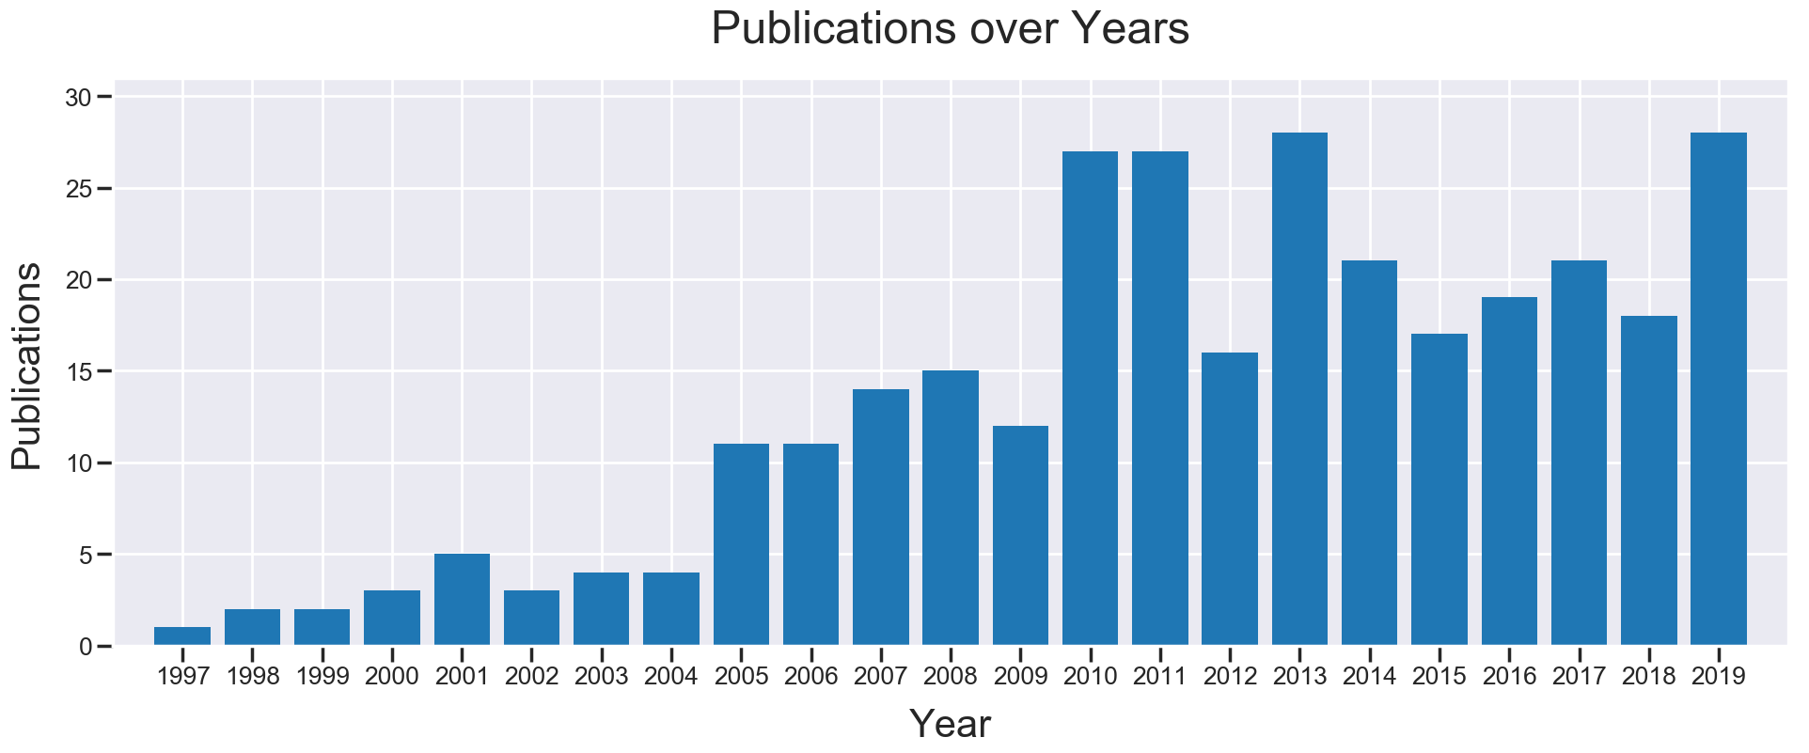
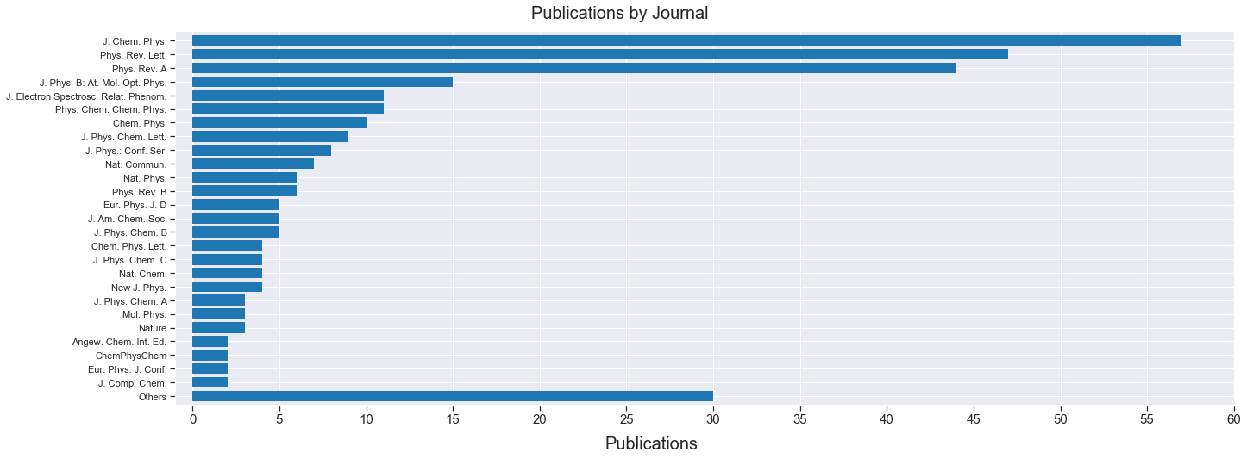
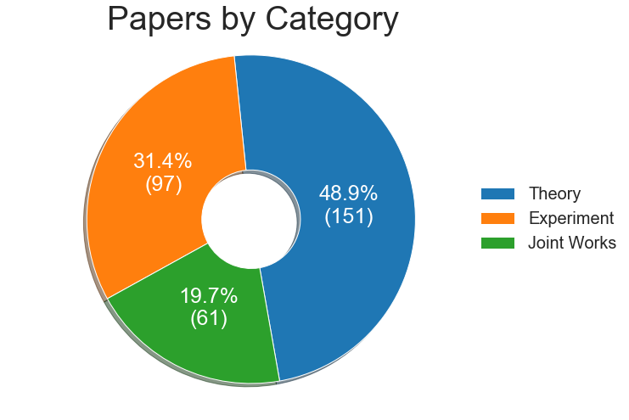
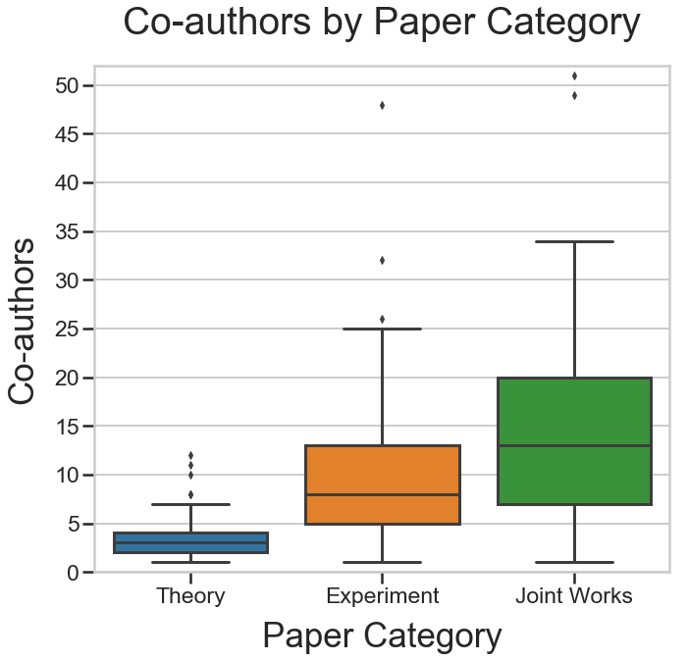
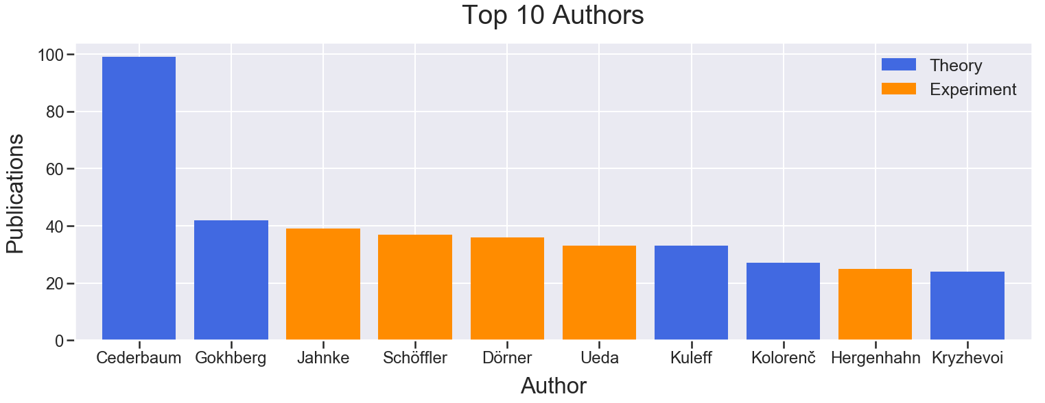
Interatomic (Intermolecular) Coulombic Decay and Related Phenomena
Statistics of the ICD Bibliography
Created by N.V. Kryzhevoi. Latest Revision: 04.10.2019

