Slide 1
Login and Registration System using Redis
Nikolay Malyshev
C18333703
DT282/4

Slide 2
Run:
To run, navigate to the folder in terminal and run
Npm install
It will run all packages in package.json
Run with :
node app.js
http://localhost:3000/

Slide 3
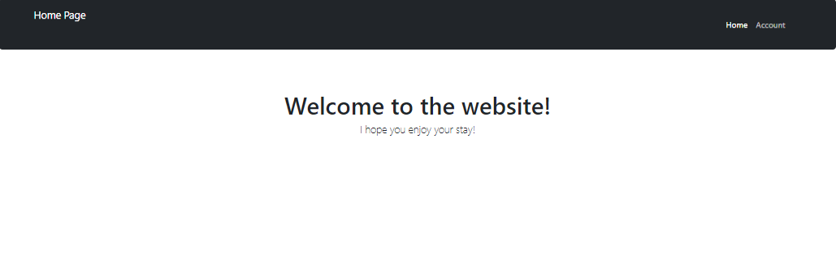
Website home page

Slide 4
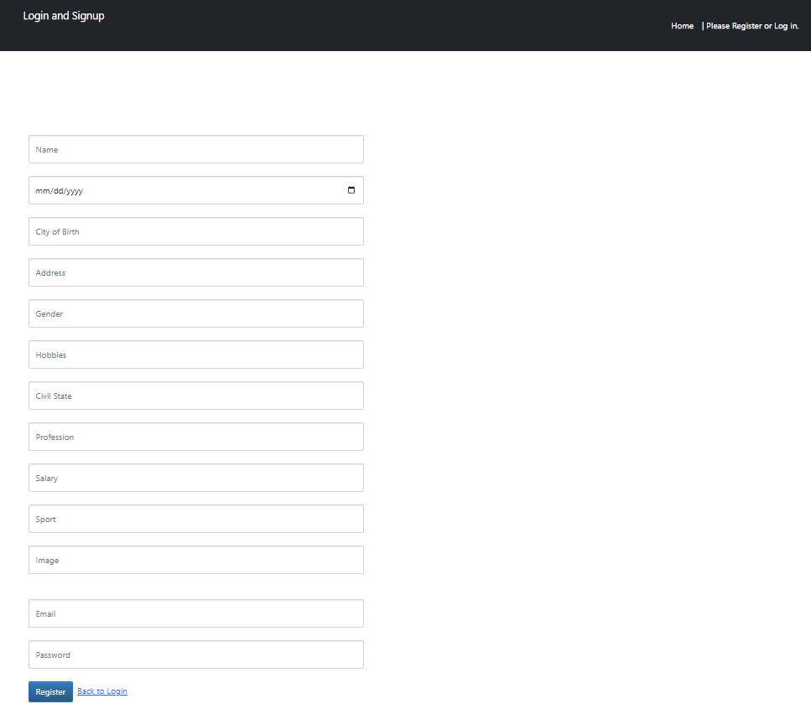
Website Sign Up

Slide 5
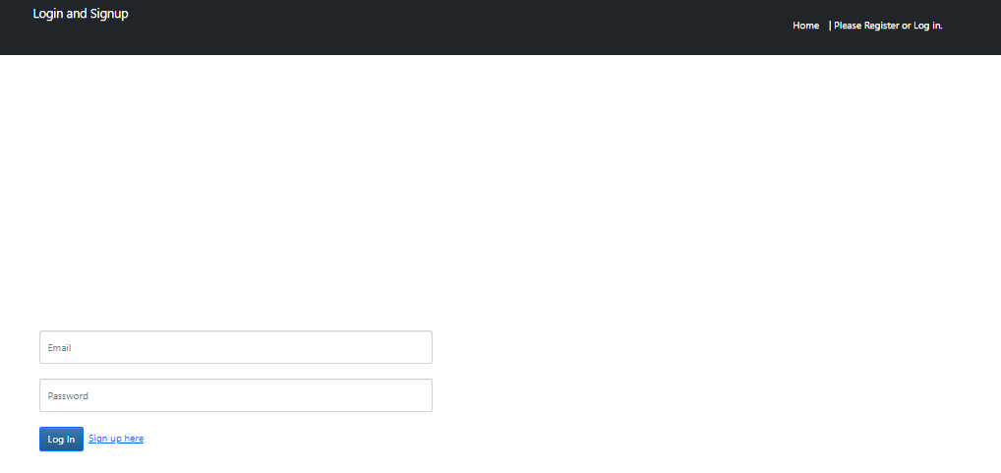
Website Login

Slide 6
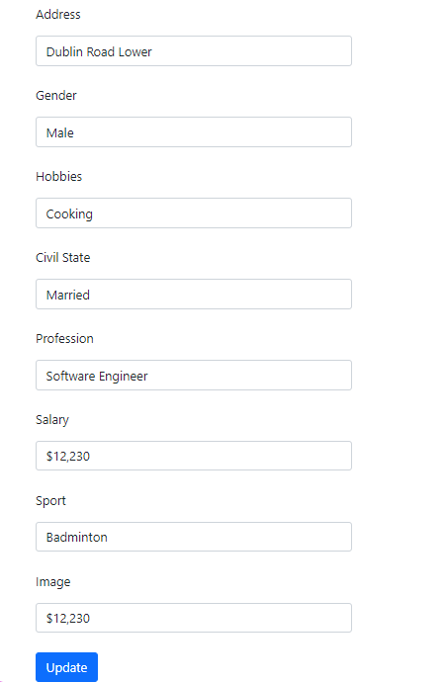
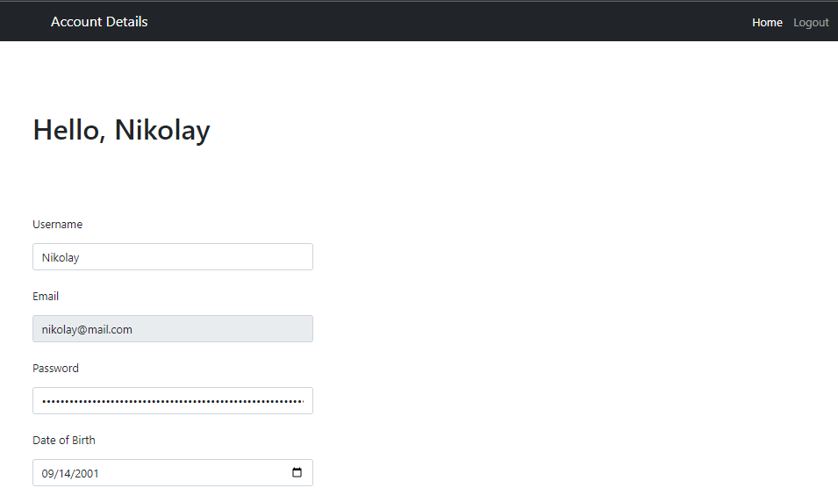
Accounts Detail Preloads

Slide 7
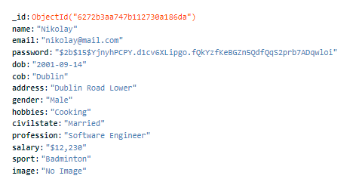
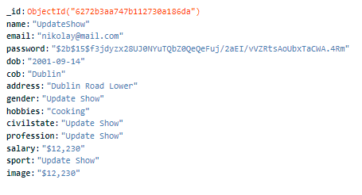

Updating in MongoDB
Email cannot be updated as that’s what is checked when updating a document to ensure that the right document is updated

Slide 8
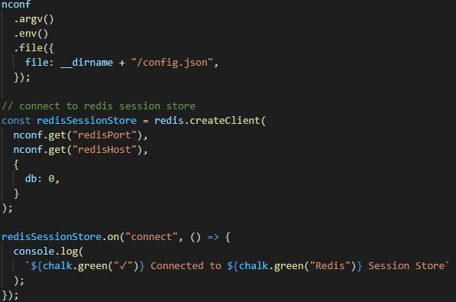
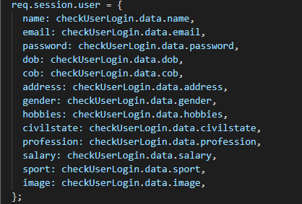
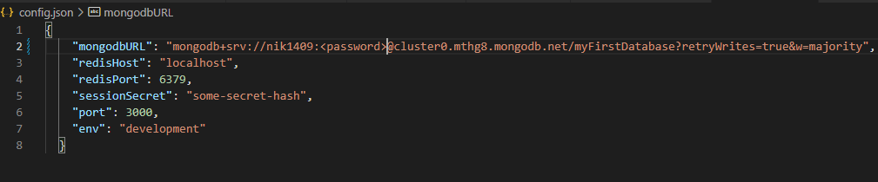
Redis & MongoDB
Values for Session

Slide 9


Bycript

Slide 10
Specification
Everything laid out in the document is completed apart from the user being able to upload an image, and that image being stored in mongodb.

Slide 11
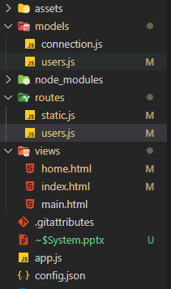
Diagram 1 : Structure

Slide 12
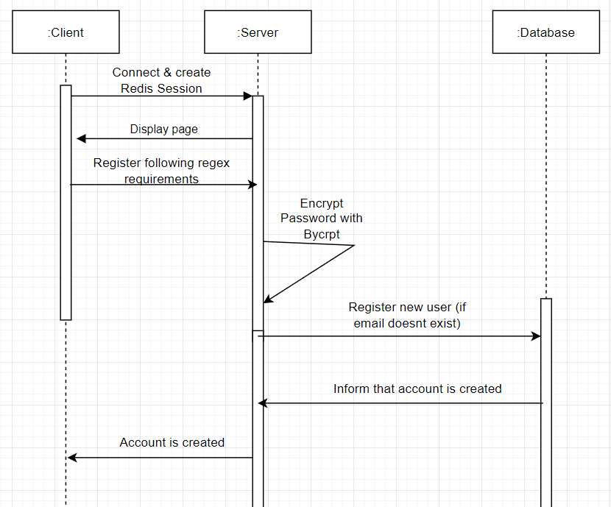
Diagram 2 : Example of Registration

