Slide 1
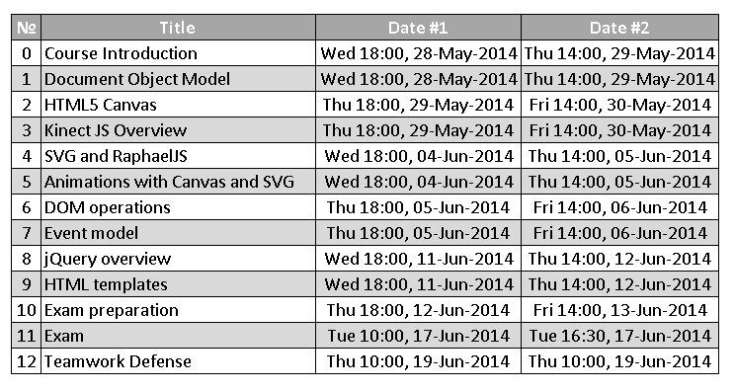
Homework
Create the following using Handlebars.js

Slide 2
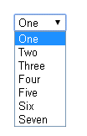
Homework (2)
Create a dynamic select using Handlebars.js
The options in the select should be generated based on a collection of JavaScript objects
Example:
var items = [{
value: 1,
text: 'One'
}, {
value: 2,
text: 'Two'
}];
var selectHTML = selectTemplate(items);

