Slide 1
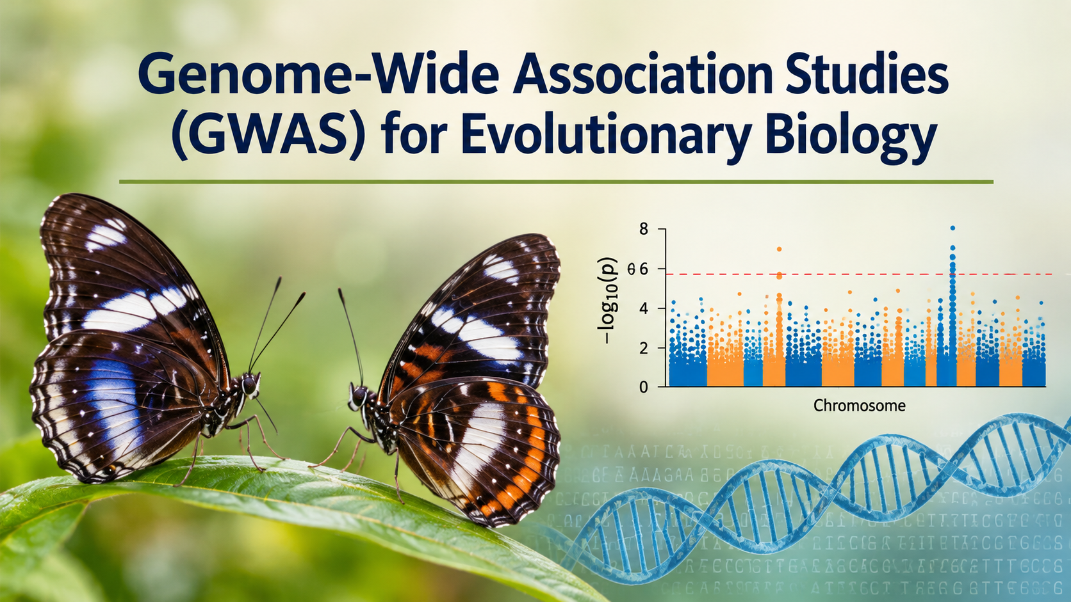
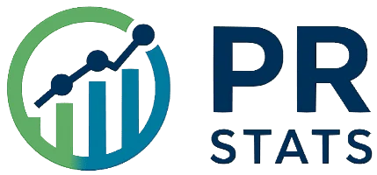
Nikolay Oskolkov, Group Leader (PI) at NIRI, Riga, Latvia

Slide 2



Genomics: Progress or Regress?
I remember times when I worked with
10 genetic variants, now we have
millions of variants thanks to WGS!

Slide 3
FOUNDATIONS
Genetic variation: the raw material of association
What varies?
Single-nucleotide variants (SNVs / SNPs): one base differs.
Insertions / deletions (indels): bases added or removed.
Structural variation (SVs): larger deletions, duplications, inversions and rearrangements.
Alleles are alternative states; genotype describes the alleles carried by an individual.
How variation is inherited
Nearby variants can be inherited together as a haplotype.
Linkage disequilibrium (LD): non-random association of alleles at different loci.
Recombination breaks down haplotypes over generations.
Allele frequencies and LD patterns differ among populations and species.
Caution of GWAS interpretation
A typed marker may not be causal;
it can tag a nearby causal variant in LD
Common variants are well captured by many SNP arrays; rare and structural variants may be missed.
Population history, relatedness and admixture shape allele frequencies.
Reference panels help interpret variation, but must be biologically appropriate.
Concepts: NHGRI, International HapMap Project; NHGRI Genomic Variation Program. genome.gov/10001688/international-hapmap-project

Slide 4
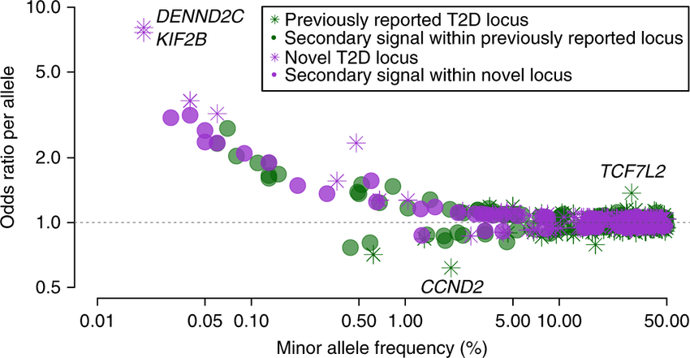
Rare variants with large effects may be missing

Slide 5
THE BASIC IDEA
GWAS: scan the genome for trait-associated markers
1 COHORT
2 GENOTYPE
3 TEST
4 INTERPRET
Individuals + phenotype
Genome-wide markers
Variant-by-variant model
Loci → biology
What is tested?
For each variant, test whether genotype dosage predicts the phenotype.
Adjust for relevant covariates, technical effects, ancestry and relatedness.
Millions of tests require stringent multiple-testing control (often P < 5 × 10⁻⁸ in human GWAS).
What does a hit mean?
A significant marker identifies an associated region, i.e. not necessarily the causal change.
Follow-up: fine-mapping, functional annotation, replication and experimental validation.
Population structure, batch effects and phenotype error can create misleading signals.
Sources: NHGRI GWAS Fact Sheet; NHGRI-EBI GWAS Catalog training. genome.gov/about-genomics/fact-sheets/Genome-Wide-Association-Studies-Fact-Sheet

Slide 6
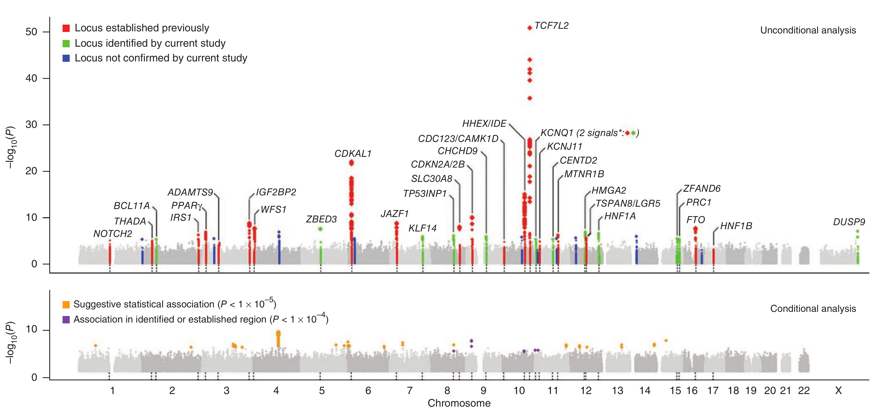
Manhattan plot visualization of GWAS results

Slide 7
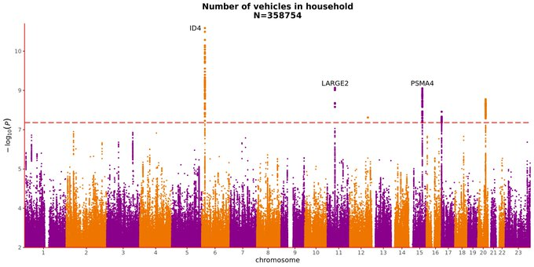
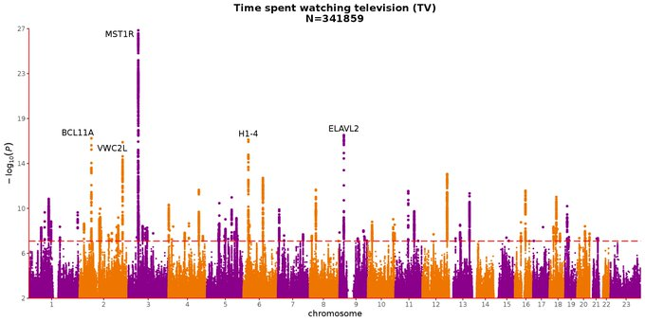
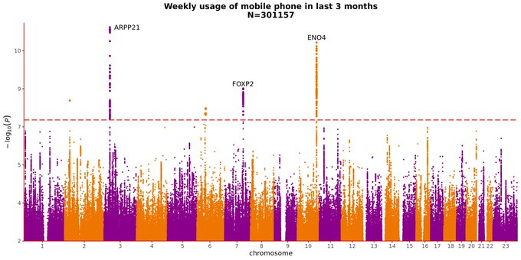
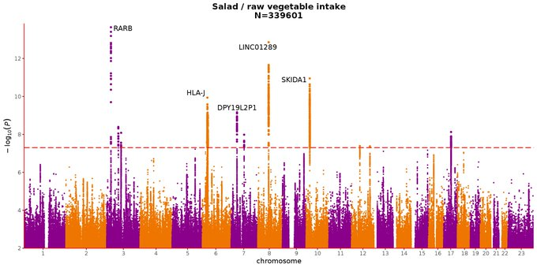
False-positive hits in GWAS

Slide 8
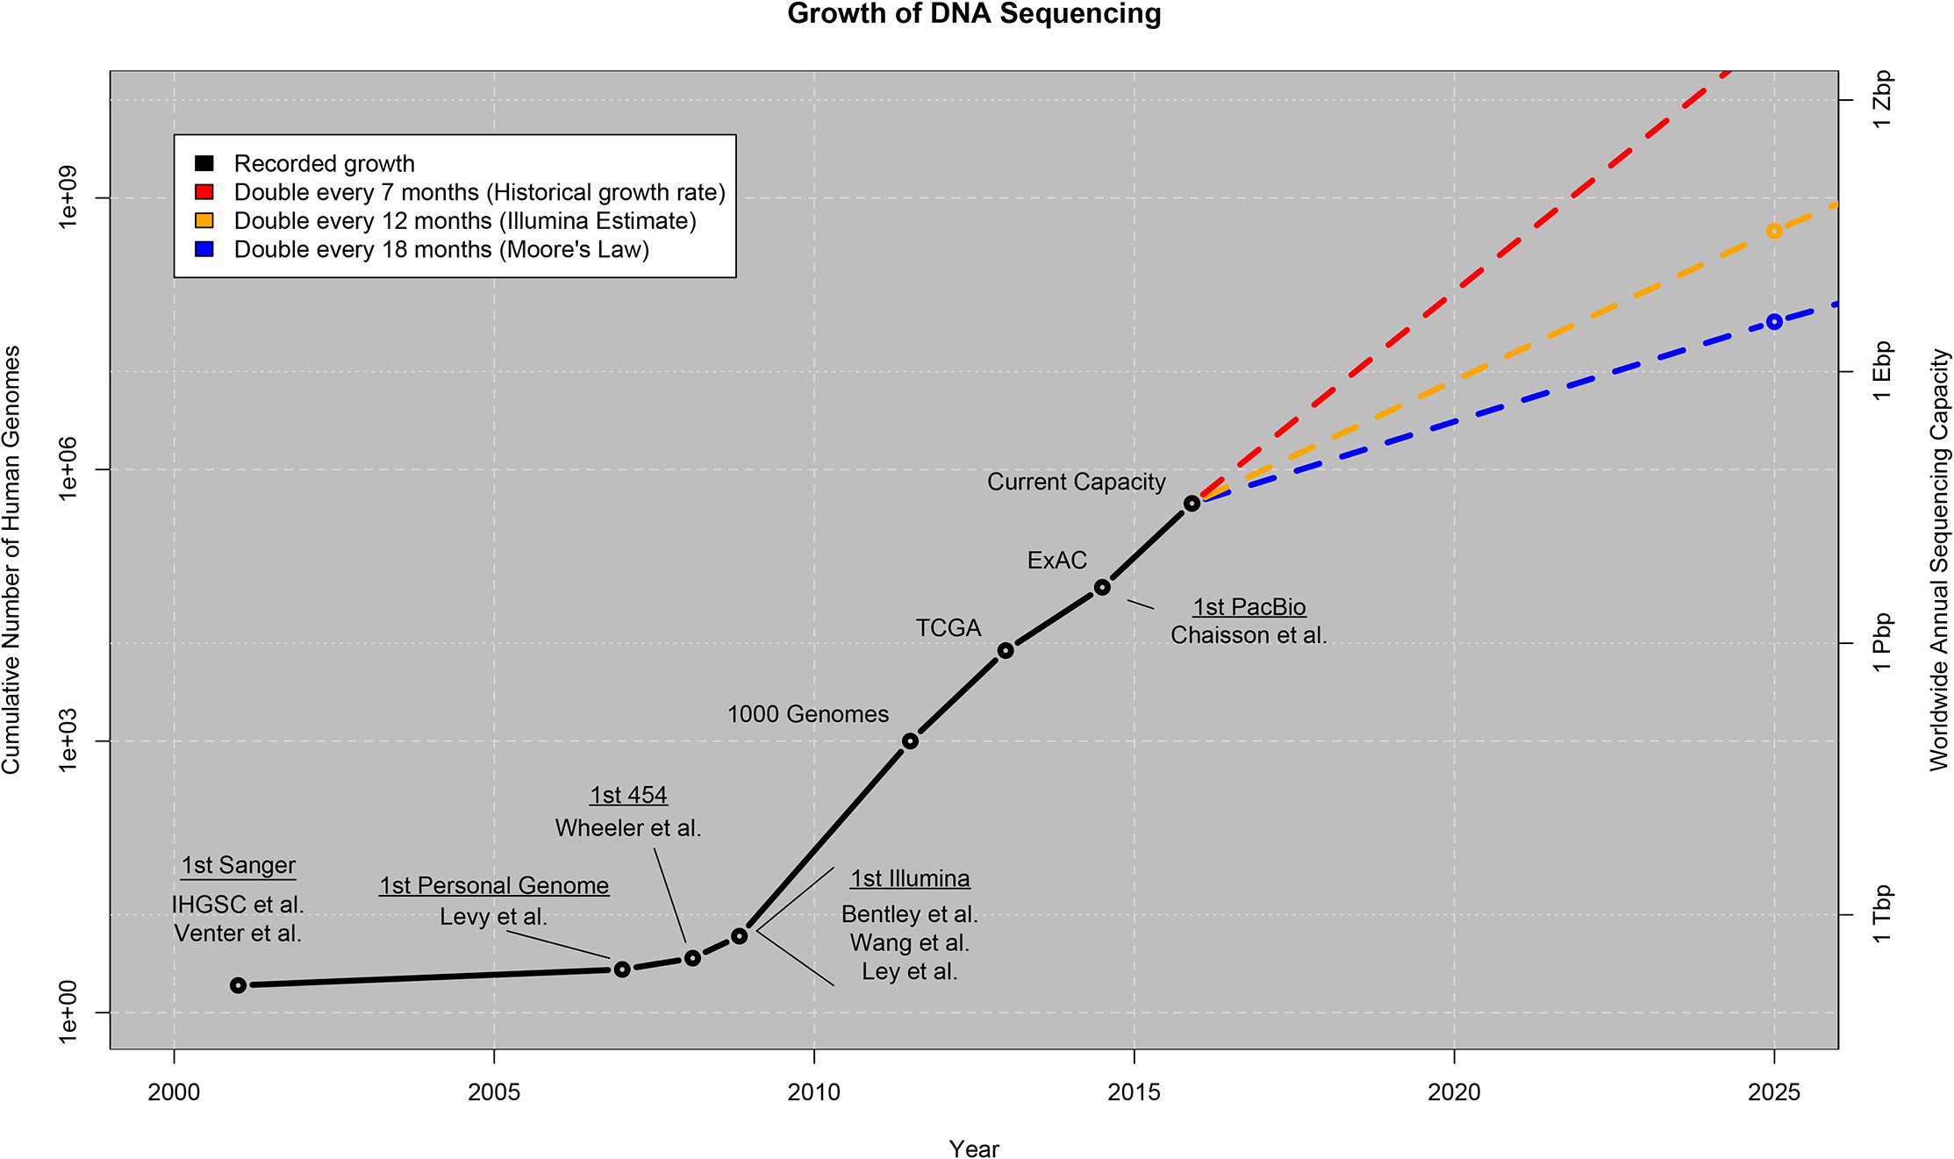
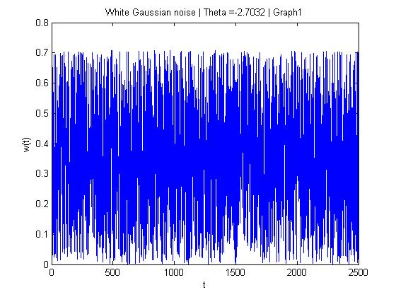
Big Data in Genomics
Genomics / WGS
: Little Data
N₁ ~ 10³
P₁ ~ 10⁶
N₁ * P₁ = N₂ * P₂ = 10⁹
Stephens et al., (2015). Big Data: Astronomical or Genomical? PLoS Biology 13(7)
scRNAseq
: Big Data
N₂ ~ 10⁶
A file with White Noise can
also take a lot of disk space
P₂ ~ 10³

Slide 9
HUMAN VARIATION RESOURCE
International HapMap Project: mapping common haplotypes
What was HapMap?
International effort launched in 2002 to describe common patterns of human DNA variation.
Central product: a genome-wide map of haplotypes and linkage disequilibrium across sampled populations.
Identified 'tag SNPs' that capture much of the information in nearby correlated variants.
Goal: make genome-wide association scans practical with fewer genotyped markers.
Why it mattered
Helped design SNP arrays.
Provided a framework for early GWAS.
Made LD and haplotype structure central to association mapping.
Important caveat
Not a complete catalogue of all human variation.
Sampling was limited compared with global diversity.
Tagging performance depends on ancestry: LD patterns are not universal.
Source: NHGRI, International HapMap Project and project fact sheet. genome.gov/10001688/international-hapmap-project

Slide 10
HUMAN VARIATION RESOURCE
1000 Genomes and HGDP: complementary views of human diversity
1000 Genomes Project (1KGP)
Public catalogue of human variation built using whole-genome sequencing, exome sequencing and genotyping.
Final Phase 3: 2,504 people from 26 populations; >88 million variants, with phased haplotypes.
Designed to capture common variants broadly; useful for allele frequencies, phasing and genotype imputation.
A widely used human reference panel—but not universal for every ancestry or species.
Human Genome Diversity Project (HGDP)
Collection created to study the breadth and history of human genetic diversity across populations worldwide.
Classic HGDP-CEPH panel: about 1,050 individuals from 52 populations (counts vary slightly by dataset/marker set).
Historically important for population structure, migration, admixture and human evolutionary history.
Compared with 1KGP, HGDP emphasizes broad geographic / population diversity rather than a large, uniform imputation panel.
Sources: 1000 Genomes Project Consortium (2015), Nature; IGSR summary; Stanford Rosenberg Lab HGDP resources. internationalgenome.org/1000-genomes-summary/

Slide 11
BIODIVERSITY GENOMICS
European Reference Genome Atlas (ERGA): reference genomes for biodiversity
What is ERGA?
Pan-European scientific community coordinating high-quality reference genomes for European biodiversity.
European node of the Earth BioGenome Project, which aims to build reference genomes across Earth's eukaryotic biodiversity.
Pilot tested a distributed model: 98 species across 33 European countries.
Work spans sampling, sequencing, assembly, annotation, data stewardship, training and shared standards.
Relevance for evolutionary biology genomics
A reference genome is the coordinate system for read mapping, variant calling and annotation.
High-quality assemblies improve detection of SNPs, indels and structural variation.
Comparative and population genomics can connect variation to adaptation, demography and conservation.
ERGA is not a human diversity panel: it supports species-specific genomics across biodiversity.
Sources: ERGA official FAQ; ERGA pilot paper (npj Biodiversity, 2024). erga-biodiversity.eu/faqs

Slide 12
TAKE-HOME COMPARISON
Four resources, different questions and different scales
Resource | Scope | Core contribution | Useful for
HapMap | Human; common variation | Haplotype / LD map; tag SNPs | Array design; early GWAS; understanding LD
1000 Genomes | Human; 26 populations | Broad variant catalogue + phased haplotypes | Allele frequencies; phasing; imputation
HGDP | Human; 52 populations | Population-diversity panel with broad geographic sampling | Population structure; ancestry; human evolution
ERGA | European biodiversity; many species | Collaborative production of high-quality species reference genomes | Read mapping; variant discovery; evolution; conservation
Key principle: choose a reference resource that matches the biological question, species and population / taxonomic diversity.
Links: HapMap — genome.gov/10001688/international-hapmap-project | 1KGP — internationalgenome.org | HGDP — rosenberglab.stanford.edu/diversity.html | ERGA — erga-biodiversity.eu

