Slide 1

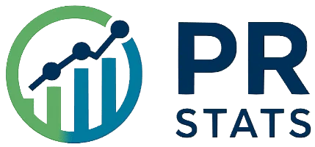
Nikolay Oskolkov, Group Leader (PI) at NIRI, Riga, Latvia

Slide 2
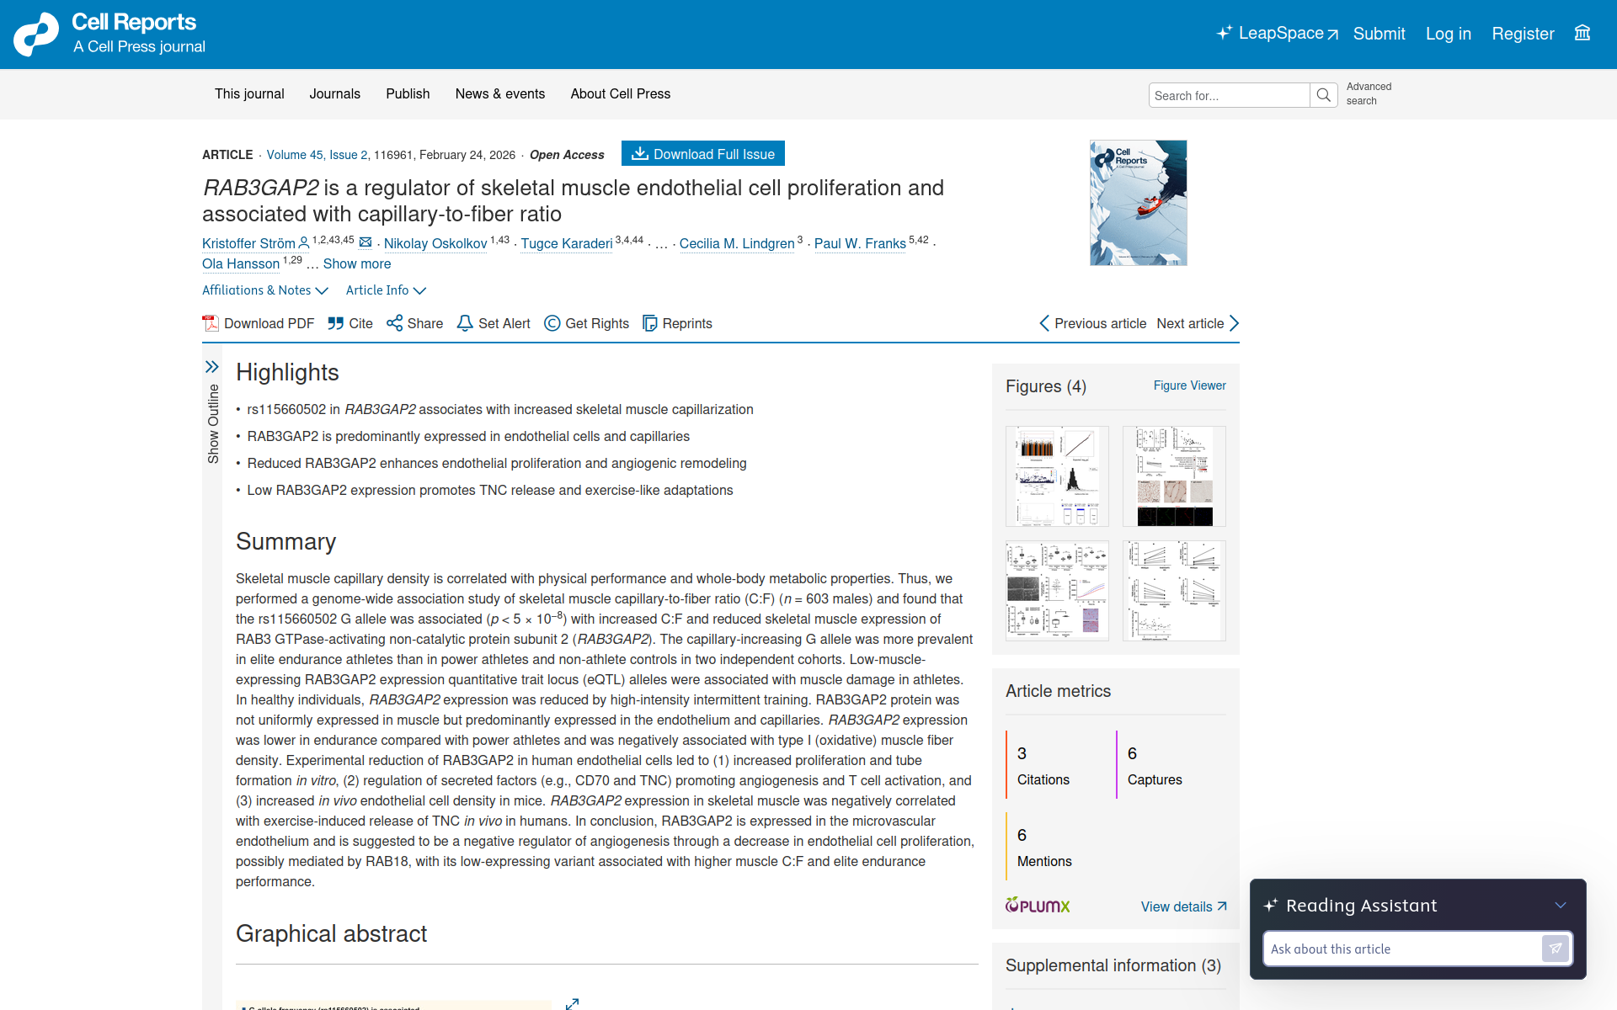

Slide 3
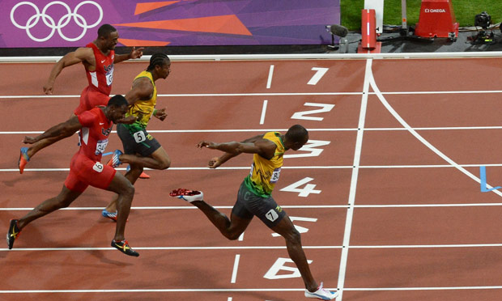

GWAS OF HISTOLOGICAL PHENOTYPES
PROVIDES INSIGHTS INTO THE GENETIC ARCHITECTURE
OF HUMAN SKELETAL MUSCLE
Nikolay Oskolkov
A few genetic advices on how to become Usain Bolt

Slide 4
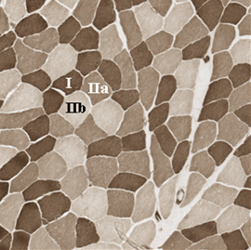
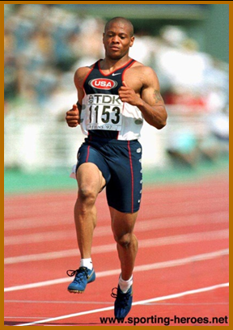
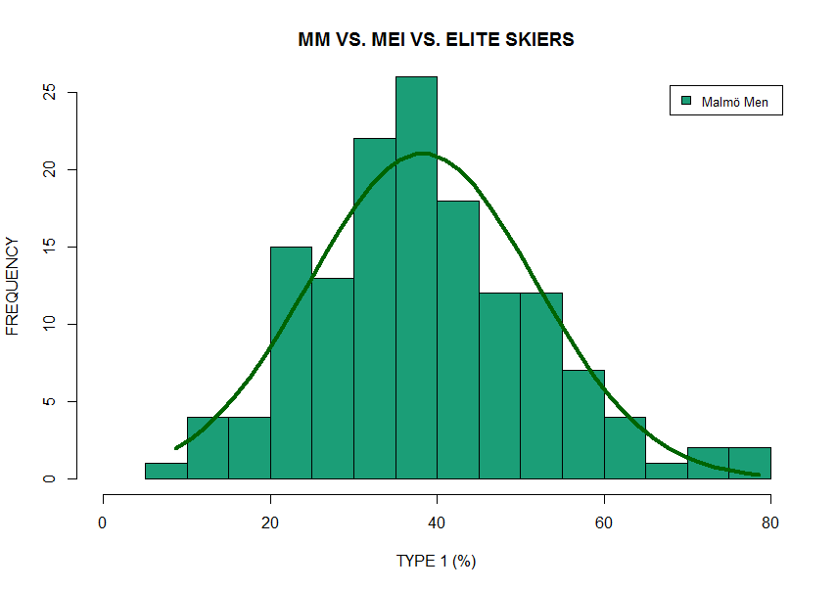
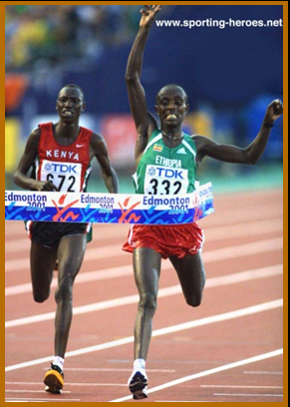
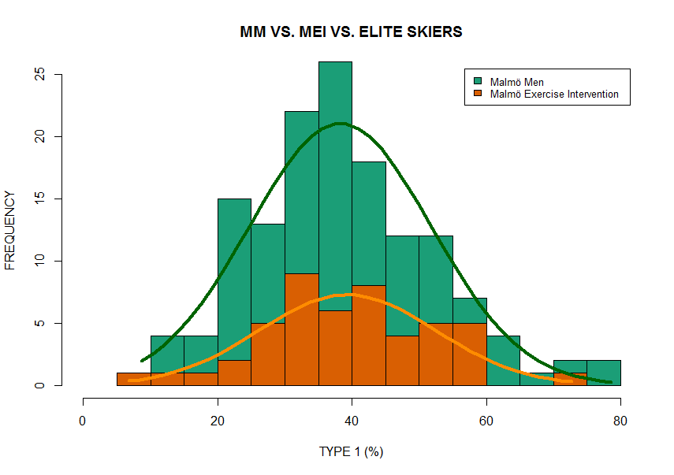
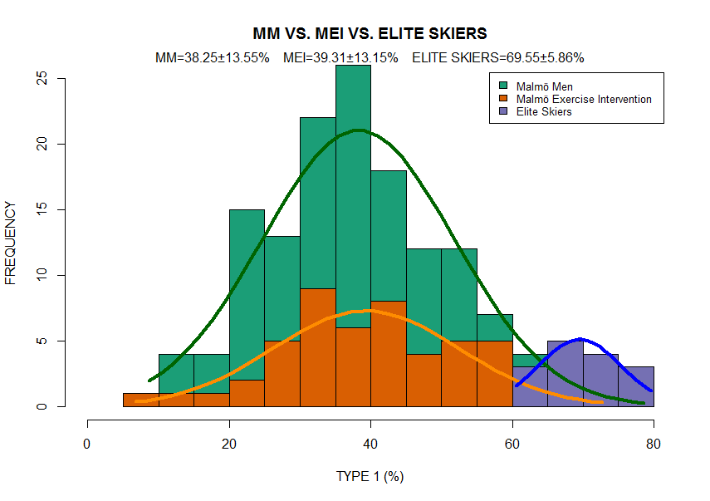
SKELETAL MUSCLE FIBRE TYPES
 | TYPE I Fibers (Red) | TYPE IIA Fibers (Red) | TYPE IIX Fibers (White)
Contraction time | Slow | Fast | Fast
Metabolism | Oxidative | Oxidative | Glycolytic
Fibre size | Small | Medium | Large
Segerström et al, J. Str. Cond. Res., 2010
Sprinter: TYPE IIA / IIX
Long distance runner: TYPE I

Slide 5
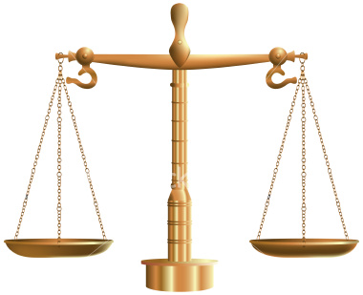
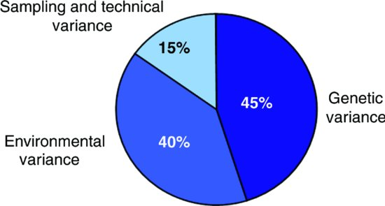
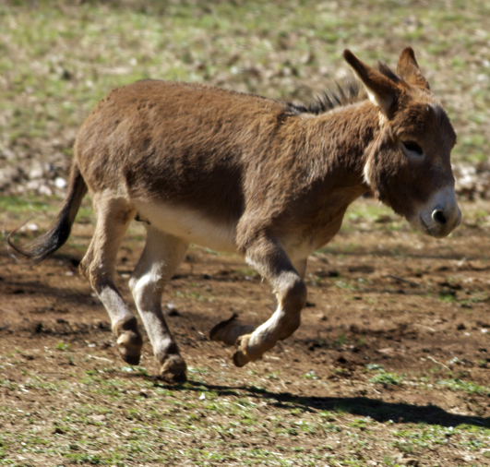
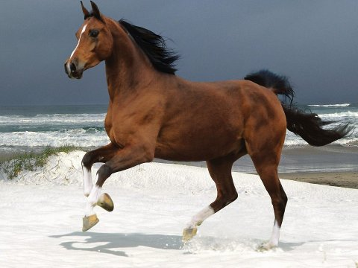
THE ROLE OF “TALENT” IN SPORTS
Exercise
Environment
Genetics
J.A. Simoneau, C. Bouchard, FASEB, 1995
If a donkey exersices a lot it will still be a very fast and trained donkey but not a racehorse

Slide 6
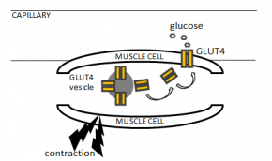
AIM:
To identify genetic variation associated with skeletal muscle histological phenotypes
- e.g. fiber types, capillary density

Slide 7
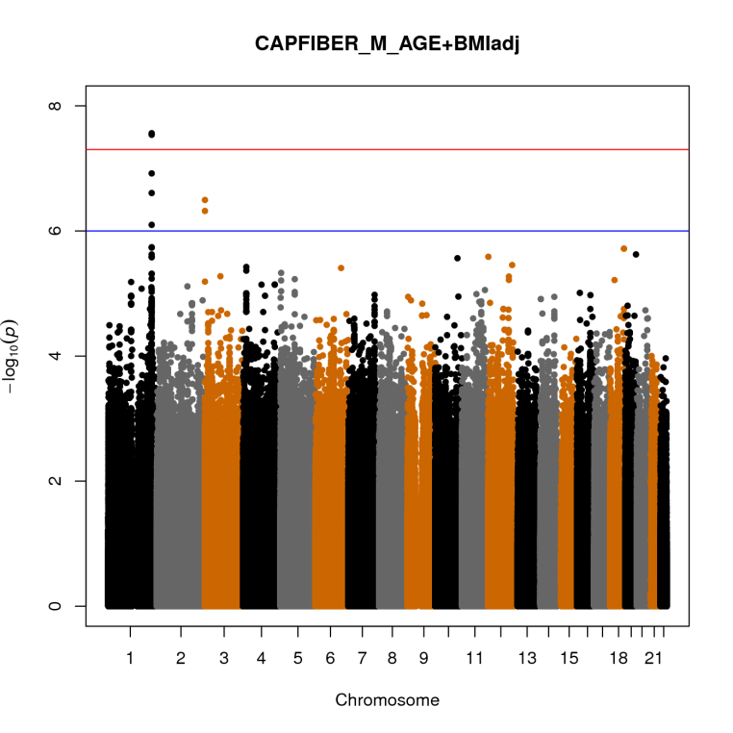
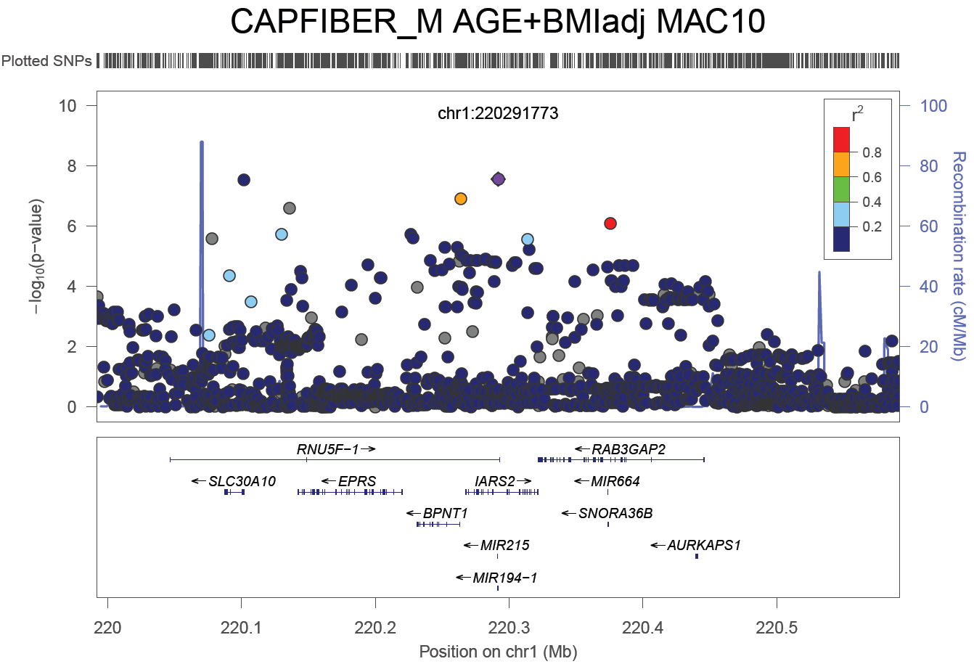
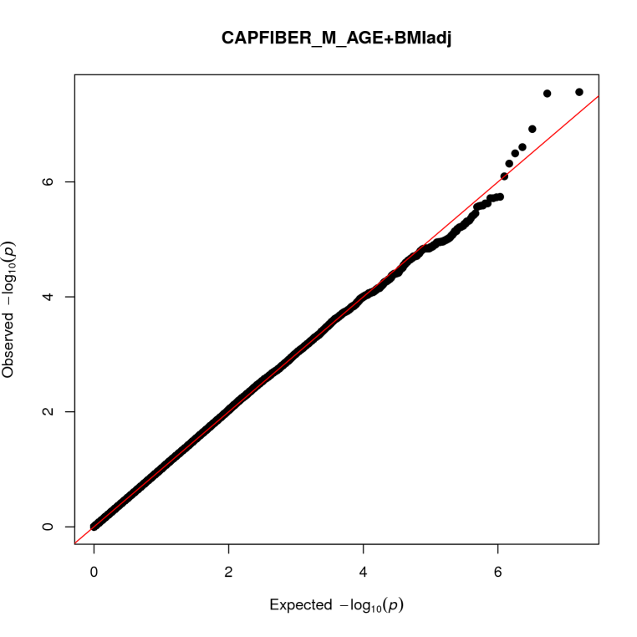
CAPILLARY DENSITY
Capillary density
LD:
R²= 0.057
D'= 0.657
rs191465330
rs115660502
λ= 1.0132
rs115660502, A/G polymorphism
MAF(ULSAM+MM+MEI)=4.8%
G-allele is associated with
increase of capillary density

Slide 8
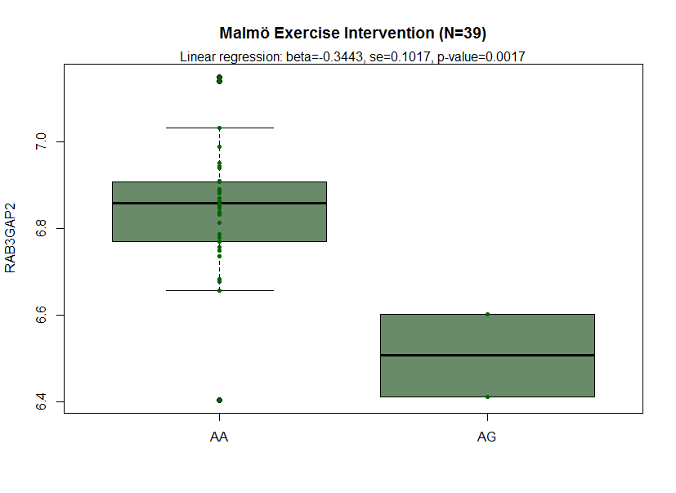
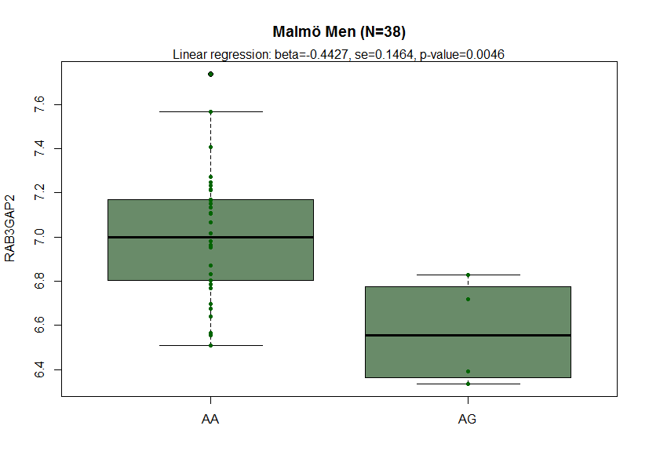
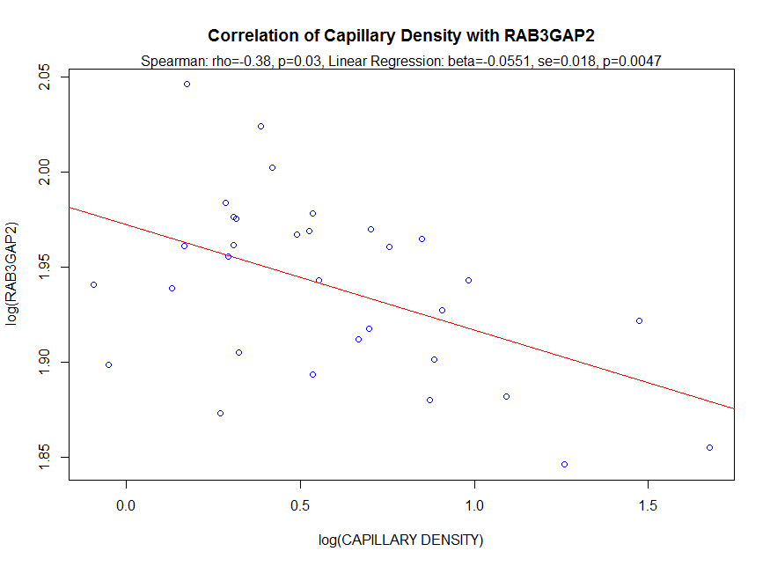
rs115660502 REGULATES CAPILLARY DENSITY VIA RAB3GAP2
Cis-eQTL meta-analysis on human skeletal muscles: MEI+MM (77 individuals)
G-allele of rs115660502 increases capillary density
G-allele of rs115660502 decreases RAB3GAP2 gene expression in skeletal muscles
RAB3GAP2 gene expression in skeletal muscles and capillary density are negatively correlated

Slide 9
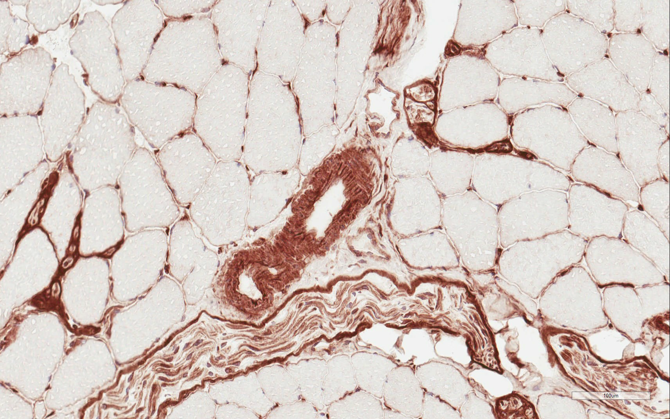
IHC STAINIG FOR RAB3GAP2 IN SKELETAL MUSCLE
RAB3GAP2 is predominantly present in capillaries of skeletal muscles

Slide 10
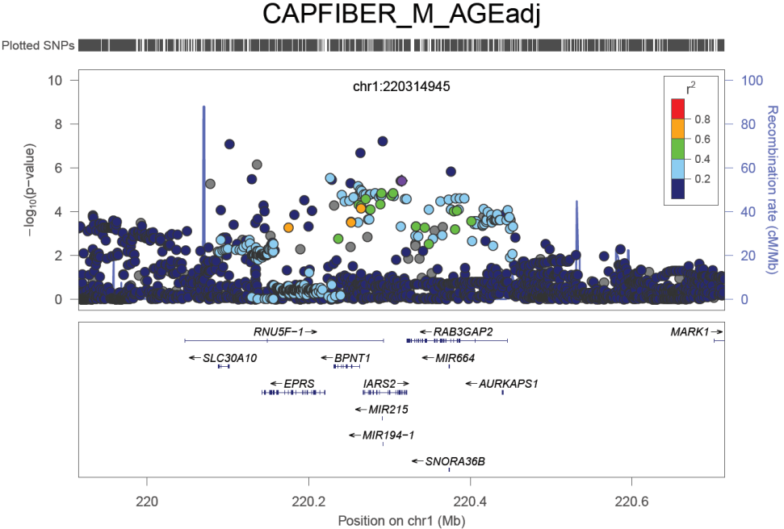
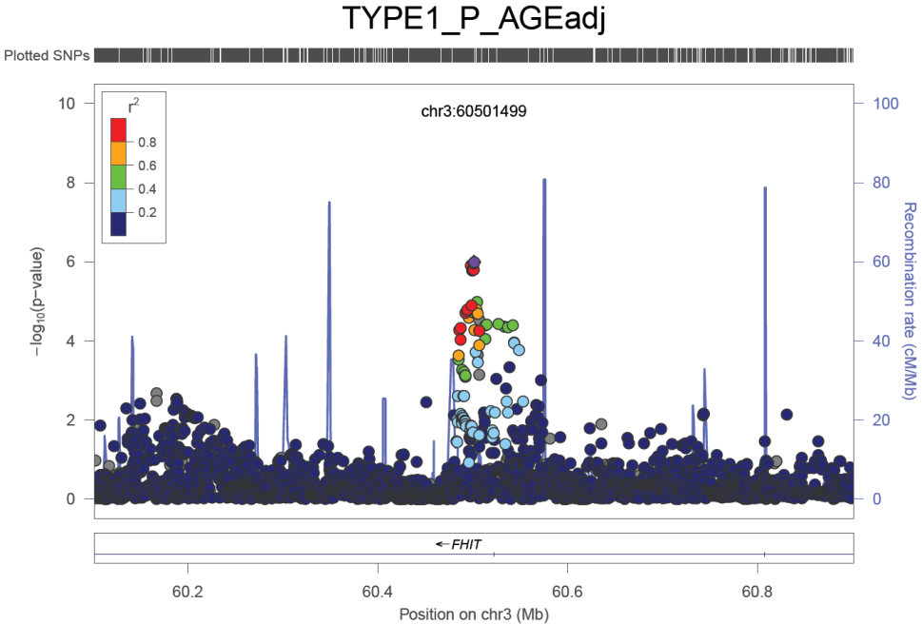
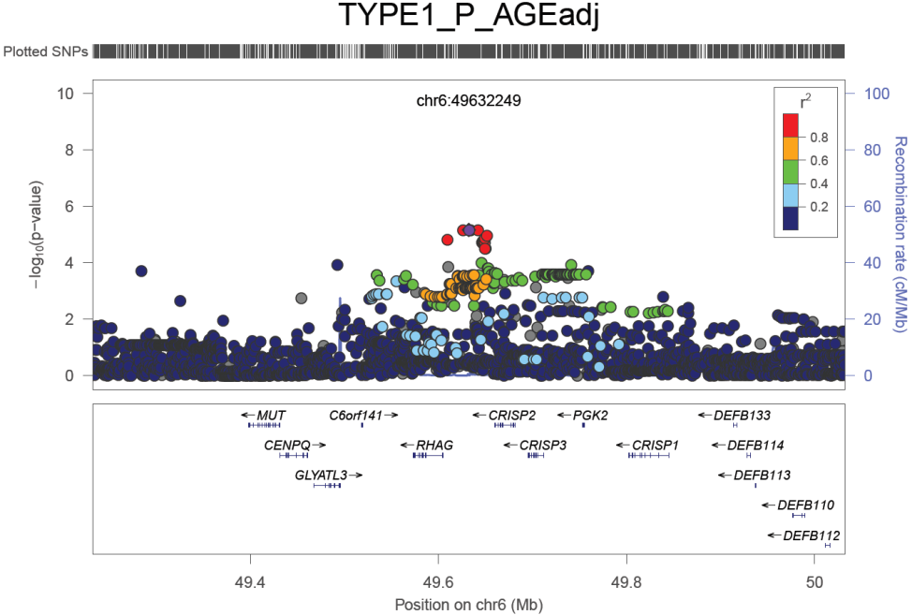
POPULATION DIFFERENTIATION SCAN FOR POSITIVE SELECTION: CAPILLARY DENSITY AND TYPE1 (%)
Loci-candidates for positive slection were selected by ranking by Fst and ∆DAF between EUR and AFR populations of 1000G
Capillary Density
DAF(EUR)=55%, DAF(AFR)=85%
TYPE1 (%)
TYPE1 (%)
DAF(EUR)=24%, DAF(AFR)=4%
DAF(EUR)=63%, DAF(AFR)=90%

Slide 11
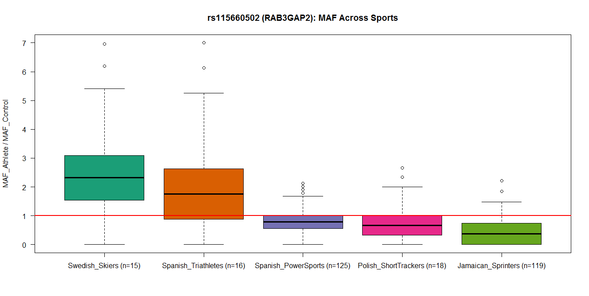
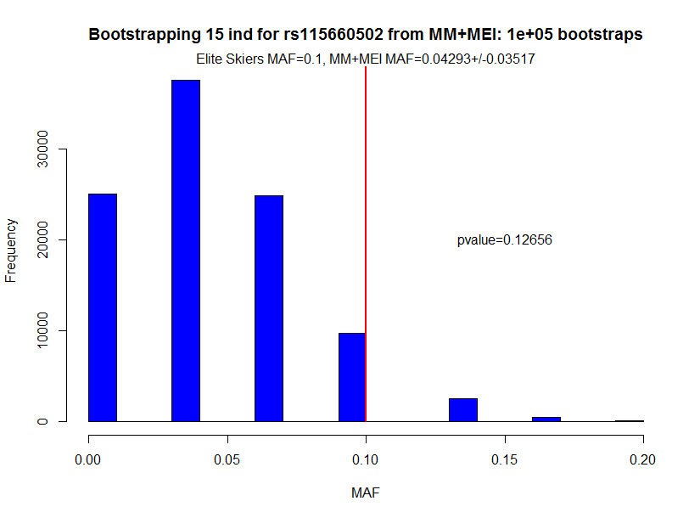
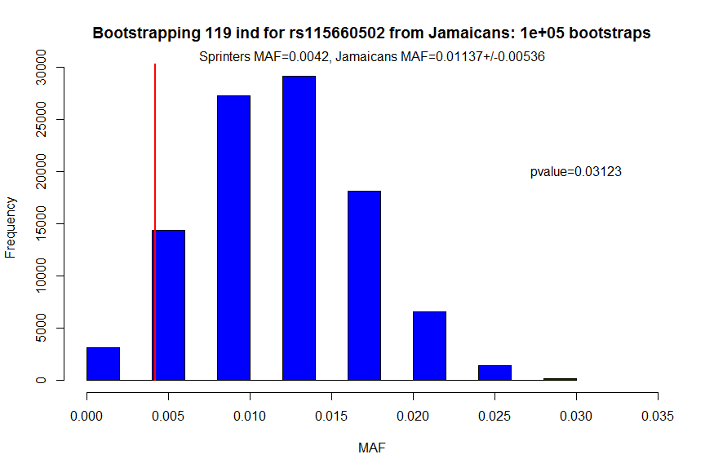
G-ALLELE OF rs115660502 IS OVERREPRESENTED IN ENDURANCE
AND UNDERREPRESENTED IN POWER SPORTS
SWEDISH CROSS-COUNTRY SKIERS: MAF=10%
SWEDISH POPULATION: MAF=4.8%
Basketball, karate, taekwondo, heavy weight lifting, judo, fencing, gymnastics
JAMAICAN SPRINTERS: MAF=0.4%
JAMAICAN POPULATION: MAF=1.1%
MAF for Sprinters
MAF for Skiers
ENDURANCE
POWER

