Slide 1


Nikolay Oskolkov, Group Leader (PI) at NIRI, Riga, Latvia

Slide 2
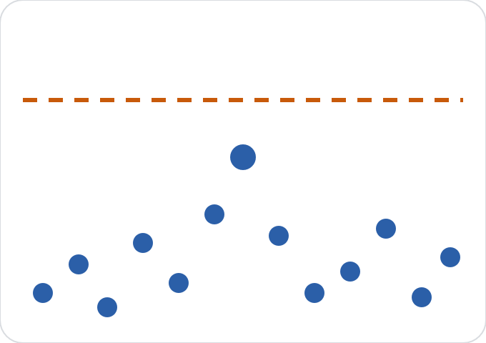
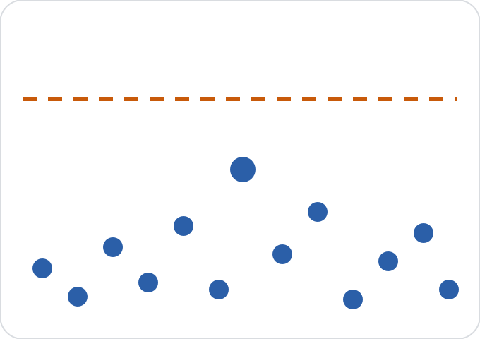
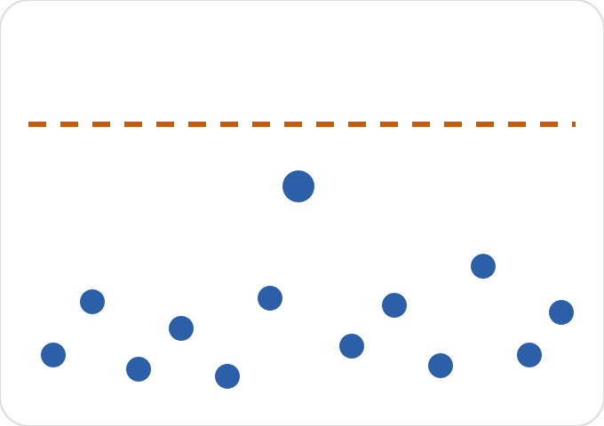
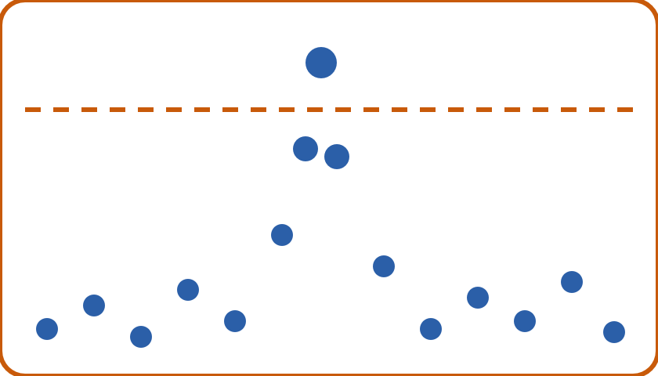

Why combine GWAS studies?
Study 1: too small
Study 2: too small
Study 3: too small
Meta-analysis: significant
More samples means more power, without sharing individual genotypes.
Schematic. Dashed line = genome-wide significance threshold.

Slide 3
What each study shares
Study | SNP | Effect / other allele | Effect β | Error SE | Samples N
Batch 1 | chr3:1204 | A / G | +0.80 | 0.35 | 10
Batch 2 | chr3:1204 | A / G | +1.10 | 0.25 | 10
β
SE
Alleles
Direction and size of the effect
How certain the study is
Align them first: flip swapped alleles
Example values are illustrative.

Slide 4
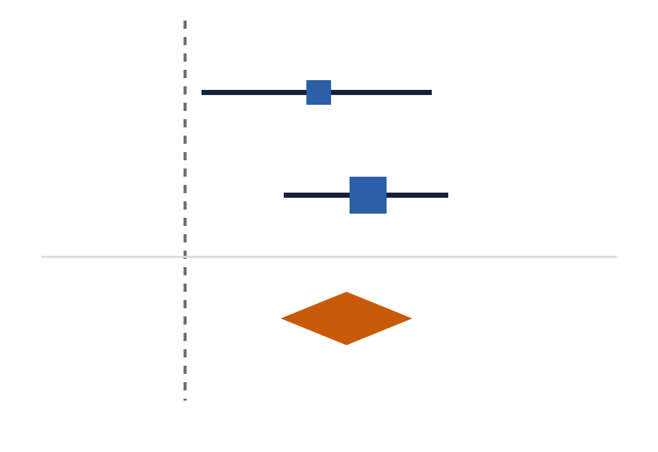
Fixed effect: weighted average
WEIGHT
w = 1 / SE²
Batch 1
COMBINED EFFECT
Batch 2
β = Σ(w·β) / Σw
Combined
COMBINED ERROR
SE = 1 / √Σw
no effect at the dashed line
Formulae: Willer et al. 2010, METAL, Table 1. Plot is a schematic.

Slide 5
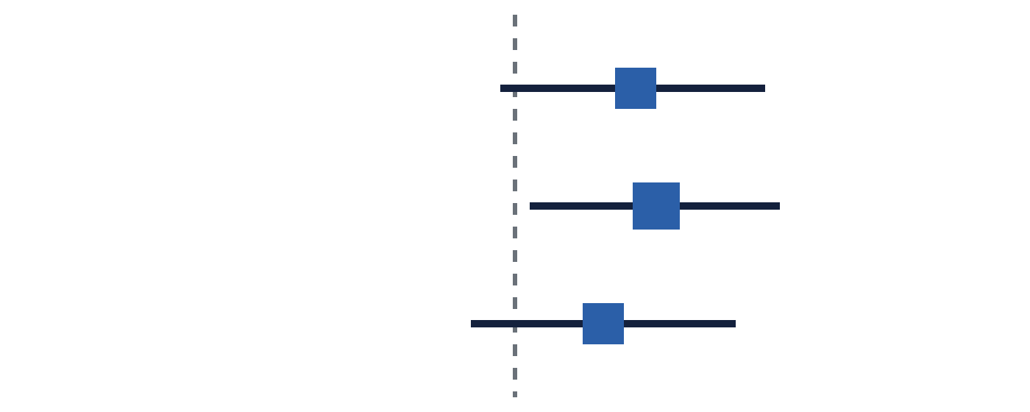
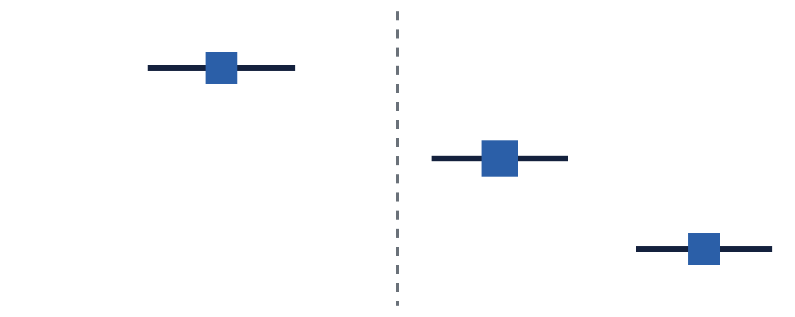
Do the studies agree?
Consistent
Heterogeneous
Intervals overlap. Low Q, I² near 0%.
Intervals do not overlap. High Q, high I².
Q tests for disagreement. I² is he percentage of the variation between studies’ estimates that comes from real differences between the studies rather than from chance.
What I² means: studies never give exactly the same estimate, because each has sampling noise from its finite sample size. I² asks how much of the spread between estimates is more than that noise would produce.
Q measures the weighted spread of the study estimates around the combined estimate
Cochran’s Q and I²: reported by both GWAMA and METAL. Plots are schematic.

Slide 6

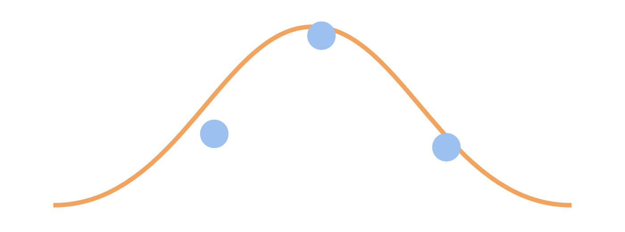
Random effects: allow real differences
Fixed
Random
One true effect. Differences are chance only.
Each study has its own true effect. τ² = spread.
Weights become 1 / (SE² + τ²). Result: wider, more cautious intervals.
DerSimonian–Laird random effects, available in GWAMA (--random). Plots are schematic.

Slide 7
Two tools, one idea
GWAMA
METAL
Fixed and random effects
Q, I² and effect directions
Needs β and SE per study
STDERR: weighted β (as left)
SAMPLESIZE: weighted z-scores
Fast and scriptable, with Q and I²
Both use the same input, one row per SNP per study, and both can apply genomic control.
Mägi & Morris 2010 (GWAMA); Willer, Li & Abecasis 2010 (METAL).

Slide 8

Our butterfly example
20 BAMs
2 batches
ANGSD
GWAMA
Results
m and i morphs
10 each: 5 m + 5 i
doAsso per batch
and METAL
Manhattan, QQ
Effect directions agree between batches?
Low heterogeneity (I²) at the top SNPs?
Forest plot for each top SNP
Hypolimnas misippus; see the course notebook for the full pipeline.

Slide 9
References
GWAMA
Mägi R, Morris AP. GWAMA: software for genome-wide association meta-analysis. BMC Bioinformatics 2010;11:288.
METAL
Willer CJ, Li Y, Abecasis GR. METAL: fast and efficient meta-analysis of genomewide association scans. Bioinformatics 2010;26(17):2190–2191. doi:10.1093/bioinformatics/btq340
Figures in this deck are schematic drawings. See the original papers for their own figures and tables.

