Slide 1


Nikolay Oskolkov, Group Leader (PI) at NIRI, Riga, Latvia

Slide 2
Missing data and general imputation principles

Slide 3
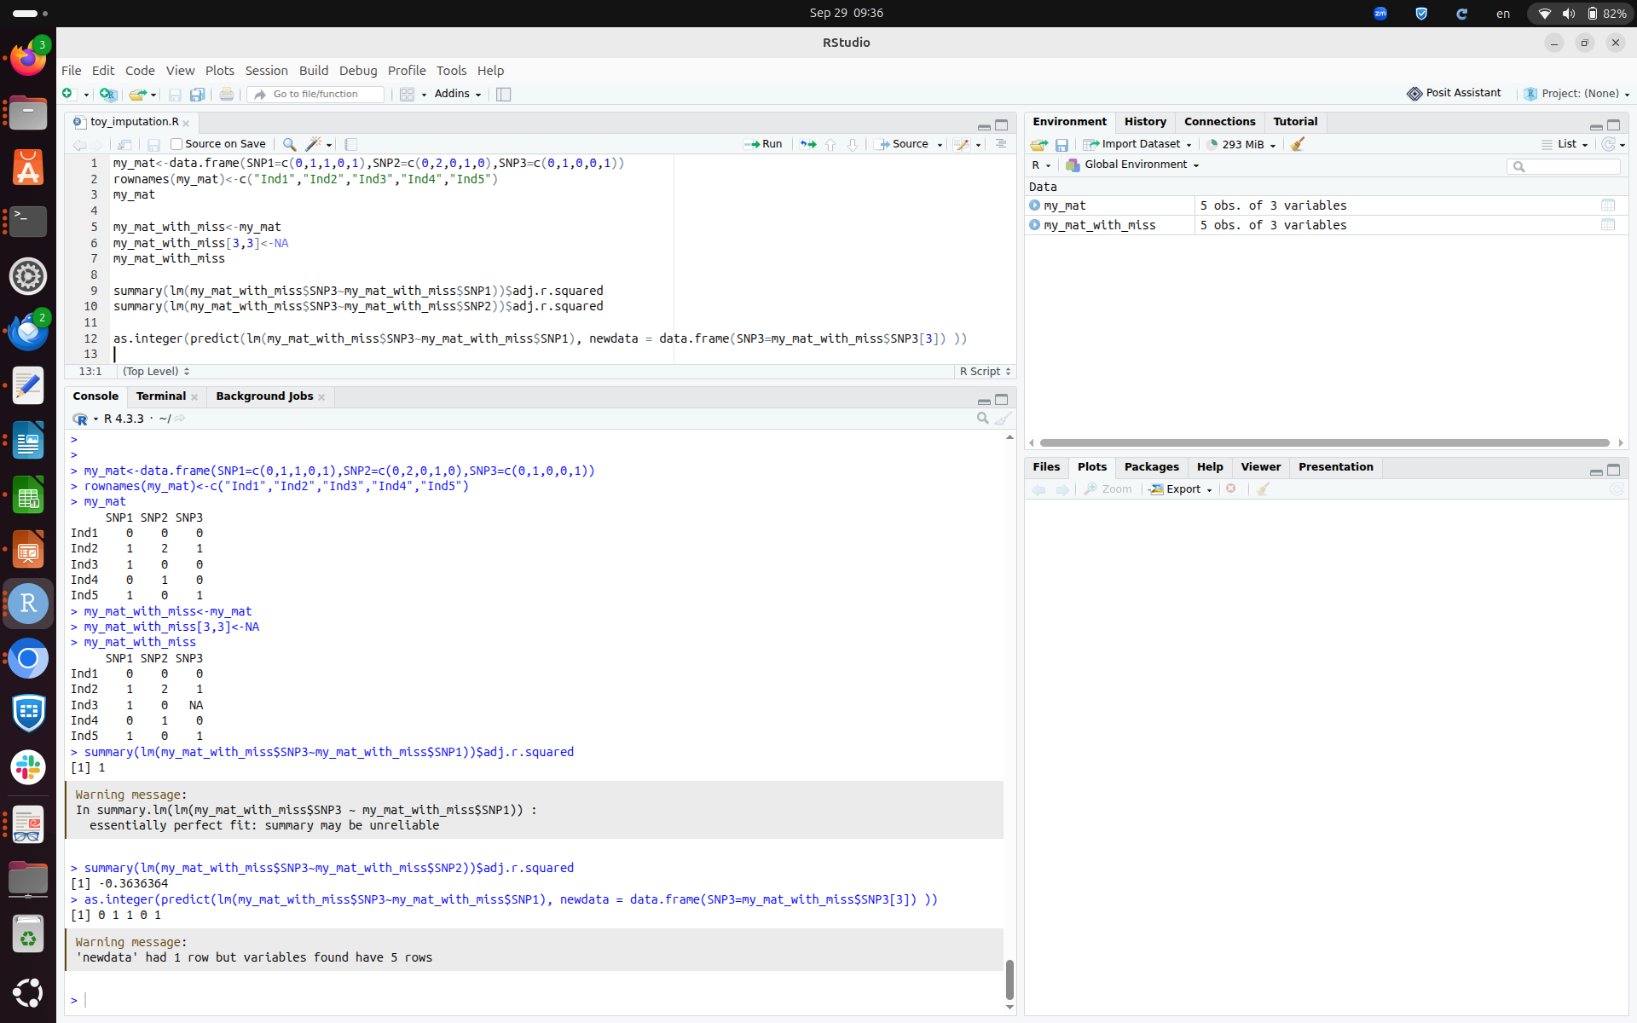

Slide 4
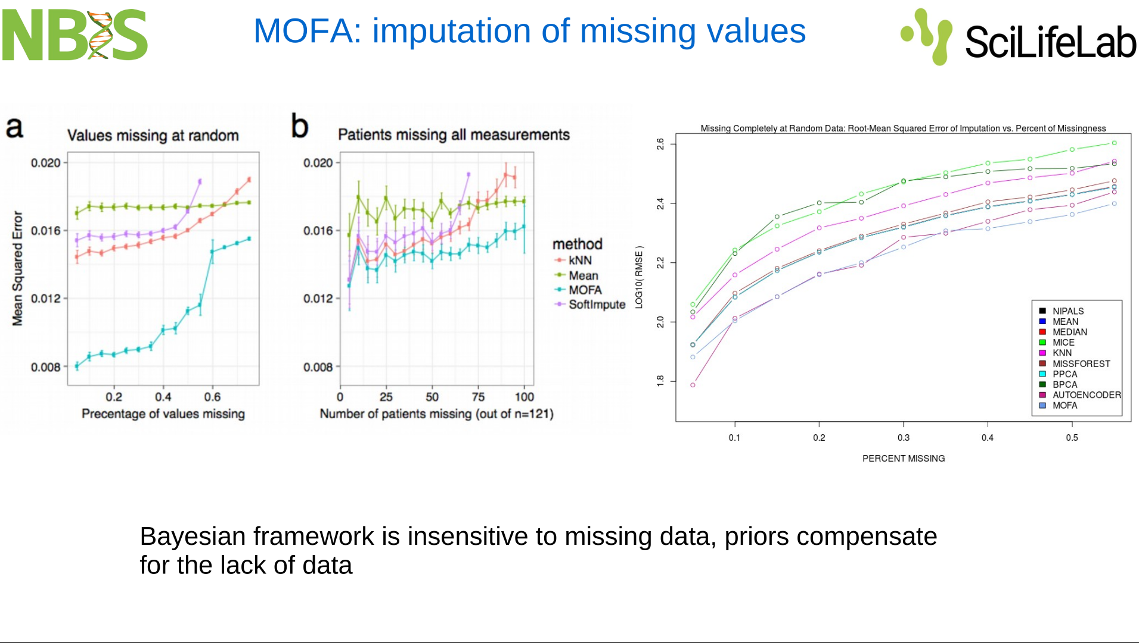

Slide 5
Genetic imputation and phasing

Slide 6
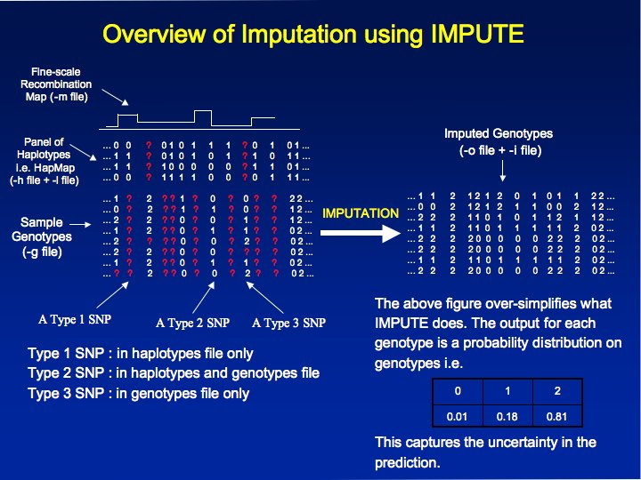

Slide 7
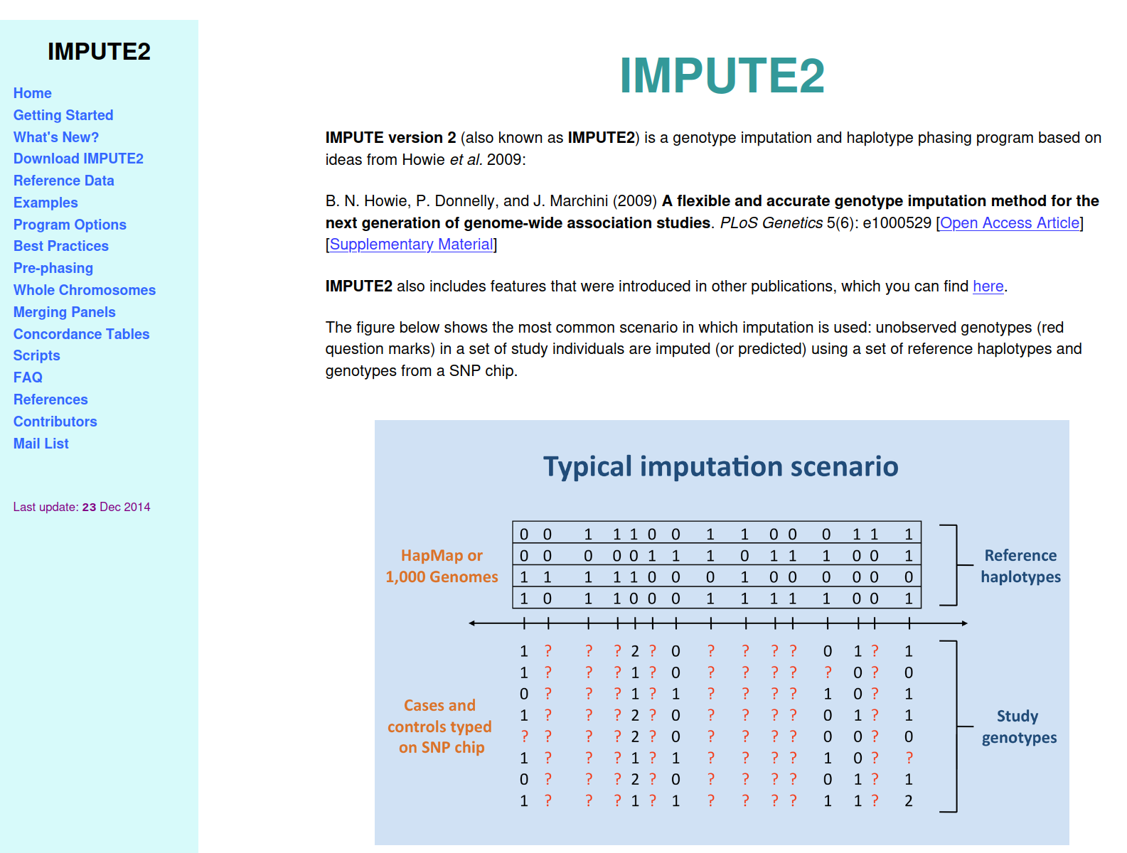
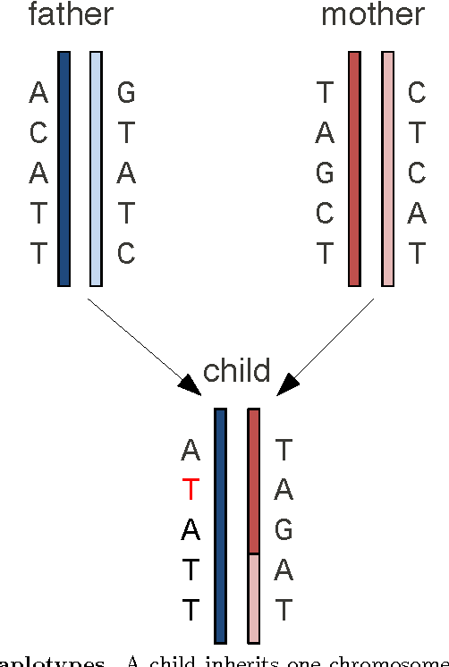
Phasing
Genotyping tells us which alleles an
individual carries at each position.
Phasing tells us which alleles are located
together on the same chromosome.

Slide 8
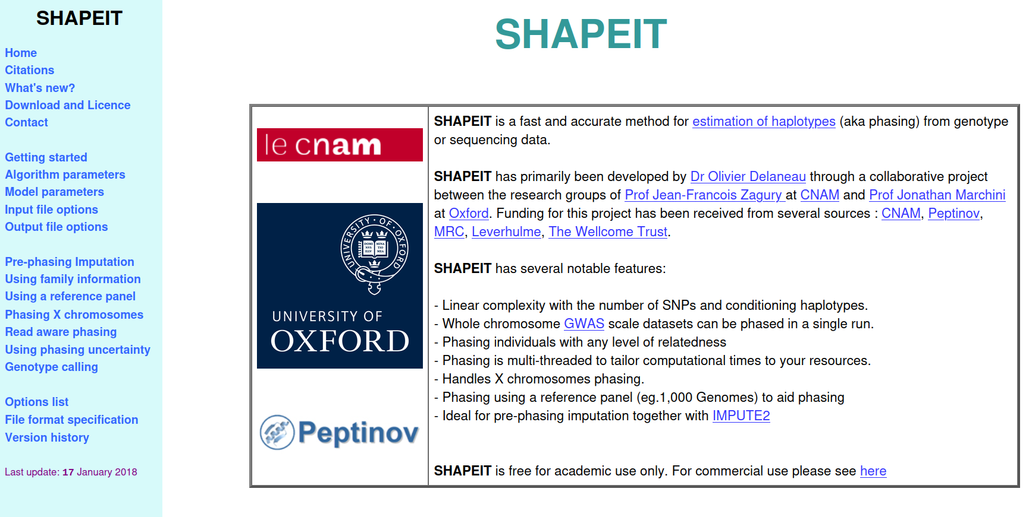

Slide 9
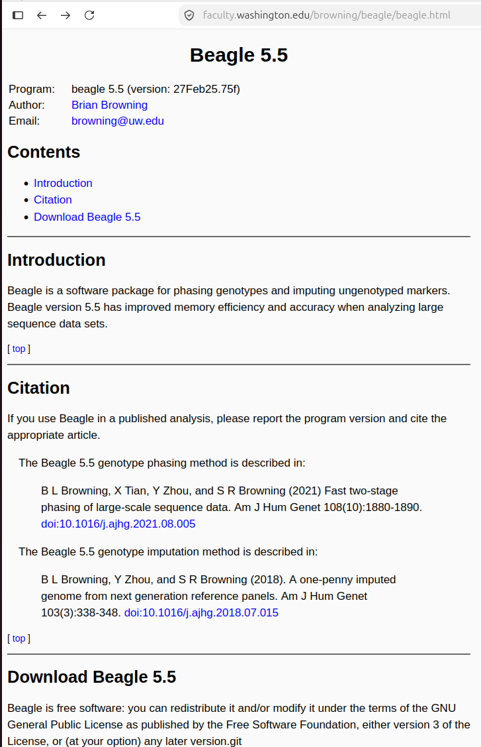
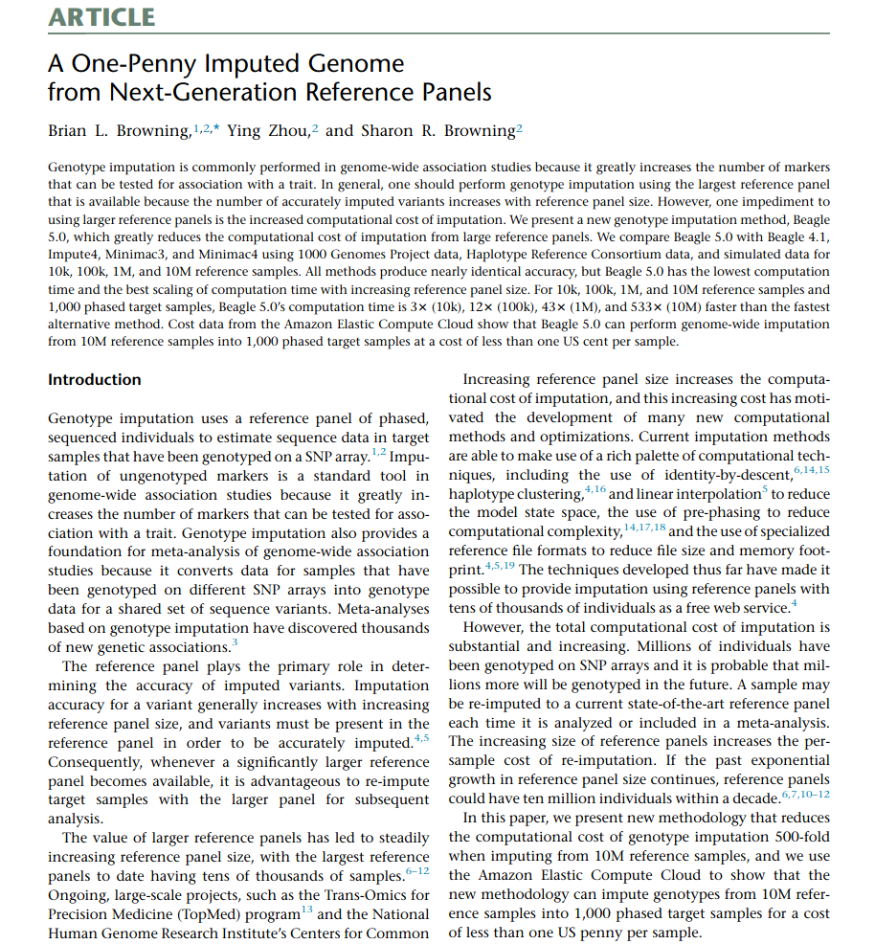

Slide 10
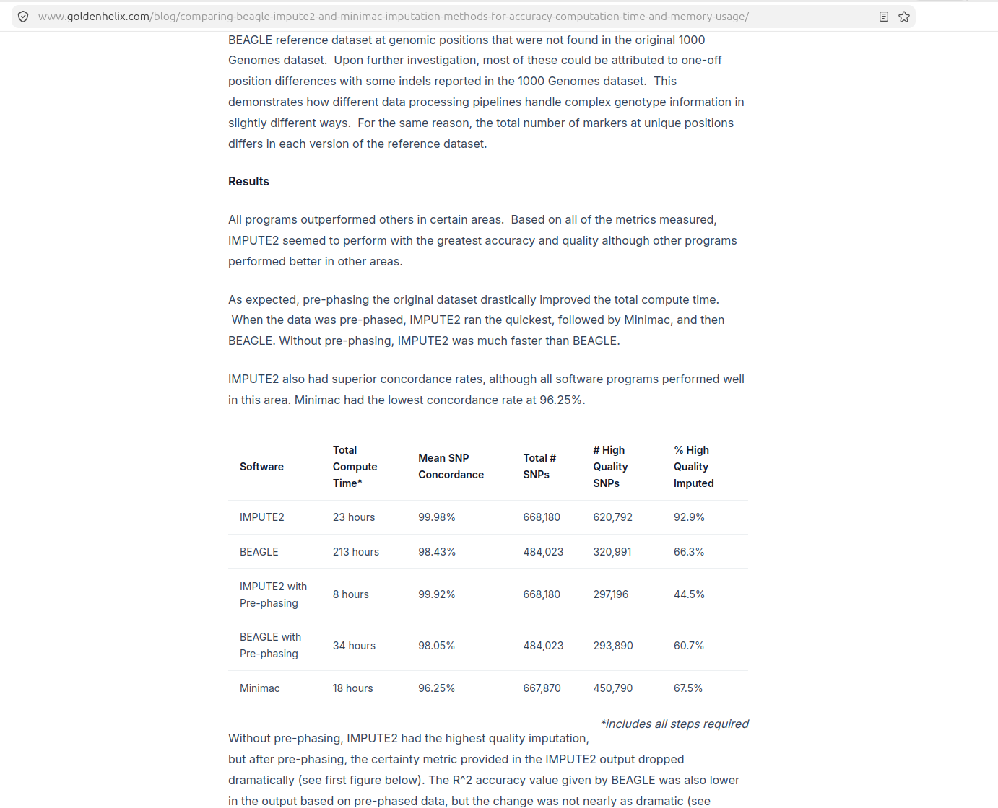

Slide 11
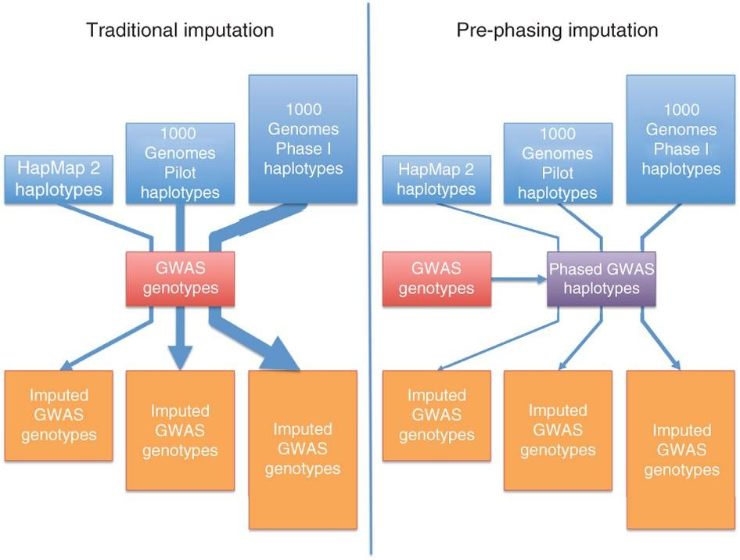

Slide 12
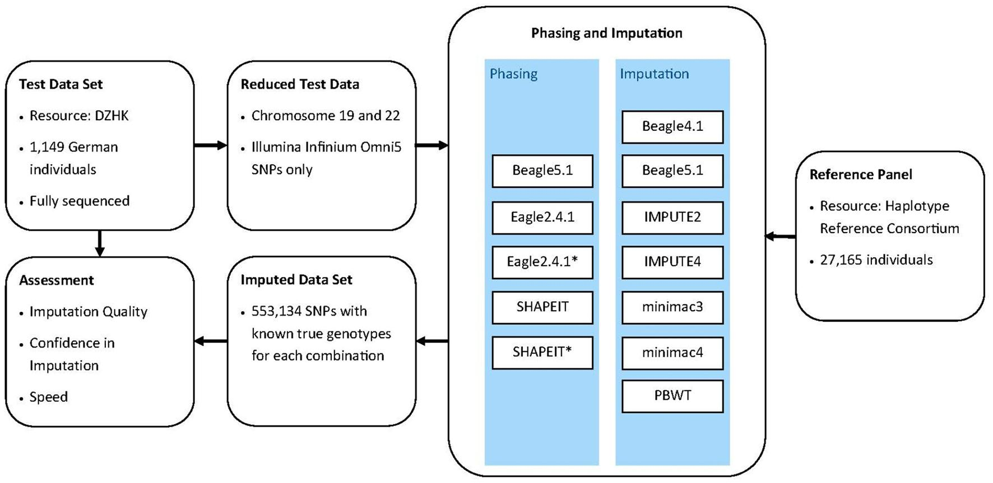

Slide 13


