Slide 1


Nikolay Oskolkov, Group Leader (PI) at NIRI, Riga, Latvia

Slide 2
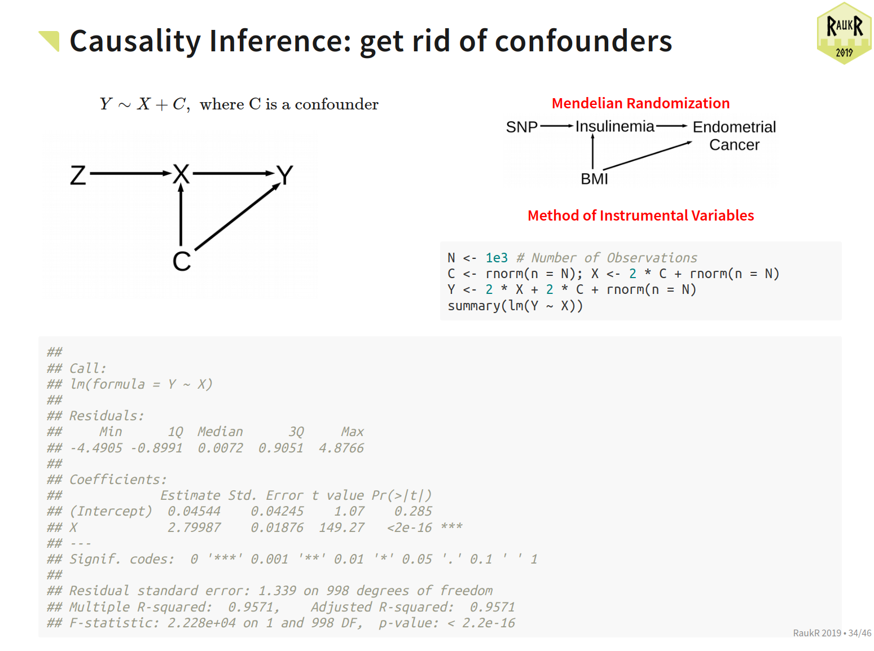

Slide 3
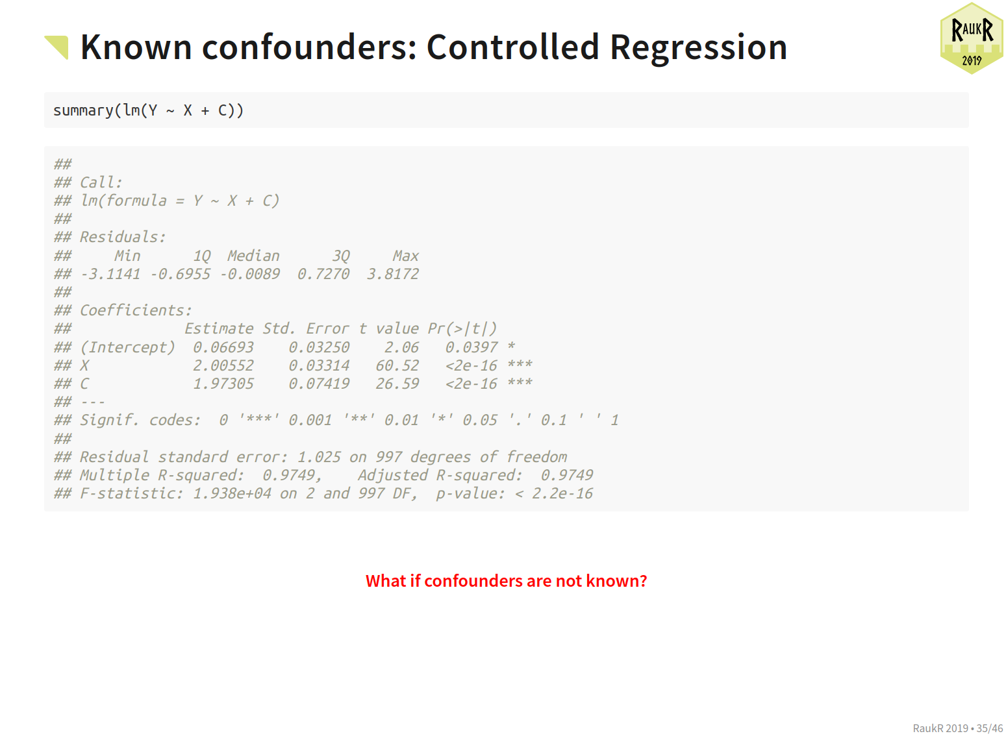

Slide 4
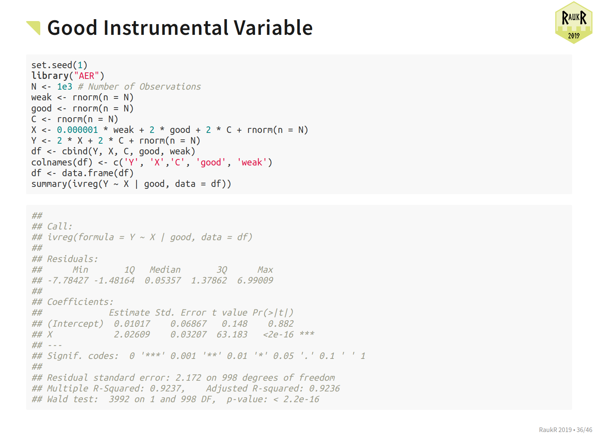

Slide 5
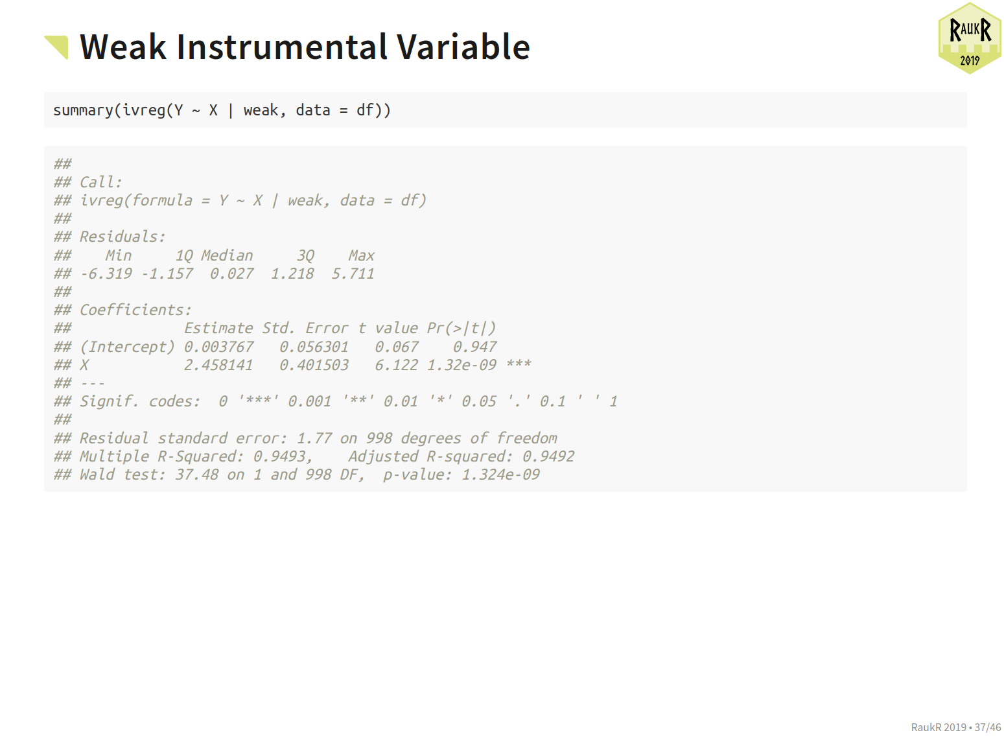

Slide 6
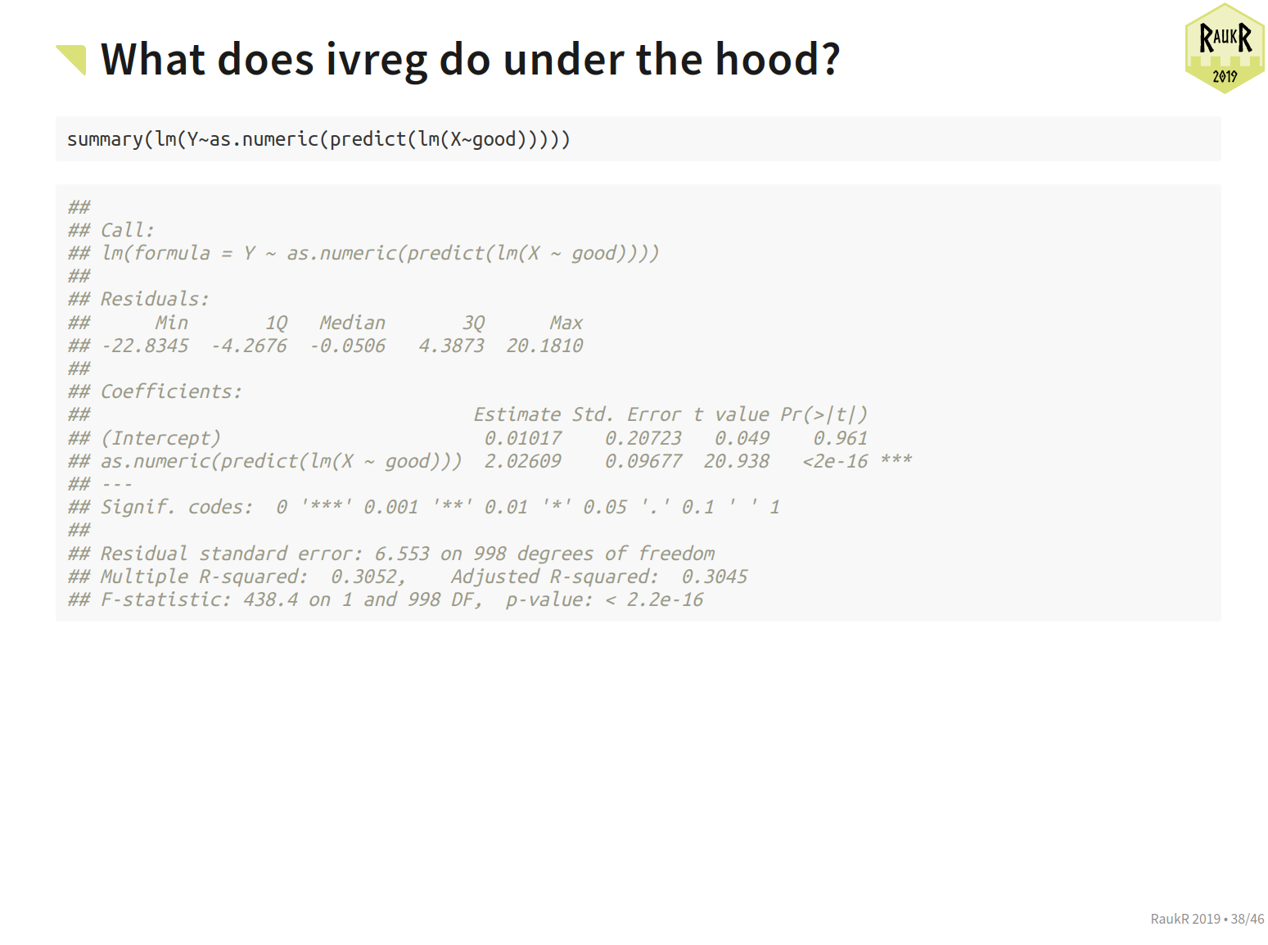

Slide 7


