Slide 1
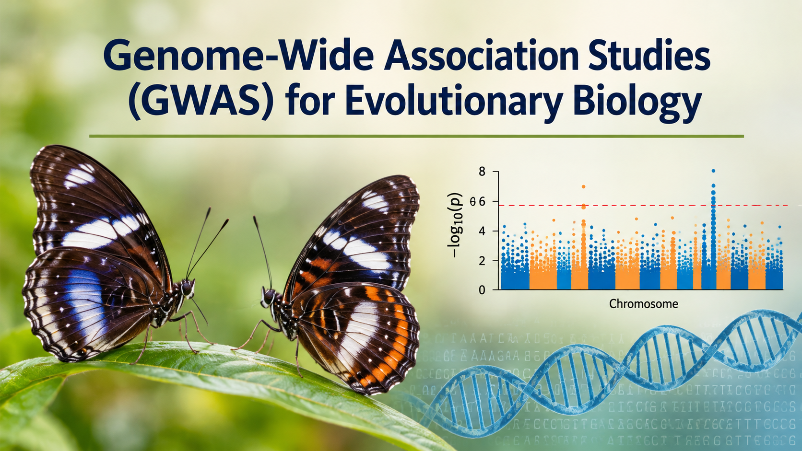

Nikolay Oskolkov, Group Leader (PI) at NIRI, Riga, Latvia

Slide 2
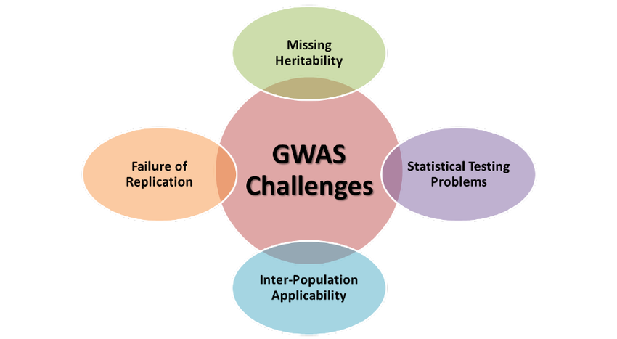
Genome Wide Association Studies
Difficulties and Problems

Slide 3
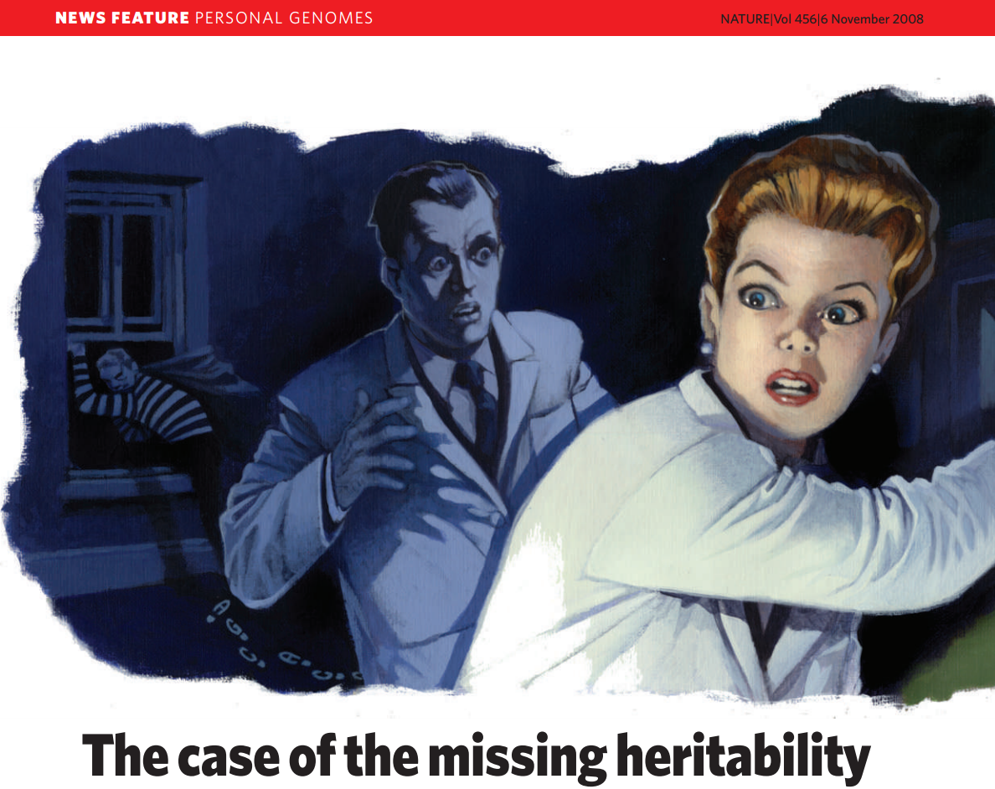
What is the consequence of variant-by-variant association?
Top variants found by traditional SNP-by-SNP association on 50 000 - 250 000 individuals
explain typically 5-10% of heritability! ALARM!

Slide 4

THE DARK MATTER
OF HUMAN GENETICS
MISSING HERITABILITY

Slide 5


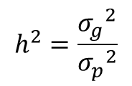

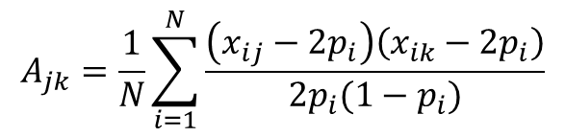
Peter Visscher and GCTA
FANTASTIC APPROACH / TOOL!
-heritability
Genetic relationsip matrix (GRM)
We do not need to do variant-by-variant fitting with linear model, instead we can calculate phenotypic variance explaned directly from genotypes of ALL GWAS VARIANTS
Peter Visscher
Jian Yang
However, GCTA has a few crucial disadvantages:
Includes way too many noisy variants, i.e. the non-causal ones, and thus further underestimates the heritability explained by the GWAS
Does not point at causal variants, it simply says that the causal variants are in the GWAS or in LD with the GWAS variants
Does reliable estimate only for large cohorts, i.e. N > 3000
Overfitting or not? Can random effects model fix overfitting?

Slide 6


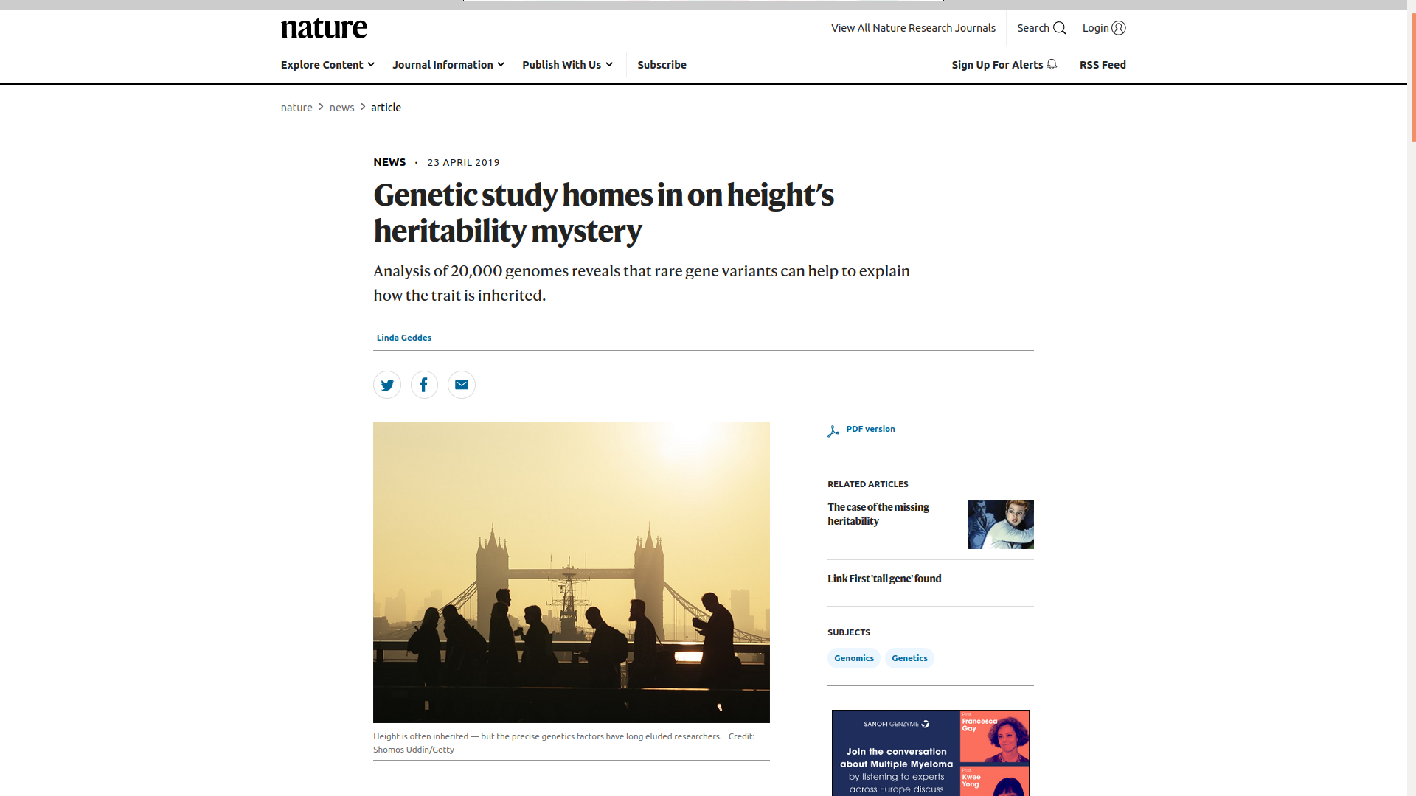
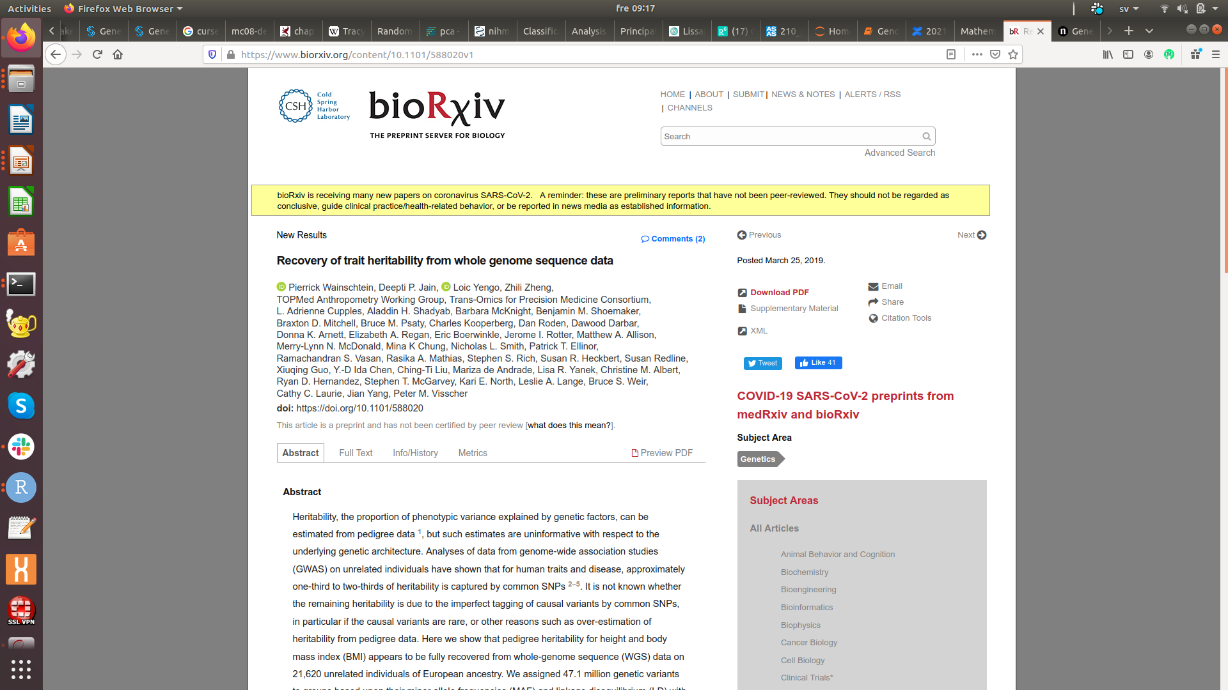
Human Height Missing Heritability Case Solved

Slide 7
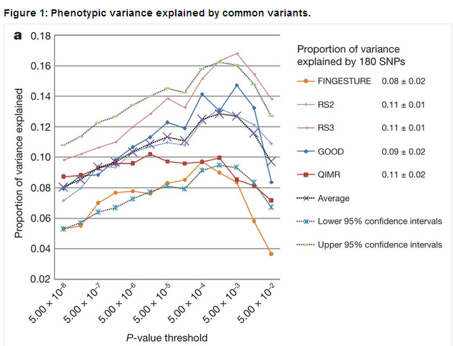
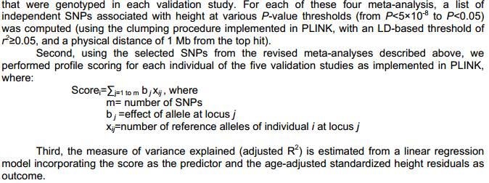
Can we do it better than GCTA? Can we find causal variants?
How did we live before the GCTA era?
E.g. the way we did it in GIANT cosortium for HEIGHT trait
We used the candidate variant approach, i.e. selected candidate variants from a discovery cohort, created genetic risk score in a validation cohort and calculated adjusted R squared in the validation cohort
16% of heritability explained

Slide 8
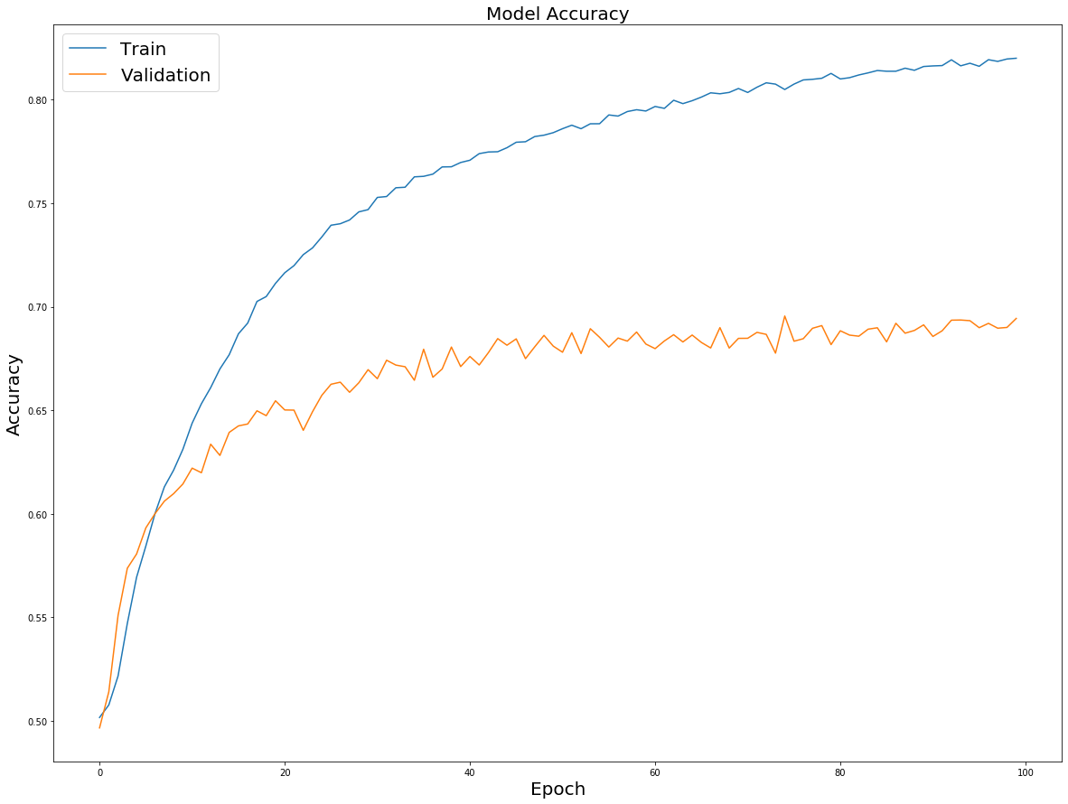

Accuracy of prediction in machine learning
My boss, who is excited about the
state-of-the-art accuracy of 98%
Me, who reported
the training accuracy
You always report
validation accuracy
Explained variance of phenotype, y, has something to do with prediction:
R^2 = 1 – (y – (a + b*x))^2 / (y - E(y))^2

Slide 9

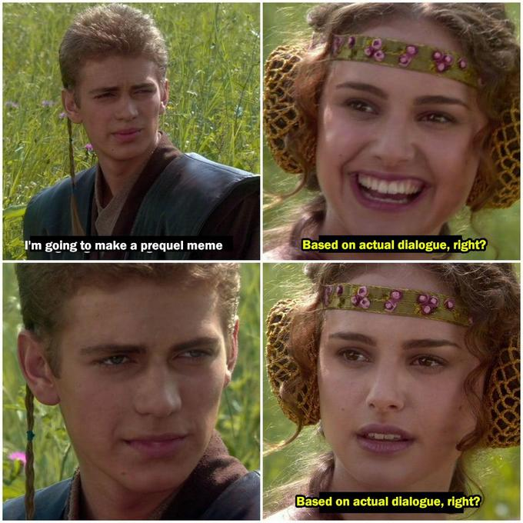
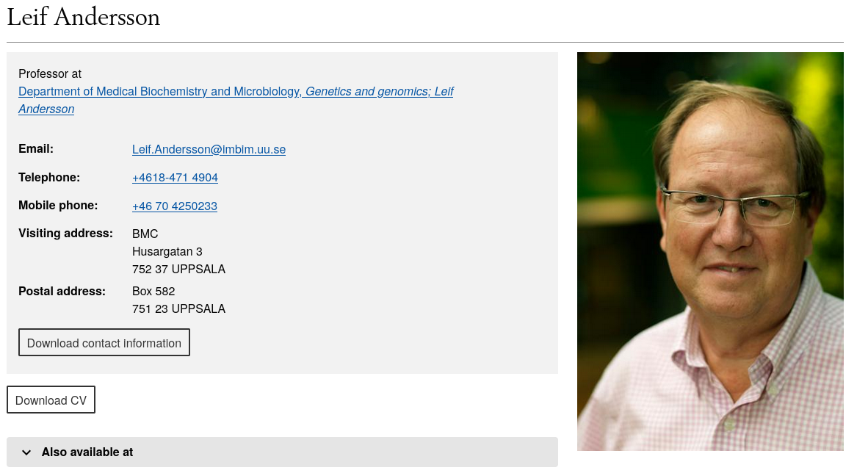
We found three genetic variants that explain 18%, 12% and 15% of phenotypic variation in herring
Genetic variants associated with human traits explain
negligible %, this is different for non-model organisms
The variant explains 20% of variation
On an independent sample, right?
On an independent sample, right?

Slide 10
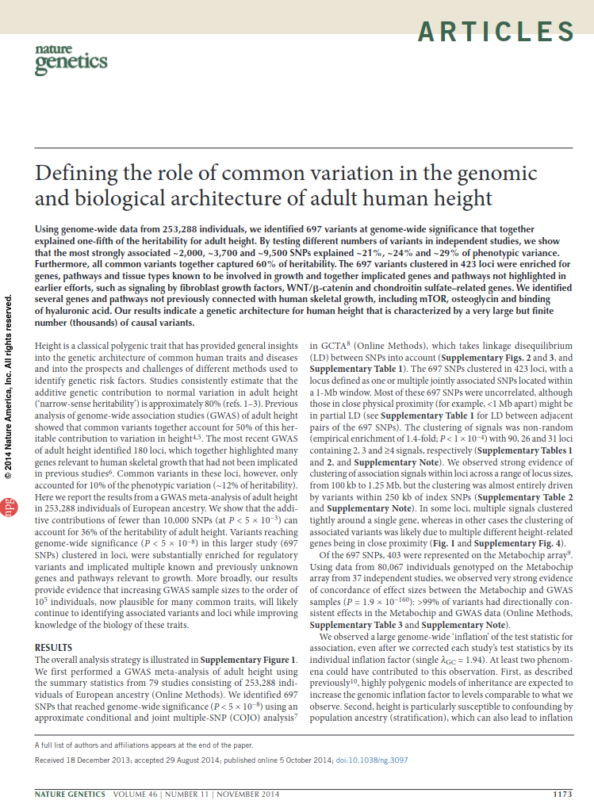
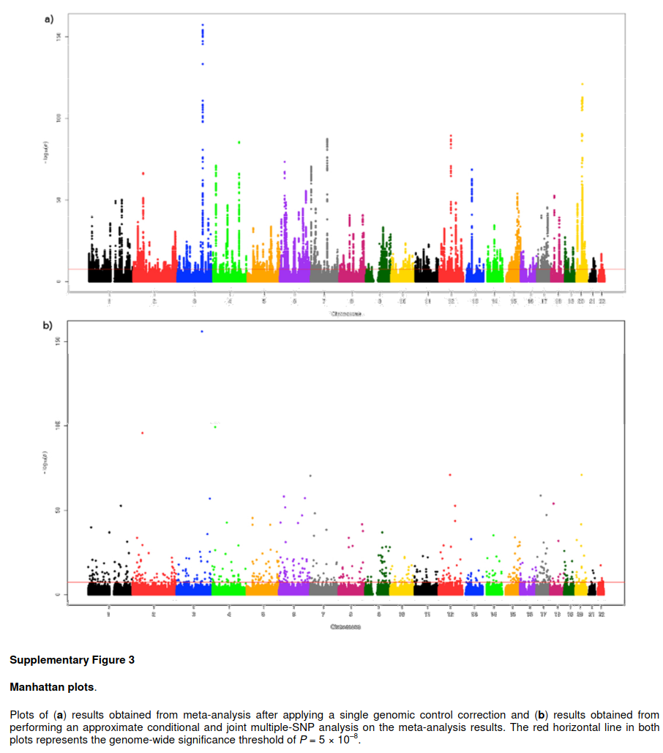

Slide 11
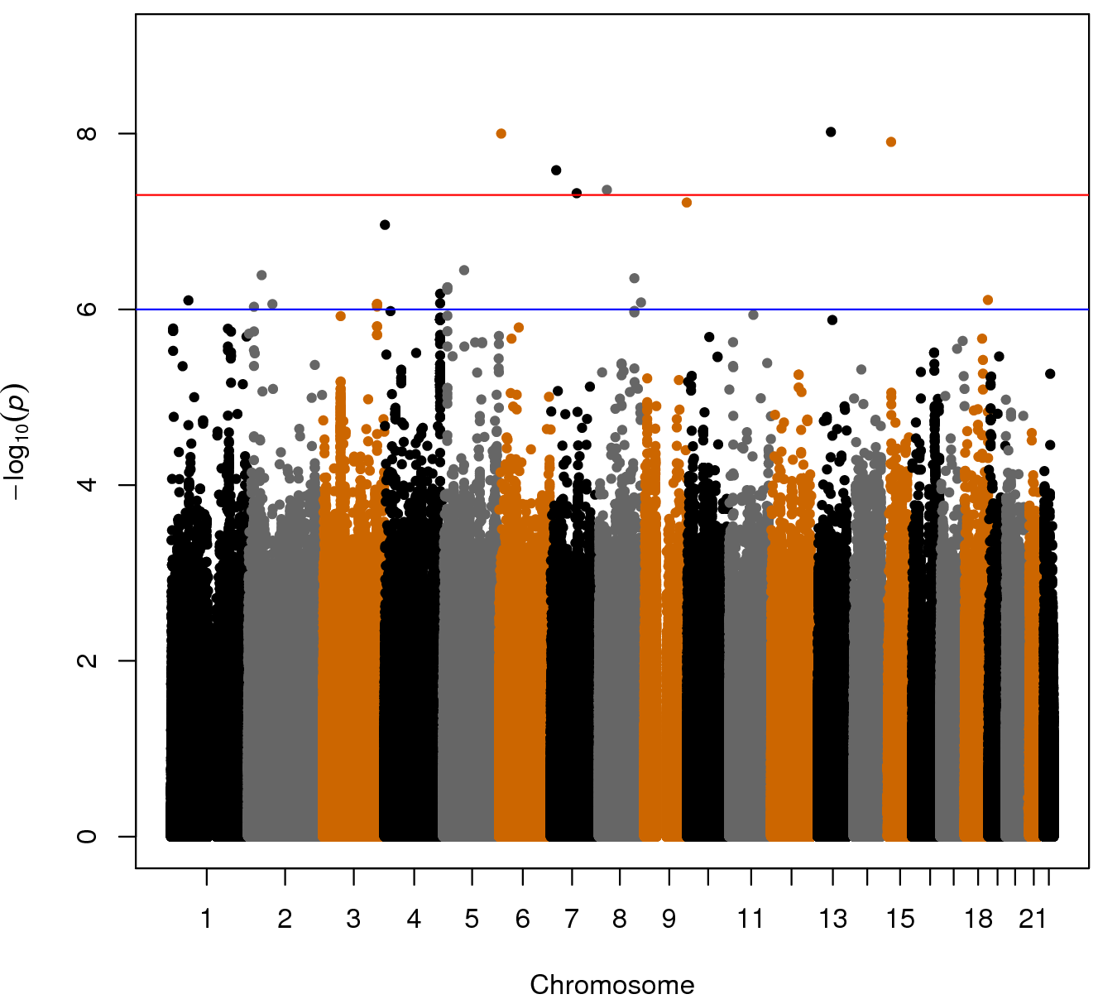
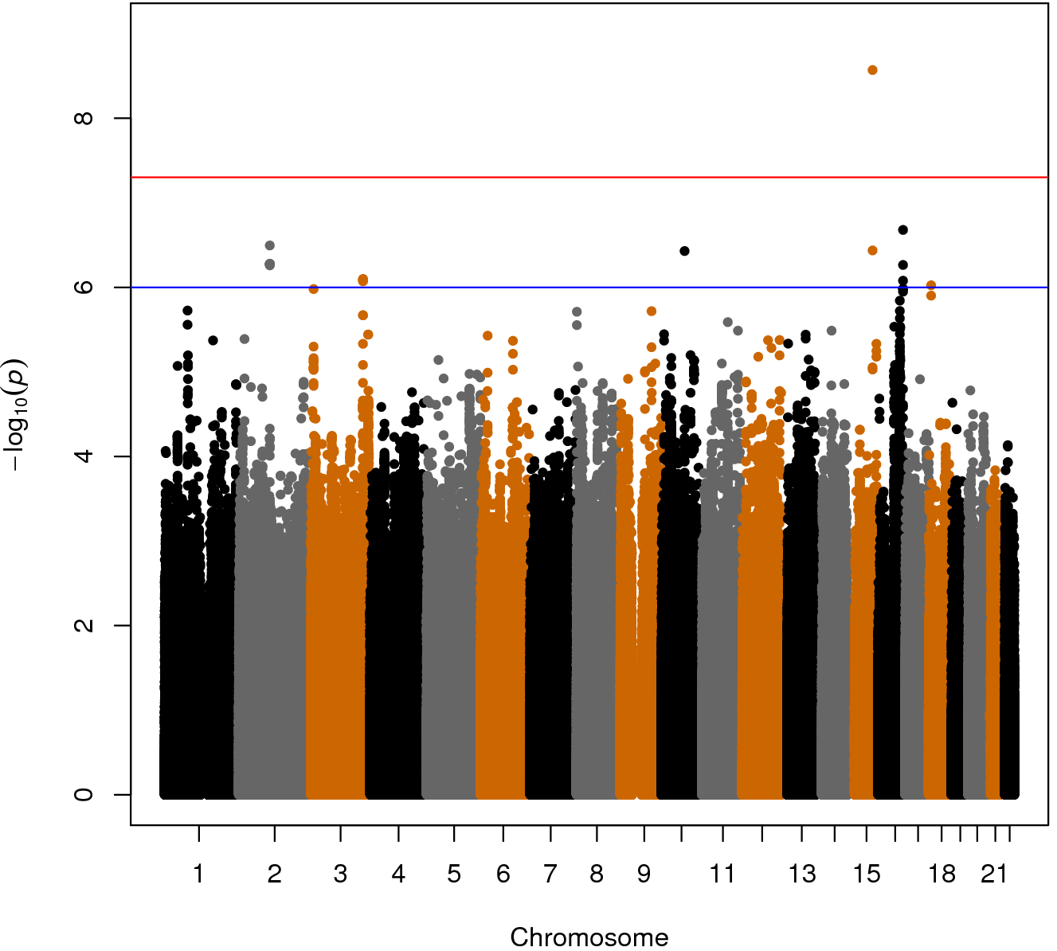
Height genome-wide association Manhattan plots (~3000 individuals)

Slide 12
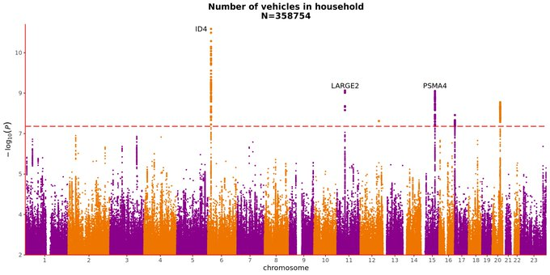
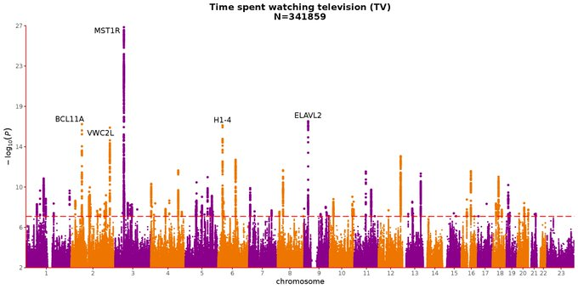
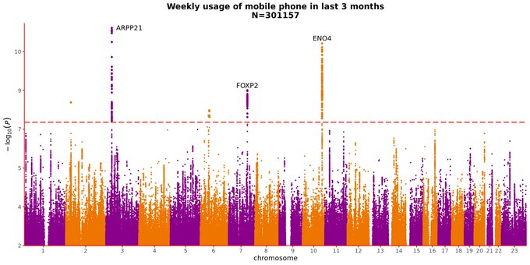
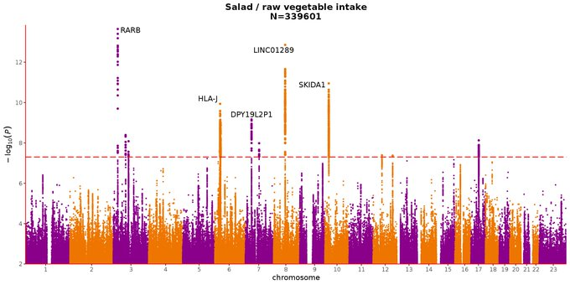

Slide 13
DISCOVERY COHORT:
IDs of SNPs associated with trait:
SNP1, SNP2 ...
Beta-effect-sizes for those SNPs:
beta1, beta2 ...
VALIDATION COHORT:
Actual genotypes for SNP1, SNP2 ...
from the validation cohort
GRS = beta1 * SNP1 + beta2 * SNP2 + …
training
Height_validation ~ GRS => Adjusted R^2
validation

Slide 14
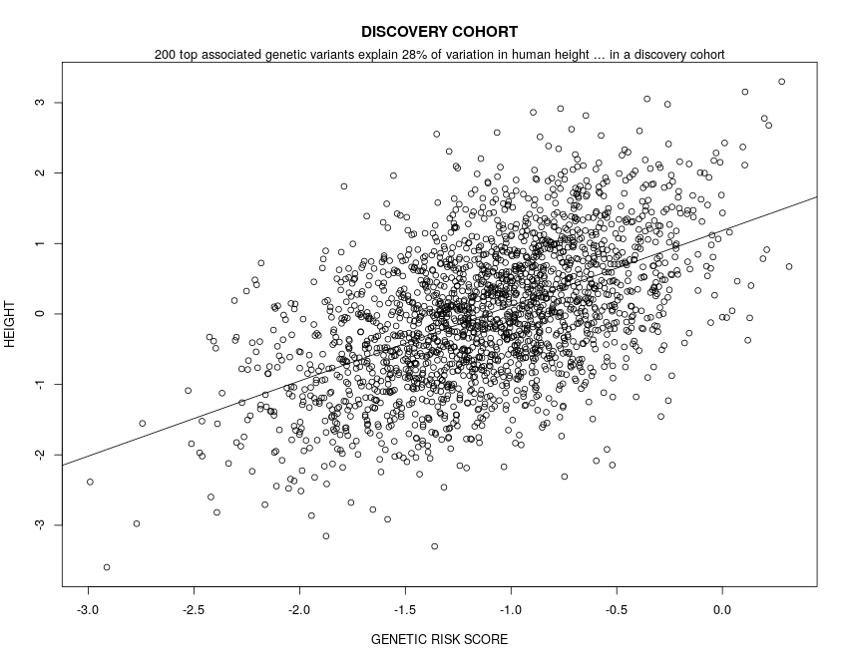
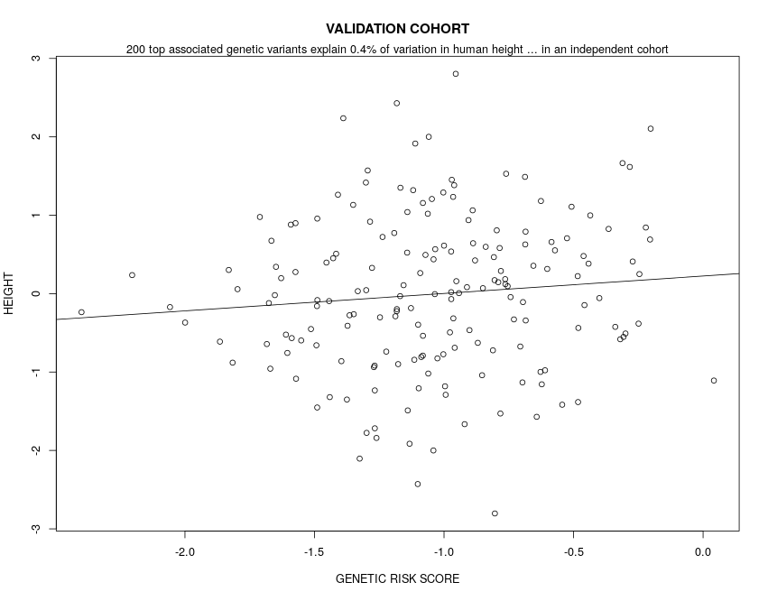
GRS = beta1_{discovery} * SNP1_{discovery} + beta2_{discovery} * SNP2_{discovery} + …
GRS = beta1_{discovery} * SNP1_{validation} + beta2_{discovery} * SNP2_{validation} + …
Height ~ GRS => Adjusted R^2
Height ~ GRS => Adjusted R^2

Slide 15
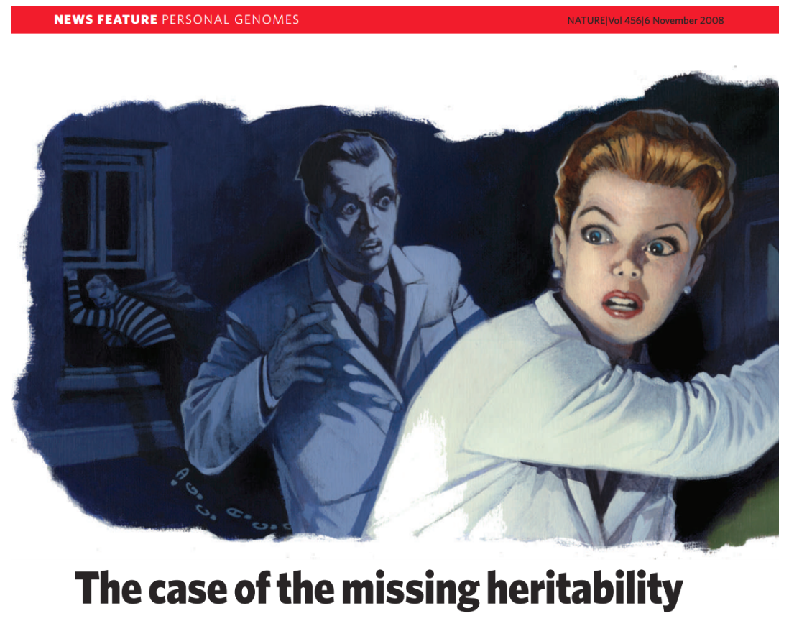

Slide 16
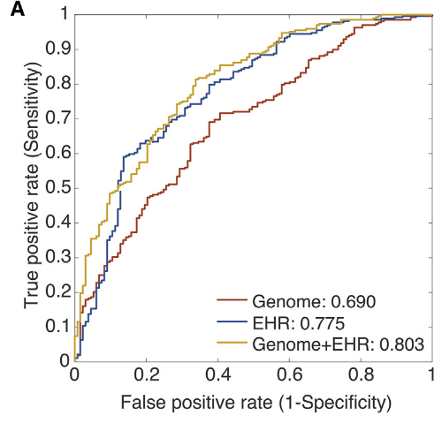
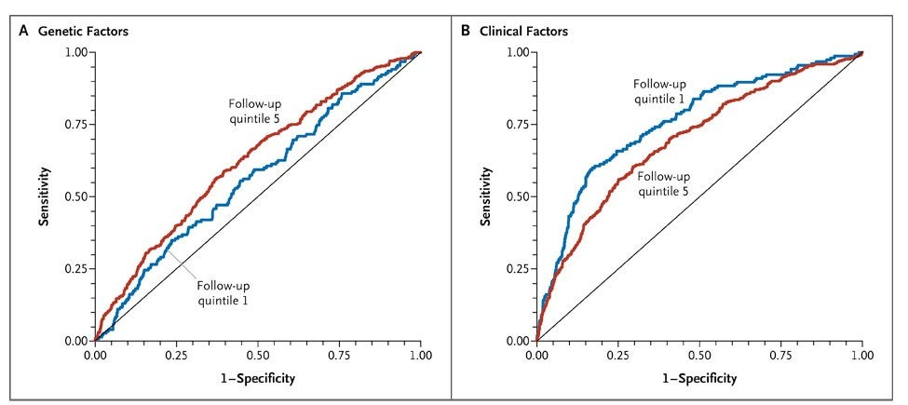
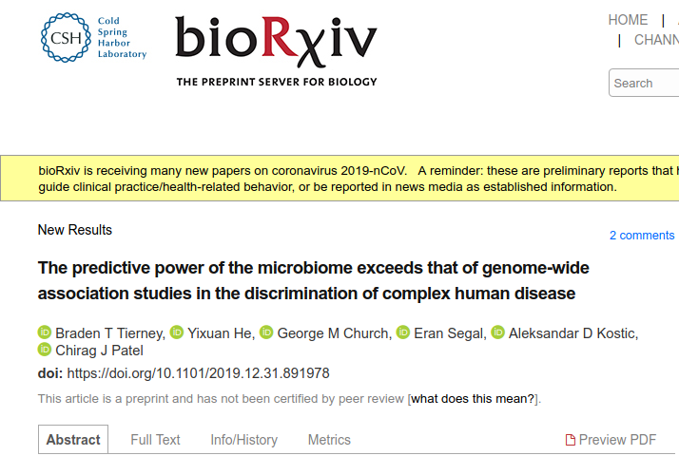
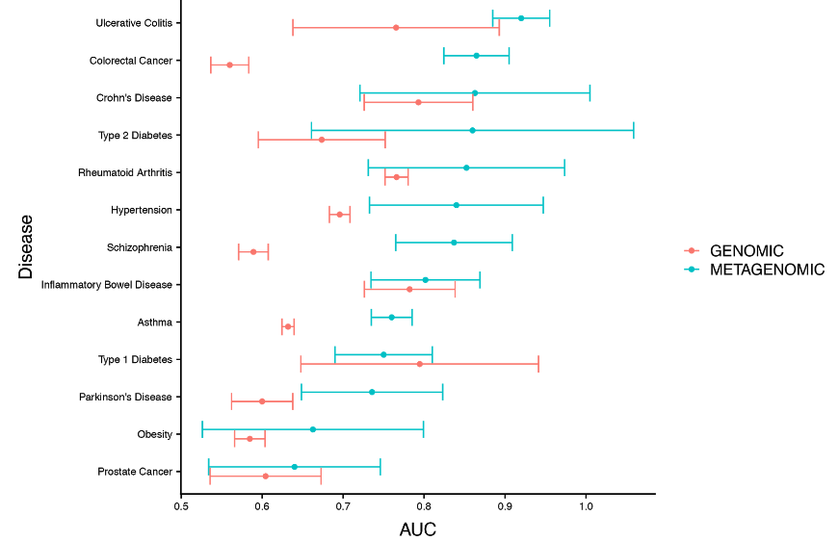
Precision Medicine: Poor Genomics Prediction
Li et al., 2018, Cell 174, 1361-1372
Decoding the Genomics of Abdominal Aortic Aneurism
Lyssenko et al., 2008, New England Journal of Medicine 359, 2220-2232
Clinical Risk Factors, DNA Variants and Development of Type 2 Diabetes

Slide 17
Human Height Missing Heritability Case Solved

Slide 18
If you report a variance explained statistic,
please make sure that it was computed on an independent dataset!
Please do not fit a new model on the independent dataset!

