Slide 1


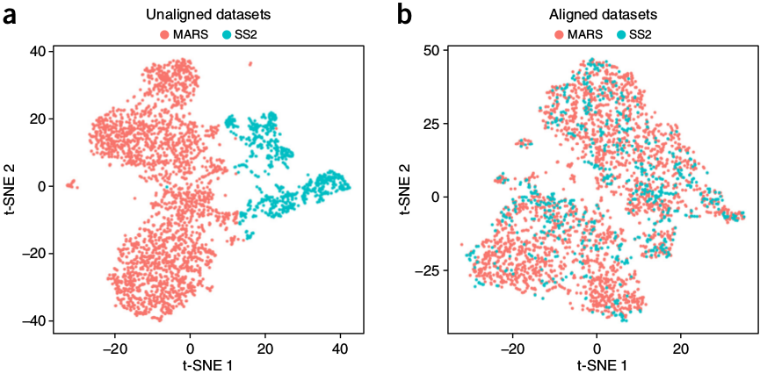



Single Cell Horizontal and Vertical Multi-Omics Integration
Physalia course, online via zoom
Nikolay Oskolkov, MRG Group Leader, LIOS, Riga, Latvia
@NikolayOskolkov
@oskolkov.bsky.social
Personal homepage:
https://nikolay-oskolkov.com
Image adapted from Butler et al. 2018

Slide 2
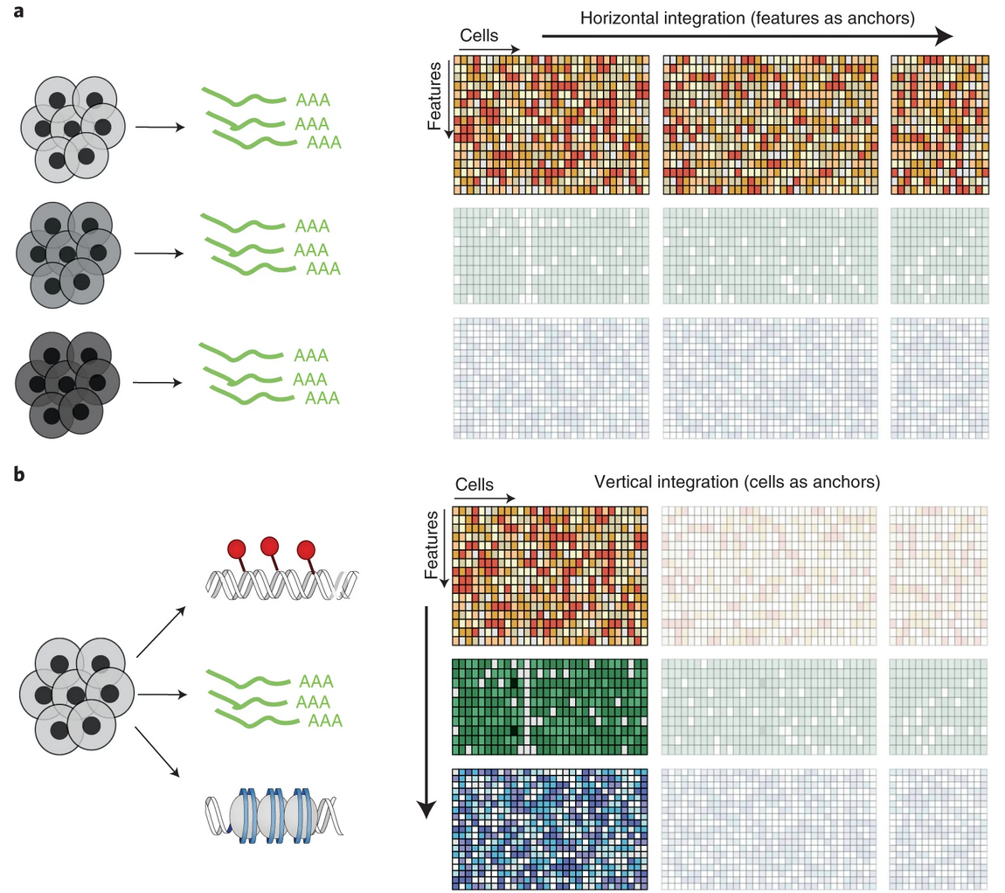
Integration across cells vs. features
Similar to batch
correction problem
Conceptually
difficult problem
Argelaguet et al. 2021

Slide 3
Integration across cells
(horizontal integration)

Slide 4
Principles of batch correction (ComBat-like)
3 cell types, 2 batches
PC2
C1
PC2
C1
C4
C6
C4
C5
C2
integration
C3
C5
C2
C6
C3
Batch 1
Batch 2
PC1
PC1
Get rid of this variable
Keep this variable
G1
G2
G3
G4
G5
C1
1
1
C2
=
1
2
β1 *
+ β2 *
C3
1
3
C4
2
1
C5
0 =
2
2
C6
2
3
Gene expression
Batch variable
Cell type variable

Slide 5
Caveat: highly desired orthogonality of
batch and variable of interest
G1
G2
G3
G4
G5
= 0
C1
1
1
C2
=
1
2
β1 *
+ β2 *
C3
1
3
C4
2
1
C5
2
2
C6
2
3
Gene expression
Batch variable
Cell type variable
These two variables should be orthogonal

Slide 6
Peculiarities of batch correction in single cell
This variable is (usually) unknown
G1
G2
G3
G4
G5
= 0
C1
1
1
C2
=
1
2
β1 *
+ β2 *
C3
1
3
C4
2
1
C5
2
2
C6
2
3
Gene expression
Batch variable
Cell type variable
1
More relevant
for single cell
1
1
2
Since single cell analysis is typically
unsupervised, we cannot always take cell
type into account in an equation (model-like
approach), therefore ComBat may fail
2
2
Cluster assignment

Slide 7
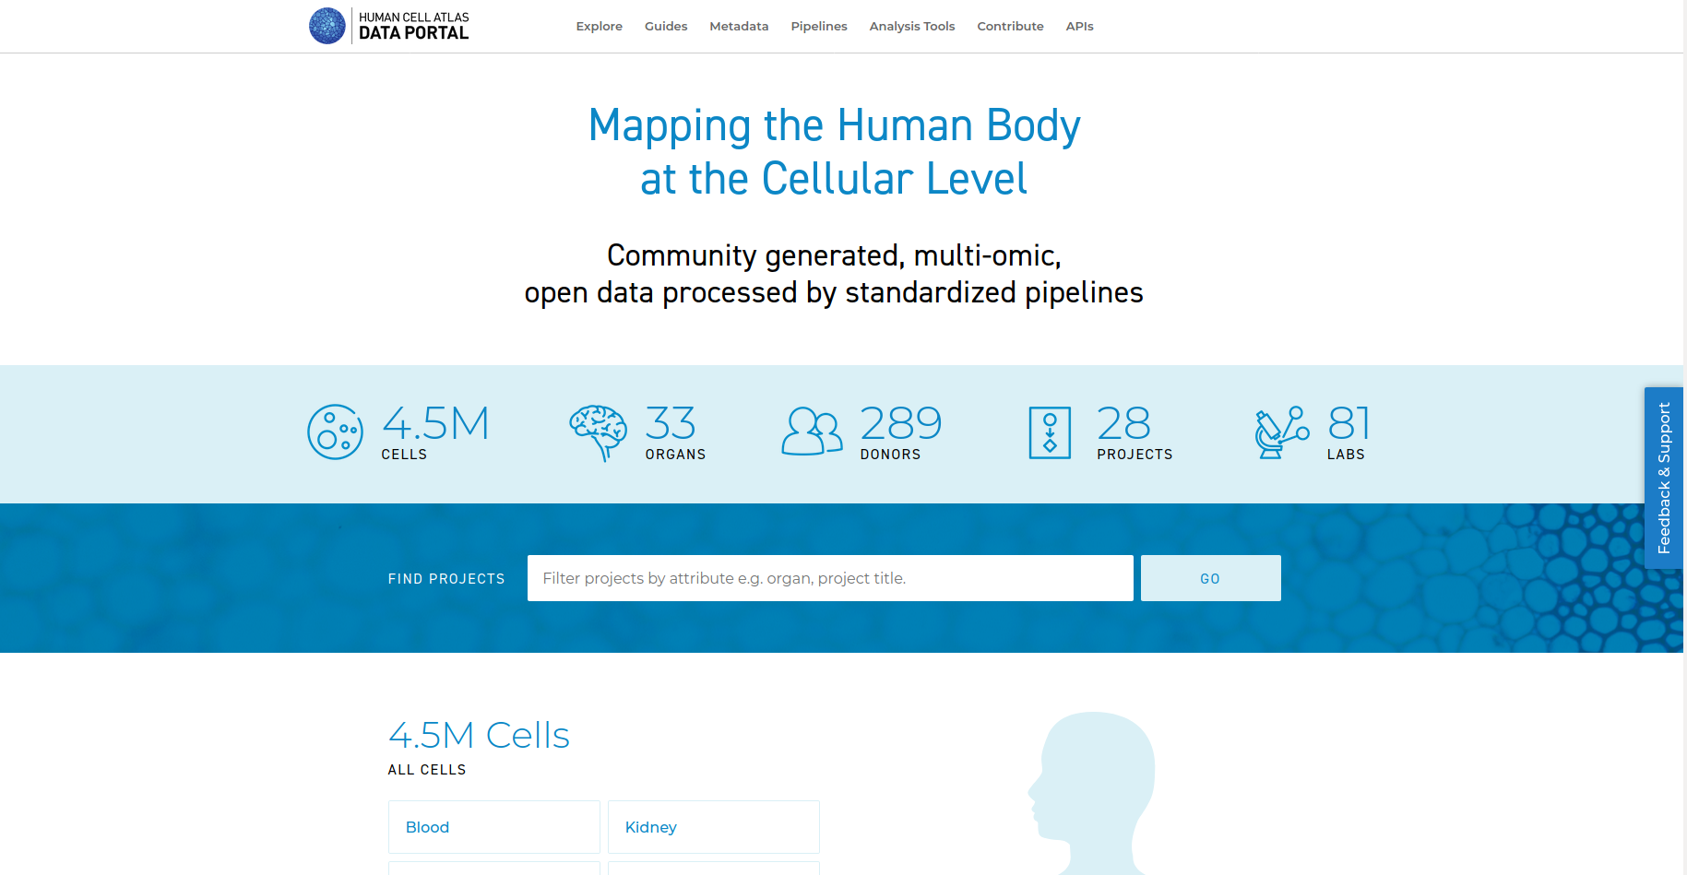
Human Cell Atlas (HCA) Consortium
HCA ambition: create a comprehensive Atlas of human cells from all organs / tissues
Data harmonization / integration is one of major challenges of HCA

Slide 8
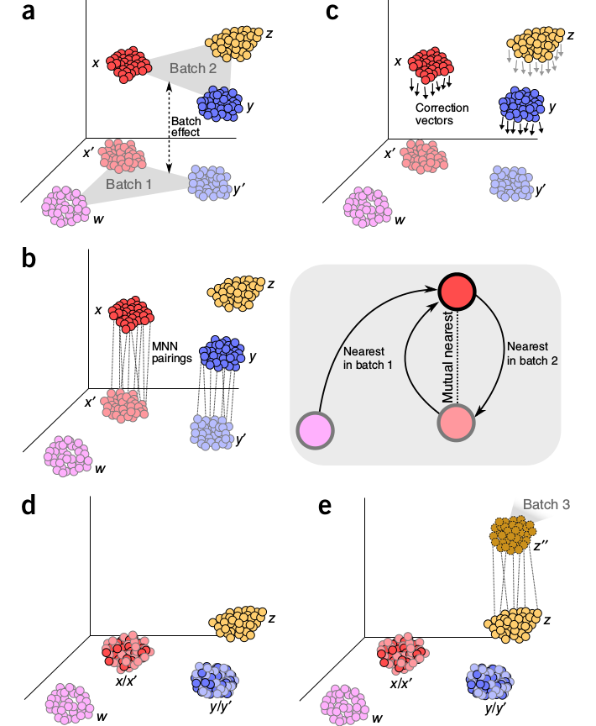
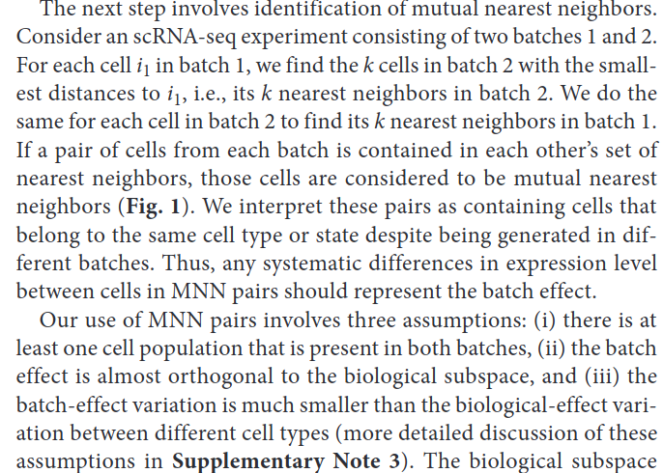
Mutual Nearest Neighbor (MNN)
Haghverdi L, Lun ATL, Morgan MD, Marioni JC. Nat Biotechnol. 2018 Jun;36(5):421-427

Slide 9
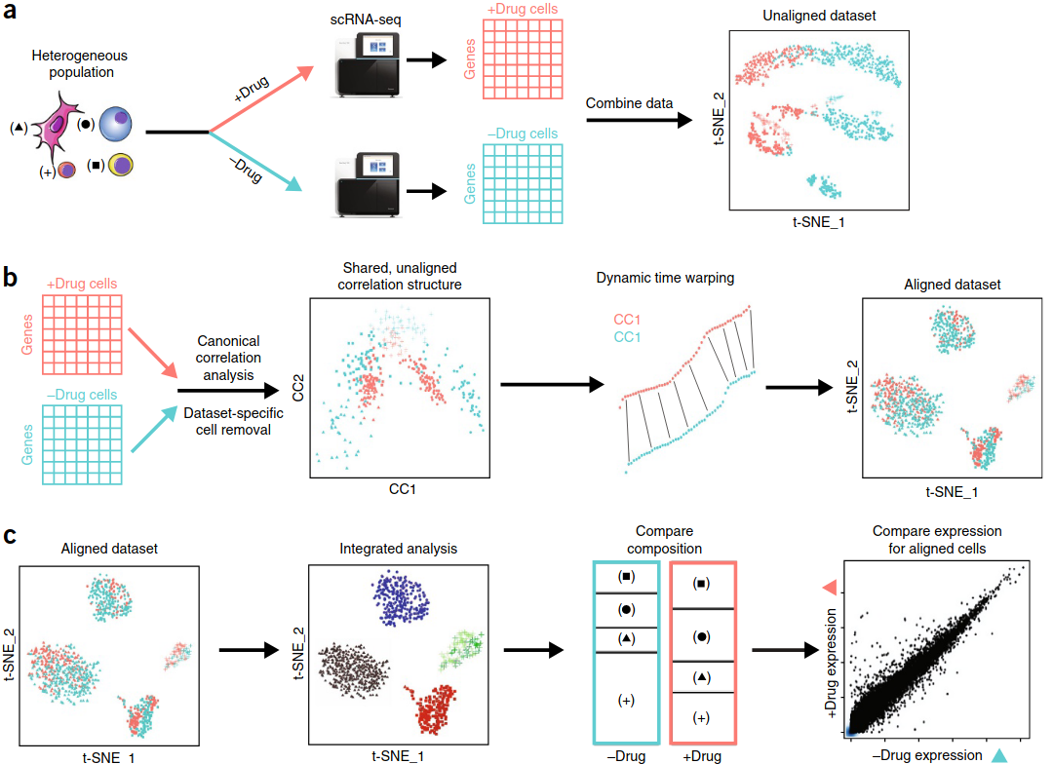
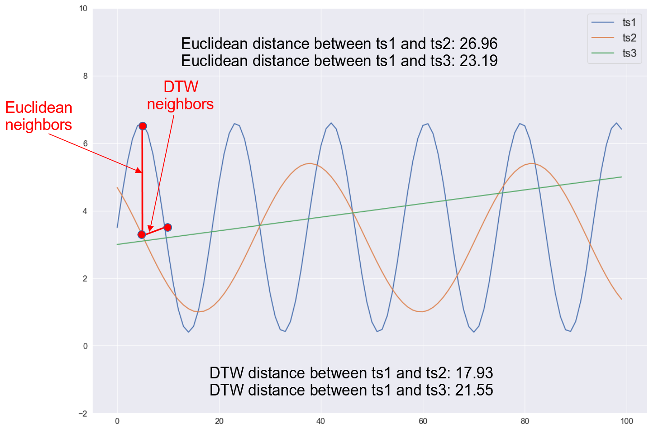
Seurat CCA + DTW integration
X
Y
P
P
N1
N2
A = cov (X, Y) = X * Y^{T}
A * u = λ * u
Dynamic Time Warping (DTW)
Butler A, Hoffman P, Smibert P, Papalexi E, Satija R. Nat Biotechnol. 2018; 36(5): 411-420

Slide 10
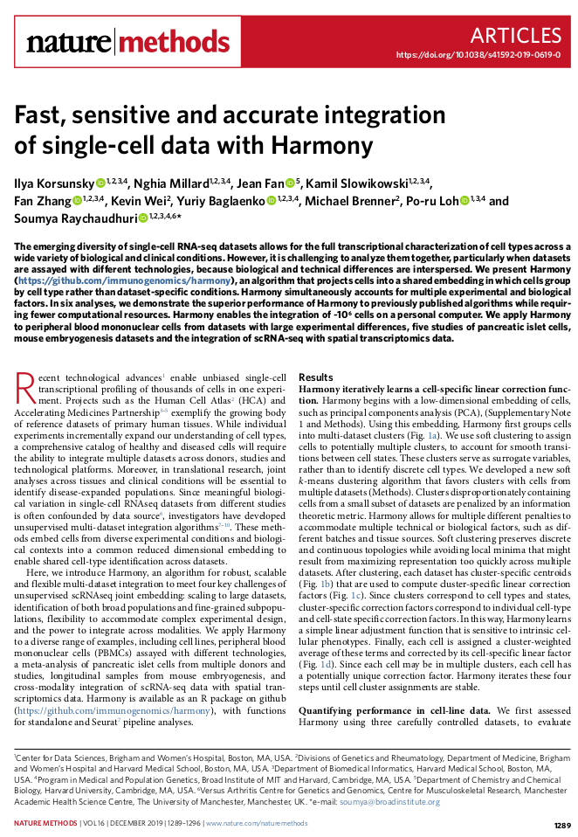
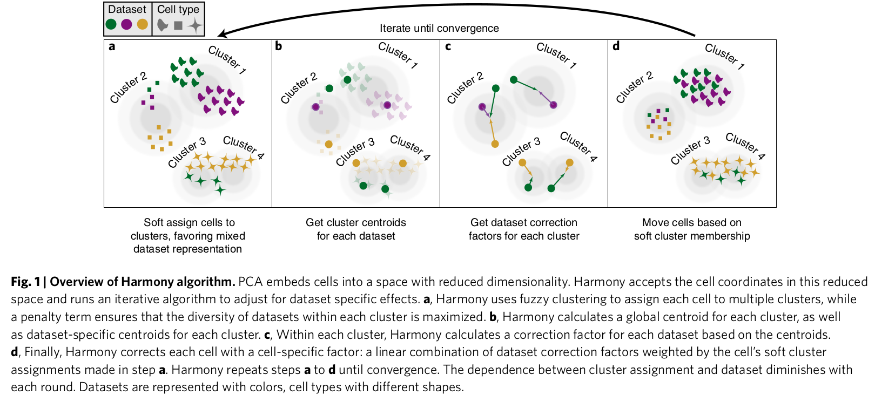
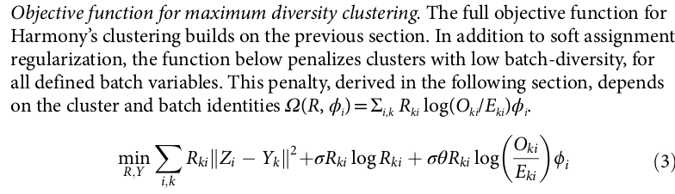
Harmony across cells integration
Harmony tries to disrupt relation between the cluster assignment and batch variable by penalizing for diversity across batches in its fuzzy k-means algorithm

Slide 11
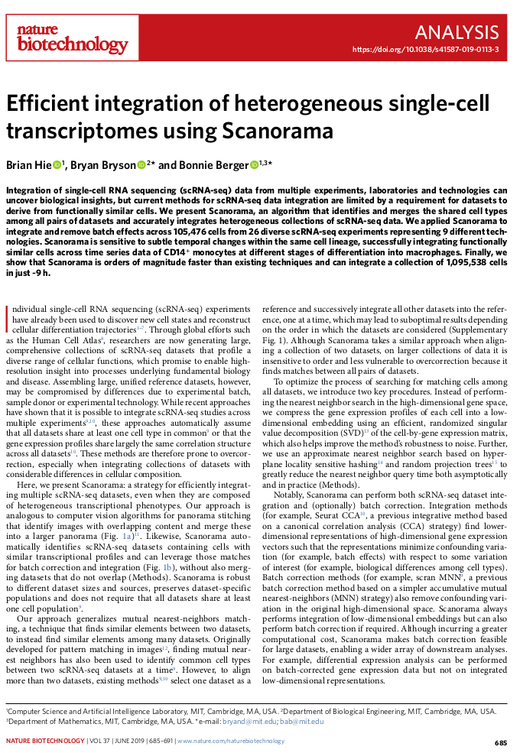
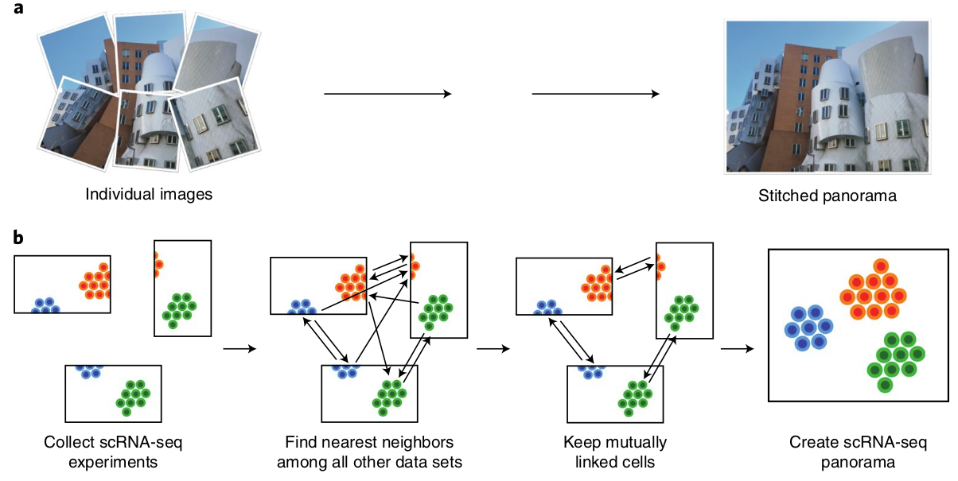
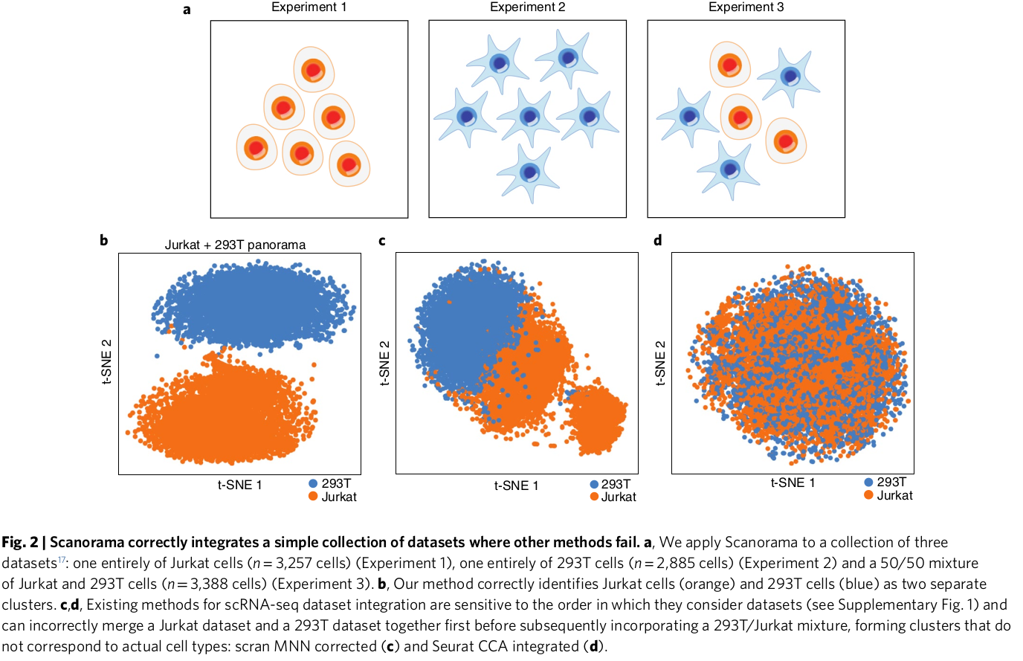
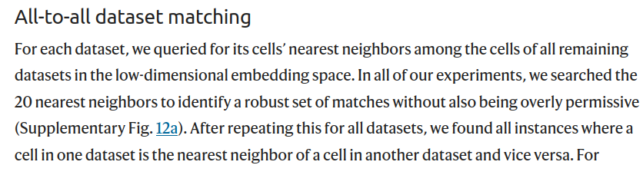
Scanorama across cells integration
MNN generalization to many
datasets instead of ref and query
Does not require at least one
cell type shared across datasets

Slide 12
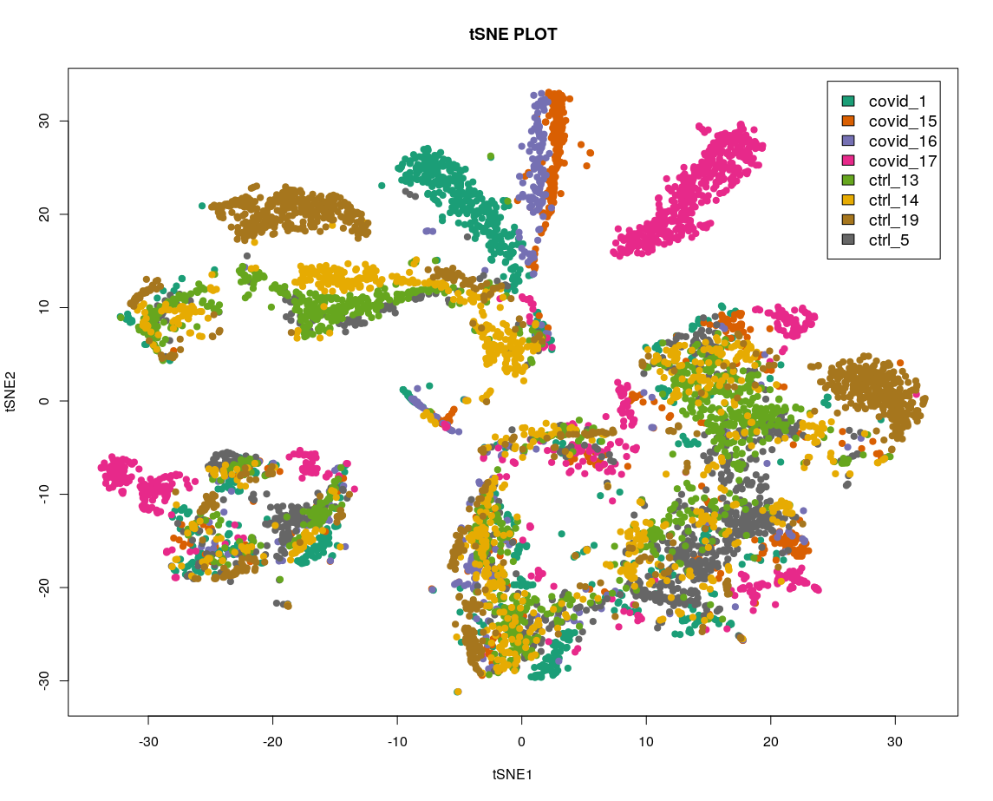
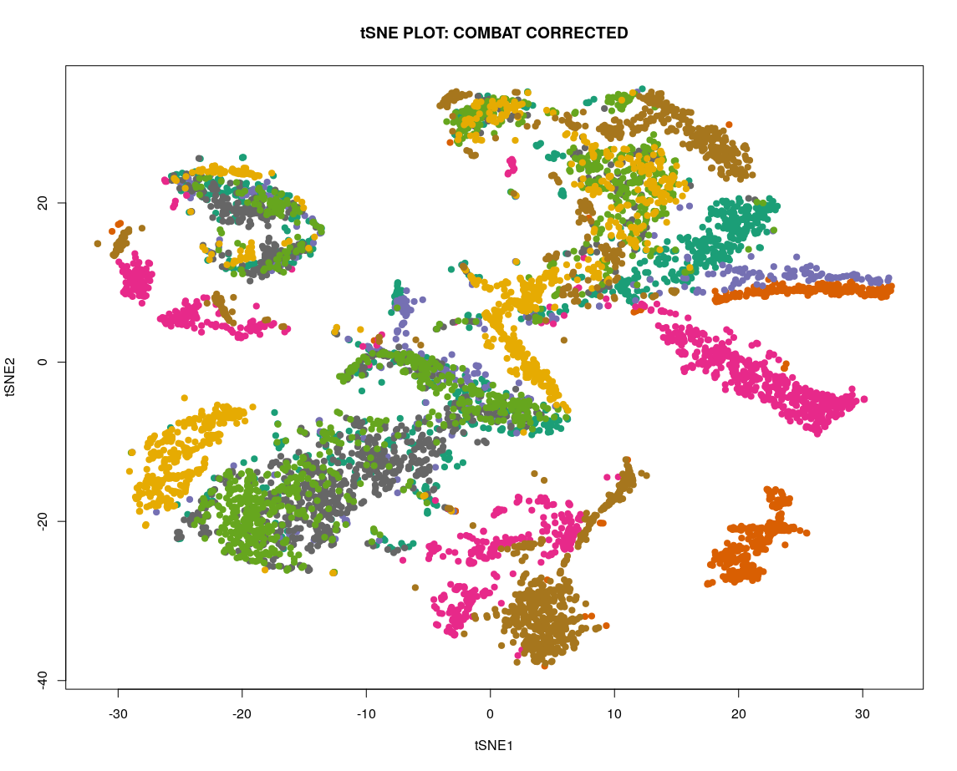
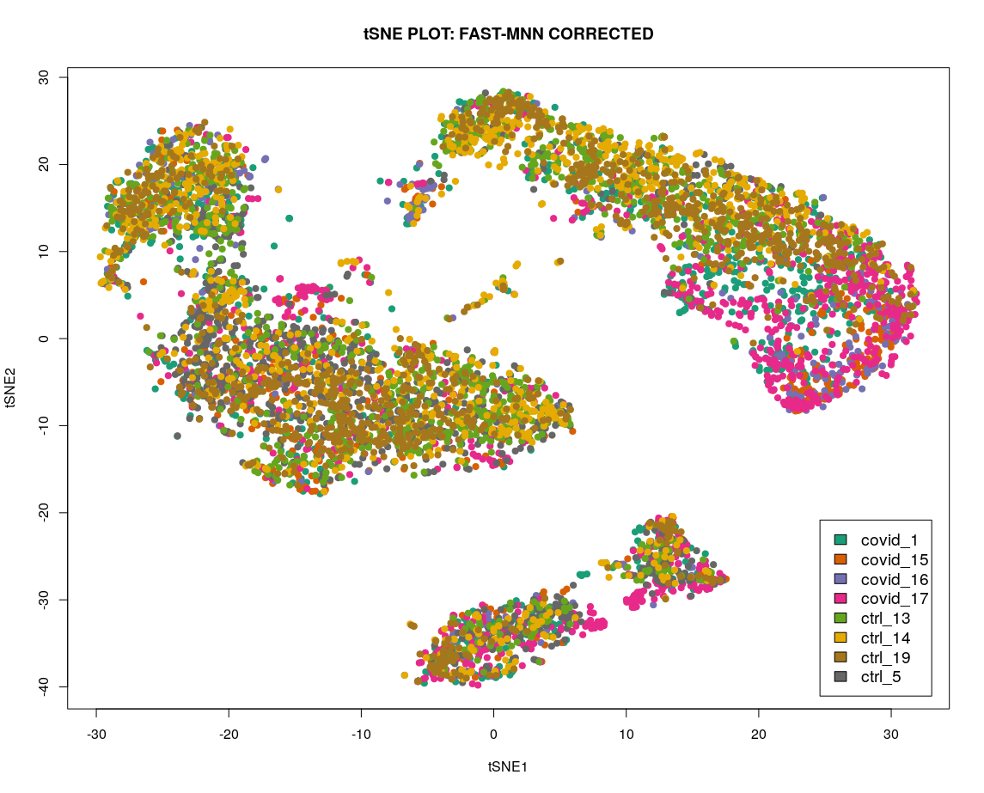
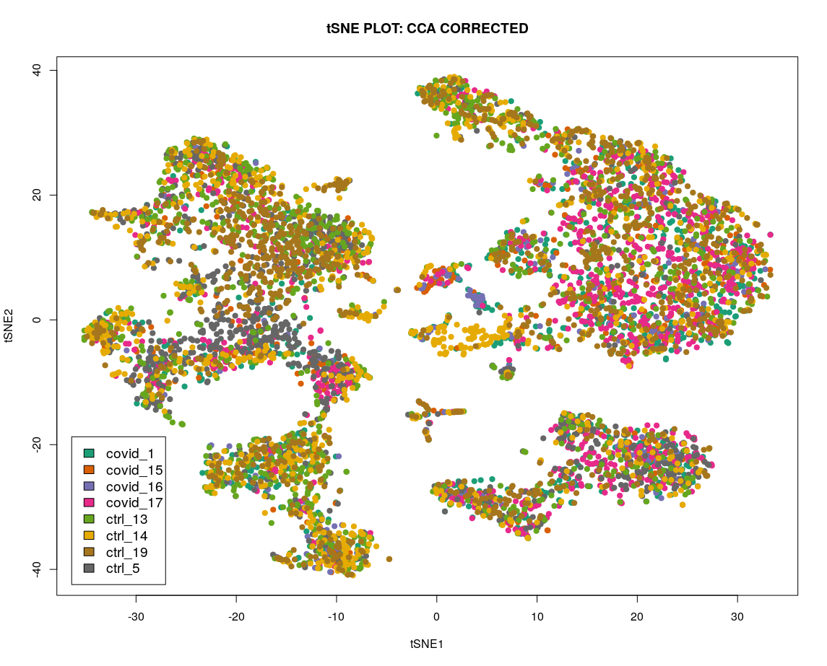
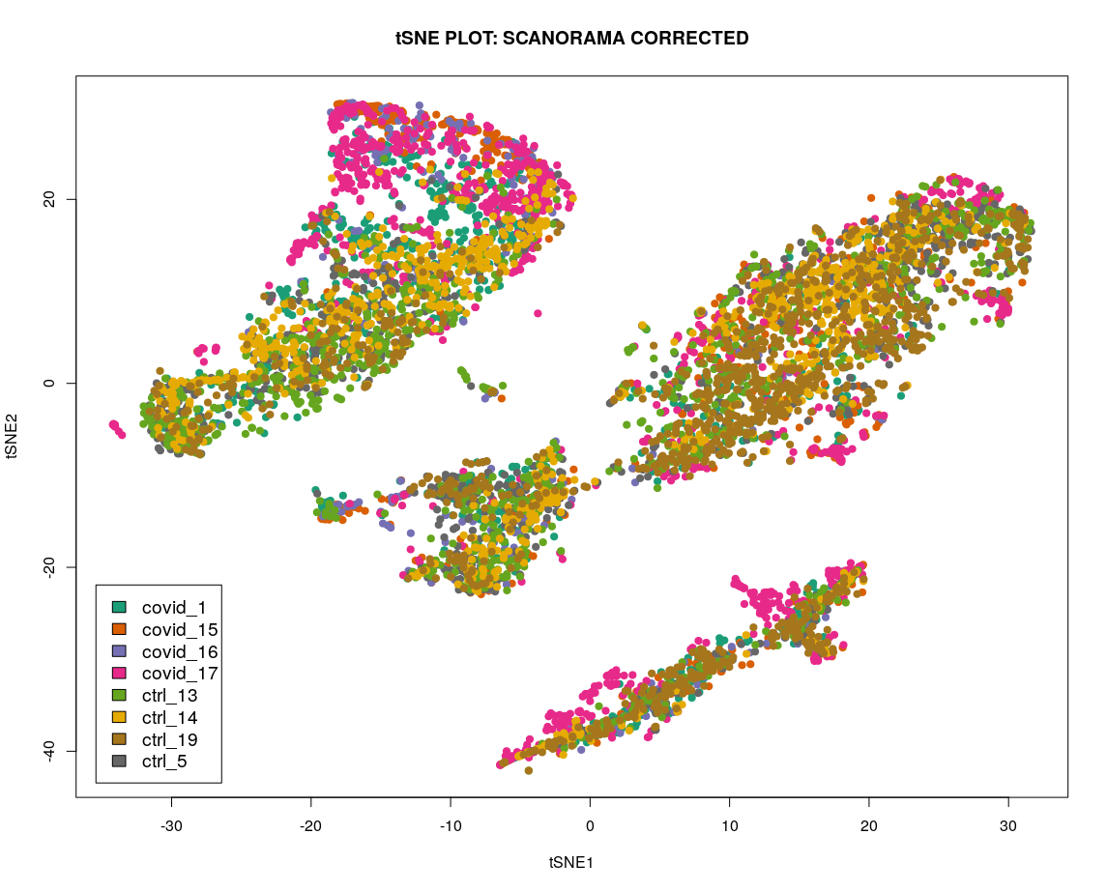
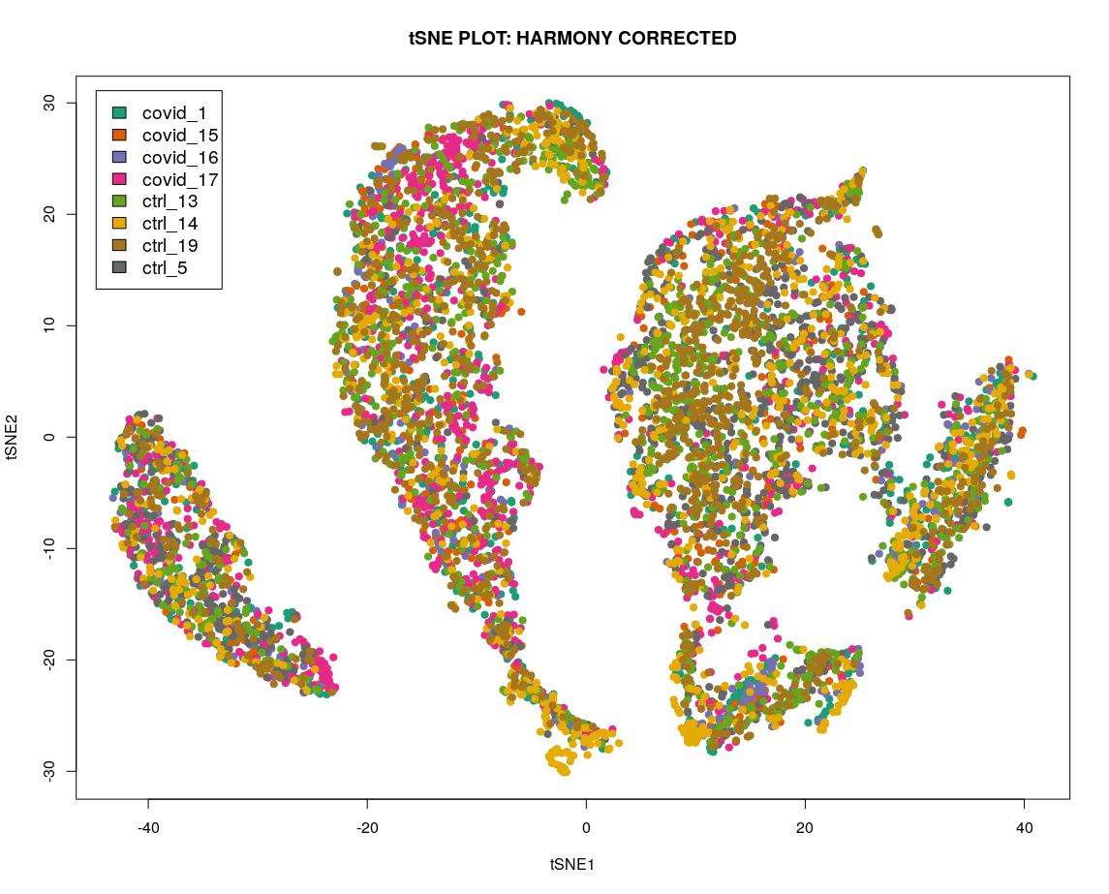
Comparing across cells integration methods

Slide 13
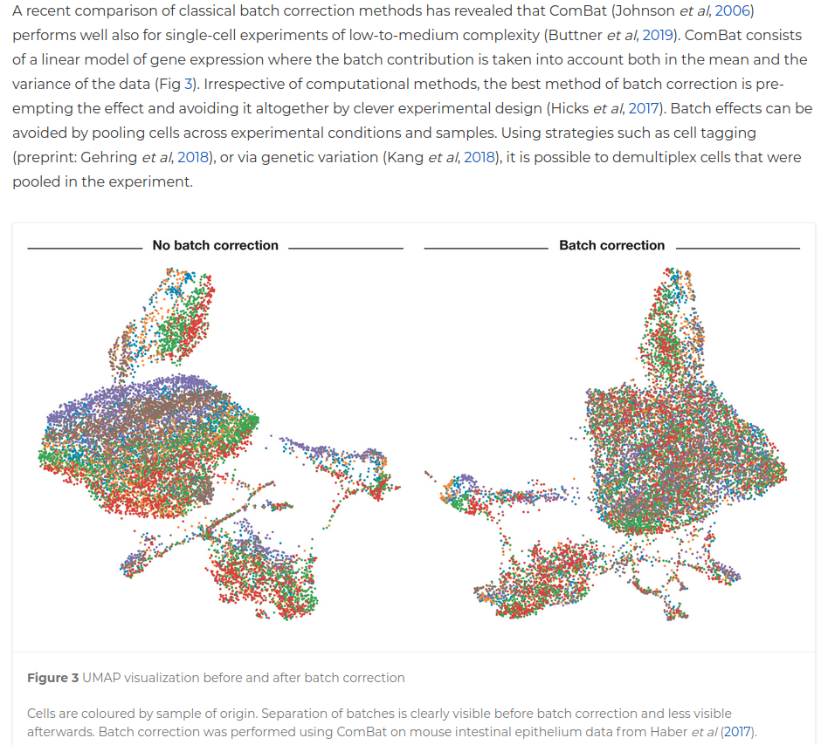
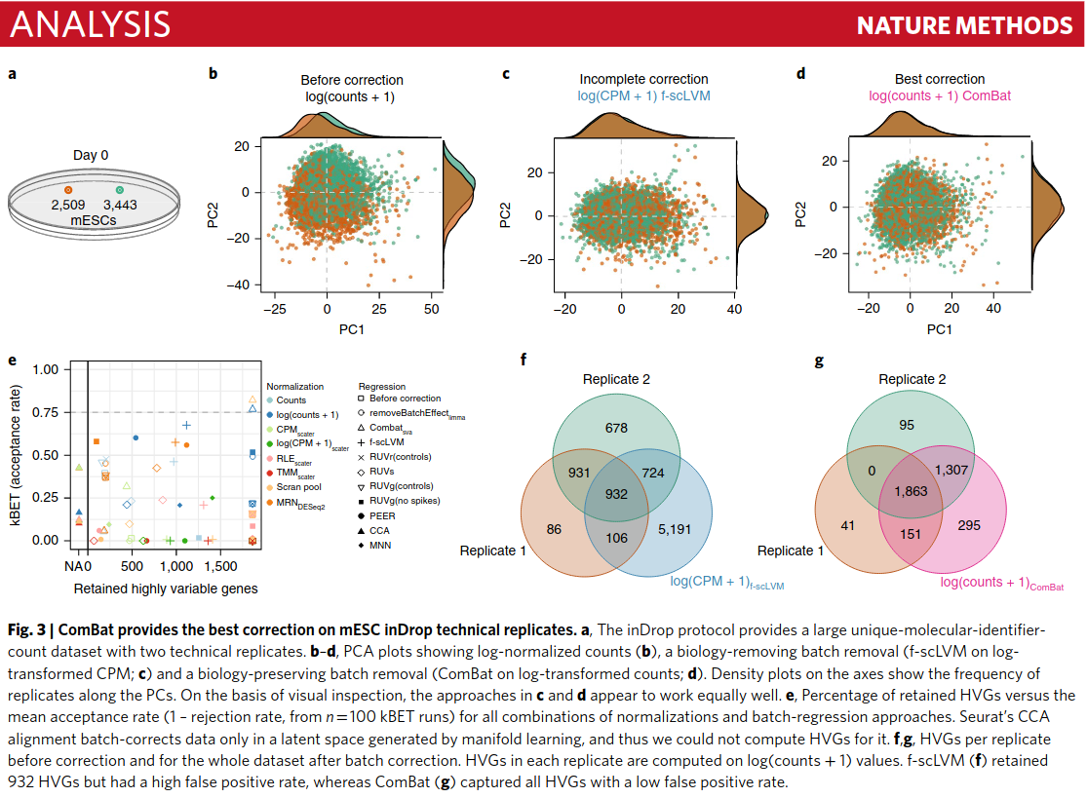
ComBat: low-complexity datasets
(subtle batch, few batches, few cell populations)
Büttner M, Miao Z, Wolf FA, Teichmann SA, Theis FJ. A test metric for assessing single-cell RNA-seq batch correction. Nat Methods. 2019 Jan;16(1):43-49. doi: 10.1038/s41592-018-0254-1
Luecken MD, Theis FJ. Current best practices in single-cell RNA-seq analysis:
a tutorial. Mol Syst Biol. 2019 Jun 19;15(6):e8746. doi: 10.15252/msb.20188746

Slide 14
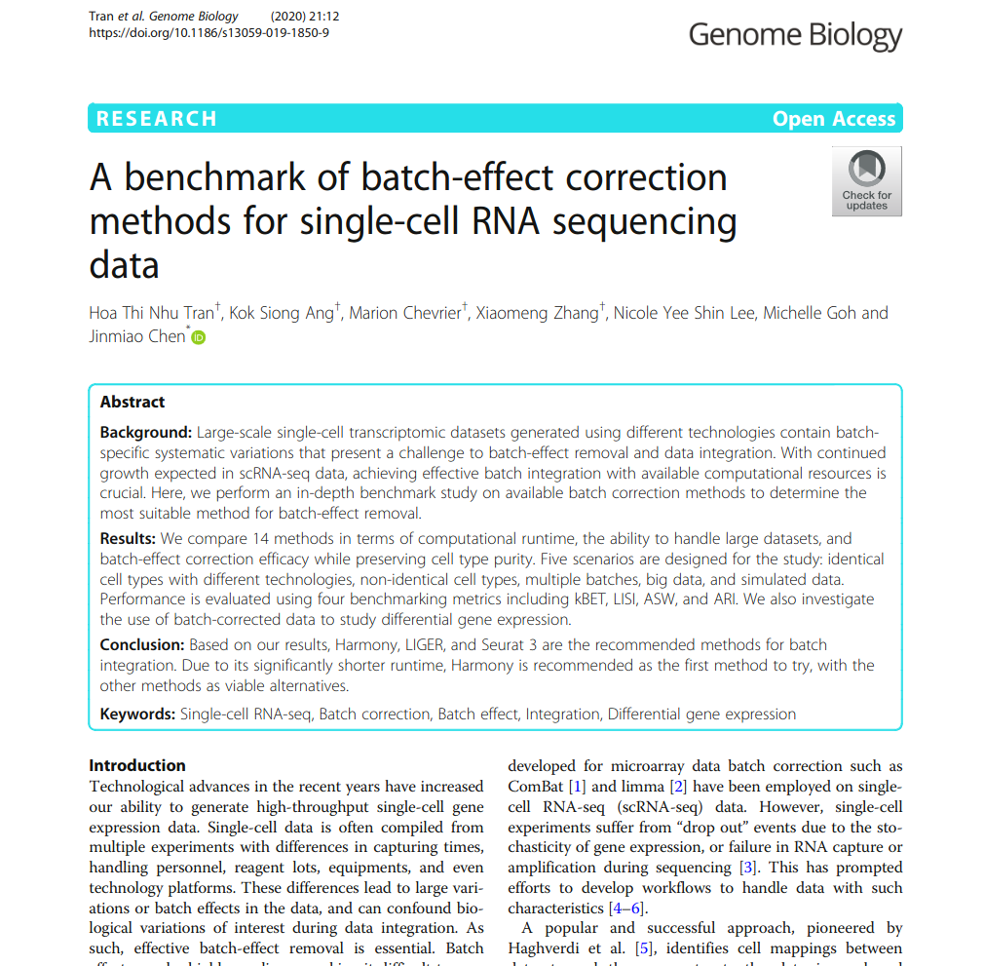
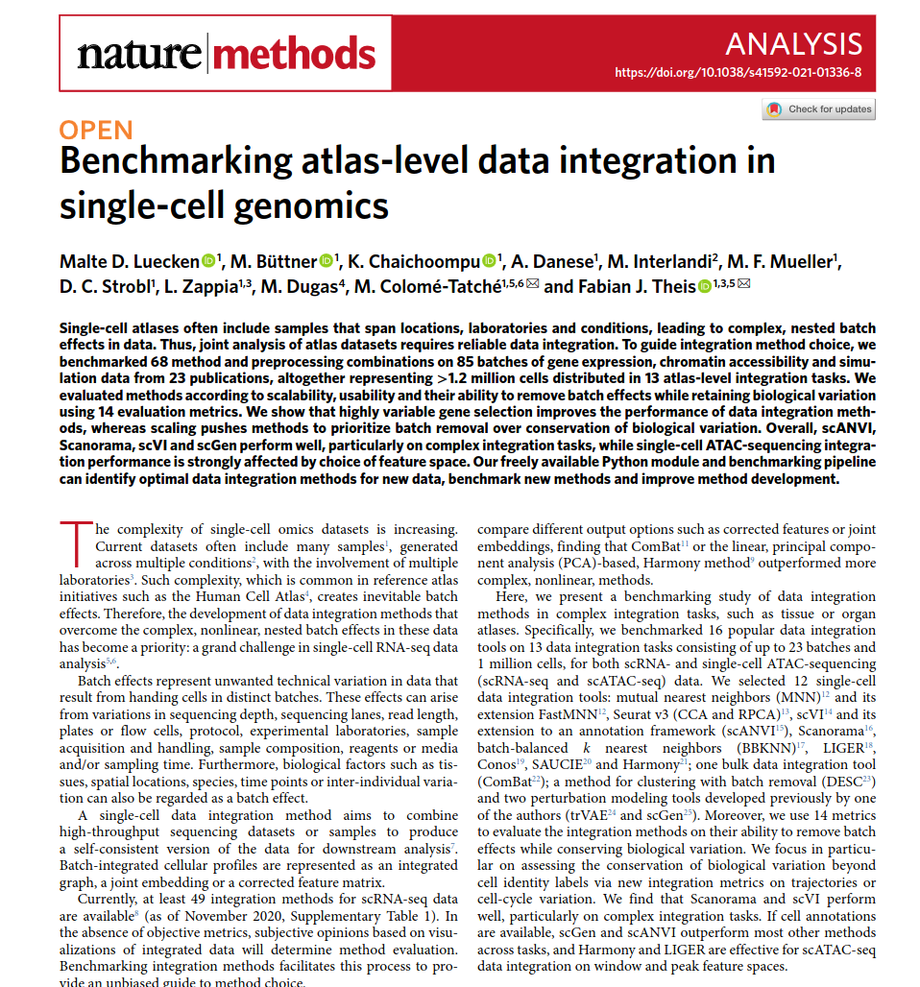
Harmony / Scanorama: complex datasets

Slide 15
Integration across features
(vertical integration)

Slide 16
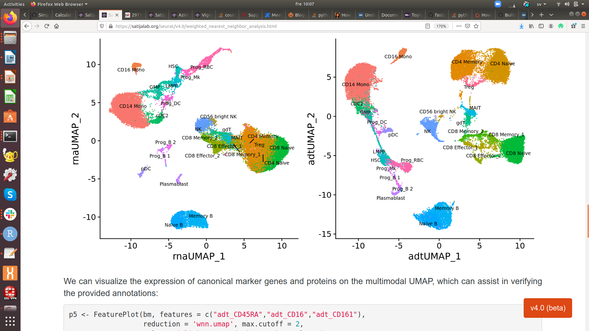
scRNAseq != Function (not always)
“Despite tremendous functional diversity, distinct populations of T cells such as effector,
regulatory, γẟ, and mucosal associated invariant T (MAIT), often cannot be effectively
separated by scRNA-seq alone, even when using the most sensitive and cutting-edge
technologies”
Hao et al. Cell 2021, 184(13): 3573-3587.e29. doi: 10.1016/j.cell.2021.04.048

Slide 17
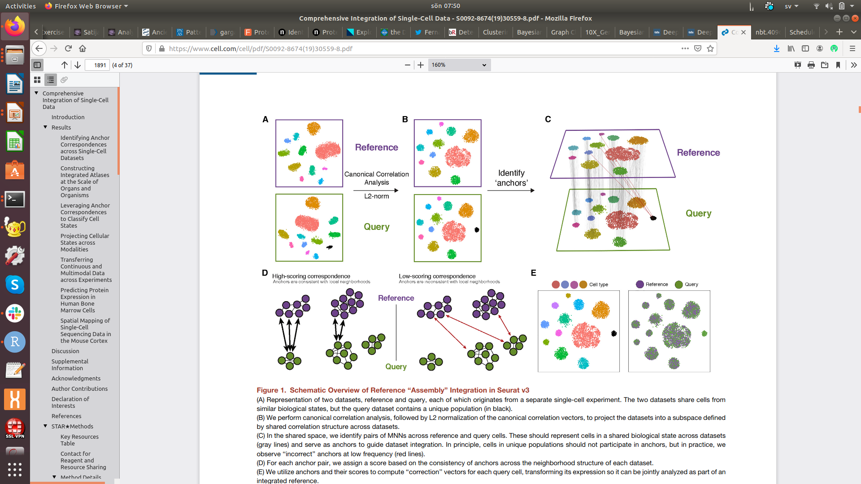
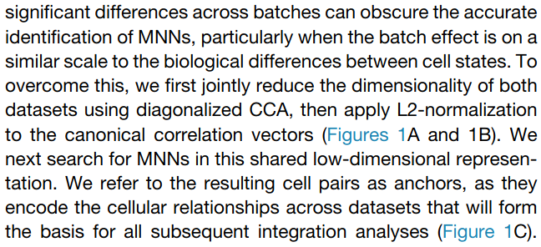
Seurat “transfer anchors across Omics”
Not the same biological cells but scATAC peaks can be
assigned to genes, so the feature names are the same
Stuart T et al., Cell. 2019 Jun 13;177(7):1888-1902.e21.

Slide 18
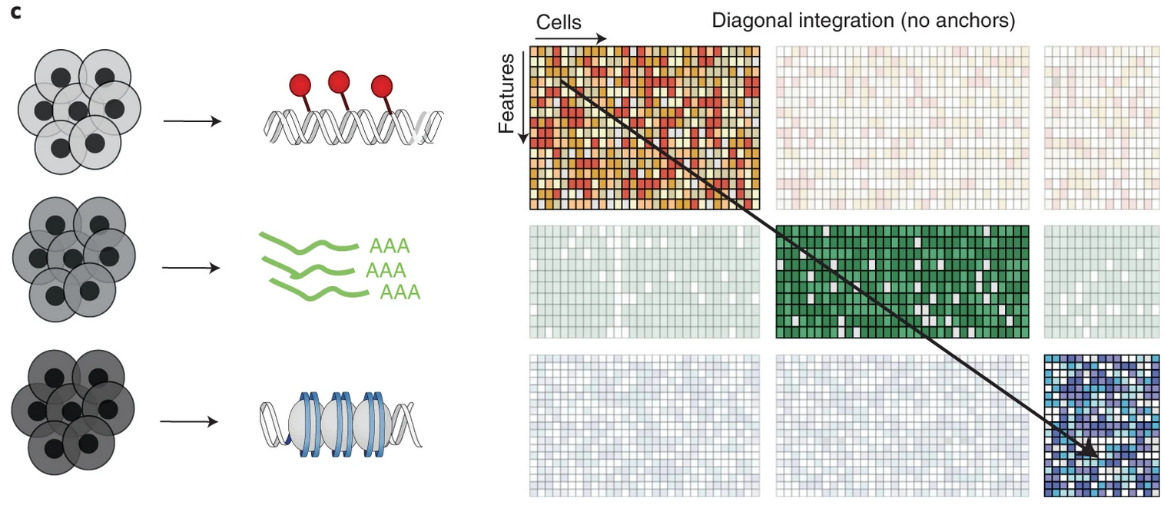
Seurat “transfer anchors across Omics”
as an example of diagonal integration
Argelaguet et al. 2021

Slide 19
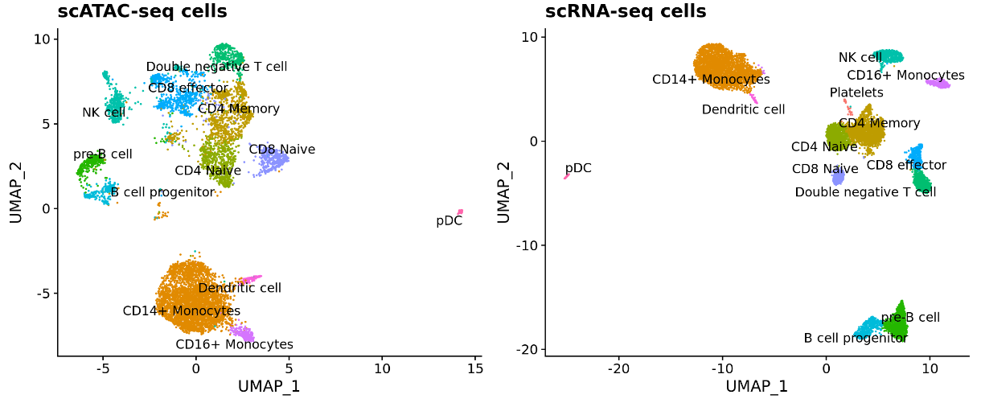
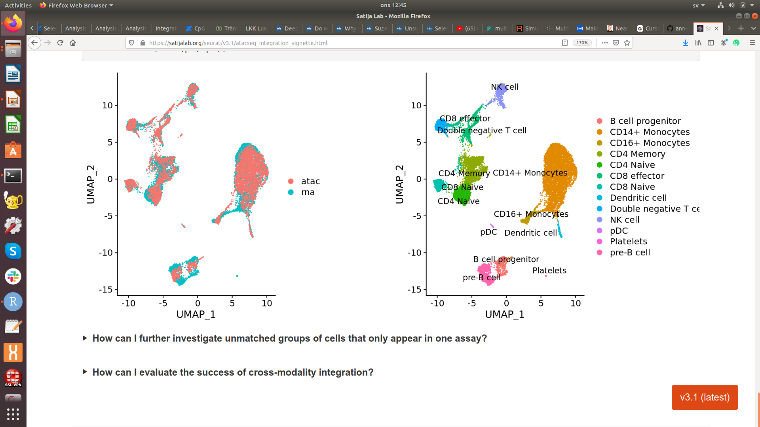
Seurat “transfer anchors across Omics”

Slide 20
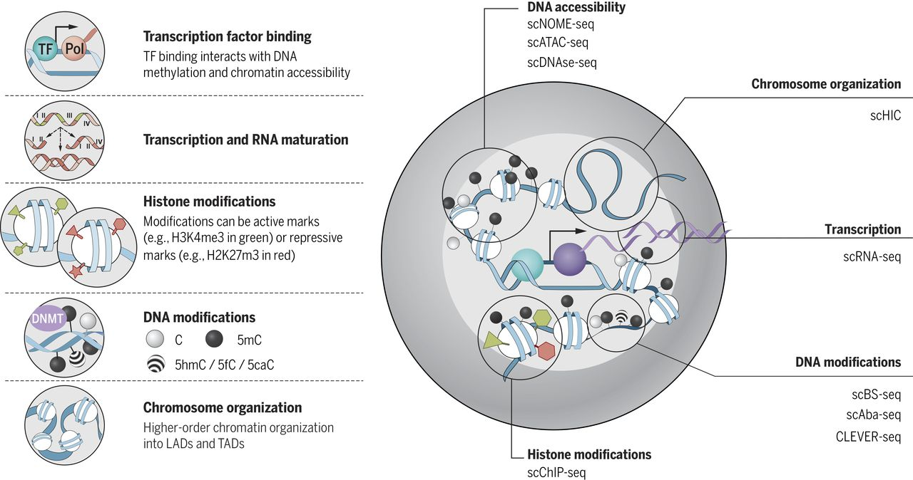
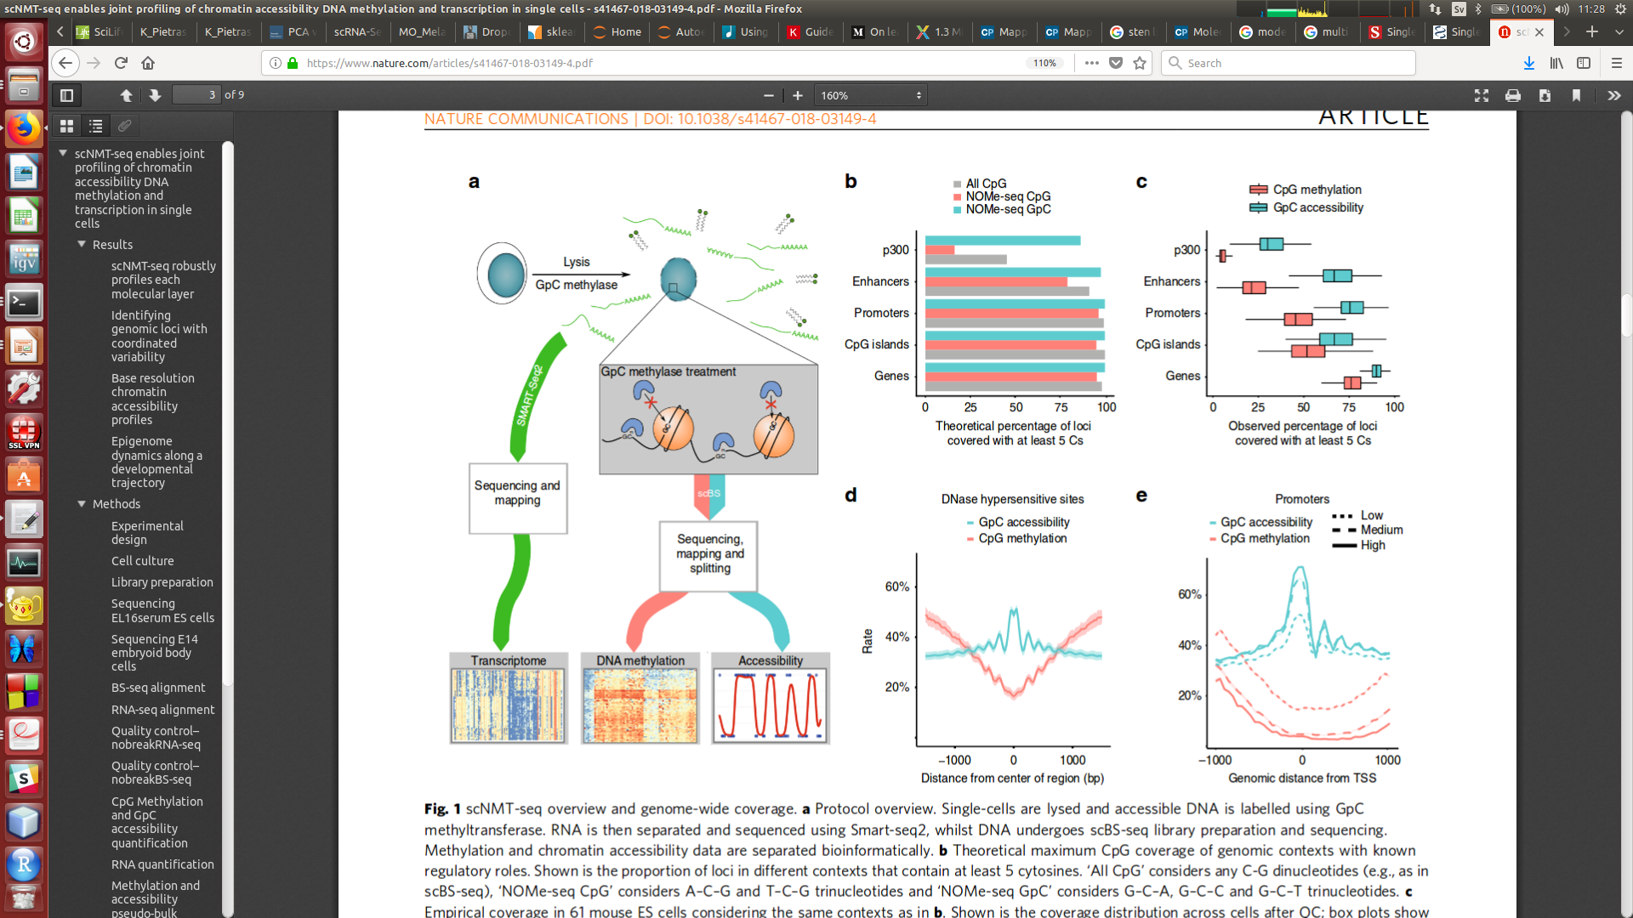
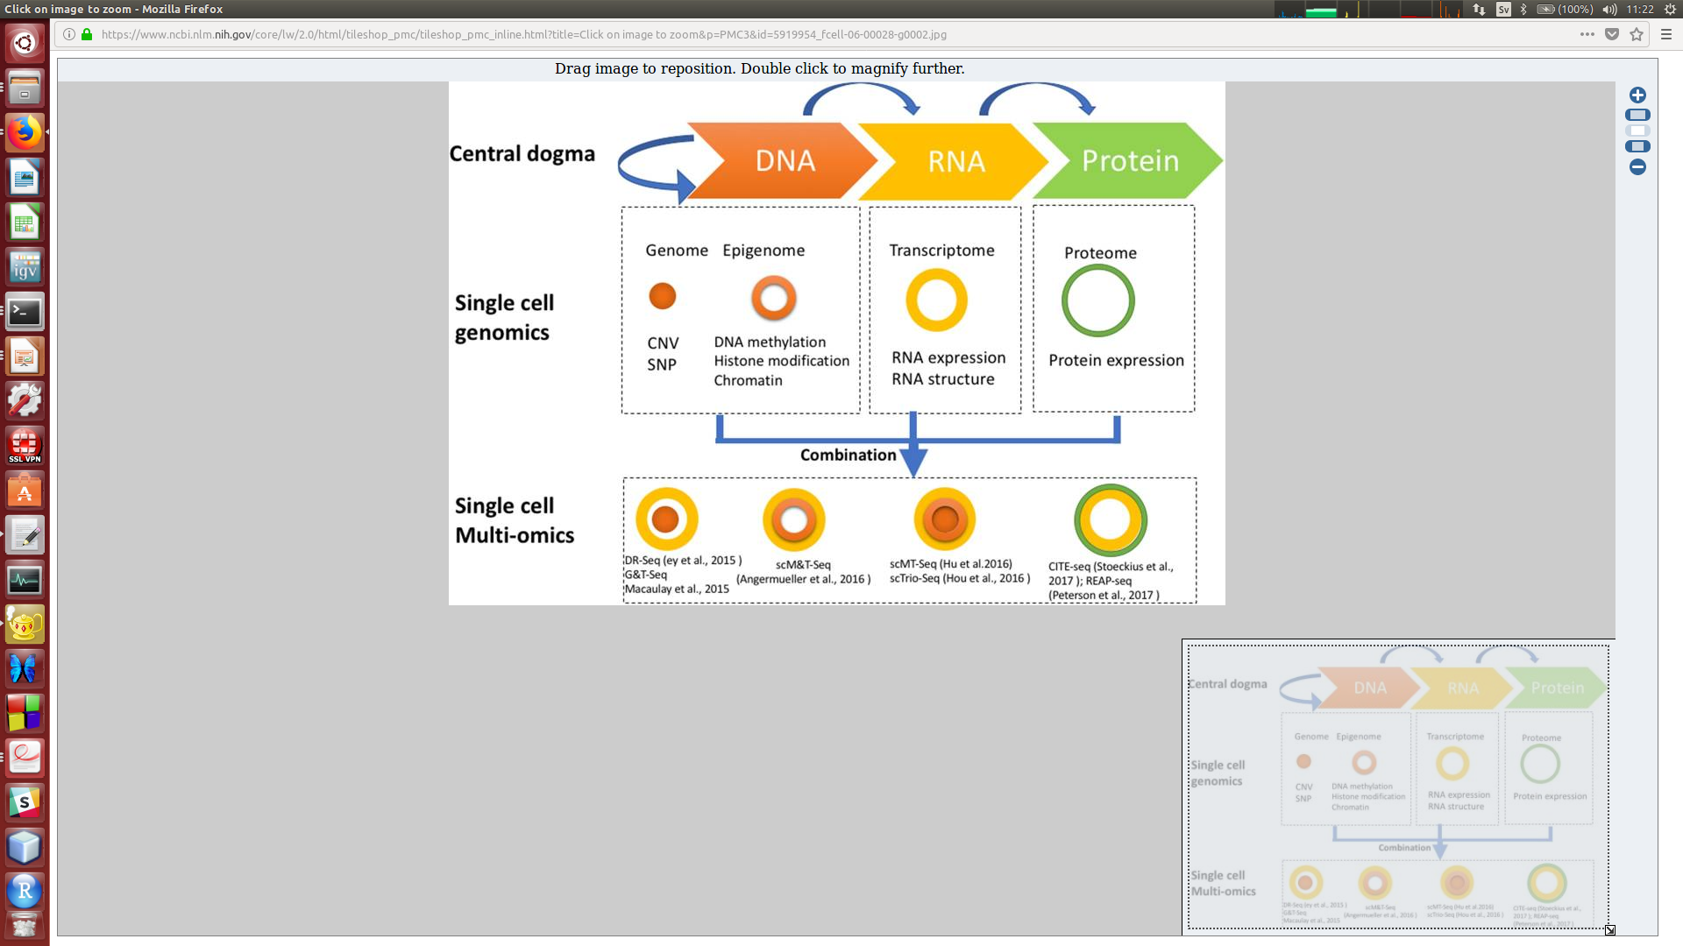
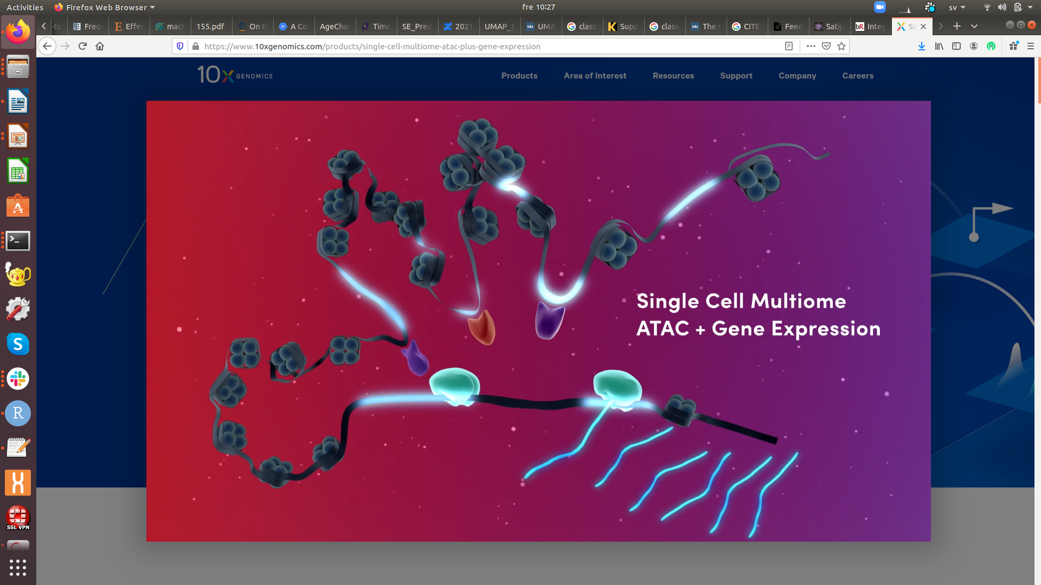
Multimodal scOmics technologies
Kelsey et al., 2017, Science 358, 69-75
Clark et al., 2018, Nature Communications 9, 781
Hu et al., 2018, Frontier in Cell and Developmental Biology 6, 1-13
10X Genomics Multiome ATAC + Gene Expression

Slide 21
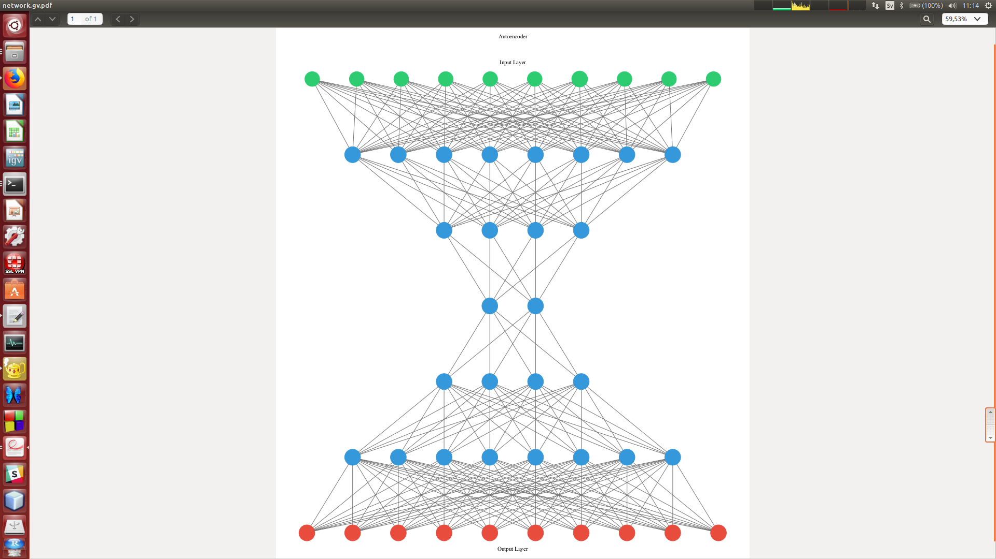
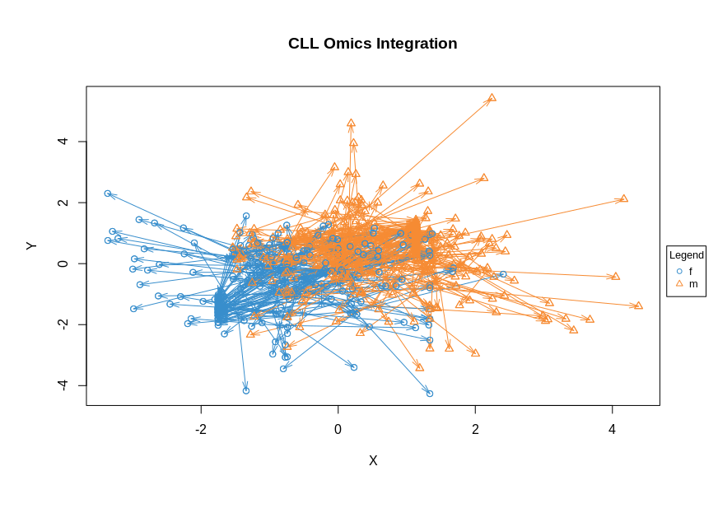
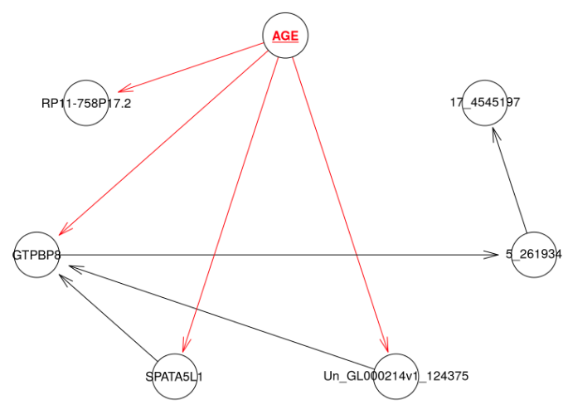
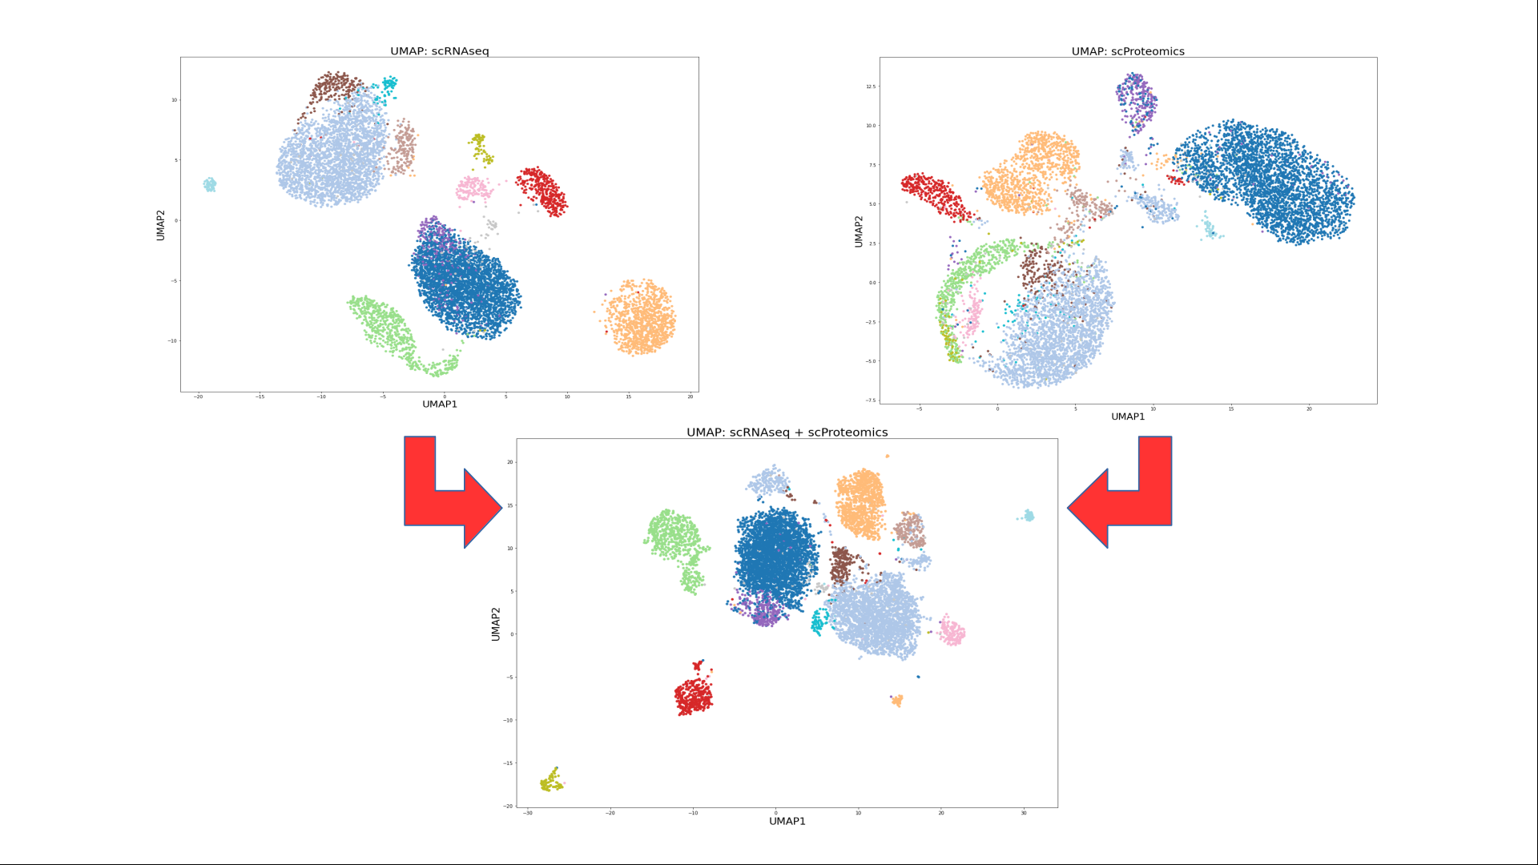
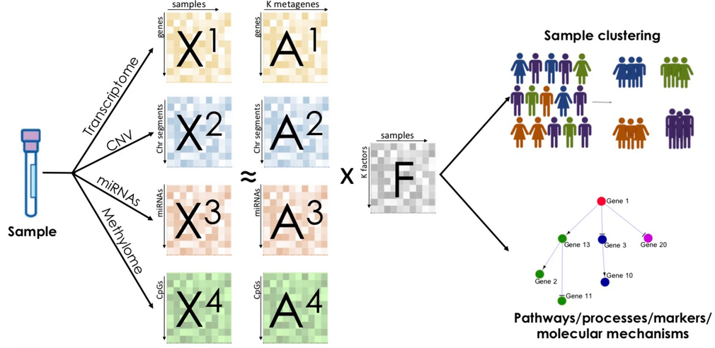

Overview of Omics integration methods
Convert to common space
Extract common variation
Combine via Bayes rule
PLS / CCA
Bayesian
networks
Neural nets
and
graphs
Bayesian
factor
analysis
UMAP

Slide 22
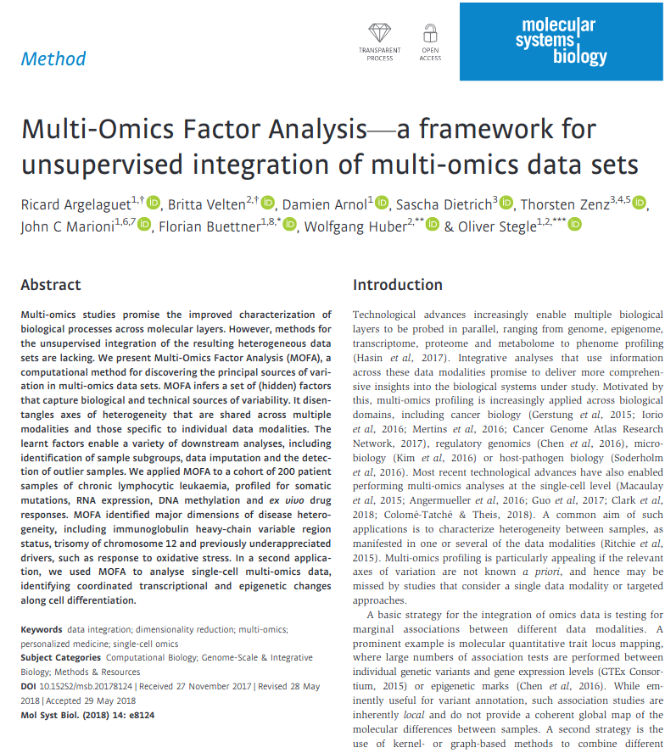
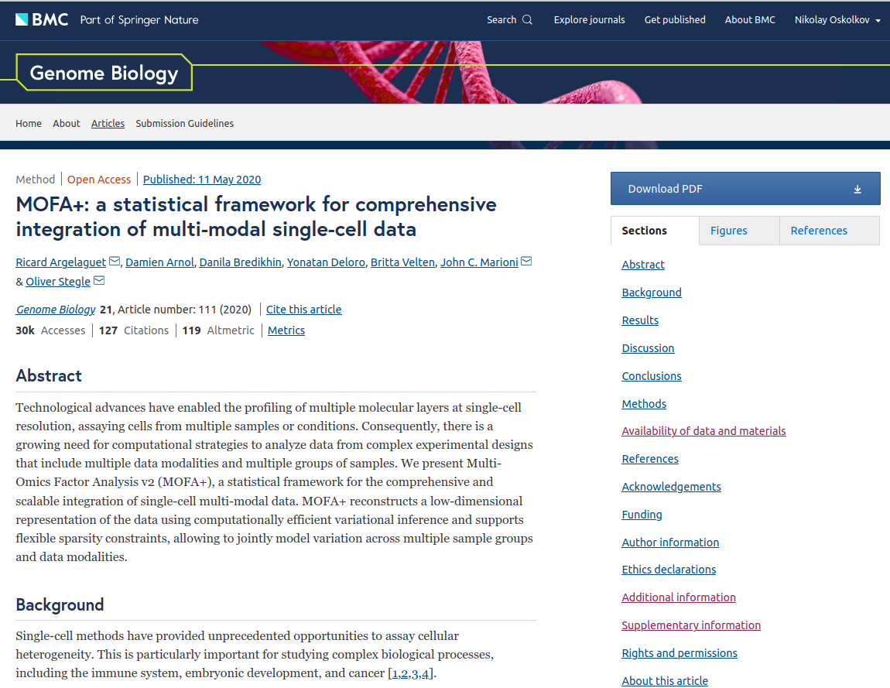
MOFA (general) and MOFA+ (single cell)

Slide 23
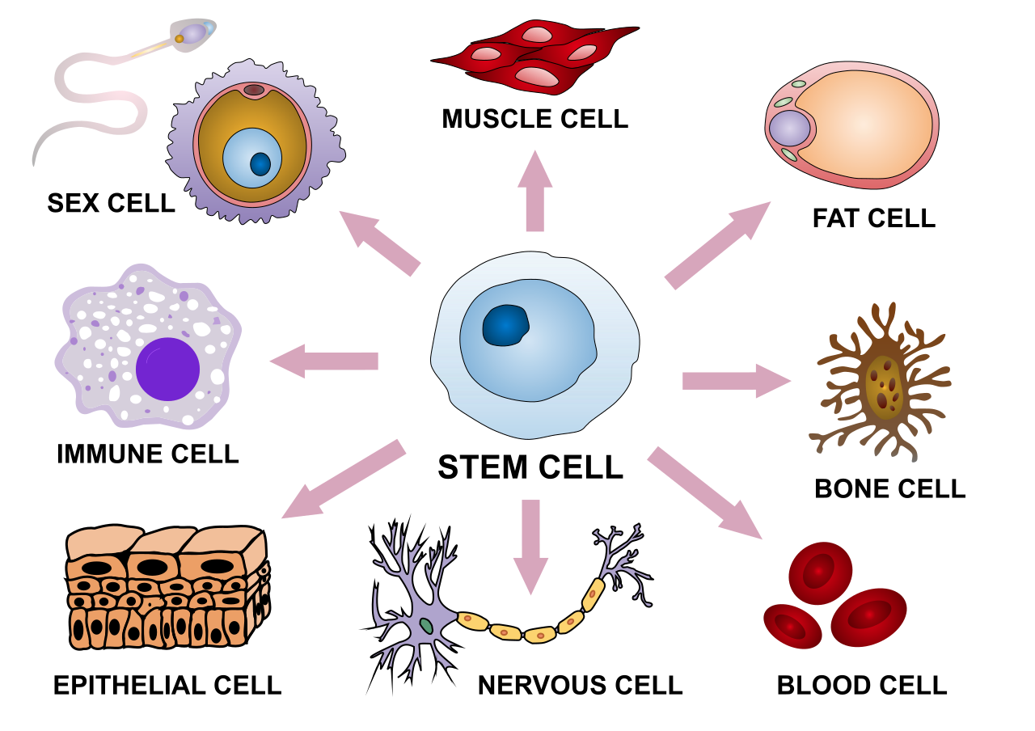
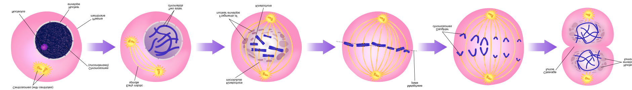
Factor Analysis: Common Axes of Variation
CELL TYPE
CELL CYCLE
L₁
L₂
P₁
P₂
P₃
N
N
N
Gene expression
Methylation
Genetic mutation

Slide 24
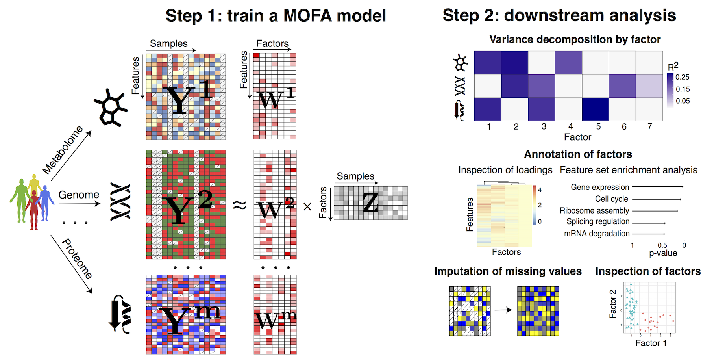
Multi-Omics Factor Analysis (MOFA)
R. Argelaguet et al., Mol. Syst. Biol. 2018

Slide 25
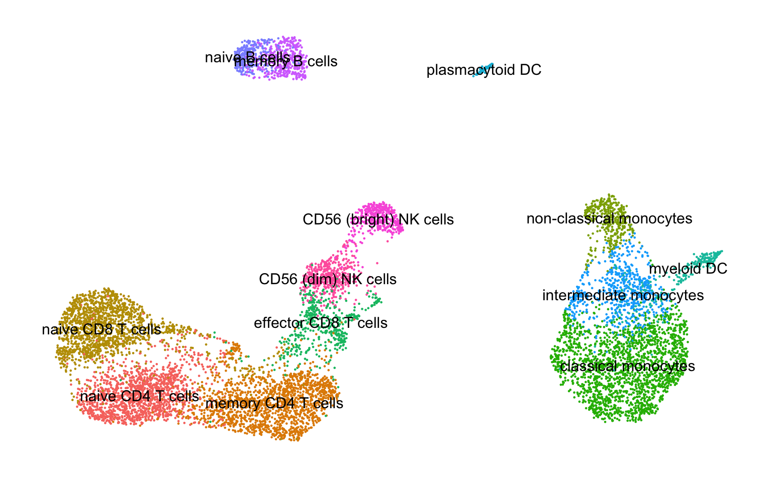
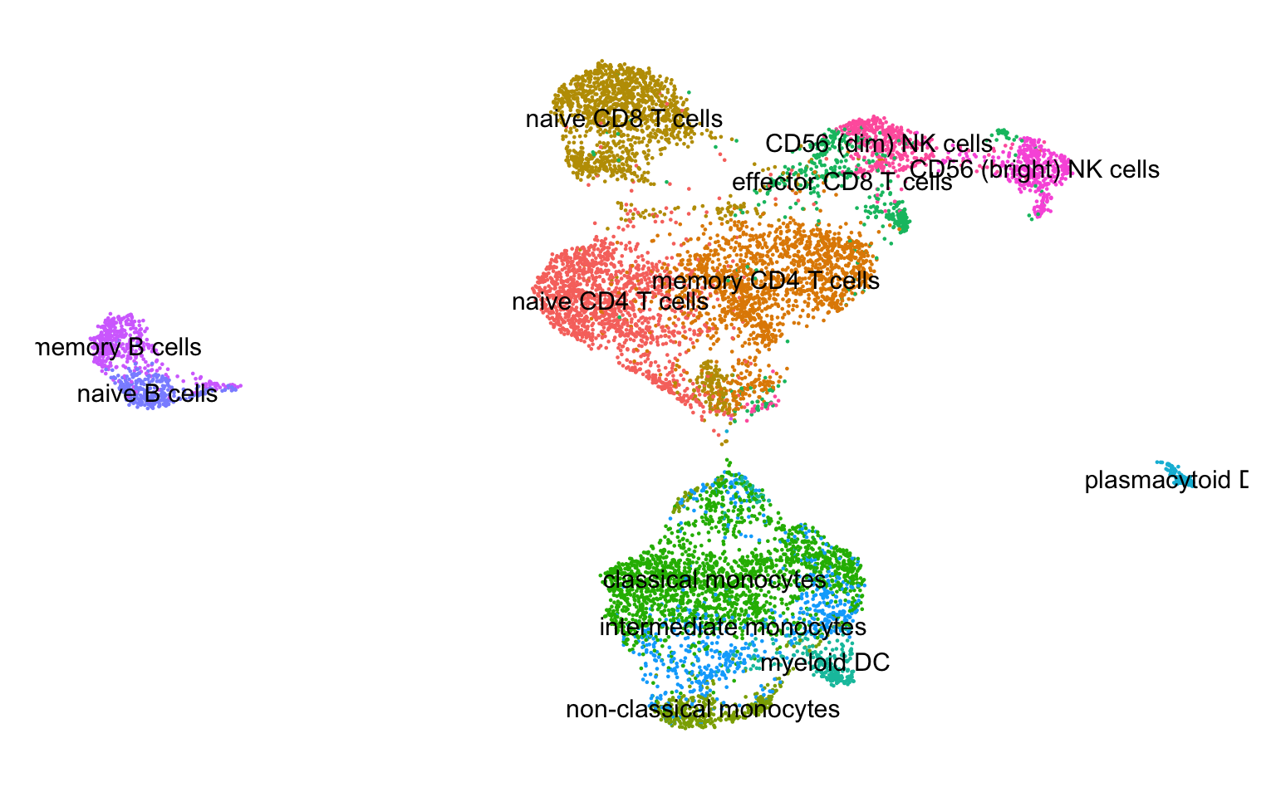
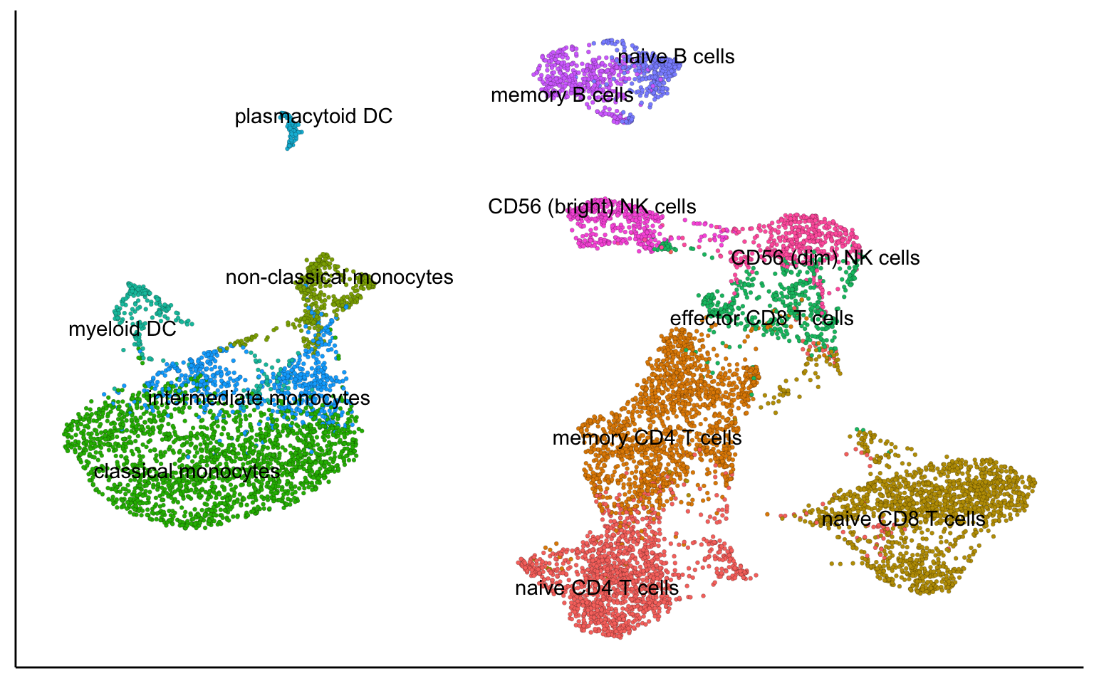
MOFA+ for scOmics Integration: 10X PBMC
scRNAseq
scATACseq
scRNAseq + scATACseq

Slide 26
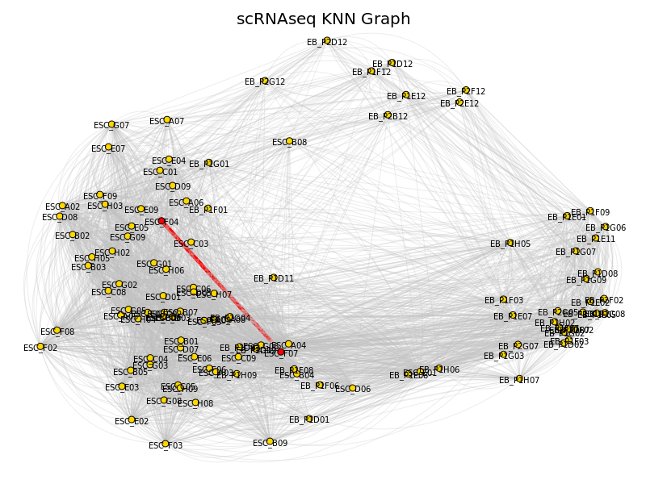
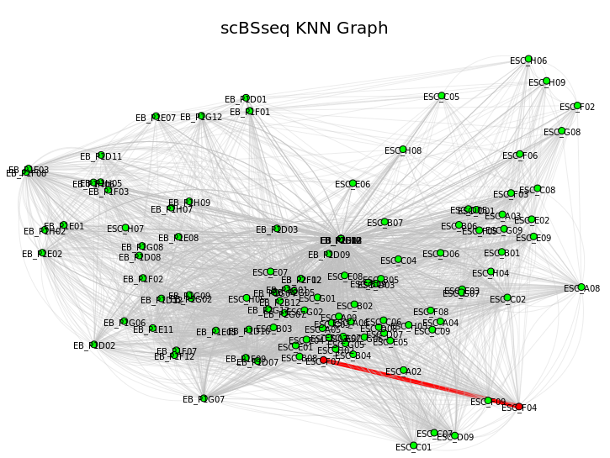
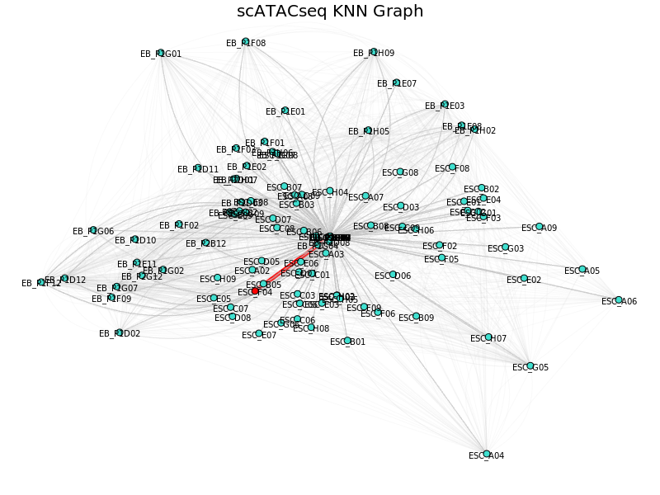


Graph Intersection Method
Hamming distance
Euclidean distance
Hamming distance
Keep edges consistently
present across the Omics

Slide 27



UMAP for data integration: CITEseq

Slide 28

Seurat Weighted Nearest Neigbors (WNN)
Hao et al. Cell 2021, 184(13): 3573-3587.e29. doi: 10.1016/j.cell.2021.04.048

Slide 29




National Bioinformatics
Infrastructure Sweden (NBIS)

