Slide 1


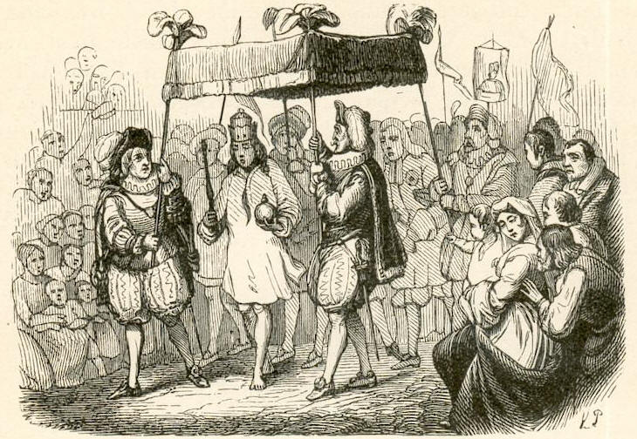
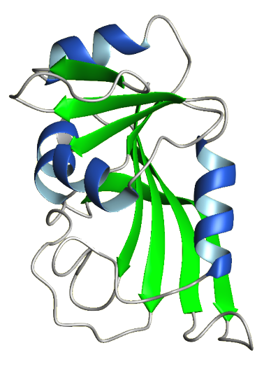
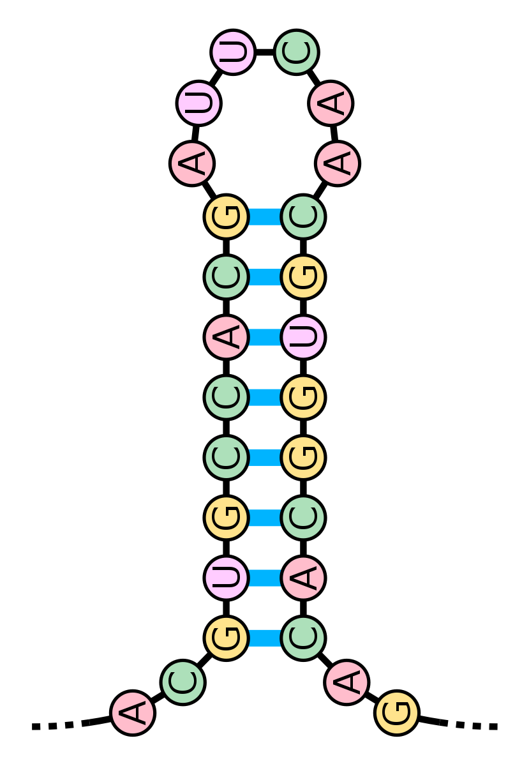
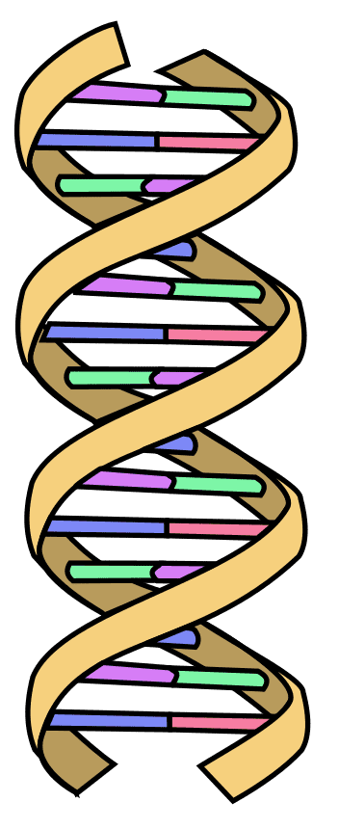
Challenges of Genomics Data Analysis
Nikolay Oskolkov, Group Leader (PI) at NIRI
https://en.wikipedia.org/wiki/The_Emperor’s_New_Clothes

Slide 2

Genomics: Progress or Regress?
I remember times when I worked with
10 genetic variants, now we have
millions of variants thanks to WGS!

Slide 3

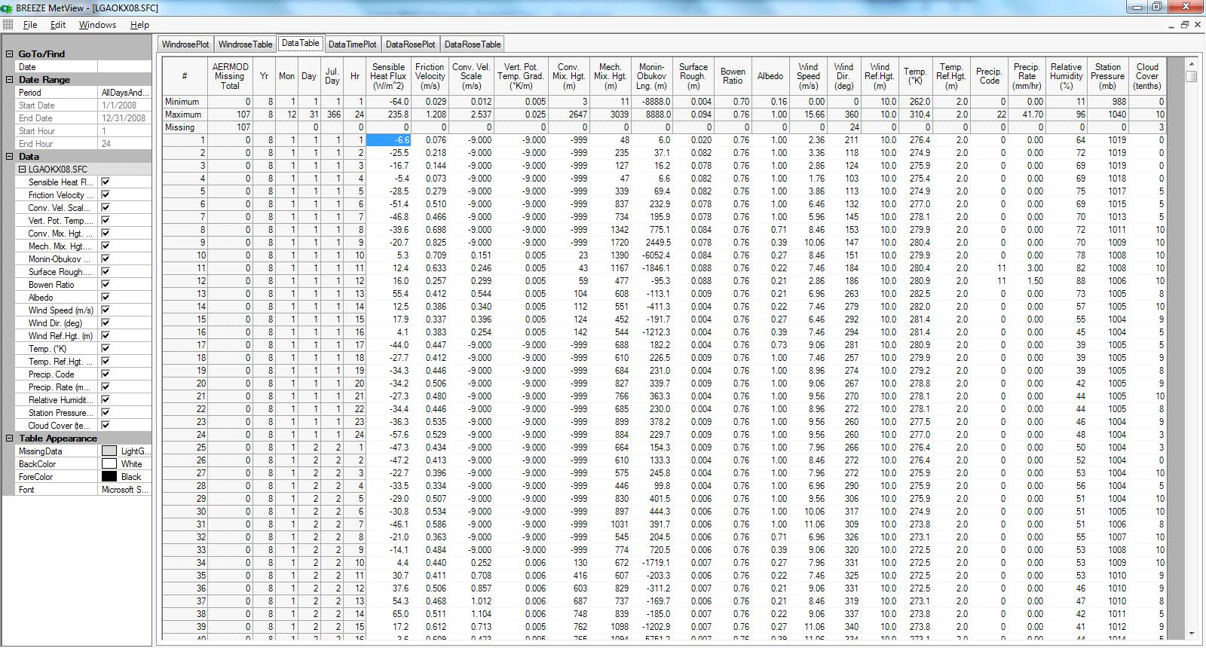


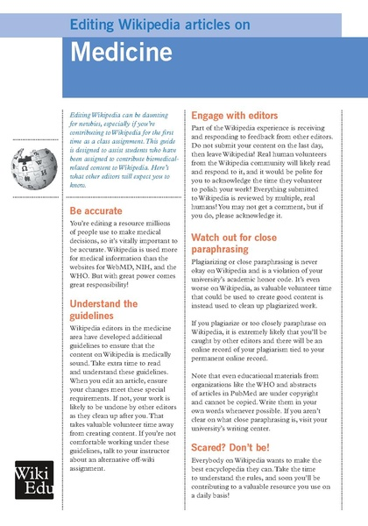
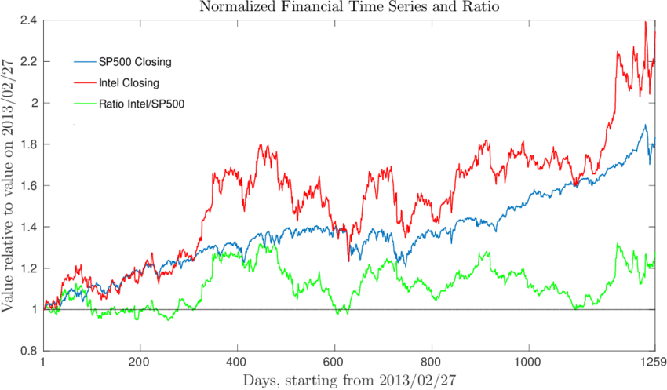
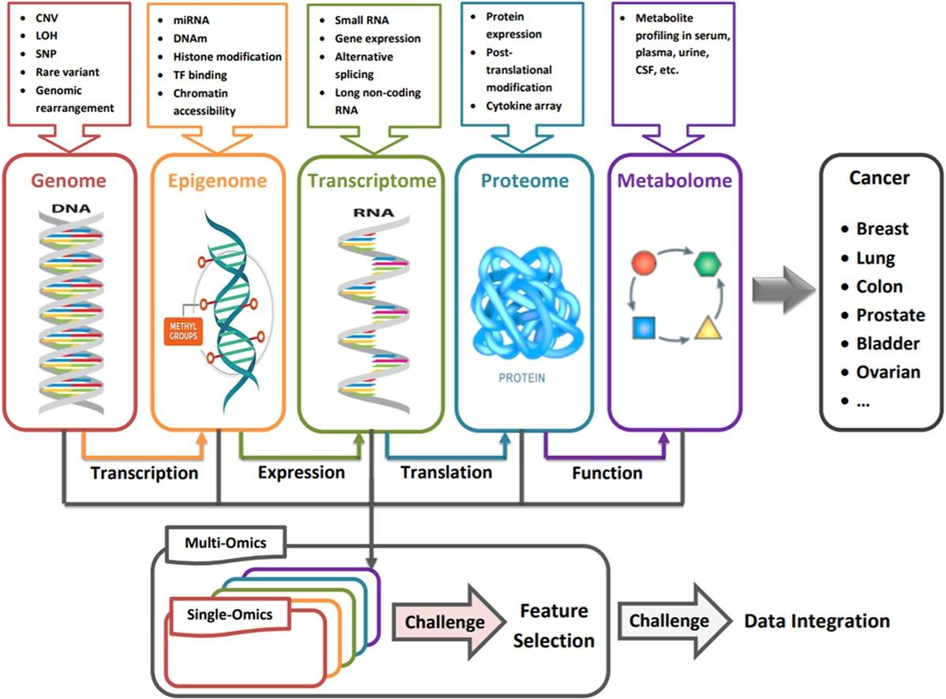

Various types of data around us
Tabular
Sound
Image
Text
DATA
Time Series
Omics Data
Video

Slide 4
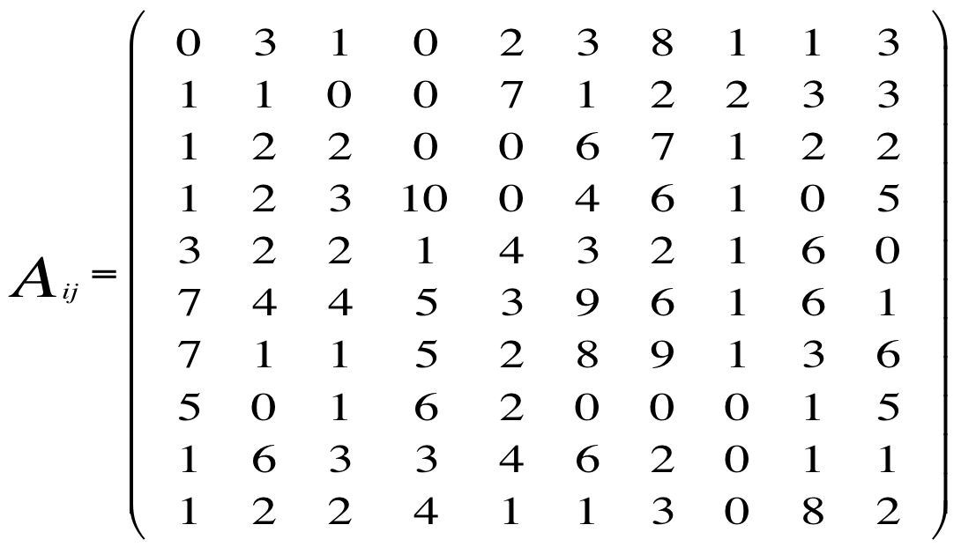
Genomics data are high dimensional
N
P dimensions
Statistical observations:
e.g. samples, cells etc.
N data points
P
Features: genes, proteins,
microbes, metabolites etc.
High Dimensional Data: P >> N
For a robust statistical analysis, one should
properly “sample” the P-dimensional space,
hence large sample size is required, N >> P

Slide 5
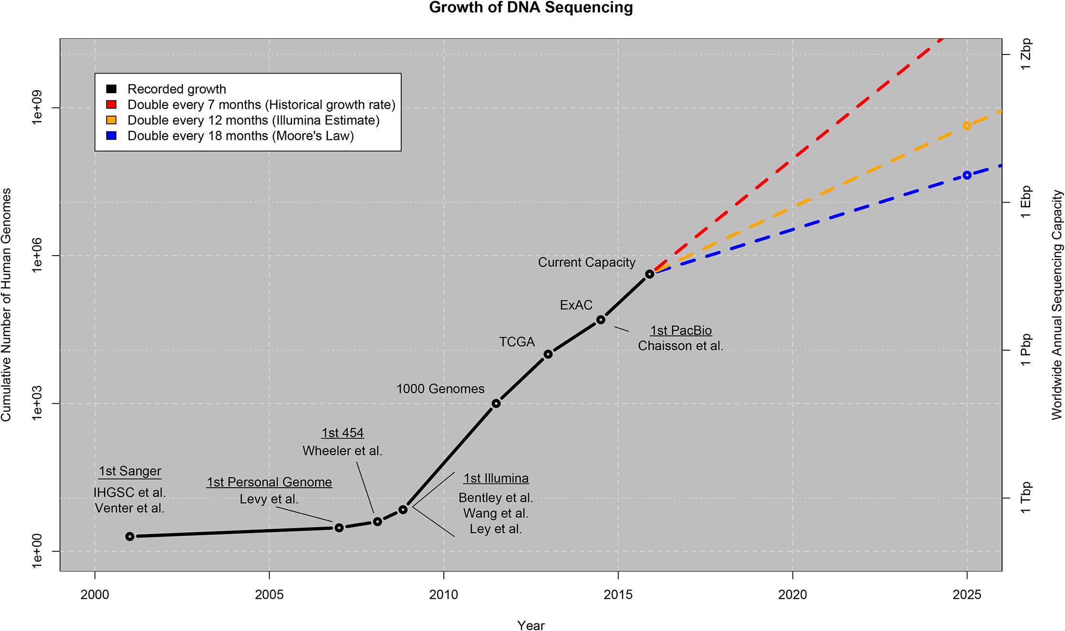
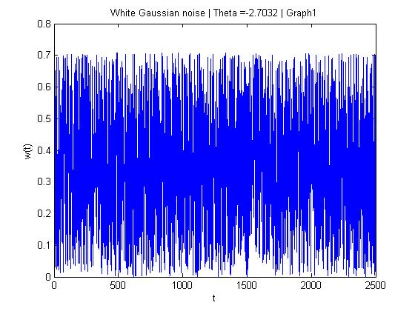
Big Data in Genomics
Genomics / WGS
: Little Data
N₁ ~ 10³
P₁ ~ 10⁶
N₁ * P₁ = N₂ * P₂ = 10⁹
Stephens et al., (2015). Big Data: Astronomical or Genomical? PLoS Biology 13(7)
scRNAseq
: Big Data
N₂ ~ 10⁶
A file with White Noise can
also take a lot of disk space
P₂ ~ 10³

Slide 6
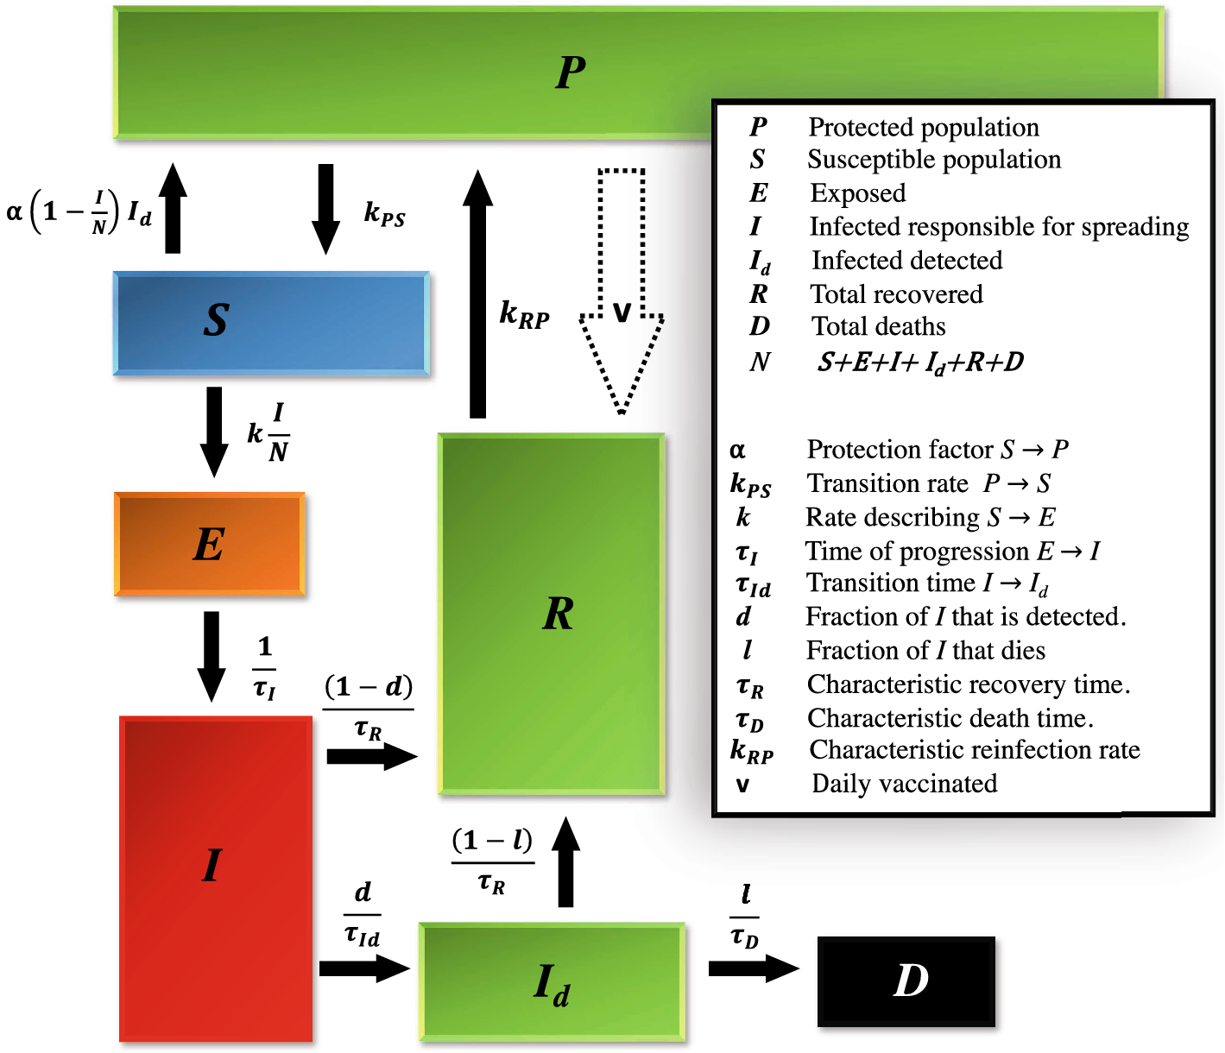
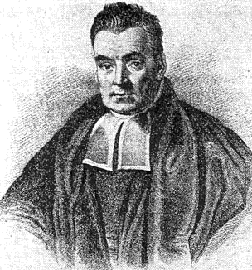

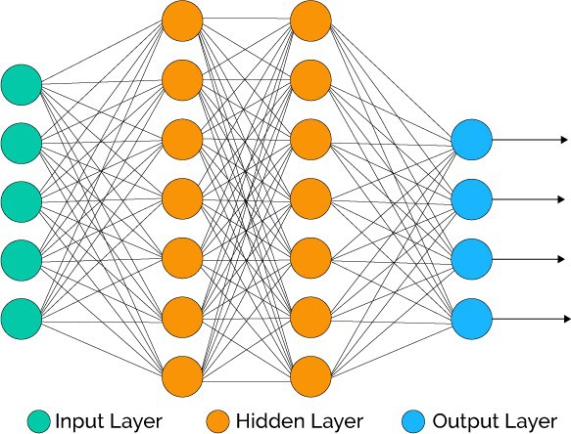
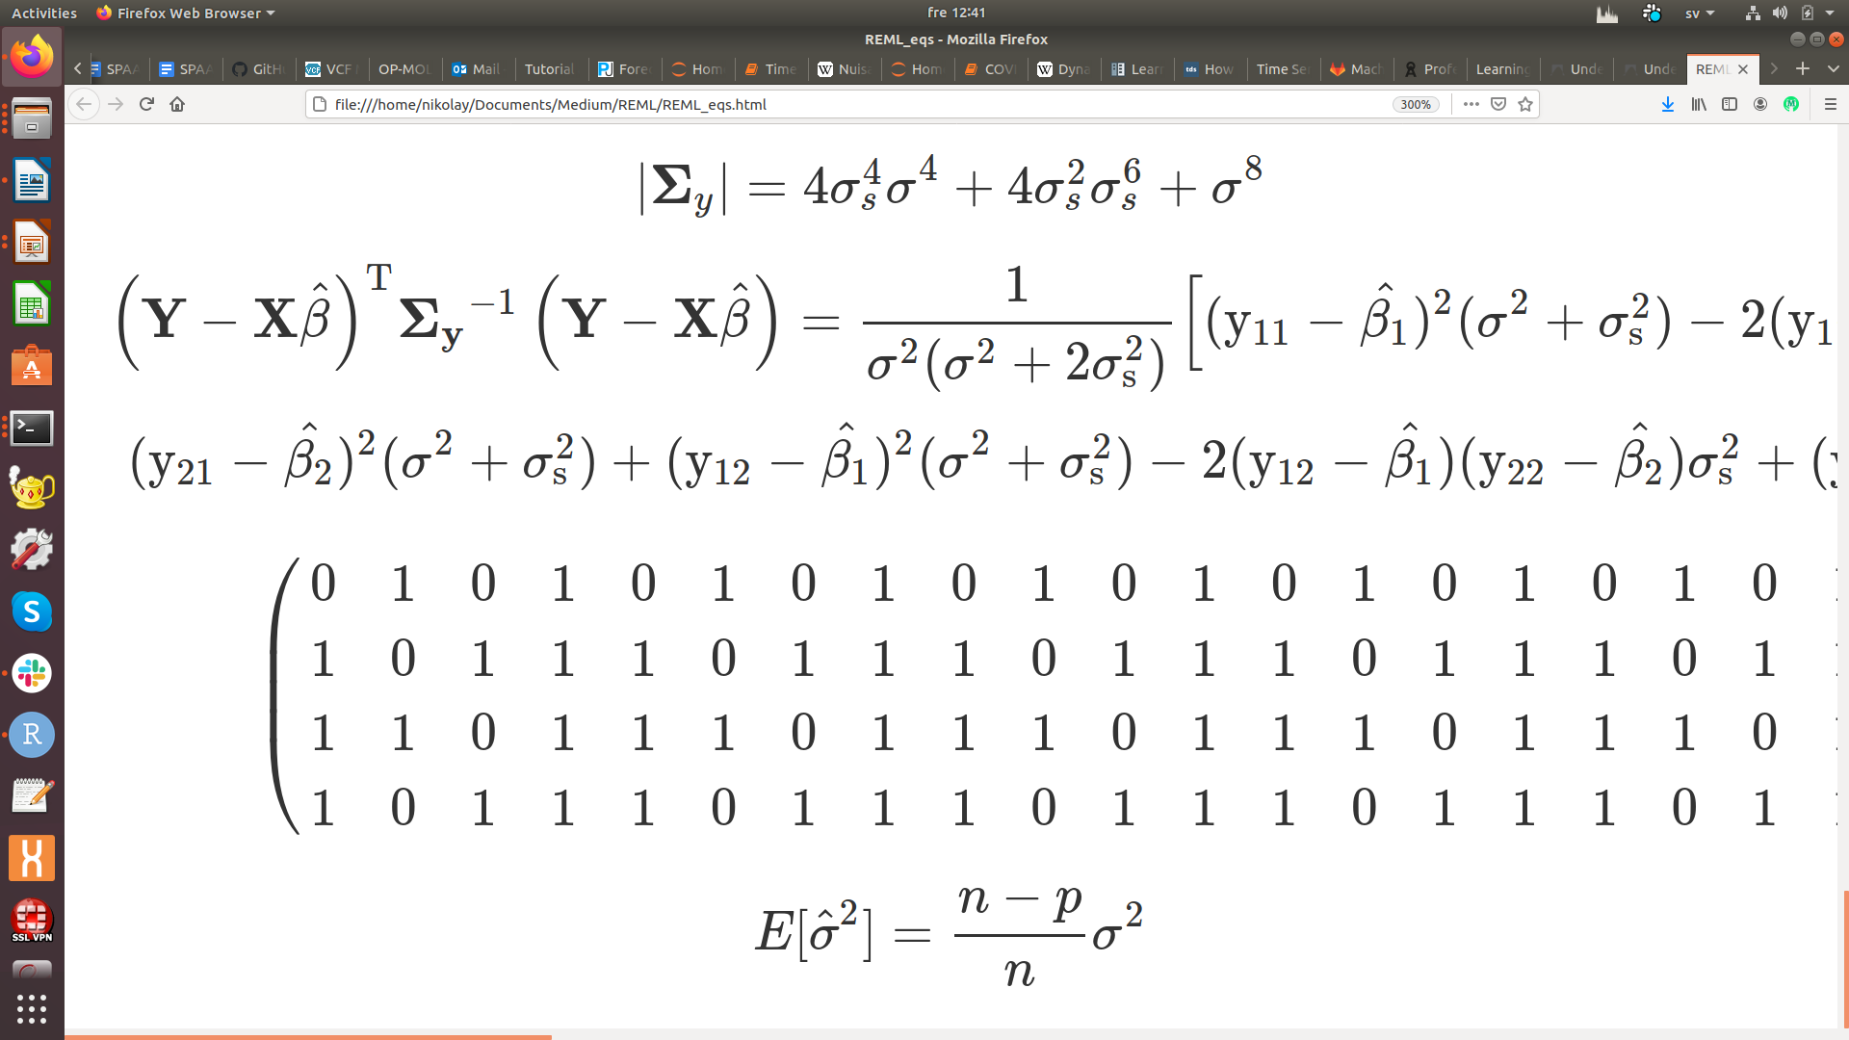
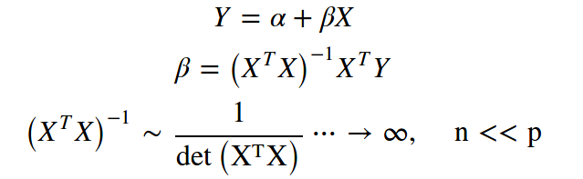
Some types of data analysis in Life Sciences
P is the number of features (genes, proteins, genetic variants etc.)
N is the number of observations (samples, cells, nucleotides etc.)
Biology / Biomedicine
Mathematical modeling
Bayesianism
Frequentism
Machine Learning
N → 0
N << P
N ≈ P
N >> P
Hypothesis-driven
Amount of Data
Data-driven
Ex.1
Ex.2
The Curse of
Dimensionality
Biased ML variance
estimator in HD-space

Slide 7
Theoretical Background
of the Curse of Dimensionality

Slide 8
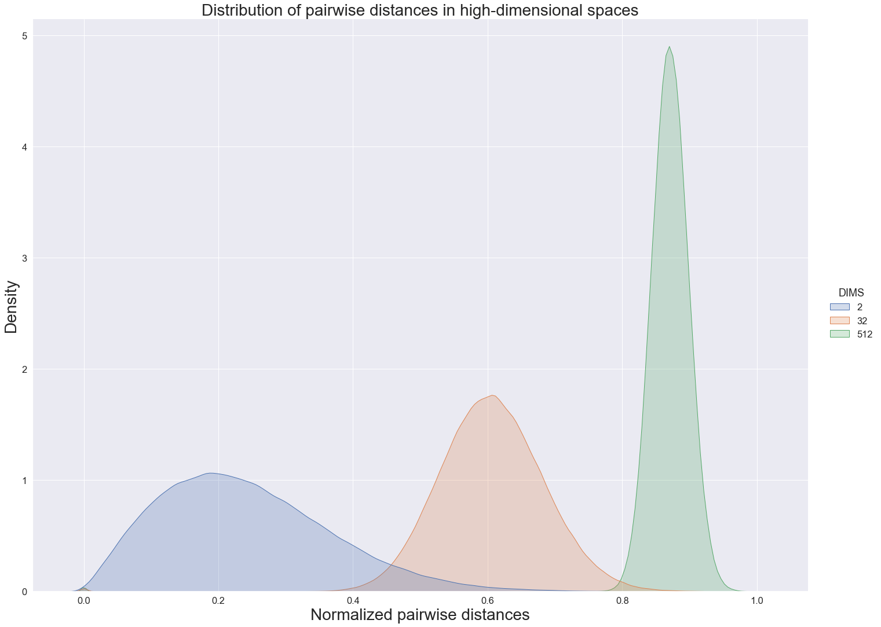
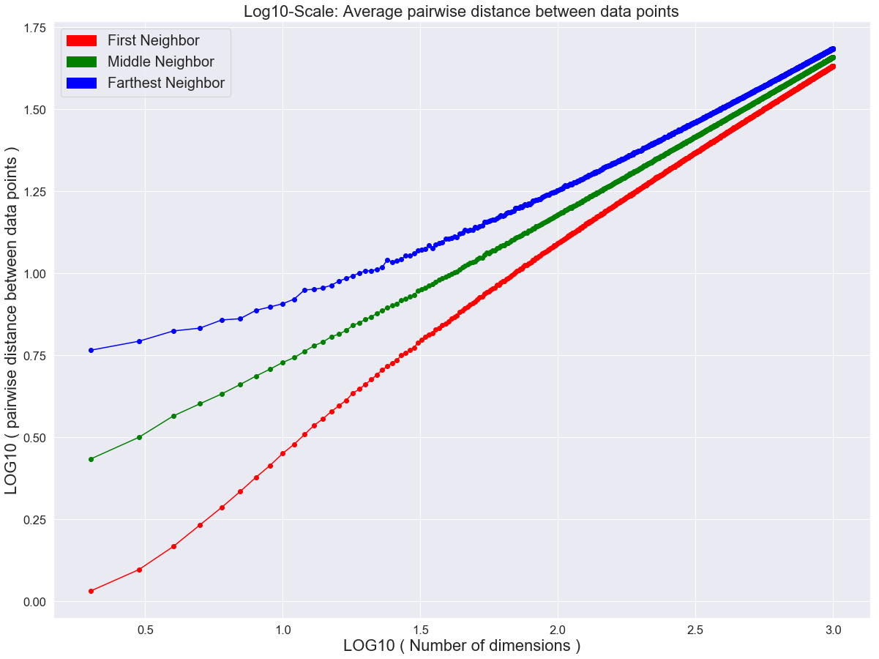
Distances in High Dimensions
Data points become far from each other
and equidistant in high dimensions
The differences between closest and farthest data point
neighbours disappears in high-dimensional spaces:
can’t run cluster analysis
In high-dimensional space we can not separate cases and controls any more

Slide 9
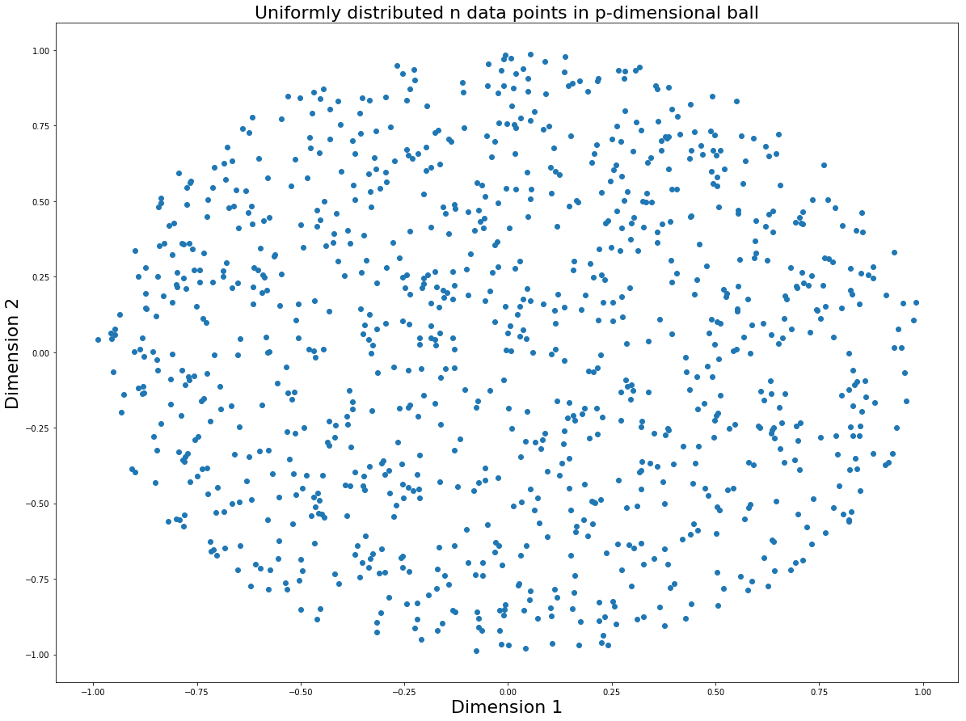
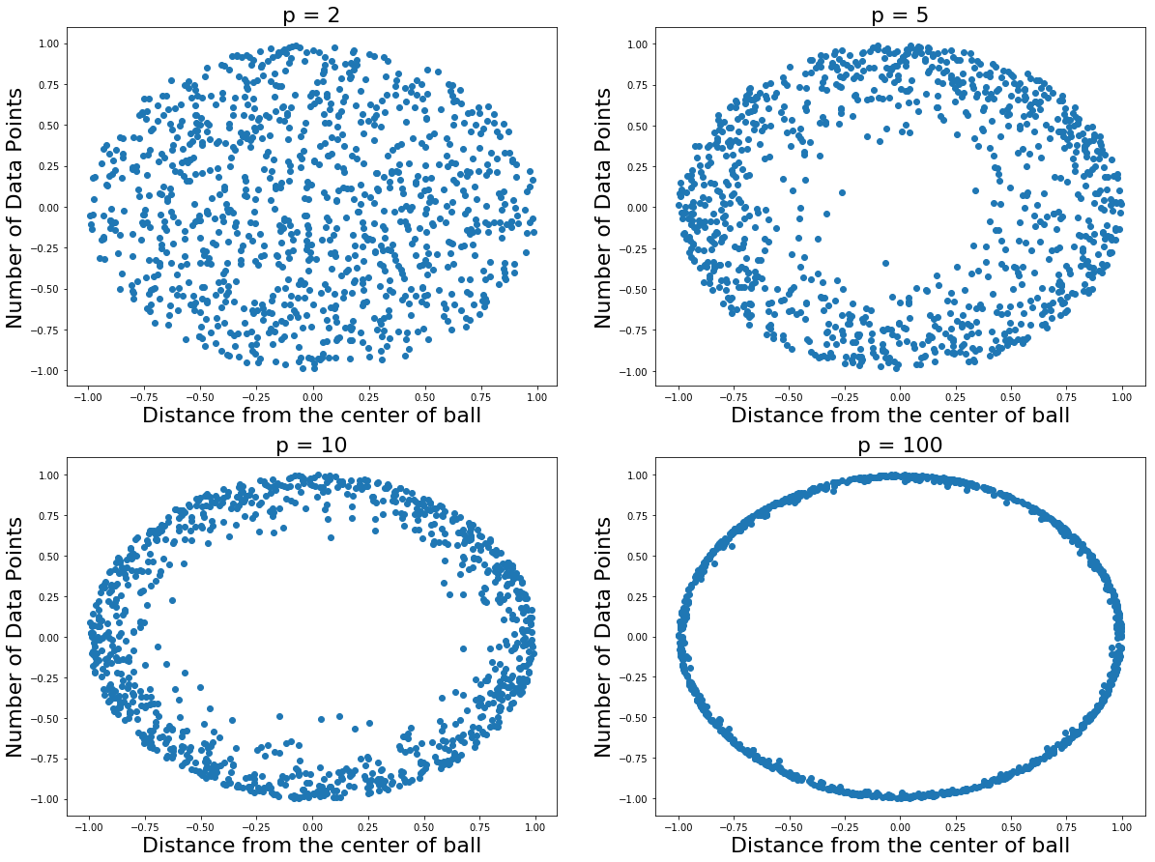

High-dimensional data make black holes
High-dimensional data can be viewed as
having a “hole in the middle”, hence the
concept of mean / centroid loses its validity,
hence we can’t use Gaussian distribution

Slide 10
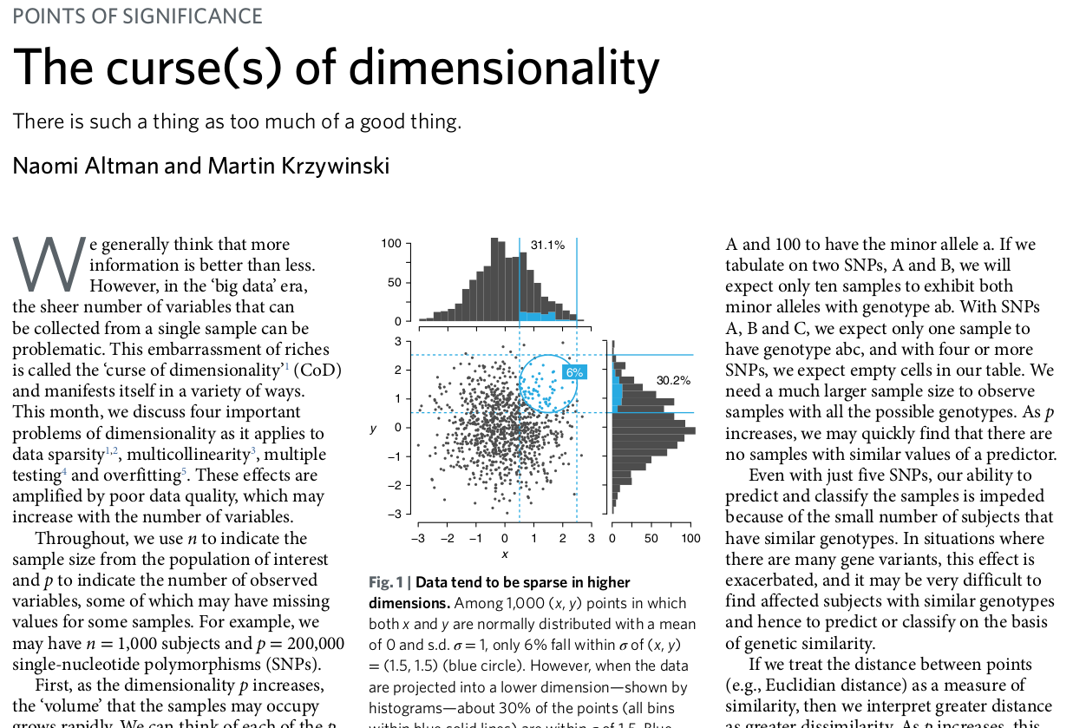
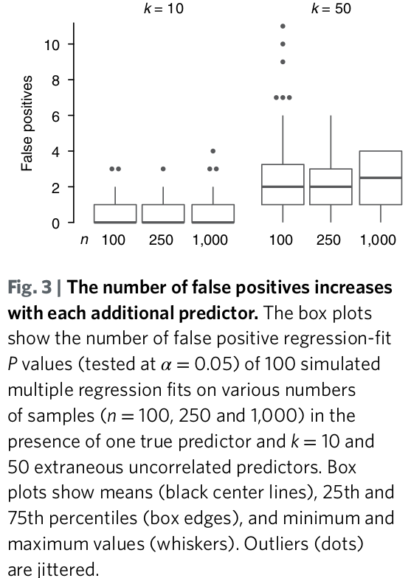
Literature on the Curse of Dimensionality
Altman N, Krzywinski M. The curse(s) of dimensionality. Nat Methods. 2018 Jun;15(6):399-400. doi: 10.1038/s41592-018-0019-x. PMID: 29855577.
Correcting for multiple testing does not solve
the problem of too many false-positive hits

Slide 11

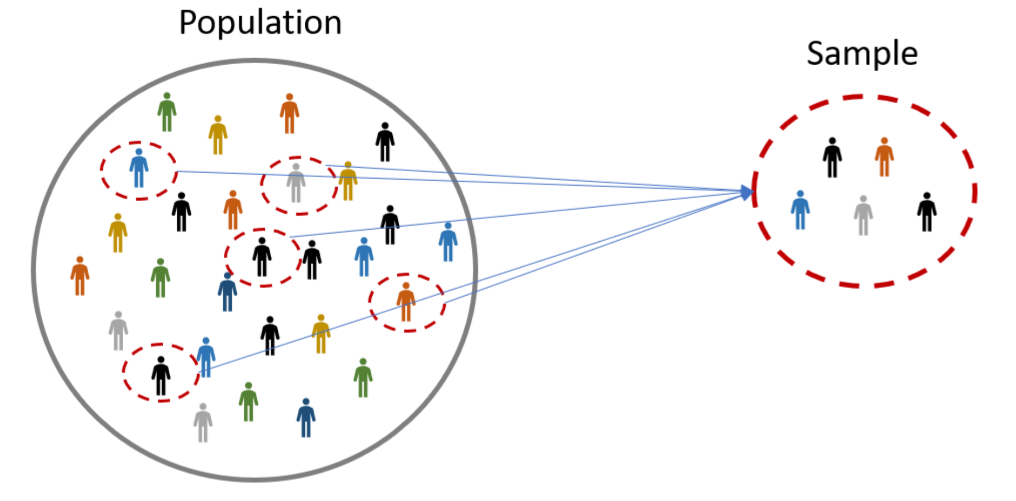

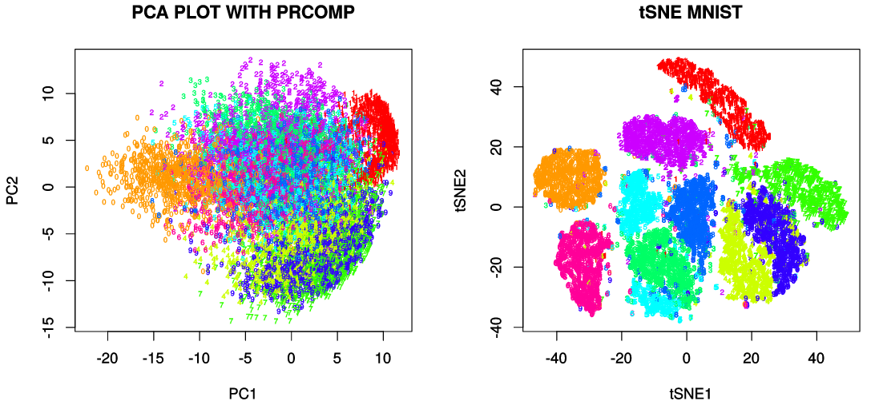
How to Combat the Curse of Dimensionality?
Increase sample size: epidemiological limit
Regularization
Dimension Reduction
Bayesian
statistics

Slide 12
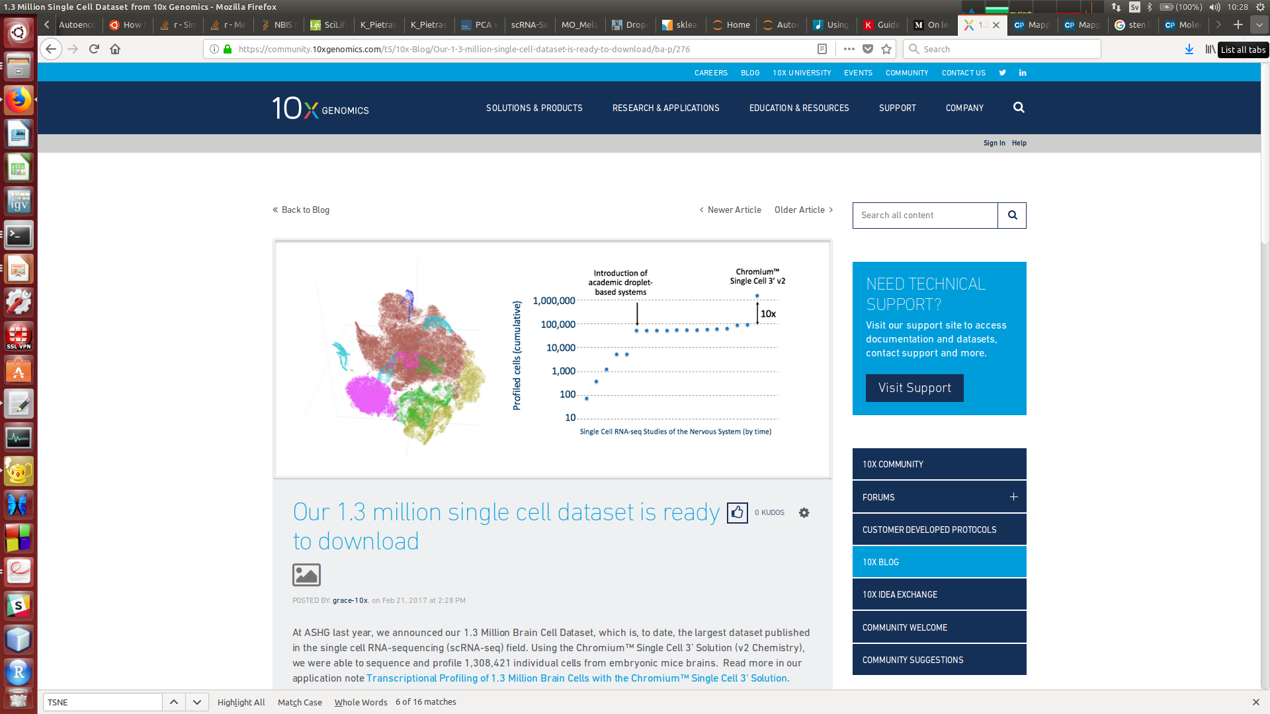
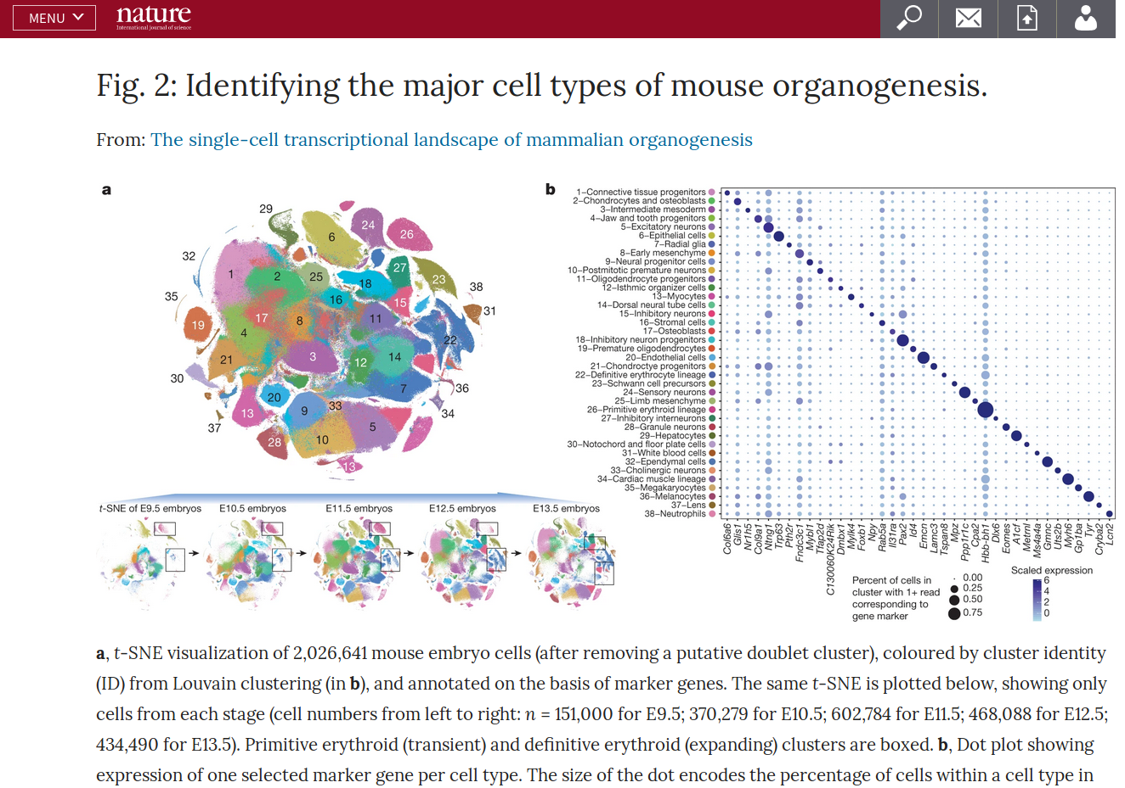
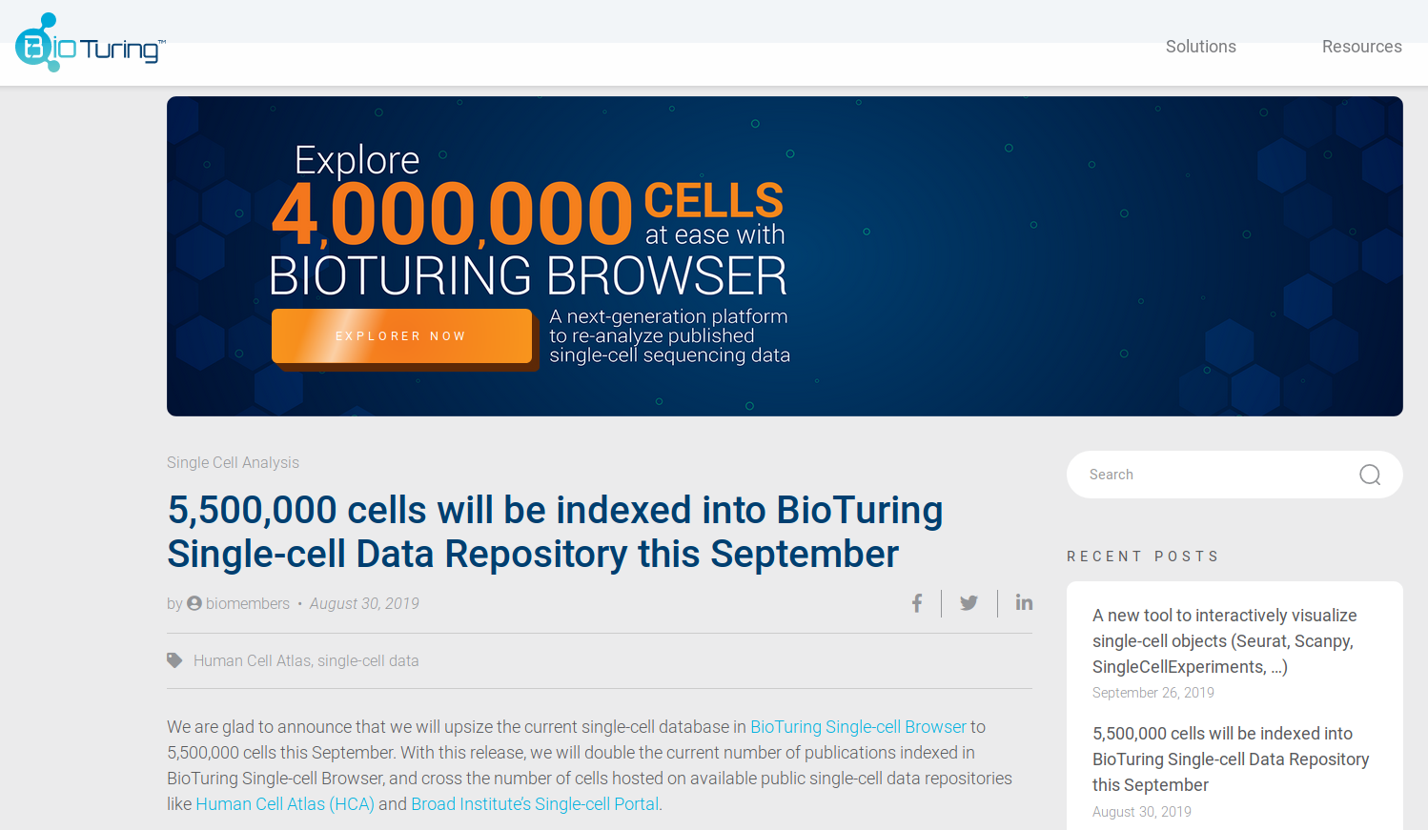
Big Data in Single Cell Genomics

Slide 13
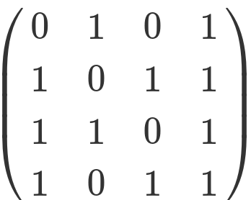
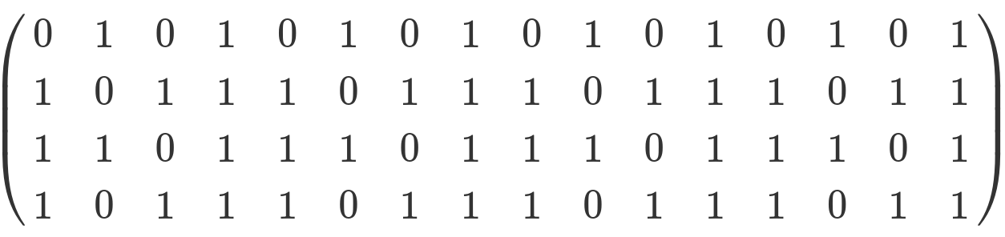
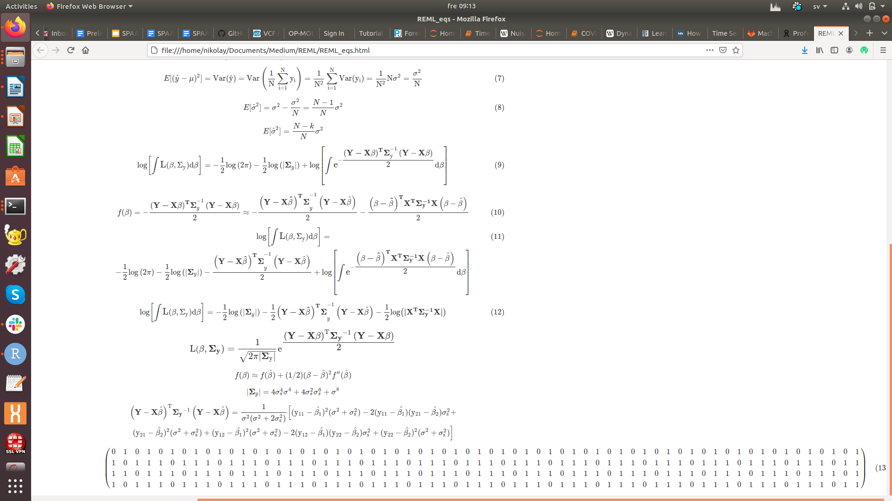
Typical Dimensions of Omics Data
Metabolomics
N ≈ P
Proteomics
N ≈ P
Metagenomics
N ≈ P
manageable
P
Transcriptomics
N << P
(Single cell: N <= P)
N
challenging
P
Genomics
N <<<< P
N
P
N
Methylomics
N <<<< P

Slide 14
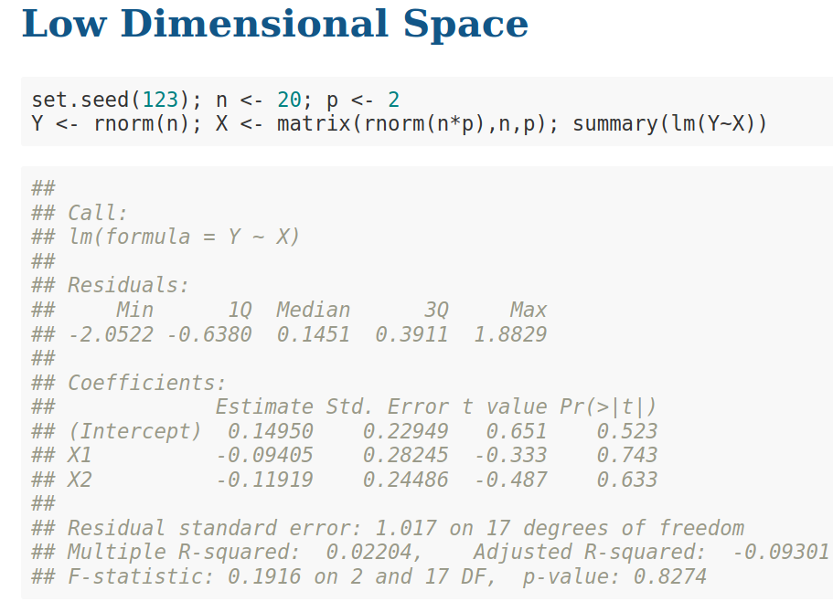

Slide 15
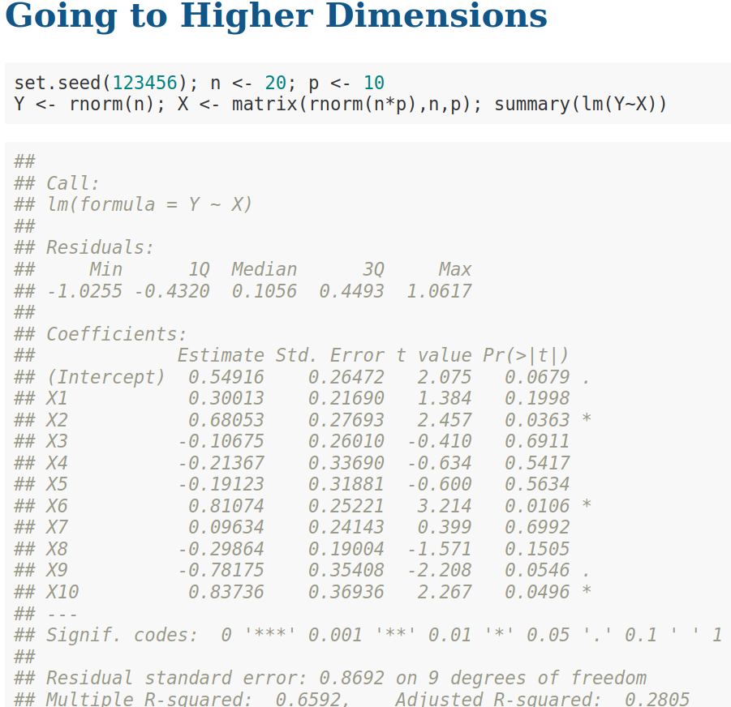

Slide 16
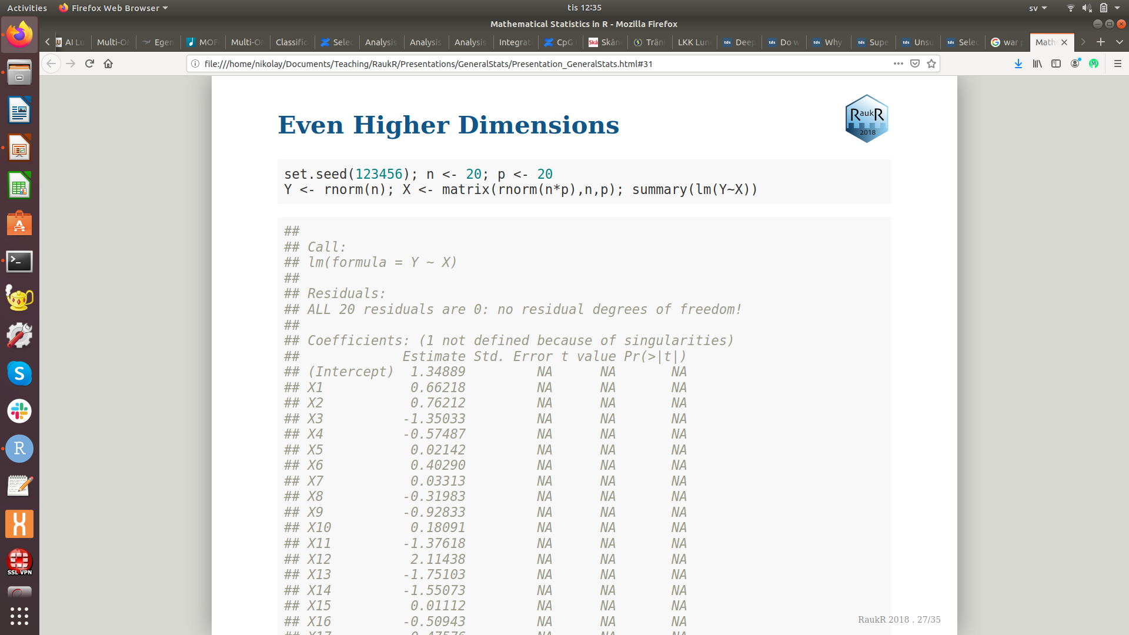

Slide 17
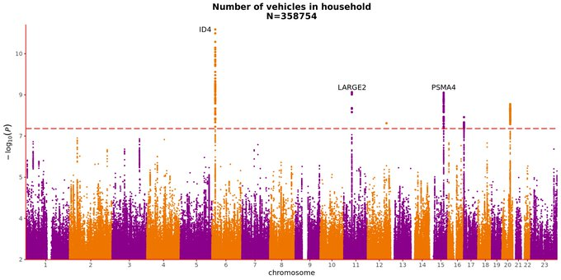
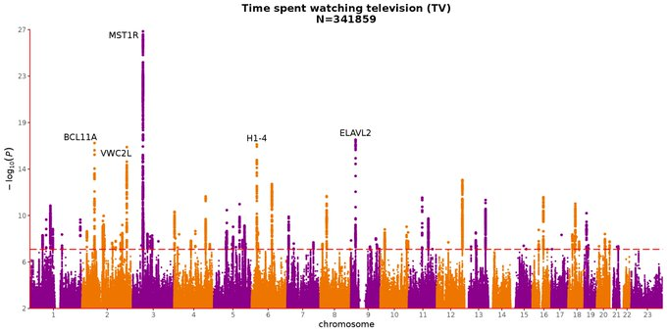
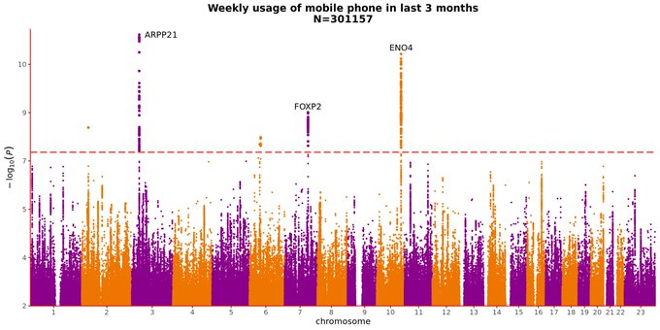
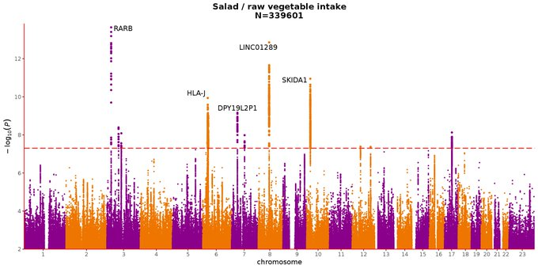
False-positive hits in GWAS

Slide 18
How The Curse of Dimensionality
Affects Genomics Research

Slide 19
Sparsity of Genomics Data
SNP A
SNP B
SNP C
Genome
n = 100
C / T
MAF = 10%
A / G
MAF = 10%
C / A
MAF = 10%
10 T - carriers
10 G - carriers
10 A - carriers
1 T- and G - carriers
0 T - and G - and A - carriers

Slide 20
Sparsity of Genomics Data
N = 100
SNP A (C / T, MAF = 10%) and SNP B (A / G, MAF = 10%)
Phen ~ SNP A + SNP B
CC
CT / TT
- minor T – allele carrier
1D SNP A:
CC
CT / TT
AA
- carrier of both minor T - and G - alleles
2D SNP A
+
SNP B:
- carrier of either minor T - or G - alleles
AG / GG

Slide 21
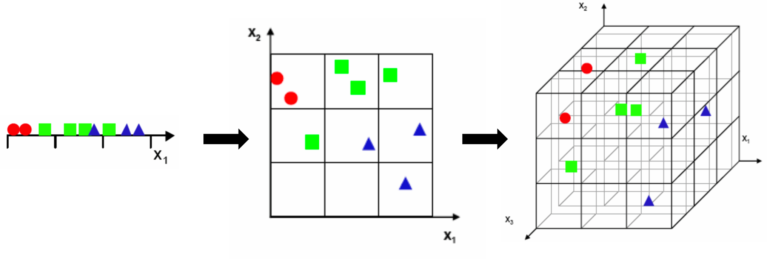
Data Sparsity in High Dimensions
Volume of high-dimensional data grows exponentially with the number of dimensions
A lot of free space appears, very difficult to sample (have observations for the whole range of values on each dimension / axis) that large space

Slide 22



Do We Have Big Data in Biomedicine?
Mark McCarthy:
Now we have found over 400 genetic signals influencing type 2 diabetes,
what on earth are we going to do with them?

Slide 23
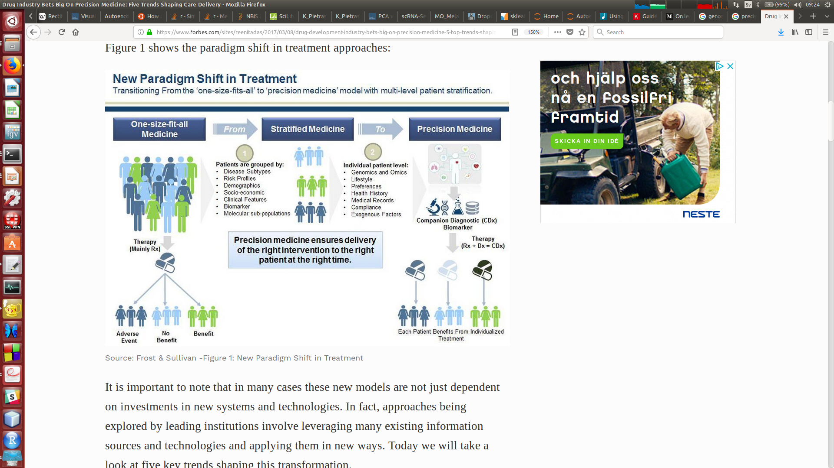

Precision Medicine:
Why isn't it in the Clinics?
Typical debate at Precision Medicine conferences:
1) Leaders: “We sequence a lot, it is important”
2) Clinicians: “This does not help us in the Clinics”

Slide 24
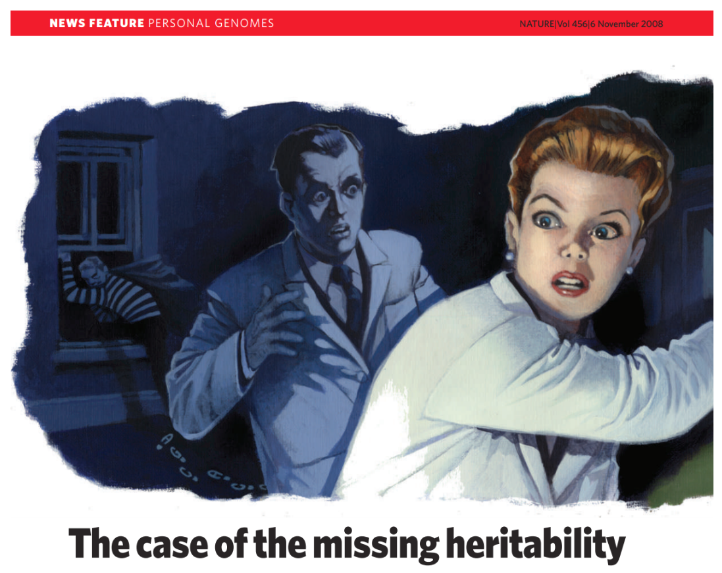
The Missing Heritability Problem
GRS = beta1 * SNP1 + beta2 * SNP2 + …
training
Phenotype ~ GRS => Adjusted R^2
validation

Slide 25
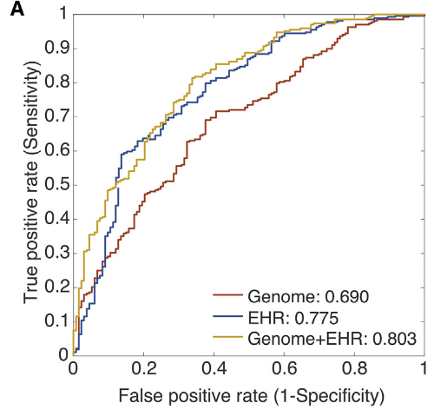
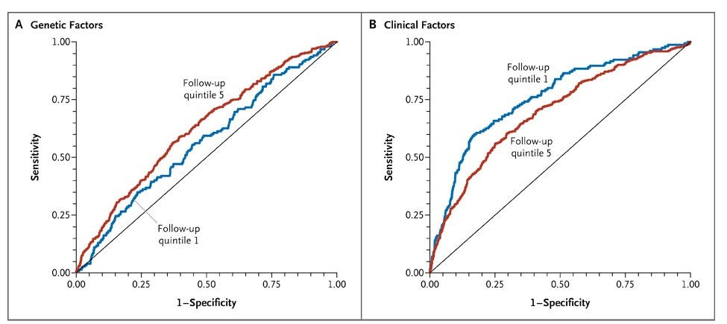
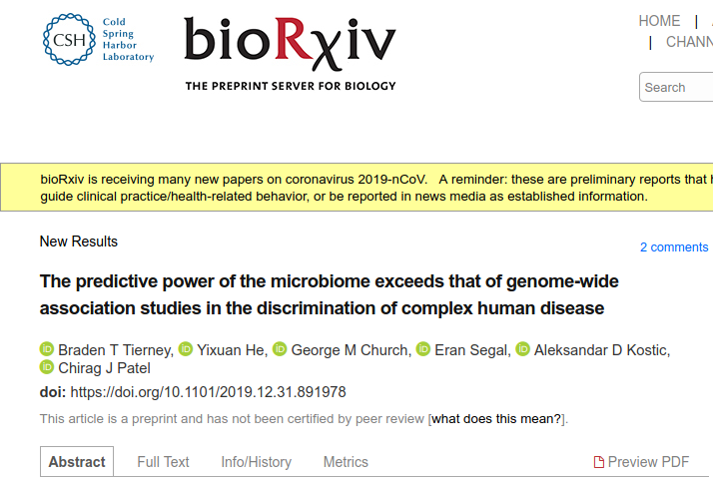
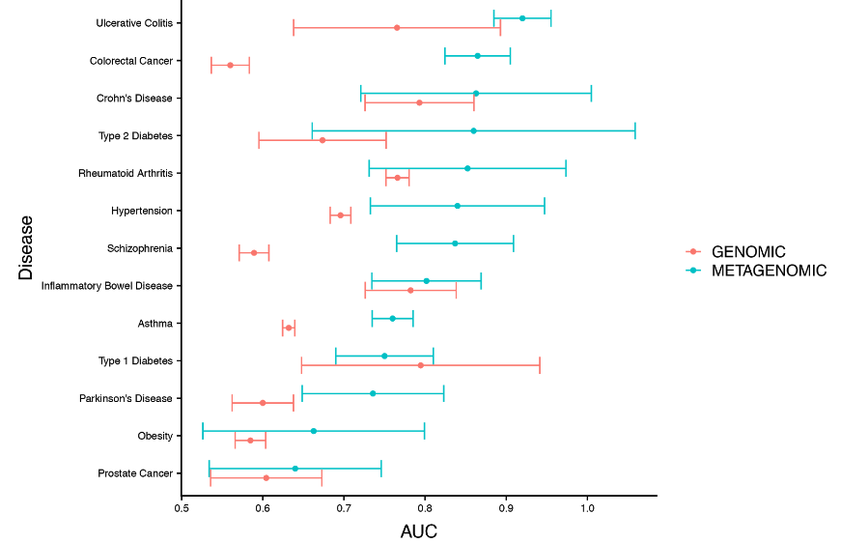
Precision Medicine: Poor Genomics Prediction
Li et al., 2018, Cell 174, 1361-1372
Decoding the Genomics of Abdominal Aortic Aneurism
Lyssenko et al., 2008, New England Journal of Medicine 359, 2220-2232
Clinical Risk Factors, DNA Variants and Development of Type 2 Diabetes

Slide 26

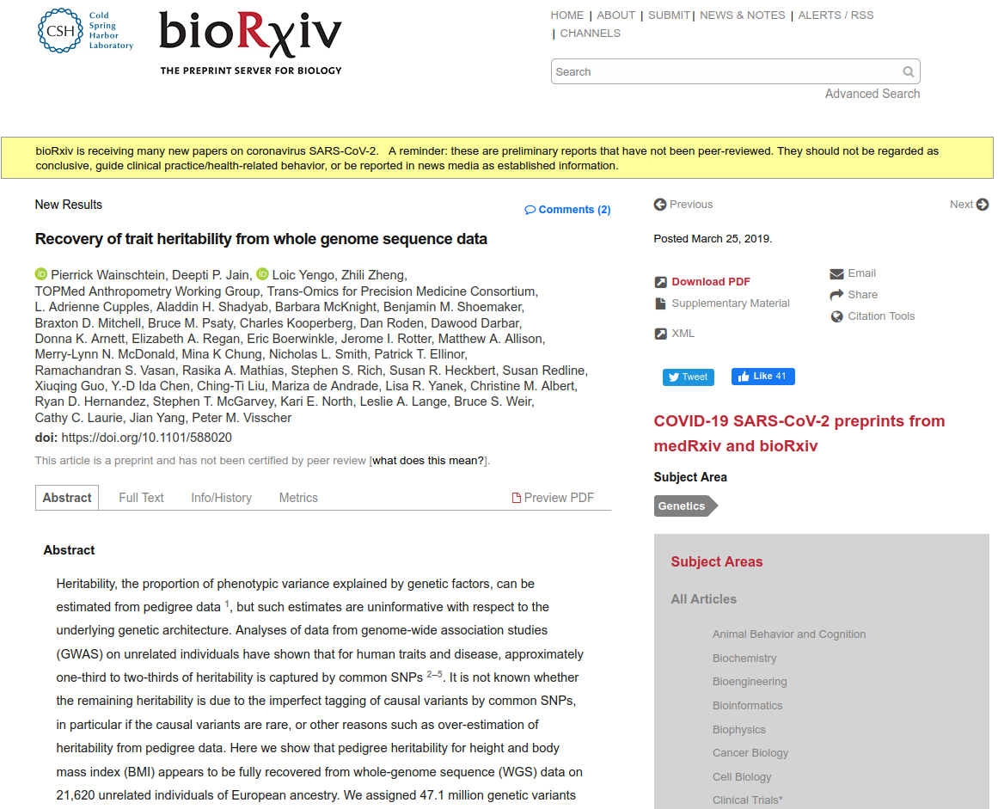
Human Height Missing Heritability Case Solved

Slide 27
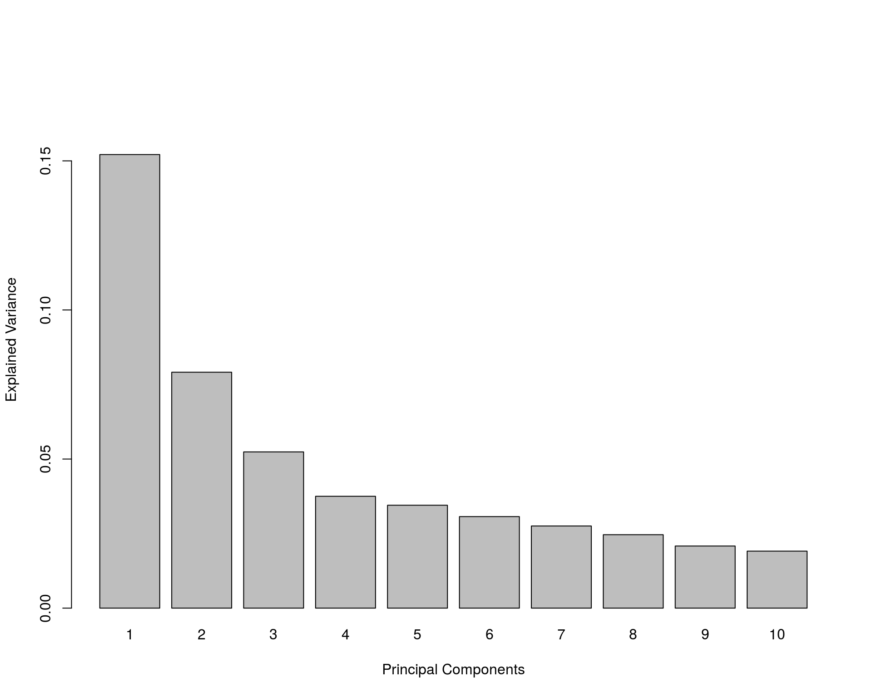
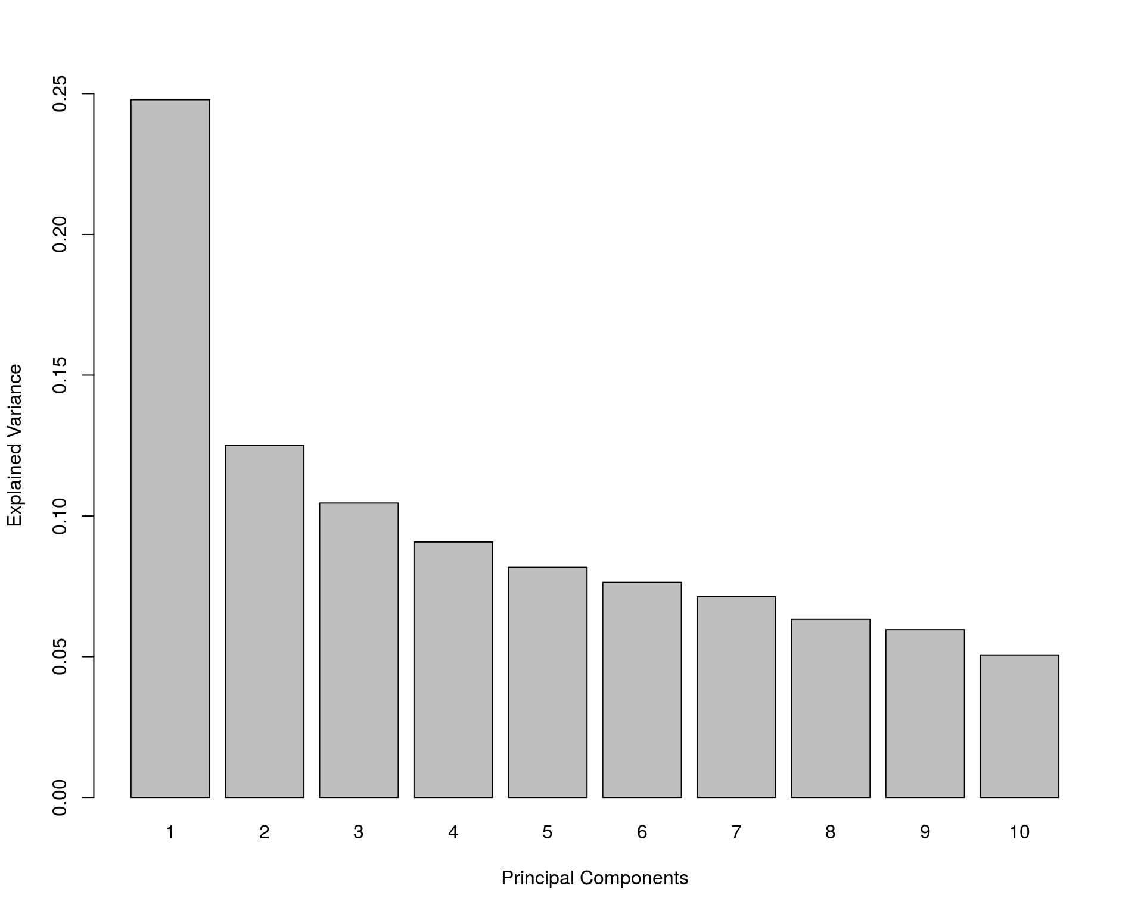
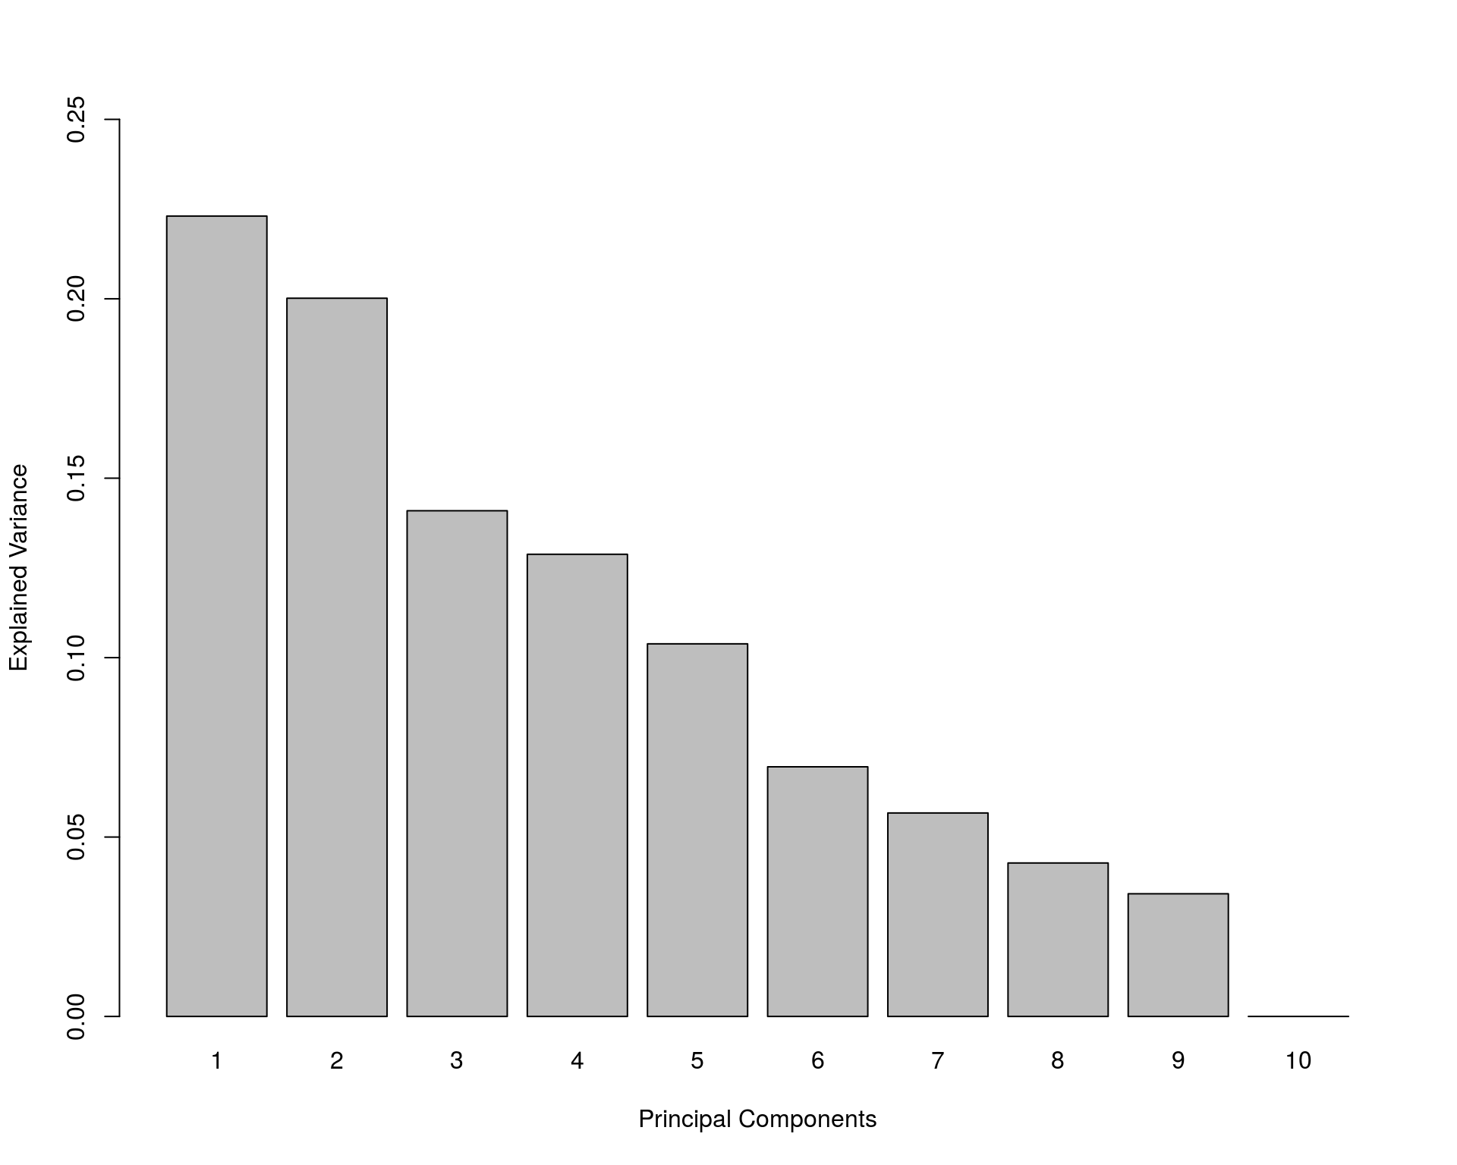
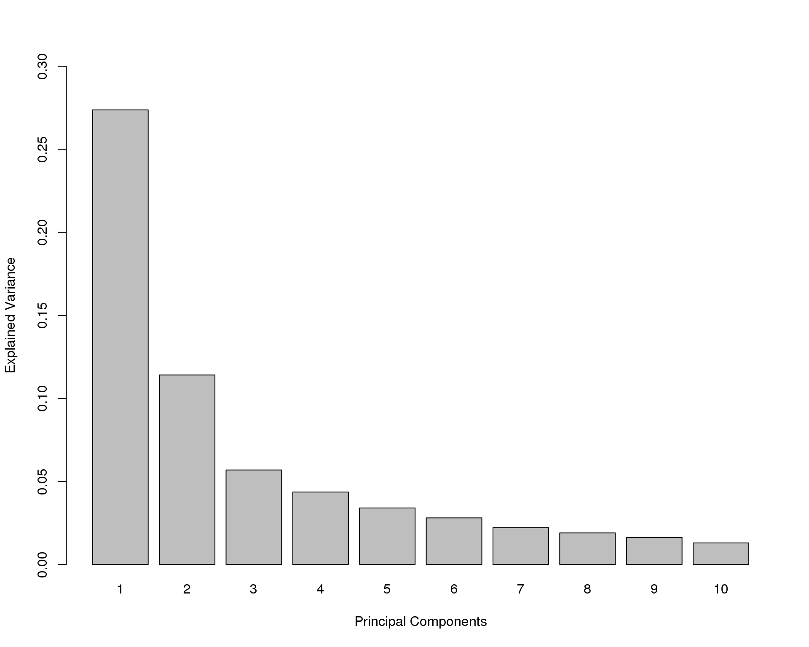
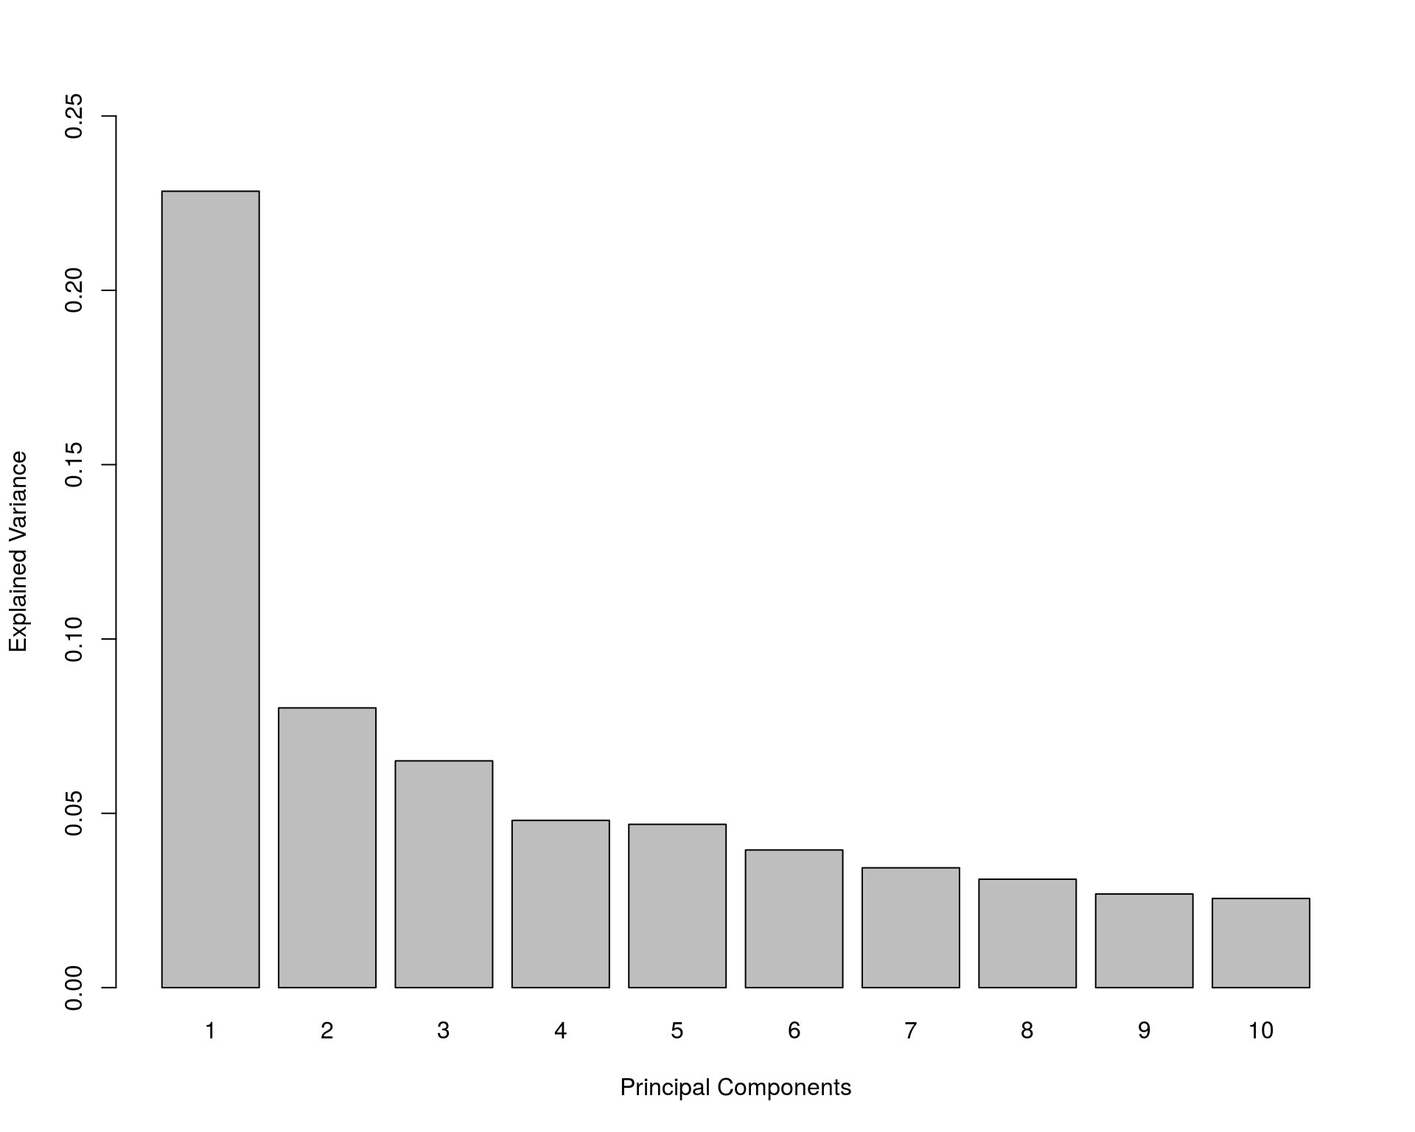

Variance Explained by PCs Across OMICs
Methylomics
Transcriptomics
Metagenomics
Proteomics
Metabolomics
Genomics

Slide 28




Symmetry of scRNAseq vs Genetic Variation
scRNAseq
Genetic
Variation

Slide 29




National Bioinformatics
Infrastricture Sweden (NBIS)

