Slide 1


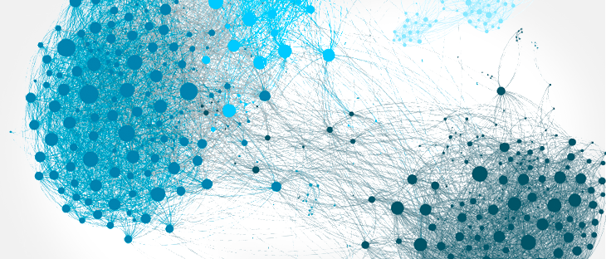



Introduction to Clustering Complex Data
Nikolay Oskolkov, Group Leader (PI) at NIRI, Riga, Latvia
@NikolayOskolkov
@oskolkov.bsky.social
Personal homepage:
https://nikolay-oskolkov.com
Image adapted from www.stratio.com

Slide 2
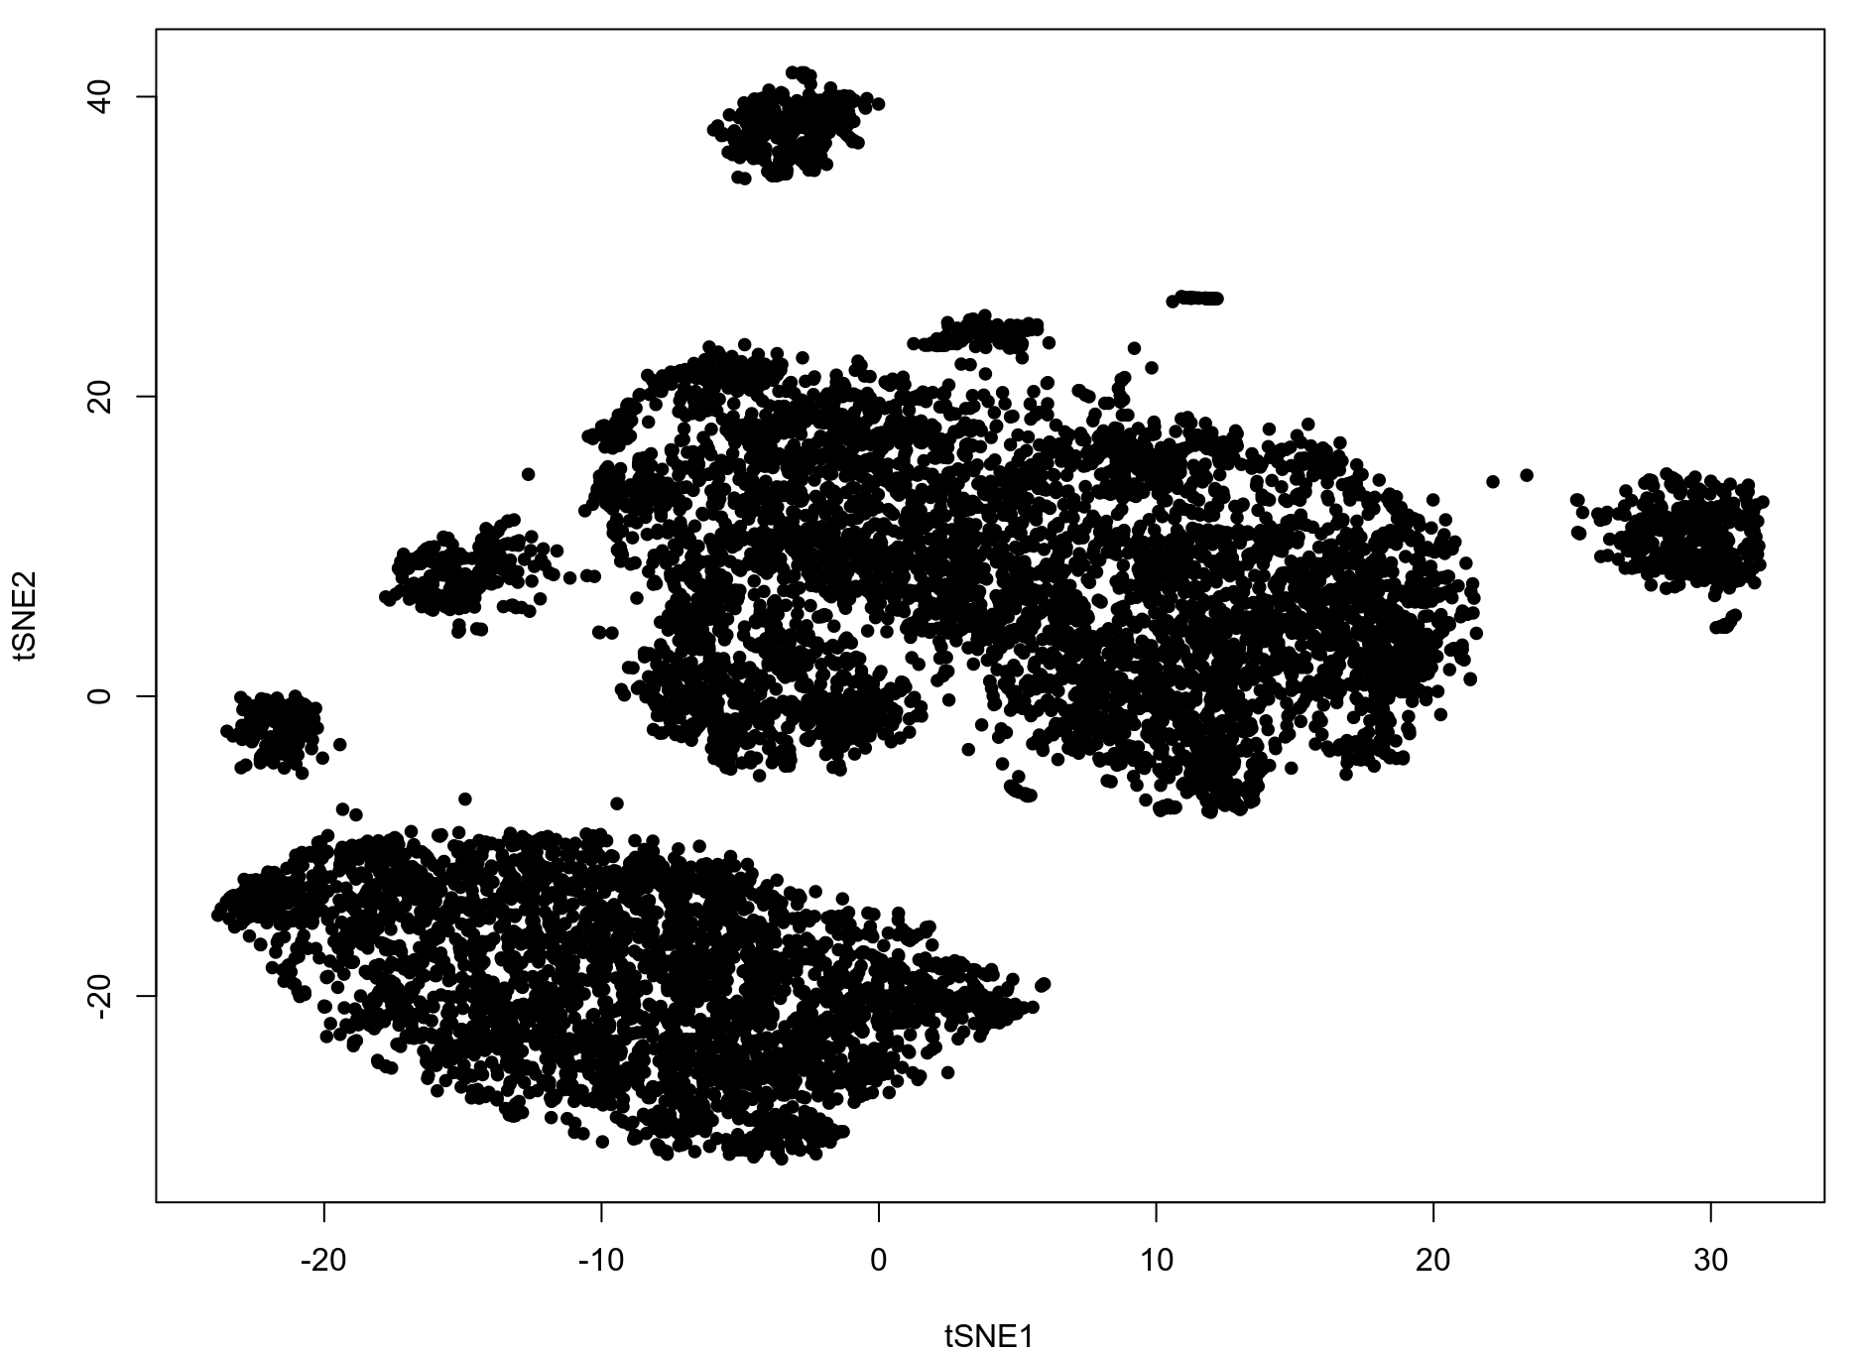
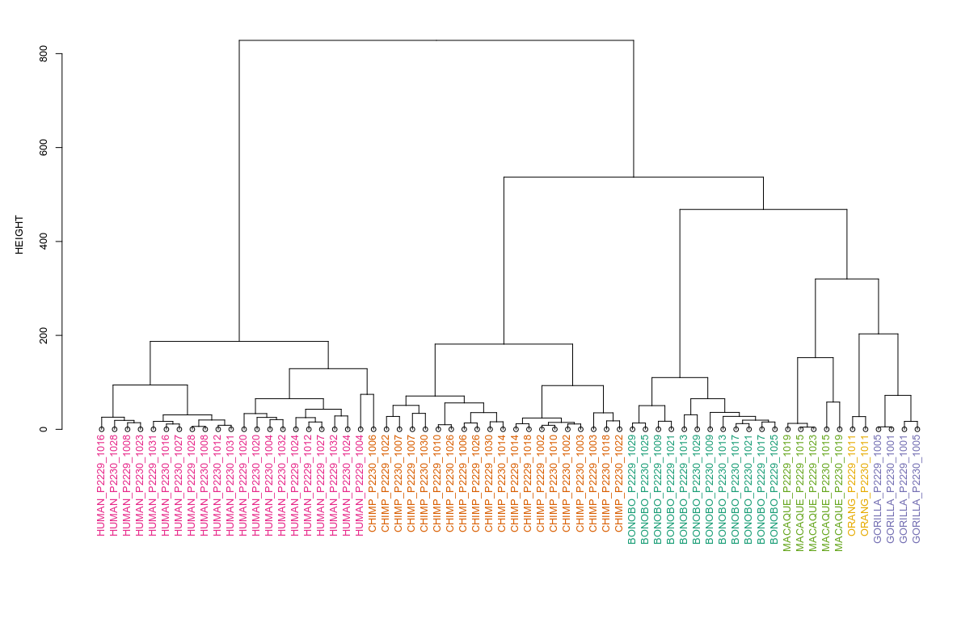

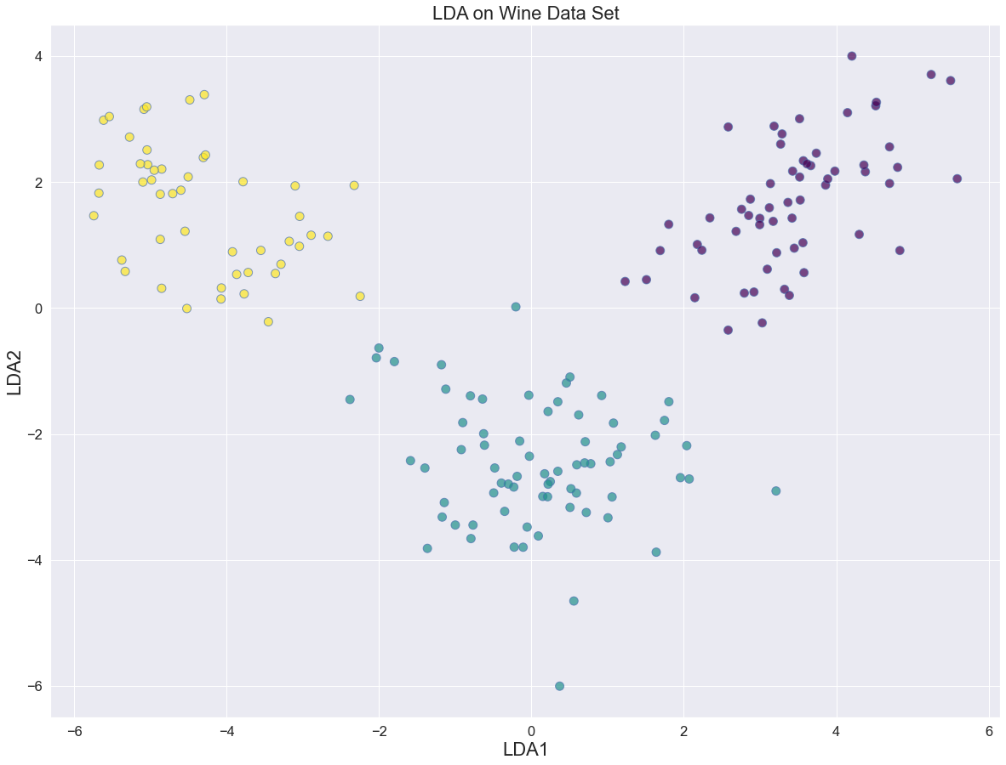
Exploratory data analysis (EDA):
dimensionality reduction and clustering
Working
hand in hand
Dimension reduction:
data pre-processing + visualization
Cluster analysis:
formal grouping of data points
based on their similarity or difference

Slide 3
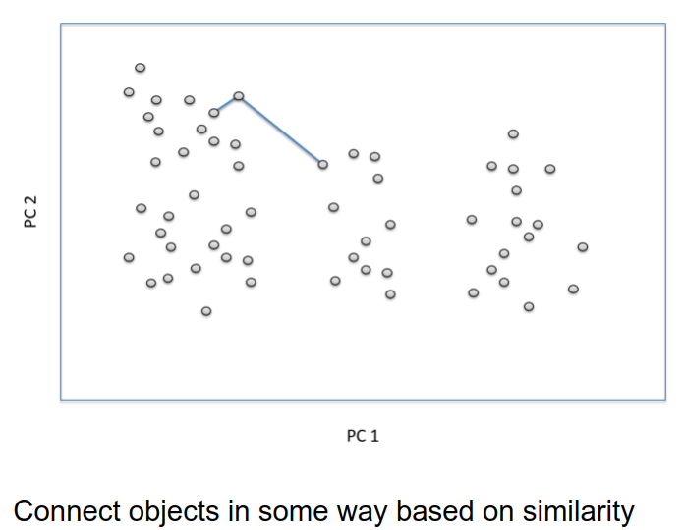
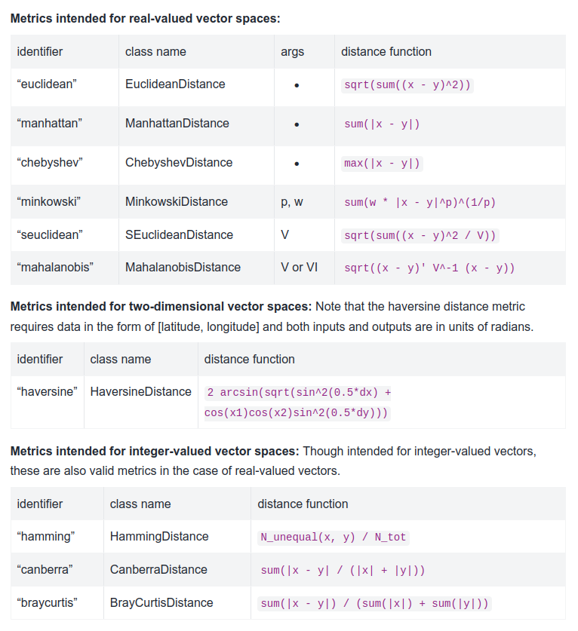
Cluster analysis logic and distance metric

Slide 4
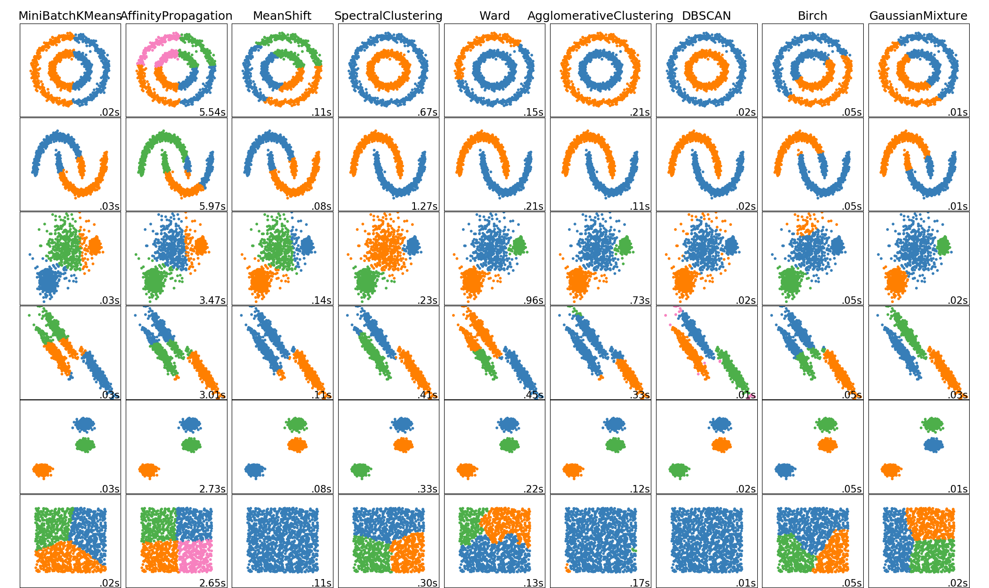
Huge variety of clustering methods available
1) Hierarchical Clustering, 2) Partitioning Clustering, 3) Density-Based Clustering, 4) Graph-Based Clustering

Slide 5
Hierarchical clustering

Slide 6
What is hierarchical clustering?
Clusters are nested (higher-ranked clusters contain lower-ranked clusters),
in other words tree-like structure (dendrogram)
There are agglomerative (bottom-up approach) and divisive (top-down approach)
types of hierarchical clustering

Slide 7
Agglomerative hierarchical clustering
S6
S7
S5
S3
S4
S2
S1
S1
S2
S3
S4
S5
S6
S7

Slide 8
Agglomerative hierarchical clustering
S6
S7
S5
S3
S4
S2
S1
S1
S2
S3
S4
S5
S6
S7

Slide 9
Agglomerative hierarchical clustering
S6
S7
S5
S3
S4
S2
S1
S1
S2
S3
S4
S5
S6
S7

Slide 10
Agglomerative hierarchical clustering
S6
S7
S5
S3
S4
S2
S1
S1
S2
S3
S4
S5
S6
S7

Slide 11
Agglomerative hierarchical clustering
S6
S7
S5
S3
S4
S2
S1
S1
S2
S3
S4
S5
S6
S7

Slide 12
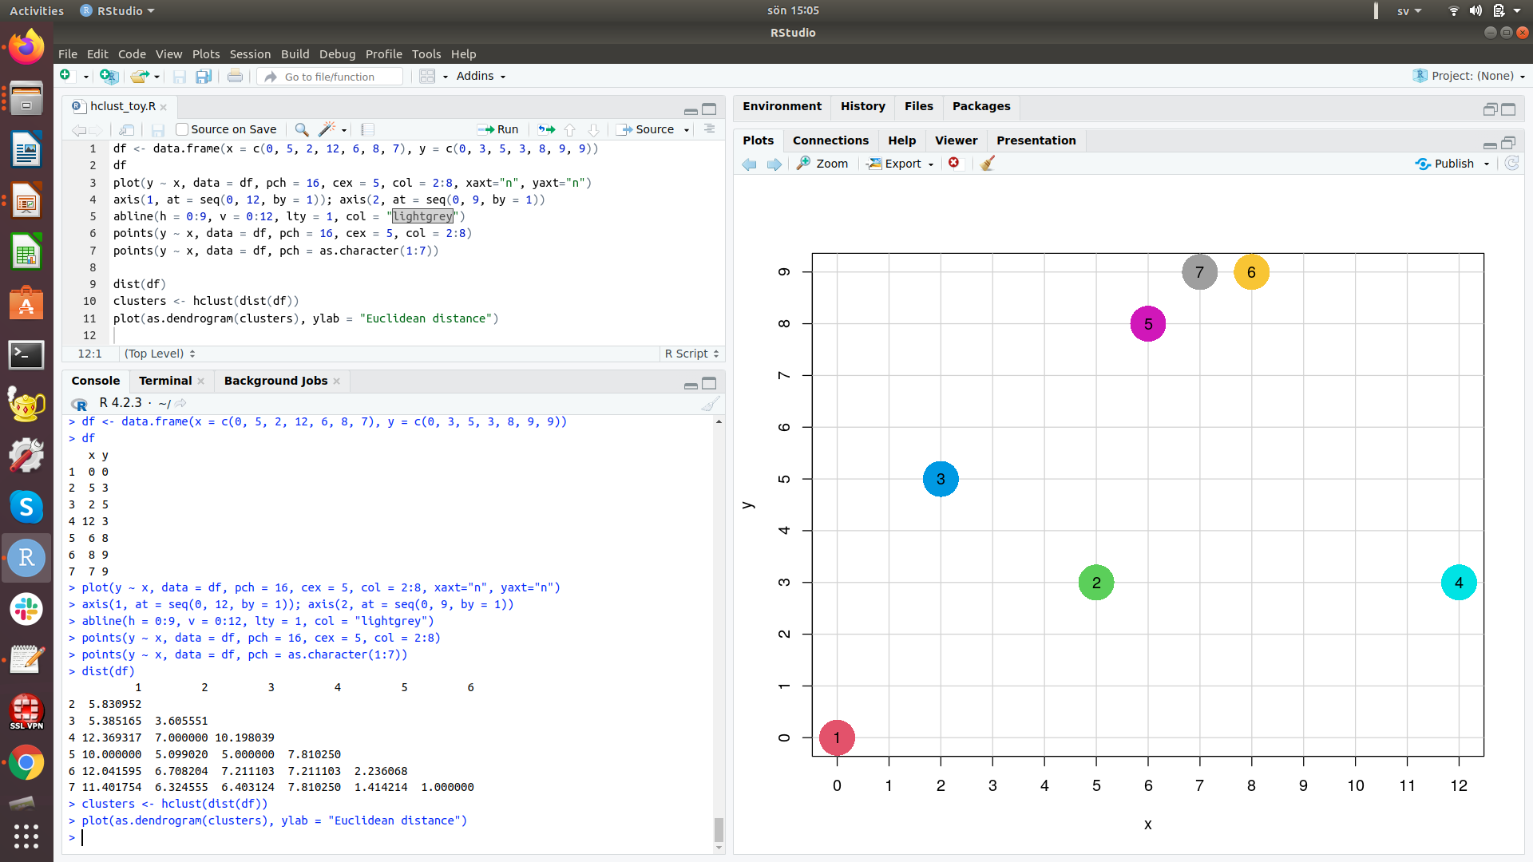
euc_dist_23 = sqrt ((2-5)^2 + (5-3)^2) = 3.605551

Slide 13
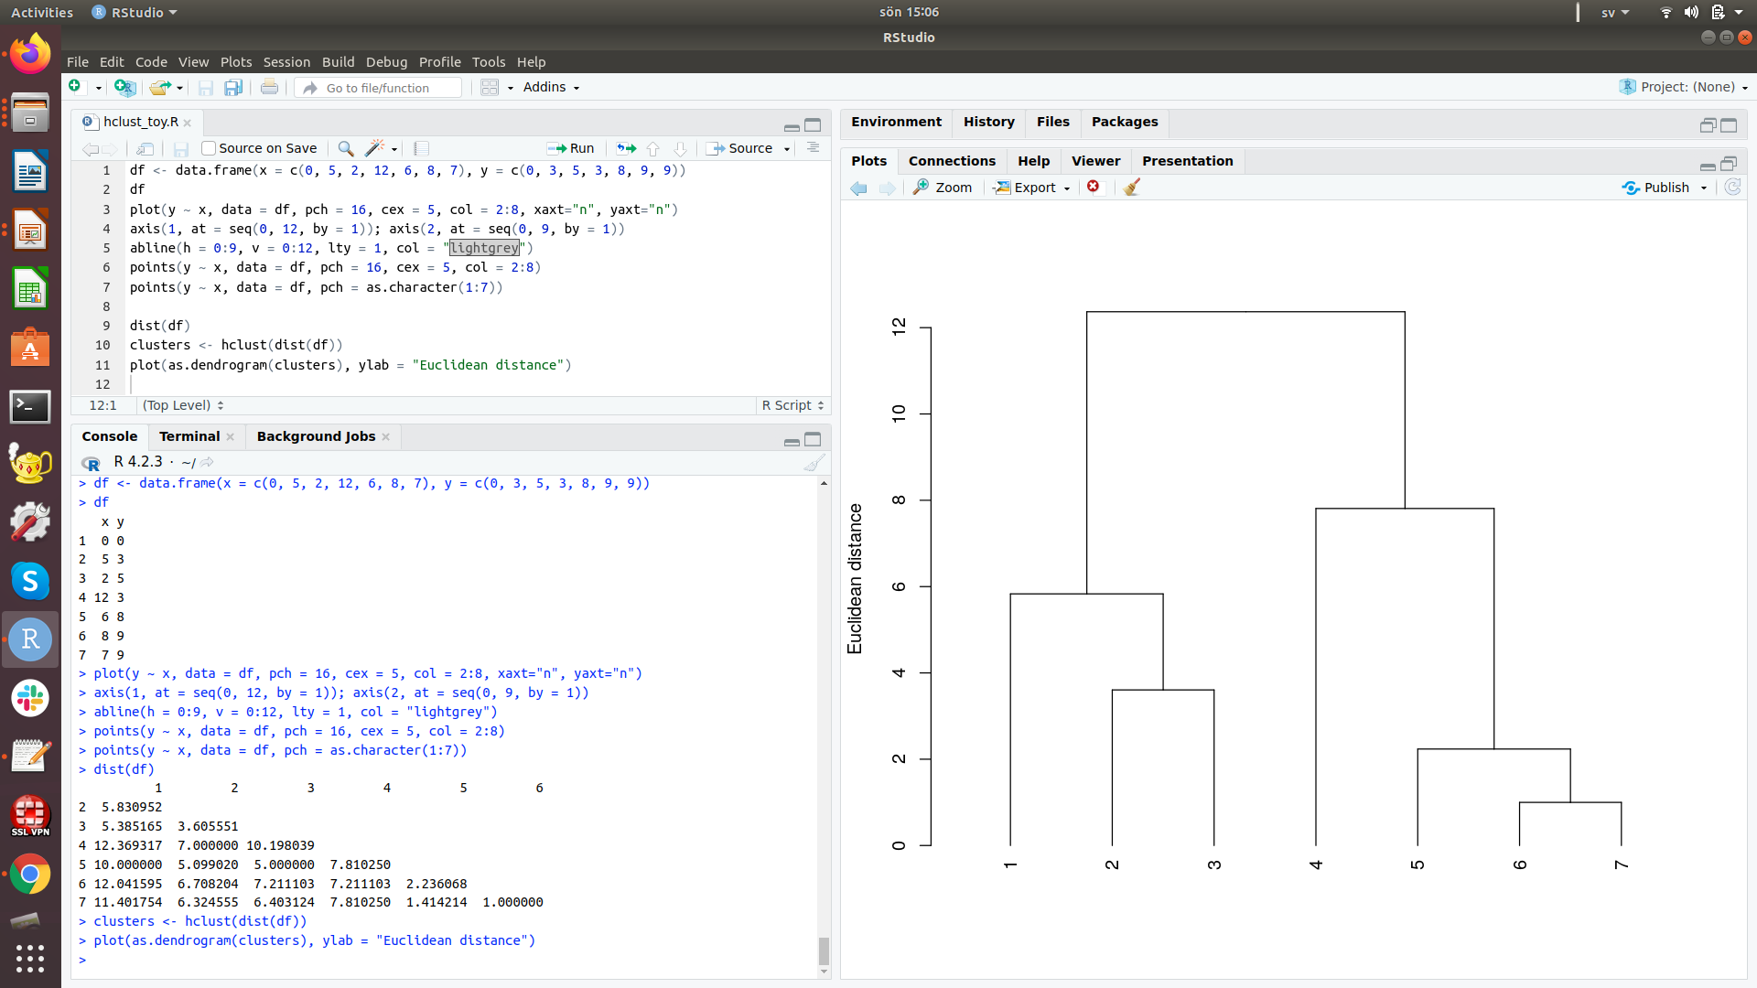
euc_dist_23 = sqrt ((2-5)^2 + (5-3)^2) = 3.605551

Slide 14
Types of hierarchical clustering
Add sample to cluster by:
1) Closest neighbor in cluster (single linkage)
2) Farthest neighbor in cluster (complete linkage)
3) Median / mean of cluster (UPGMA / UPGMC)
4) Least change in variation (Ward)
Disadvantages of hierachical clustering (no matter type):
Very sensitive to noise in data

Slide 15
Partitioning clustering

Slide 16
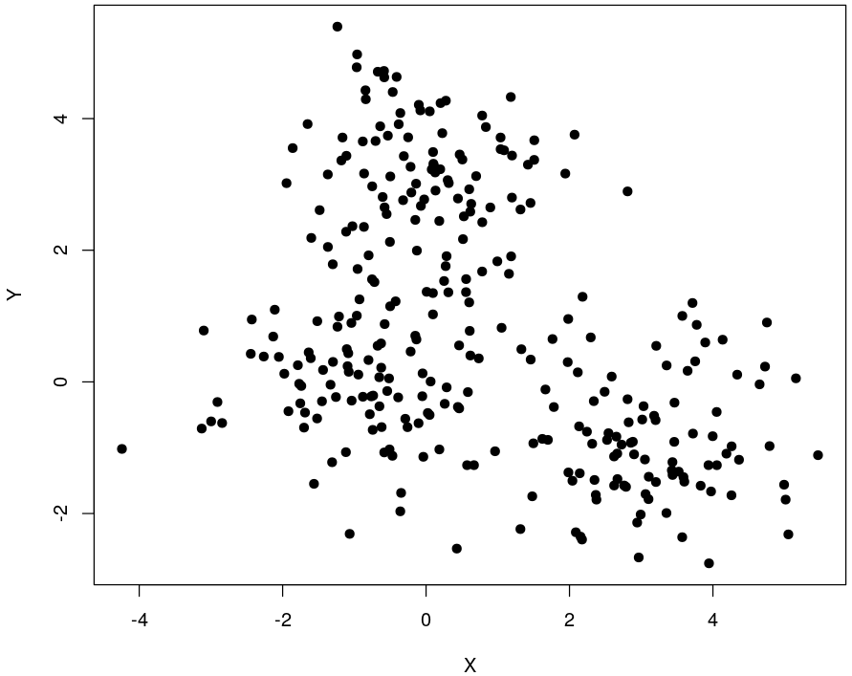
Partitioning principle
Assign points to
K = 2, 3, 4, 5, …
groups (clusters)
No dendrogram!
K-means, C-means, PAM, GMM, ...

Slide 17
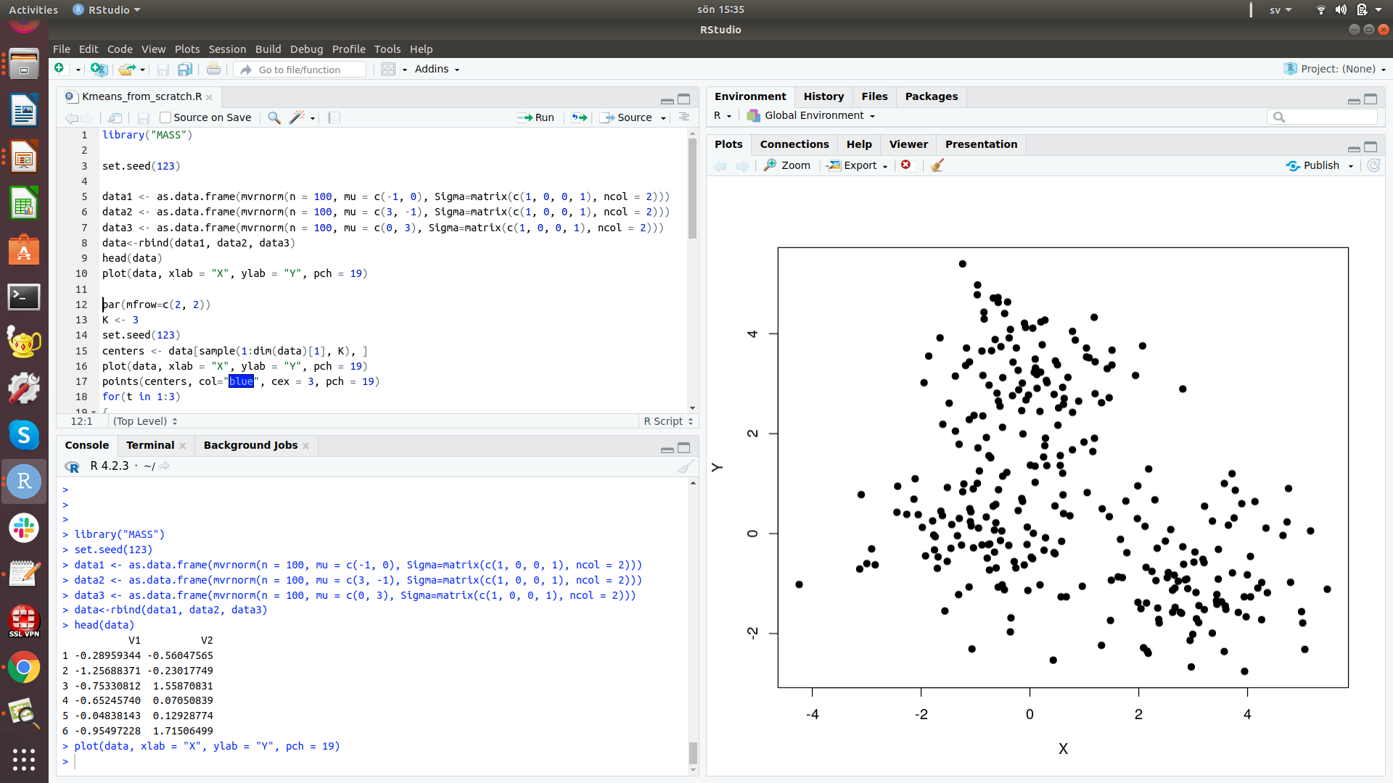

Slide 18
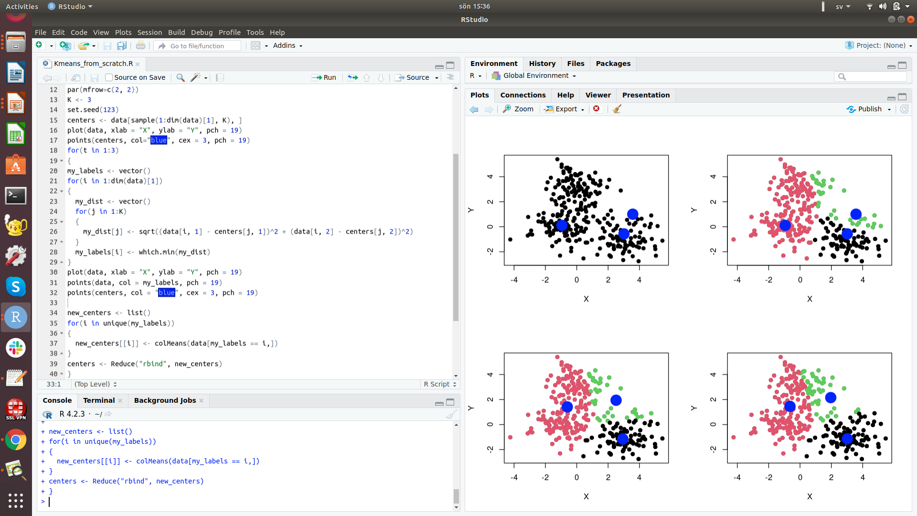

Slide 19
Clustering time series data:
examples from epidemiology
and marine ecology

Slide 20
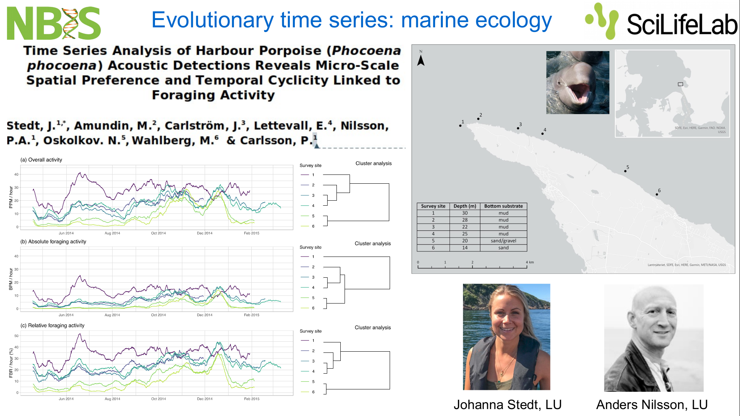
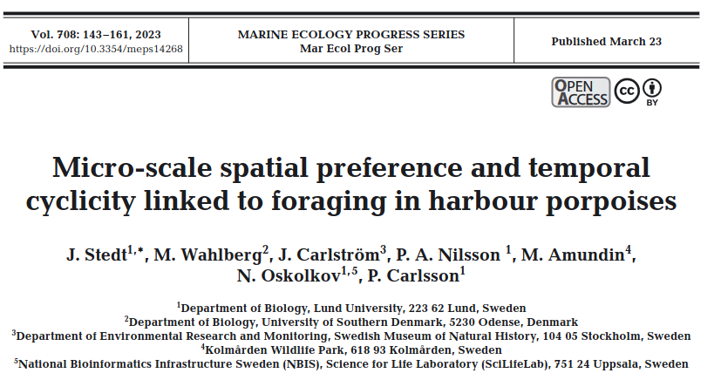
Foraging activity of harbour porpoises
Foraging activity of harbour porpoises is time series data

Slide 21
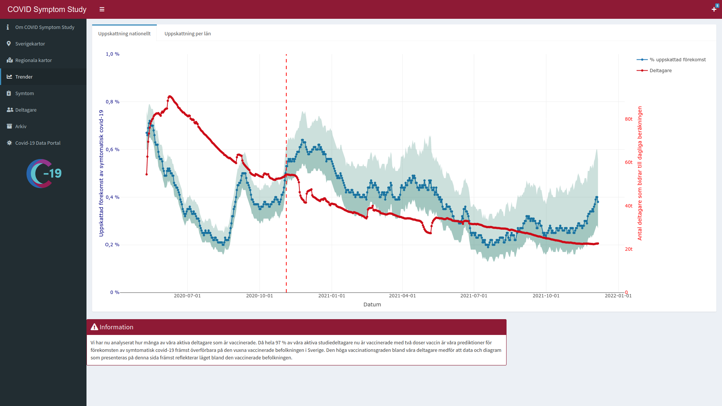
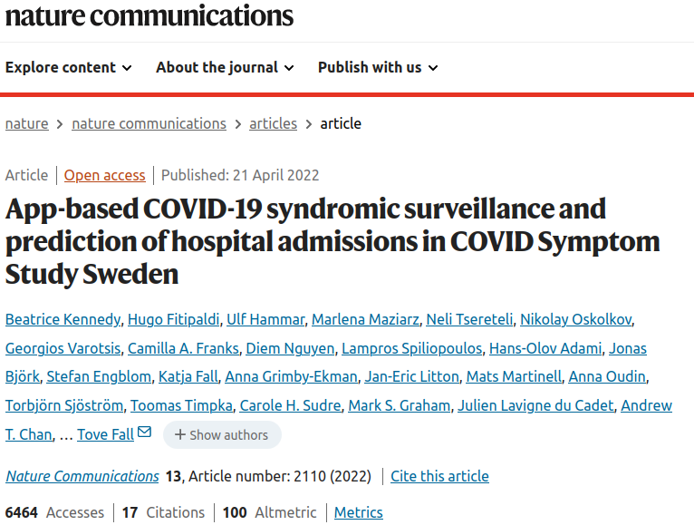
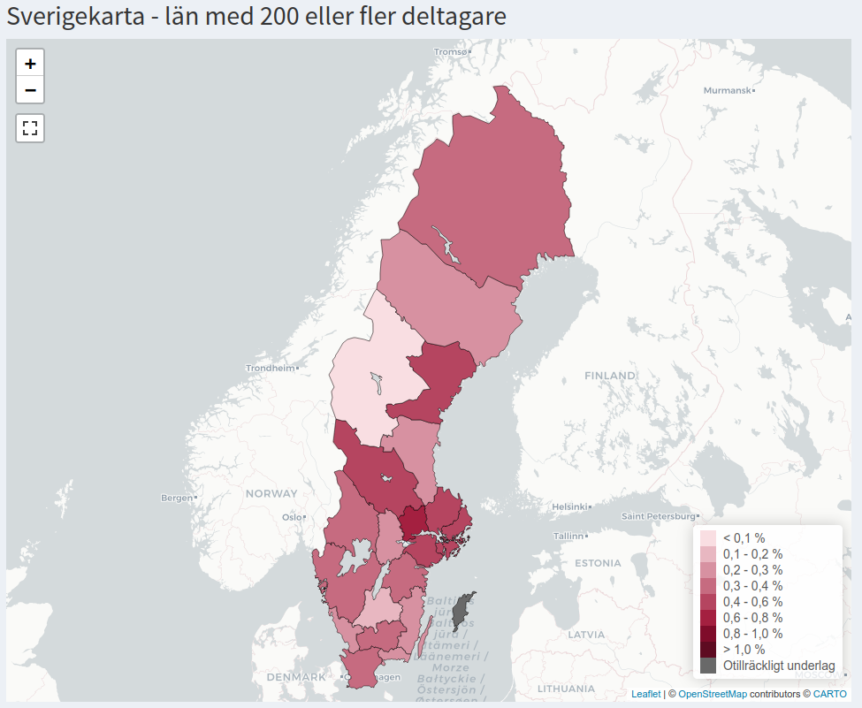
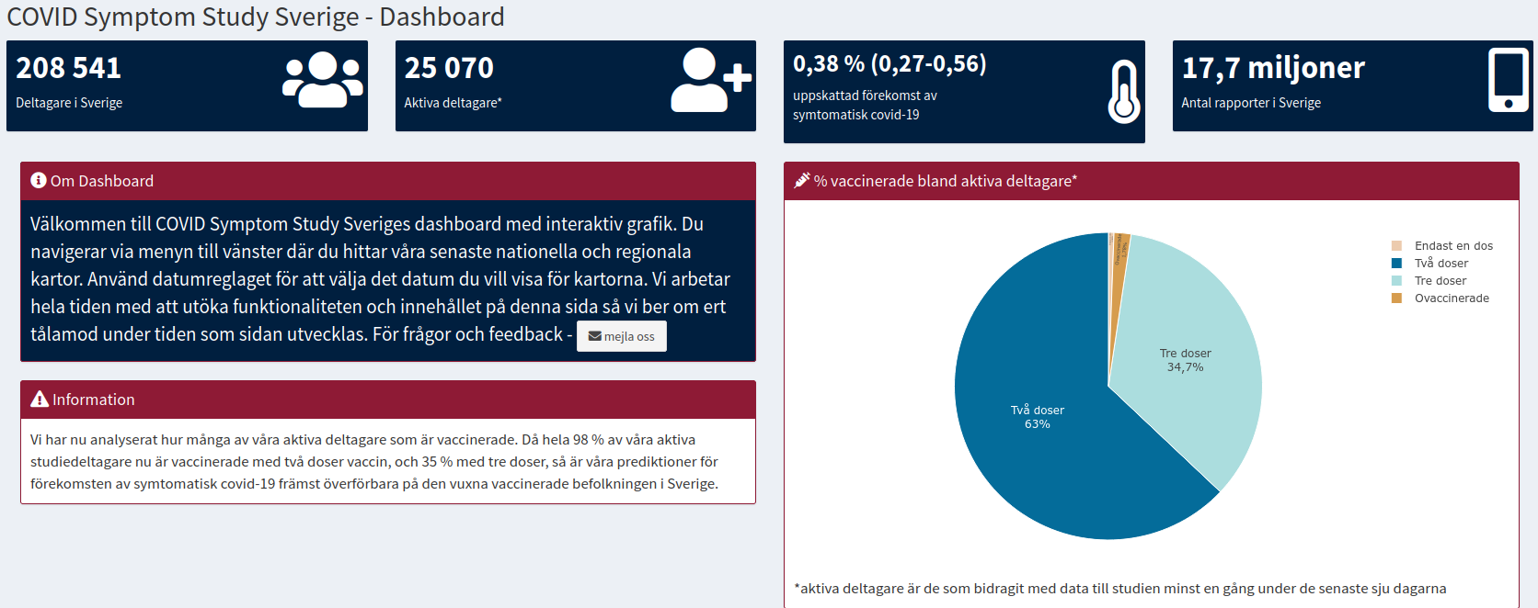
Covid Symptom Study Sweden (CSSS)
Covid prevalence in Sweden in time
is time series data

Slide 22
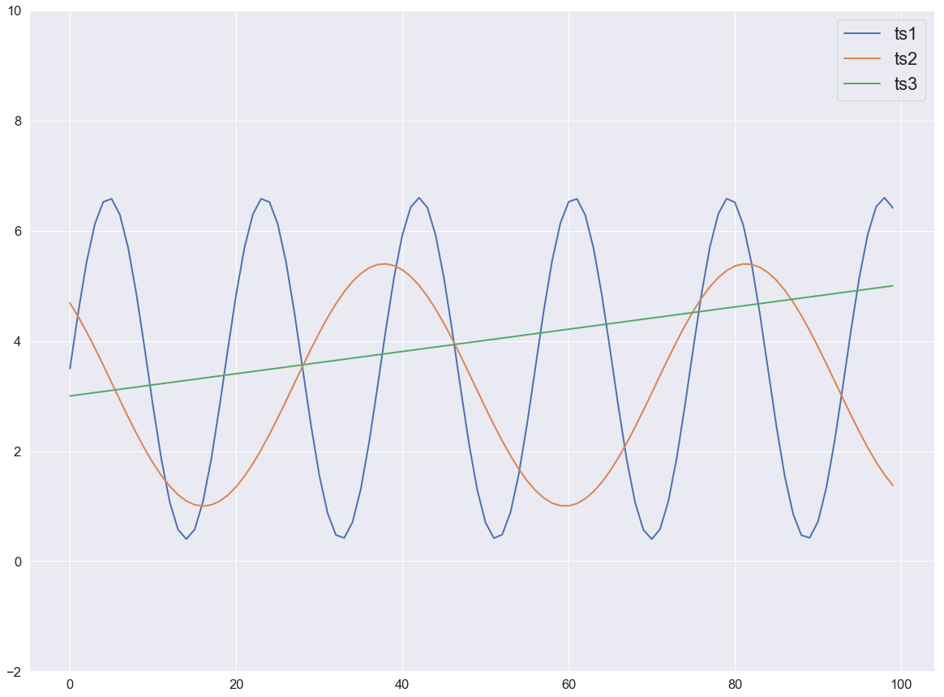
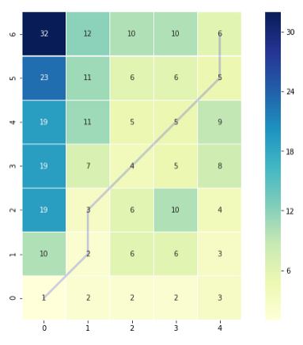

Dynamic Time Warping (DTW)
Euclidean distance between ts1 and ts2: 26.96
Euclidean distance between ts1 and ts3: 23.19
DTW
neighbors
Euclidean
neighbors
cumulative
cost matrix
DTW distance between ts1 and ts2: 17.93
DTW distance between ts1 and ts3: 21.55

Slide 23
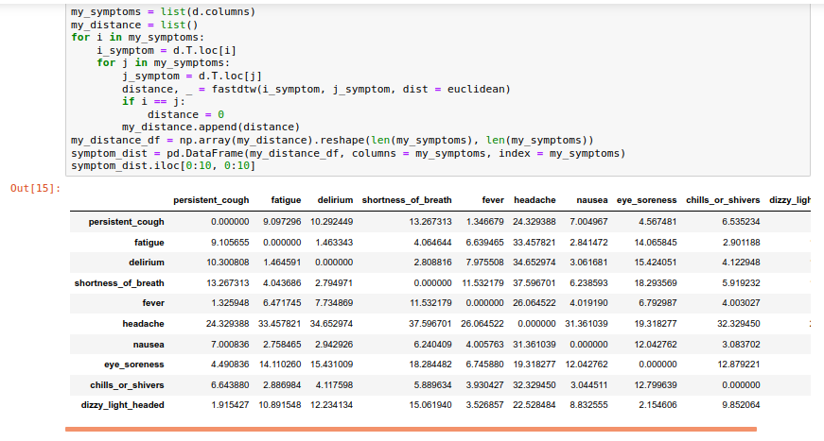
CSSS: DTW pairwise similarity matrix

Slide 24
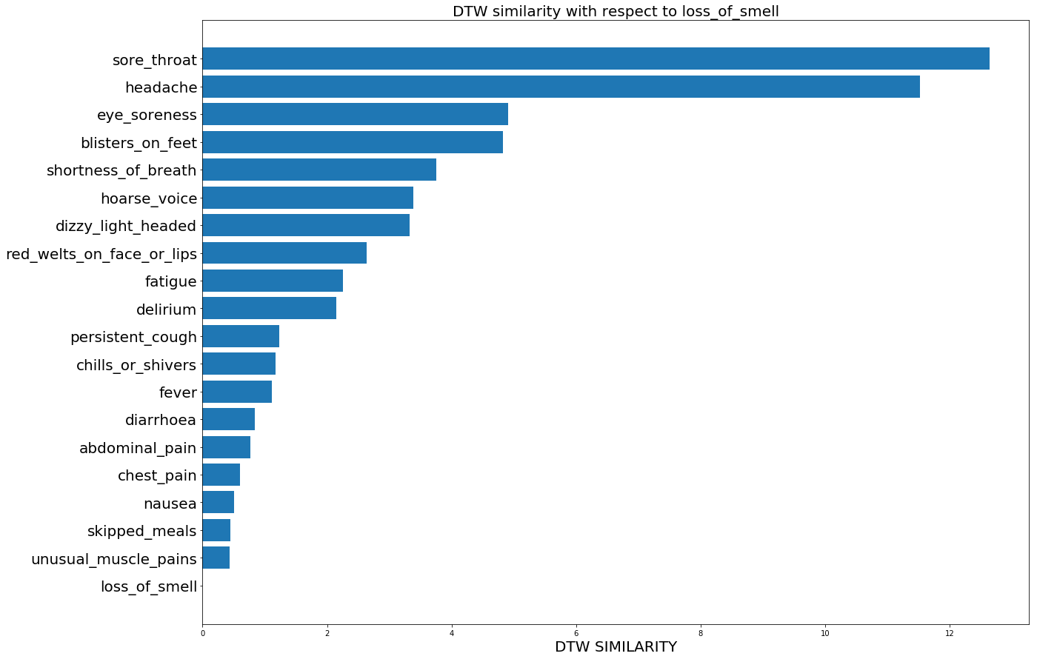
DTW symptom similarity to Loss of Smell

Slide 25
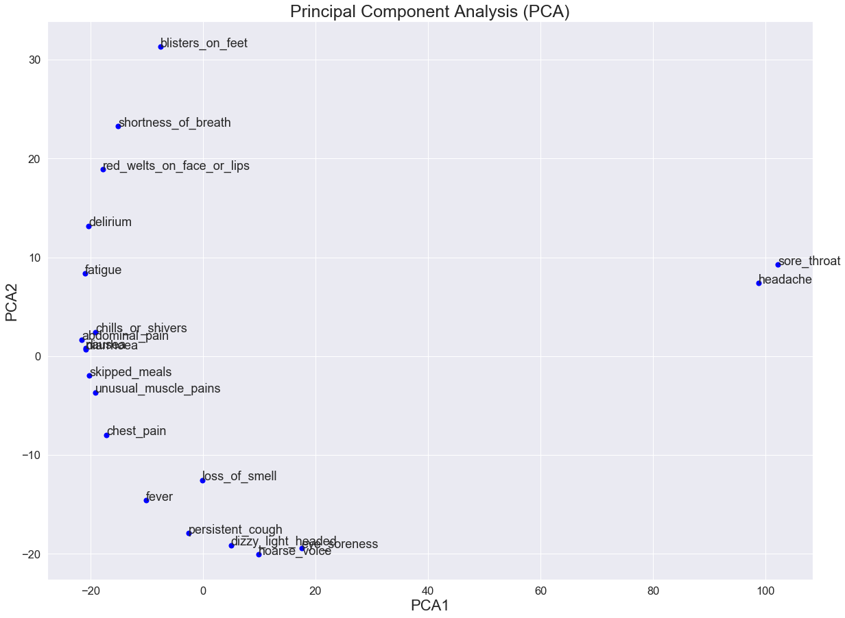
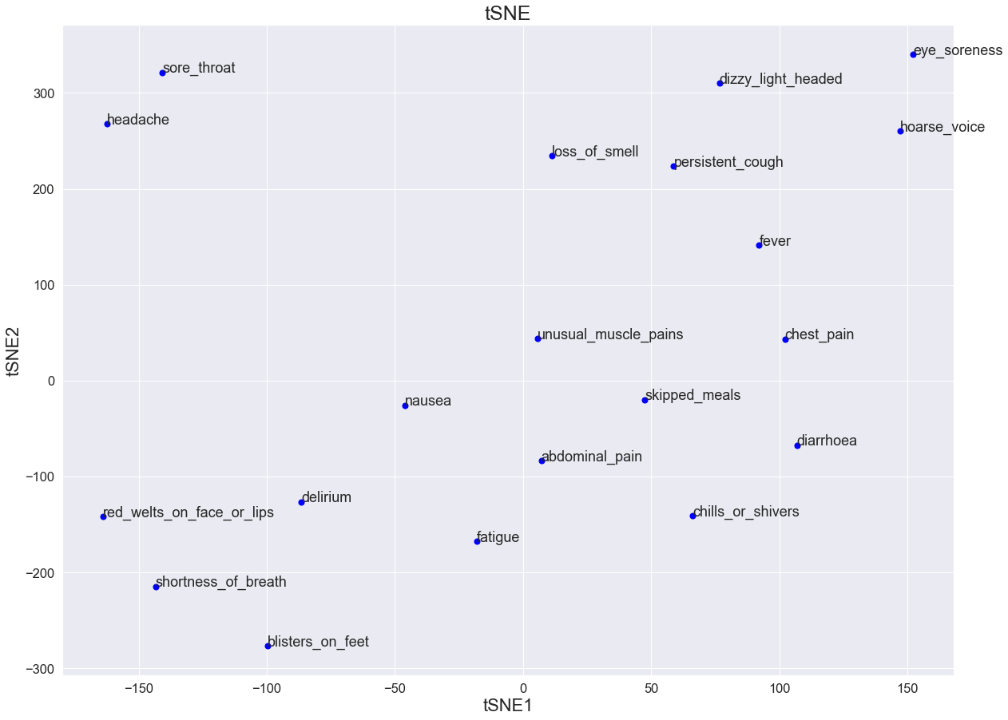
DTW Based Dimension Reduction

Slide 26
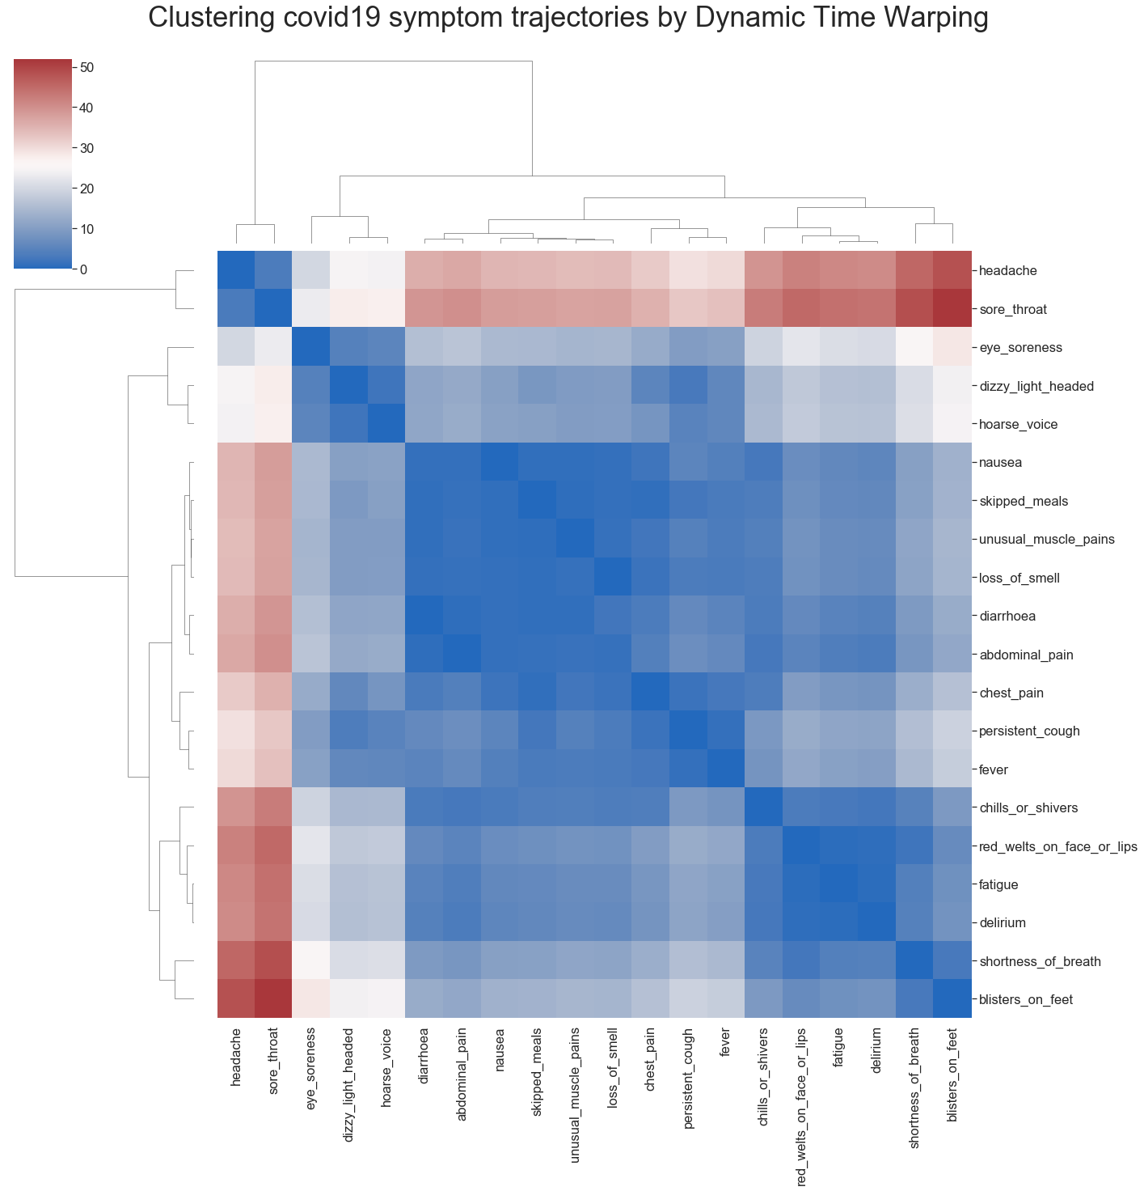
CSSS: covid19 trajectory clustering

Slide 27
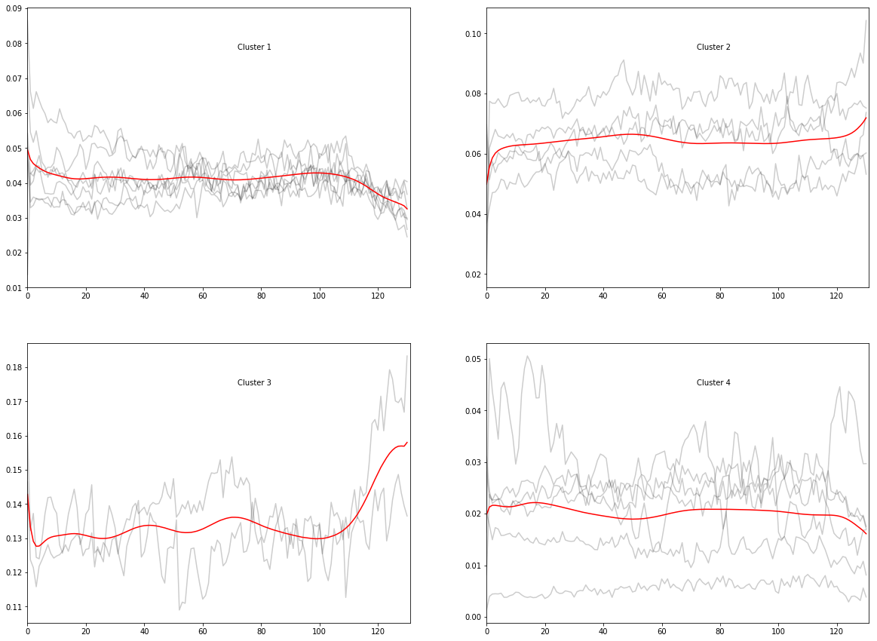
Covid19 Trajectory Clustering
loss_of_smell, skipped_meals,
unusual_muscle_pains
eye_soreness, dizzy_light_headed,
hoarse_voice, fever, persistent_cough
shortness_of_breath, fatigue, delirium
headache, sore_throat

