Slide 1


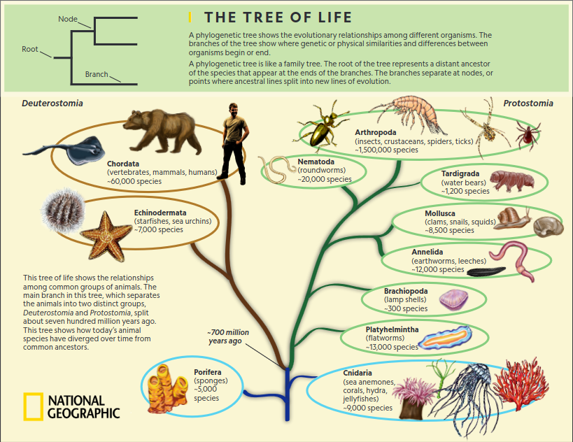
Phylogenetic Analysis
Nikolay Oskolkov, Biology Department, Lund University,
Principal Investigator, Group Leader at NIRI

Slide 2
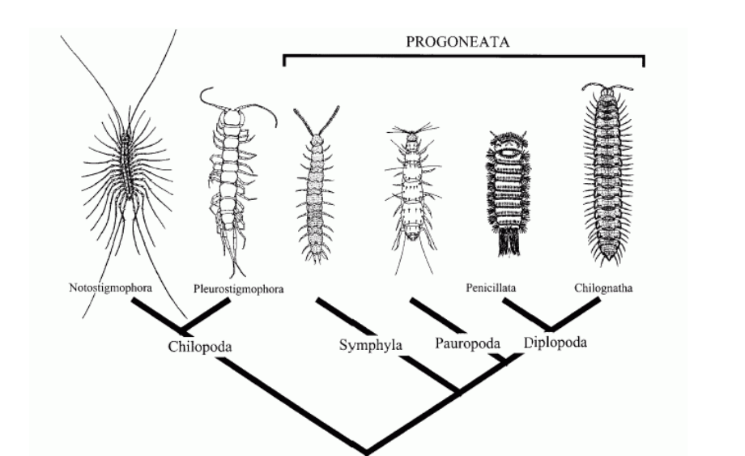
What is a phylogeny?
A phylogeny is an inference of the historical genealogy of groups of organisms

Slide 3
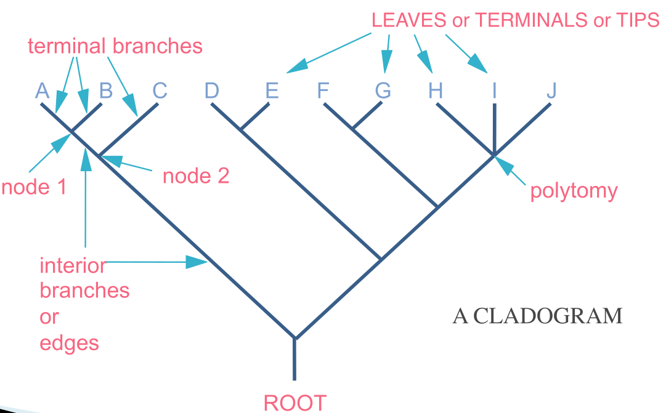
Terminology of a phylogenetic tree

Slide 4
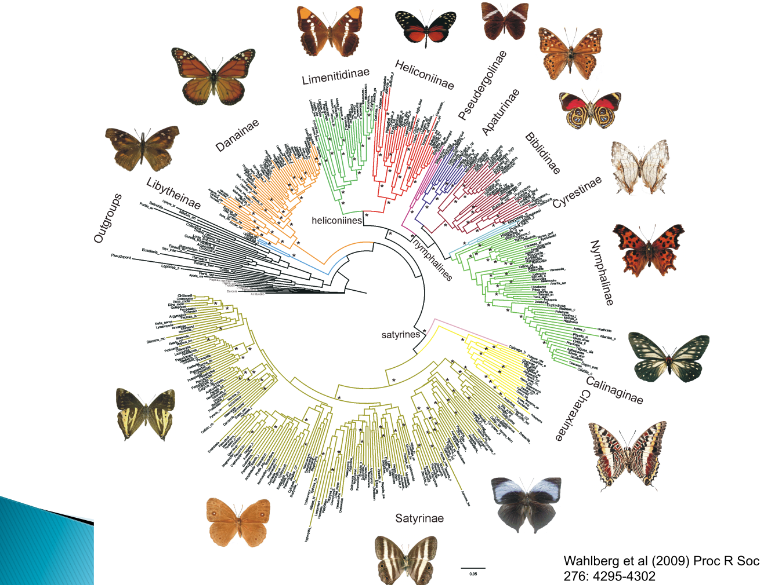
Example of a complex phylogenetic tree

Slide 5
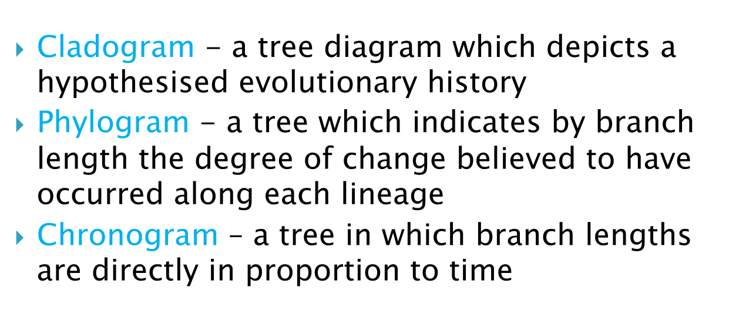
Some basic concepts

Slide 6
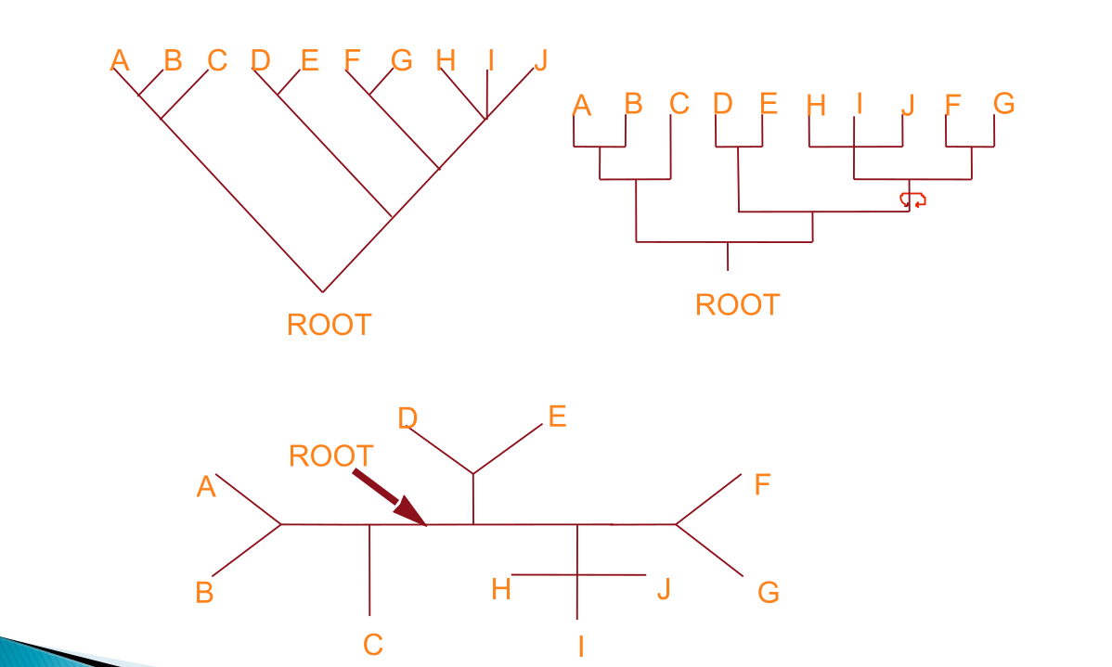
Rooted and unrooted phylogenetic trees
Rooting a tree using an outgroup. Outgroup is a related organism that diverged earlier

Slide 7
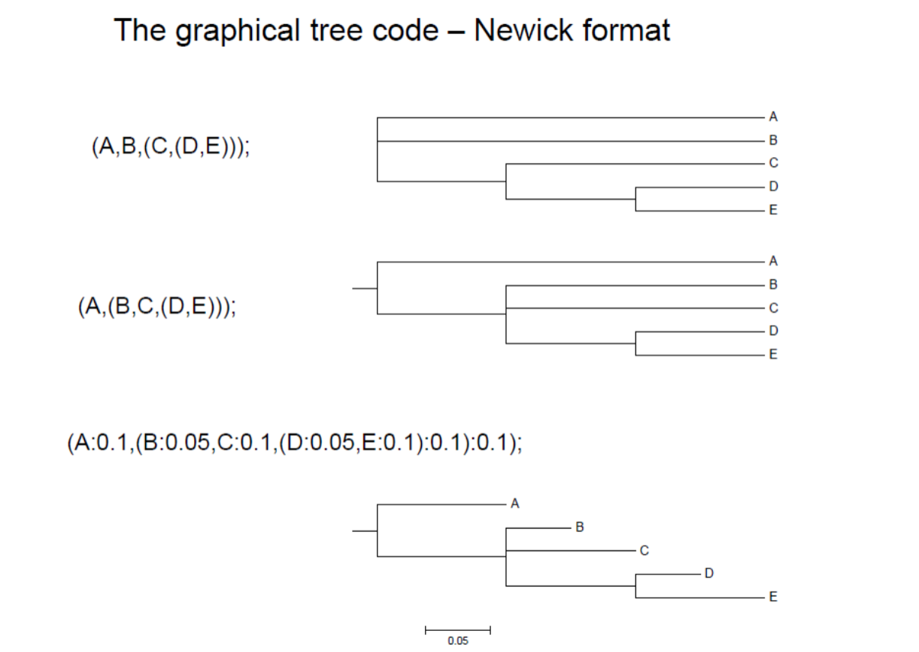
Phylogenetic tree formats

Slide 8
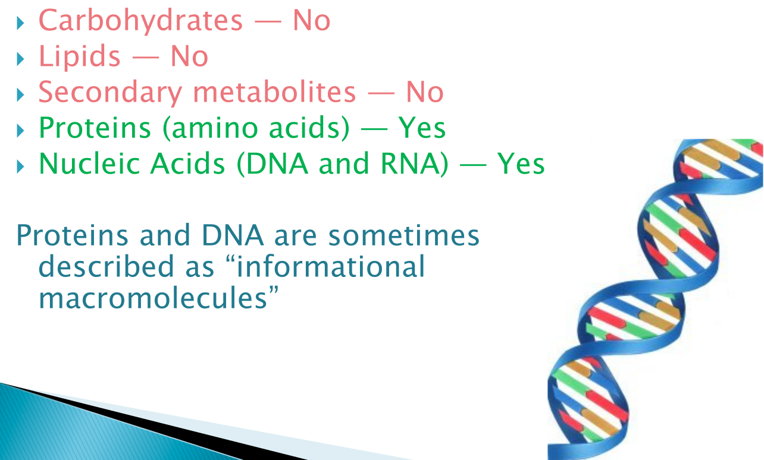
Molecular phylogeny

Slide 9
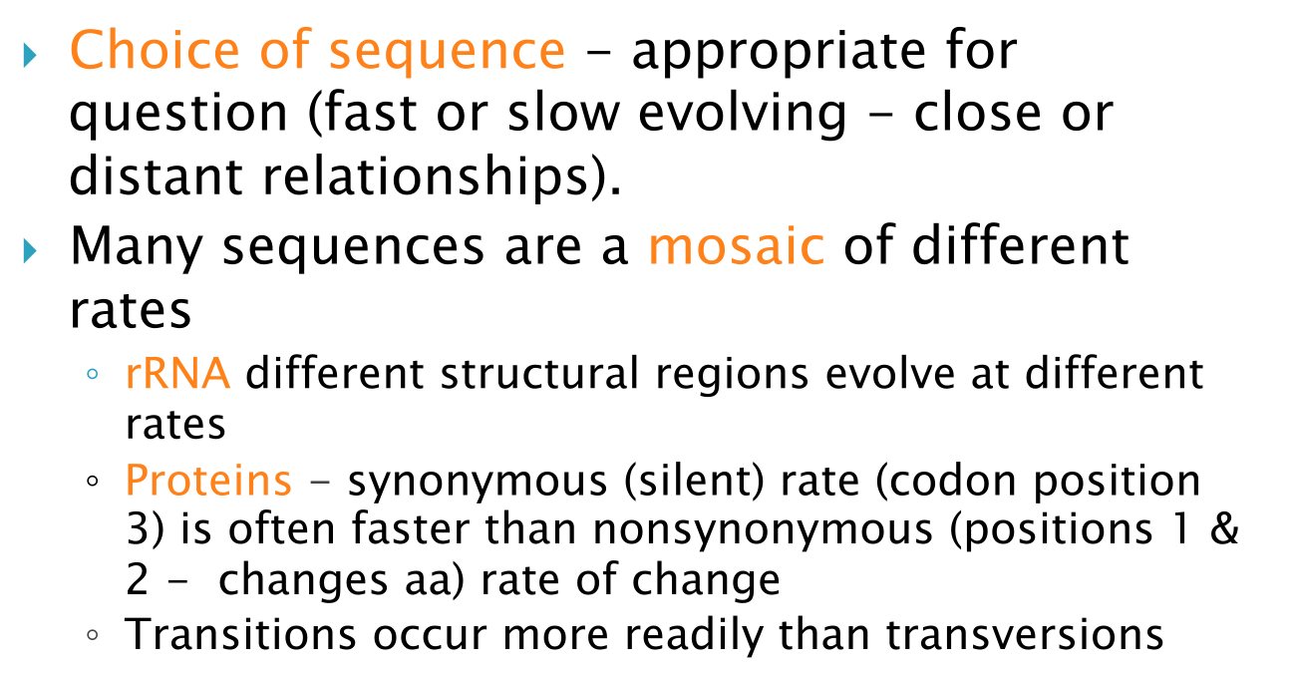
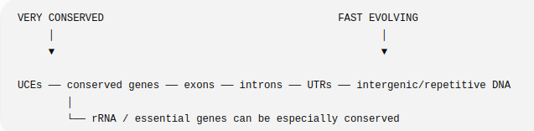
The choice of sequence
DNA gradient
mutation rate:

Slide 10
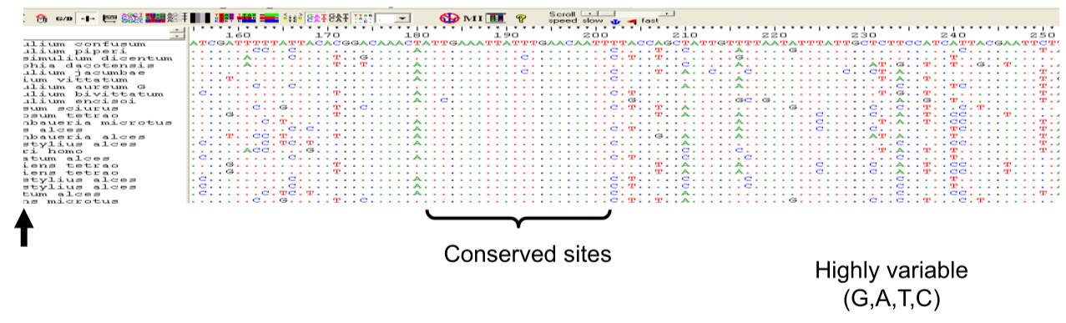
Conserved vs highly-variables sites

Slide 11
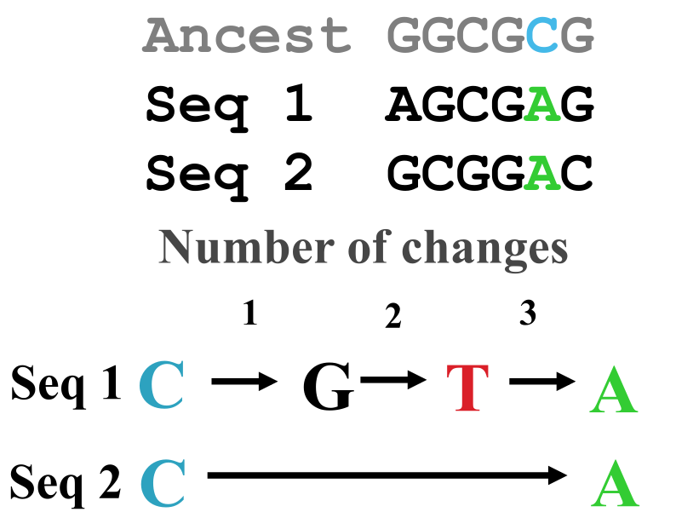
The effect of saturation
Models of evolution attempt to infer the missing information through correcting for “multiple hits”

Slide 12
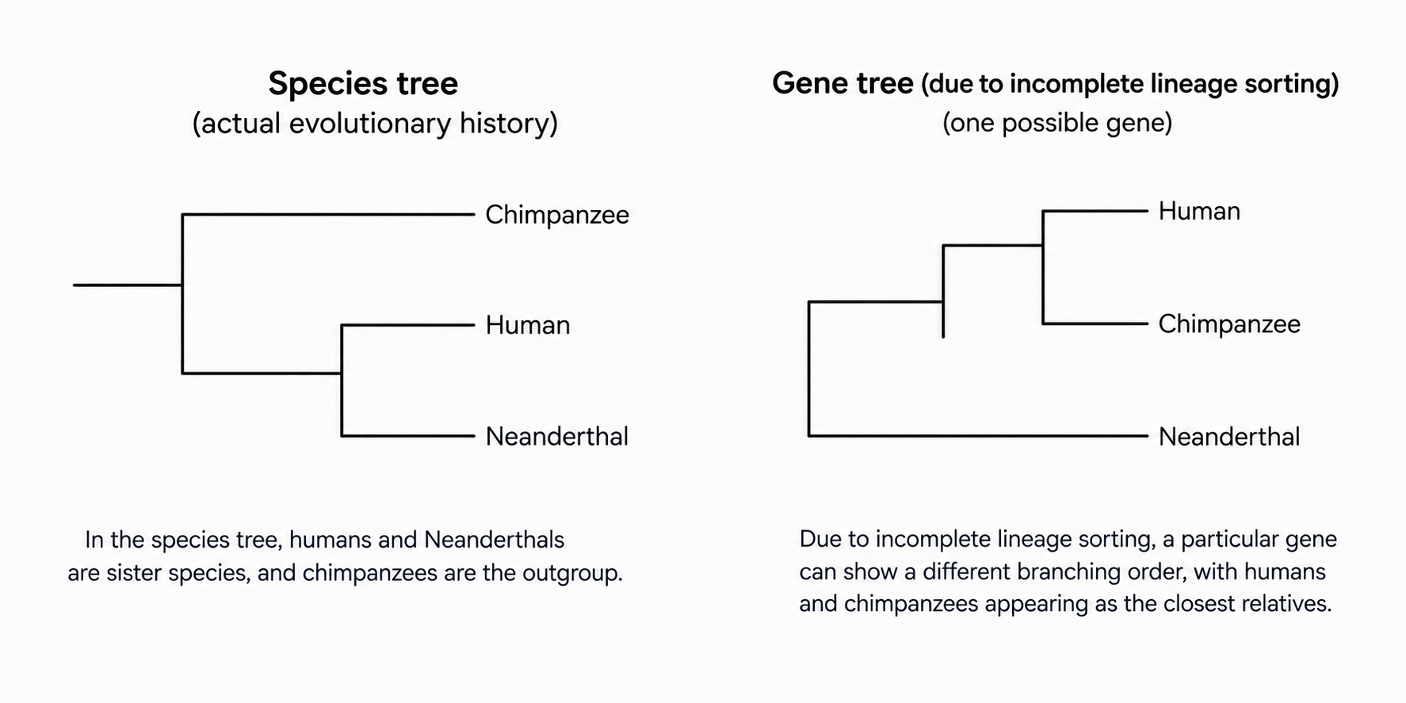
Incomplete lineage sorting
Gene phylogenetic trees may differ from species phylogenetic trees due to ILS

Slide 13
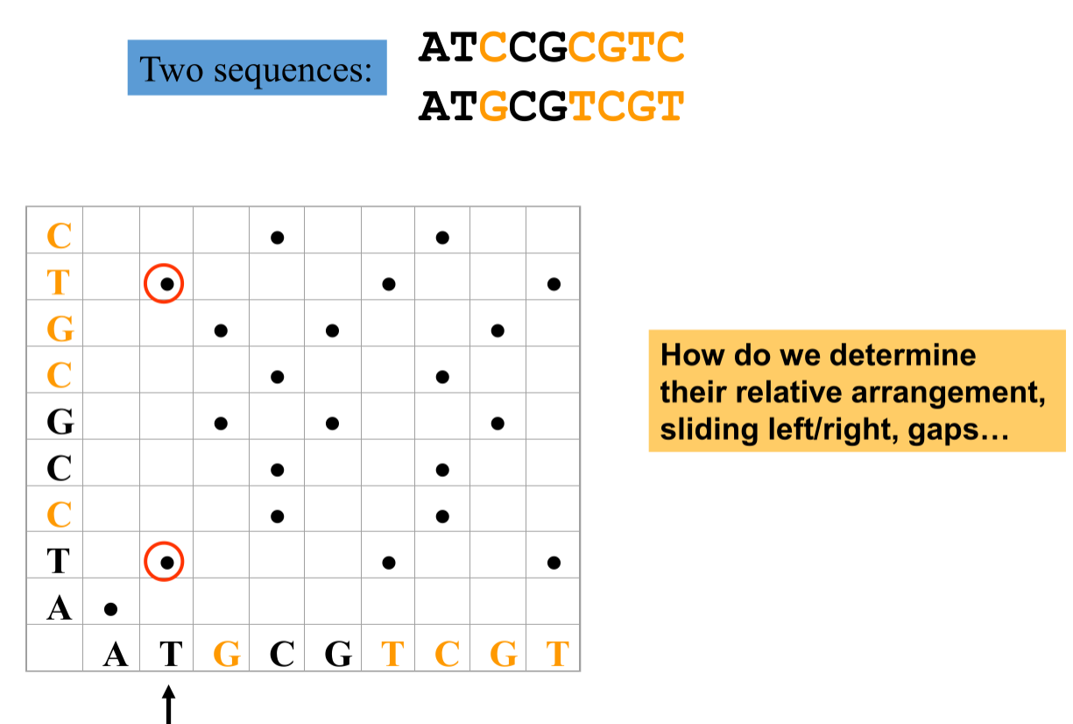
Alignment of two nucleotide sequences

Slide 14
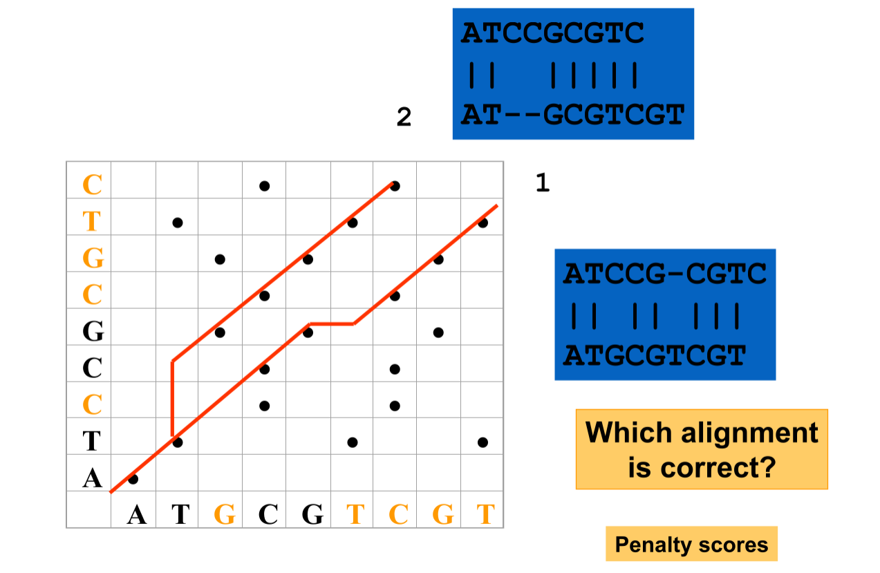
Different alignment scenarios

Slide 15
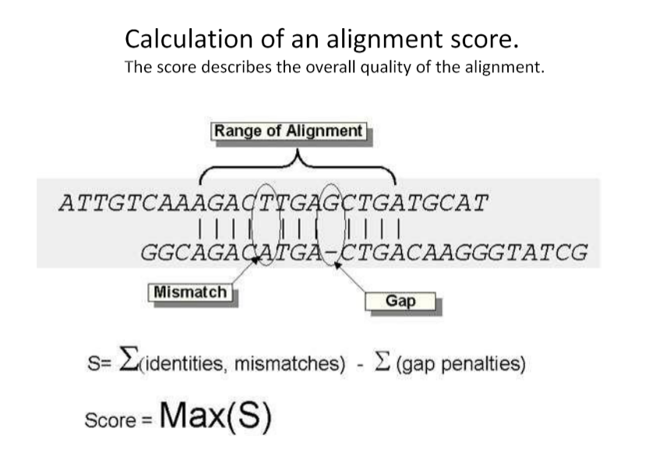
Alignment quality scores computation
Similarity (homology) is a very strong assumption, which might be totally wrong!

Slide 16
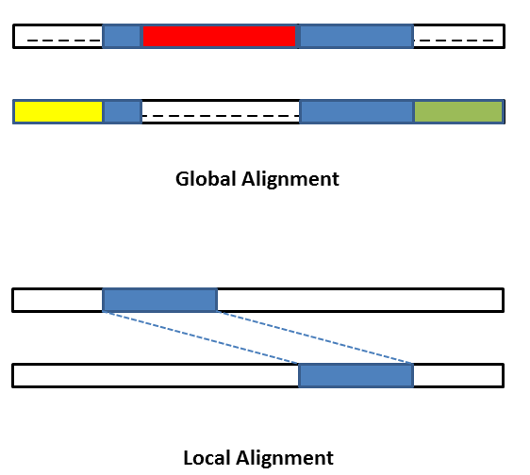
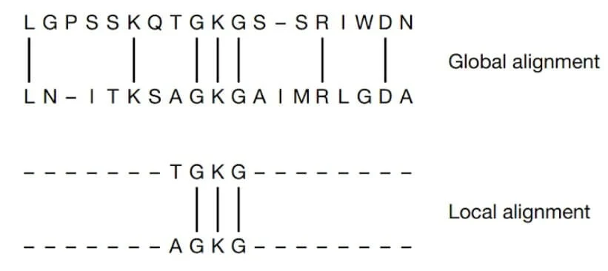
Global vs. local alignment
Local: Smith-Waterman
Global: Needleman-Wunsch

Slide 17
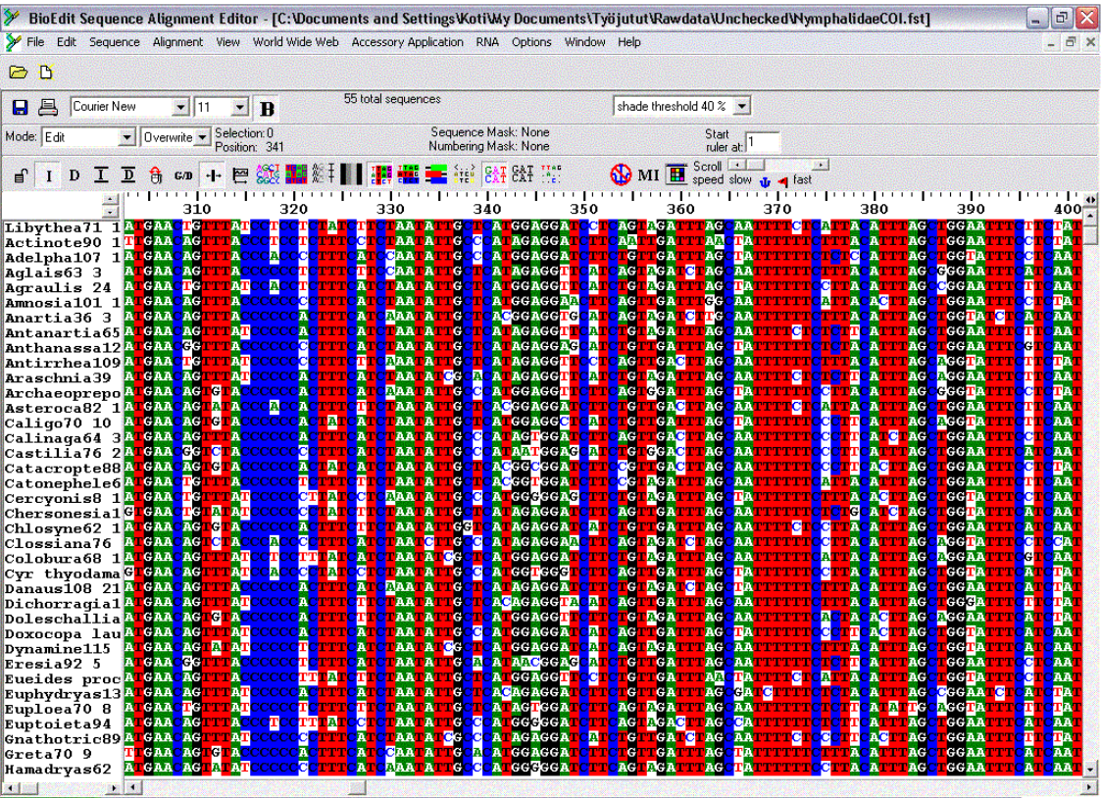
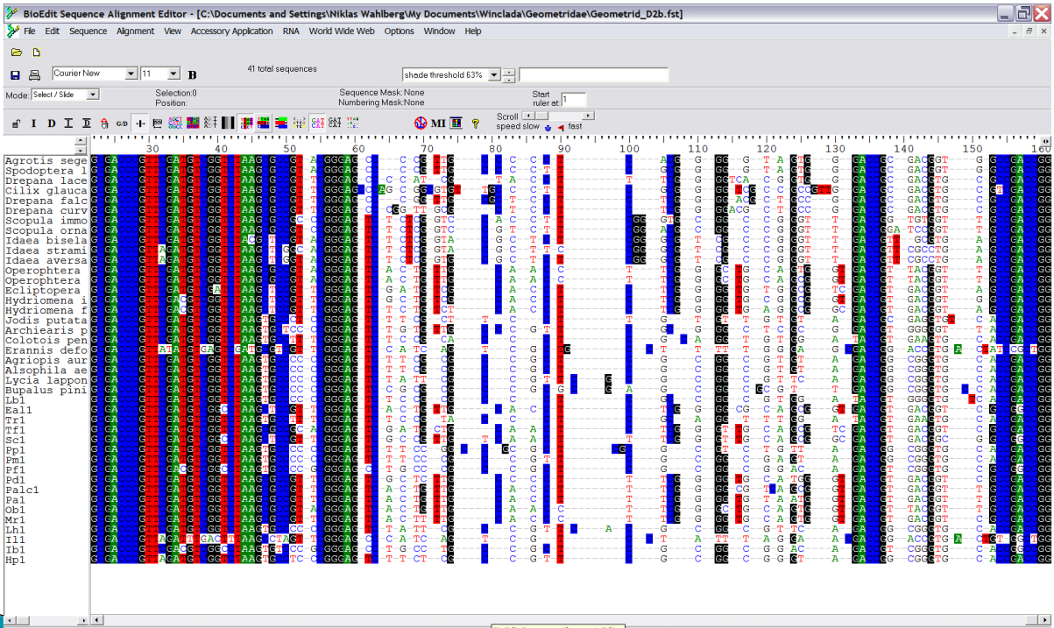
Multiple sequence alignment (global)
Easy!
Difficult!

Slide 18
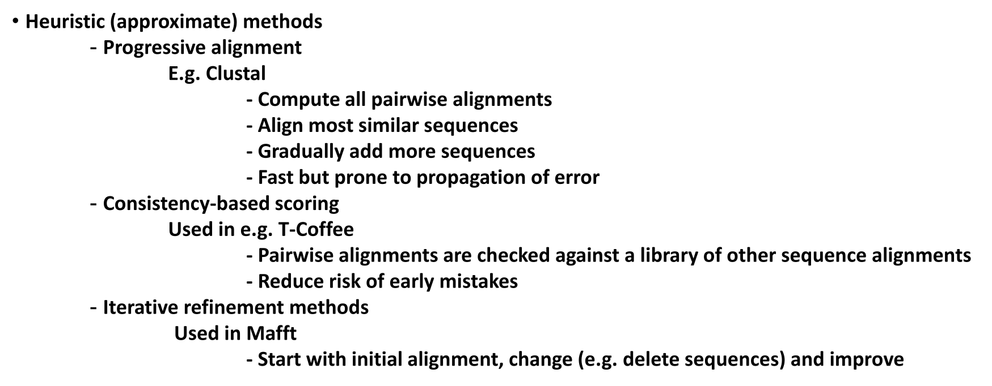
Multiple sequence alignment algorithms
Sabonsolin, J., Lao, D. A comprehensive systematic literature review of multiple sequence alignment algorithms. Discov Computing 29, 33 (2026).
https://doi.org/10.1007/s10791-026-09911-3

Slide 19
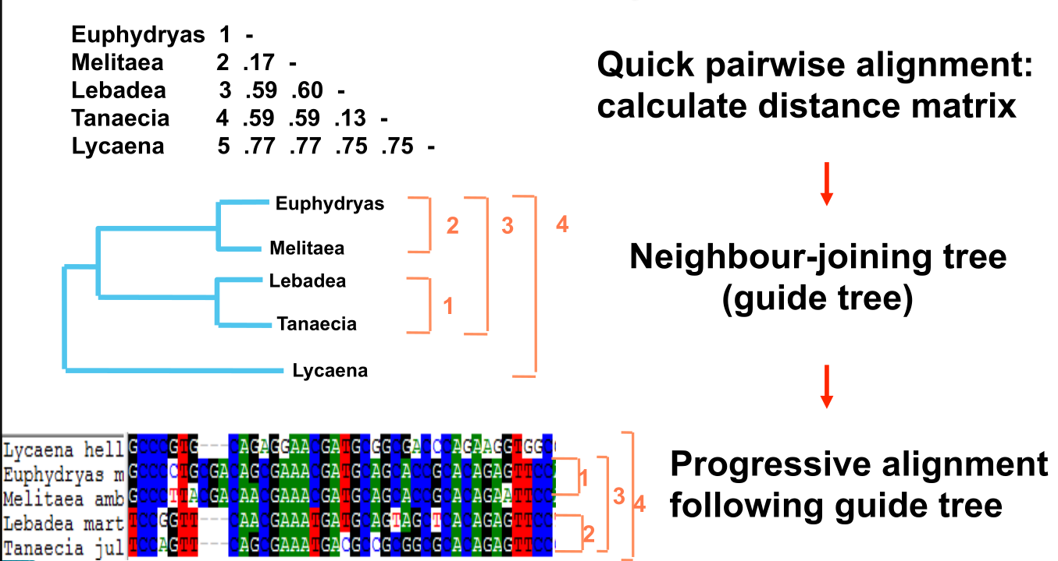
Clustal multiple sequence alignment

Slide 20
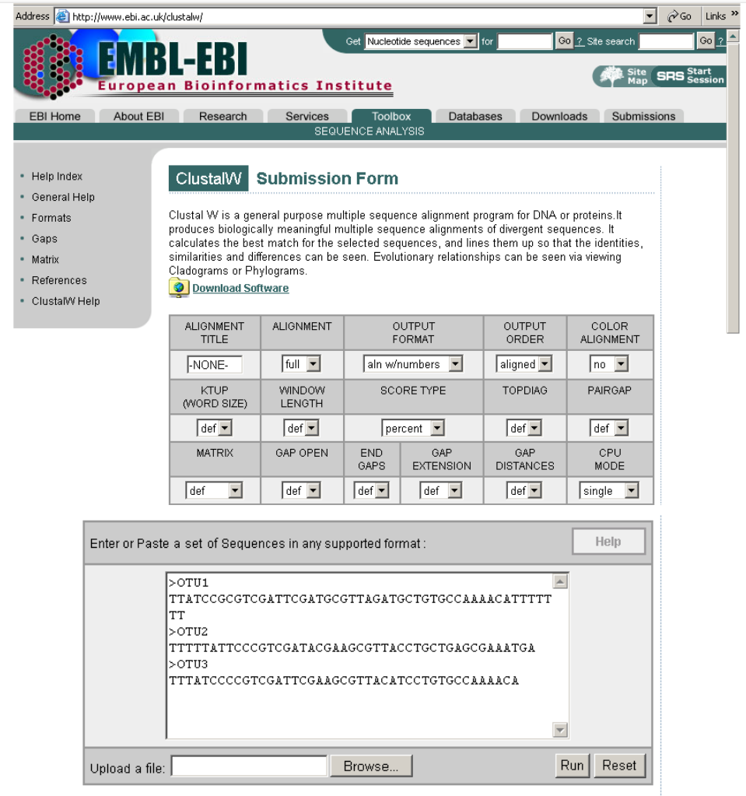
MSA online via Clustal

Slide 21
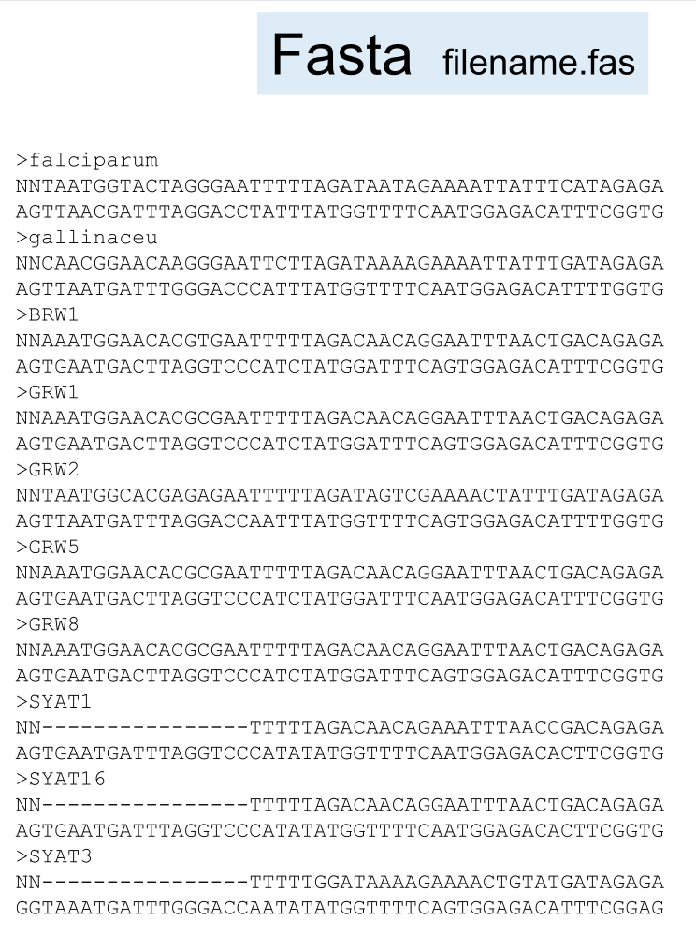
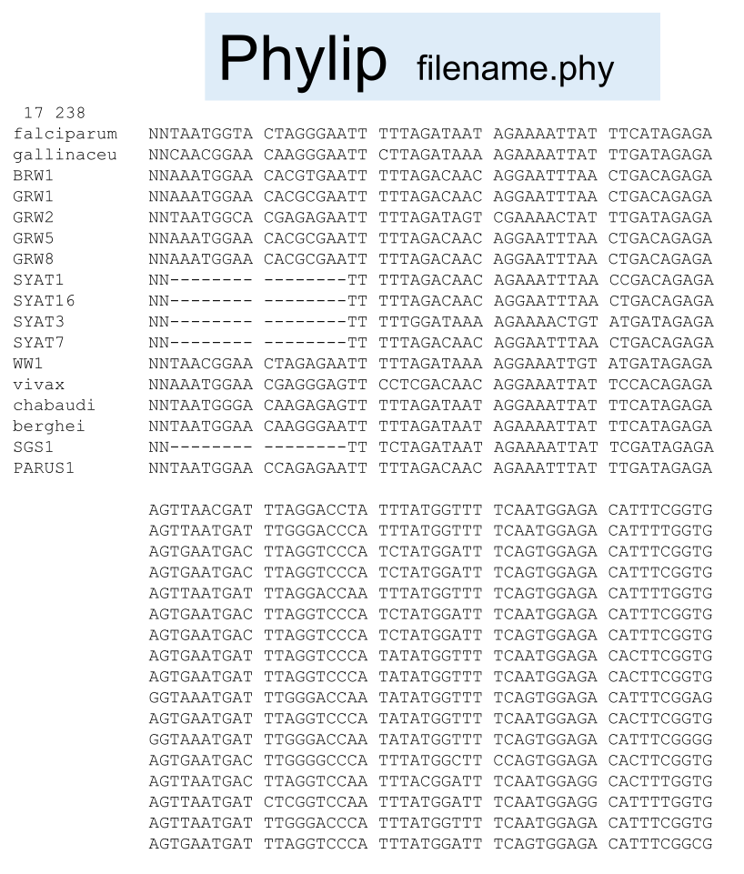
Multiple sequence alignment file formats

Slide 22
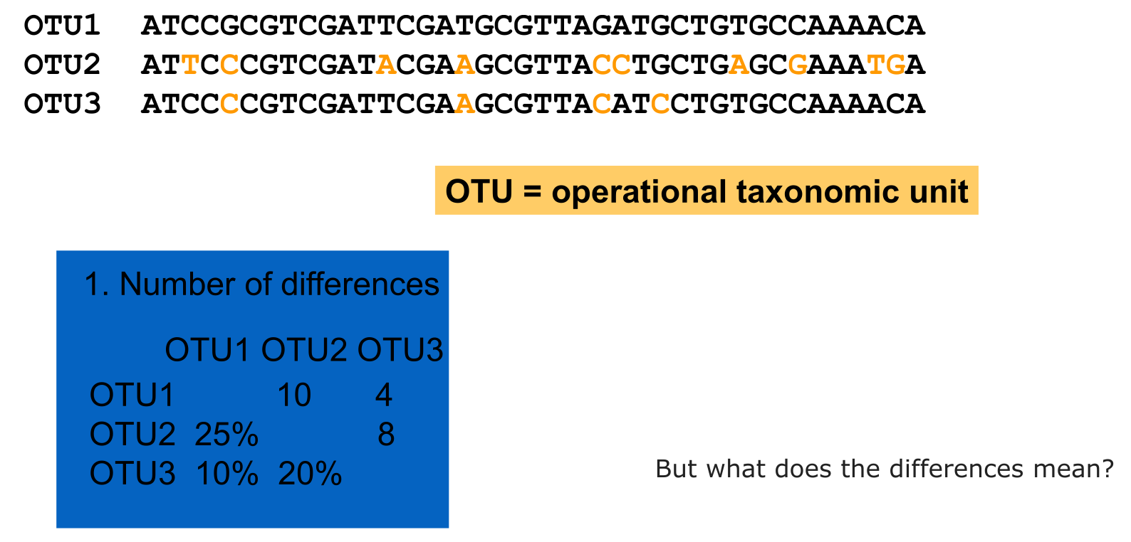
Genetic (Hamming) distance

Slide 23
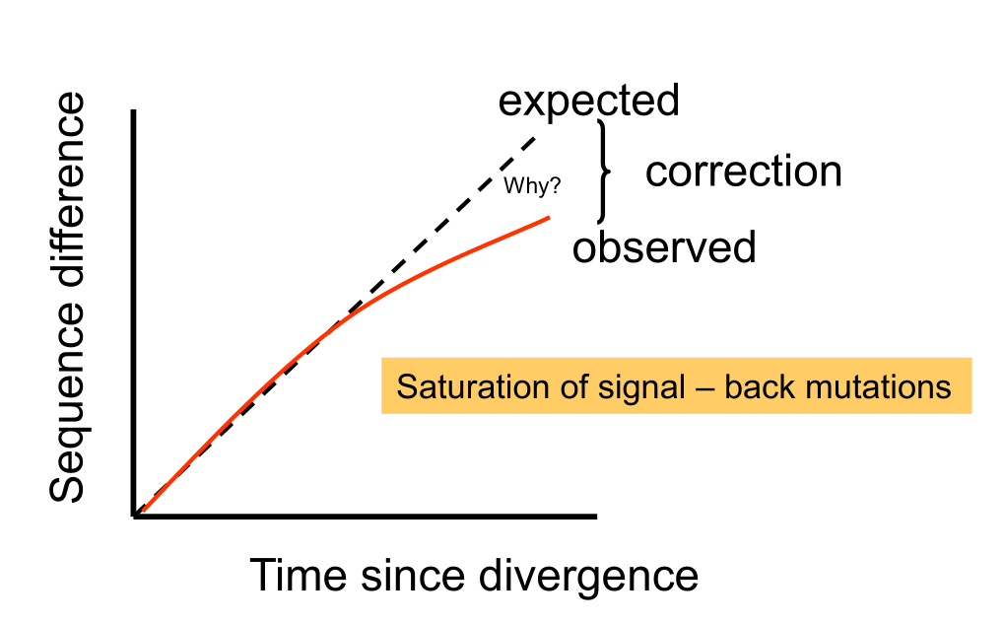
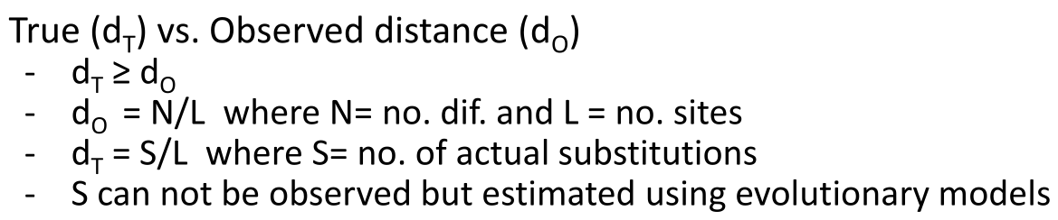
Corrected genetic distance

Slide 24
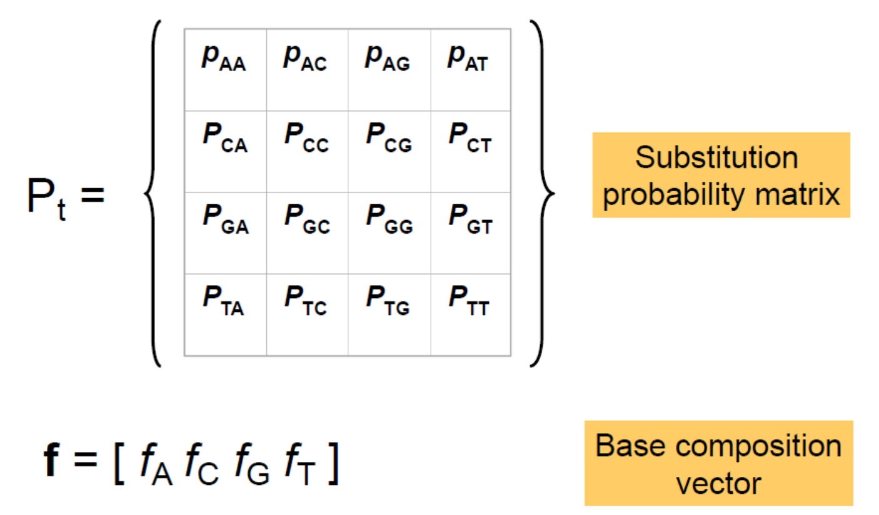
Model of nucleotide sequence evolution
A
C
G
T
A
C
G
T

Slide 25
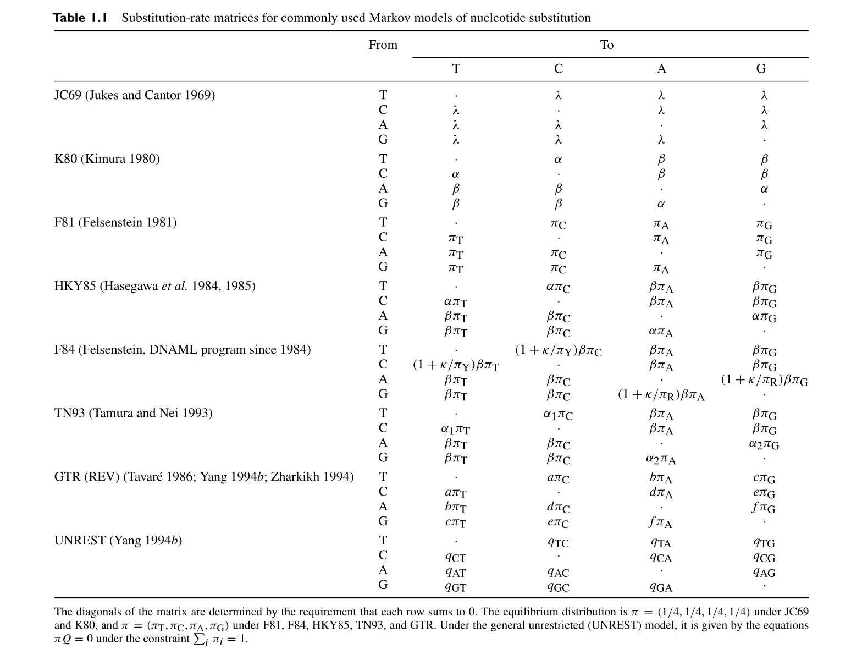
Model of nucleotide sequence evolution

Slide 26
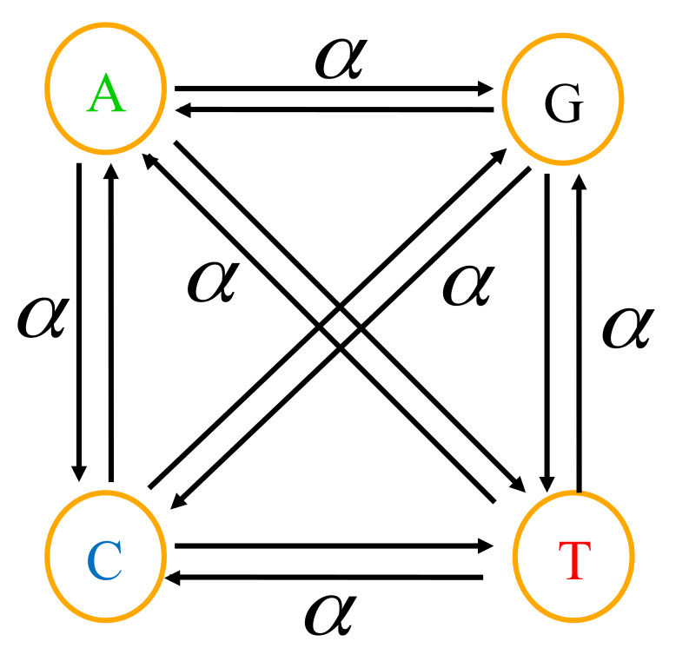
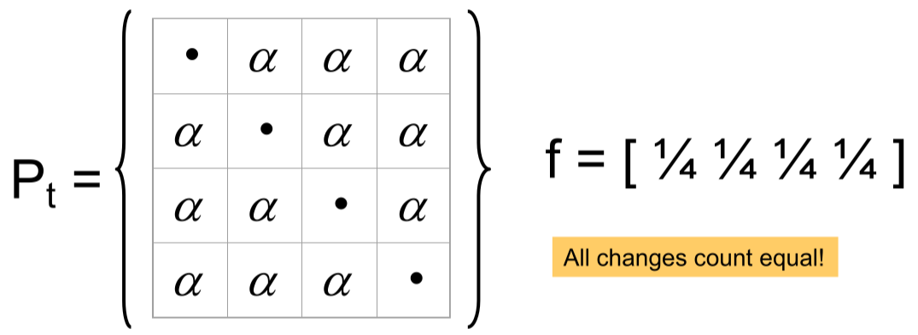
Jukes-Cantor (JC69) model

Slide 27
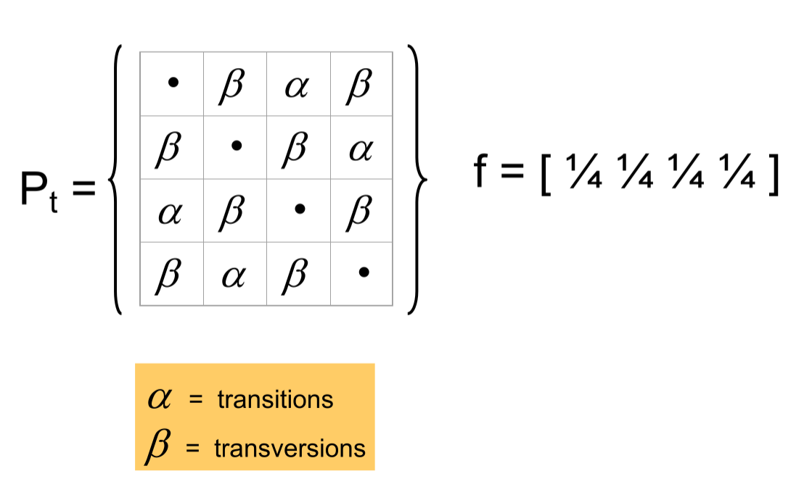
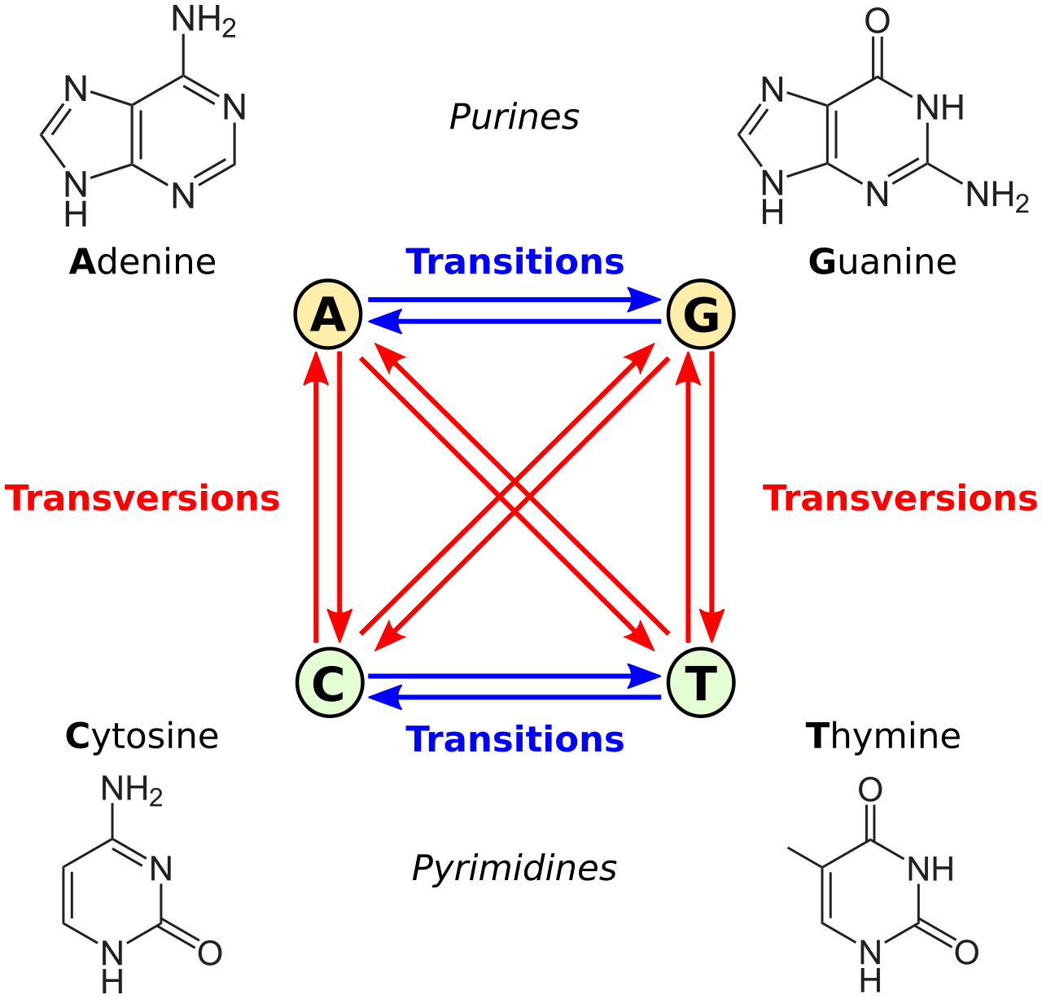
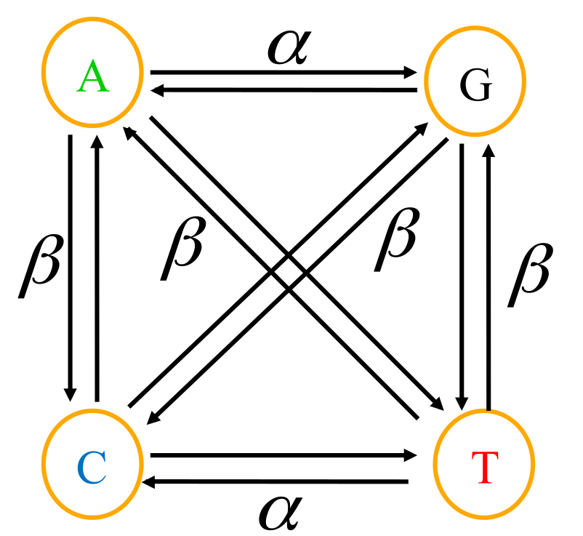
Kimura (K80) model

Slide 28
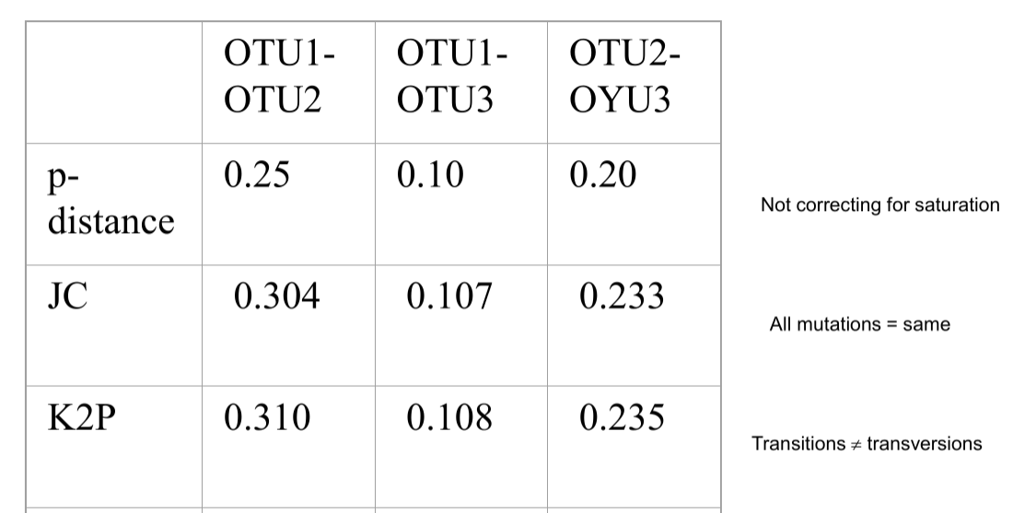
Comparing nucleotide substitution models
d_JC = -3/4 × ln(1 - 4/3 × p)
Corrected genetic distance is greater than the Hamming distance!

Slide 29
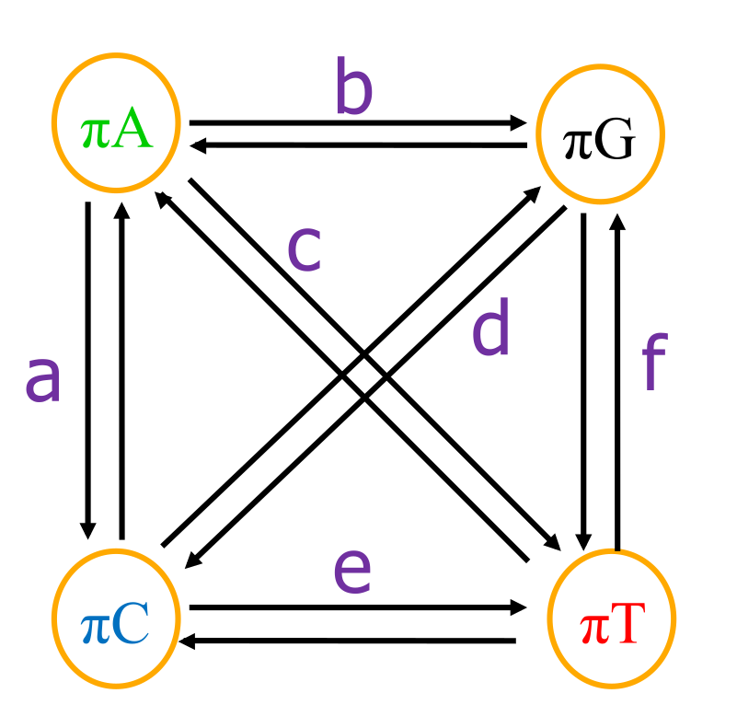
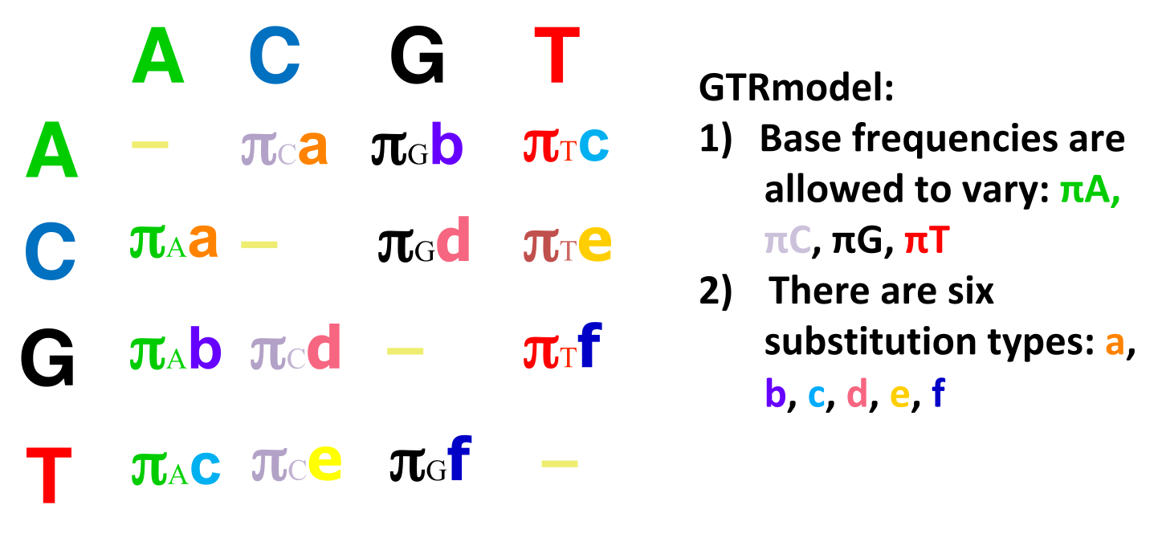
General time reversible (GTR) model
All other models are special cases of GTR

Slide 30
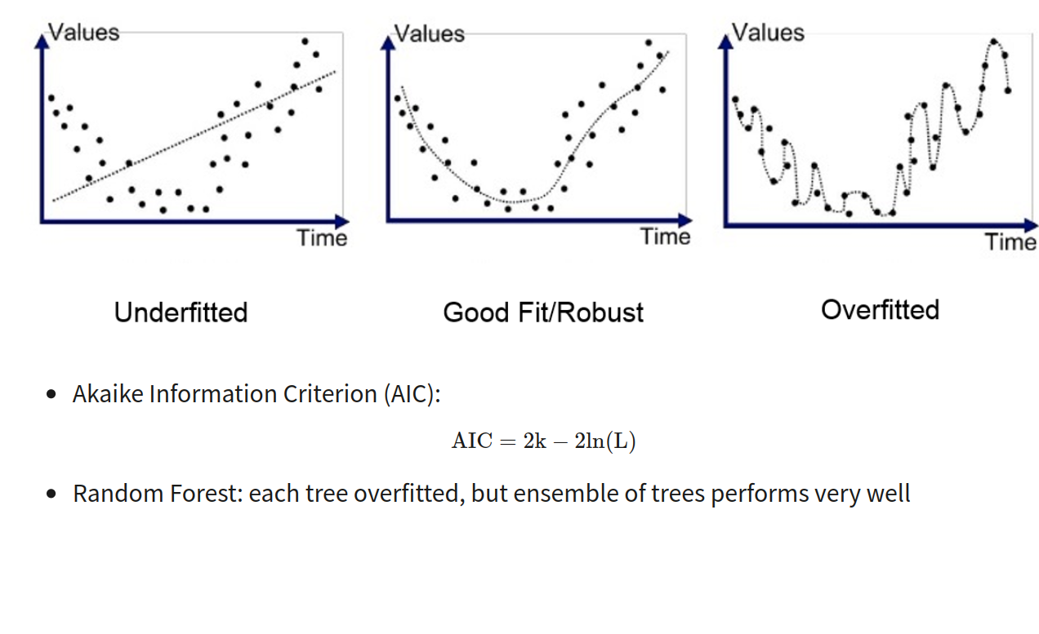
Model selection: over-fitting vs. under-fitting

Slide 31
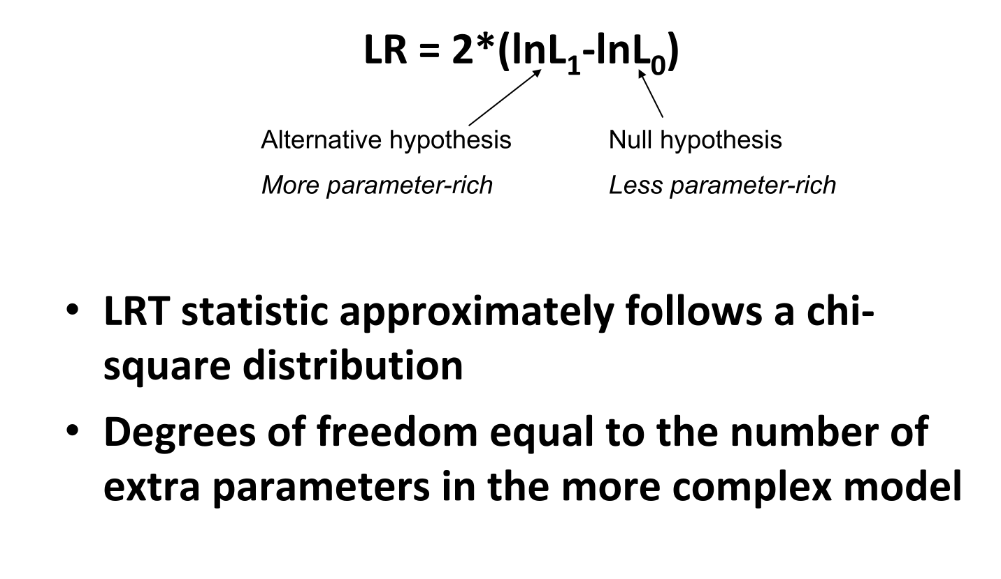
Likelihood Ratio Test (LRT)

Slide 32
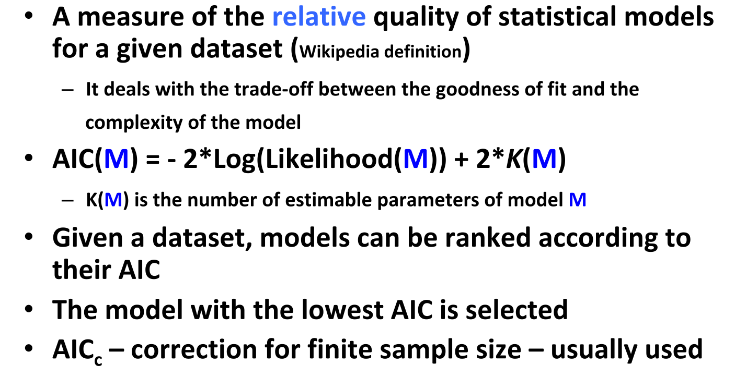
Akaike Information Criterion (AIC)

Slide 33
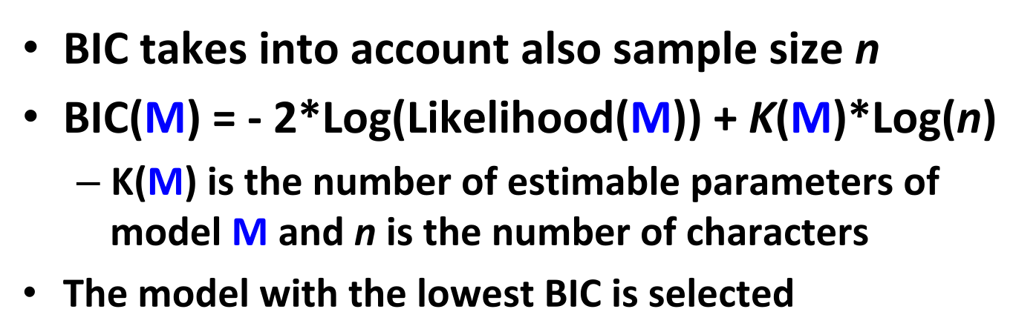
Bayesian Information Criterion (BIC)

Slide 34
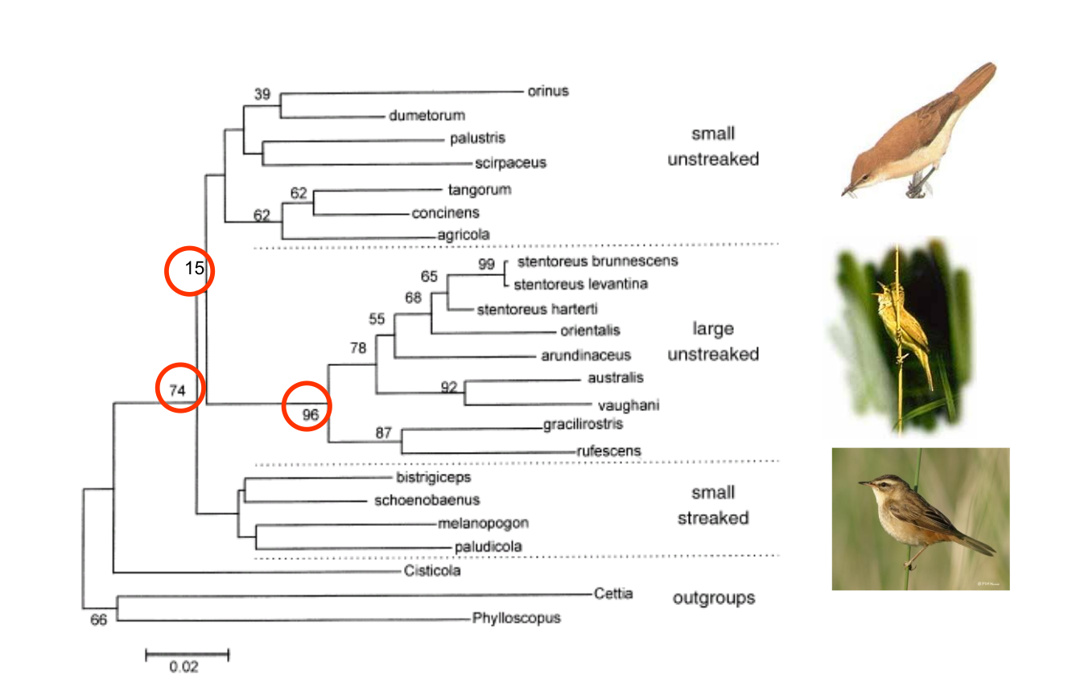
Phylogenetic tree with bootstrapping

Slide 35
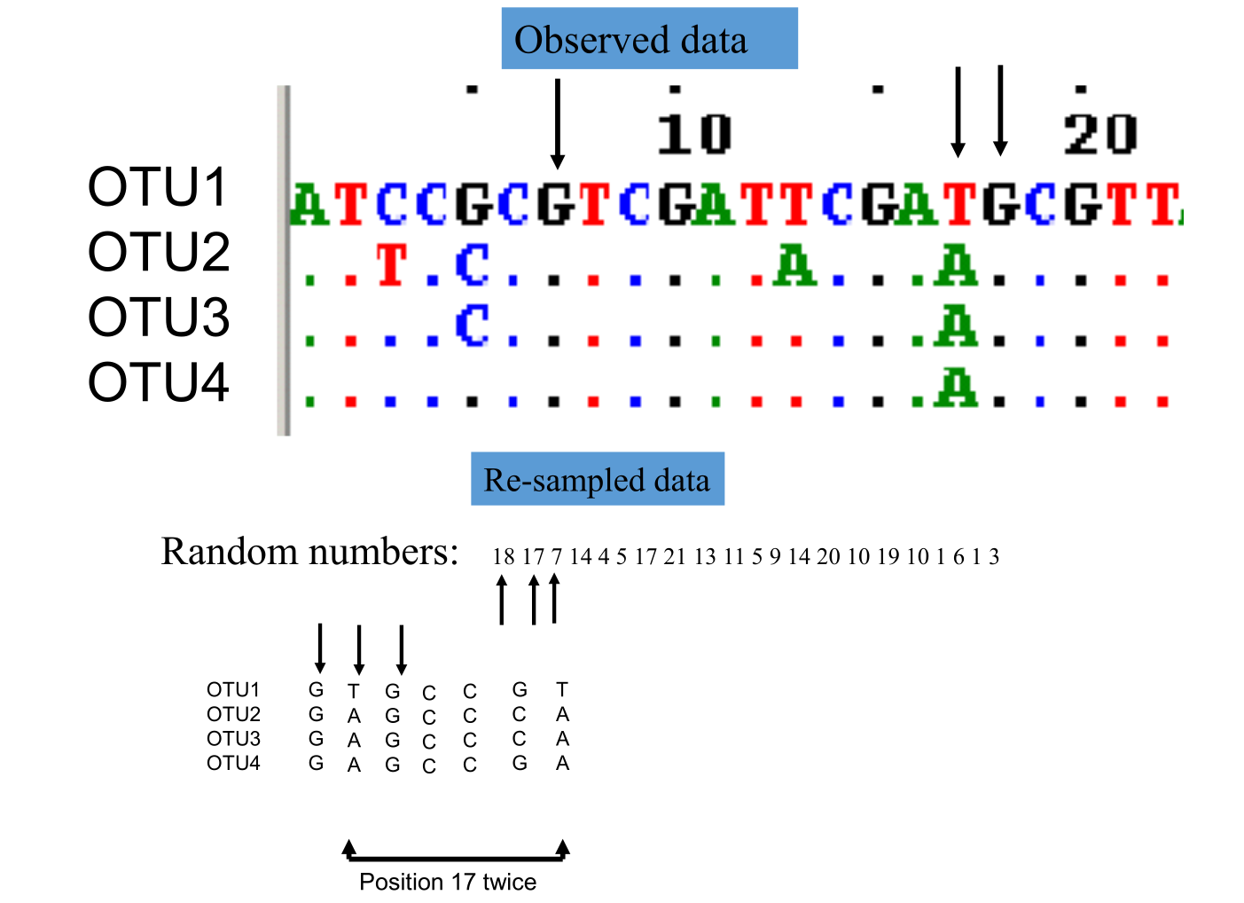
Bootstrapping: resampling with replacement

Slide 36
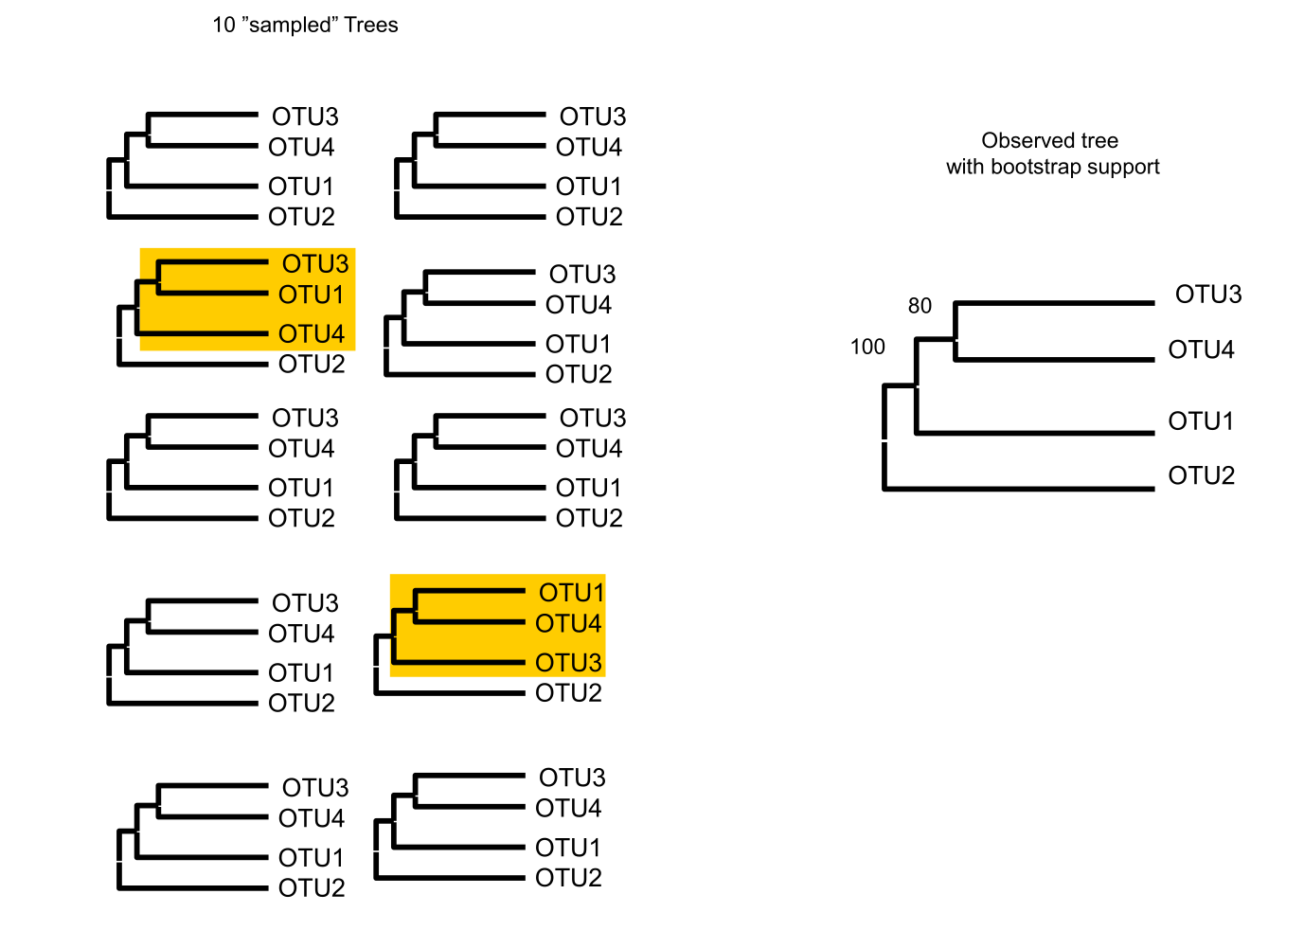
Resamples phylogenetic trees

Slide 37
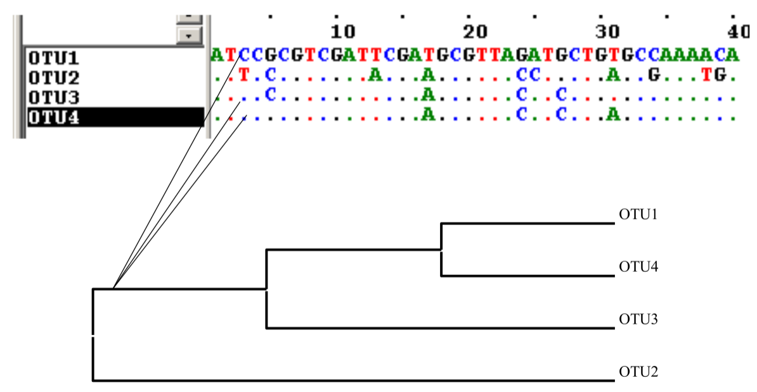
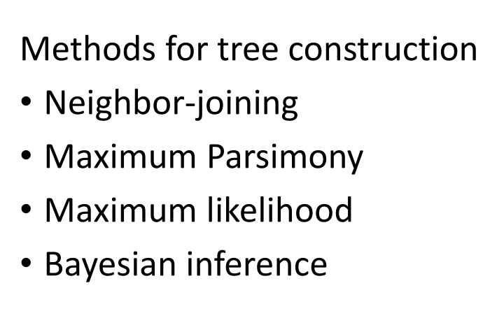
Constructing phylogenetic trees

Slide 38
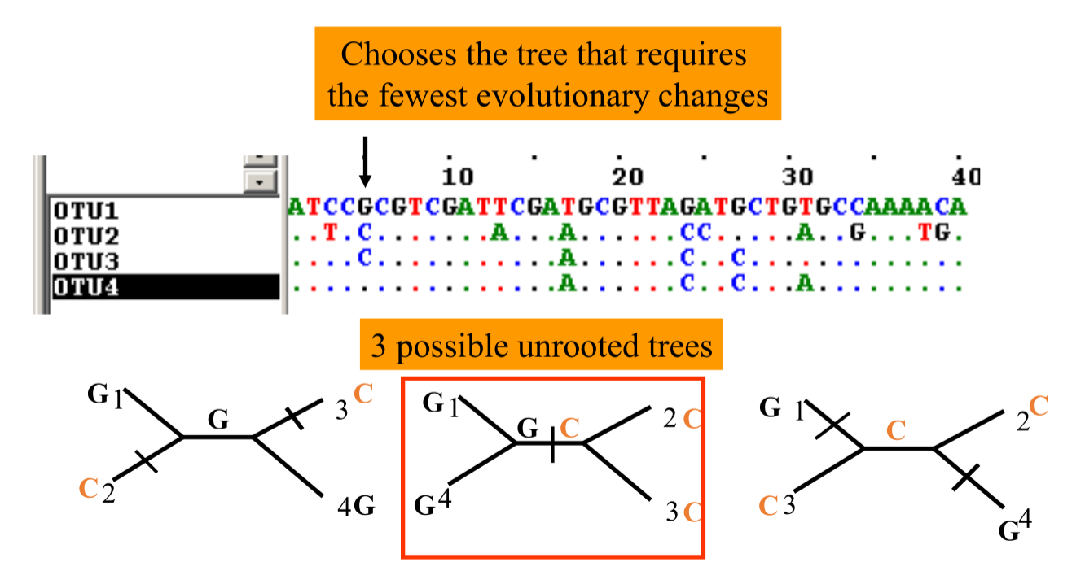
Maximum parsimony

Slide 39
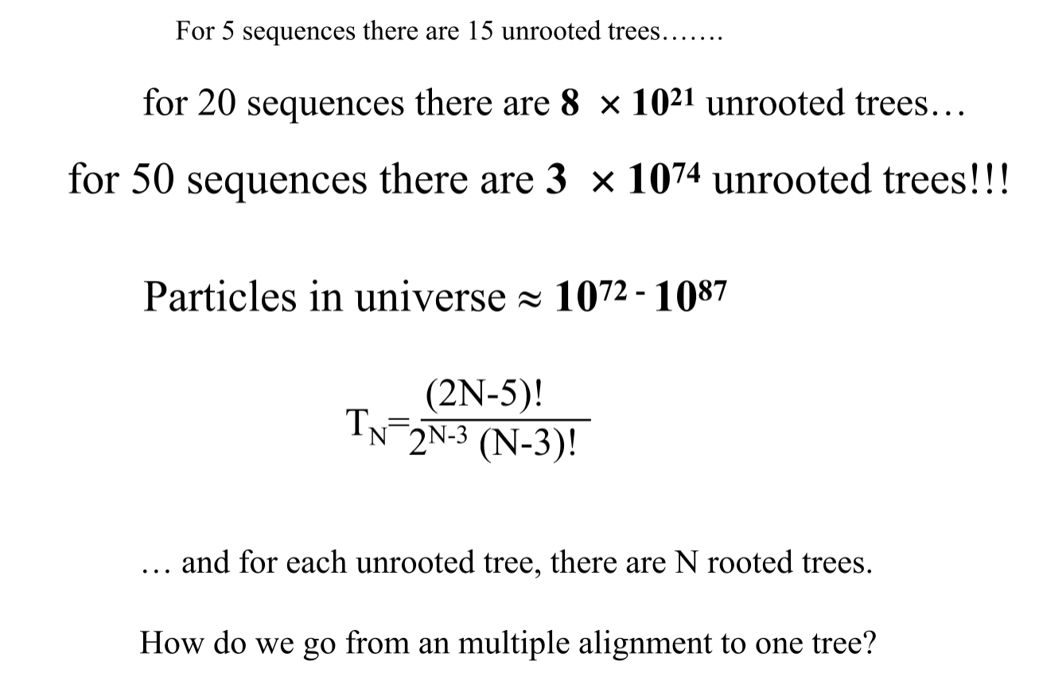
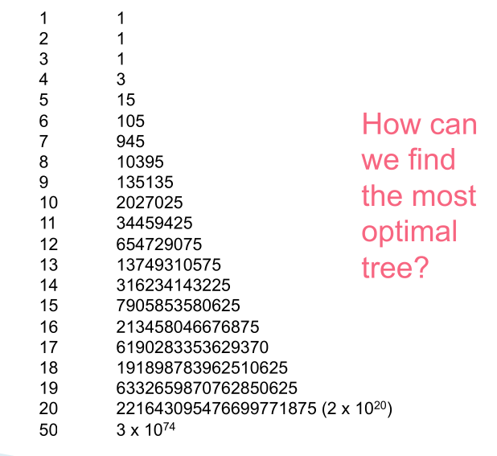
Maximum parsimony bottleneck
Exhaustive search is very resource demanding and time consuming!

Slide 40

Maximum Likelihood principle

Slide 41

Maximum Likelihood for phylogeny

Slide 42


Derivative of likelihood function
The necessary condition of likelihood extremum is zero first derivative!
Ziheng Yang, Computational Molecular Evolution 2006

Slide 43

Phylogenetic tree with highest likelihood

Slide 44




Some types of data analysis in Life Sciences
Mathematical modeling
Bayesianism
Frequentism
Machine Learning
N → 0
N << P
N ≈ P
N >> P
Hypothesis-driven
Data-driven
Amount of Data
P is the number of features (genes, proteins, genetic variants etc.)
N is the number of observations (samples, cells, nucleotides etc.)

Slide 45


Frequentist vs. Bayesian linear fitting
Fitting Frequentist linear model
Fitting Bayesian linear model

Slide 46


Drawing possible fits from Posterior
Slope and intersect are not fixed values any more
MCMC can draw infinite number
of fits from proximity of optimal
slope and intercept parameters

Slide 47

Bayes theorem

Slide 48


Slide 49


Slide 50

Combining priors with likelihoods

Slide 51

Thank you for your attention!

