Slide 1
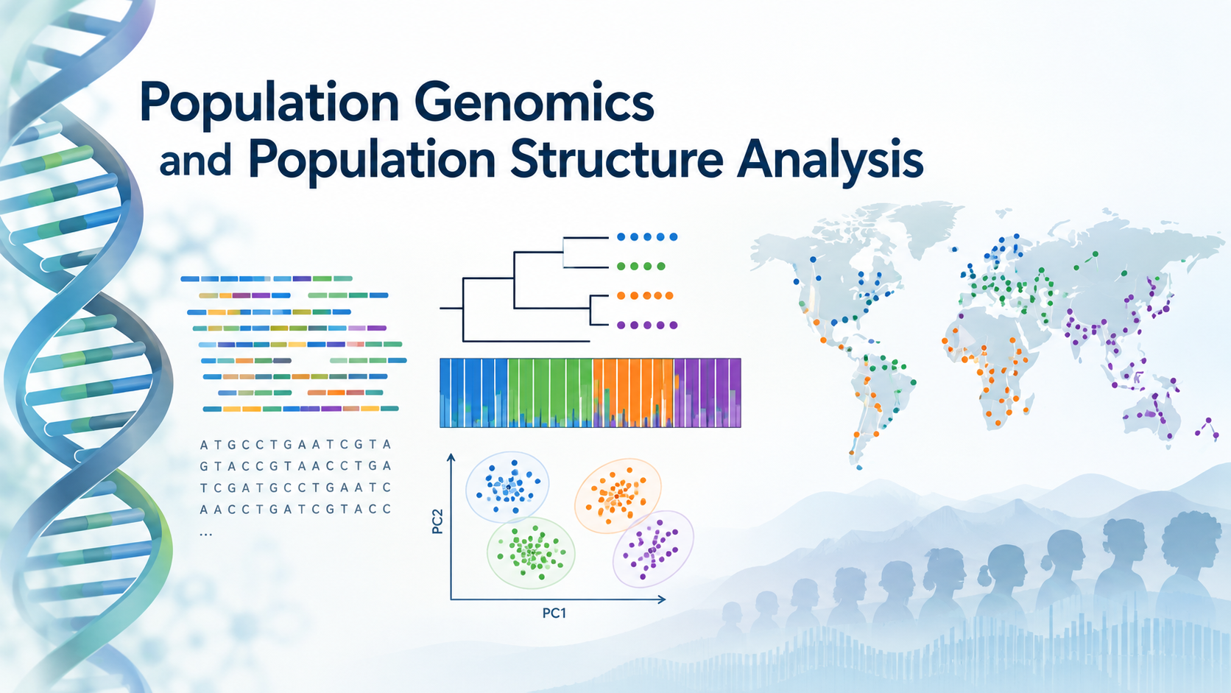
Introgression detection with D-statistic using Neanderthal genomics
PR Stats Course
Nikolay Oskolkov, Group Leader (PI) at NIRI, Riga, Latvia

Slide 2
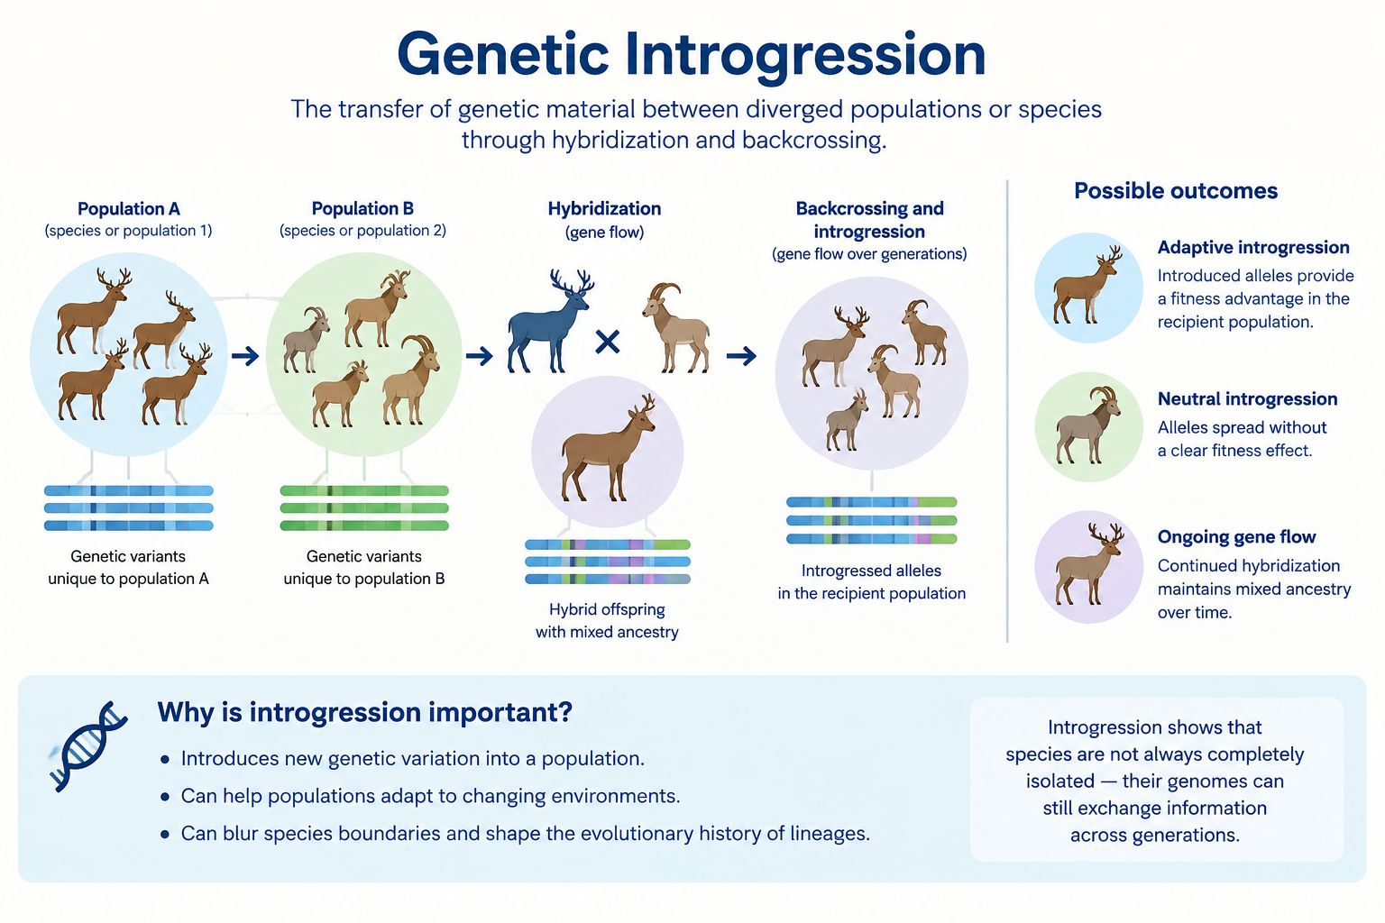

Slide 3
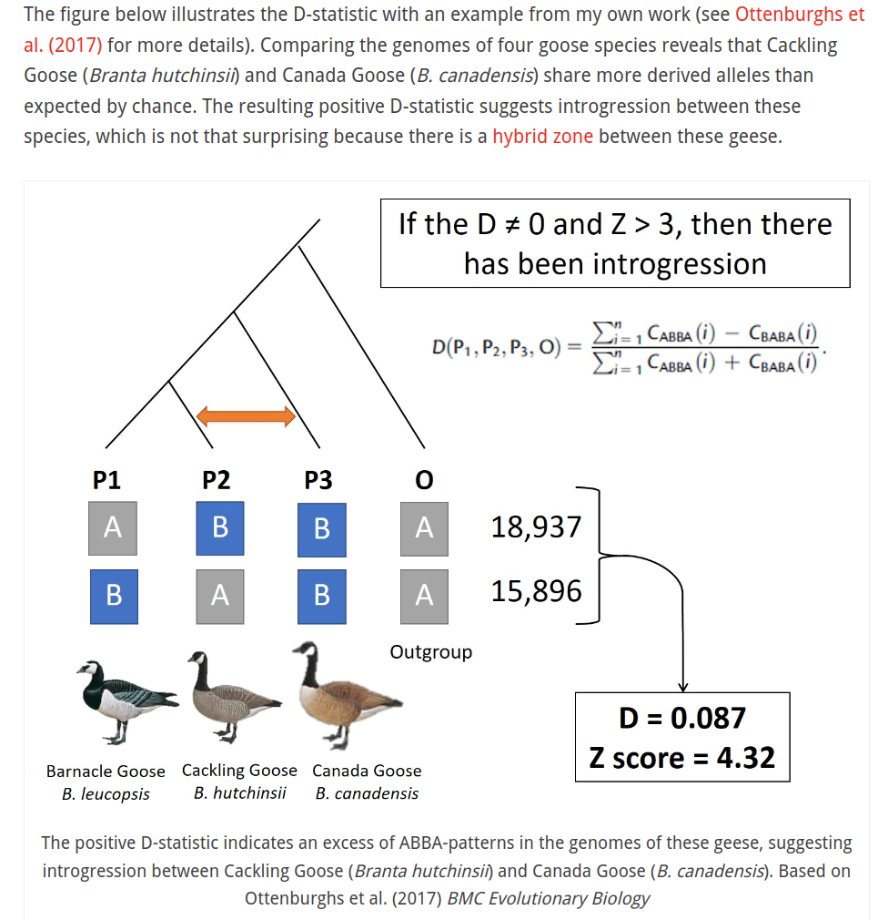

Slide 4
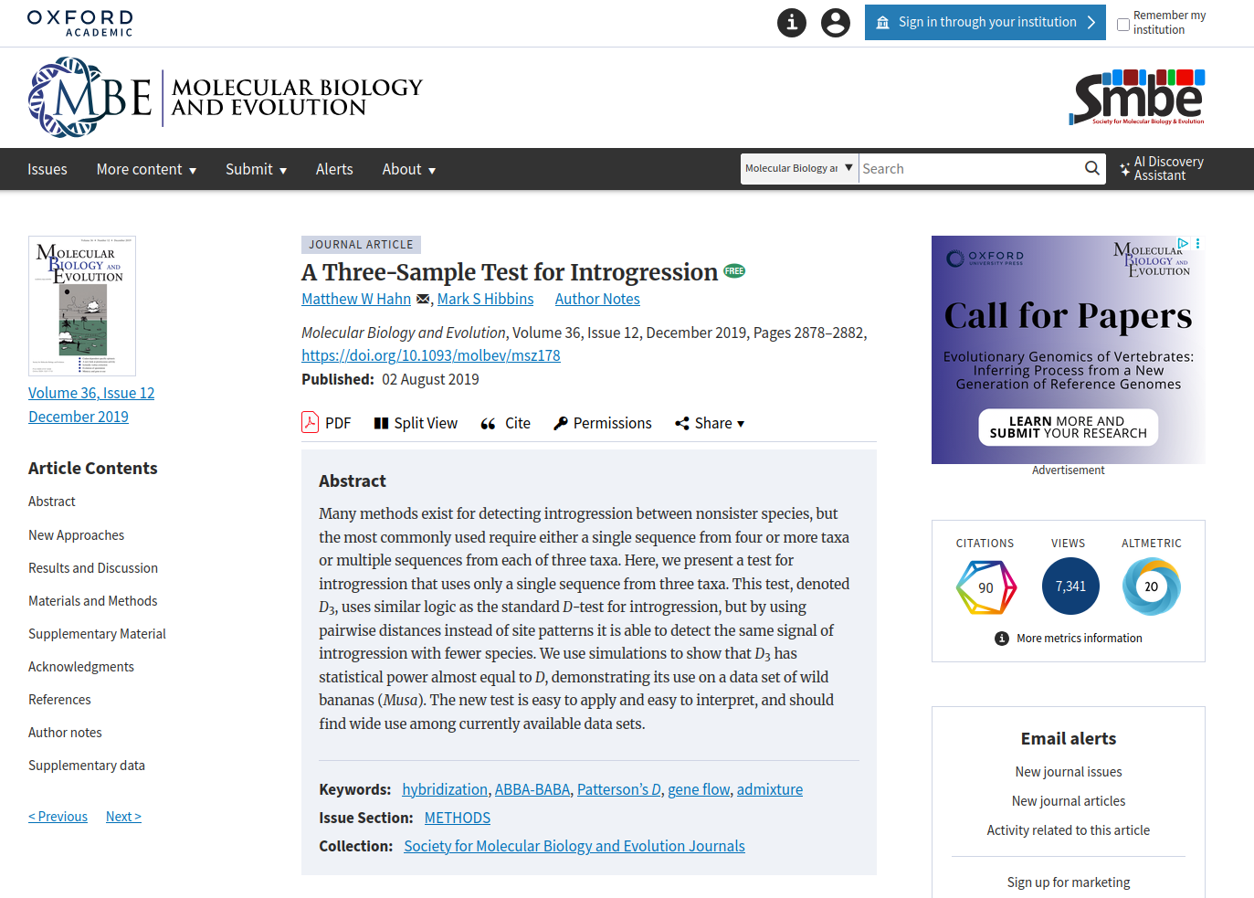

Slide 5


Introduction
to ancient DNA data analysis
...very brief and just in case :))

Slide 6


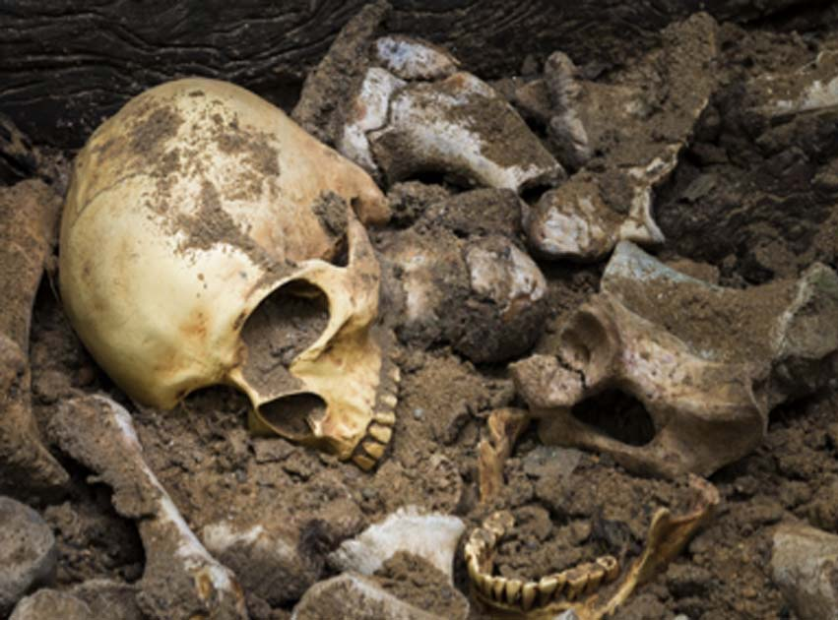

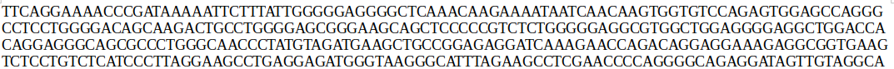
Ancient DNA (aDNA) from archaeological samples
Peculiarity: very few samples with little amounts of DNA, hence hard for statistical analysis
Low statistical evidence to make confident conclusions, predictions can rarely be validated

Slide 7
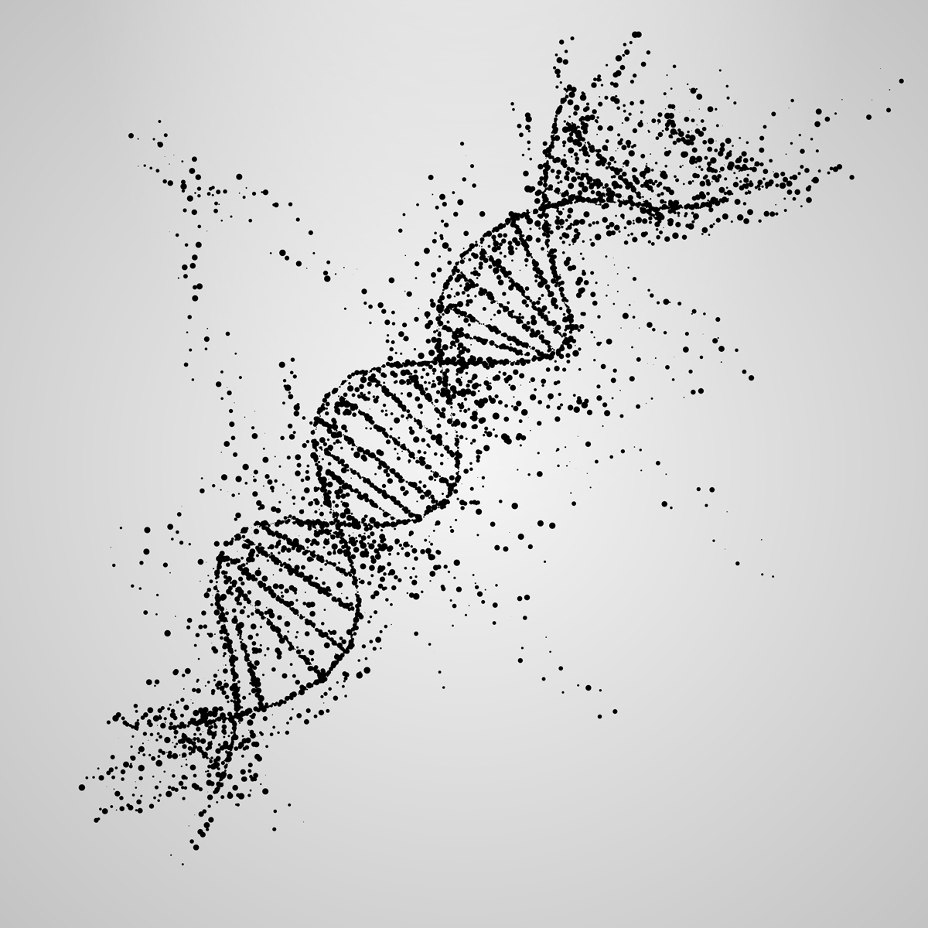
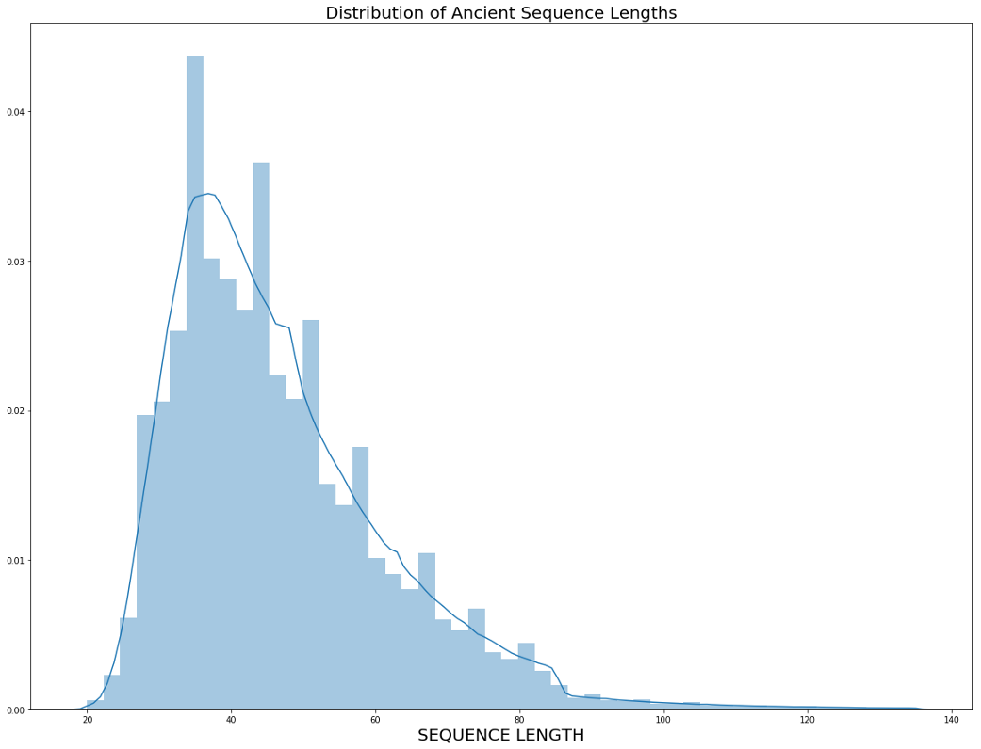
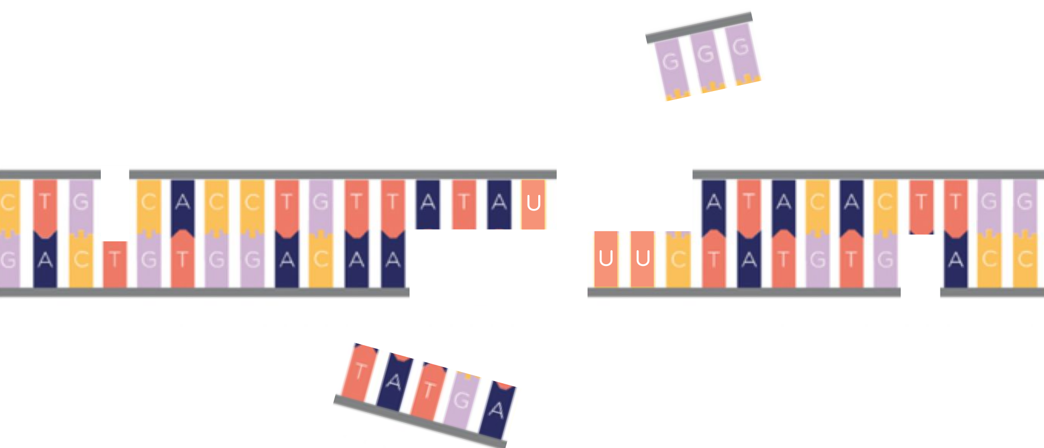
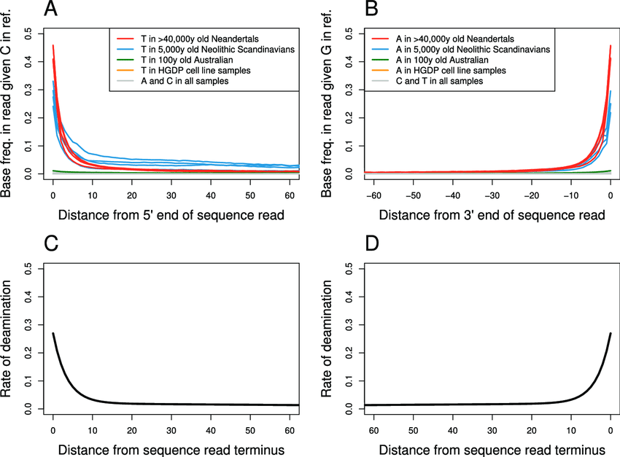
Ancient DNA (aDNA) degradation
DNA fragmentation
A problem with specificity of taxonomic assignment of sequenced DNA reads
Damage / deamination pattern
Deamination process: C → T, G → A
U
Skoglund et al. 2014

Slide 8
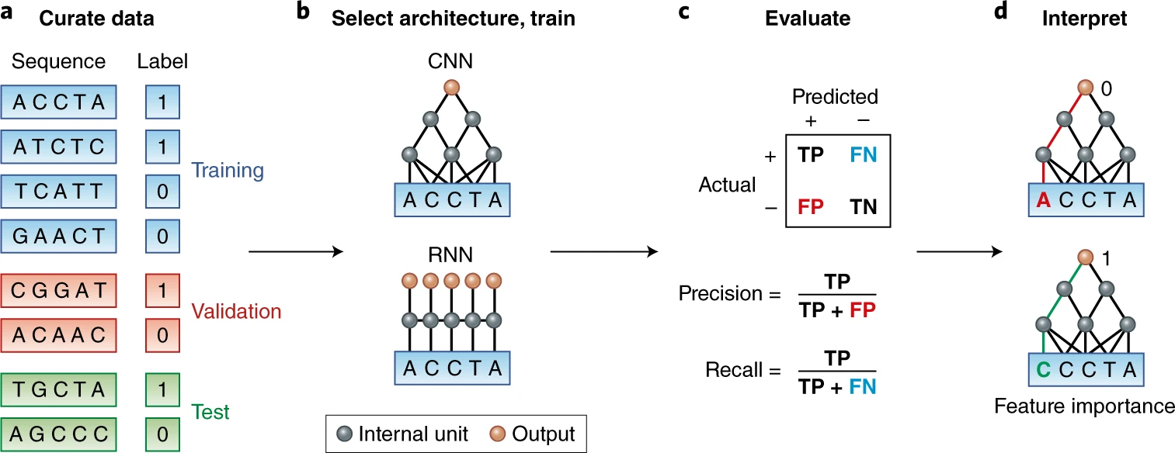
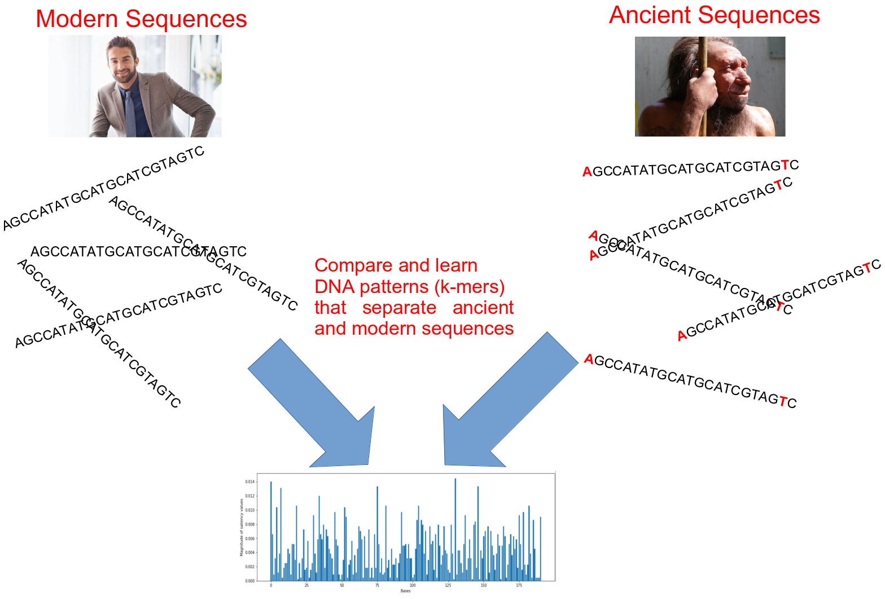
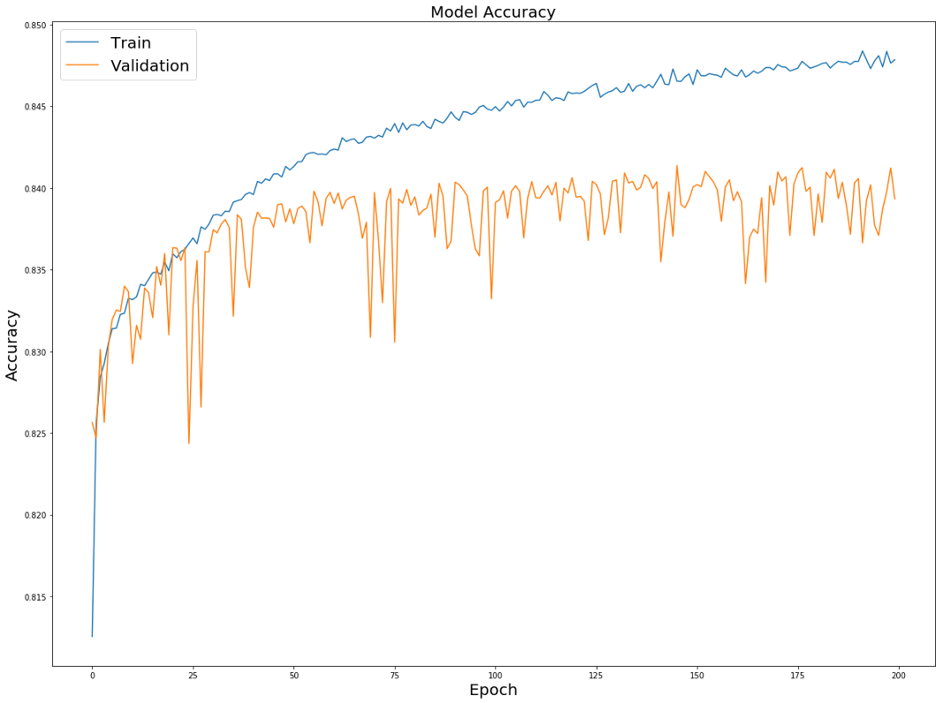
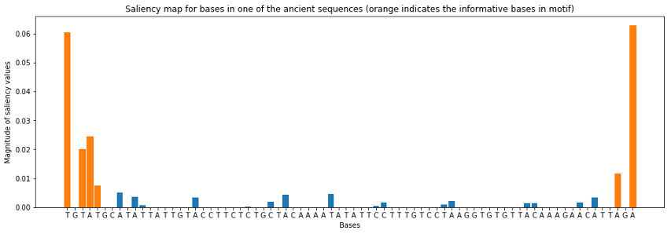

Deep Learning: going beyond deamination?
Zou et al., 2018, Nature Genetics 51, 12-18
Oskolkov et al., unpublished

Slide 9
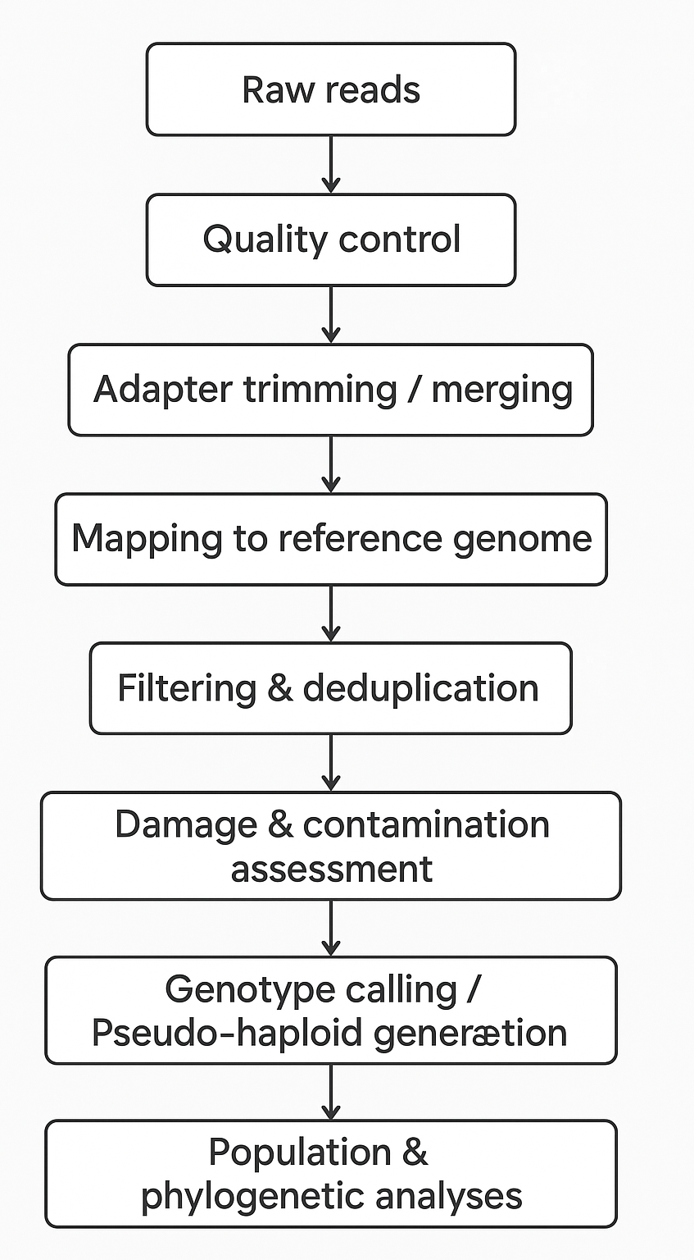
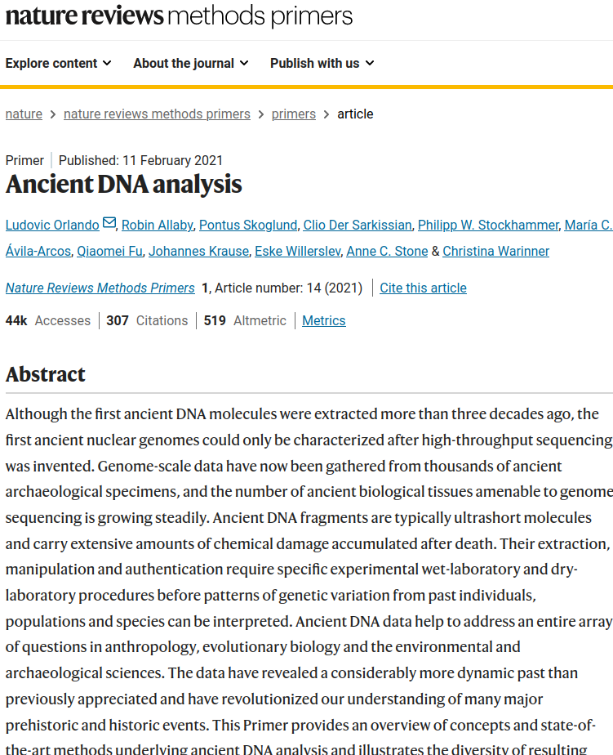
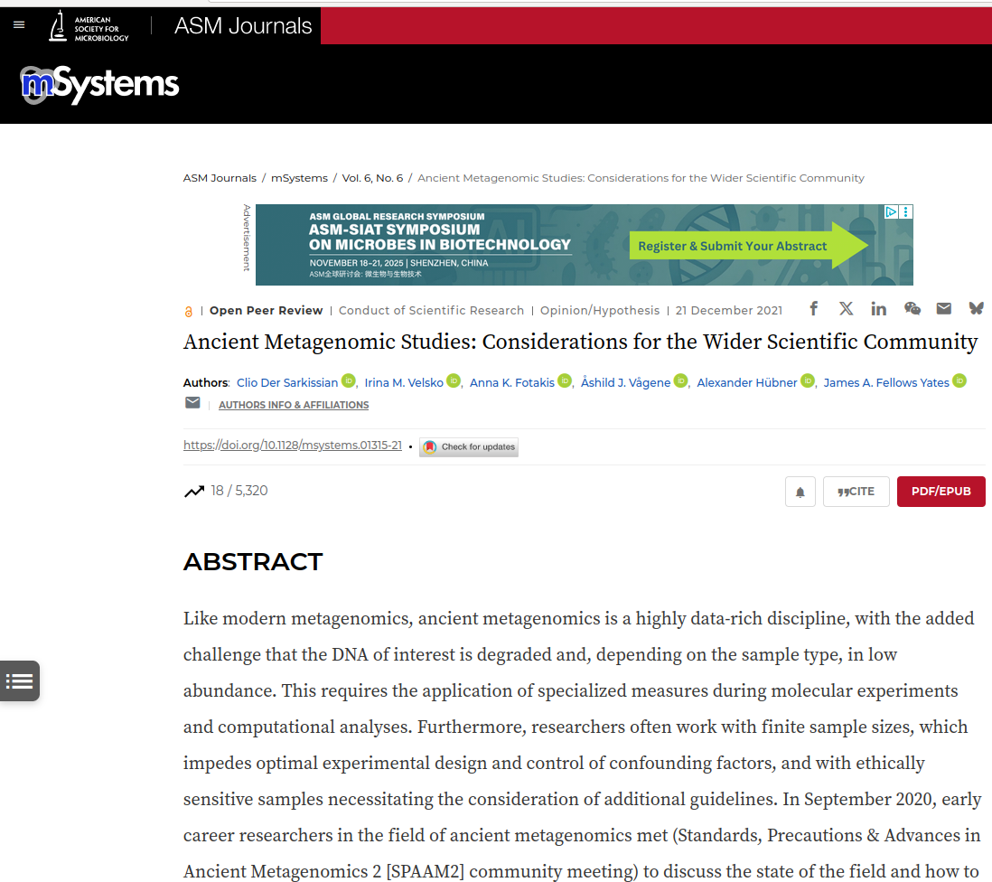
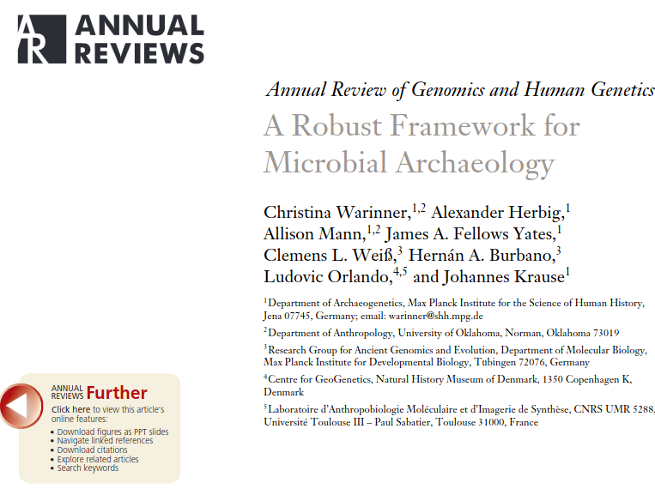
Ancient DNA (aDNA) Analysis Workflow

Slide 10
Neanderthal introgression
in modern human populations

Slide 11
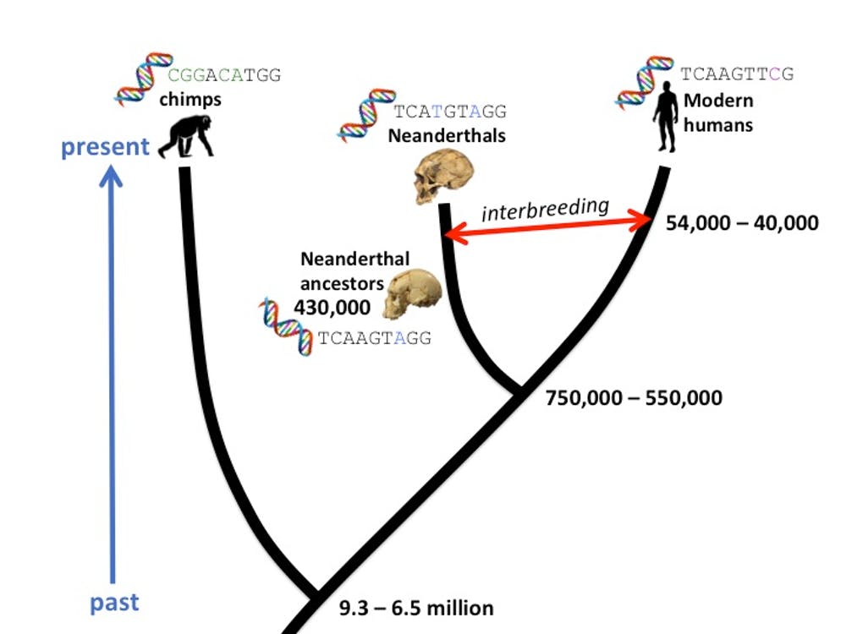
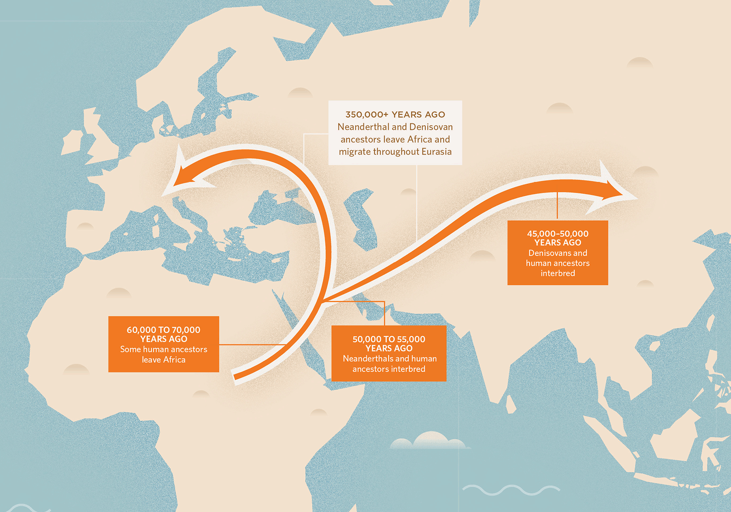
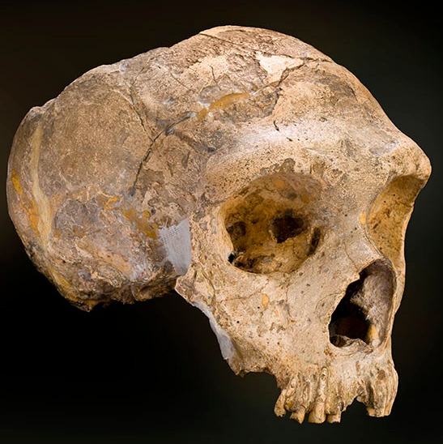
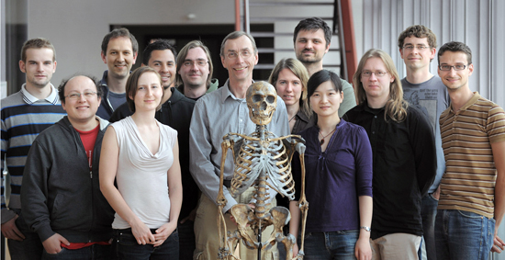
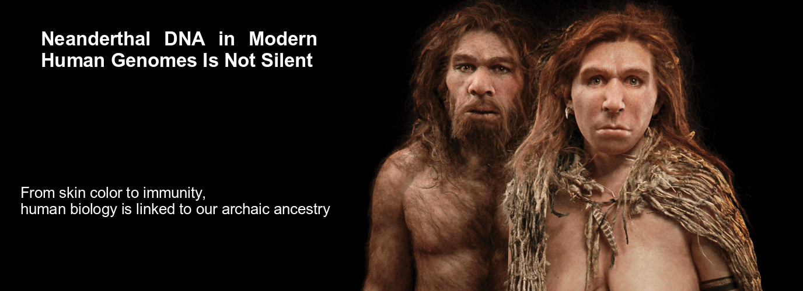
Neanderthal Genomics
2010 Draft Neanderthal Genome Sequenced

Slide 12
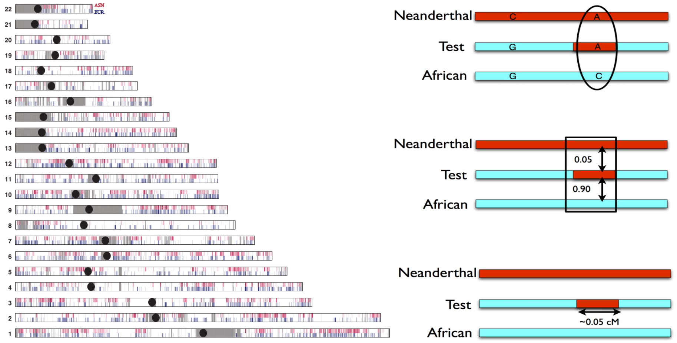
Segments of Neanderthal introgression
Conditional Random Fields (CRF): David Reich et al., Nature 2014, 2016
S* and S’ statistics: Benjamin Vernot and Joshua Akey, Science 2014, 2016

Slide 13
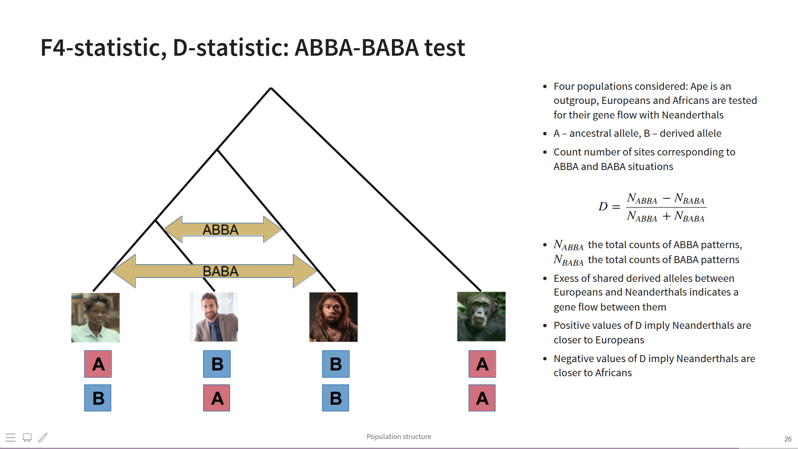

Slide 14
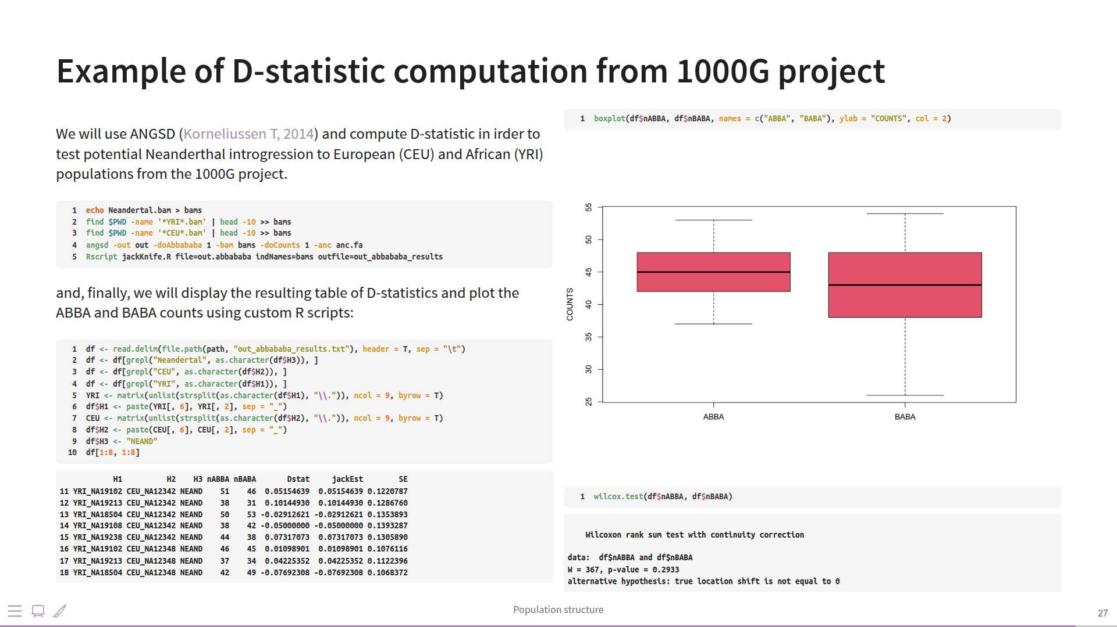

Slide 15
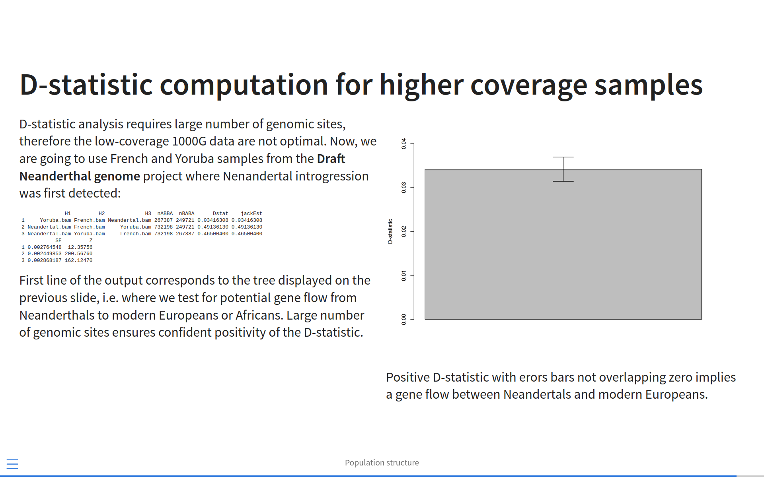

Slide 16
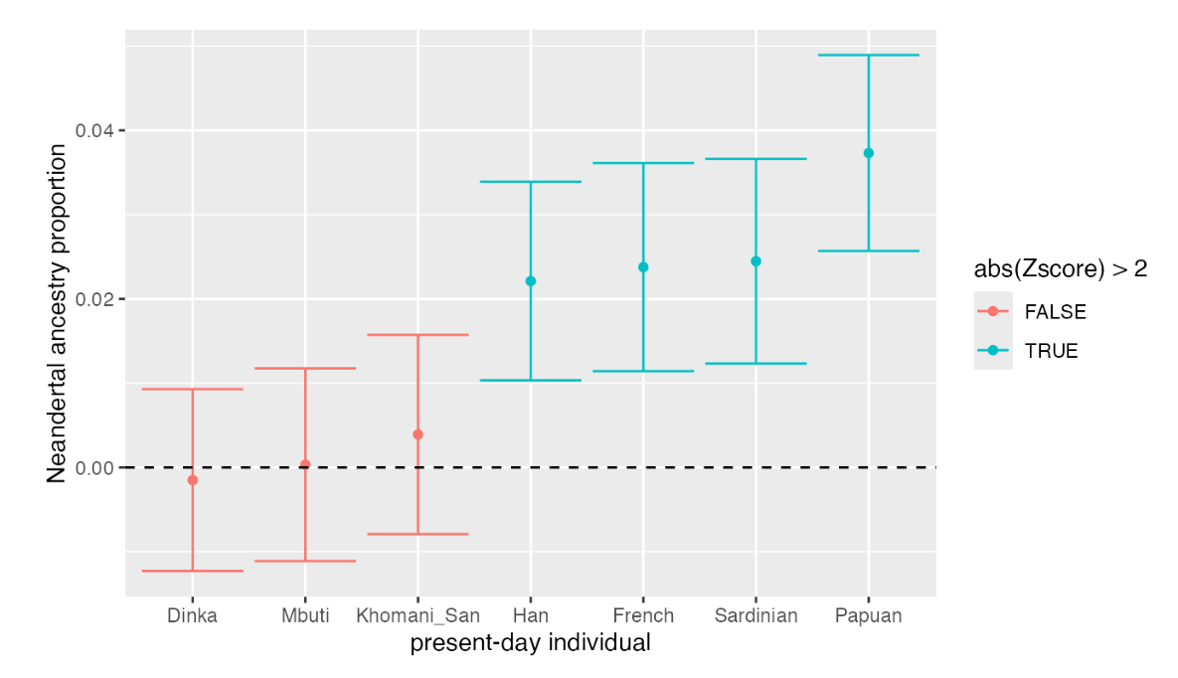

Slide 17
