Slide 1


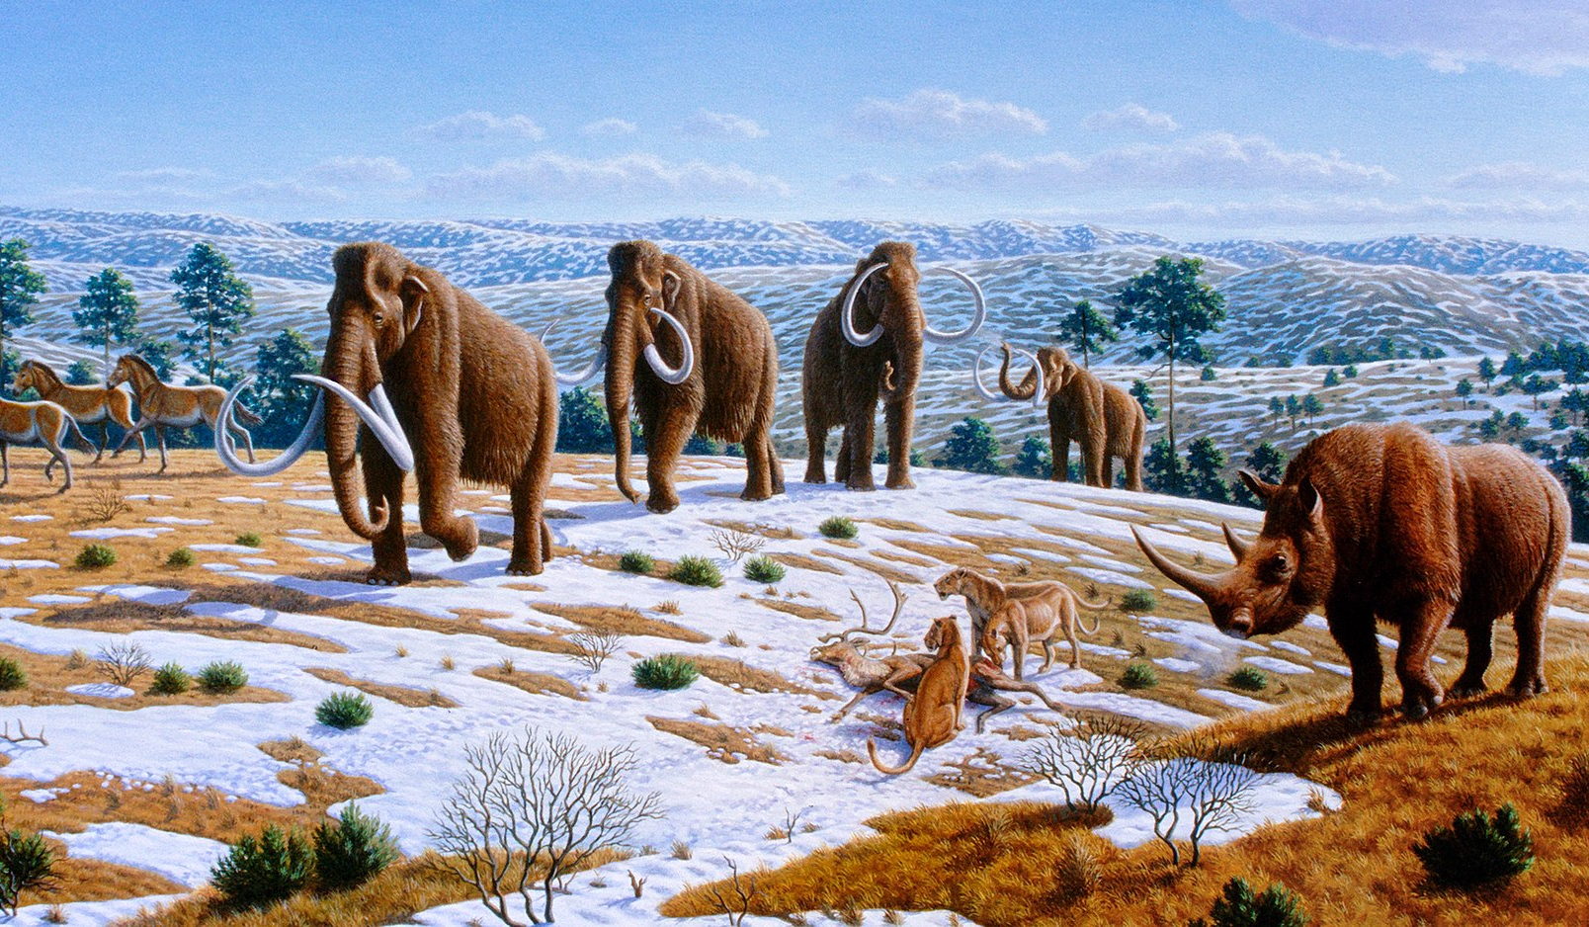
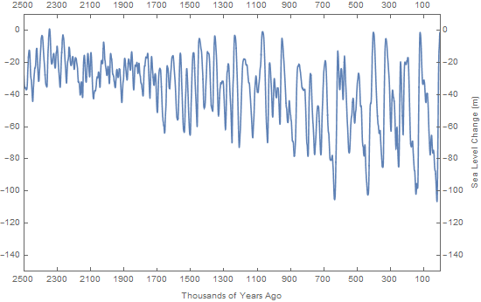
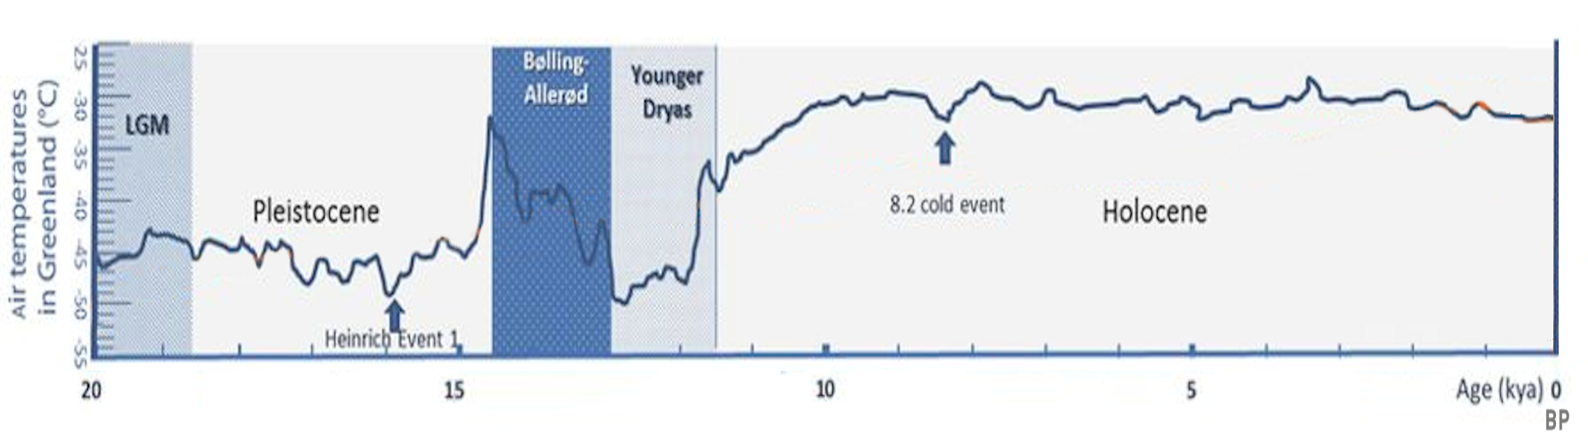
Evolutionary time series and selection signals
Nikolay Oskolkov, Group Leader (PI) at NIRI, Riga, Latvia
Images adapted from Wikipedia, Pleistocene Park

Slide 2
Introduction to Time Series:
White Noise and Random Walk

Slide 3
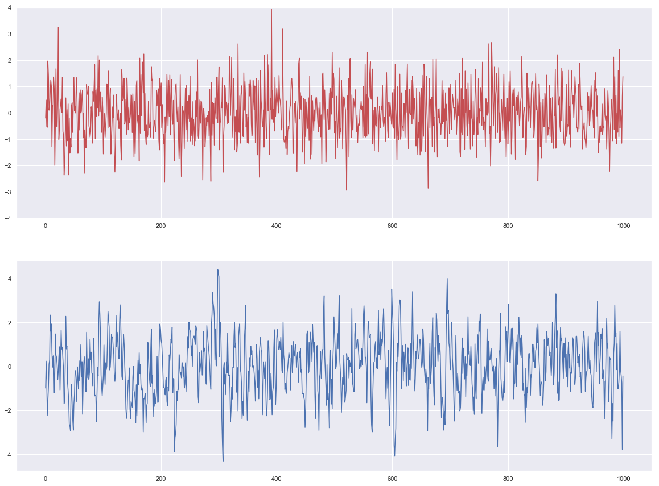
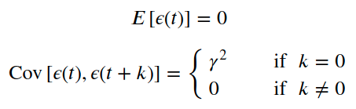
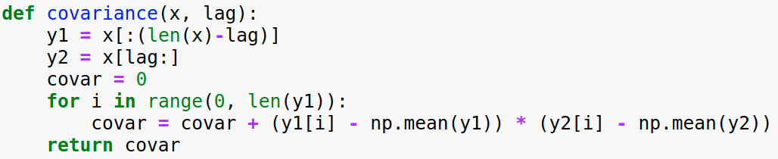
White Noise vs. Correlated Signal
White Noise:
Autocorrelation / temporal covariance
1, 2, 3, 4, 5
2,
1, 2, 3, 4, 5
Pearson correlation

Slide 4
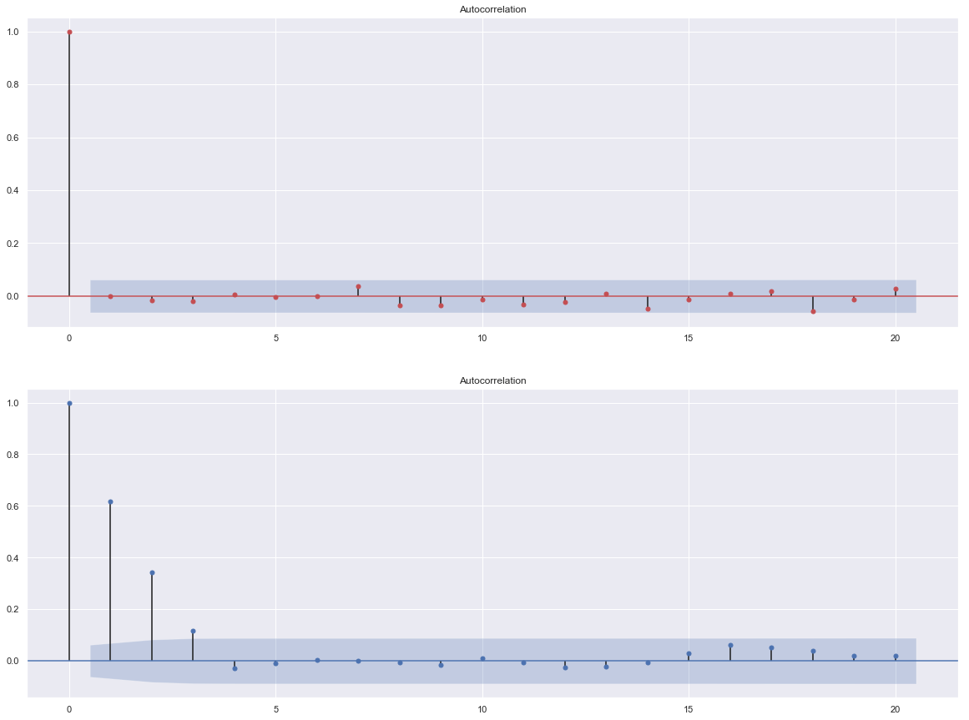
Autocorrelation / Temporal Covariance
Pearson correlation coefficient
Lag
Pearson correlation coefficient
Lag

Slide 5
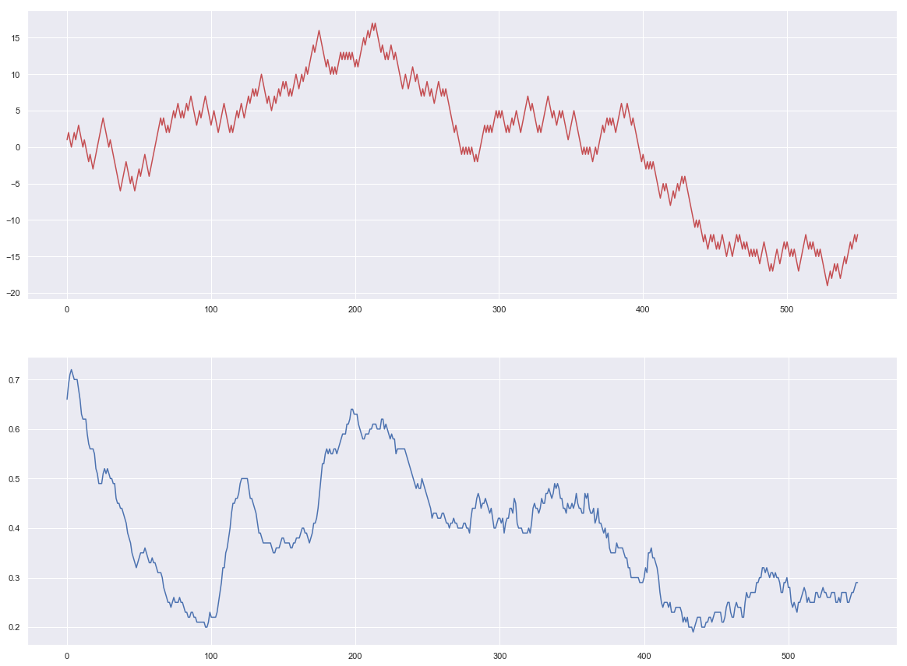
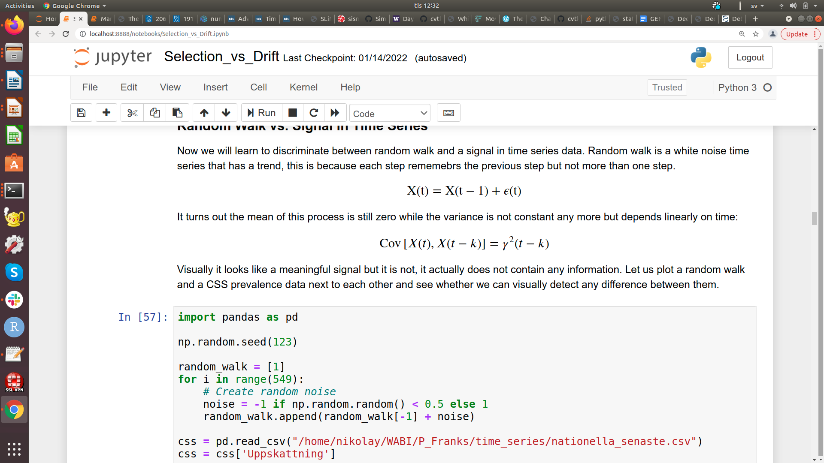
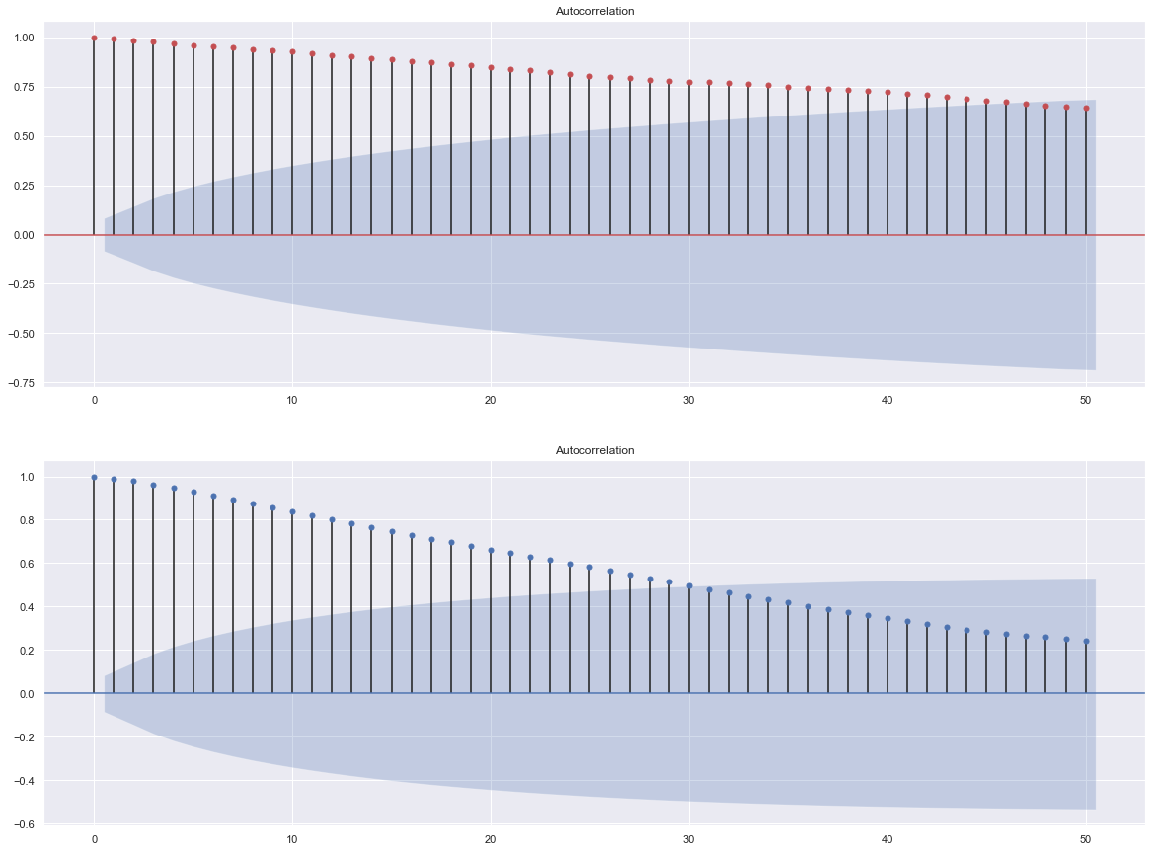
Random Walk (Short-Memory Process)
Markov chain:
White noise

Slide 6
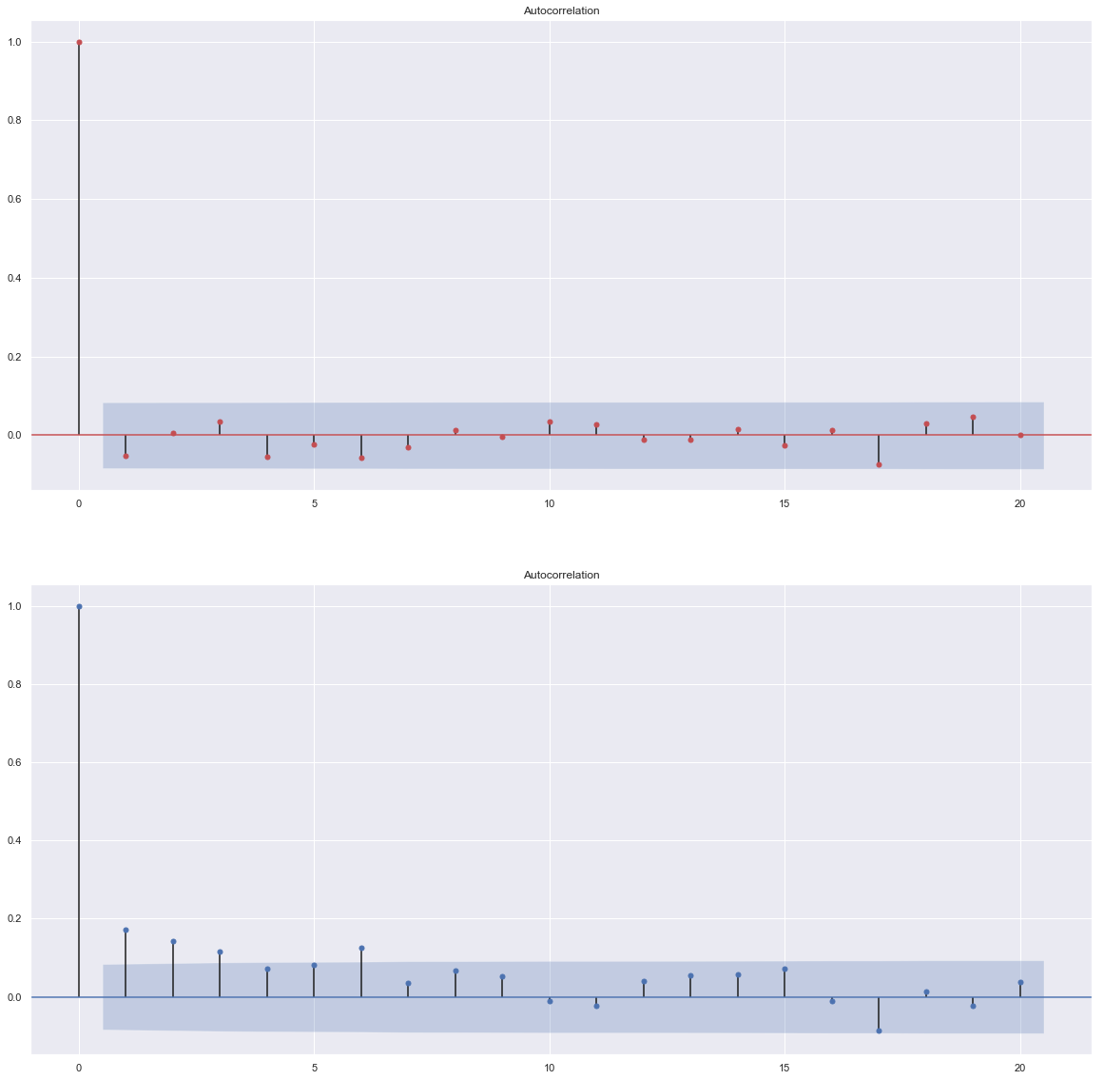
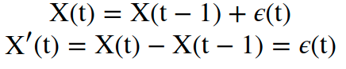
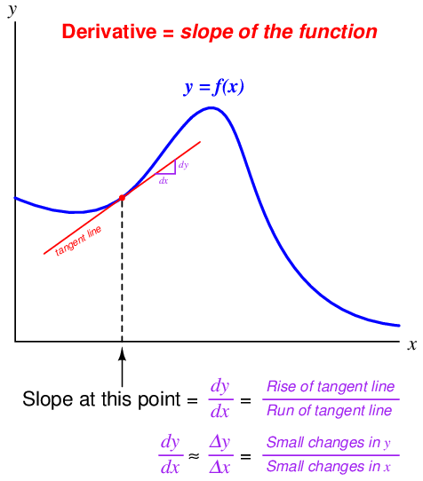
Autocorrelation of First Derivative
Derivative of a random walk is a white noise:
Pearson correlation coefficient
Lag
Pearson correlation coefficient
Lag

Slide 7
Allele Frequency Temporal Trajectory

Slide 8
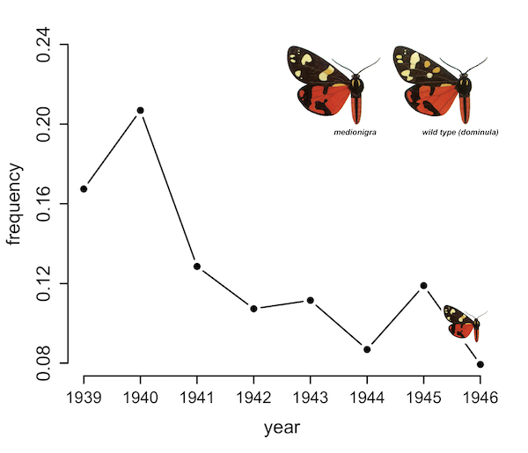
Allele Frequency: Selection vs. Drift
Is the change in
allele frequency
purely random?
Fisher & Ford (1947)

Slide 9
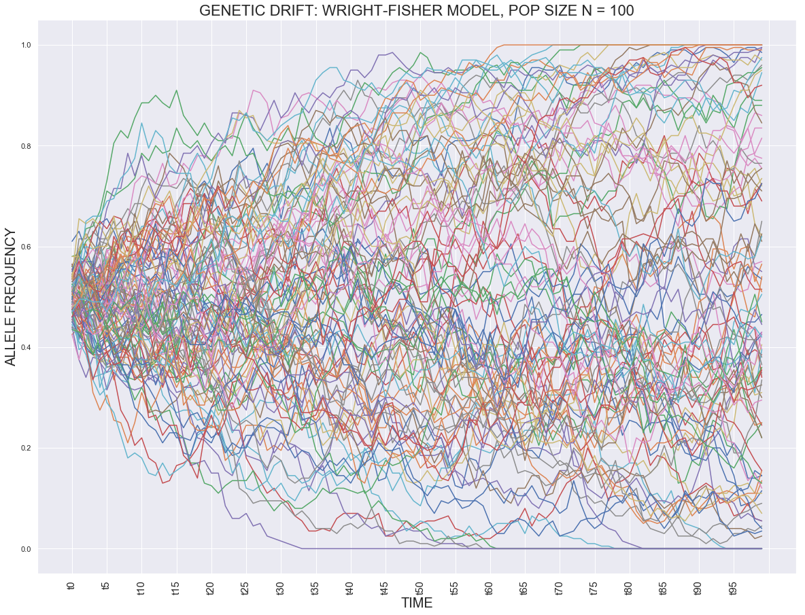
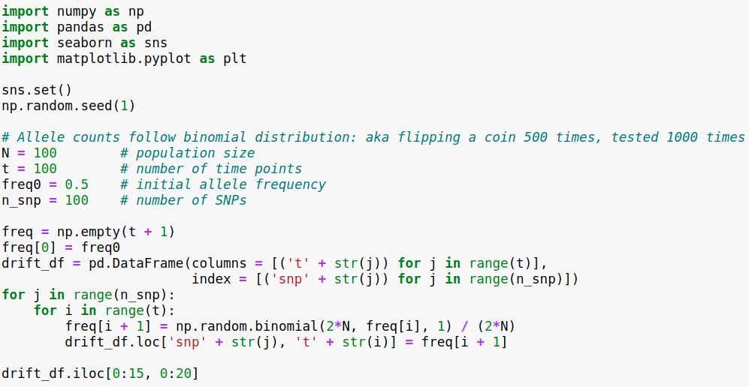
Genetic Drift as a Random Walk
Genetic drift is a random walk
(Markov chain) from Wright-Fisher
model definition

Slide 10
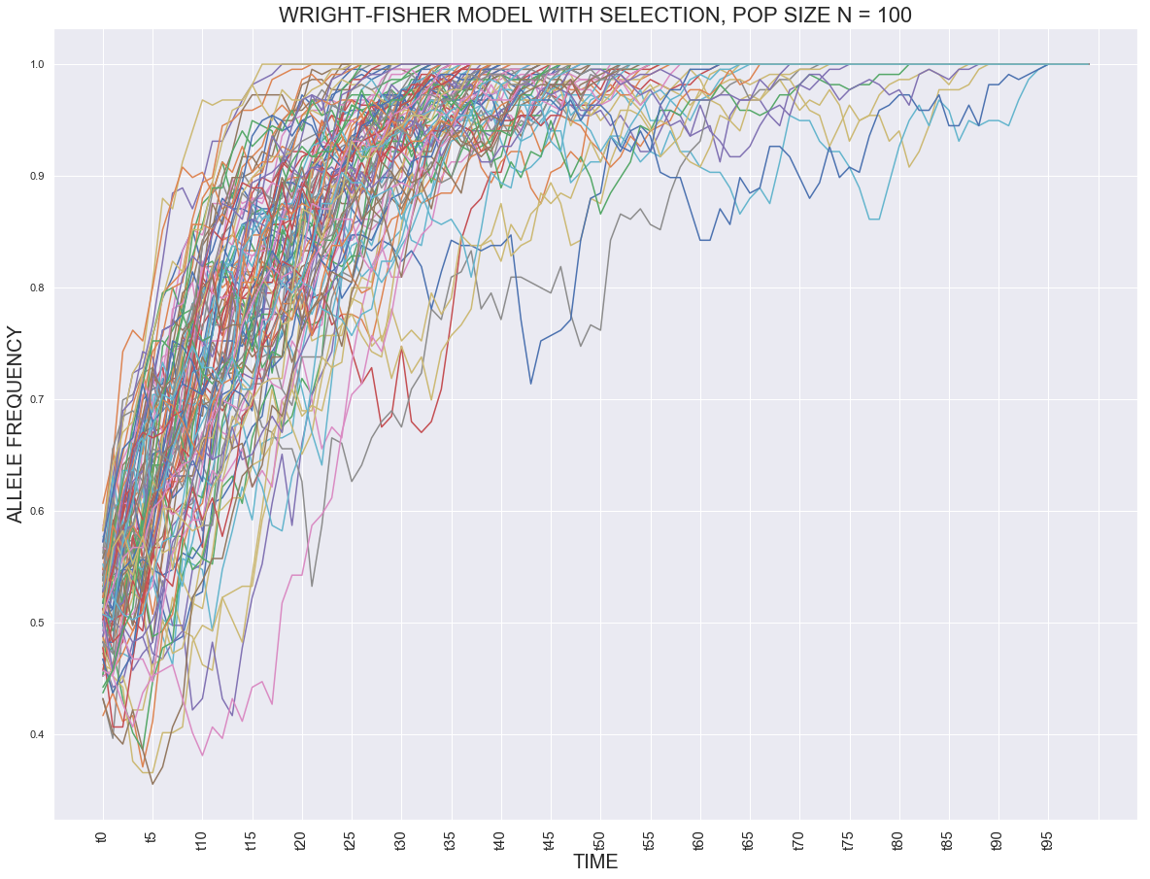
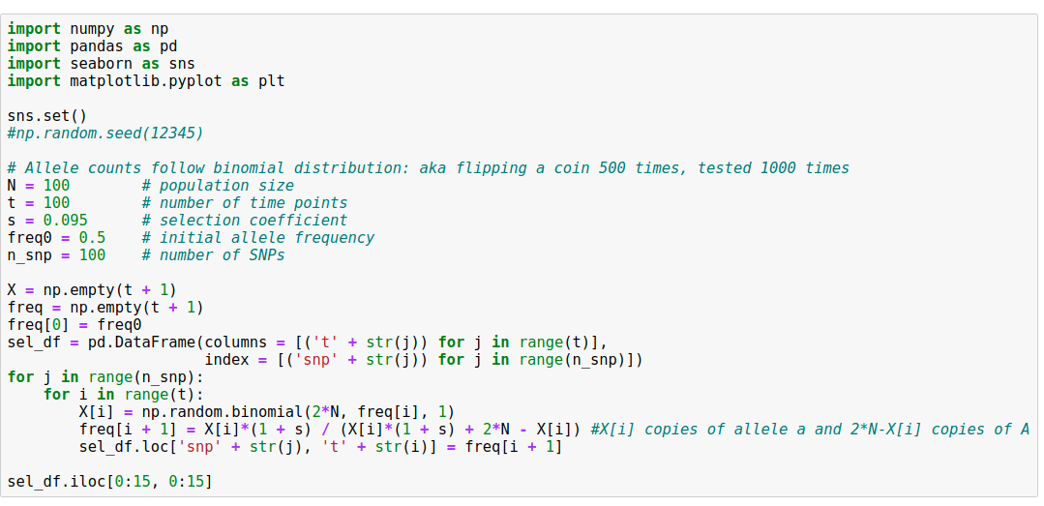
Wright-Fisher with Selection
Adding selection (s) makes allele
frequency trajectory more
directional (faster fixation)

Slide 11
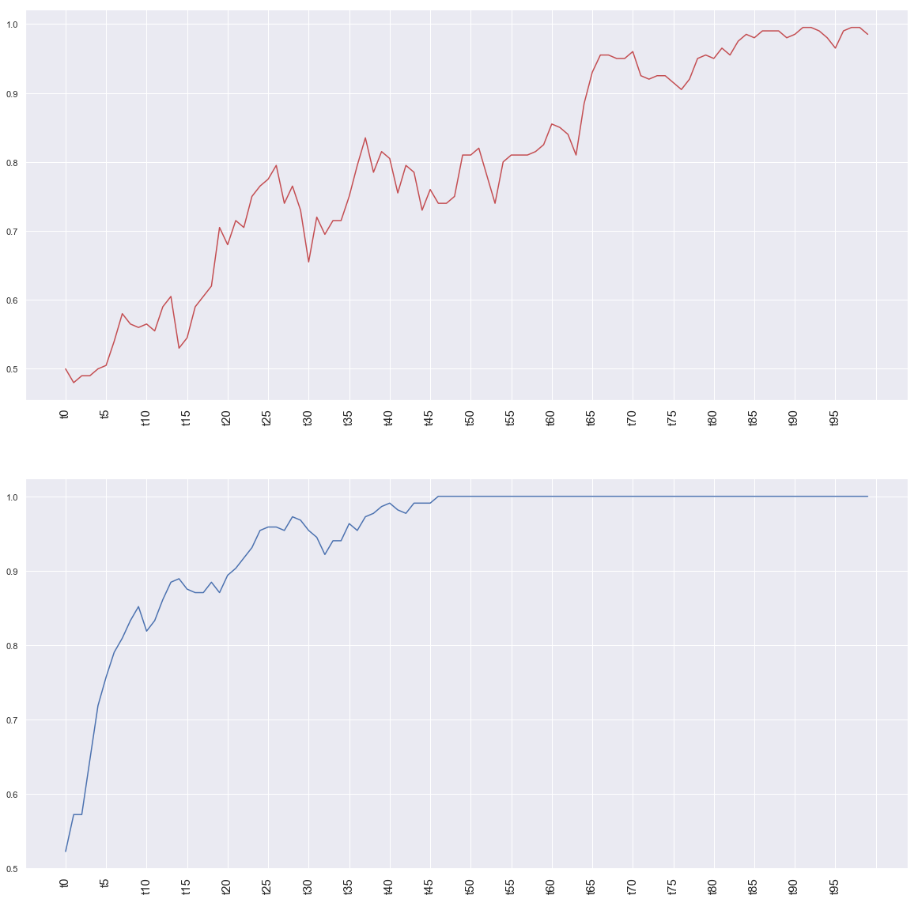
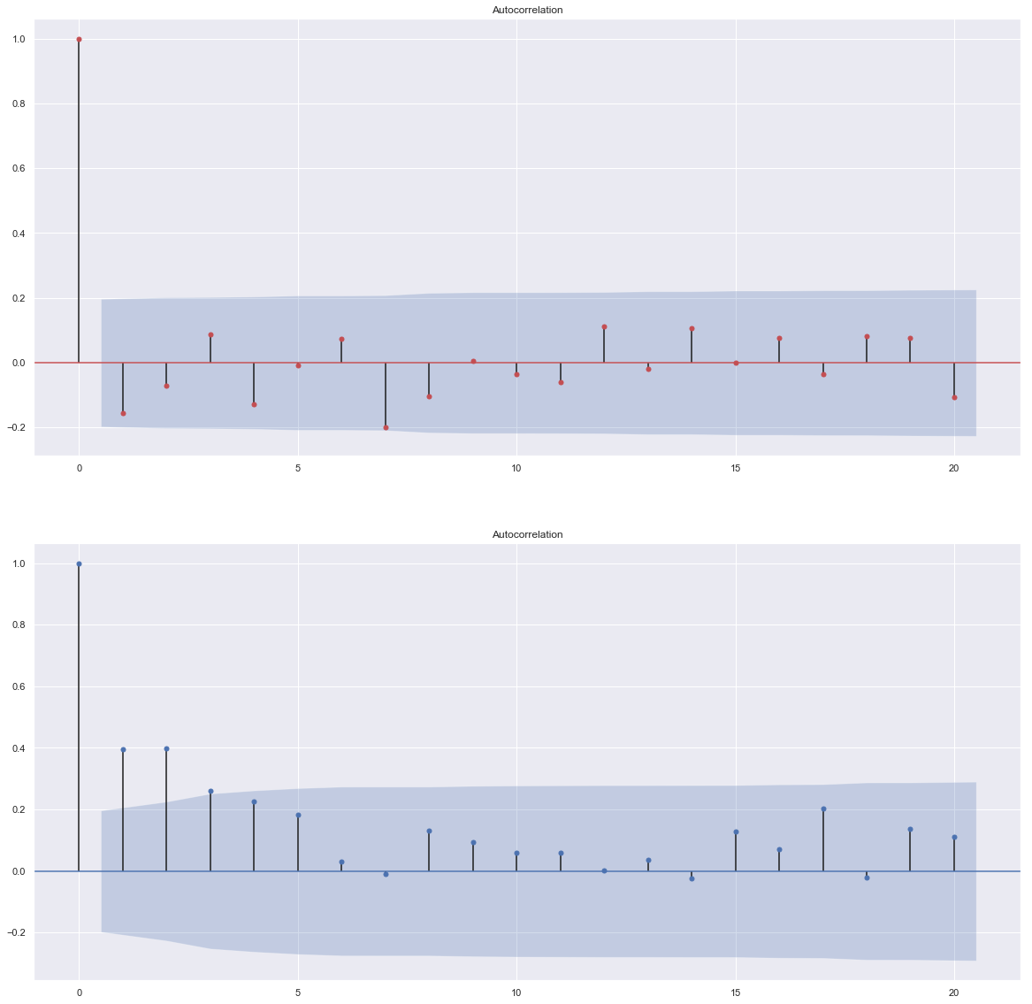
Genetic Drift vs. Natural Selection:
Autocorrelation of First Derivative

Slide 12
Buffalo & Coop, PNAS 2020
Temporal Covariance Approach

Slide 13
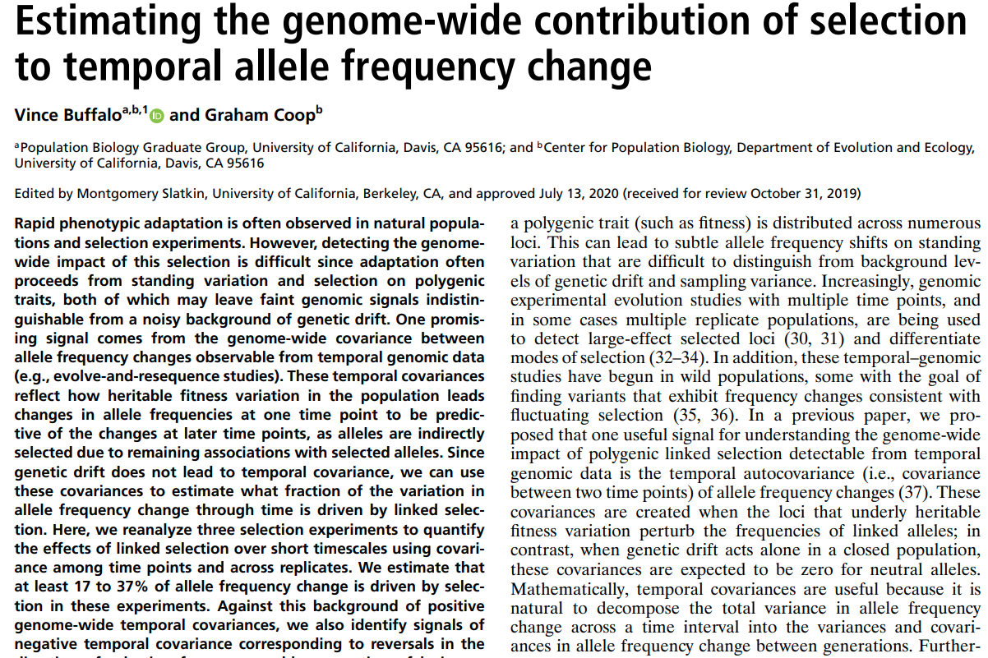
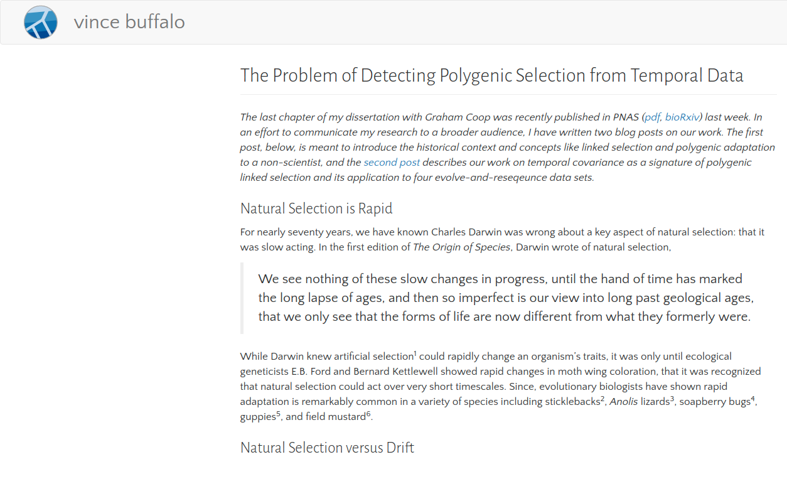

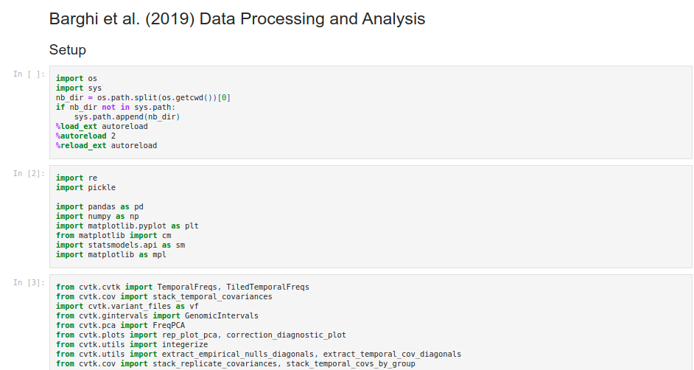
Detecting Selection in Time Series Data
Notebooks are poorly commented,
hard to run and understand
(personally for me)

Slide 14
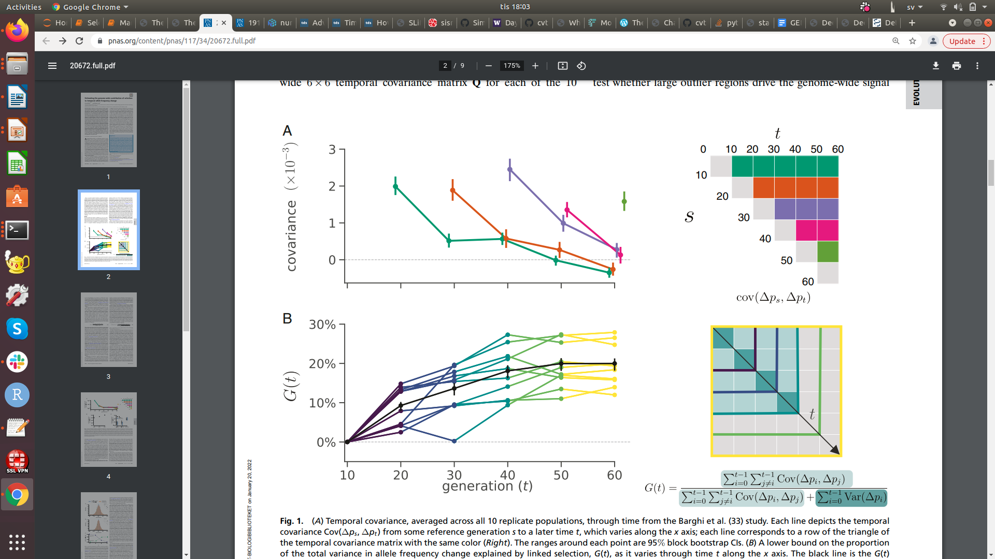
Buffalo & Coop Analysis: Barghi et al. 2019
What is a temporal covariance?
Why do you compute the temporal covariance on Δ allele frequency?
Why do you expect a temporal covariance to be positive under selection?
Why can’t genetic drift demonstrate a non-zero temporal covariance?

Slide 15
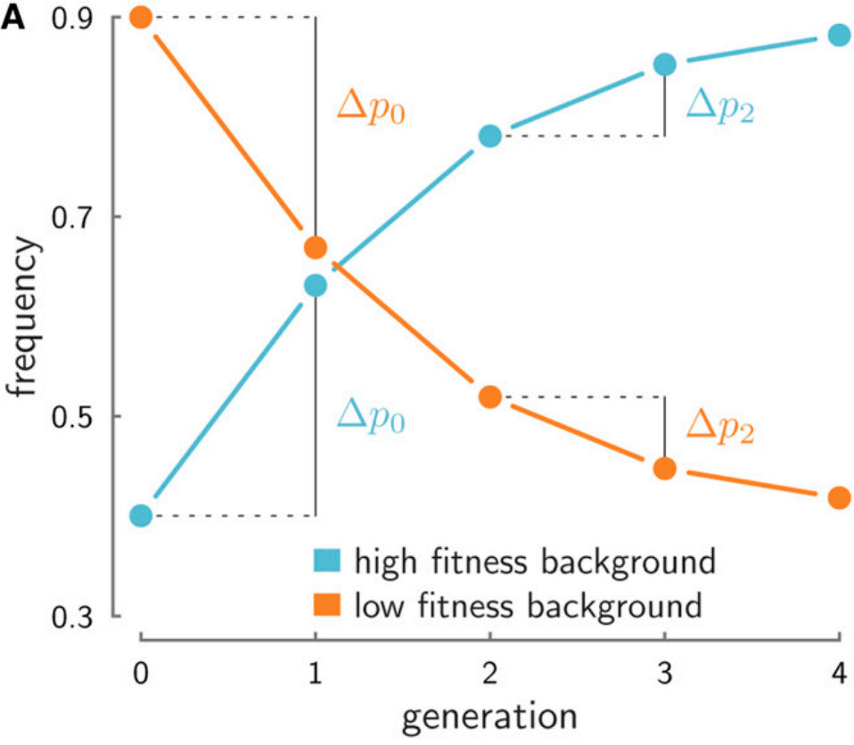
Explanation of Buffalo & Coop Method
If we were to track this neutral allele’s frequency trajectory through time in the entire population, we would see it rise between the two first consecutive generations, and then rise again between the next two, as long as it remains associated with a fraction of the father’s beneficial genes. The neutral allele’s frequencies between the second and first generation (mathematically, Δp1=p2−p1), and the third and second generation (Δp2=p3−p2) would both change in the same direction when they are associated with a good background, creating positive temporal covariance in the frequency trajectory.
In contrast, genetic drift cannot create positive temporal covariance in neutral allele frequency trajectories. Another way to say this is that when different chromosomes have heritable fitness differences, the frequency change of an allele at one time interval can be predictive of the changes at later generations, as long as the allele is still associated with its fitness background, and that background has the same effect on fitness.

Slide 16
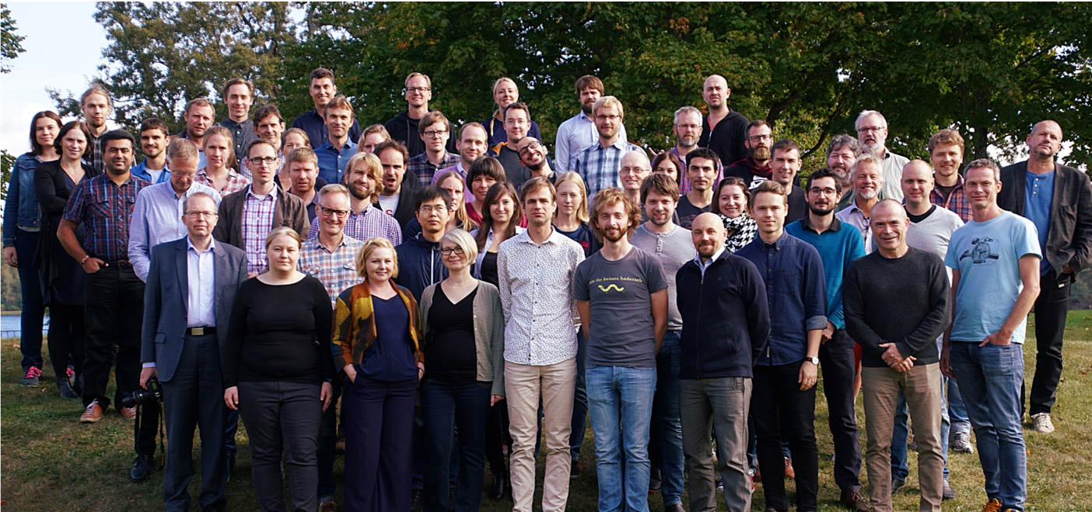



National Bioinformatics
Infrastricture Sweden (NBIS)

