Slide 1
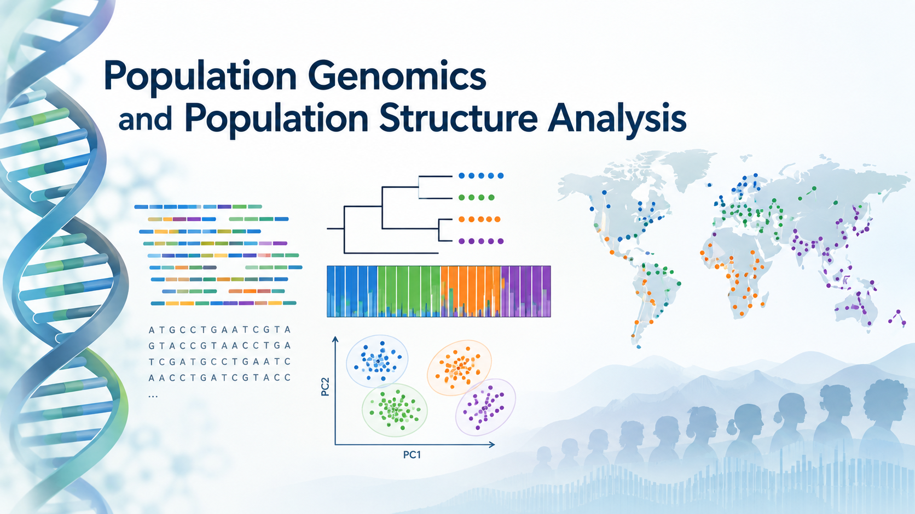
Probabilistic variant calling from low-coverage data with ANGSD
PR Stats Course
Nikolay Oskolkov, Group Leader (PI) at NIRI, Riga, Latvia

Slide 2
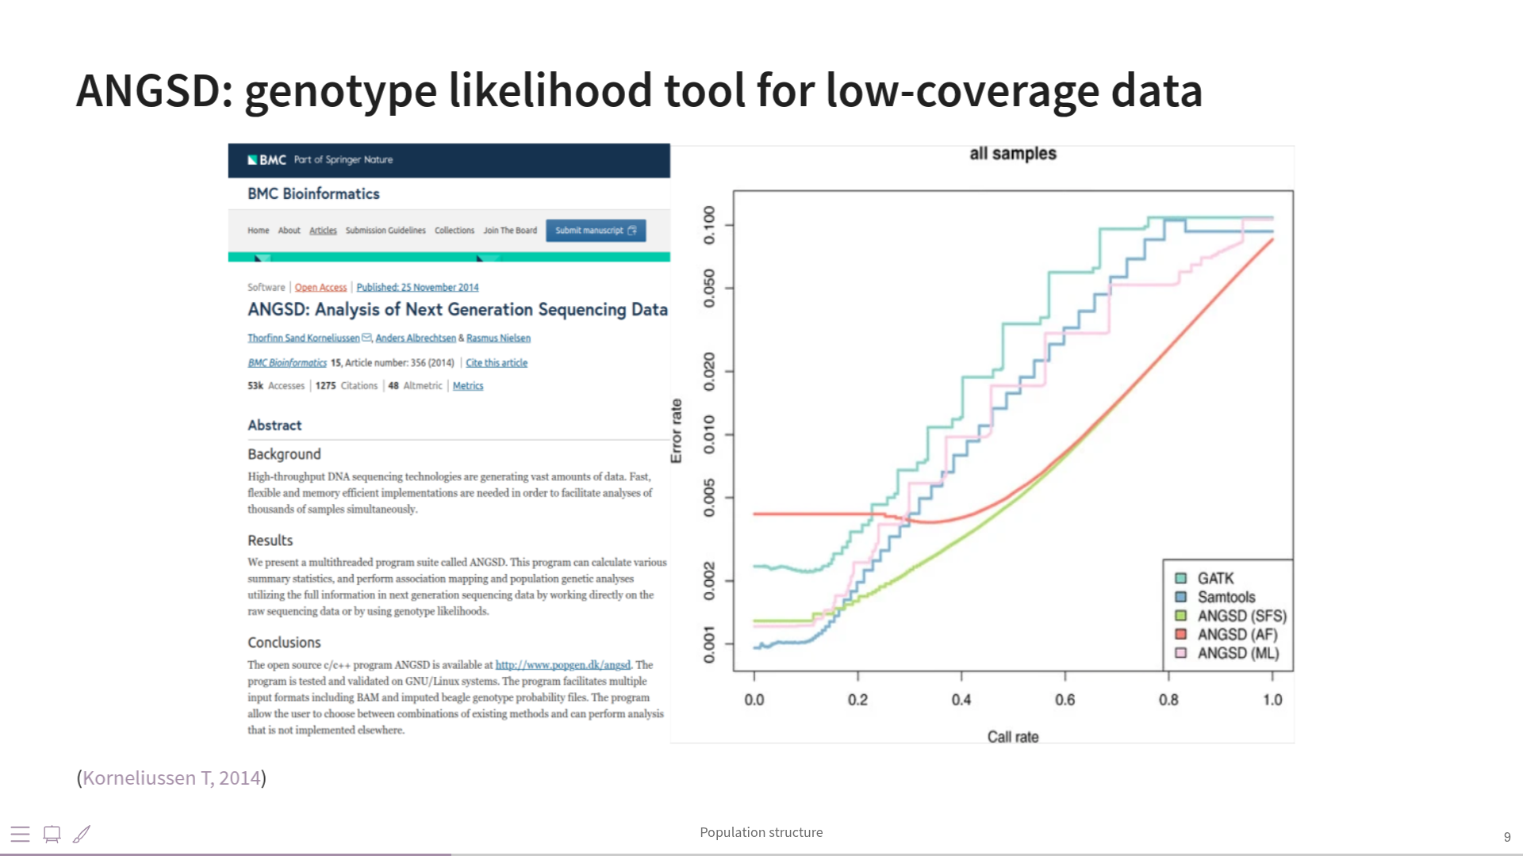

Slide 3
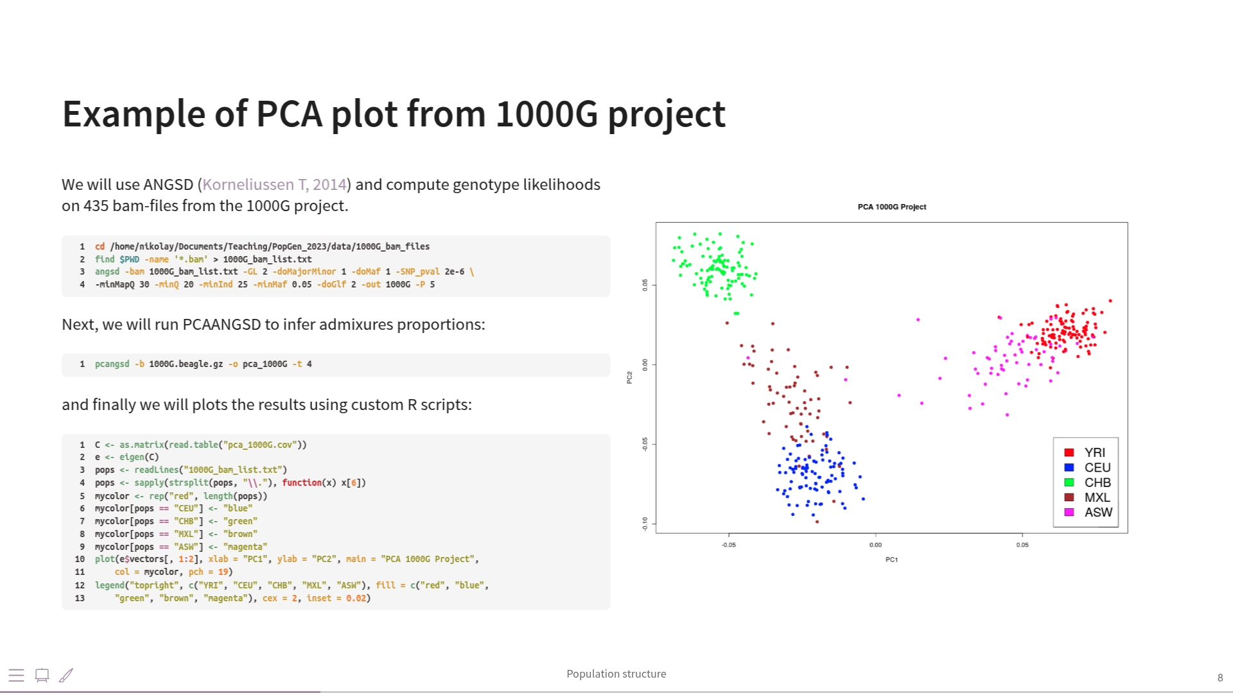

Slide 4
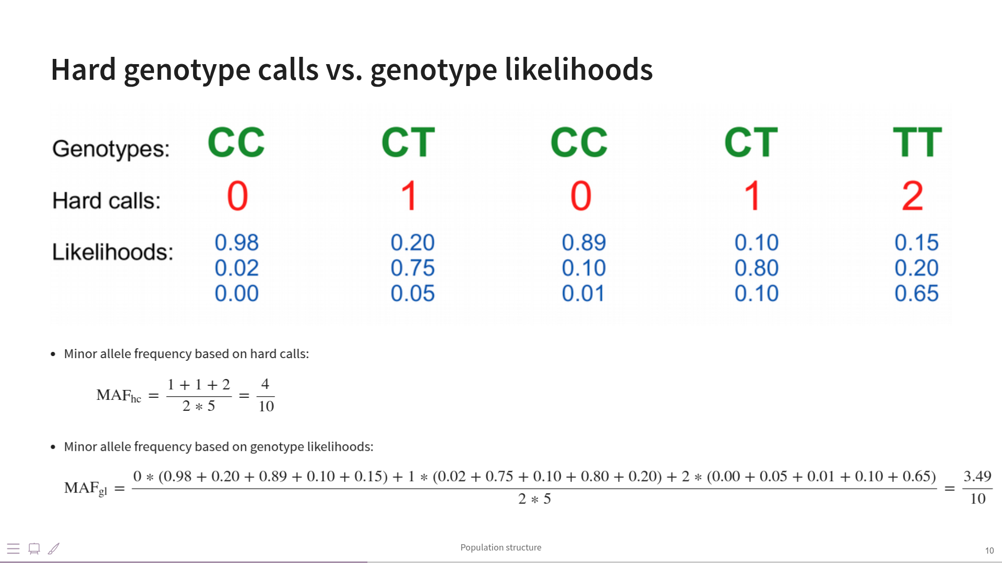

Slide 5
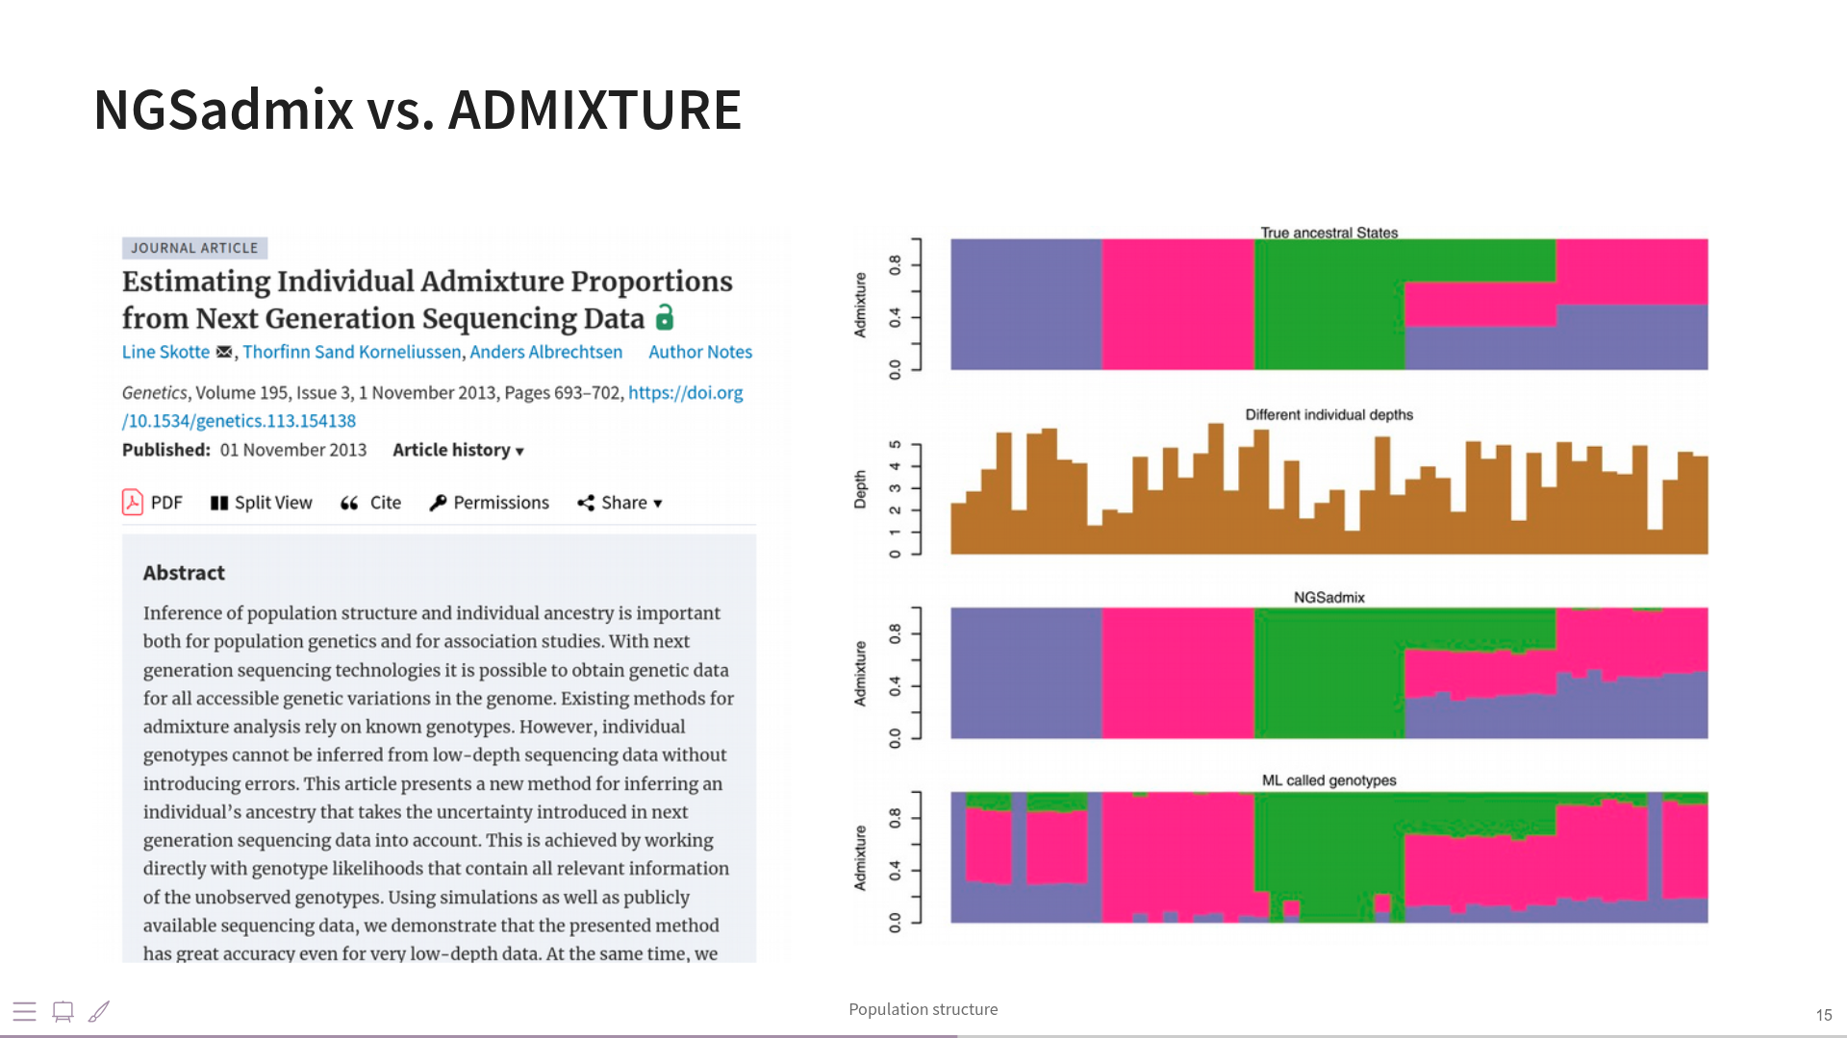

Slide 6
