Slide 1


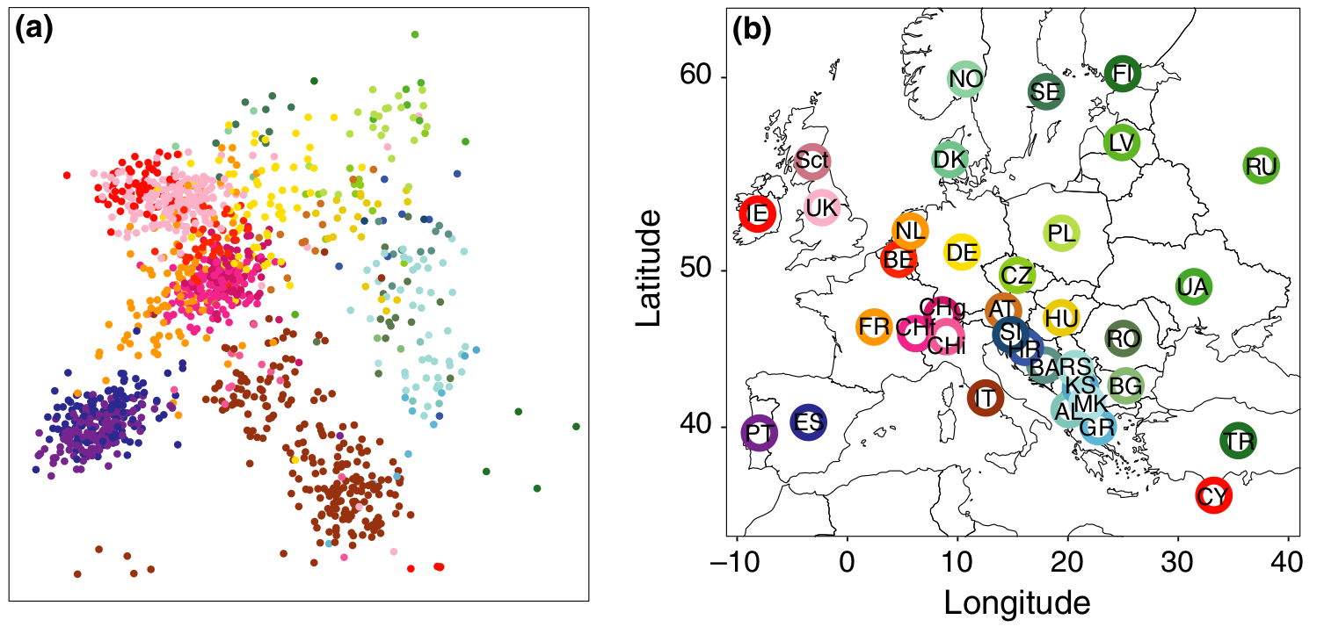
PCA for Population Genetics
Nikolay Oskolkov, Group Leader (PI) at NIRI, 28.09.2026

Slide 2
PCA Introduction

Slide 3

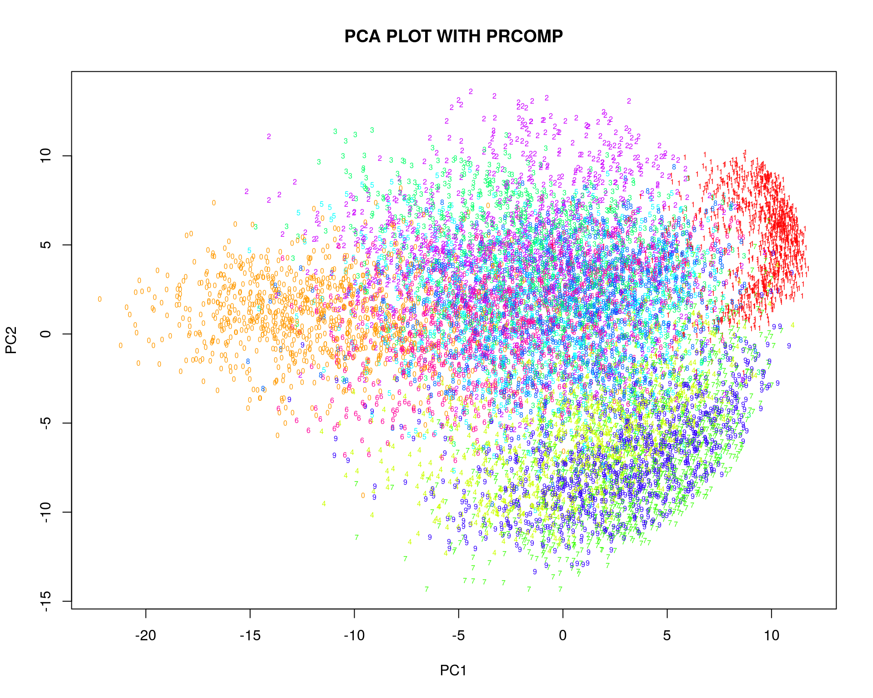
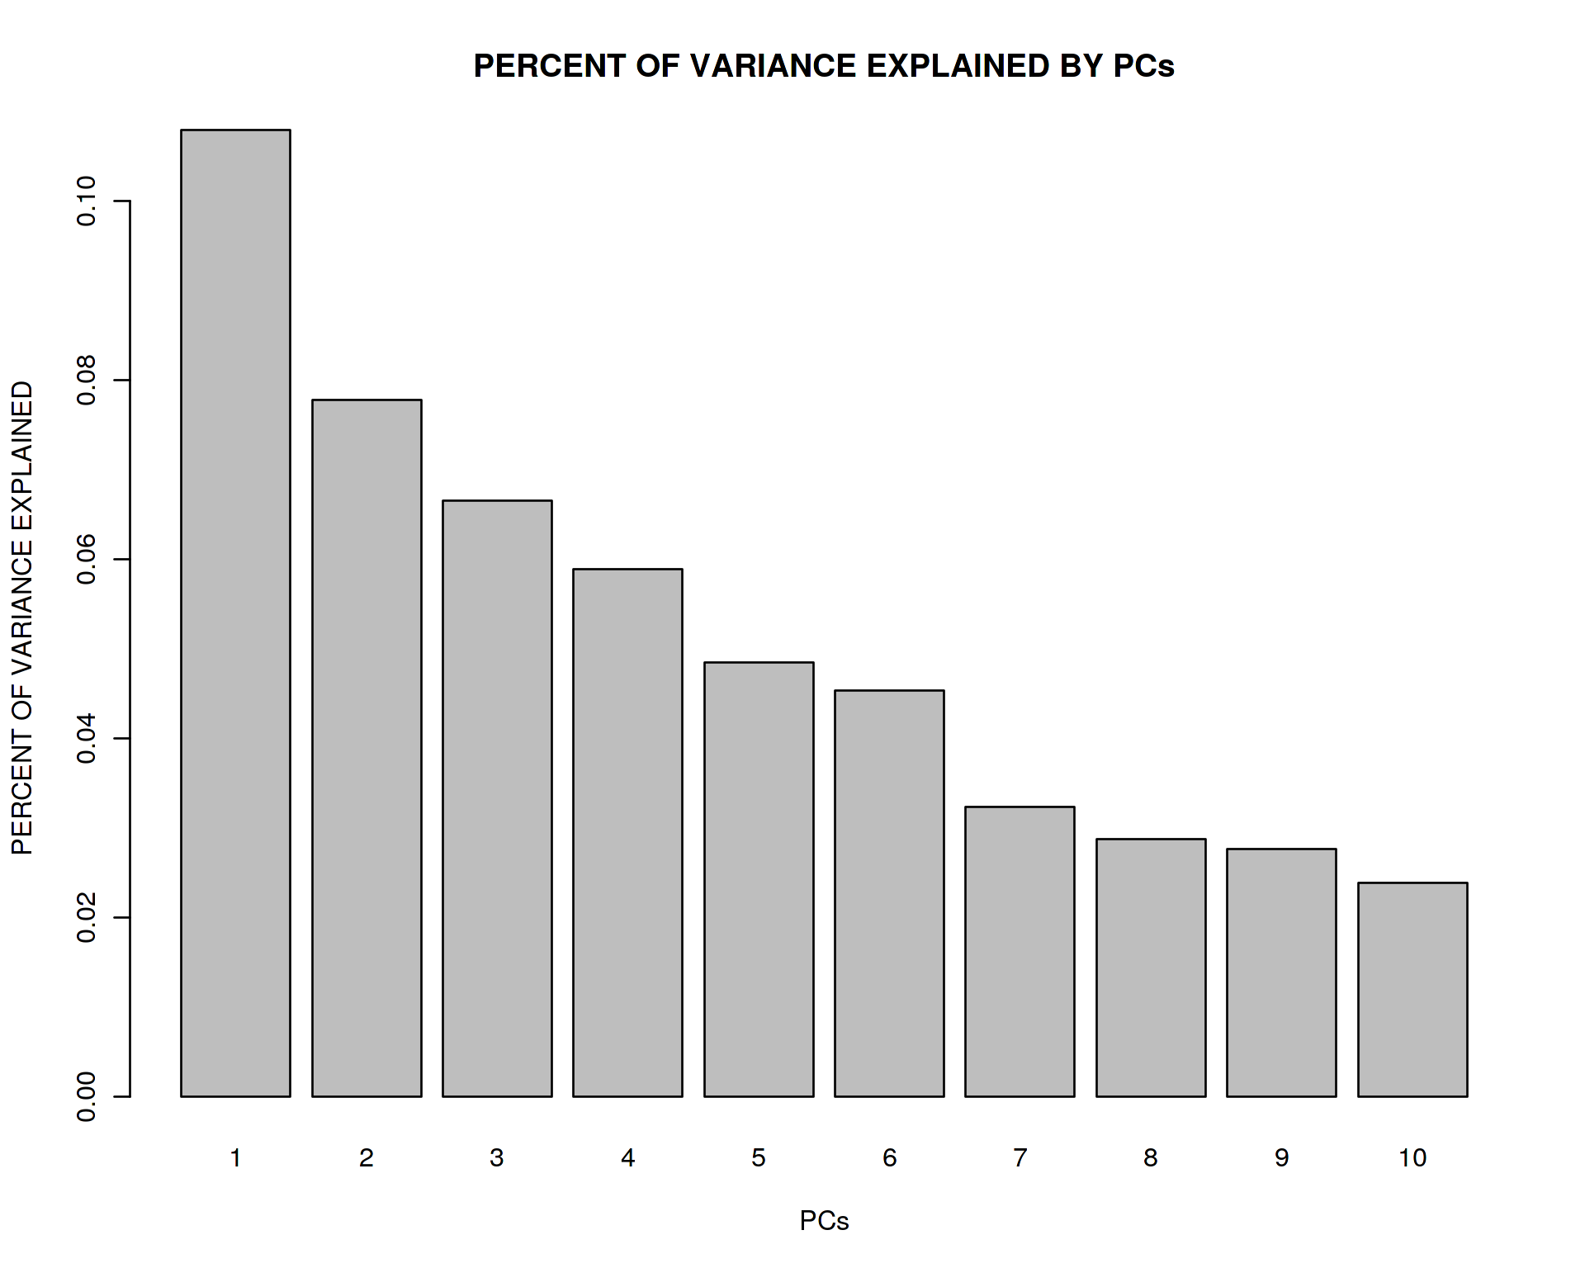
How to compute PCA from scratch
Coding in R:
Mathematically:
data_centered <- scale(data, center = TRUE, scale = FALSE)
covariance <- t(data_centered) %*% data_centered
eig <- eigen(covariance)
plot(eig$vectors[,1:2]); barplot(eig$values / sum(eig$values))
M_{ij} = X_{ij} – μ_{j}
A = (1/N)*M^{T}*M
A*u = λ*u
It can be analytically derived that
the eigen value decomposition in PCA
is equivalent to projecting data on axes
of maximal variation in the data

Slide 4
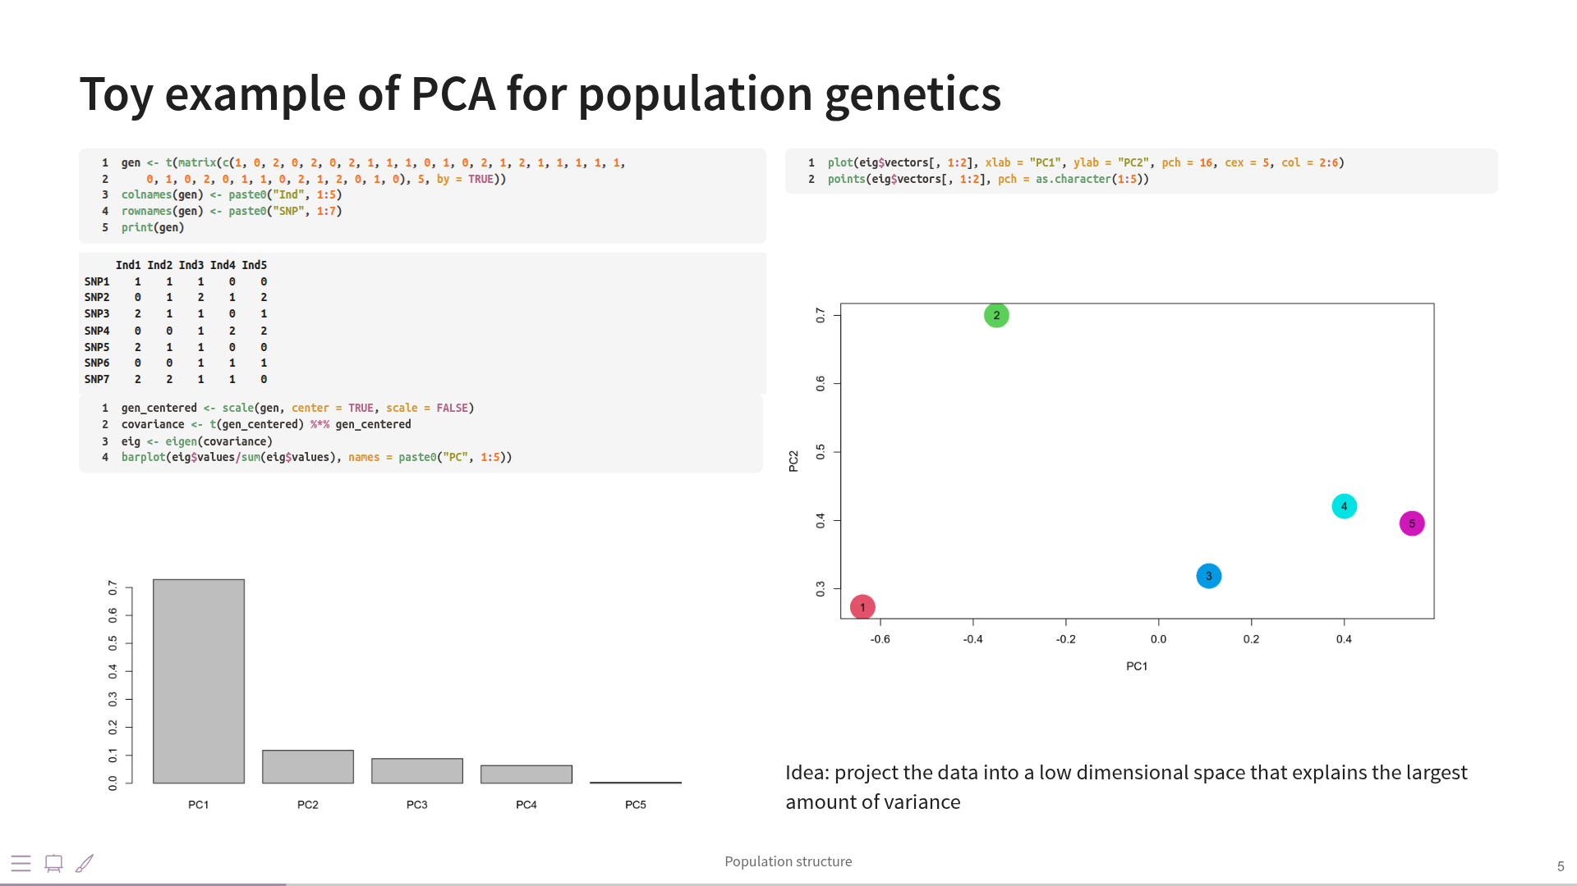

Slide 5
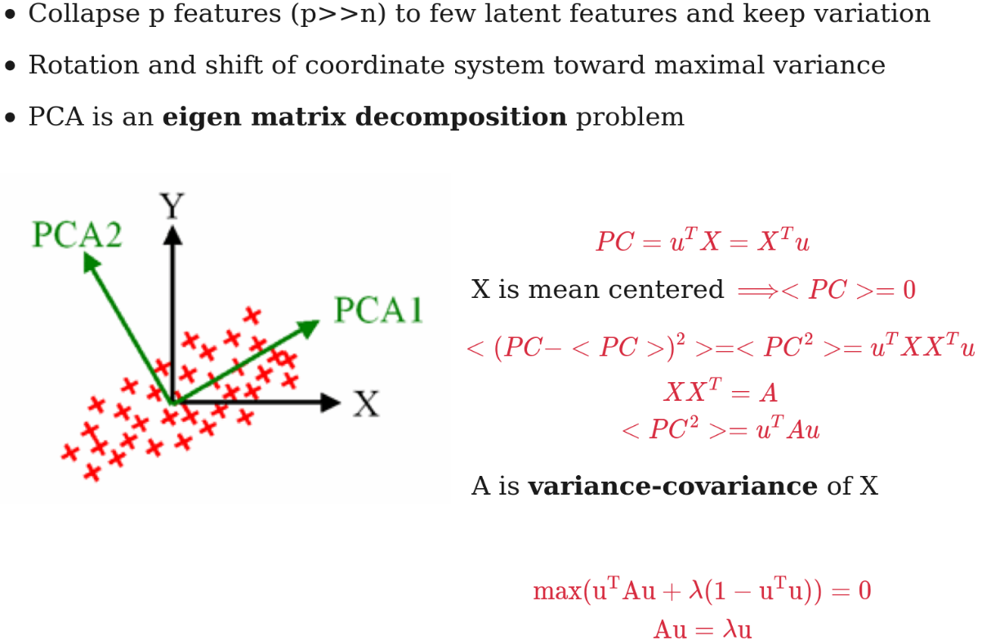
How maximization of covariance
is related to eigen value decomposition

Slide 6
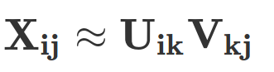
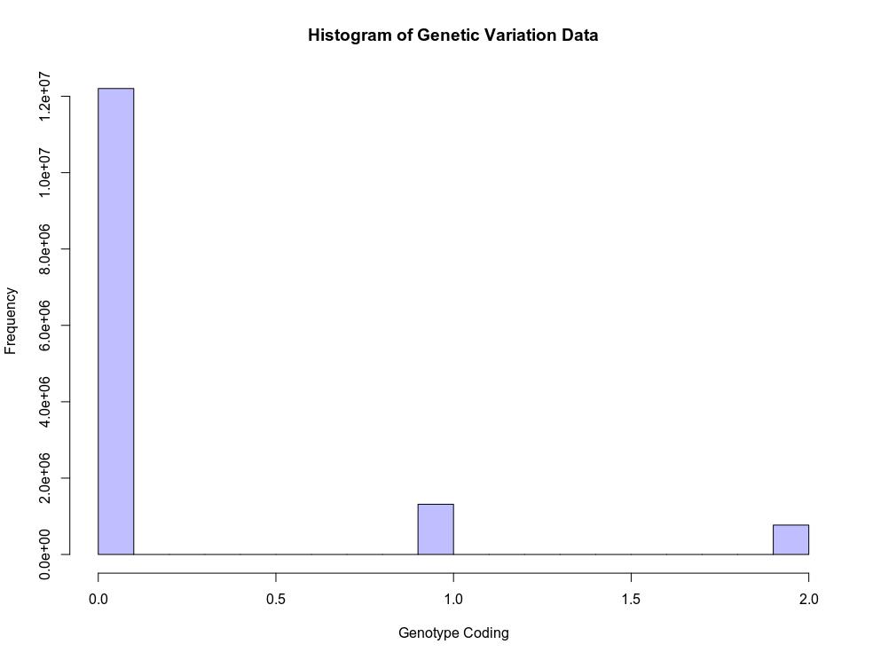
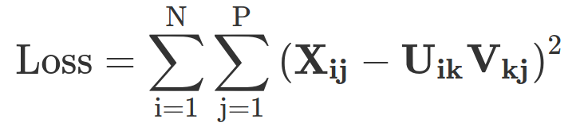
PCA on Genetic Variation: Euclidean Distance
P
D
P
x
V_{kj}
D
N
X_{ij}
≈
N
U_{ik}
Loadings
Data
Low-dimensional
data representation
(embeddings)

Slide 7
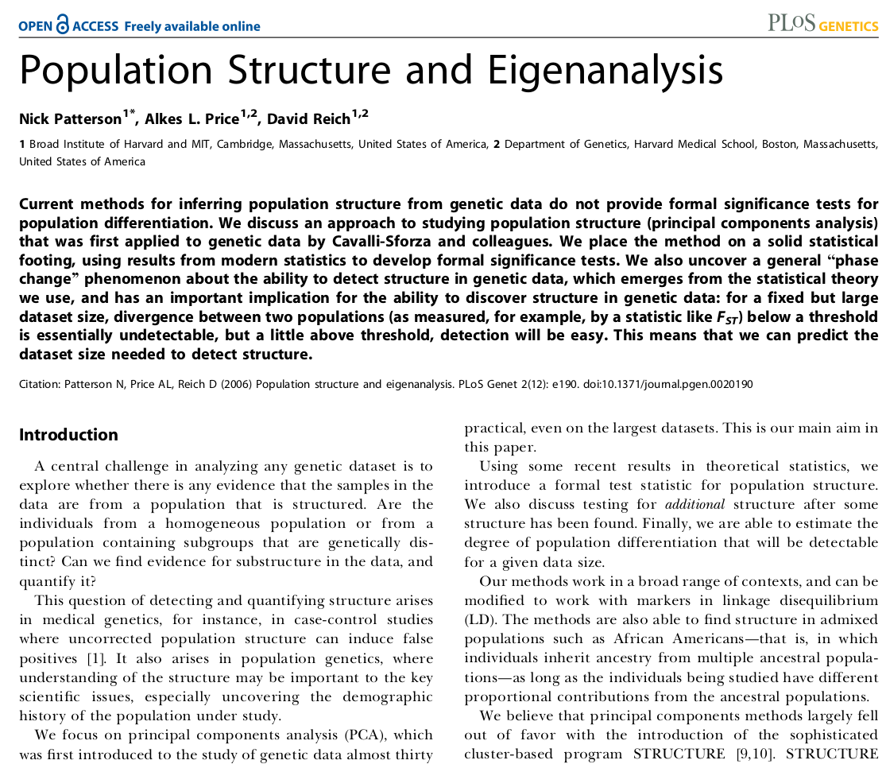
PCA and Gaussian Distribution Assumption
One concern with applying this approach to genetic data is
that the entries in the matrix M do not have the Gaussian
distributions expected for a Wishart matrix; instead, they
correspond to the three possible genotypes at each SNP.
However it is not critical that the entries in the m x n matrix
M be Gaussian. Soshnikov [25] showed that the same TW limit
arose if the cell entries were any distribution with high-order
moments no greater than the Gaussian. The matrix X is a sum
of n rank 1 matrices, and Soshnikov’s result suggests that the
same limit would be obtained from any probability distribu-
tion in which the columns of M are independent, isotropic
(all directions are equiprobable), and such that the column
norms have moments no larger than those for a column of
independent Gaussian entries. In all our genetic applications,
the column norms are in fact bounded, so we can expect the
sample covariance matrices to behave well. This theory, originally
developed for the case of Gaussian matrix entries, thus seemed
likely to work well with large genetic biallelic data arrays. The
remainder of this paper verifies that this is the case.

Slide 8
What Flora Jay thinks about non-Gaussian
distribution of genetic variation data
Both PCA and FA optimize a Euclidean distance (L2 norm) between the original data and its low-rank approximation.
L2 norm is a consequence of data normality assumption. Why do people still use PCA / FA for non-normally distributed
categorical data such as genetic variation?
This norm is often used for convenience because it allows easy and quick/immediate optimization of the problem. So it is
true that the loss/ or the model could be changed. There is a trade off between the "quality/accuracy/reality"
of the model and the optimization procedure. What we personally experimented with, rather than changing the loss
was to add information in the form of constraints on the U or V matrices (e.g. Caye et al
https://hal.archives-ouvertes.fr/hal-01676712). It works but leads to more complex non deterministic optimization procedure.
For other models you can think about Dystruct, Admixture, treemix etc.

Slide 9
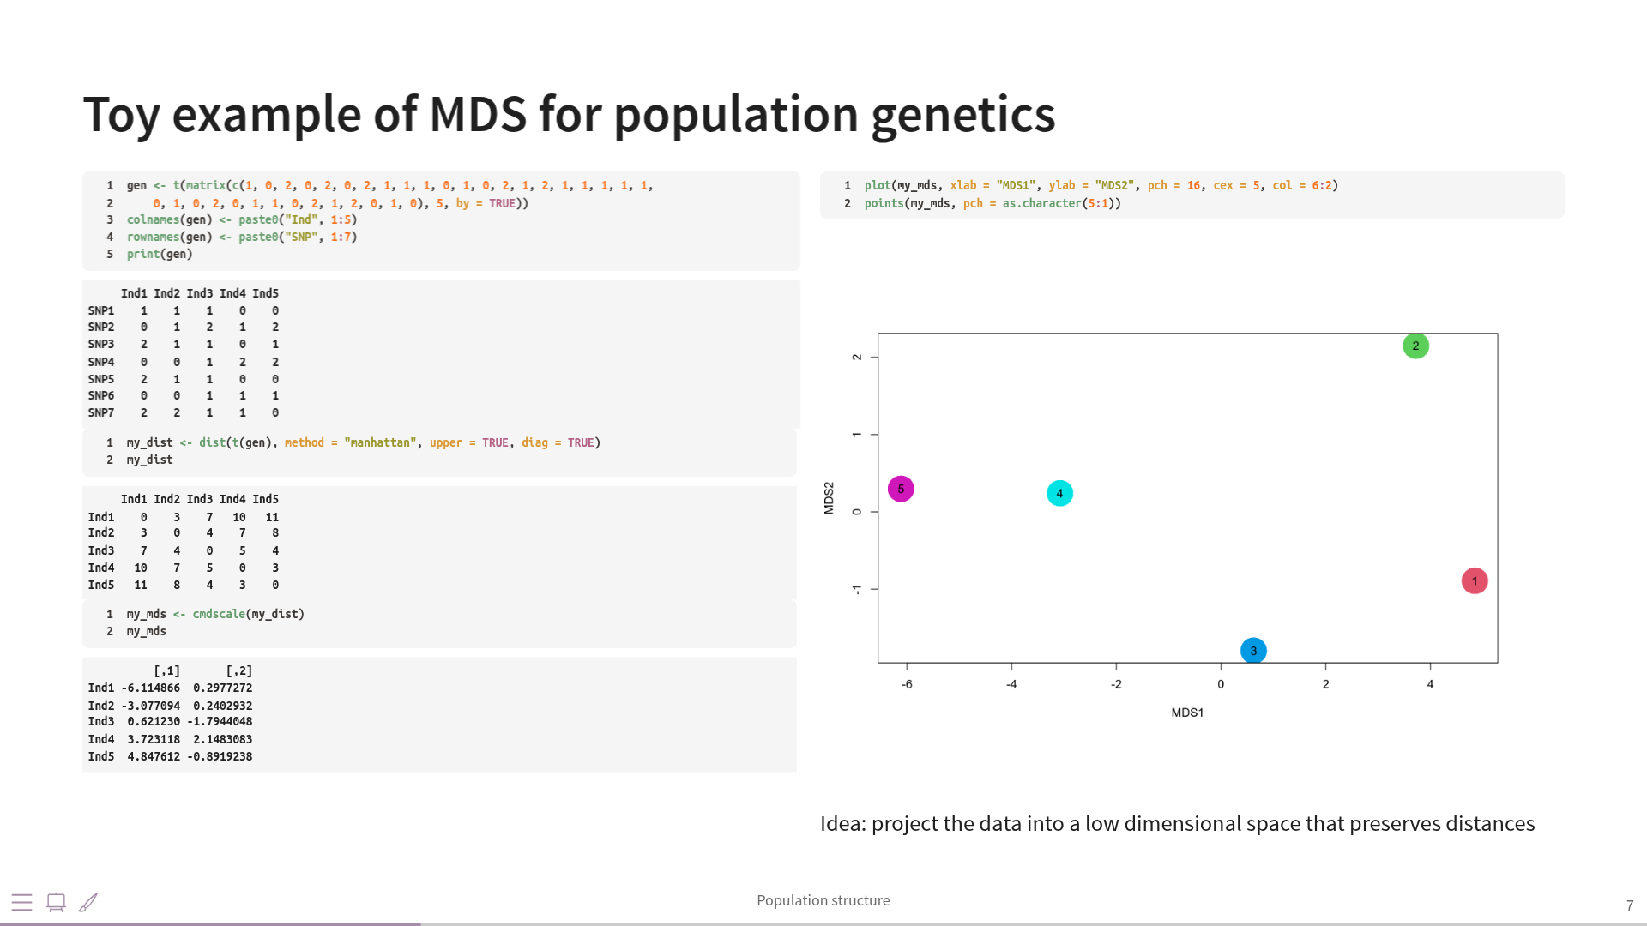

Slide 10
Significant Principal Components

Slide 11
Patterson, Price and Reich: Plos Genetics 2006
Largest eigen values follow Tracy-Widom distribution
Therefore we can implement a formal statistical test for detecting population structure
in genetic variation data
PCA dimensionality reduction is directly related to cluster analysis
Number of largest PCA eigenvalues is approximately the number of clusters
There is some sort of “phase transition” when population structure becomes visible

Slide 12
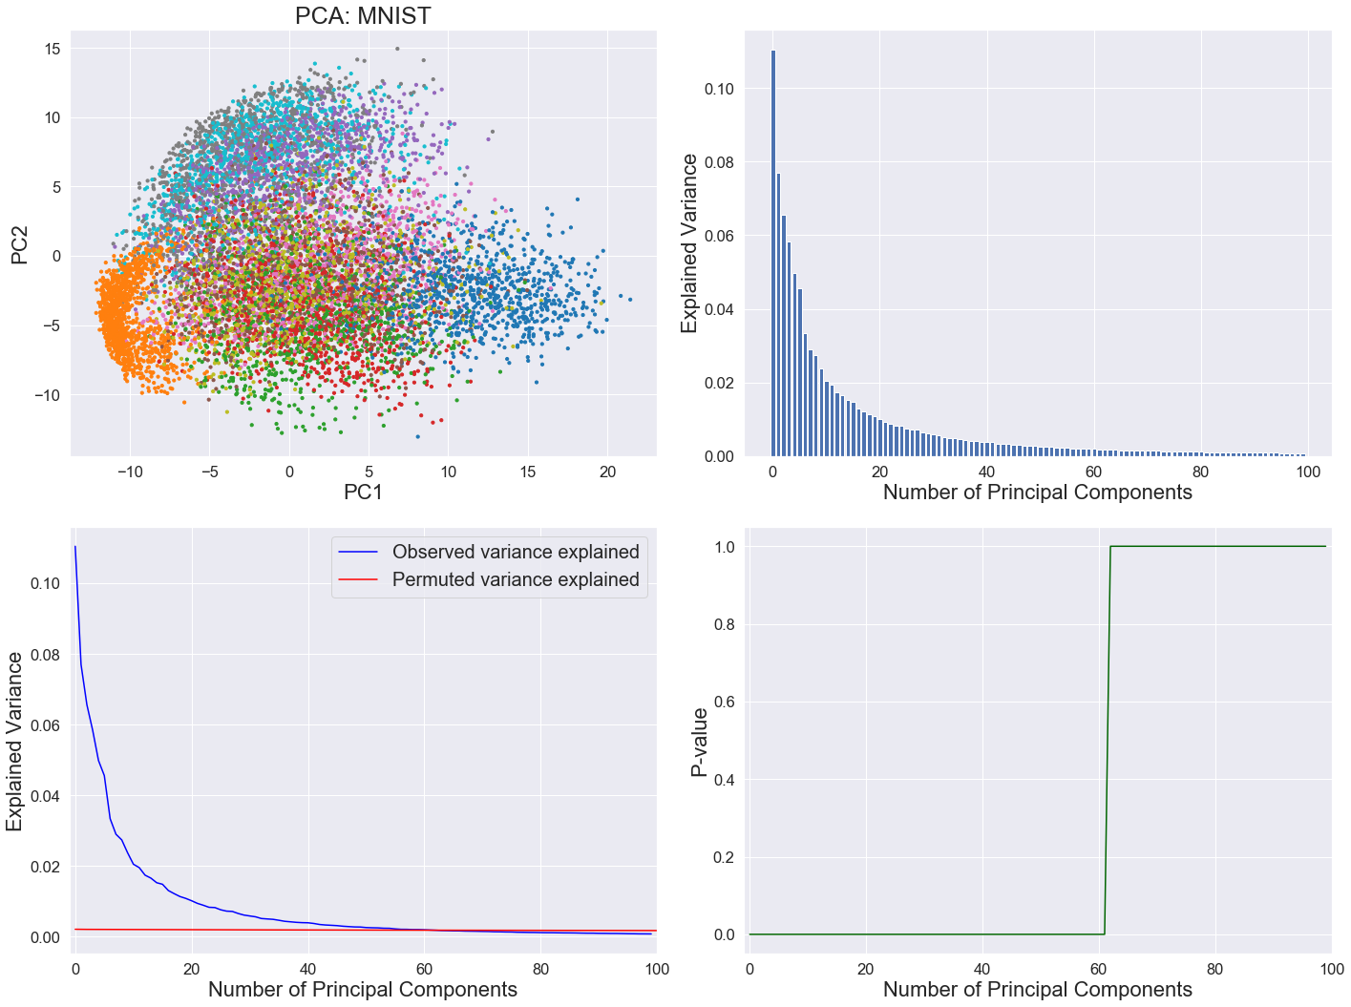
Estimating the number of informative PCs
Tracy-Widom approach

Slide 13

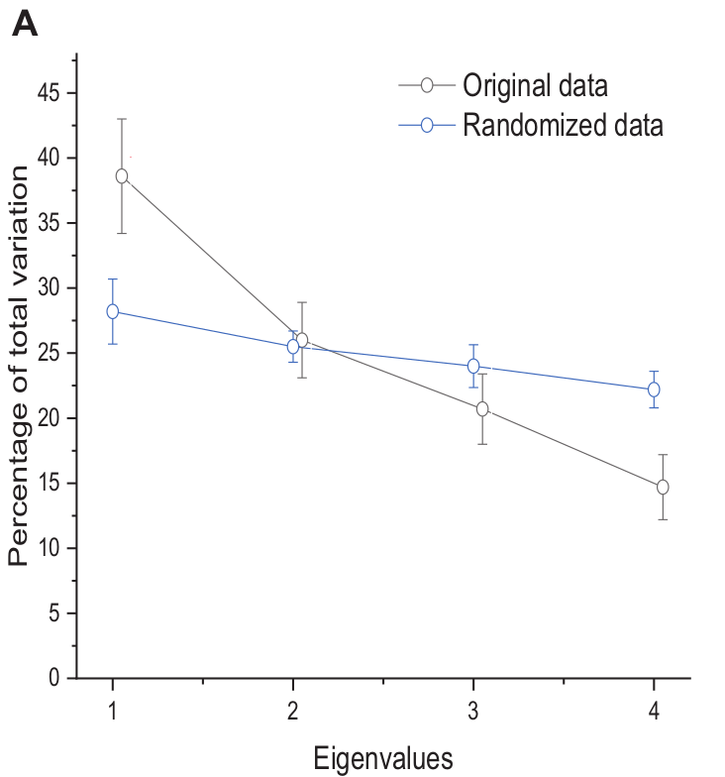
Statistically Significant Principal Components

Slide 14
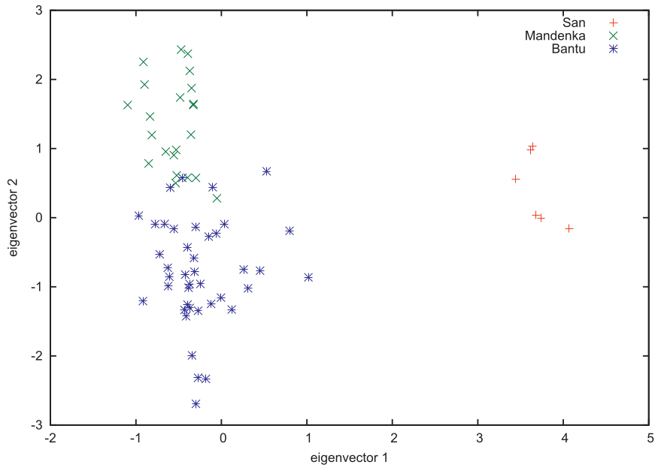
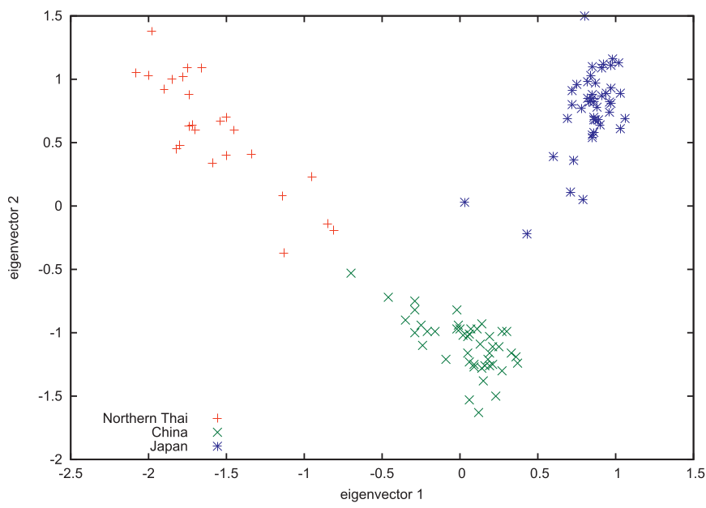
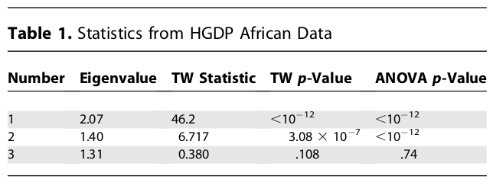
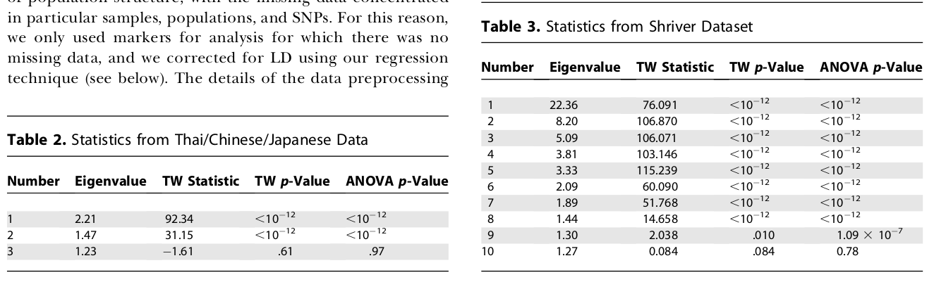
Tracy-Widom Significant Axes
A third issue is that our methods require that divergence is small, and that allele frequencies are divergent primarily
because of drift. We attempted to apply our methods to an African-American dataset genotyped on a panel of ancestry-
informative markers [34]. The Tracy–Widom theory breaks down here with dozens of ‘‘significant’’ axes.

Slide 15
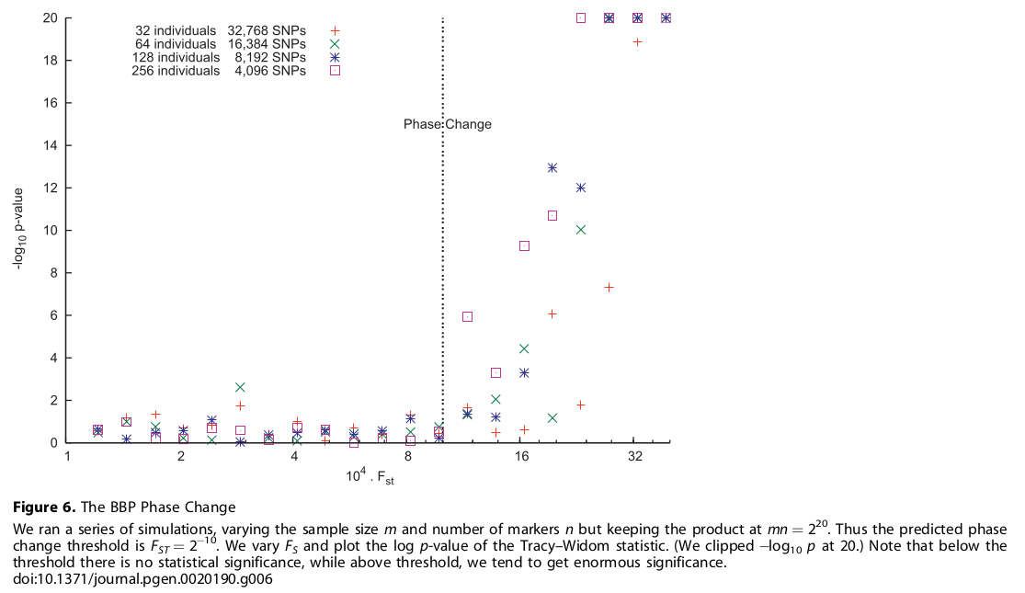
Phase Transition in Population Structure

Slide 16
PCA in Population Genetics:
Literature Review

Slide 17
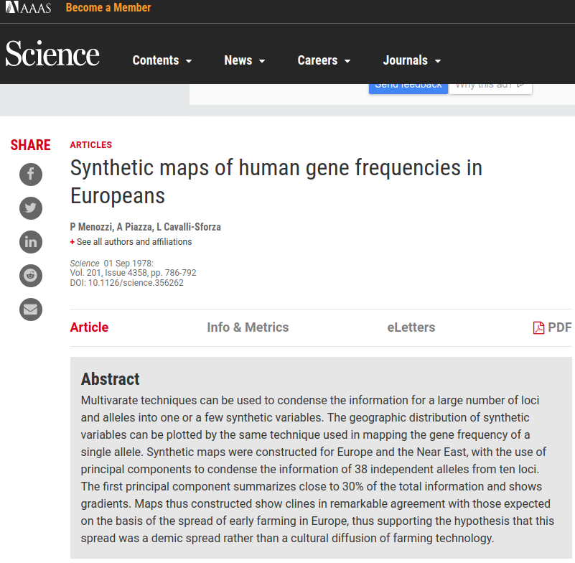

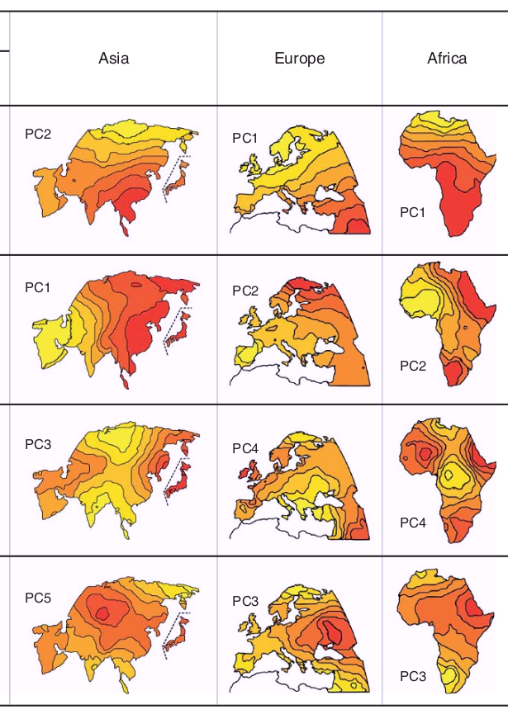
Menozzi, Piazza and Cavalli-Sforza
Genetic distances correlate with geographical distances possibly due to people’s migration
Neolithic farming migration rather than a cultural diffusion of farming technology

Slide 18
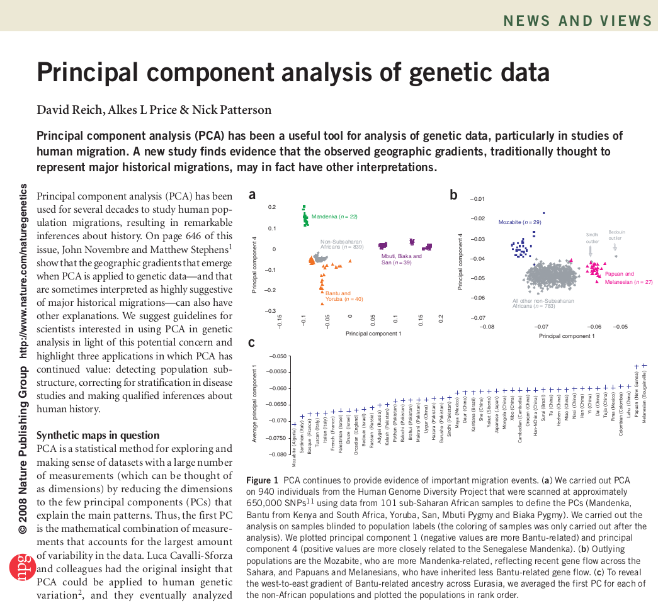
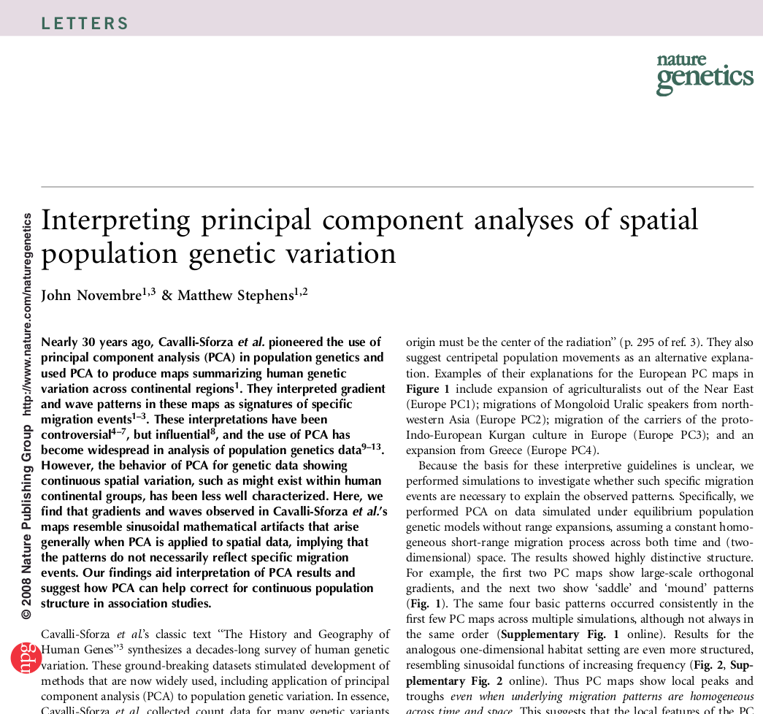
Reich, Price, Patterson and Novembre
Genetic distances correlate with geographical
distances possibly due to isolation by distance
and not necessarily migration

Slide 19
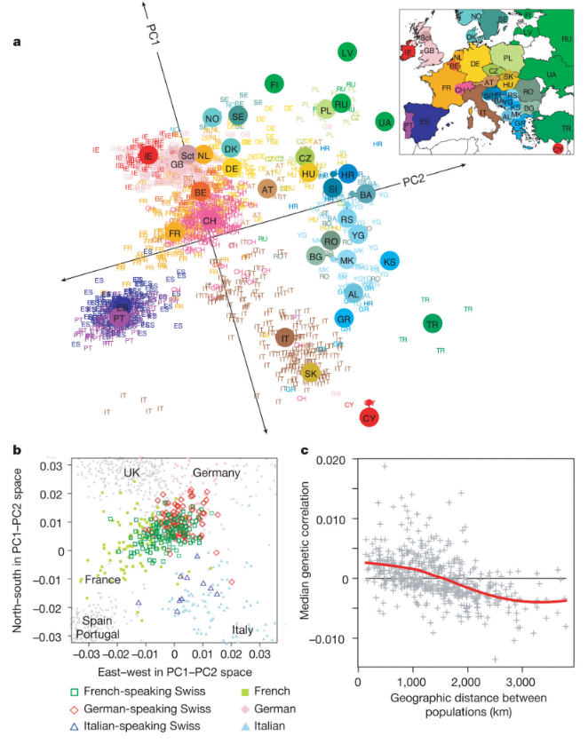
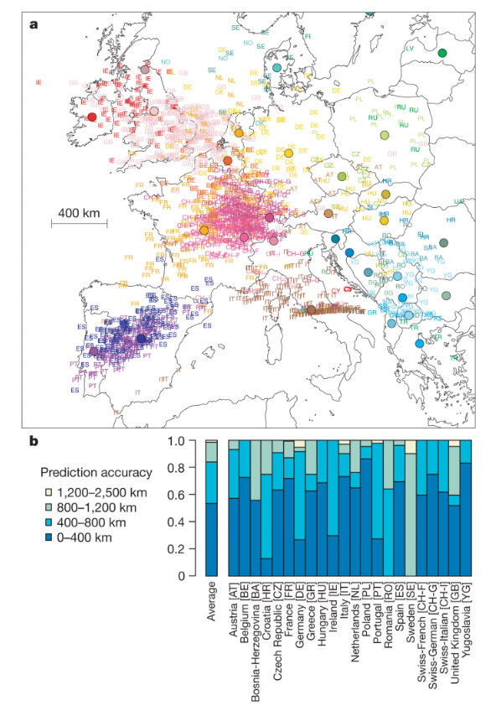
More from John Novembre, Nature 2008

Slide 20
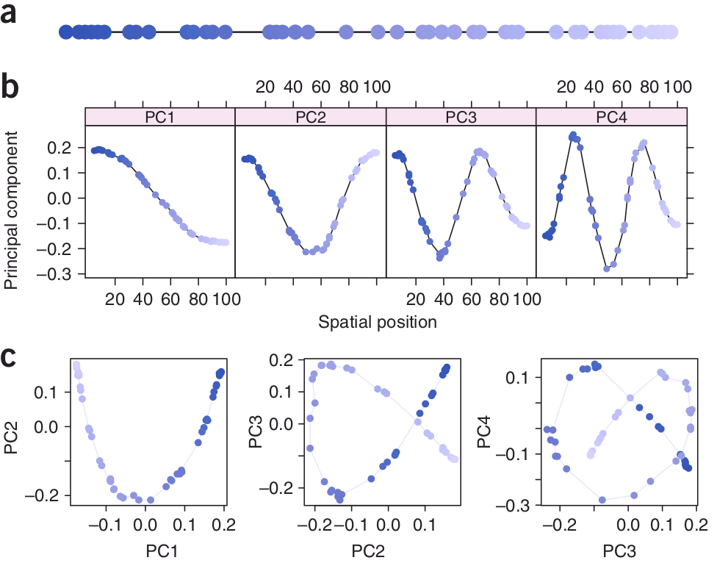
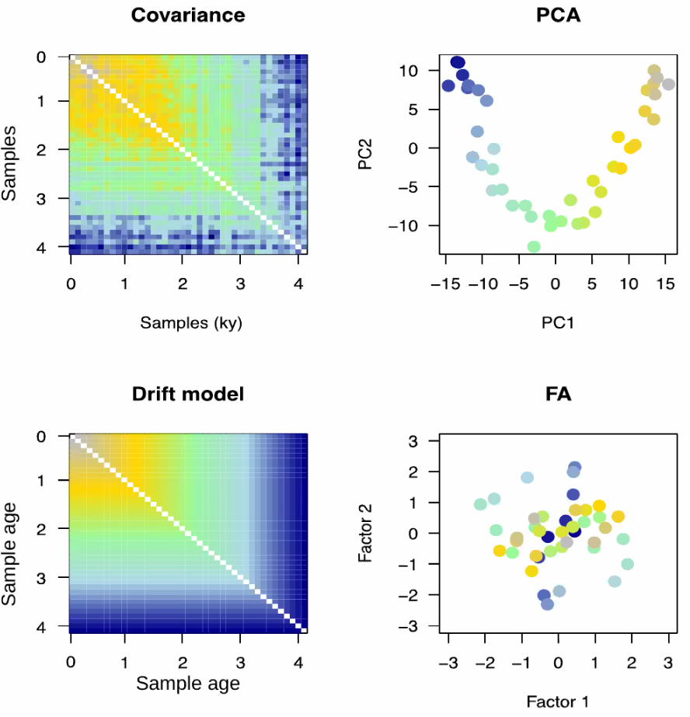
Horseshoe Effect: Spatial and Temporal
Novembre & Stephens, Nat. Genetics 2008
Francois & Jay, Nat. Communications 2020

Slide 21
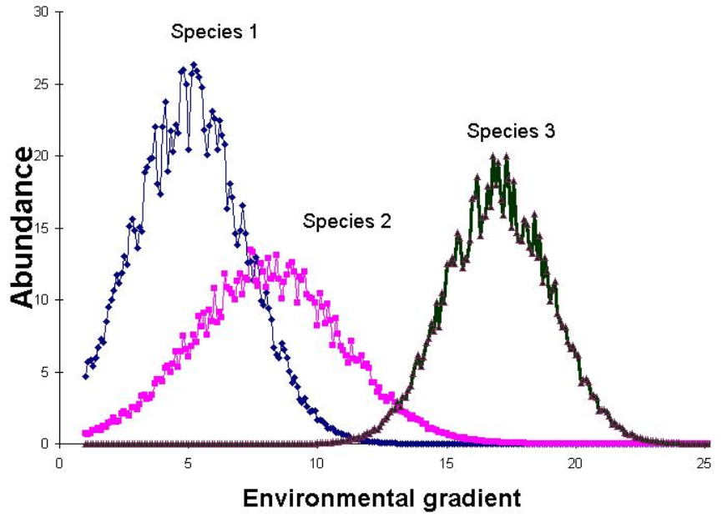
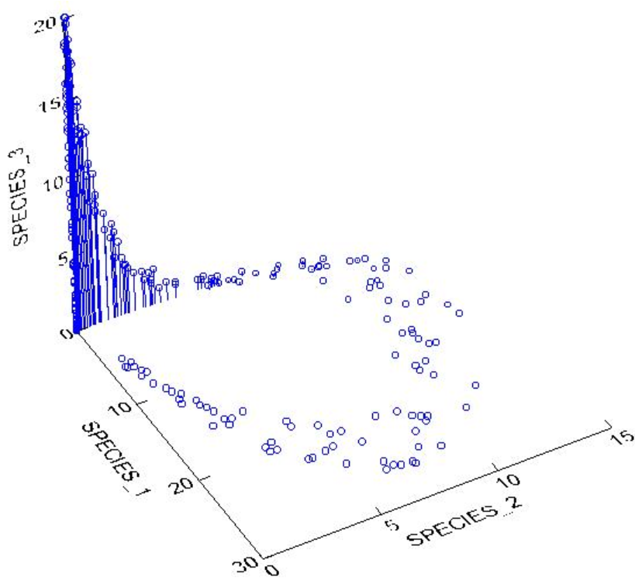
Horseshoe Effect: Ecology Example

Slide 22
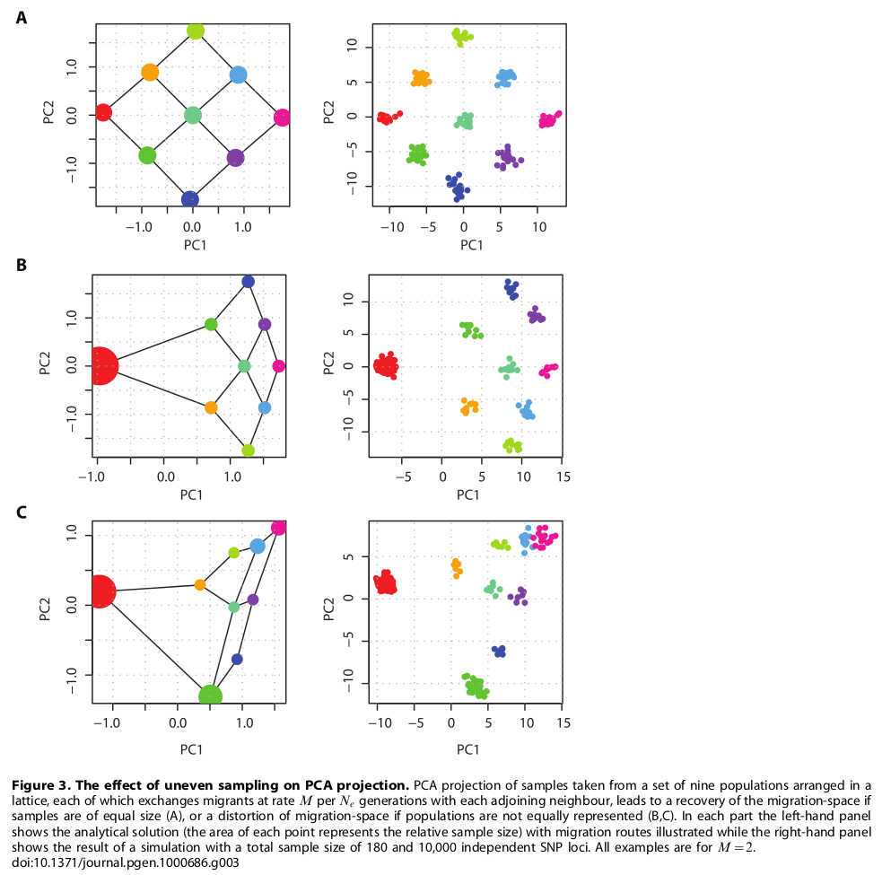
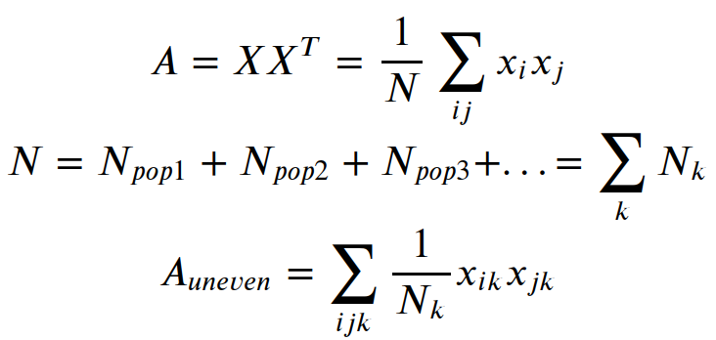
PCA: Effect of Uneven Sampling
“The results described here provide an explanation. First, from Equation 10 it can be seen that the the matrix M is influenced by the relative sample size from each population through the components _x0016_ t_i . For instance, even if all populations are equally divergent from each other, those for which there are fewer samples will have larger values of _x0016_ t_i because relatively more pairwise comparisons are between populations”
McVean G., PLoS Genet 5(10), 2009

Slide 23
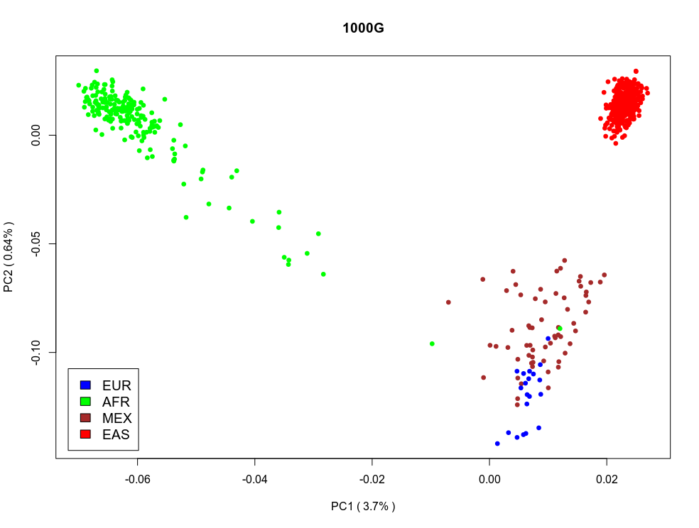
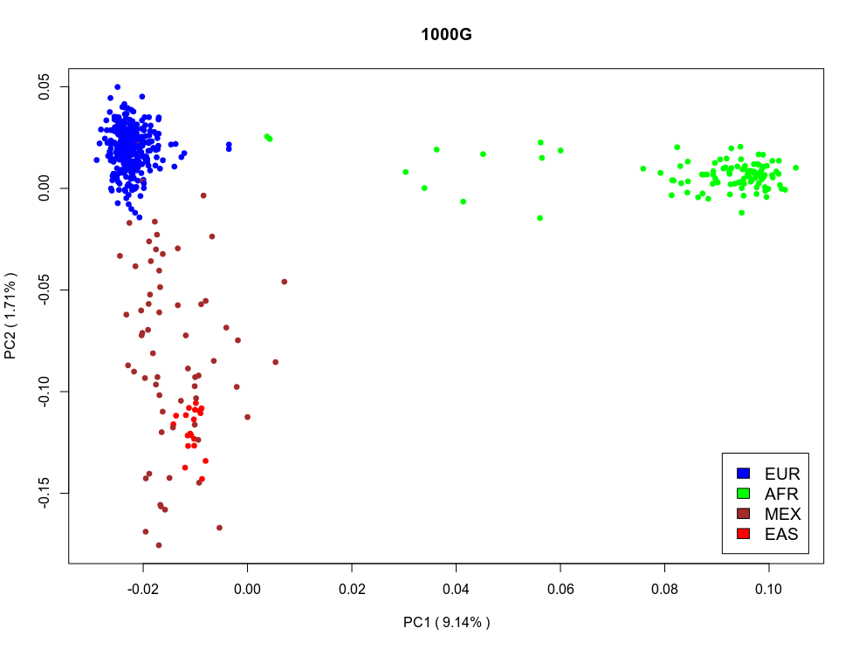
1000G: Uneven Sampling of Populations
Downsampled Europeans
Downsampled Asians

Slide 24
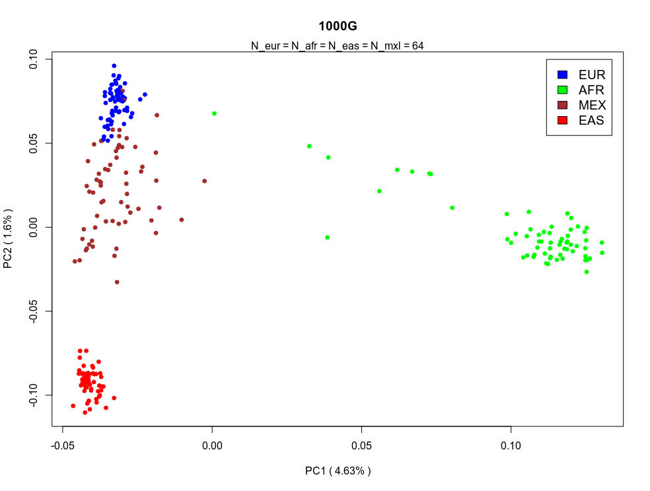
1000G: Even Sampling of Populations

Slide 25
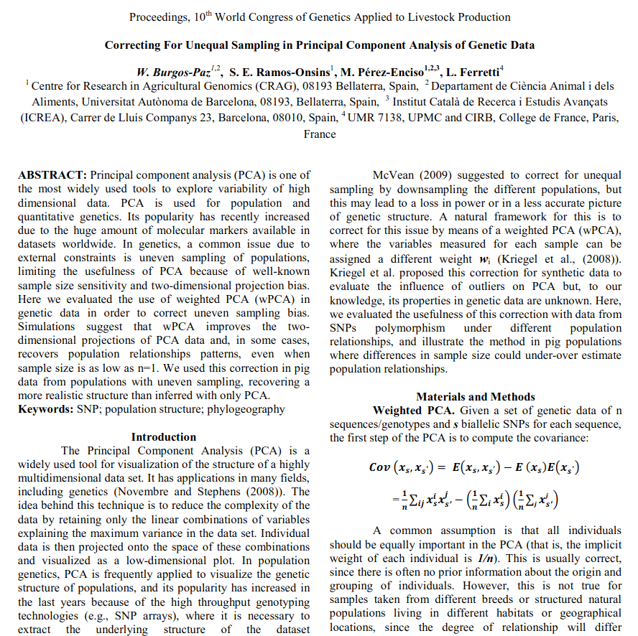
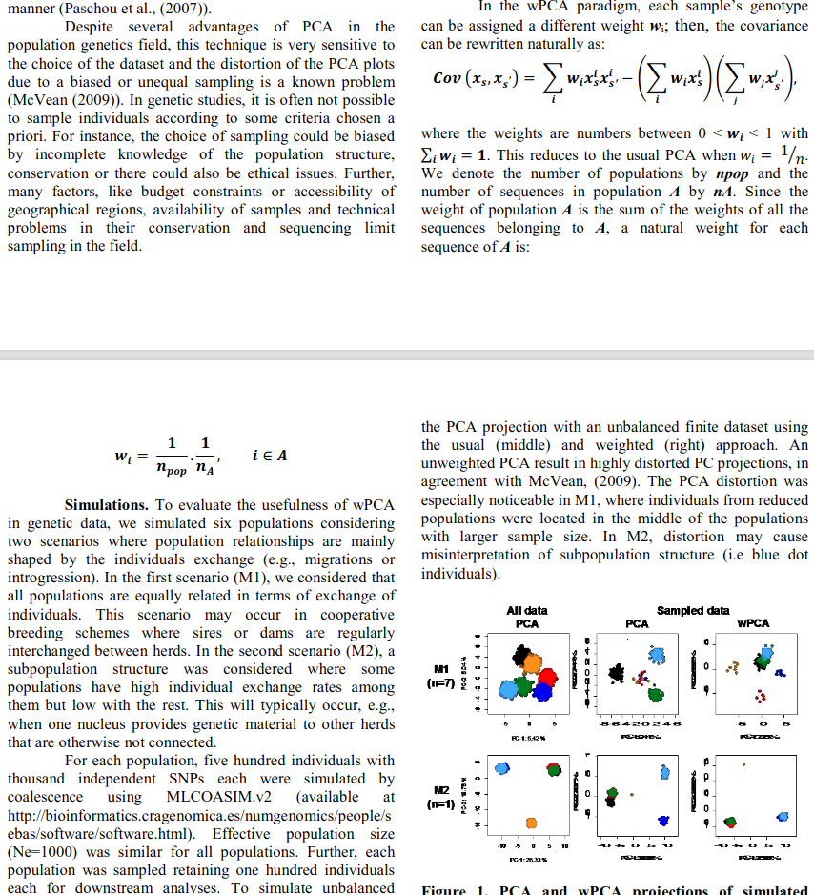
1000G: Correcting for Uneven Sampling

Slide 26
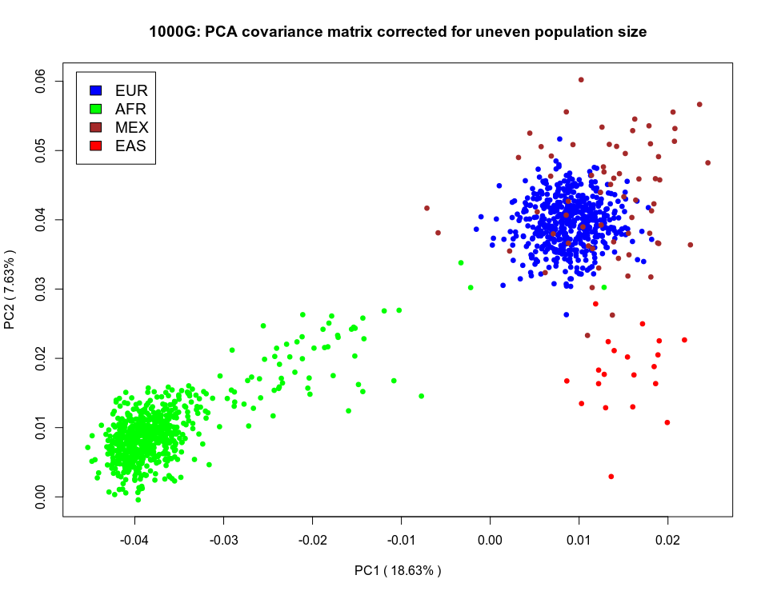
1000G: Correcting for Uneven Sampling
Normalize each sample
by its population size
before computing the
covariance matrix
Is it still an unsupervised
technique?

Slide 27
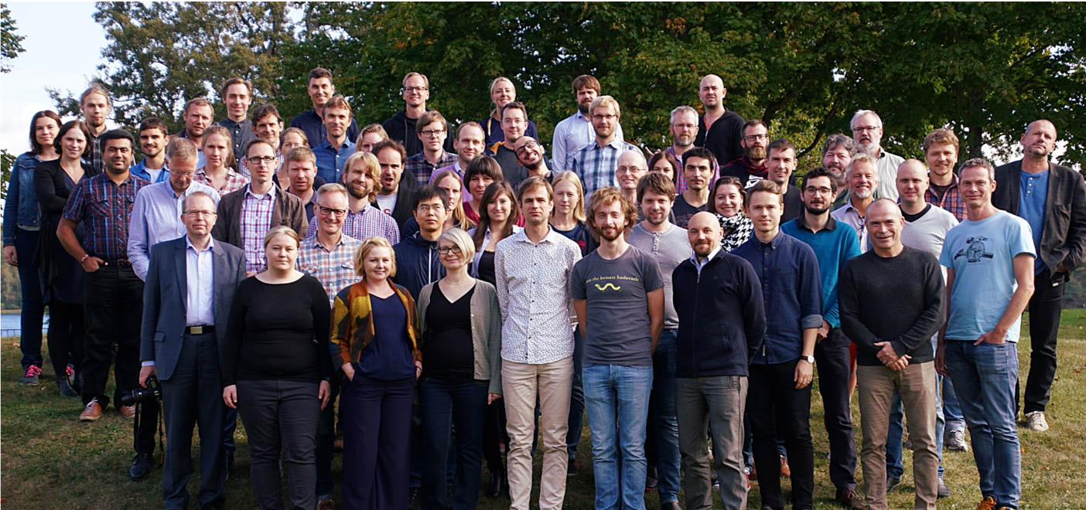



National Bioinformatics
Infrastricture Sweden (NBIS)

Slide 28
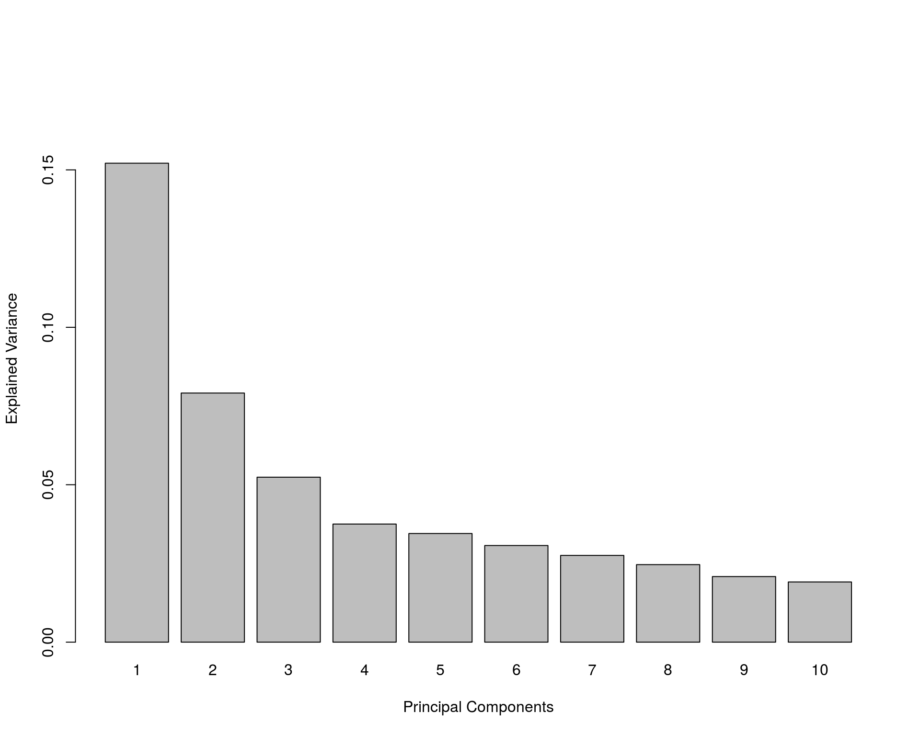
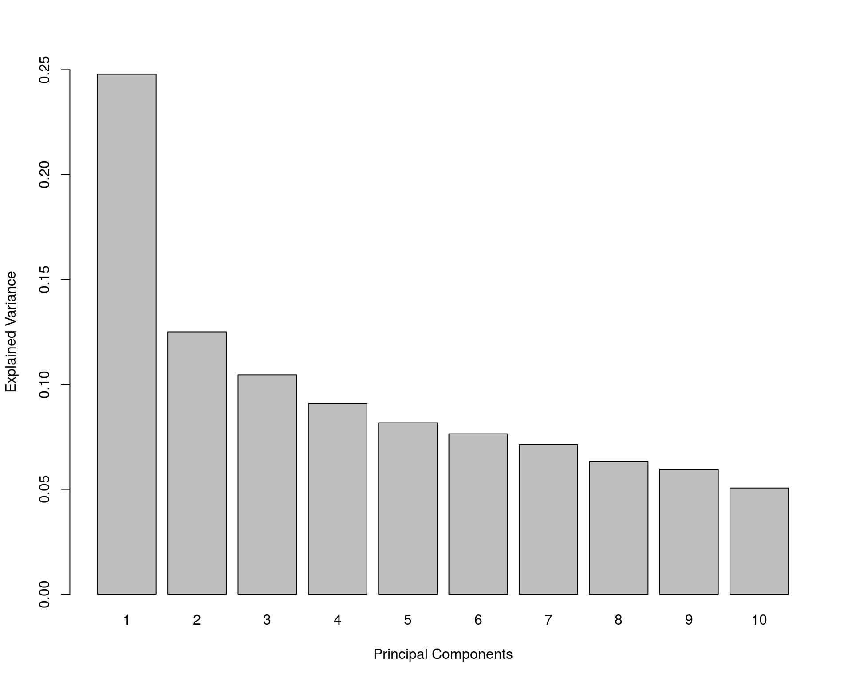
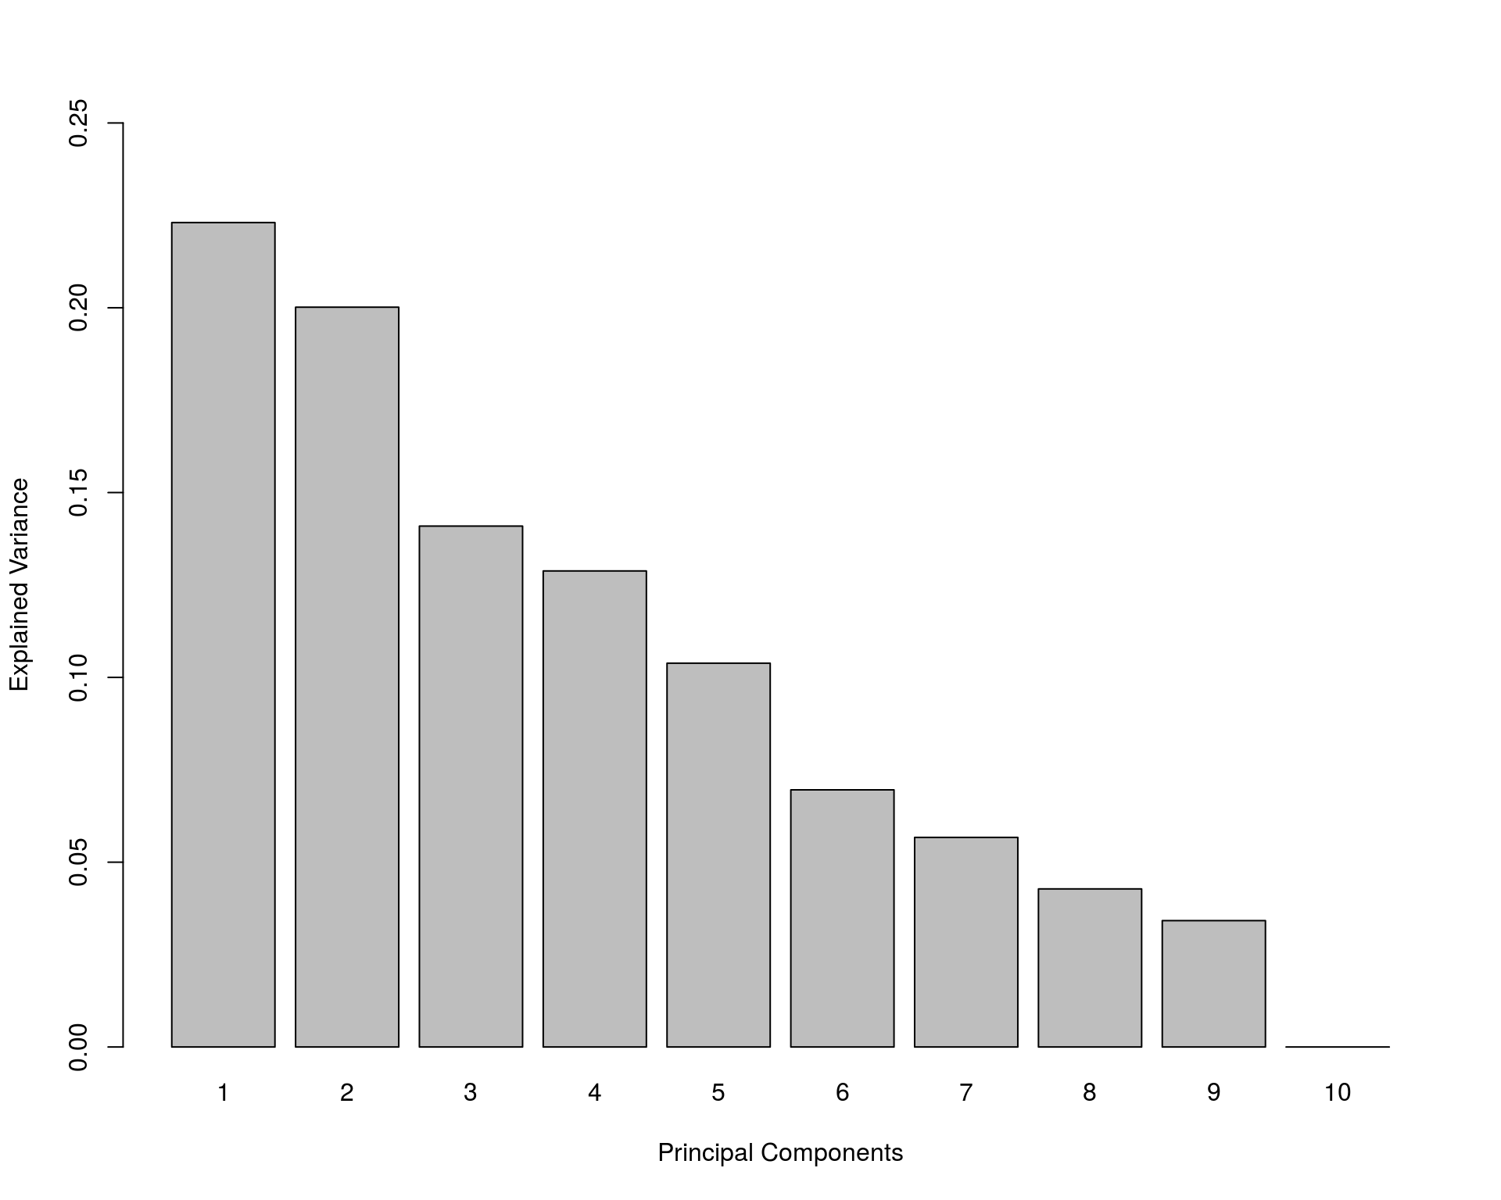
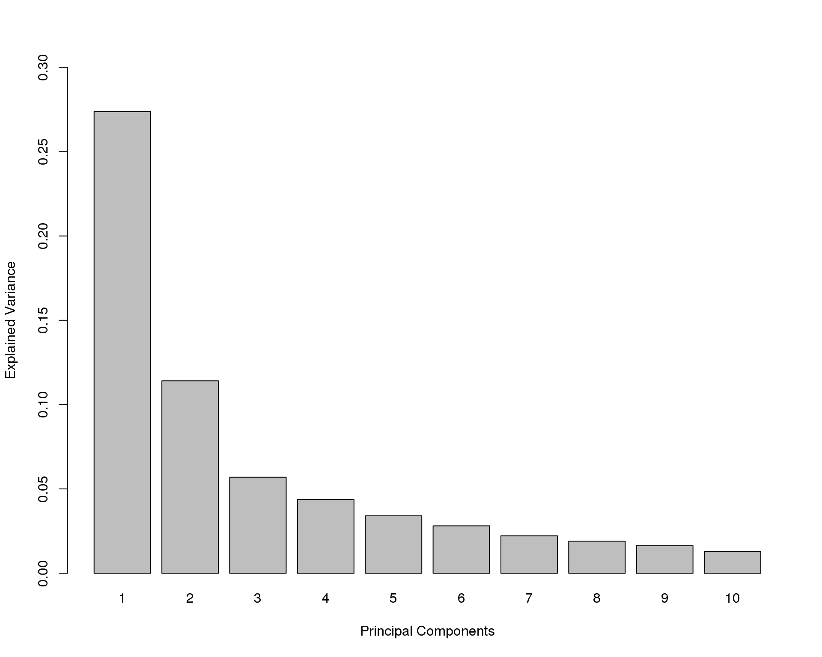
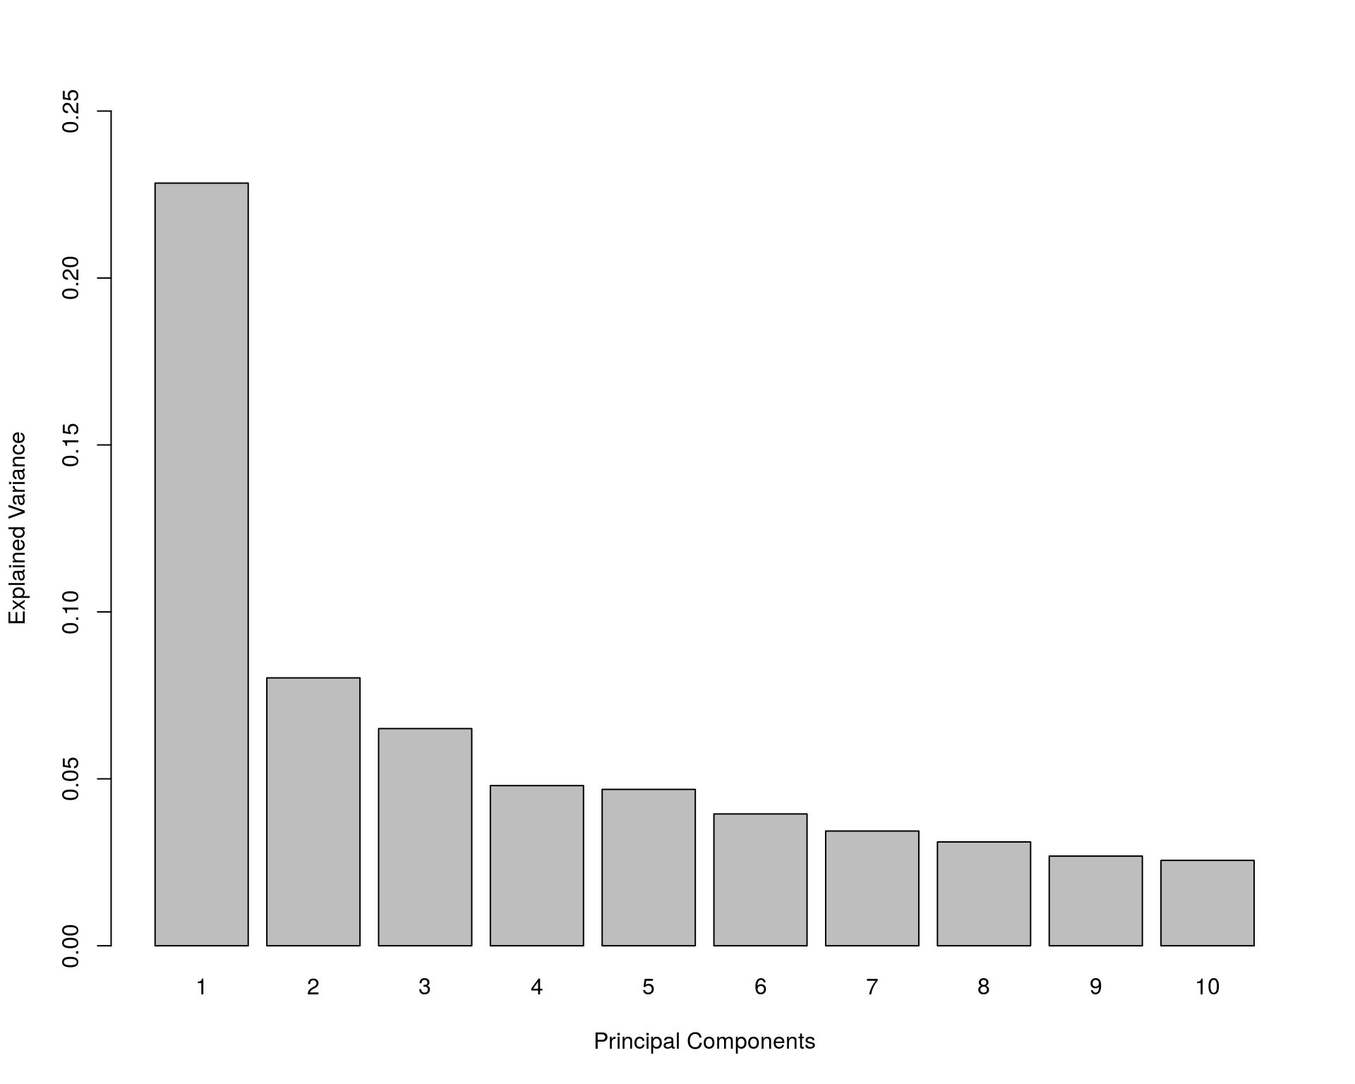
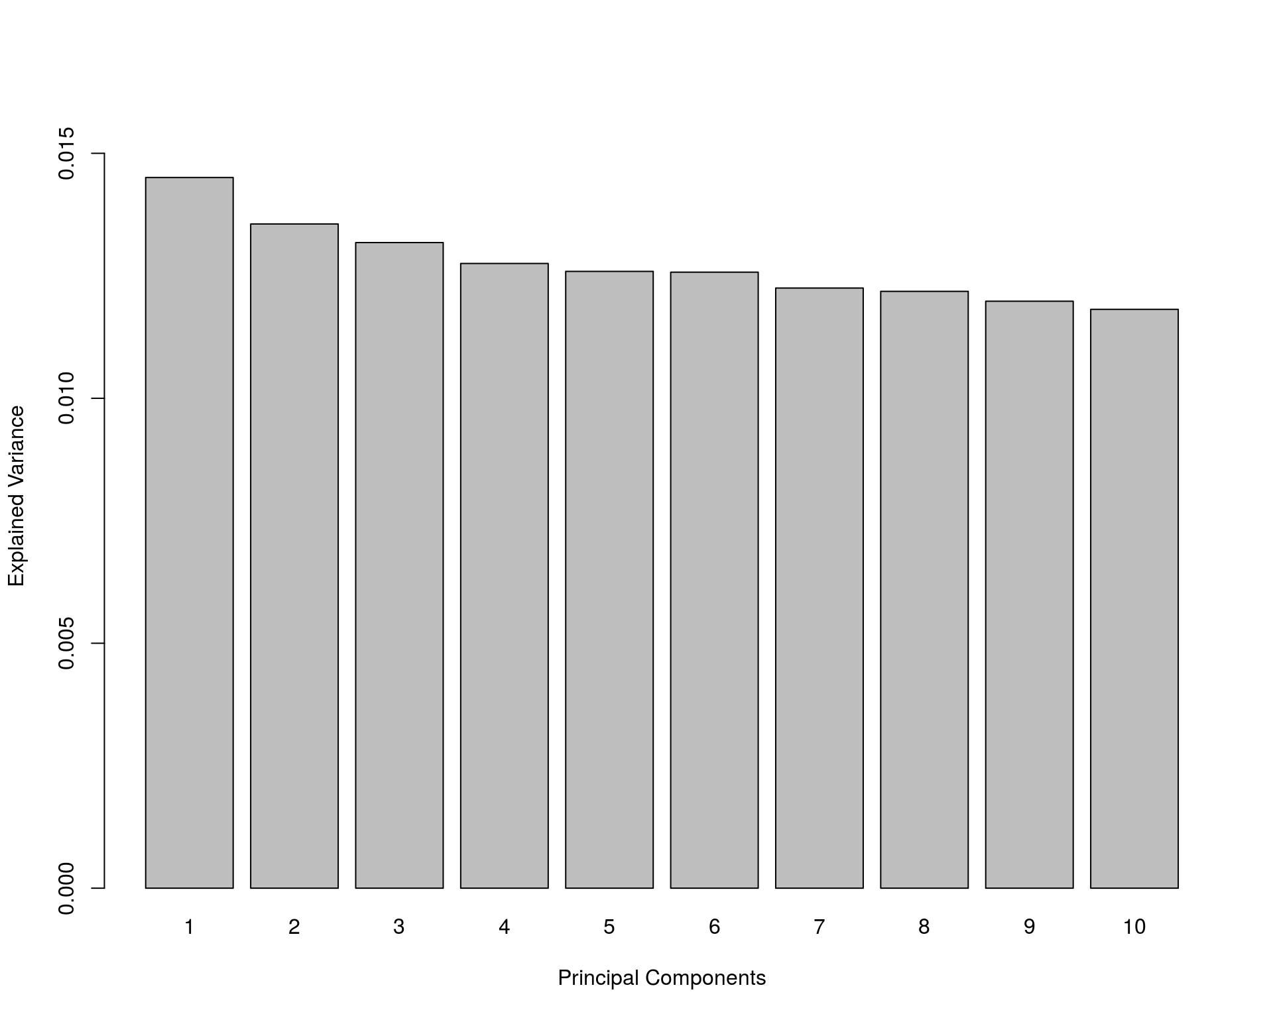
Variance Explained by PCs Across OMICs
Methylomics
Transcriptomics
Metagenomics
Proteomics
Metabolomics
Genomics

Slide 29
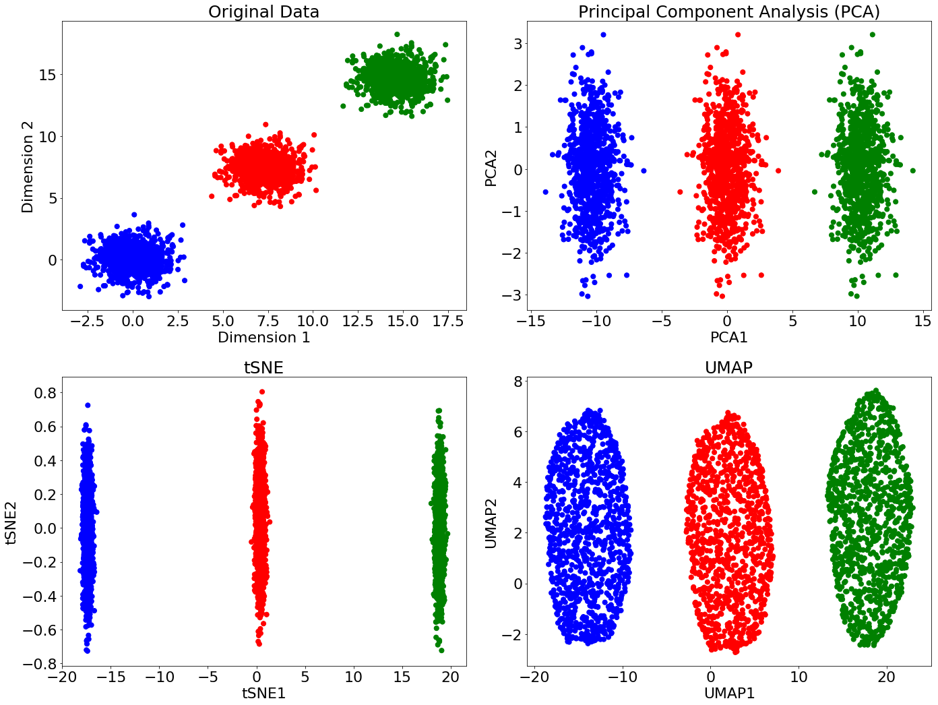
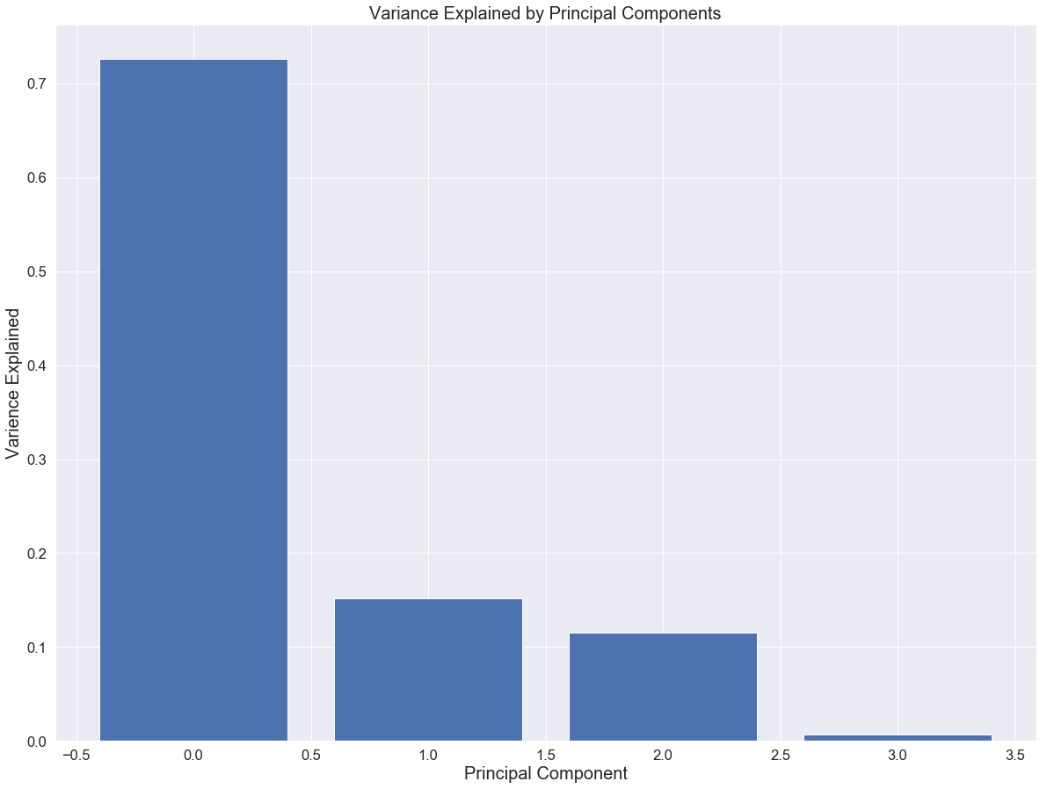
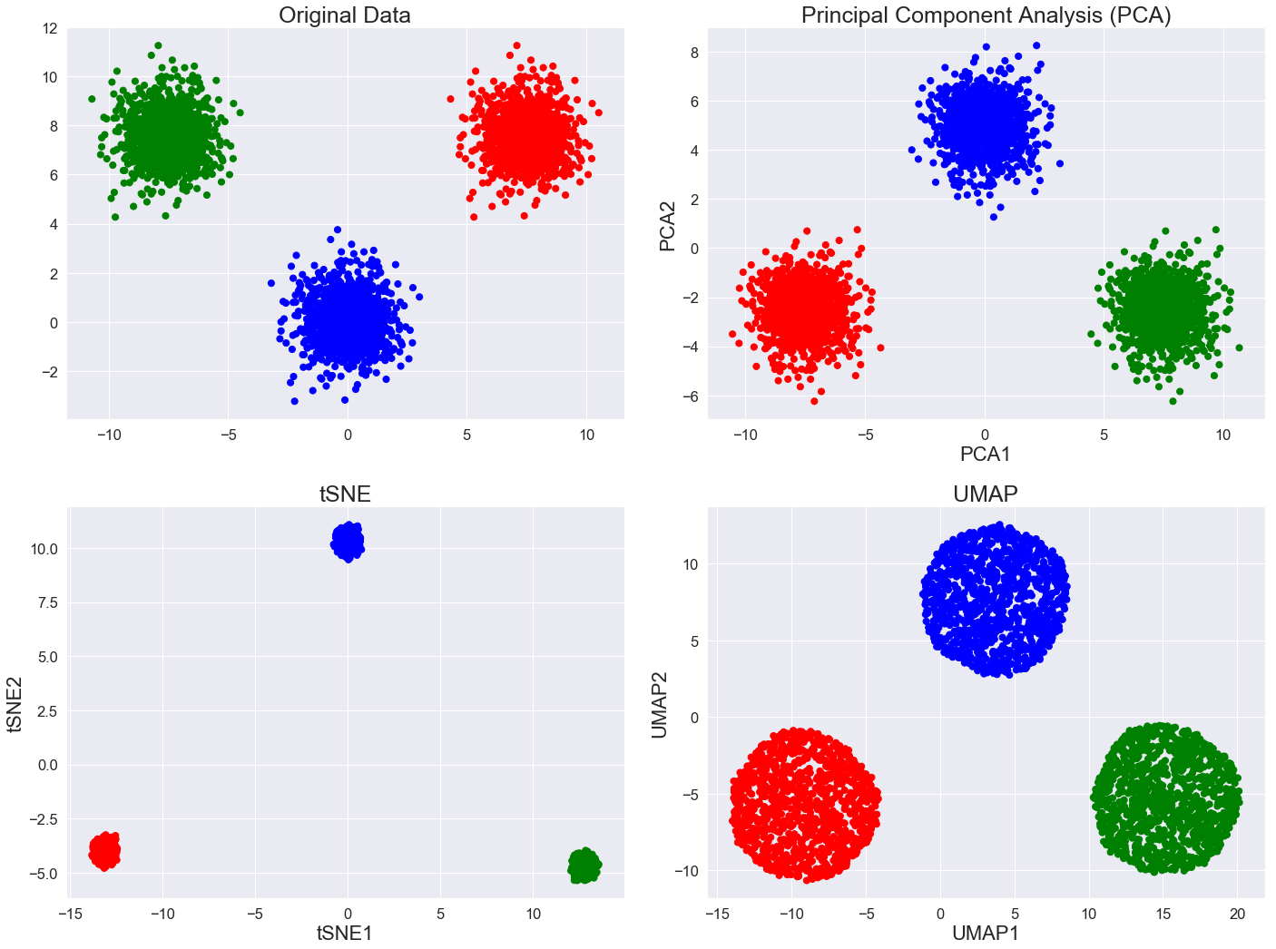
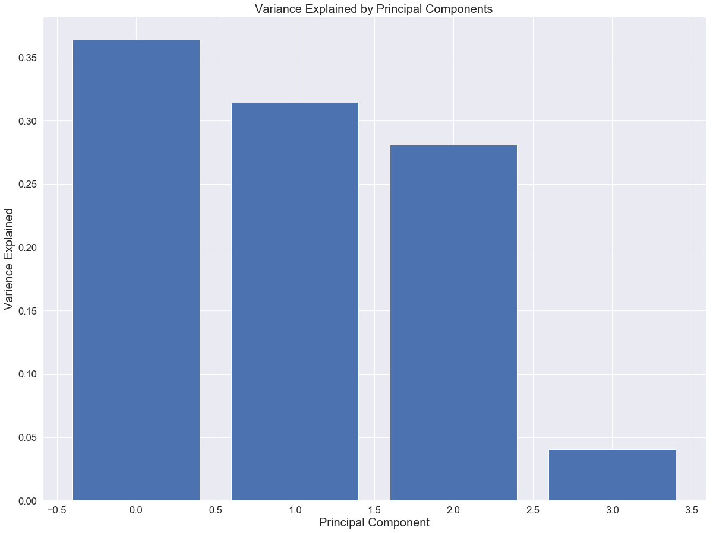
Symmetry of scRNAseq vs Genetic Variation
scRNAseq
Genetic
Variation

Slide 30
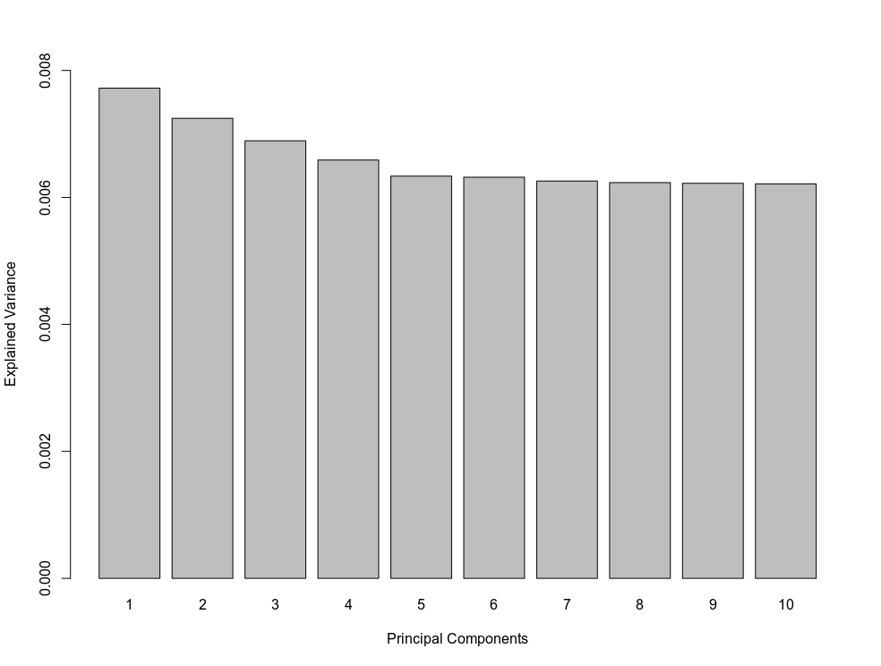
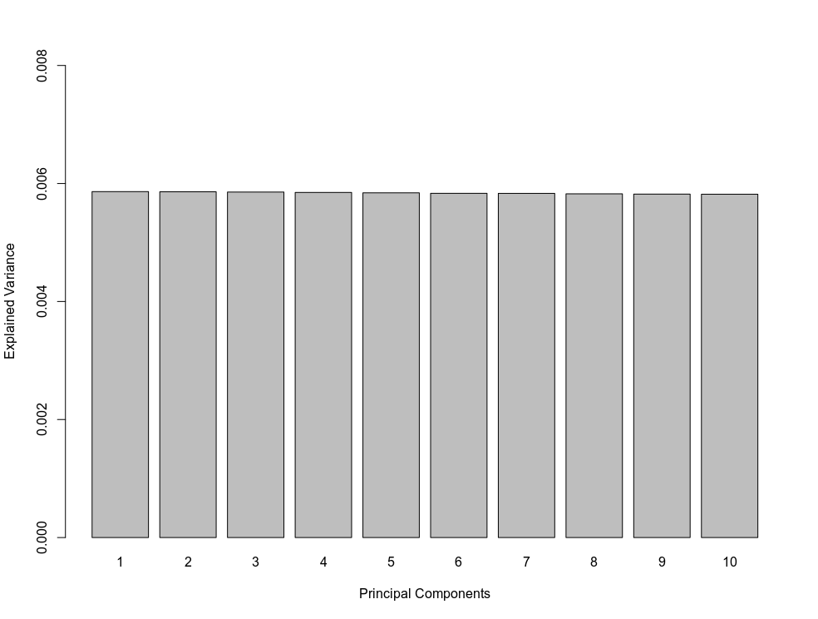
Lack of Variation in Genetic Variation: GWAS

Slide 31
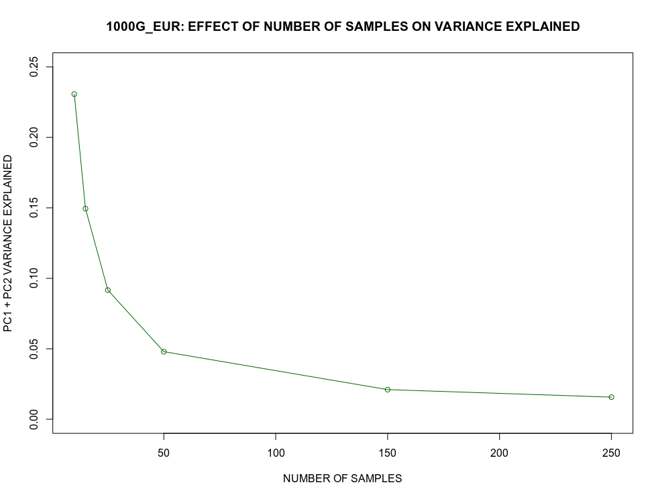
Lack of Genetic Variation or Sample Size?

Slide 32
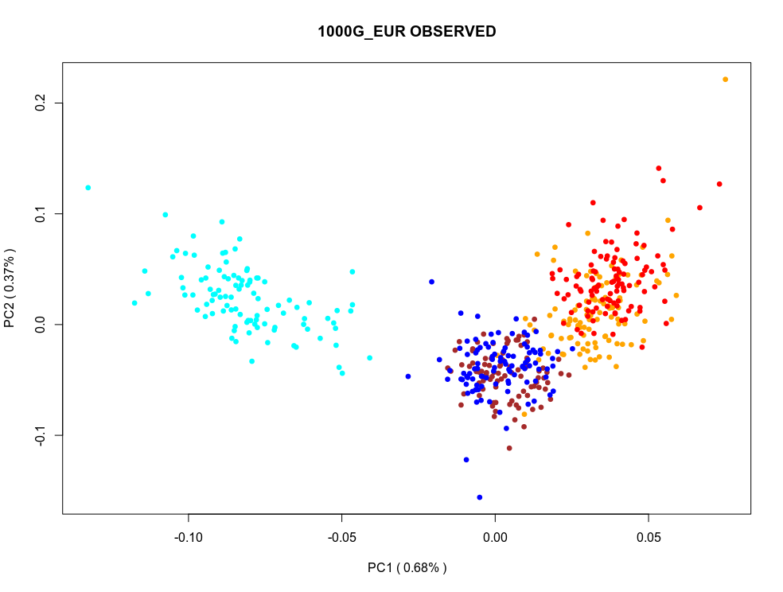

Randomization in 1000G_EUR Data

Slide 33


Low Variation in 1000G_EUR Data

Slide 34

Low Variation in 1000G_EUR Data

Slide 35


How is Variance Explained in Other OMICs?
In other OMICs the observed variance explained is typically well
separated from the variance explained of the shuffled data matrix

Slide 36



Distances in High Dimensions
Pairwise distances grow as:
dist ~ sqrt ( p )
data points become far apart

Slide 37



Clustering in UMAP Space
MNIST
benchmark dataset
It looks like replacing original data by UMAP components can mitigate
the harm from the Curse of Dimensionality and allow better clustering

